Slide 1
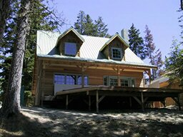
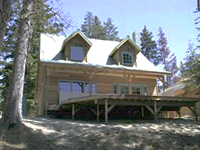
Image transformations
Contrast change
T

Slide 2
Point processing
Change range of image:
  Apply the same function to each pixel value
Many applications
Common
  Linear sensors produce strange pictures
    The world has high dynamic range, 8 bits is too few
    Typically 12 bit sensor, 8 bit image
  Most cameras process sensor results before they report them

Slide 3
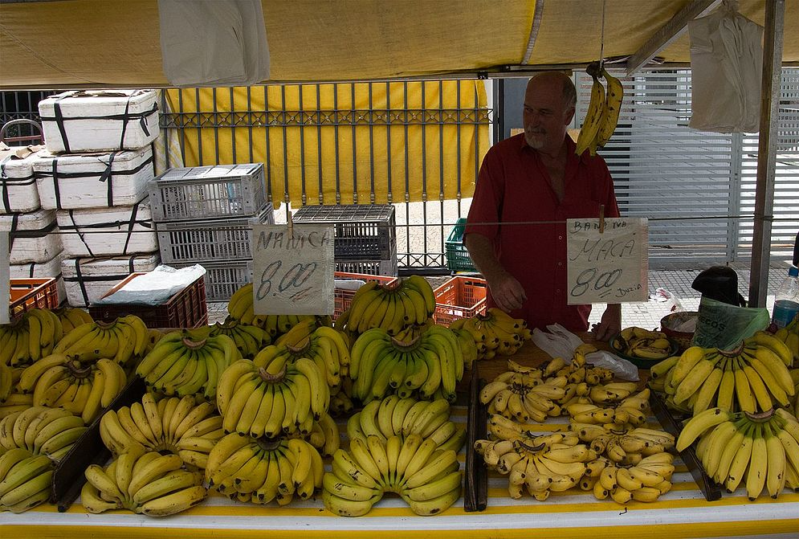
From wikipedia

Slide 4
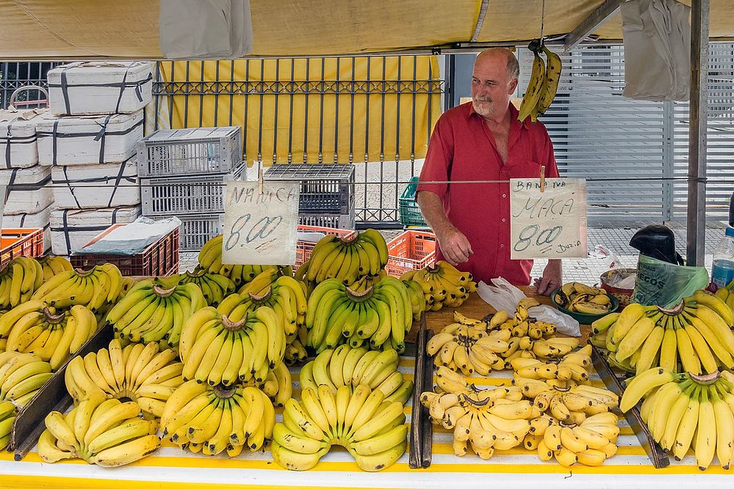
From wikipedia

Slide 5
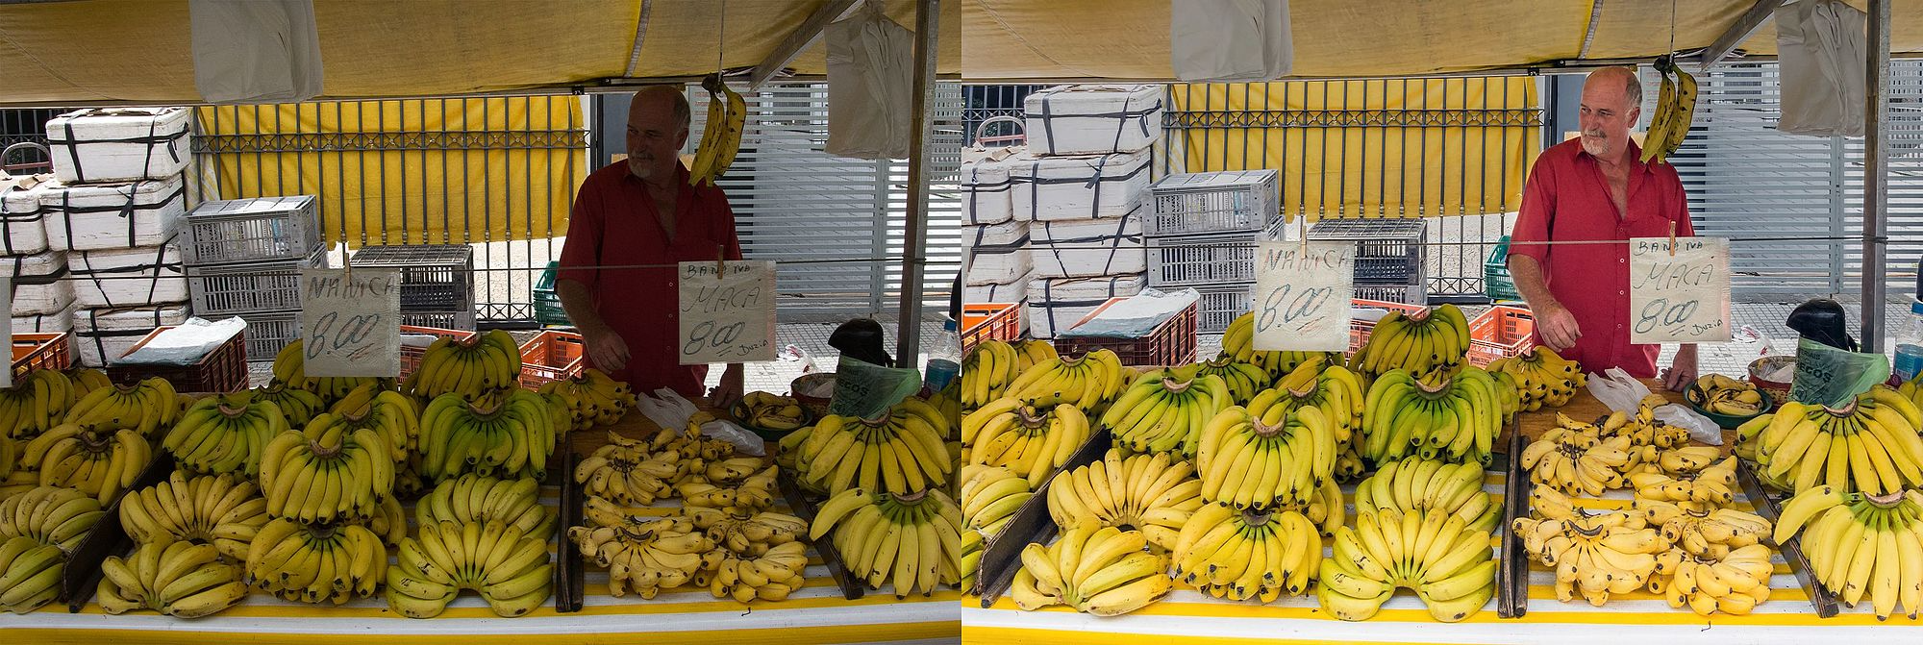
From wikipedia

Slide 6
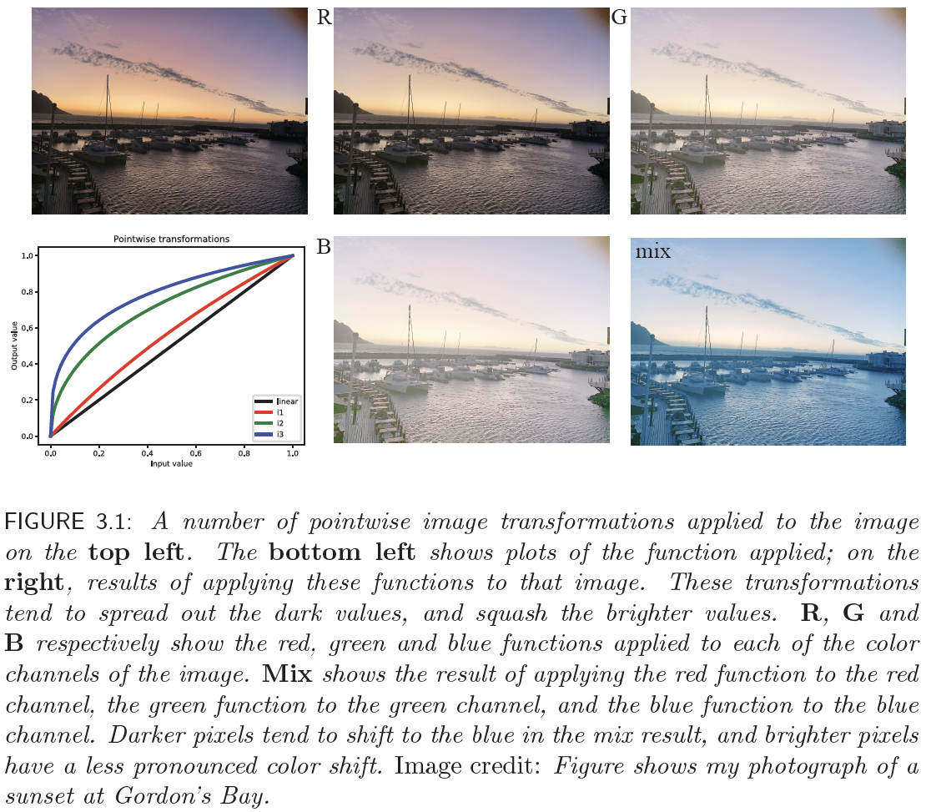

Slide 7
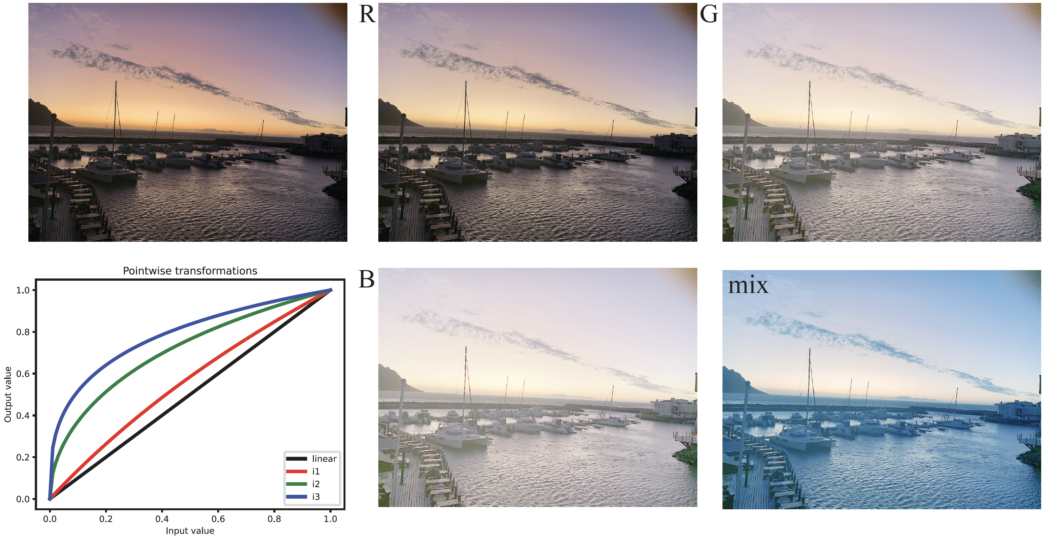

Slide 8
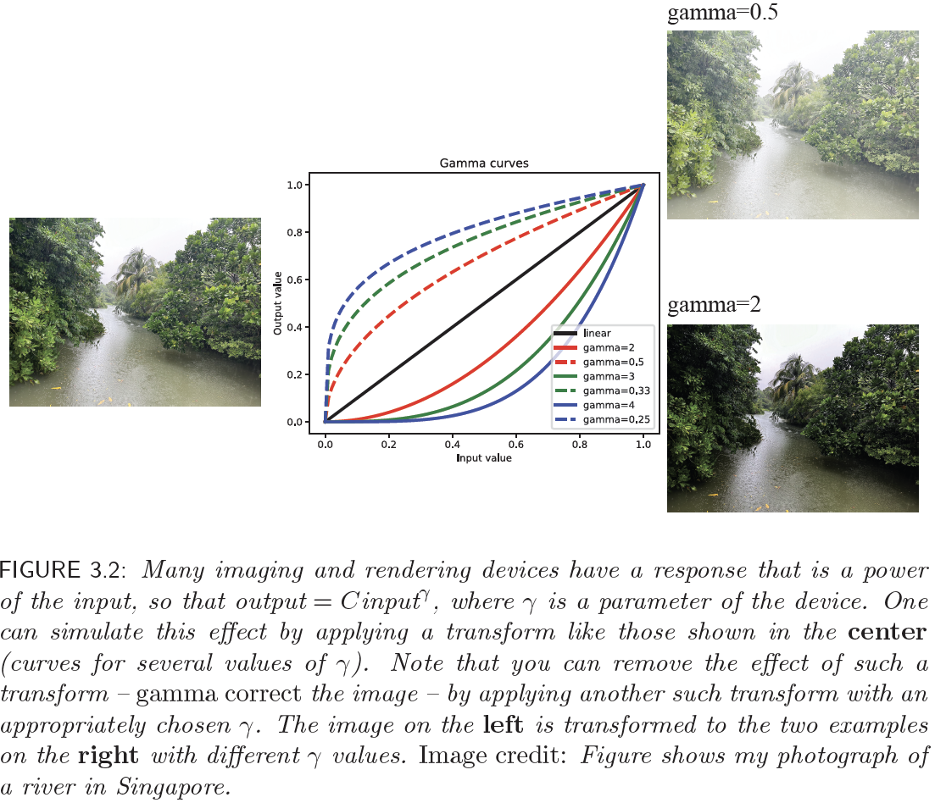

Slide 9
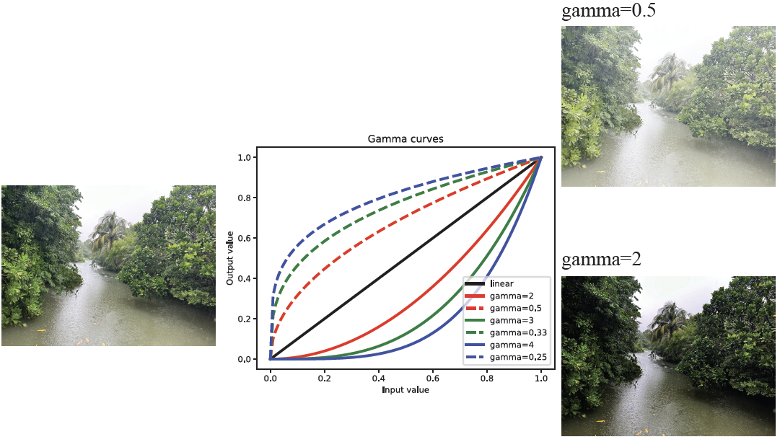

Slide 10
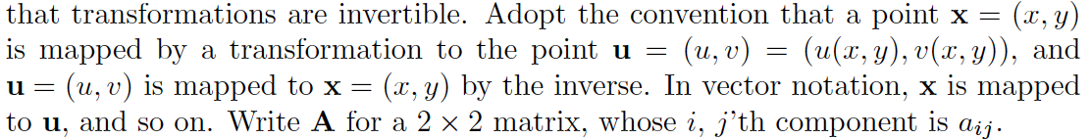
Transformations
Notation:

Slide 11
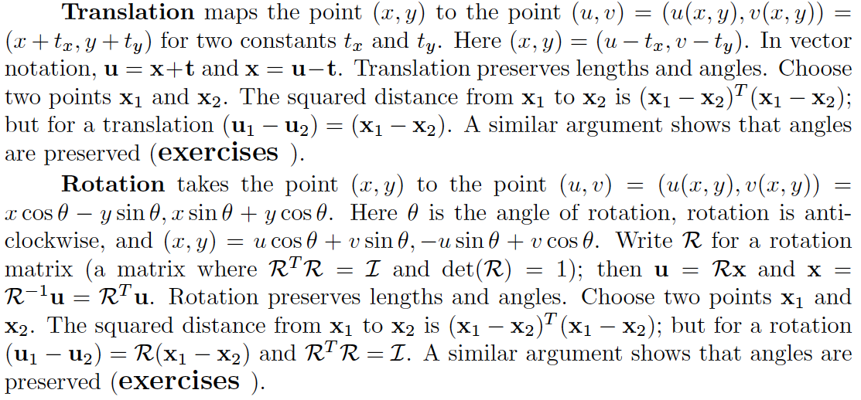
Translation and rotation

Slide 12
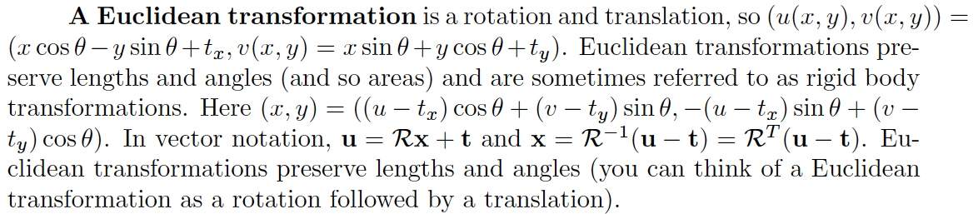
Euclidean Transformations

Slide 13
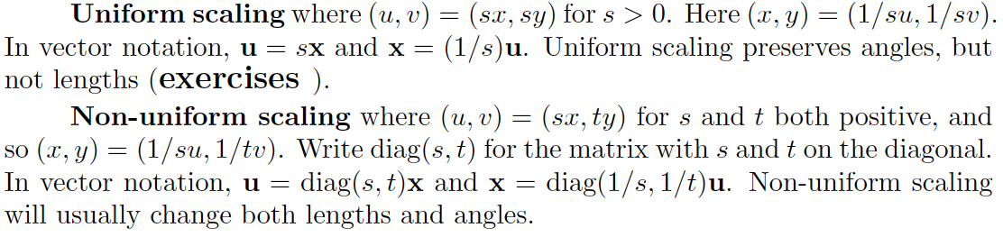
Scaling

Slide 14
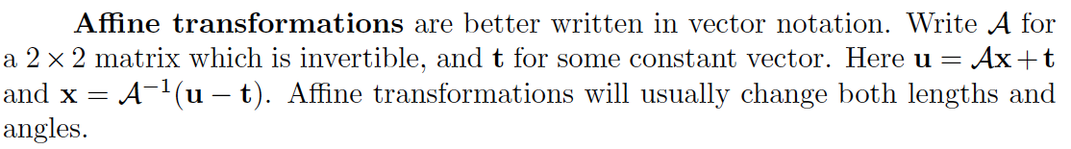
Affine transformations

Slide 15
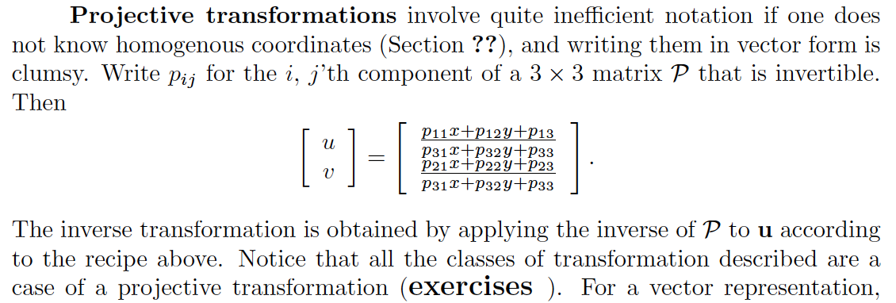
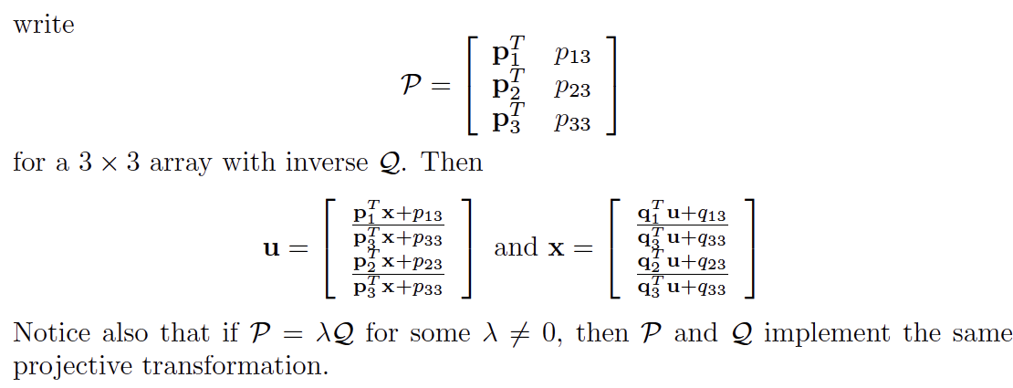
Projective transformations

Slide 16
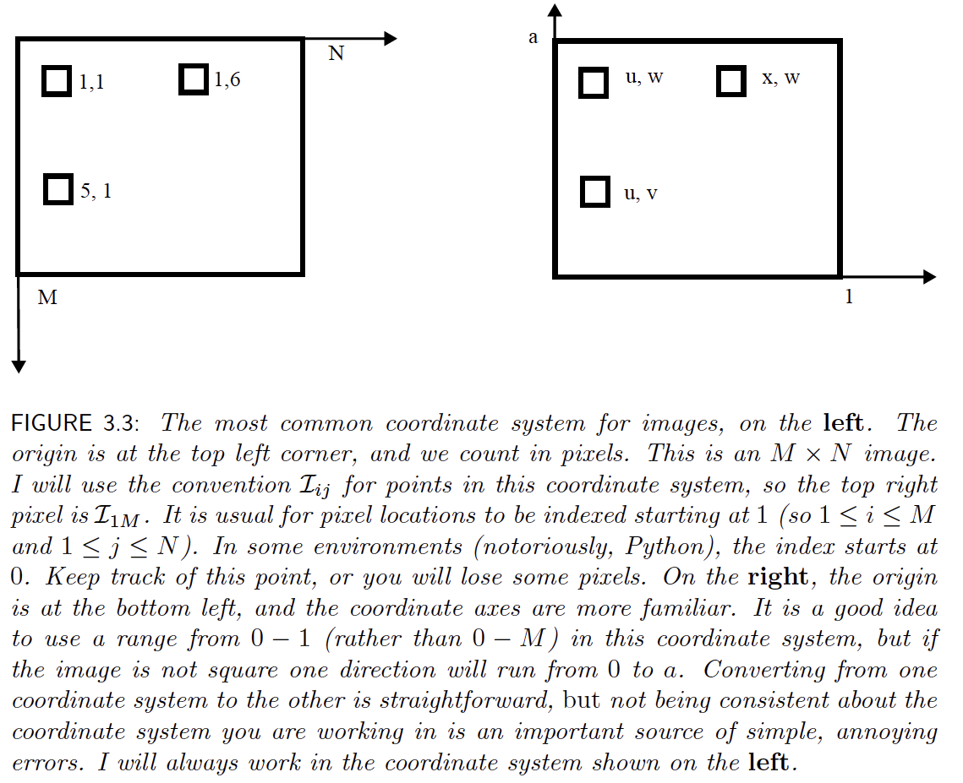

Slide 17
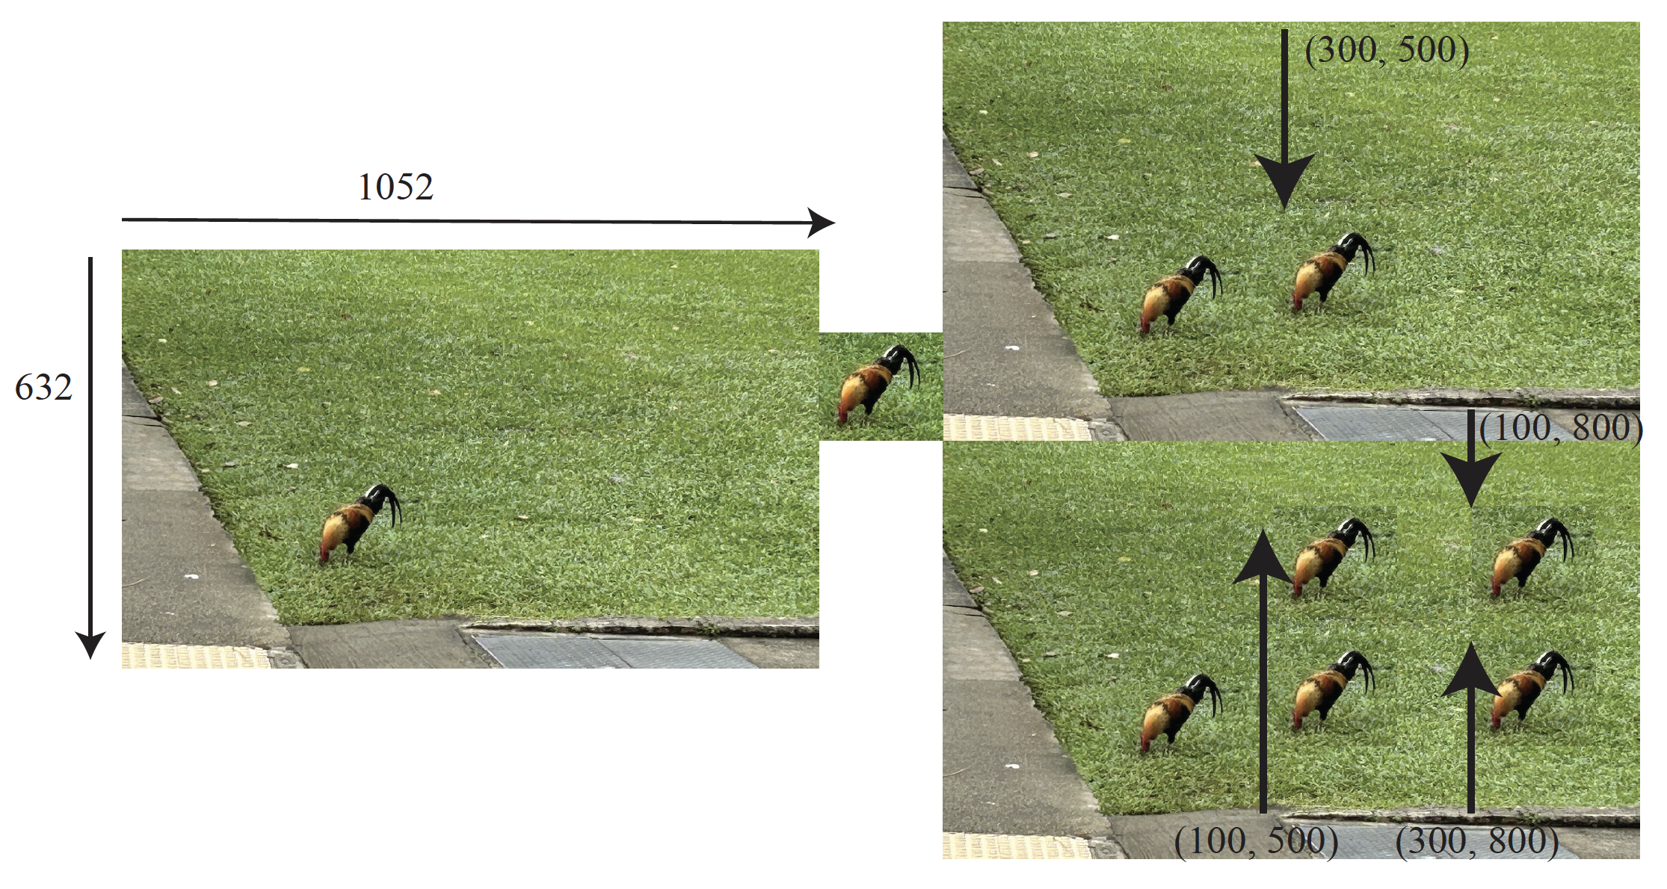

Slide 18
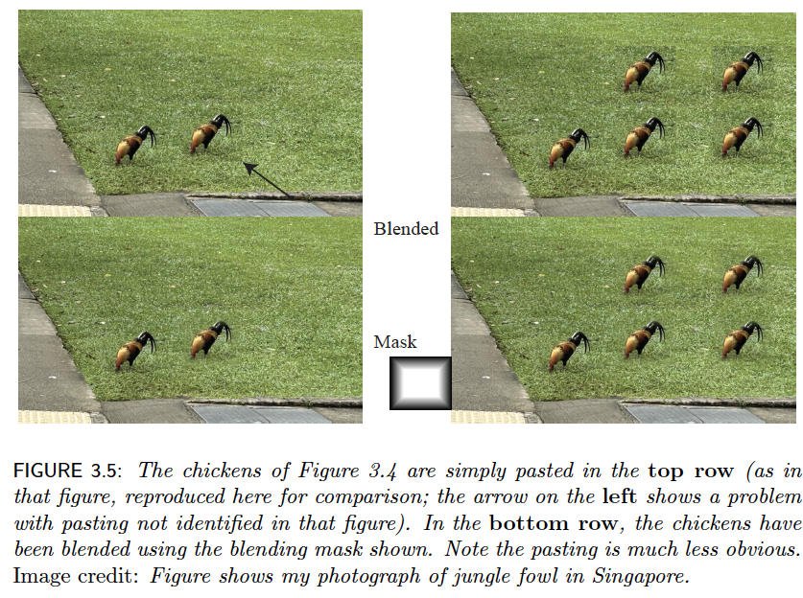
Blending

Slide 19
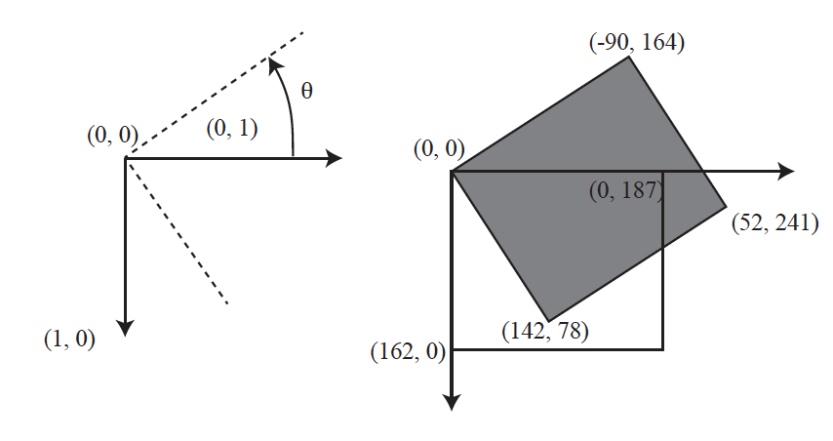
Image rotation

Slide 20
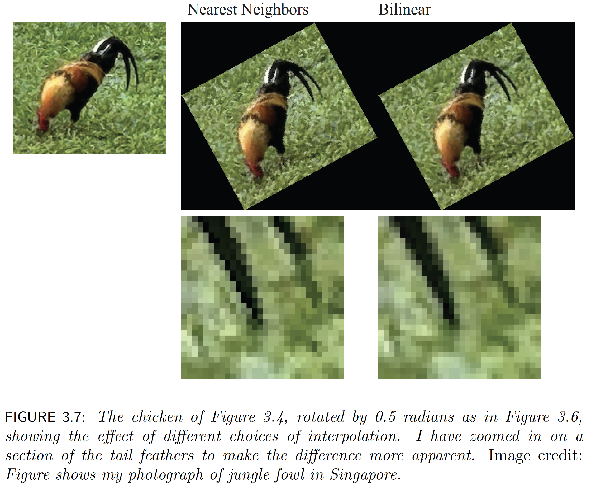

Slide 21
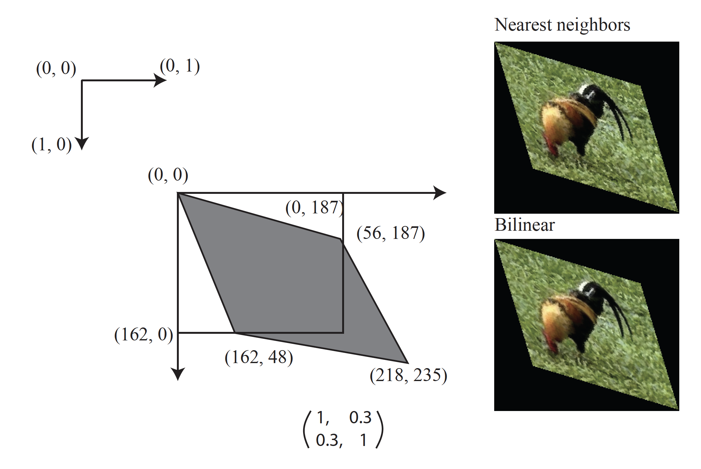

Slide 22
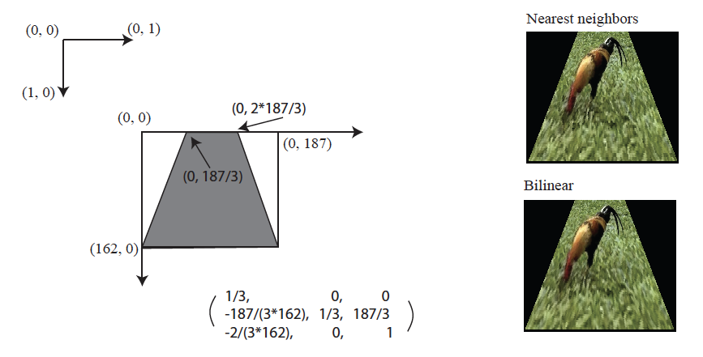

Slide 23
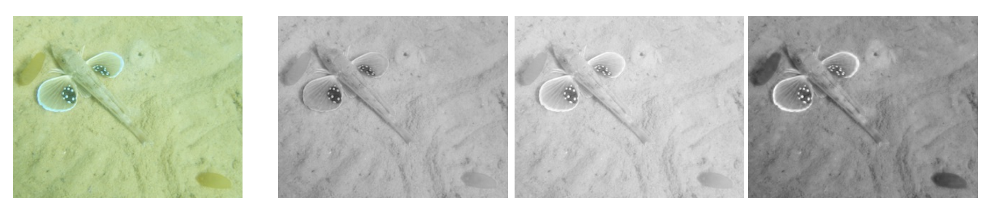
Image separations

Slide 24
Registering separations
What happens if R, G, B aren’t exactly aligned?
(historical photographs)
Fix R
Slide G by tx, ty, compute match cost
Choose tx, ty with best match
Do B same way
Q: what match cost?
Q: what if there are many translations?

Slide 25
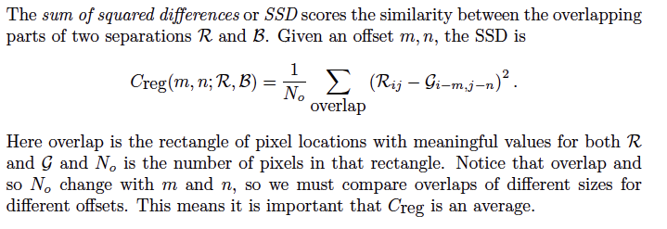
Match Costs
SSD (sum of squared differences)

Slide 26
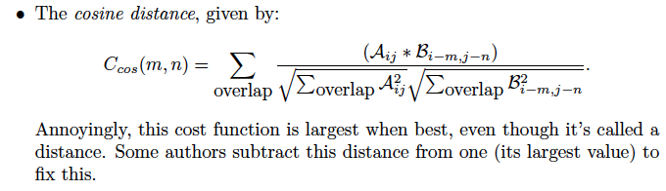
Match Costs
Cosine distance

Slide 27
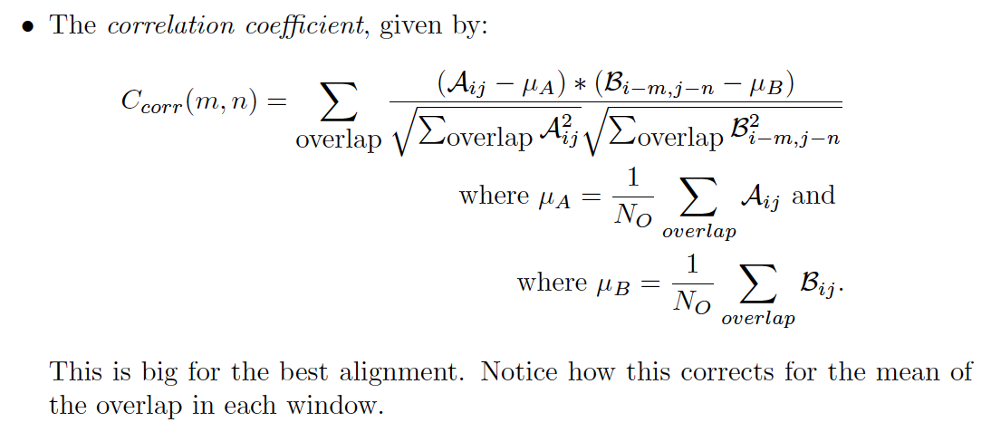
Match Costs
Cosine distance

Slide 28
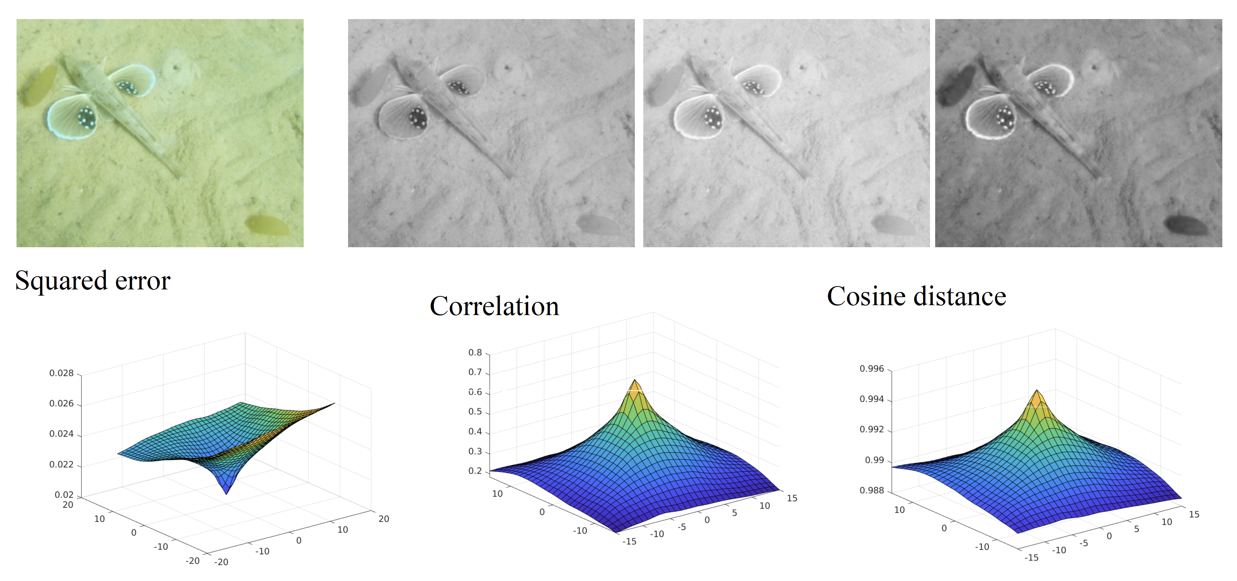
The cost surface

Slide 29
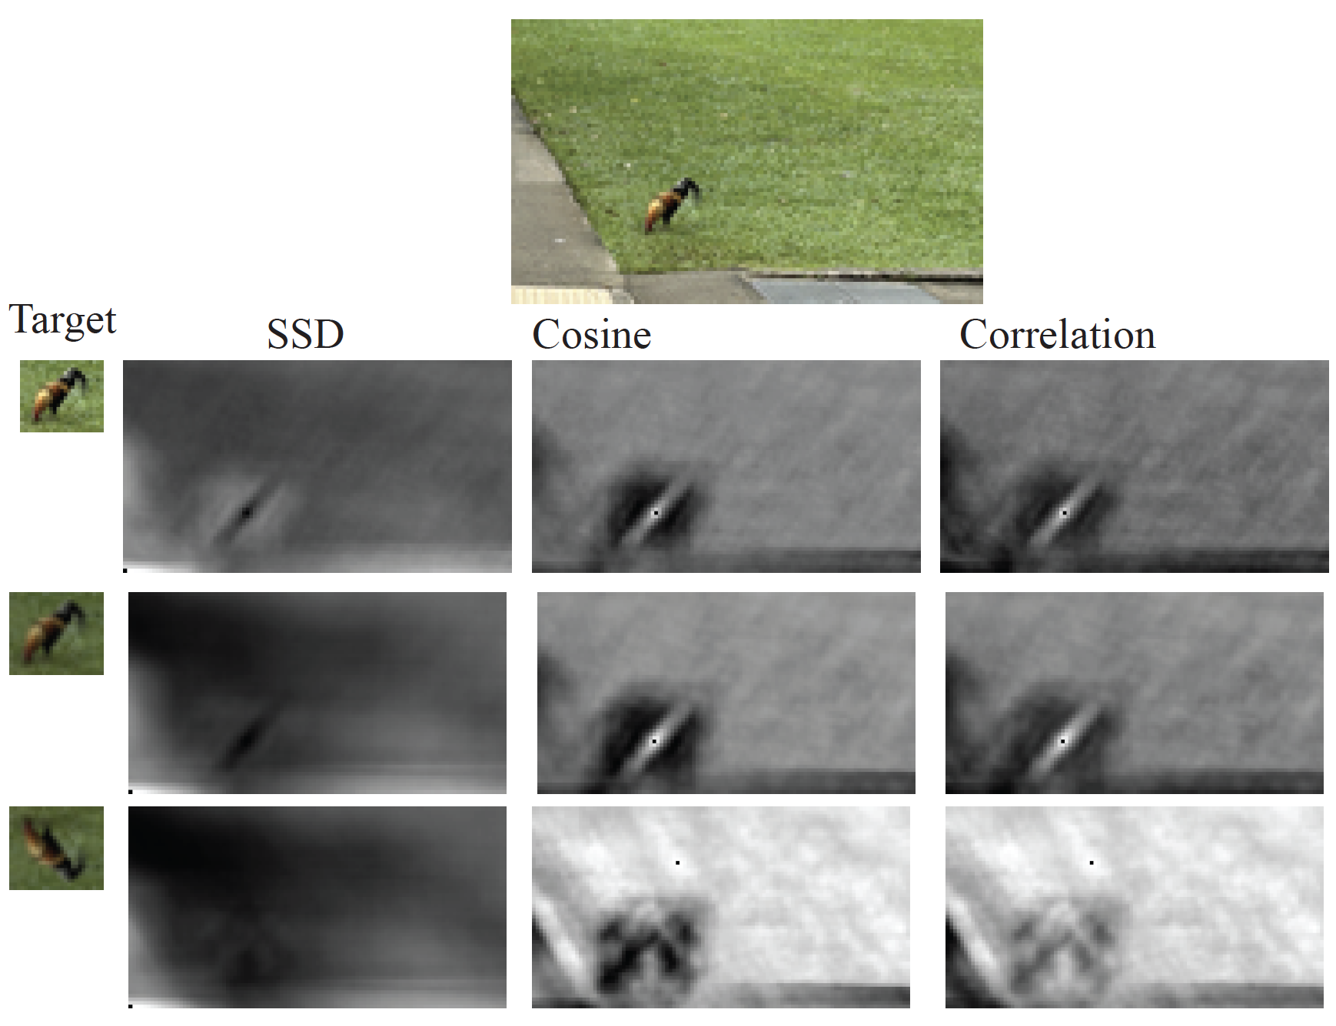
Lagniappe – find the chicken

Slide 30
What if there are many translations?
Build a gaussian pyramid (for example, 2x downsampling)
Align coarsest (N)’th scale by tx, ty
This gives estimate 2 tx, 2 ty for (N-1) scale translation
AND search range (-1, 0, 1) x (-1, 0, 1)
search to get tx’, ty’
Redo for N-2’th scale, etc.
Very powerful pattern: Coarse to fine search

