Slide 1
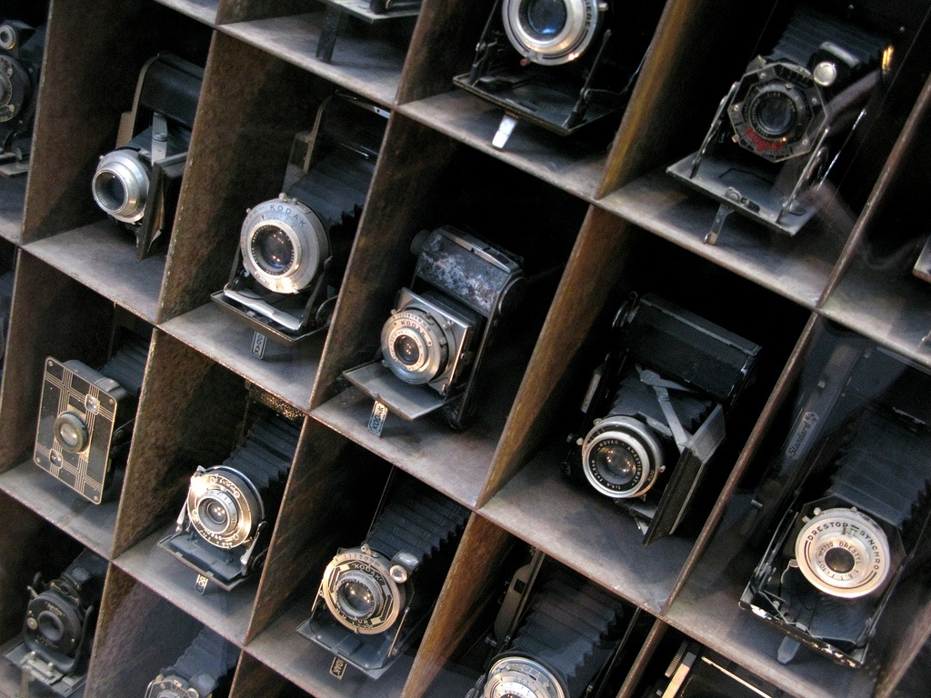
Introduction to cameras

Slide 2
Overview
Pinhole projection model
Cameras with lenses
  Depth of field
  Field of view
  Lens aberrations
Digital sensors

Slide 3
Let’s design a camera
Idea 1: put a piece of film in front of an object
Do we get a reasonable image?
Slide by Steve Seitz

Slide 4
Pinhole camera
Add a barrier to block off most of the rays
Slide by Steve Seitz
Notes:
It gets inverted

Slide 5
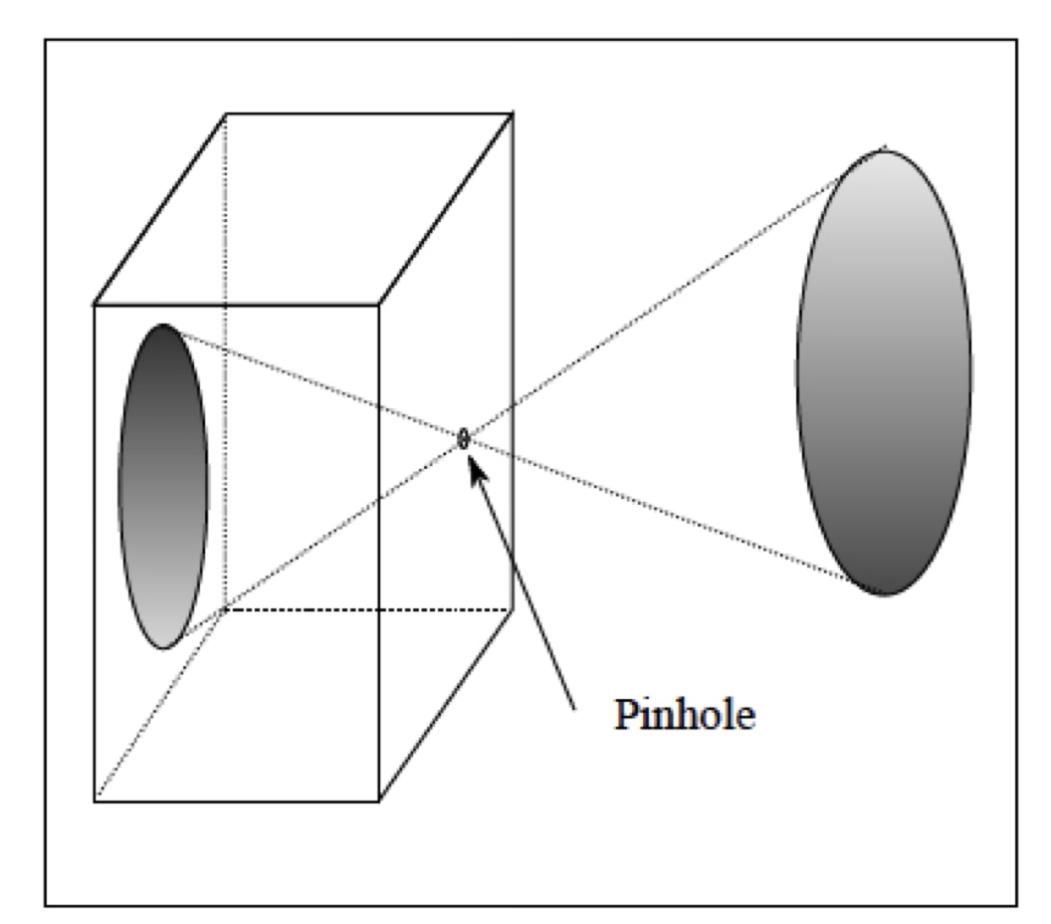
Pinhole camera

Slide 6
Pinhole camera
Captures pencil of rays – all rays through a single point: aperture, center of projection, optical center, focal point, camera center, pinhole
The image is formed on the image plane
It is upside down (but that doesn’t matter)

Slide 7
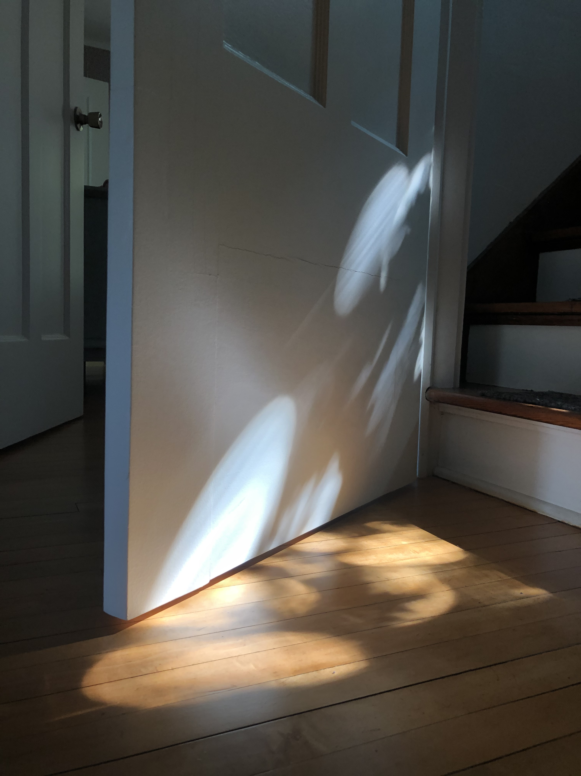
Accidental pinhole cameras are everywhere

Slide 8
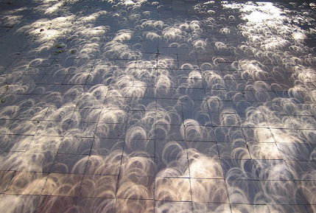
Accidental pinhole cameras are everywhere
Tree shadow during a solar eclipse
photo credit: Nils van der Burg
http://www.physicstogo.org/index.cfm
Slide by Steve Seitz

Slide 9
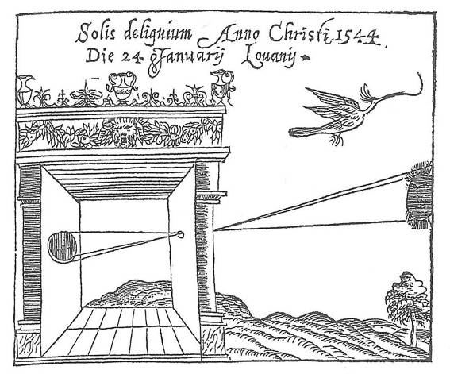
Camera obscura
Basic principle known to Mozi (470-390 BCE), Aristotle (384-322 BCE)
Drawing aid for artists: described by Leonardo da Vinci (1452-1519)
Gemma Frisius, 1558
Source: A. Efros

Slide 10
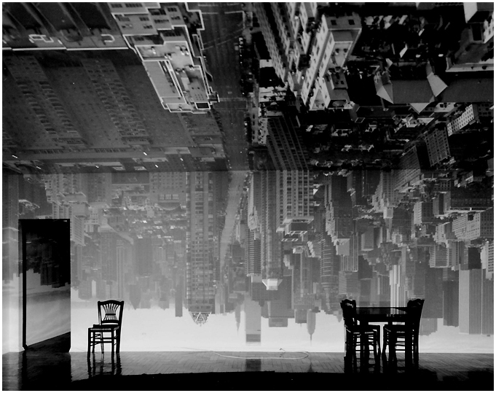
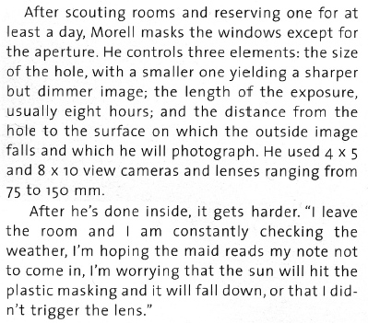
Turning a room into a camera obscura
From Grand Images Through a Tiny Opening, Photo District News, February 2005
Abelardo Morell, Camera Obscura Image of Manhattan View Looking South in Large Room, 1996
https://www.abelardomorell.net/camera-obscura

Slide 11
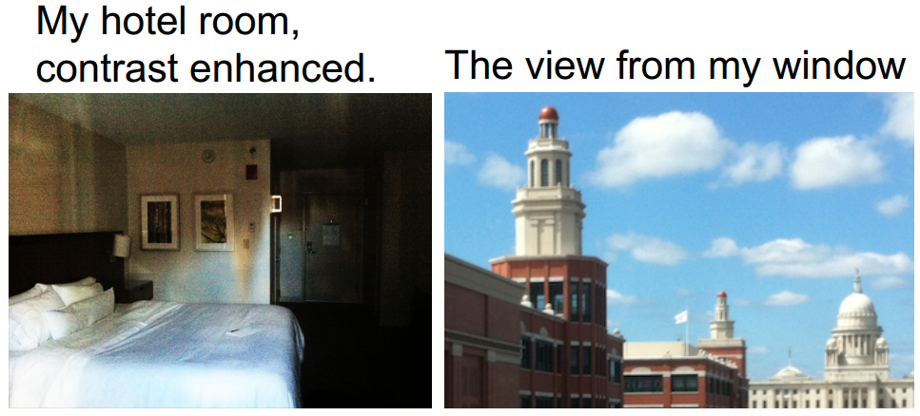
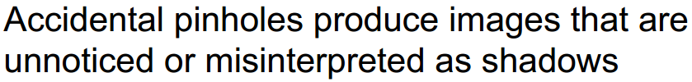
Turning a room into a camera obscura
A. Torralba and W. Freeman, Accidental Pinhole and Pinspeck Cameras, CVPR 2012

Slide 12
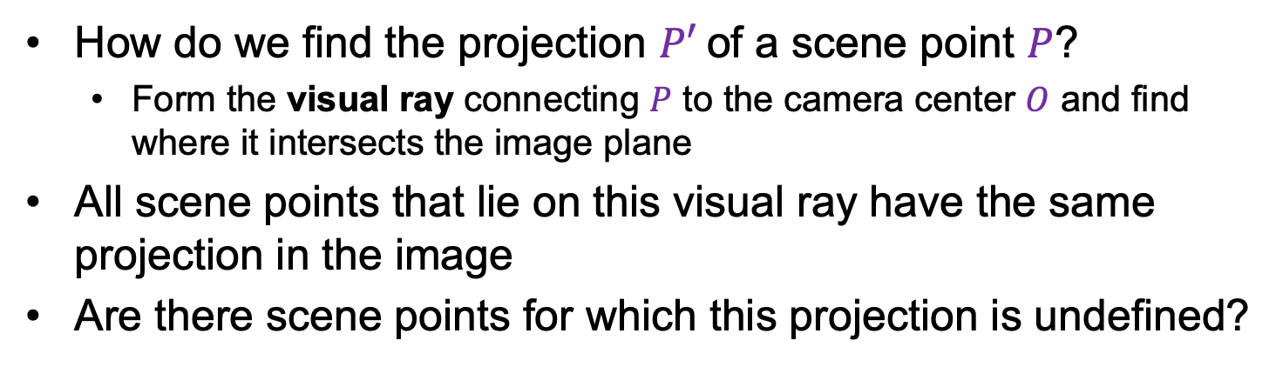



Modeling projection
$$P$$
$$O$$
$$P′$$
How do we find the projection $P′$of a scene point $P$?
  Form the visual ray connecting $P$ to the camera center $O$ and find where it intersects the image plane
All scene points that lie on this visual ray have the same projection in the image
Are there scene points for which this projection is undefined?

Slide 13
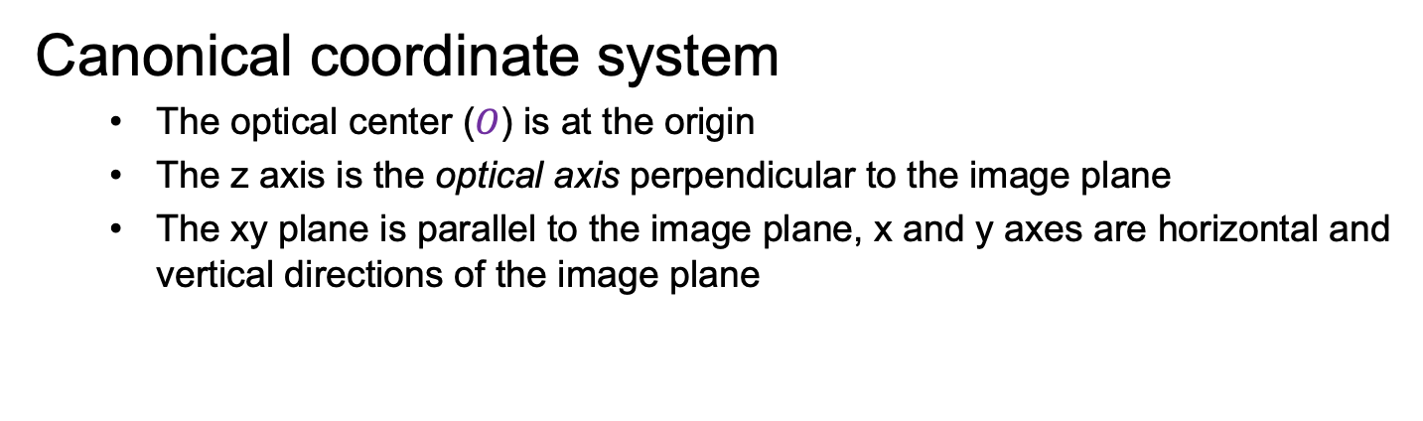



Modeling projection
$$P$$
$$y$$
$$z$$
$$O$$
$$x$$
$$P′$$
Canonical coordinate system
  The optical center ($O$) is at the origin
  The z axis is the optical axis perpendicular to the image plane
  The xy plane is parallel to the image plane, x and y axes are horizontal and vertical directions of the image plane

Slide 14
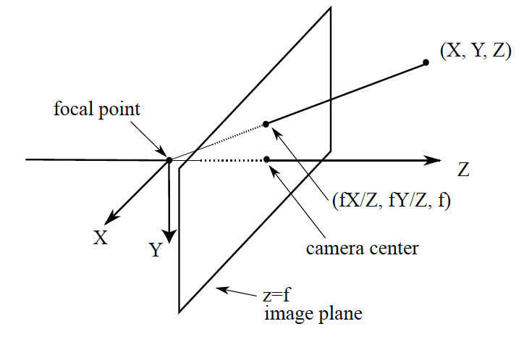
Abstraction with right handed coordinate system

Slide 15




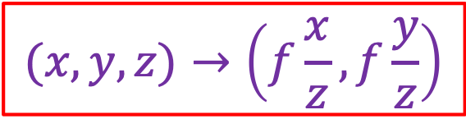

Deriving projected coordinates
$$P$$
$$y$$
$$f$$
$$z$$
$$=f\frac{y}{z}$$
$$O$$
$$y^{′}$$
$$P′$$
$$(x,y,z)→\left(f\frac{x}{z},f\frac{y}{z}\right)$$

Slide 16
Deriving projected coordinates
Note: instead of dealing with an image that is upside down, most of the time we will pretend that the image plane is in front of the camera center

Slide 17
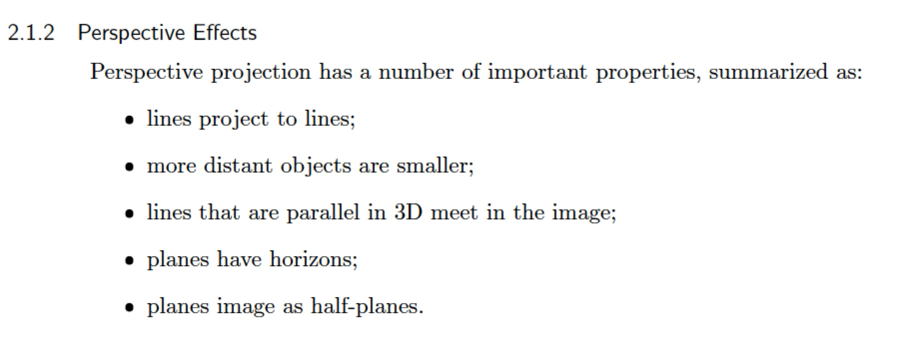
Perspective effects

Slide 18
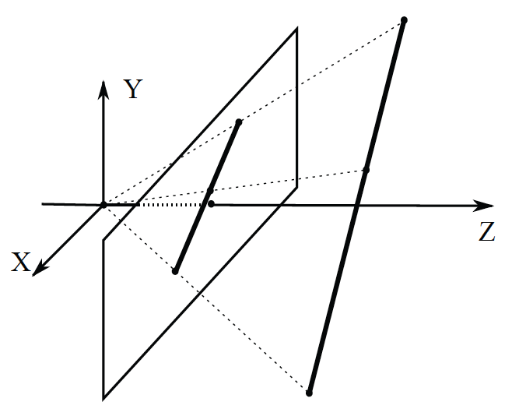
Lines -> lines

Slide 19
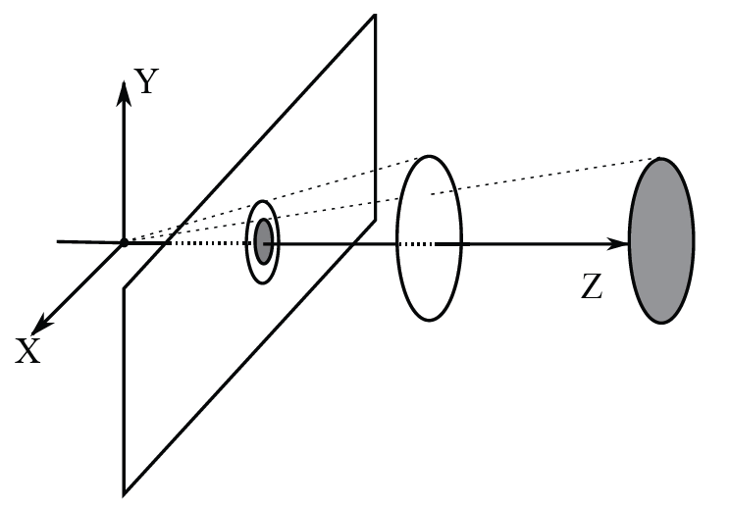
More distant objects are smaller

Slide 20
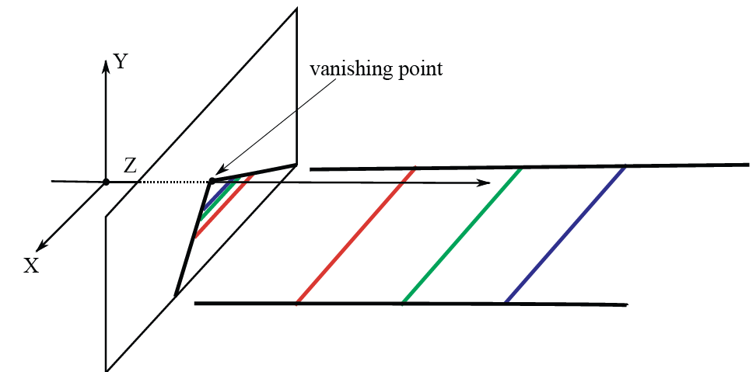
Lines that are parallel in 3D meet in the image

Slide 21
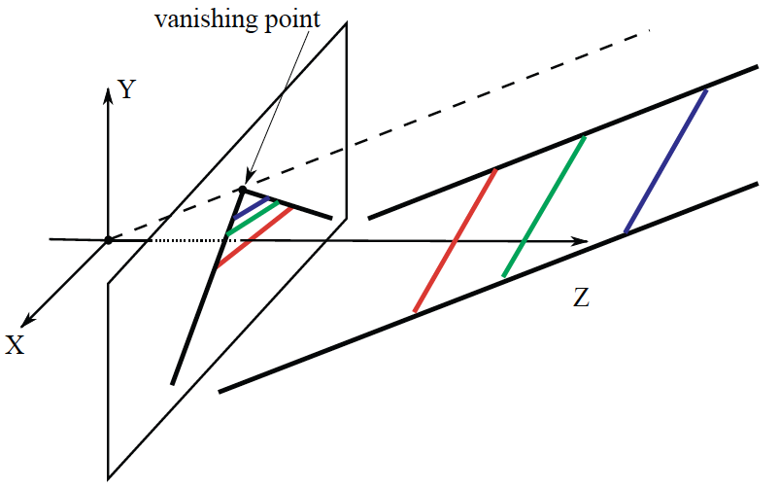
Lines that are parallel in 3D meet in the image

Slide 22
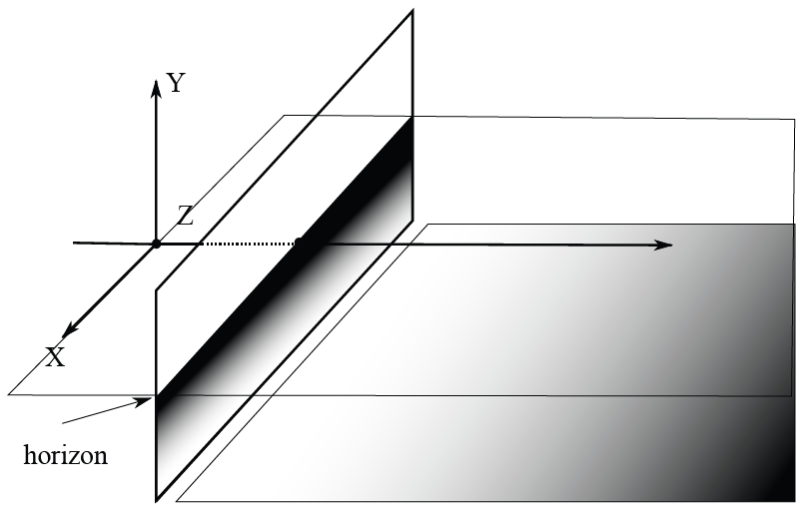
Planes have horizons

Slide 23
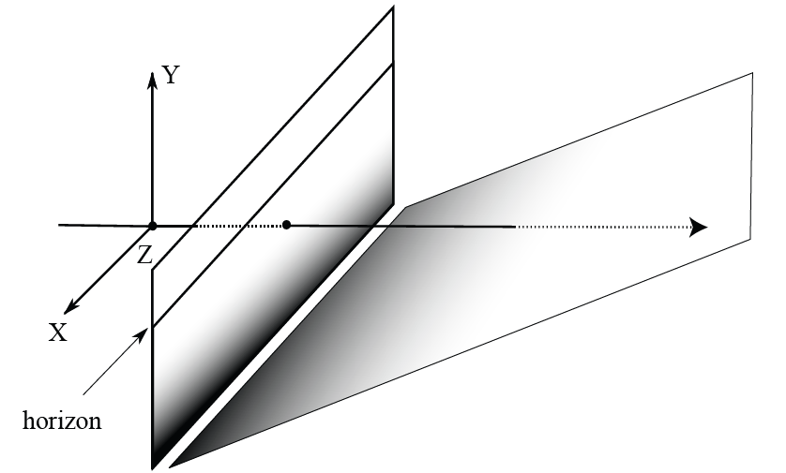
Planes have horizons

Slide 24
On a plane, closer to horizon is further away

Slide 25
Shapes are foreshortened

Slide 26
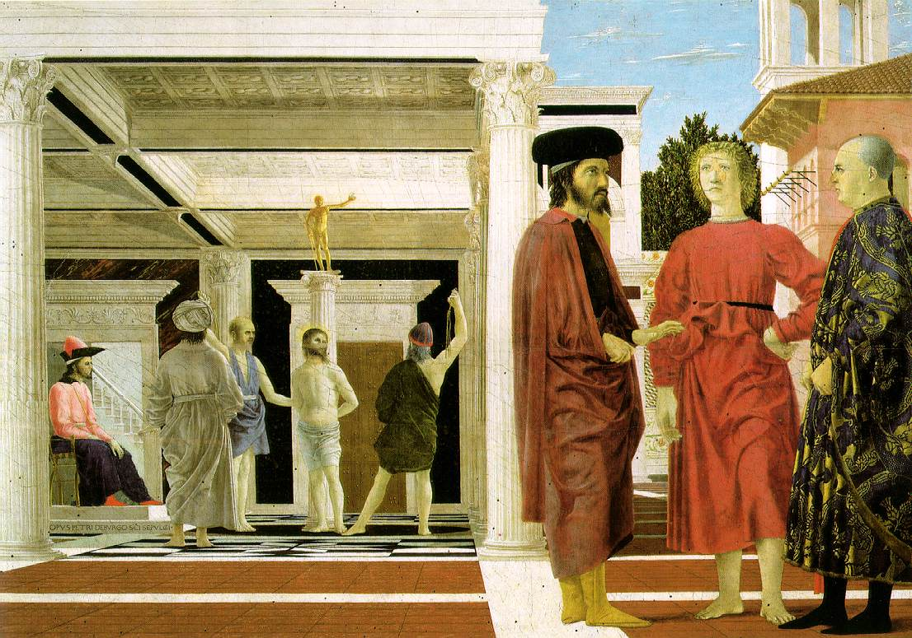
Spot the property!
Piero della Francesca, Flagellation of Christ, 1455-1460

Slide 27
Spot the property!
Piero della Francesca, Flagellation of Christ, 1455-1460

Slide 28
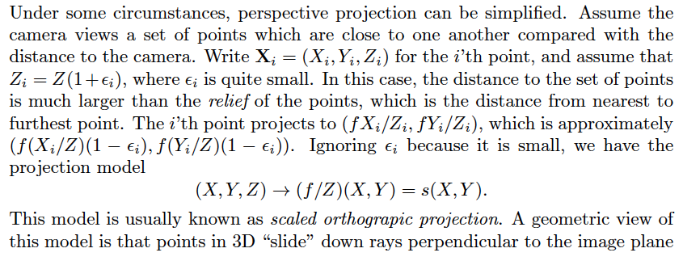
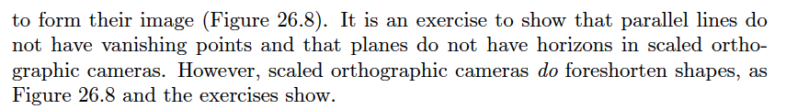
Scaled orthographic projection

Slide 29
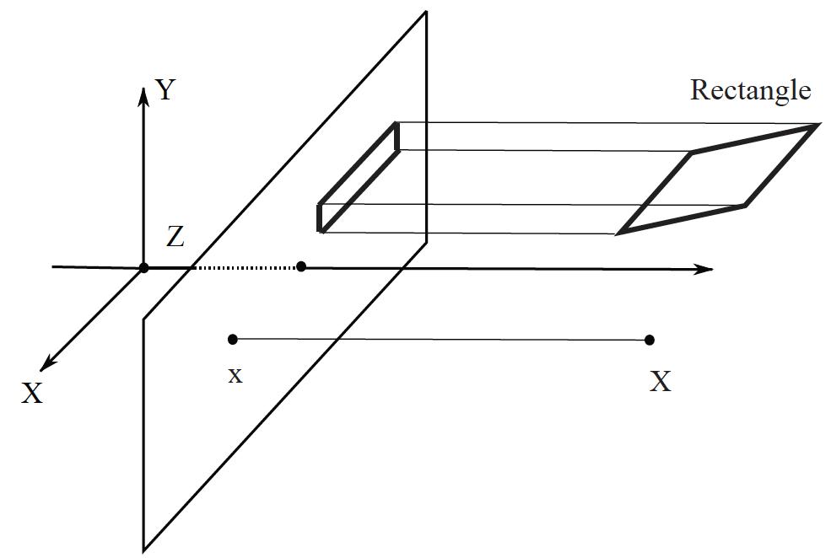
Scaled orthographic projection

Slide 30
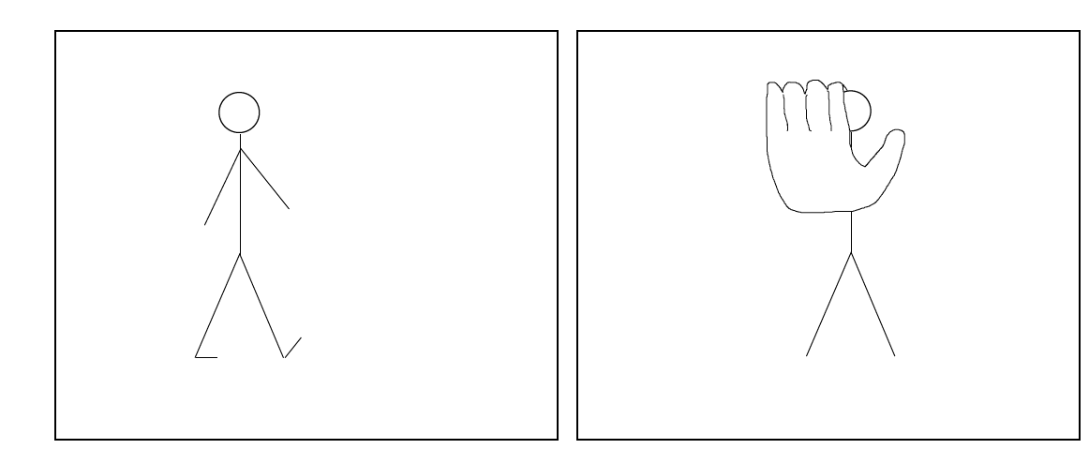
Scaled orthographic projection in pictures of people
Likely SOP
Clearly perspective

Slide 31
Why cameras have lenses
The pinhole is small, so relatively little light gets in (dark image)
Bigger pinhole -> brighter but fuzzier image
A lens system collects more light, but discourages fuzziness

Slide 32
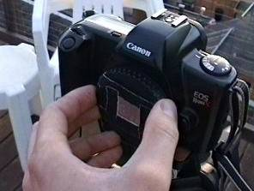
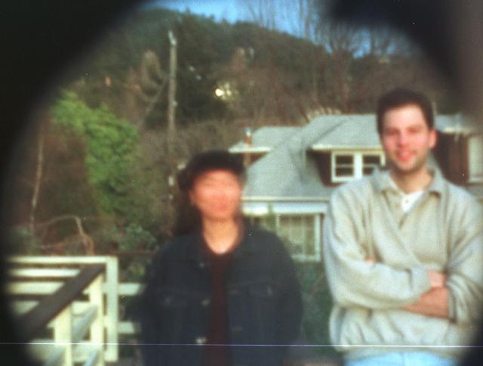
Home-made pinhole camera
What is wrong with this image?
Source: P. Debevec via A. Efros

Slide 33
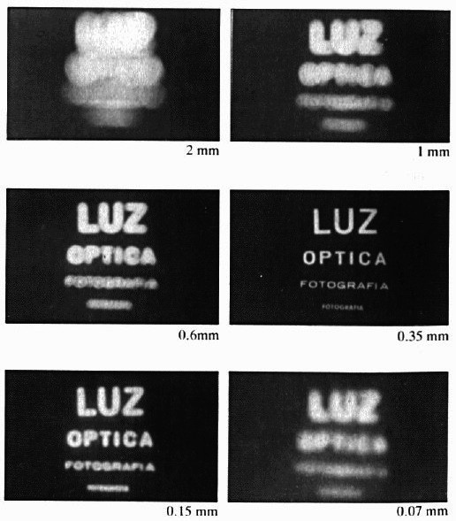
Shrinking the aperture
Why not make the aperture as small as possible?
  Less light gets through
  Diffraction!
Slide by Steve Seitz

Slide 34
Shrinking the aperture

Slide 35
Overview
Pinhole projection model
Cameras with lenses

Slide 36
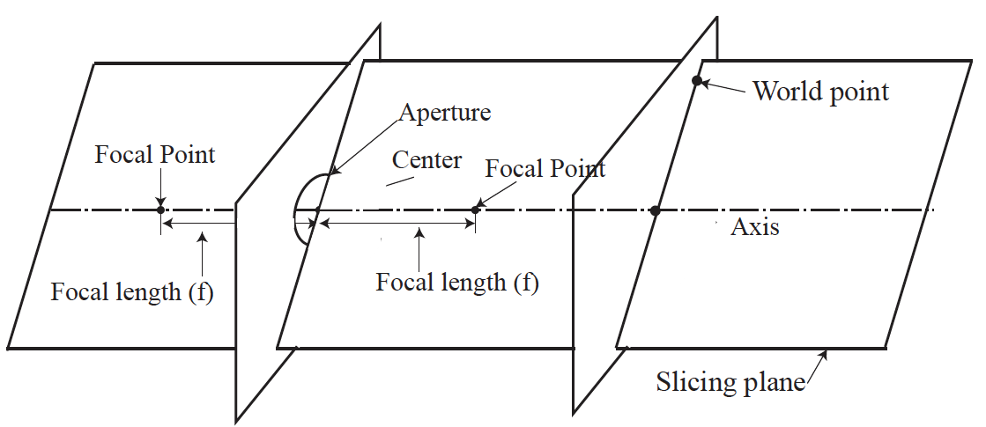
Lens model – rotational symmetry
A lens focuses light onto the film
  Thin lens model:

Slide 37
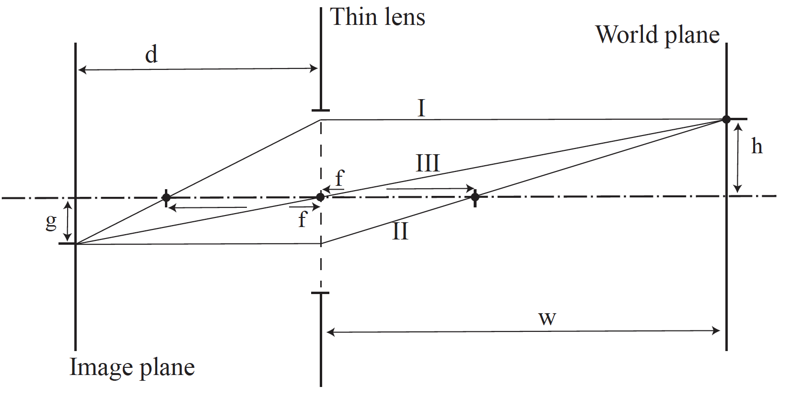
A thin lens, 2D drawing

Slide 38
A thin lens, 2D drawing
Properties:
Ray arriving perp to lens plane passes through fp (I)
Ray arriving through fp leaves perp to lens (II)
Ray through lens center is unrefracted (III)
You can show: 1/f=1/w +1/d

Slide 39
A thin lens, 2D drawing
Properties:
Previous slide identifies where rays leaving a world point focus
All other rays leaving world point and arriving at lens aperture focus on same point

Slide 40
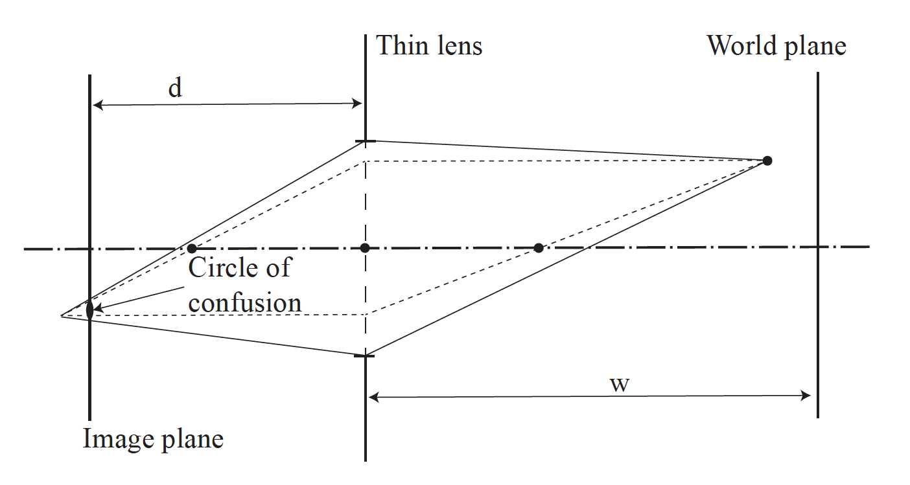
A thin lens – world point too close
Rays focus slightly behind image plane, constructing
a circle of confusion on image plane

Slide 41
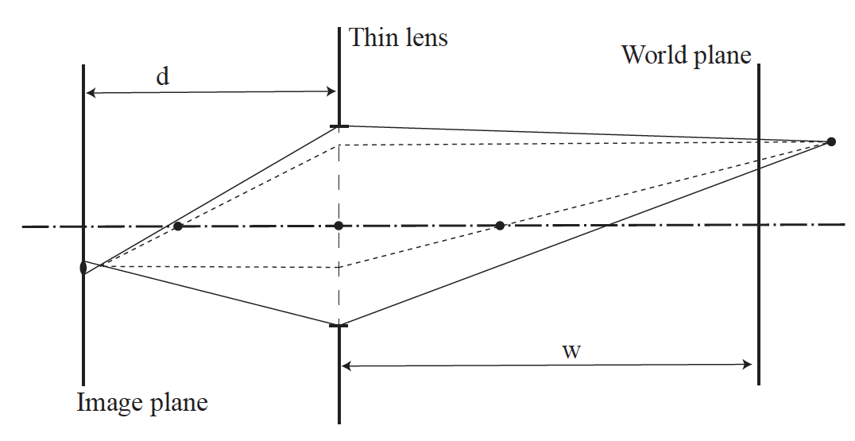
A thin lens – world point too far
Rays focus slightly in front of image plane, constructing
a circle of confusion on image plane

Slide 42
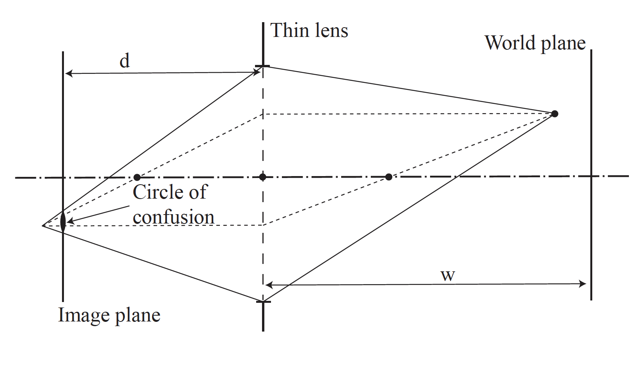
The aperture of the lens
Bigger aperture -> bigger circle of confusion for point at fixed location

Slide 43
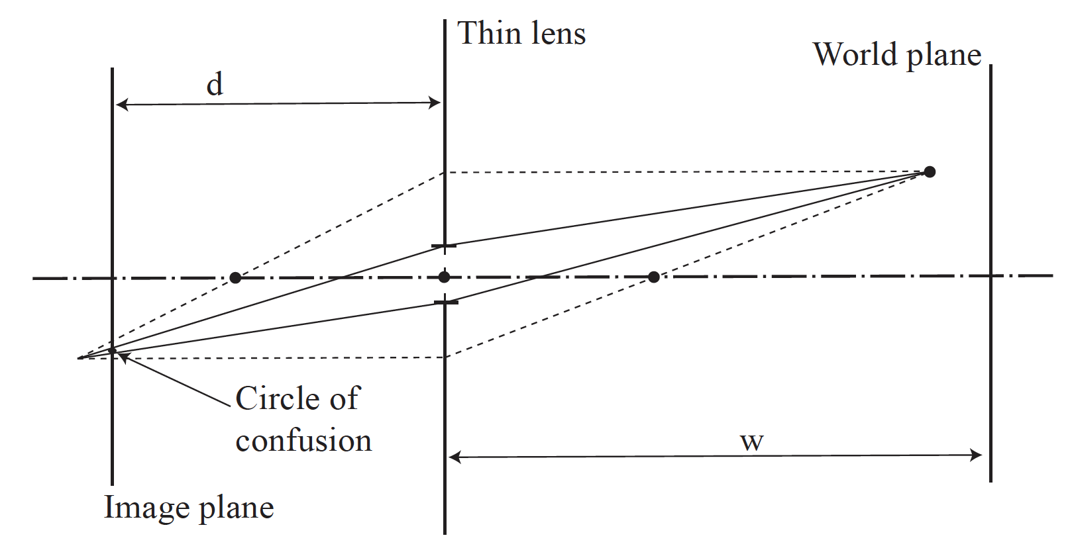
The aperture of the lens
Smaller aperture -> Smaller circle of confusion for point at fixed location

Slide 44
The aperture of the lens
Smaller aperture -> Smaller circle of confusion for point at fixed location
Bigger aperture -> bigger circle of confusion for point at fixed location
Depth of field:
range of depths around focal plane where circle of confusion < threshold
(i.e. points in focus)
Alternatively:
Bigger aperture: collects more light but smaller depth of field
Smaller aperture: collects less light, but larger depth of field

Slide 45
Adding a lens
A lens focuses light onto the film
  Thin lens model:
    Rays passing through the center are not deviated
    (pinhole projection model still holds)
Slide by Steve Seitz

Slide 46
Adding a lens
focal plane
focal point
f
A lens focuses light onto the film
  Thin lens model:
    Rays passing through the center are not deviated
    (pinhole projection model still holds)
    All rays parallel to the optical axis pass through the focal point
    All parallel rays converge to points on the focal plane
Slide by Steve Seitz

Slide 47
Thin lens formula
Where does the lens focus the rays coming from a given point in the scene?
image plane
lens
scene
Slide by Frédo Durand
Notes:
This is the relation between the focal length (f), the distance of the object from the camera (D), and the distance at which the object will be in focus (D’)

Slide 48
Thin lens formula
What is the relation between the focal length ( f ),
the distance of the object from the optical center (D),
and the distance at which the object will be in focus (D′)?
D′
D
f
image plane
lens
scene
Slide by Frédo Durand
Notes:
This is the relation between the focal length (f), the distance of the object from the camera (D), and the distance at which the object will be in focus (D’)

Slide 49
Thin lens formula
Similar triangles everywhere!
D′
D
f
image plane
lens
scene
Slide by Frédo Durand

Slide 50
Thin lens formula
y′/y = D′/D
Similar triangles everywhere!
D′
D
f
y
y′
image plane
lens
scene
Slide by Frédo Durand

Slide 51
Thin lens formula
y′/y = D′/D
Similar triangles everywhere!
y′/y = (D′−f )/f
D′
D
f
y
y′
image plane
lens
scene
Slide by Frédo Durand

Slide 52
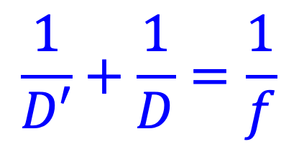
Thin lens formula
$$\frac{1}{D′}+\frac{1}{D}=\frac{1}{f}$$
Any point satisfying the thin lens equation is in focus.
What happens when D is very large?
D′
D
f
image plane
lens
scene
Slide by Frédo Durand
Notes:
And the set of all such points forms a plane parallel to the image (plane of focus).
Uses of the formula: given focal length and depth in scene that you want to be in focus, it tells you where to put the image plane. Given f and distance of image plane from camera center, it tells you which depth in the scene will be in focus.

Slide 53
Overview
Pinhole projection model
Cameras with lenses
  Depth of field
  Field of view

Slide 54
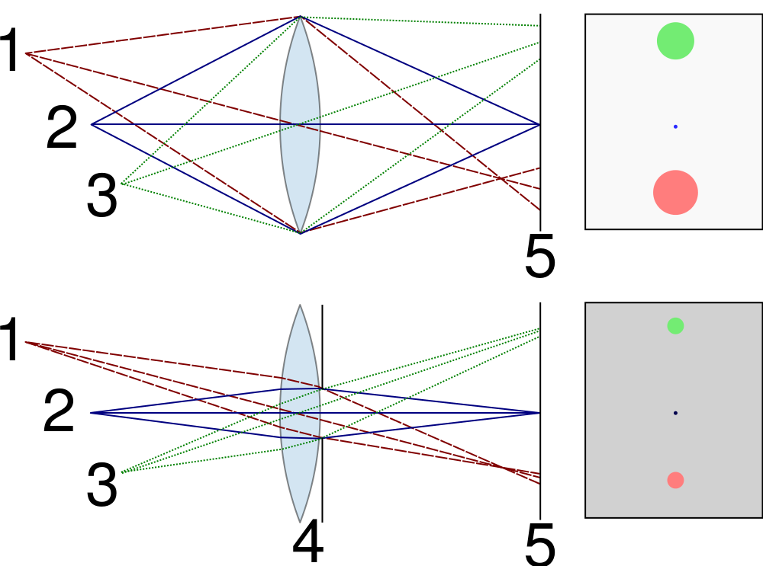
Depth of field
For a fixed focal length and image plane, there is a specific distance at which objects are “in focus”
  Other points project to a “circle of confusion” in the image

Slide 55

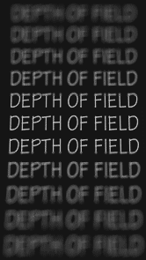
Depth of field
Depth of field is the distance between the nearest and farthest objects in a scene that appear acceptably sharp
in an image (Wikipedia)
Image source
(via A. Efros)

Slide 56
Controlling depth of field
Figure source

Slide 57


Controlling depth of field
Changing the aperture size affects depth of field
  A smaller aperture increases the range in which the object is approximately in focus
  But small aperture reduces amount of light – need to increase exposure
Figure source

Slide 58


Varying the aperture
Large aperture = small DOF
Small aperture = large DOF
Slide by A. Efros

Slide 59
Field of view
The field of view is the angular extent of the world observed by the camera (Wikipedia)
What determines the FOV?

Slide 60
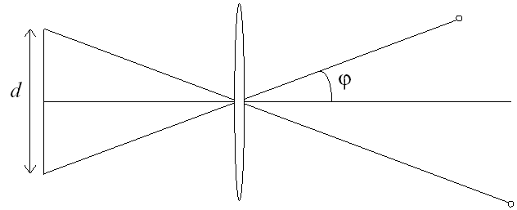
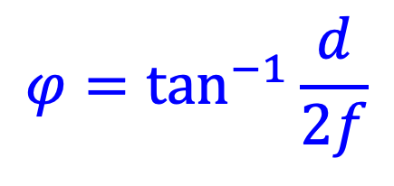
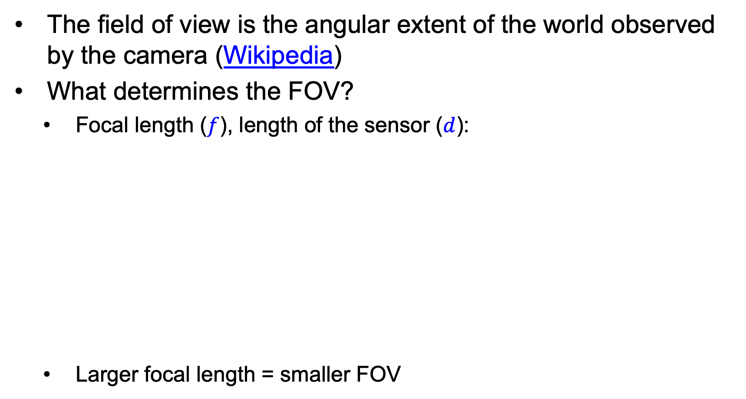
Field of view
The field of view is the angular extent of the world observed by the camera (Wikipedia)
What determines the FOV?
  Focal length ($f$), length of the sensor ($d$):
  Larger focal length = smaller FOV
f
$$φ=\tan^{−1}{\frac{d}{2f}}$$

Slide 61
Field of view
Slide by A. Efros
Notes:
The field of view is the angular extent of the world that is observed by the camera.

Slide 62
Field of view
Slide by A. Efros

Slide 63

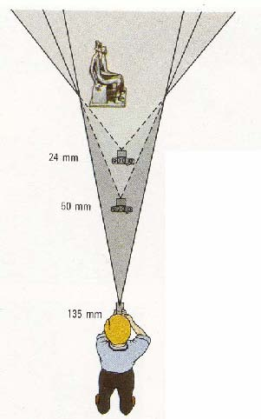

Field of view / focal length
Large FOV, small f
Camera close to car
Small FOV, large f
Camera far from the car
Sources: A. Efros, F. Durand

Slide 64



Same effect for faces
wide-angle
standard
telephoto
Source: F. Durand

Slide 65
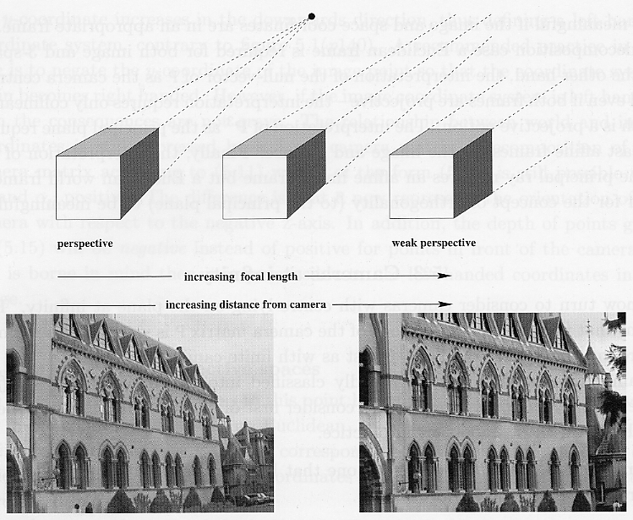
Approximating an orthographic camera
Source: Hartley & Zisserman

Slide 66
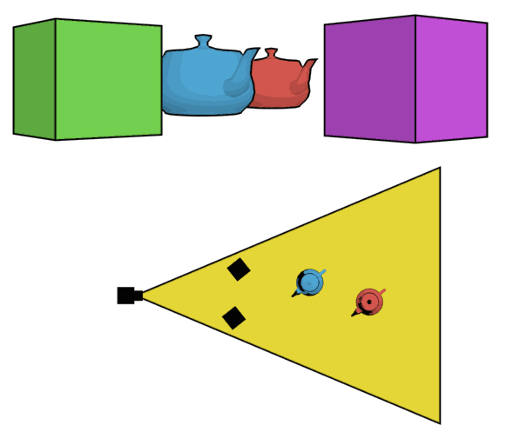
The dolly zoom
Continuously adjusting the focal length while the camera moves away from (or towards) the subject
http://en.wikipedia.org/wiki/Dolly_zoom

Slide 67
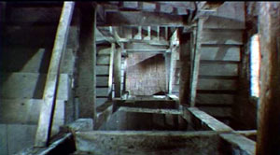
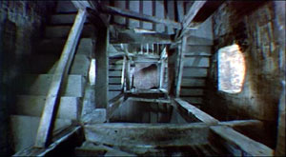
The dolly zoom
Continuously adjusting the focal length while the camera moves away from (or towards) the subject
“The Vertigo shot”
Example of dolly zoom from Goodfellas (YouTube)
Example of dolly zoom from La Haine (YouTube)

Slide 68
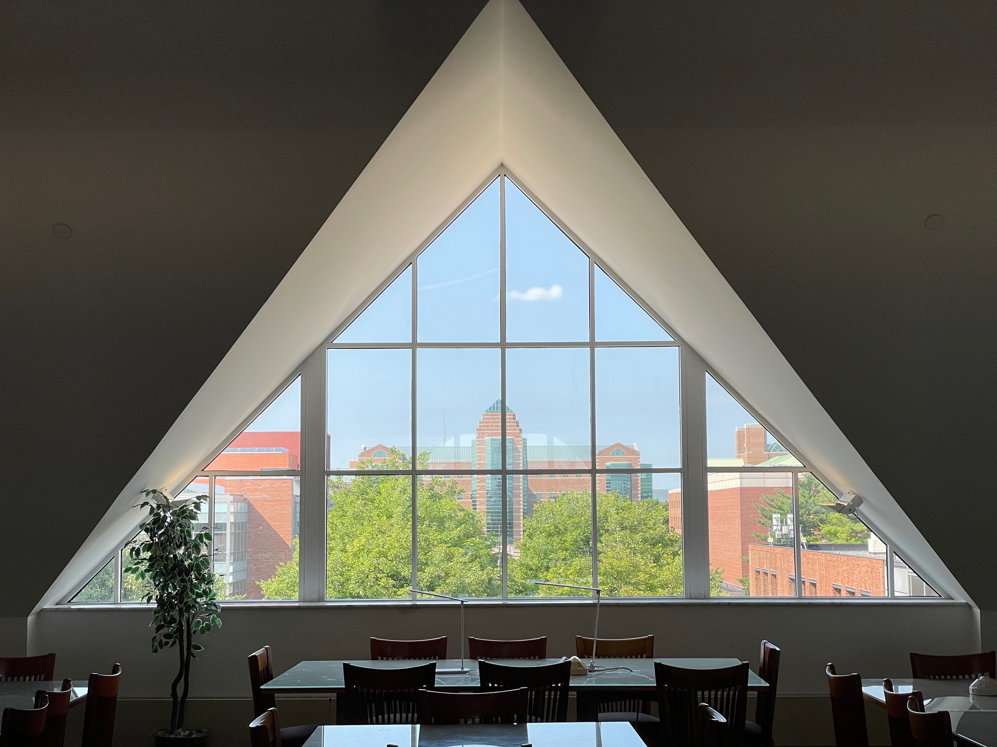

My “dolly zoom”

Slide 69
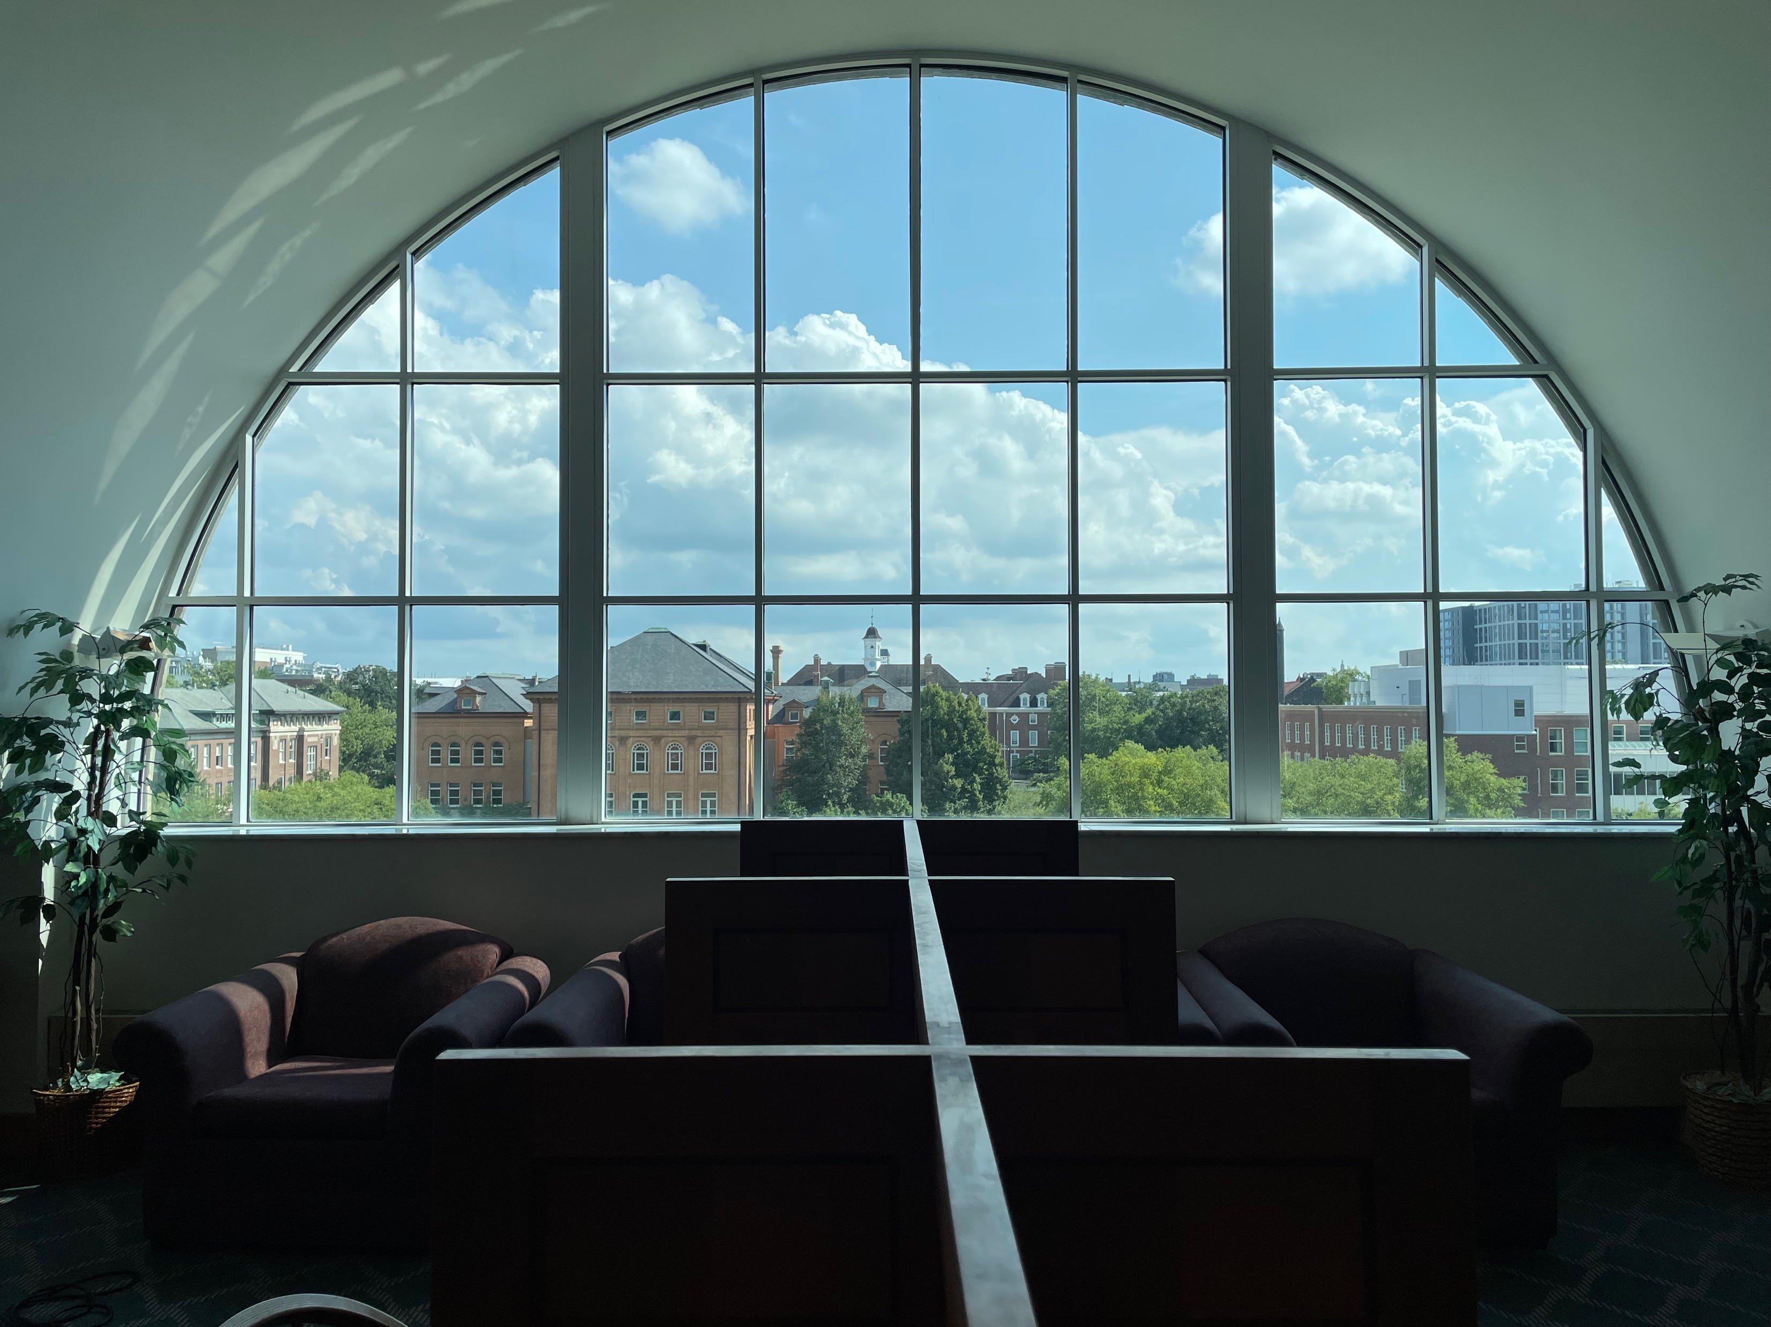
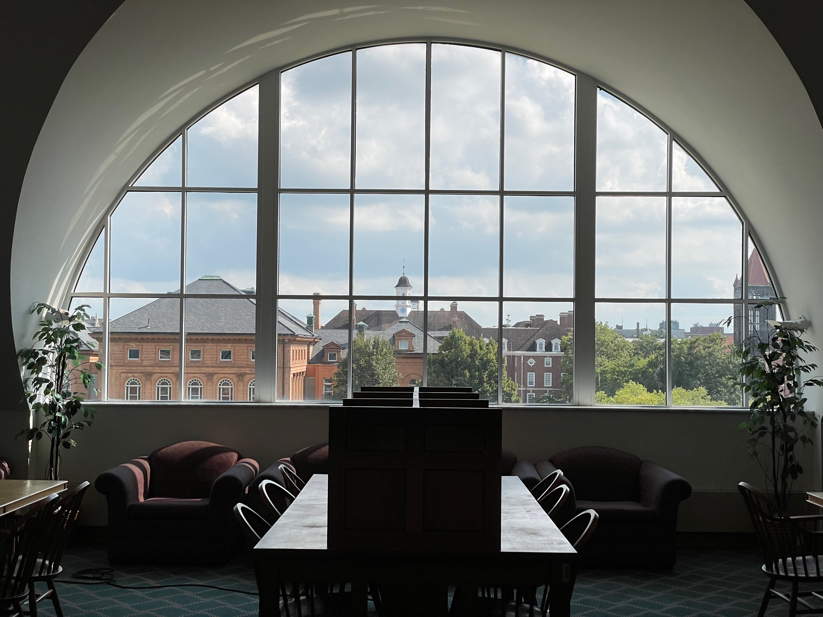
My “dolly zoom”

Slide 70
Choice of lens and viewpoint: A COVID-era illustration
Source

Slide 71
Overview
Pinhole projection model
Cameras with lenses
  Depth of field
  Field of view
  Lens aberrations

Slide 72
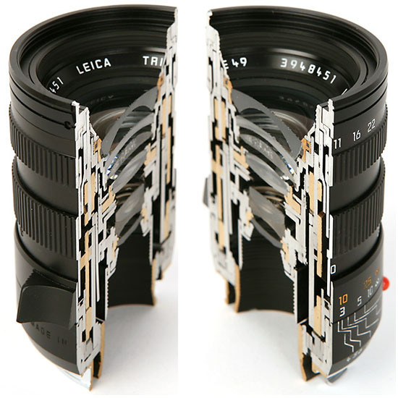

Real lenses

Slide 73



Lens flaws: Vignetting

Slide 74


Lens flaws: Radial distortion
Caused by imperfect lenses
Distortion is stronger towards the edges of the photo
No distortion
Pin cushion
Barrel

Slide 75

Lens flaws: Spherical aberration
Spherical lenses don’t focus light perfectly
Rays farther from the optical axis focus closer

Slide 76



Lens flaws: Chromatic aberration
Lens has different refractive indices for different wavelengths: causes color fringing
Near Lens Center
Near Lens Outer Edge

Slide 77
Overview
Pinhole projection model
Cameras with lenses
  Depth of field
  Field of view
  Lens aberrations
Digital sensors

Slide 78


Digital camera sensors
Each cell in a sensor array is a light-sensitive diode that converts photons to electrons
  Dominant in the past: Charge Coupled Device (CCD)
  Dominant now: Complementary Metal Oxide Semiconductor (CMOS)
http://electronics360.globalspec.com/article/9464/ccd-vs-cmos-the-shift-in-image-sensor-technology

Slide 79



Color filter arrays
Bayer grid (1976)
Demosaicing:
Estimation of missing components from neighboring values
Why more green?
Human Luminance Sensitivity Function
Source: Steve Seitz

Slide 80

Color filter arrays
Bayer grid (1976)
Demosaicing:
Estimation of missing components from neighboring values
Recent cameraphone technology: pixel binning

Slide 81
Camera response functions
Camera sensors are almost always linear BUT
image dynamic range is too big for 8 bits
Typical cameras apply a non-linearity before or during digitization – the camera response function
This varies from camera to camera

Slide 82

Camera response functions

Slide 83

Camera response functions – simulated images

Slide 84




Misc. digital camera artifacts
Noise
    low light is where you most notice noise
    light sensitivity (ISO) / noise tradeoff
    stuck pixels
In-camera processing
    oversharpening can produce halos
Compression
    JPEG artifacts, blocking
Blooming
    CCD charge overflowing into neighboring pixels
Color artifacts
    Color moire
    Purple fringing from microlenses

Slide 85



Historic milestones
Pinhole model: Mozi (470-390 BCE),
Aristotle (384-322 BCE)
Principles of optics (including lenses):
Alhacen (965-1039 CE)
Camera obscura: Leonardo da Vinci
(1452-1519), Johann Zahn (1631-1707)
First photo: Joseph Nicephore Niepce (1822)
Daguerréotypes (1839)
Photographic film (Eastman, 1889)
Cinema (Lumière Brothers, 1895)
Color Photography (Lumière Brothers, 1908)
Television (Baird, Farnsworth, Zworykin, 1920s)
First consumer camera with CCD
Sony Mavica (1981)
First fully digital camera: Kodak DCS100 (1990)
Alhacen’s notes
Niepce, “La Table Servie,” 1822
https://en.wikipedia.org/wiki/History_of_photography
Old television camera

Slide 86

First digitally scanned photograph
NIST (1957), 176x176 pixels
http://listverse.com/history/top-10-incredible-early-firsts-in-photography/
Notes:
From the website: “Russell Kirsch was a computer pioneer at the National Institute of Standards and Technology in the USA when he developed the system by which a camera could be fed into a computer. The photo is of Kirsch’s three month old son Walden and it measured a mere 176×176 pixels. Baby Walden now works in communications for Intel.”

Slide 87
Camera sales over time
Source
Notes:
CIPA: Camera & Imaging Products Association

Slide 88
Camera sales over time
The full chart…
Source
Notes:
CIPA: Camera & Imaging Products Association

