Slide 1
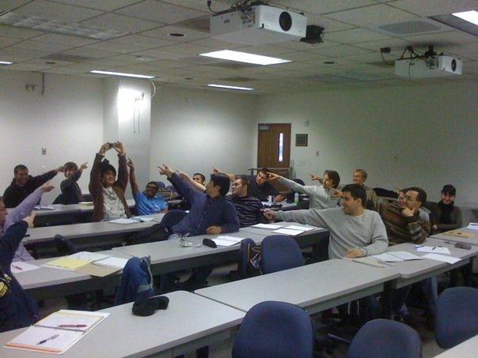
Epipolar geometry
Photo by Frank Dellaert
Many slides adapted from J. Johnson and D. Fouhey

Slide 2
Outline
Motivation
Epipolar geometry setup
Epipolar constraint
Essential matrix
Fundamental matrix
Estimating the fundamental matrix
Monocular visual odometry

Slide 3
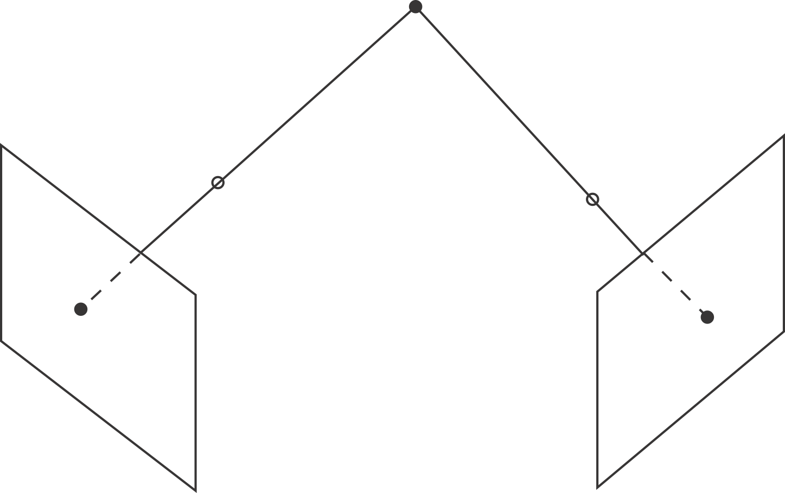
What happens in two views
3 degrees of freedom
2 measurements
2 measurements

Slide 4
All of Camera Geometry
From the picture
  two views of a point give four measurements of three DOF
  this means
    correspondence is constrained
    if we have enough points and enough pix we can recover
      points
      cameras

Slide 5
Two views of the same 3D scene, because:
You have two
  Eyes
  Cameras
OR the camera moves

Slide 6
Consider two views of the same 3D scene
What constraints must hold between two projections of the same 3D point?

Slide 7
Consider two views of the same 3D scene
Given a 2D point in one view, where can we find the corresponding point in the other view?

Slide 8
Consider two views of the same 3D scene
Given only 2D correspondences, how can we calibrate the two cameras, i.e., estimate their relative position and orientation and the intrinsic parameters?

Slide 9
Consider two views of the same 3D scene
Key idea: we want to answer all these questions without explicit 3D reasoning, by considering the projections of camera centers and visual rays into the other view

Slide 10



Epipolar geometry setup
$$O$$
$$O′$$
Suppose we have two cameras with centers $O$, $O′$
The baseline is the line connecting the origins

Slide 11



Epipolar geometry setup
$$O$$
$$e′$$
$$O′$$
$$e$$
Epipoles $e$, $e′$ are where the baseline intersects the image planes, or projections of the other camera in each view

Slide 12



Epipolar geometry setup
$$X$$
$$x$$
$$x′$$
$$O$$
$$e′$$
$$O′$$
$$e$$
Consider a point $X$, which projects to $x$ and $x′$

Slide 13

Epipolar geometry setup
$$X$$
$$x$$
$$x′$$
$$O$$
$$e′$$
$$O′$$
$$e$$
The plane formed by $X$, $O$, and $O′$ is called an epipolar plane
There is a family of planes passing through $O$ and $O′$

Slide 14
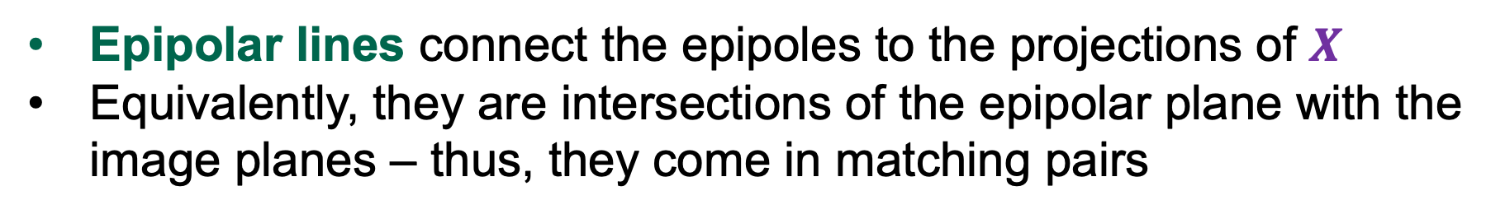
Epipolar geometry setup
$$X$$
$$x$$
$$x′$$
$$O$$
$$e′$$
$$O′$$
$$e$$
Epipolar lines connect the epipoles to the projections of $X$
Equivalently, they are intersections of the epipolar plane with the image planes – thus, they come in matching pairs

Slide 15
Epipolar geometry setup: Summary
$$X$$
Epipolar plane
$$x$$
$$x′$$
Epipolar lines
$$O$$
Baseline
$$e′$$
$$O′$$
$$e$$
Epipoles

Slide 16
Example configuration: Converging cameras
$$O$$
$$e′$$
$$O′$$
$$e$$
Epipoles are finite, may be visible in the image

Slide 17
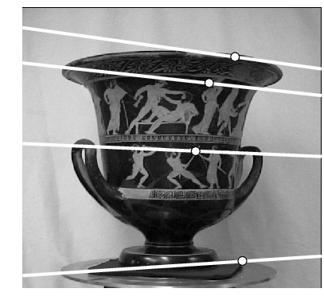
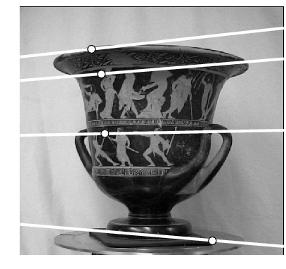
Example configuration: Converging cameras

Slide 18


Example configuration: Motion parallel to image plane
$$O$$
$$O′$$
Where are the epipoles and what do the epipolar lines look like?

Slide 19


Example configuration: Motion parallel to image plane
$$e$$
$$e′$$
$$O$$
$$O′$$
Epipoles infinitely far away, epipolar lines parallel

Slide 20
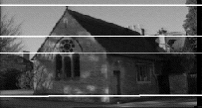
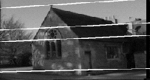
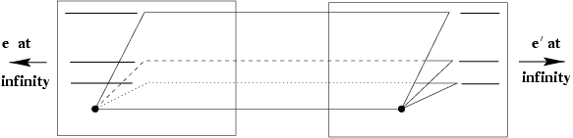
Example configuration: Motion parallel to image plane

Slide 21




Example configuration: Motion perpendicular to image plane
$$e′$$
Epipole is “focus of expansion” and coincides with the principal point of the camera
Epipolar lines go out from principal point
$$O′$$
$$e$$
$$O$$

Slide 22
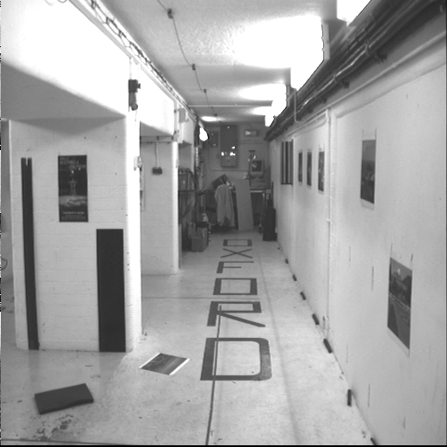
Example configuration: Motion perpendicular to image plane

Slide 23
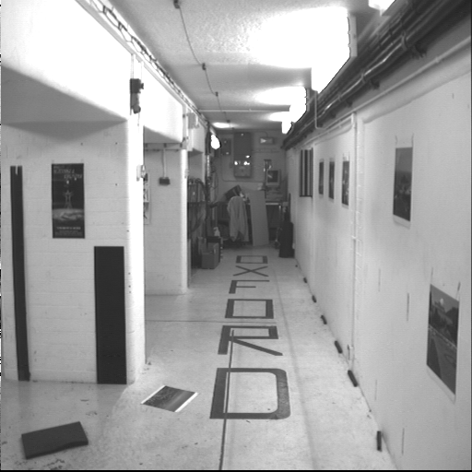
Example configuration: Motion perpendicular to image plane

Slide 24

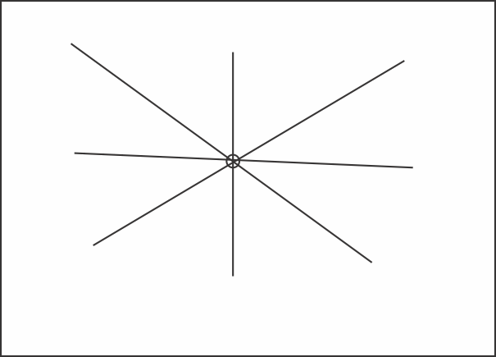
Epipoles (resp. epipolar lines)
Informative on their own
Epipole and epipolar lines in camera 1 - where is camera 2?

Slide 25
Outline
Motivation
Epipolar geometry setup
Epipolar constraint

Slide 26

Epipolar constraint
$$x$$
$$O$$
Suppose we observe a single point $x$ in one image

Slide 27
Epipolar constraint
$$x$$
$$O$$
$$e′$$
$$O′$$
$$e$$
Where can we find the $x′$ corresponding to $x$ in the other image?

Slide 28

Epipolar constraint
$$x$$
$$O$$
$$e′$$
$$O′$$
$$e$$
Where can we find the $x′$ corresponding to $x$ in the other image?
Along the epipolar line corresponding to $x$ (projection of visual ray connecting $O$ with $x$ into the second image plane)

Slide 29


Epipolar constraint
$$x′$$
$$O$$
$$e′$$
$$O′$$
$$e$$
Similarly, all points in the left image corresponding to $x′$ have to lie along the epipolar line corresponding to $x′$

Slide 30




Epipolar constraint
$$x$$
$$x′$$
$$l$$
$$l′$$
$$O$$
$$e′$$
$$O′$$
$$e$$
Potential matches for $x$ have to lie on the matching epipolar line $l′$
Potential matches for $x′$ have to lie on the matching epipolar line $l$

Slide 31
Epipolar constraint: Example

Slide 32
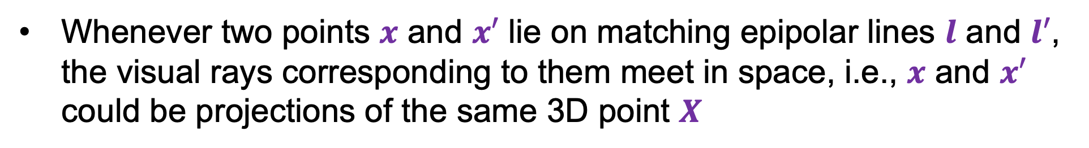
Epipolar constraint
$$X$$
$$x$$
$$x′$$
$$l$$
$$l′$$
$$O$$
$$e′$$
$$O′$$
$$e$$
Whenever two points $x$ and $x′$ lie on matching epipolar lines $l$ and $l′$, the visual rays corresponding to them meet in space, i.e., $x$ and $x′$ could be projections of the same 3D point $X$

Slide 33
Epipolar constraint
$$x$$
$$x′$$
$$O$$
$$e′$$
$$O′$$
$$e$$
Remember: in general, two rays do not meet in space!

Slide 34









Epipolar constraint
$$X$$
$$x$$
$$x′$$
$$l$$
$$l′$$
$$O$$
$$e′$$
$$O′$$
$$e$$
X, x, x’, O, O’ are coplanar
Know O, O’
  Choose x – This yields the plane and so l’ and x’ lies on l’
    So there is some vector function f(x; O, O’) such that
    f(x; O, O’)^T x’=0

Slide 35



Epipolar constraint
$$X′$$
$$X$$
$$x$$
$$x′$$
$$l$$
$$l′$$
$$O$$
$$e′$$
$$O′$$
$$e$$
Caveat: if $x$ and $x′$ satisfy the epipolar constraint, this doesn’t mean they have to be projections of the same 3D point

Slide 36
Outline
Motivation
Epipolar geometry setup
Epipolar constraint
Essential matrix

Slide 37

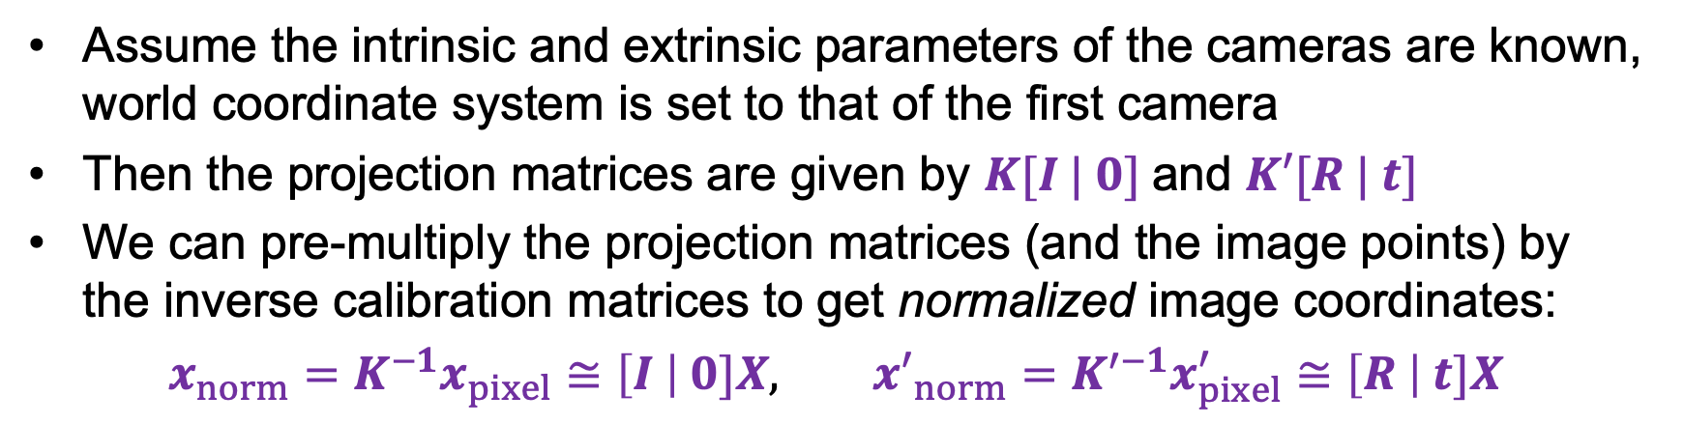




Math of the epipolar constraint: Calibrated case
$$X$$
$$x$$
$$x′$$
$$t$$
$$R$$
Assume the intrinsic and extrinsic parameters of the cameras are known, world coordinate system is set to that of the first camera
Then the projection matrices are given by $K[I | 0]$and $K′[R | t]$
We can pre-multiply the projection matrices (and the image points) by the inverse calibration matrices to get normalized image coordinates:
$x_{norm}=K^{−1}x_{pixel}≅\left[I \right| 0]X,$ ${x′}_{norm}=K^{′−1}x_{pixel}^{′}≅\left[R \right| t]X$

Slide 38
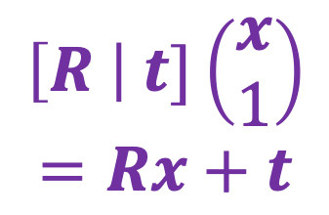
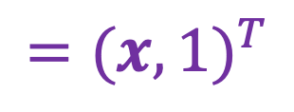
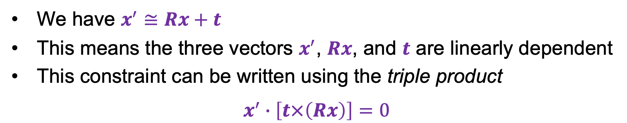
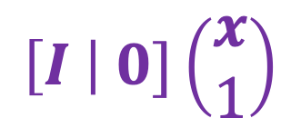



Math of the epipolar constraint: Calibrated case
$$X$$
$$={(x,1)}^{T}$$
$$x_{norm}≅\left[I \right| 0]X$$
$${x′}_{norm}≅\left[R \right| t]X$$
$$\left[I \right| 0]\left(\begin{aligned}x \\ 1\end{aligned}\right)$$
$$x$$
$$x^{′}$$
$$\left[R \right| t]\left(\begin{aligned}x \\ 1\end{aligned}\right)$$
$$=Rx+t$$
$$t$$
$$R$$
We have $x^{′}≅Rx+t$
This means the three vectors $x^{′}$, $Rx$, and $t$ are linearly dependent
This constraint can be written using the triple product
$$x^{′}∙\left[t×\left(Rx\right)\right]=0$$

Slide 39
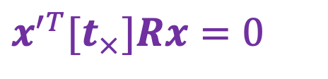
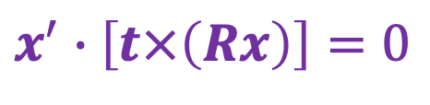
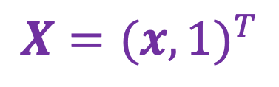
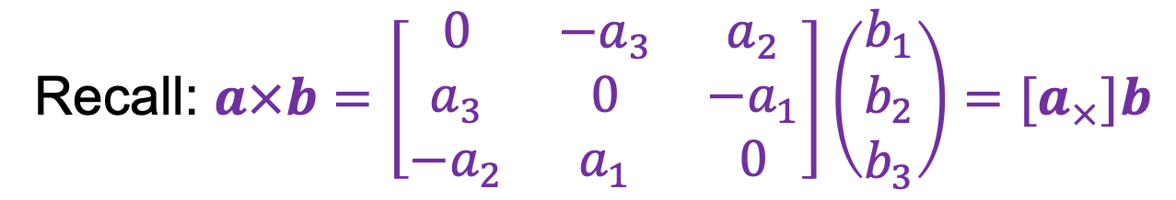
Math of the epipolar constraint: Calibrated case
$$X={(x,1)}^{T}$$
$$\left[I \right| 0]\left(\begin{aligned}x \\ 1\end{aligned}\right)$$
$$x$$
$$x^{′}$$
$$\left[R \right| t]\left(\begin{aligned}x \\ 1\end{aligned}\right)$$
$$=Rx+t$$
$$t$$
$$R$$
$$x^{′}∙\left[t×\left(Rx\right)\right]=0$$
$$x^{′T}{[t}_{×}]Rx=0$$
Recall: $a×b=\left[\begin{matrix}0 & −a_{3} & a_{2} \\ a_{3} & 0 & −a_{1} \\ {−a}_{2} & a_{1} & 0\end{matrix}\right]\left(\begin{aligned}b_{1} \\ b_{2} \\ b_{3}\end{aligned}\right)=[a_{×}]b$

Slide 40

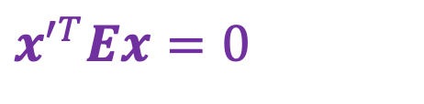
Math of the epipolar constraint: Calibrated case
$$X={(x,1)}^{T}$$
$$\left[I \right| 0]\left(\begin{aligned}x \\ 1\end{aligned}\right)$$
$$x$$
$$x^{′}$$
$$\left[R \right| t]\left(\begin{aligned}x \\ 1\end{aligned}\right)$$
$$=Rx+t$$
$$t$$
$$R$$
$$x^{′}∙\left[t×\left(Rx\right)\right]=0$$
$$x^{′T}{[t}_{×}]Rx=0$$
$$x^{′T}Ex=0$$
Essential Matrix
H. C. Longuet-Higgins. A computer algorithm for reconstructing a scene from two projections. Nature 293 (5828): 133–135, September 1981

Slide 41
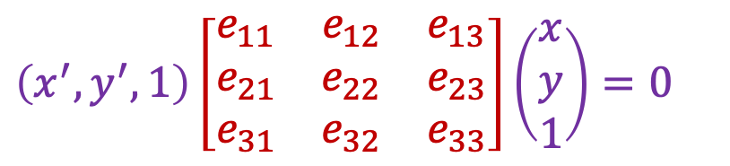

The essential matrix
$$X$$
$$x$$
$$x^{′}$$
$$x^{′T}Ex=0$$
$$\left(x^{′},y^{′},1\right)\left[\begin{matrix}e_{11} & e_{12} & e_{13} \\ e_{21} & e_{22} & e_{23} \\ e_{31} & e_{32} & e_{33}\end{matrix}\right]\left(\begin{aligned}x \\ y \\ 1\end{aligned}\right)=0$$

Slide 42

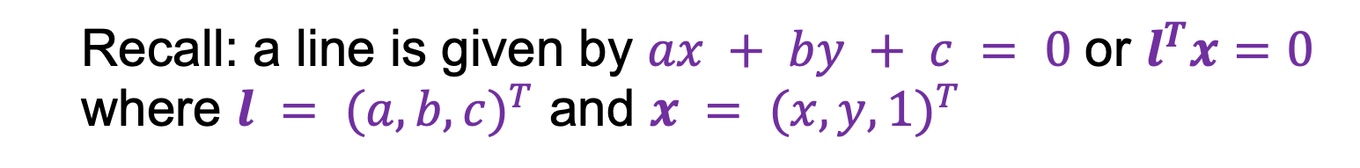
The essential matrix: Properties
$$X$$
$$x$$
$$x^{′}$$
$$l^{′}$$
$$x^{′T}Ex=0$$
$Ex$ is the epipolar line associated with $x$ ($l′=Ex$)
  Recall: a line is given by $ax + by + c = 0$ or $l^{T}x=0$ where $l = {(a,b,c)}^{T}$ and $x = {(x,y,1)}^{T}$

Slide 43

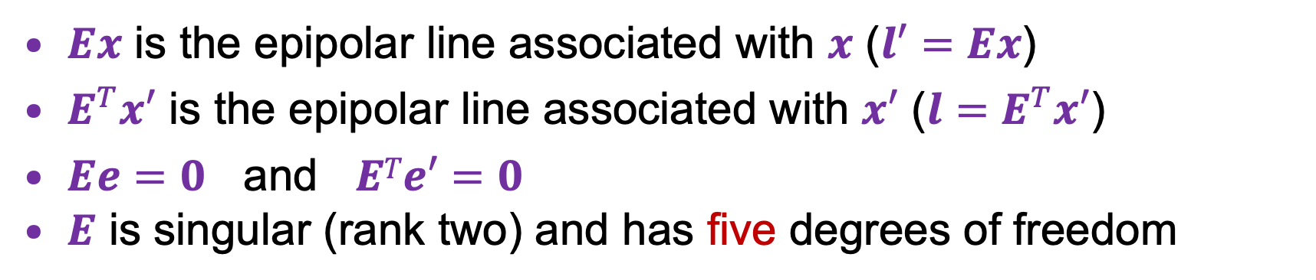
The essential matrix: Properties
$$X$$
$$x$$
$$x^{′}$$
$$l$$
$$x^{′T}Ex=0$$
$Ex$ is the epipolar line associated with $x$ ($l′=Ex$)
$E^{T}x′$ is the epipolar line associated with $x′$ ($l=E^{T}x′$)
$Ee=0$ and $ETe′=0$
$E$ is singular (rank two) and has five degrees of freedom

Slide 44
Outline
Motivation
Epipolar geometry setup
Epipolar constraint
Essential matrix
Fundamental matrix

Slide 45
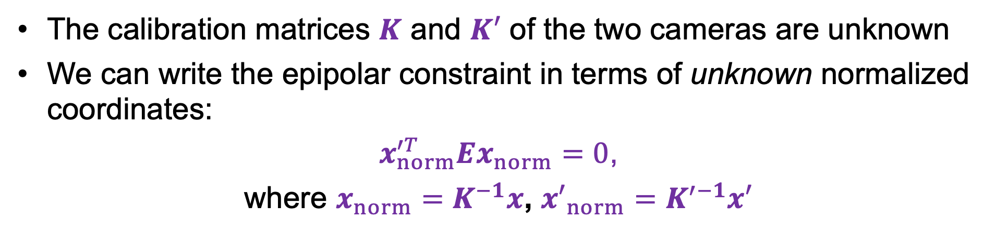
Epipolar constraint: Uncalibrated case
$$X$$
$$x$$
$$x^{′}$$
The calibration matrices $K$ and $K′$ of the two cameras are unknown
We can write the epipolar constraint in terms of unknown normalized coordinates:
$x_{norm}^{′T}Ex_{norm}=0$,
where $x_{norm}=K^{−1}x$, ${x′}_{norm}=K^{′−1}x′$

Slide 46




Epipolar constraint: Uncalibrated case
$$X$$
$$x$$
$$x^{′}$$
$$x_{norm}^{′T}Ex_{norm}=0$$
$x^{′T}Fx=0$, where $F={K′}^{−T}EK^{−1}$
$$x_{norm}=K^{−1}x$$
Fundamental Matrix
$${x′}_{norm}=K^{′−1}x′$$
Faugeras et al., (1992), Hartley (1992)

Slide 47


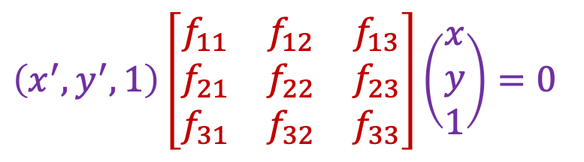
The fundamental matrix
$$X$$
$$x$$
$$x^{′}$$
$$l$$
$$l′$$
$$x^{′T}Fx=0$$
$$\left(x^{′},y^{′},1\right)\left[\begin{matrix}f_{11} & f_{12} & f_{13} \\ f_{21} & f_{22} & f_{23} \\ f_{31} & f_{32} & f_{33}\end{matrix}\right]\left(\begin{aligned}x \\ y \\ 1\end{aligned}\right)=0$$

Slide 48
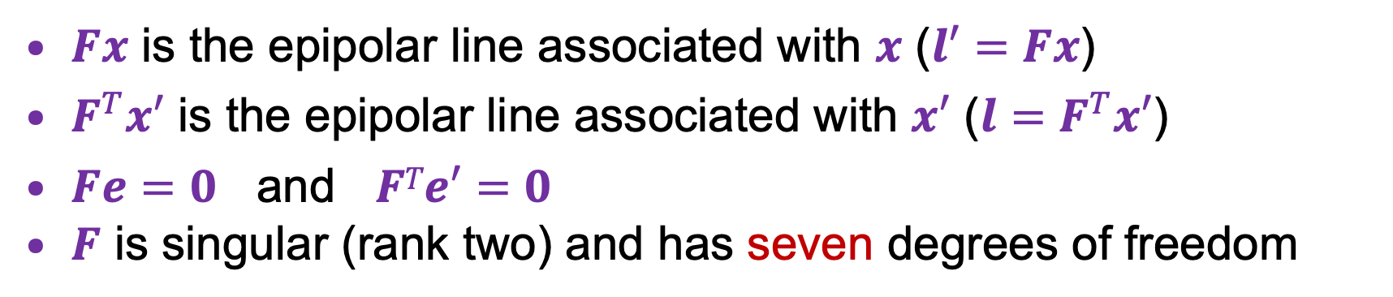
The fundamental matrix: Properties
$$X$$
$$x$$
$$x^{′}$$
$$l$$
$$l′$$
$$x^{′T}Fx=0$$
$Fx$ is the epipolar line associated with $x$ ($l′=Fx$)
$F^{T}x′$ is the epipolar line associated with $x′$ ($l=F^{T}x′$)
$Fe=0$ and $FTe′=0$
$F$ is singular (rank two) and has seven degrees of freedom

Slide 49

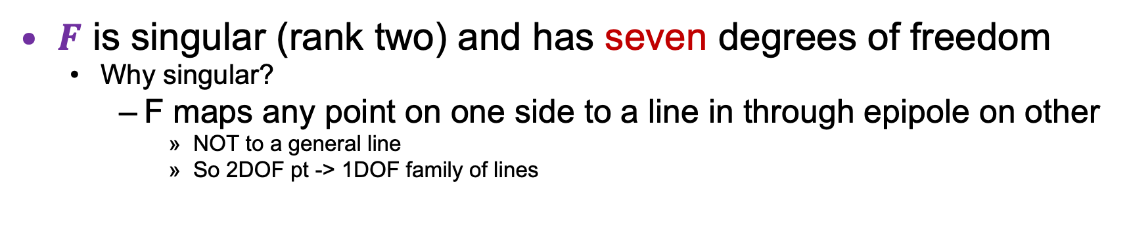




The fundamental matrix: Properties
$$X$$
$$x$$
$$x^{′}$$
$$x^{′T}Fx=0$$
$$l$$
$$l′$$
$F$ is singular (rank two) and has seven degrees of freedom
  Why singular?
    F maps any point on one side to a line in through epipole on other
      NOT to a general line
      So 2DOF pt -> 1DOF family of lines

Slide 50
Outline
Motivation
Epipolar geometry setup
Epipolar constraint
Essential matrix
Fundamental matrix
Estimating the fundamental matrix

Slide 51
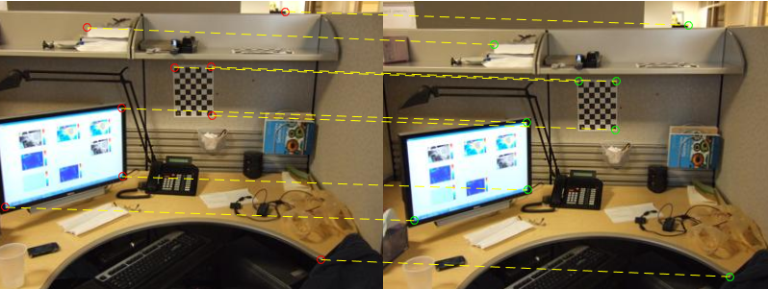

Estimating the fundamental matrix
Given: correspondences $x={(x,y,1)}^{T}$ and $x^{′}={(x′,y′,1)}^{T}$

Slide 52


Estimating the fundamental matrix
Given: correspondences $x={(x,y,1)}^{T}$ and $x^{′}={(x′,y′,1)}^{T}$
Constraint: ${x′}^{T}Fx=0$
$$\left(x^{′},y^{′},1\right)\left[\begin{matrix}f_{11} & f_{12} & f_{13} \\ f_{21} & f_{22} & f_{23} \\ f_{31} & f_{32} & f_{33}\end{matrix}\right]\left(\begin{aligned}x \\ y \\ 1\end{aligned}\right)=0$$
$$\left(x^{′}x,x^{′}y, x′,y^{′}x,y^{′}y,y′,x,y,1\right)\left(\begin{aligned}f_{11} \\ f_{12} \\ f_{13} \\ \begin{aligned}f_{21} \\ f_{22} \\ f_{23}\end{aligned} \\ \begin{aligned}f_{31} \\ f_{32} \\ f_{33}\end{aligned}\end{aligned}\right)=0$$

Slide 53




The eight point algorithm
$$\left[\begin{matrix} & & & ⋮ & & & & & \\ x^{′}x & x^{′}y & x′ & y^{′}x & y^{′}y & y′ & x & y & 1 \\ & & & ⋮ & & & & & \end{matrix}\right]\left(\begin{aligned}f_{11} \\ f_{12} \\ f_{13} \\ \begin{aligned}f_{21} \\ f_{22} \\ f_{23}\end{aligned} \\ \begin{aligned}f_{31} \\ f_{32} \\ f_{33}\end{aligned}\end{aligned}\right)=0$$
$$U$$
Homogeneous least squares to find $f$:
$${\arg{\min_{\begin{aligned} \\ \left\|f\right\|=1\end{aligned}}\left\|Uf\right\|}}_{2}^{2}$$
Eigenvector of $U^{T}U$ with smallest eigenvalue

Slide 54


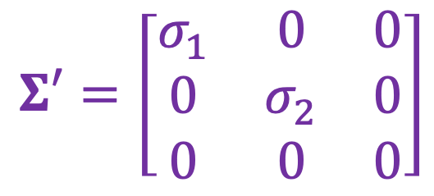

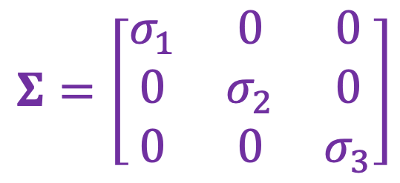
Enforcing rank-2 constraint
We know $F$ needs to be singular/rank 2. How do we force it to be singular?
Solution: take SVD of the initial estimate and throw out the smallest singular value
$$F_{init}=UΣV^{T}$$
$$Σ=\left[\begin{matrix}σ_{1} & 0 & 0 \\ 0 & σ_{2} & 0 \\ 0 & 0 & σ_{3}\end{matrix}\right]$$
$$Σ′=\left[\begin{matrix}σ_{1} & 0 & 0 \\ 0 & σ_{2} & 0 \\ 0 & 0 & 0\end{matrix}\right]$$
$$F=UΣ′V^{T}$$

Slide 55
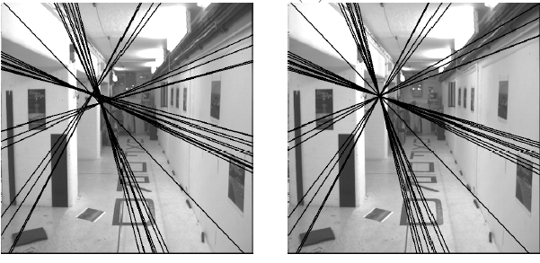

Enforcing rank-2 constraint
Initial $F$ estimate
Rank-2 estimate

Slide 56
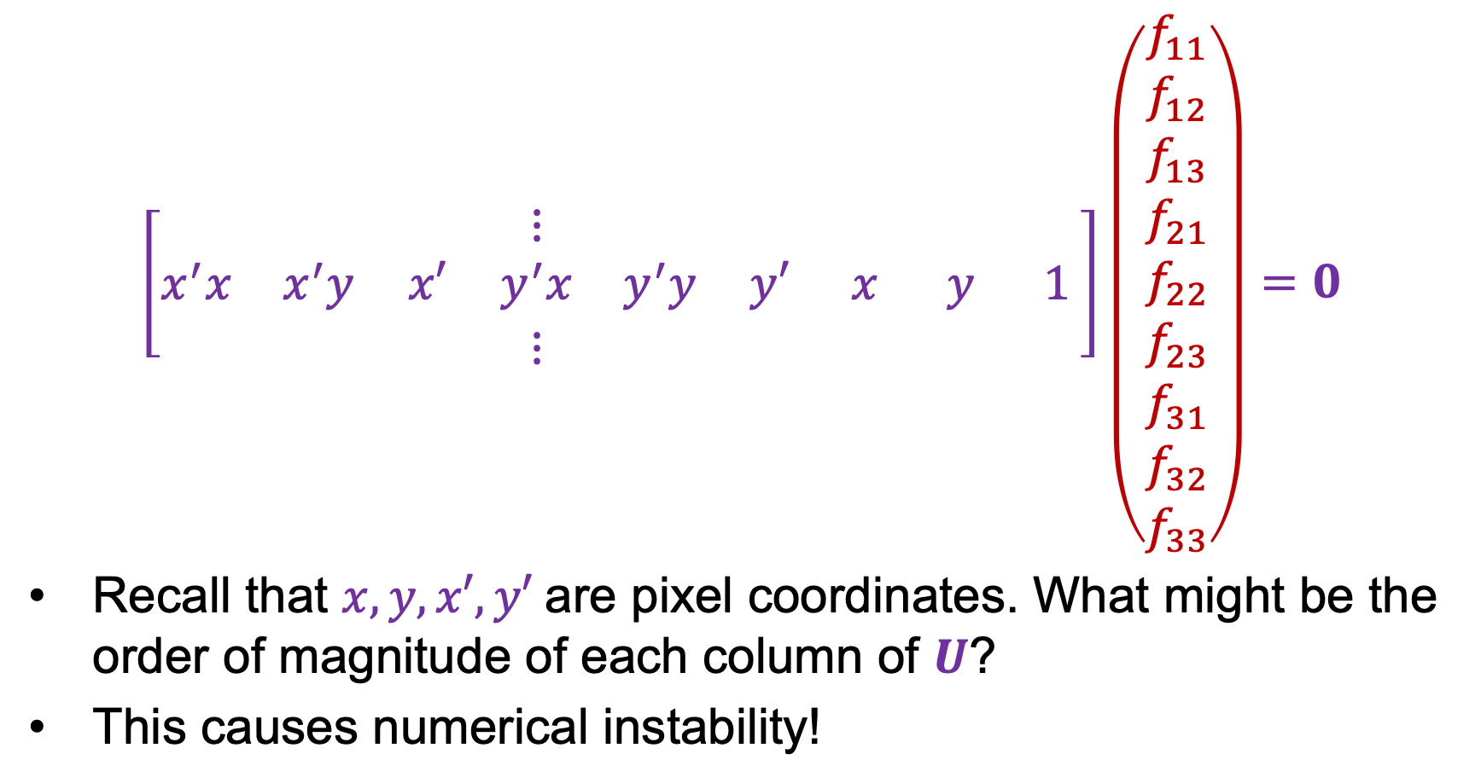
Normalized eight point algorithm
$$\left[\begin{matrix} & & & ⋮ & & & & & \\ x^{′}x & x^{′}y & x′ & y^{′}x & y^{′}y & y′ & x & y & 1 \\ & & & ⋮ & & & & & \end{matrix}\right]\left(\begin{aligned}f_{11} \\ f_{12} \\ f_{13} \\ \begin{aligned}f_{21} \\ f_{22} \\ f_{23}\end{aligned} \\ \begin{aligned}f_{31} \\ f_{32} \\ f_{33}\end{aligned}\end{aligned}\right)=0$$
Recall that $x, y, x′, y′$are pixel coordinates. What might be the order of magnitude of each column of $U$?
This causes numerical instability!
$$\begin{matrix}\begin{matrix}{10}^{6} & {10}^{6} & {10}^{3}\end{matrix} & \begin{matrix}{10}^{6} & {10}^{6} & {10}^{3}\end{matrix} & \begin{matrix}{10}^{3} & {10}^{3} & 1\end{matrix}\end{matrix}$$
$$U$$

Slide 57
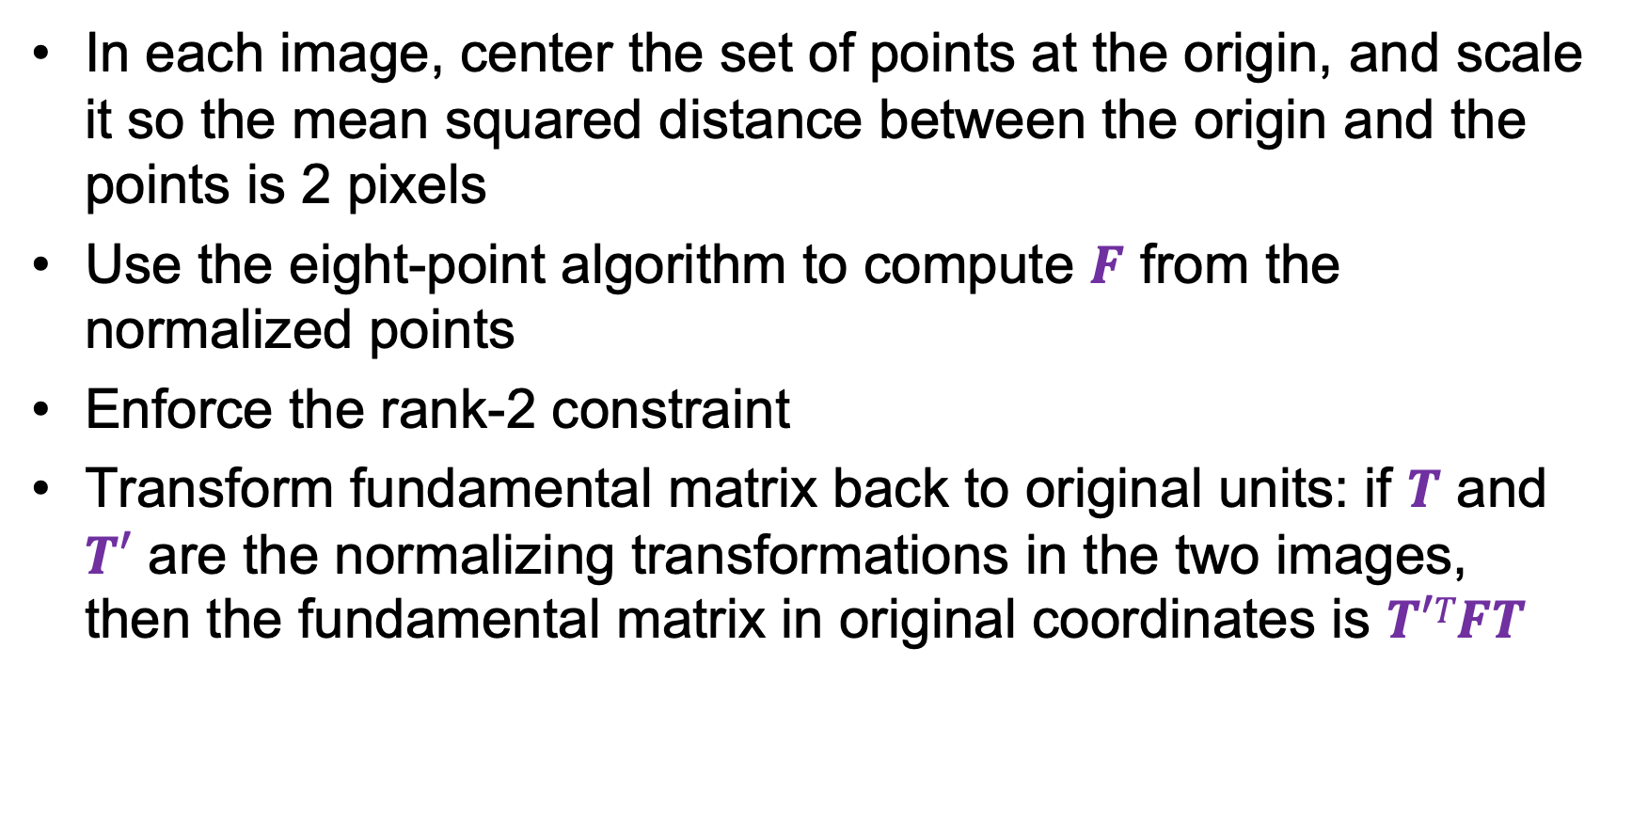
The normalized eight-point algorithm
In each image, center the set of points at the origin, and scale it so the mean squared distance between the origin and the points is 2 pixels
Use the eight-point algorithm to compute $F$ from the normalized points
Enforce the rank-2 constraint
Transform fundamental matrix back to original units: if $T$ and $T′$ are the normalizing transformations in the two images,
then the fundamental matrix in original coordinates is $T′TFT$
R. Hartley. In defense of the eight-point algorithm. TPAMI 1997

Slide 58
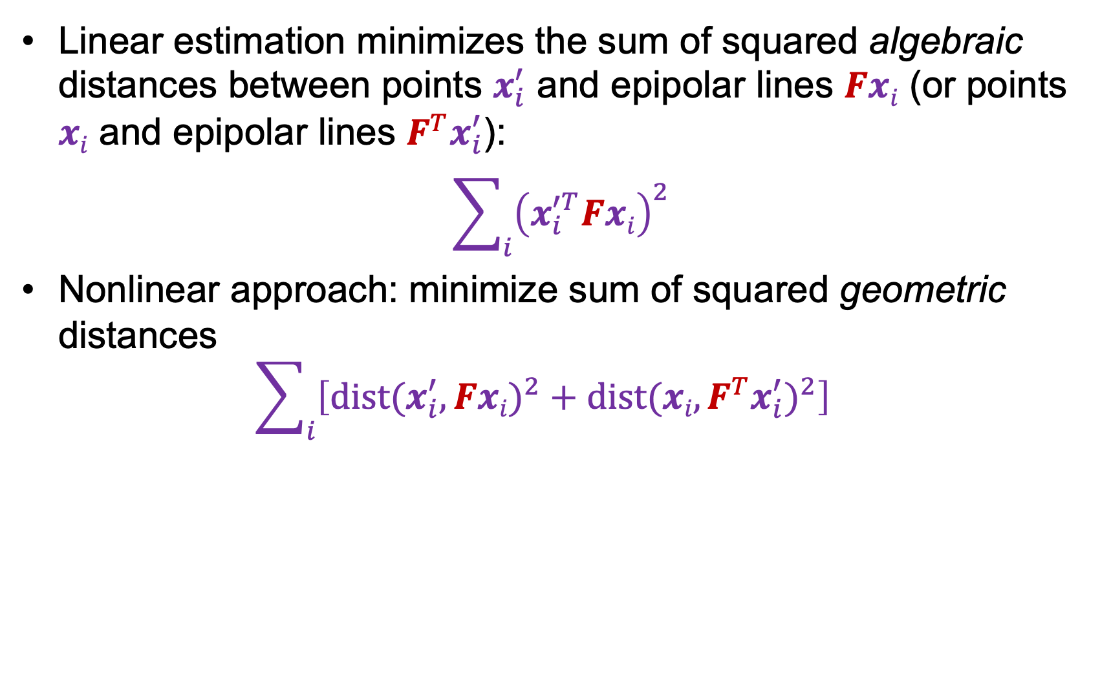
Nonlinear estimation
Linear estimation minimizes the sum of squared algebraic distances between points $x_{i}^{′}$ and epipolar lines $Fxi$ (or points $xi$ and epipolar lines $F^{T}x_{i}^{′}$):
$$\sum_{i}{{\left(x_{i}^{′T}Fxi\right)}^{2}}$$
Nonlinear approach: minimize sum of squared geometric distances
$$\sum_{i}{\left[{dist(x_{i}^{′},Fxi)}^{2}+{dist(xi,F^{T}x_{i}^{′})}^{2}\right]}$$
x_{i}

Slide 59
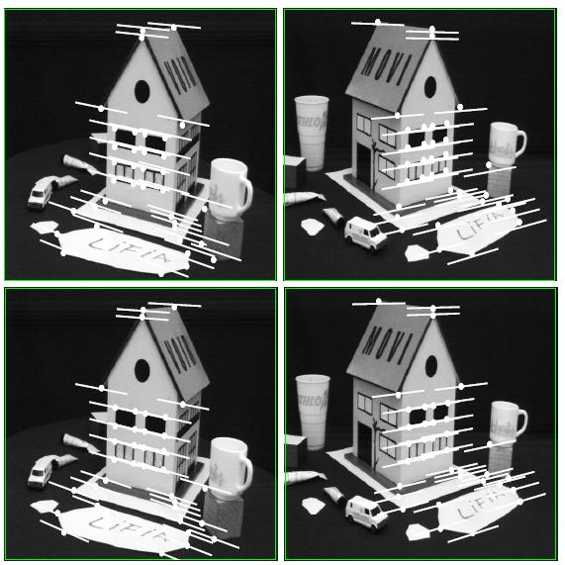
Comparison of estimation algorithms
 | 8-point | Normalized 8-point | Nonlinear least squares
Av. Dist. 1 | 2.33 pixels | 0.92 pixel | 0.86 pixel
Av. Dist. 2 | 2.18 pixels | 0.85 pixel | 0.80 pixel

Slide 60

Seven-point algorithm
Set up least squares system with seven pairs of matches and solve for null space (two vectors) using SVD
Solve for polynomial equation to get coefficients of linear combination of null space vectors that satisfies $det⁡(F)=0$
Source: e.g., M. Pollefeys tutorial (2000)

Slide 61
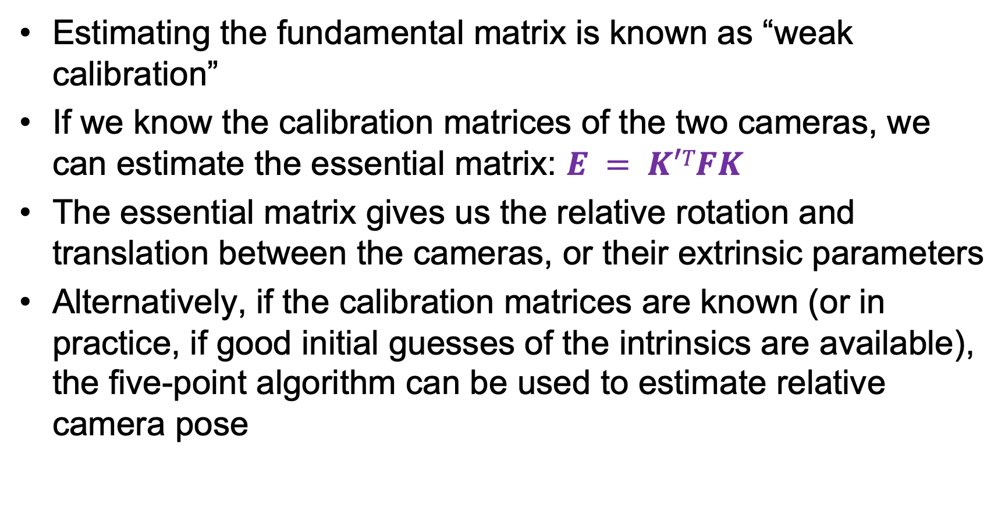
From epipolar geometry to camera calibration
Estimating the fundamental matrix is known as “weak calibration”
If we know the calibration matrices of the two cameras, we can estimate the essential matrix: $E = K′TFK$
The essential matrix gives us the relative rotation and translation between the cameras, or their extrinsic parameters
Alternatively, if the calibration matrices are known (or in practice, if good initial guesses of the intrinsics are available), the five-point algorithm can be used to estimate relative camera pose
D. Nister. An efficient solution to the five-point relative pose problem. IEEE Trans. PAMI, 2004

Slide 62
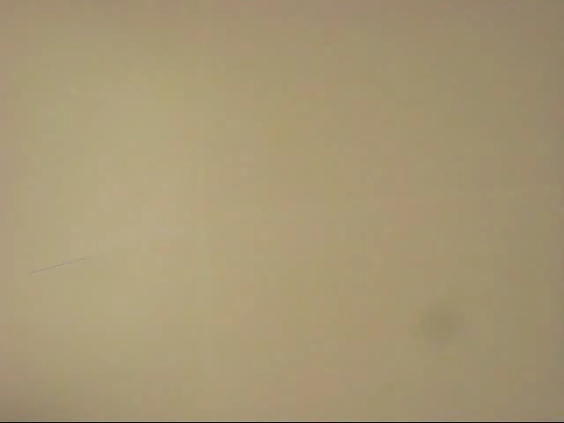
The Fundamental Matrix Song
http://danielwedge.com/fmatrix/

Slide 63
Monocular visual odometry
A calibrated camera
  views a static scene,
  moves,
  views again
Q: how did it move?
  We care, because this allows us to recover movement from single cameras
  We should be able to tell
    Recall epipoles etc are quite informative about movement

Slide 64
Visual odometry
Use eight point algorithm, recover fundamental matrix
Recall:
But we know calibration, which yields essential matrix
Q: what can we get out of essential matrix?

Slide 65
Visual odometry, II
Antisymmetric
Unknown constant
Rotation

Slide 66

Visual odometry, III
Recall singular value decomposition
Orthonormal
Diagonal matrix
Of non-negative singular
values

Slide 67
Visual odometry, IV
Notice
So that
and
have the same singular values
Singular values( ) = singular values( )

Slide 68
Visual odometry, V
Check
Write

Slide 69
Visual odometry, VI
Write
Check
is antisymmetric
is a rotation

Slide 70
Visual odometry, VII
So we can recover
Rotation exactly
Translation up to scale
From an essential matrix

