Slide 1
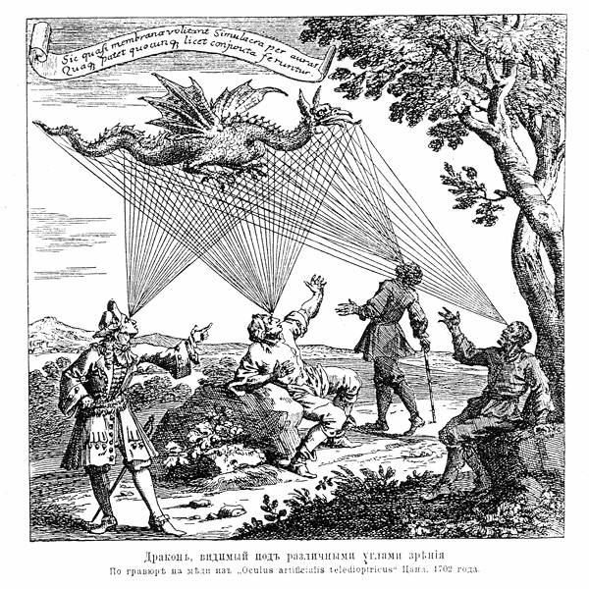
Structure from motion

Slide 2
Outline: Structure from motion
Problem definition and ambiguities
Affine structure from motion
  Factorization
Projective structure from motion
  Bundle adjustment
Modern structure from motion pipeline

Slide 3



Structure from motion
?
Camera 1
?
Camera 3
?
$$K1, R1,t1$$
?
$$K3,R3,t3$$
Camera 2
$$K2,R2,t2$$

Slide 4
Recall: Calibration
Camera 1
?
?
$$K1, R1,t1$$
Camera 3
$$K3,R3,t3$$
Camera 2
?
$$K2,R2,t2$$
Given a set of known 3D points seen by a camera, compute the camera parameters

Slide 5
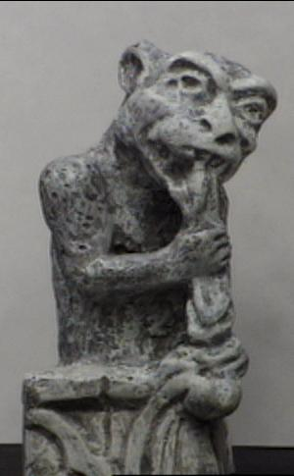
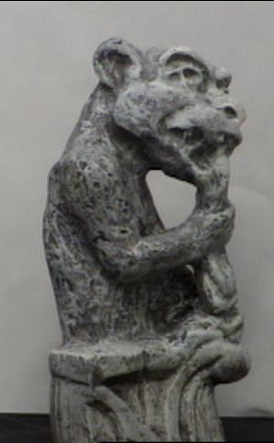
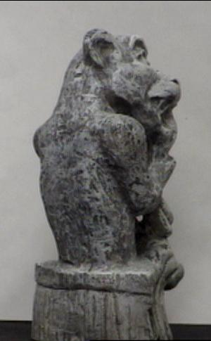
Triangulation
Given projections of a 3D point in two or more images (with known camera matrices), find the coordinates of the point

Slide 6

Triangulation
Given projections of a 3D point in two or more images (with known camera matrices), find the coordinates of the point
$$X?$$

Slide 7





Triangulation
Given projections of a 3D point in two or more images (with known camera matrices), find the coordinates of the point
$$X?$$
$$x2$$
$$x1$$
$$O1$$
$$O2$$

Slide 8

Triangulation
We want to intersect the two visual rays corresponding to
$x1$ and $x2$, but because of noise and numerical errors, they don’t meet exactly
$$X?$$
$$x2$$
$$x1$$
$$O1$$
$$O2$$

Slide 9





Ignored camera
intrinsics cause
cameras are known!
$$X?$$
$$x2$$
$$x1$$
$$O1$$
$$O2$$

Slide 10
Remember camera is known,
And substitute
Affine coordinates of image point

Slide 12


Triangulation – Straightforward Approaches
Above gives two possible points, average them
Choose least squares X_3
Find shortest segment connecting the two viewing rays and let $X$ be the midpoint of that segment
$$X$$
$$x2$$
$$x1$$
$$O1$$
$$O2$$

Slide 13




Triangulation: Nonlinear approach
Find $X$ that minimizes
$${\left\|{proj(P}_{1}X)−x_{1}\right\|}_{2}^{2}+{\left\|{proj(P}_{2}X)−x_{2}\right\|}_{2}^{2}$$
Minimize reprojection error
$$X?$$
$$P1X$$
$$x2$$
$$x1$$
$$P2X$$
$$O1$$
$$O2$$

Slide 14
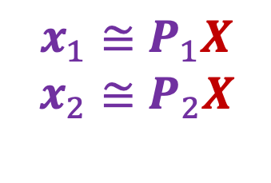
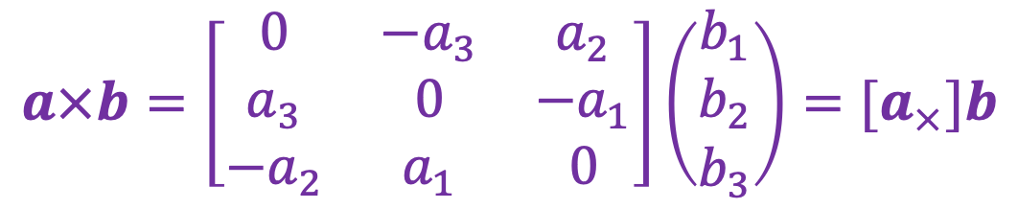
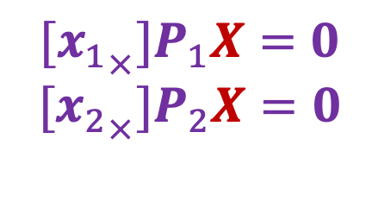
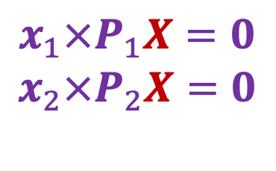
Triangulation: Linear approach
$$x_{1}≅P_{1}X$$
$$x_{2}≅P_{2}X$$
$$x_{1}×P_{1}X=0$$
$$x_{2}×P_{2}X=0$$
$$[{x_{1}}_{×}]P_{1}X=0$$
$$[{x_{2}}_{×}]P_{2}X=0$$
Rewrite cross product as matrix multiplication:
$$a×b=\left[\begin{matrix}0 & −a_{3} & a_{2} \\ a_{3} & 0 & −a_{1} \\ {−a}_{2} & a_{1} & 0\end{matrix}\right]\left(\begin{aligned}b_{1} \\ b_{2} \\ b_{3}\end{aligned}\right)=[a_{×}]b$$

Slide 15
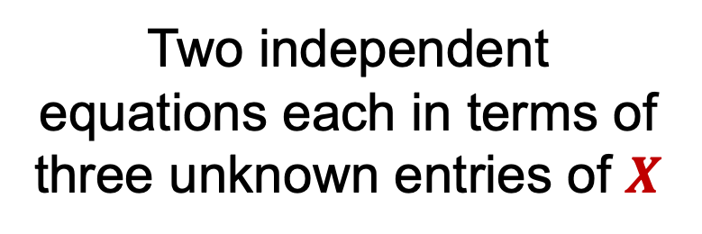
Triangulation: Linear approach
$$x_{1}≅P_{1}X$$
$$x_{2}≅P_{2}X$$
$$x_{1}×P_{1}X=0$$
$$x_{2}×P_{2}X=0$$
$$[{x_{1}}_{×}]P_{1}X=0$$
$$[{x_{2}}_{×}]P_{2}X=0$$
Two independent equations each in terms of
three unknown entries of $X$

Slide 16



Preview: Structure from motion
Figure credit: Noah Snavely
Camera 1
Camera 3
$$R1,t1$$
Camera 2
$$R2,t2$$
$$R3,t3$$
Given 2D point correspondences between multiple images, compute the camera parameters and the 3D points
Notes:
Structure from motion solves the following problem:
Given a set of images of a static scene with 2D points in correspondence, shown here as color-coded points, find…
a set of 3D points P and
a rotation R and position t of the cameras that explain the observed correspondences. In other words, when we project a point into any of the cameras, the reprojection error between the projected and observed 2D points is low.
This problem can be formulated as an optimization problem where we want to find the rotations R, positions t, and 3D point locations P that minimize sum of squared reprojection errors f. This is a non-linear least squares problem and can be solved with algorithms such as Levenberg-Marquart. However, because the problem is non-linear, it can be susceptible to local minima. Therefore, it’s important to initialize the parameters of the system carefully. In addition, we need to be able to deal with erroneous correspondences.

Slide 17
Preview: Structure from motion
?
Camera 1
Camera 3
$$R1,t1$$
Camera 2
$$R2,t2$$
$$R3,t3$$
Structure: Given known cameras and projections of the same 3D point in two or more images, compute the 3D coordinates of that point
  Triangulation!
Notes:
Structure from motion solves the following problem:
Given a set of images of a static scene with 2D points in correspondence, shown here as color-coded points, find…
a set of 3D points P and
a rotation R and position t of the cameras that explain the observed correspondences. In other words, when we project a point into any of the cameras, the reprojection error between the projected and observed 2D points is low.
This problem can be formulated as an optimization problem where we want to find the rotations R, positions t, and 3D point locations P that minimize sum of squared reprojection errors f. This is a non-linear least squares problem and can be solved with algorithms such as Levenberg-Marquart. However, because the problem is non-linear, it can be susceptible to local minima. Therefore, it’s important to initialize the parameters of the system carefully. In addition, we need to be able to deal with erroneous correspondences.

Slide 18
Preview: Structure from motion
Camera 1
?
Camera 3
$$R1,t1$$
Camera 2
?
?
$$R2,t2$$
$$R3,t3$$
Motion: Given a set of known 3D points seen by a camera, compute the camera parameters
  Calibration!
Notes:
Structure from motion solves the following problem:
Given a set of images of a static scene with 2D points in correspondence, shown here as color-coded points, find…
a set of 3D points P and
a rotation R and position t of the cameras that explain the observed correspondences. In other words, when we project a point into any of the cameras, the reprojection error between the projected and observed 2D points is low.
This problem can be formulated as an optimization problem where we want to find the rotations R, positions t, and 3D point locations P that minimize sum of squared reprojection errors f. This is a non-linear least squares problem and can be solved with algorithms such as Levenberg-Marquart. However, because the problem is non-linear, it can be susceptible to local minima. Therefore, it’s important to initialize the parameters of the system carefully. In addition, we need to be able to deal with erroneous correspondences.

Slide 19
Recall: Triangulation
?
Camera 1
Camera 3
$$K1, R1,t1$$
$$K3,R3,t3$$
Camera 2
$$K2,R2,t2$$
Given known cameras and projections of the same 3D point in two or more images, compute the 3D coordinates of that point

Slide 20








Structure from motion: Problem formulation
Given: $m$images of $n$ fixed 3D points such that (ignoring visibility)
$xij ≅ Pi Xj$, $i = 1, … , m, j = 1, … , n$
Problem: estimate $m$ projection matrices $Pi$ and $n$ 3D points $Xj$ from the $mn$ correspondences $xij$
$$Xj$$
$$x1j$$
$$x3j$$
$$x2j$$
$$P1$$
$$P3$$
$$P2$$

Slide 21
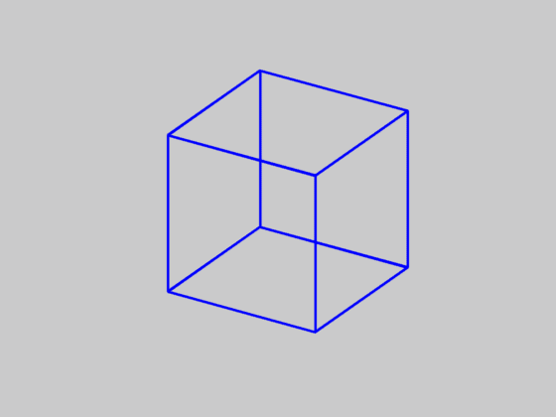
Is SFM always uniquely solvable?
Necker cube
Source: N. Snavely

Slide 22
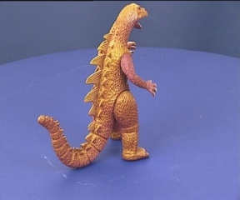
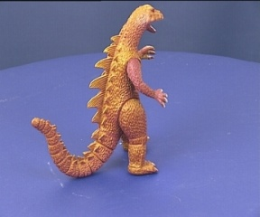
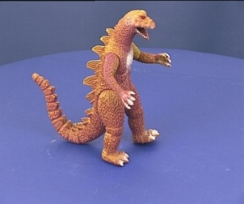
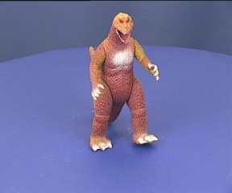
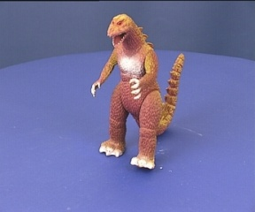
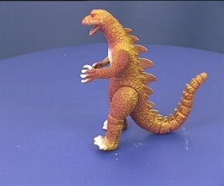
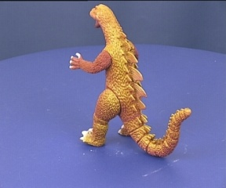
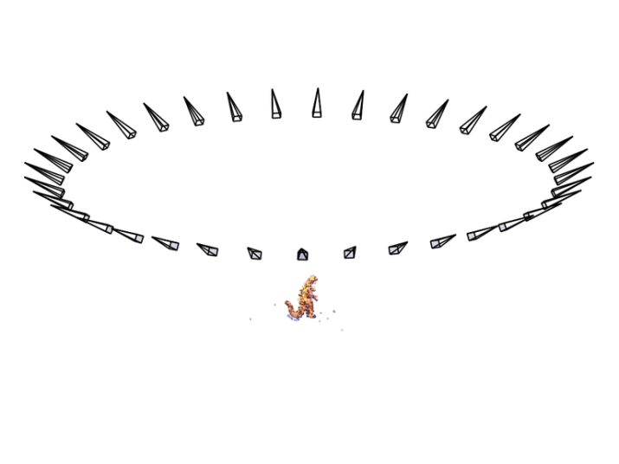
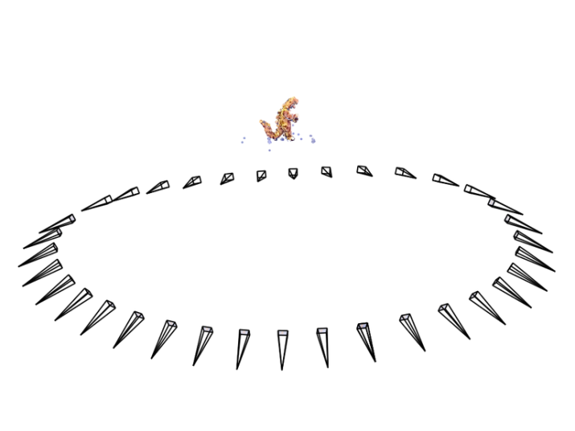
Is SFM always uniquely solvable?
Could actually happen in affine structure from motion:
Source: N. Snavely
Notes:
Necker reversal ambiguity:
This arises because an object rotating by ρ and its mirror image rotating by −ρ generate the same image under parallel projection, see figure 14.9(a). Thus, structure is only recovered up to a reflection about the frontal plane. This ambiguity is absent in the perspective case because the points have different depths in the two interpretations and so do not project to coincident image points.

Slide 23
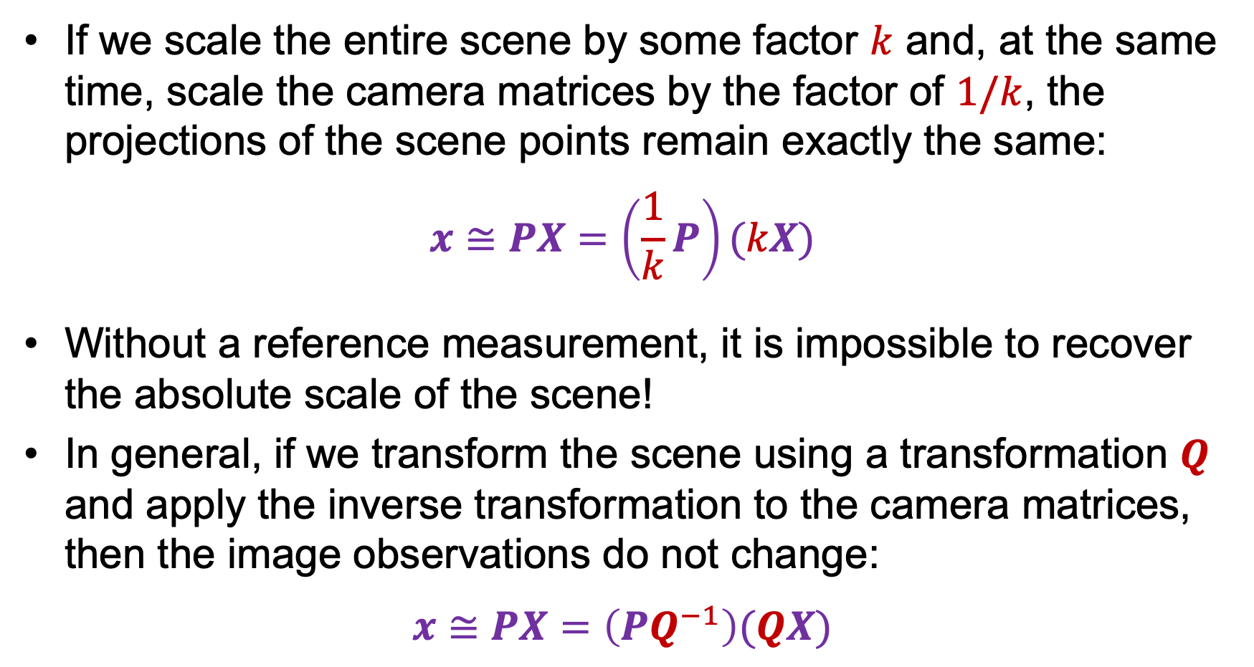
Structure from motion ambiguity
If we scale the entire scene by some factor $k$ and, at the same time, scale the camera matrices by the factor of $1/k$, the projections of the scene points remain exactly the same:
$$x≅PX=\left(\frac{1}{k}P\right)(kX)$$
Without a reference measurement, it is impossible to recover the absolute scale of the scene!
In general, if we transform the scene using a transformation $Q$ and apply the inverse transformation to the camera matrices, then the image observations do not change:
$$x≅PX=\left(PQ^{−1}\right)(QX)$$

Slide 24
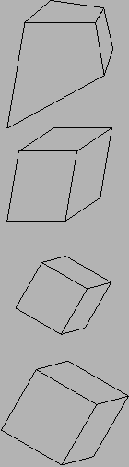
Types of ambiguity
Projective
15dof
Preserves intersection and tangency
Affine
12dof
Preserves parallellism, volume ratios
Similarity
7dof
Preserves angles, ratios of length
Euclidean
6dof
Preserves angles, lengths
With no constraints on the camera calibration matrix or on the scene, we get a projective reconstruction
Need additional information to upgrade the reconstruction to affine, similarity, or Euclidean

Slide 25
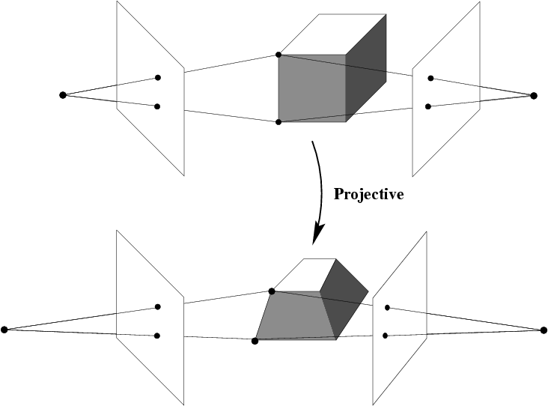
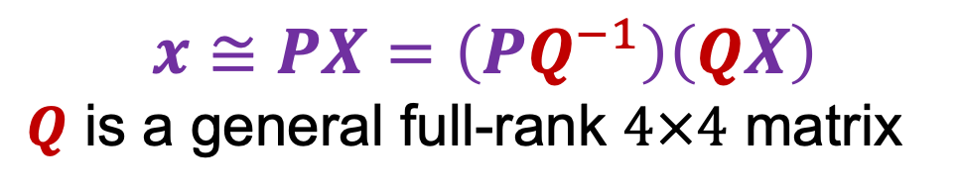
Projective ambiguity
With no constraints on the camera calibration matrices or on the scene, we can reconstruct up to a projective ambiguity:
$$x≅PX=\left(PQ^{−1}\right)\left(QX\right)$$
$Q$ is a general full-rank $4×4$ matrix

Slide 26
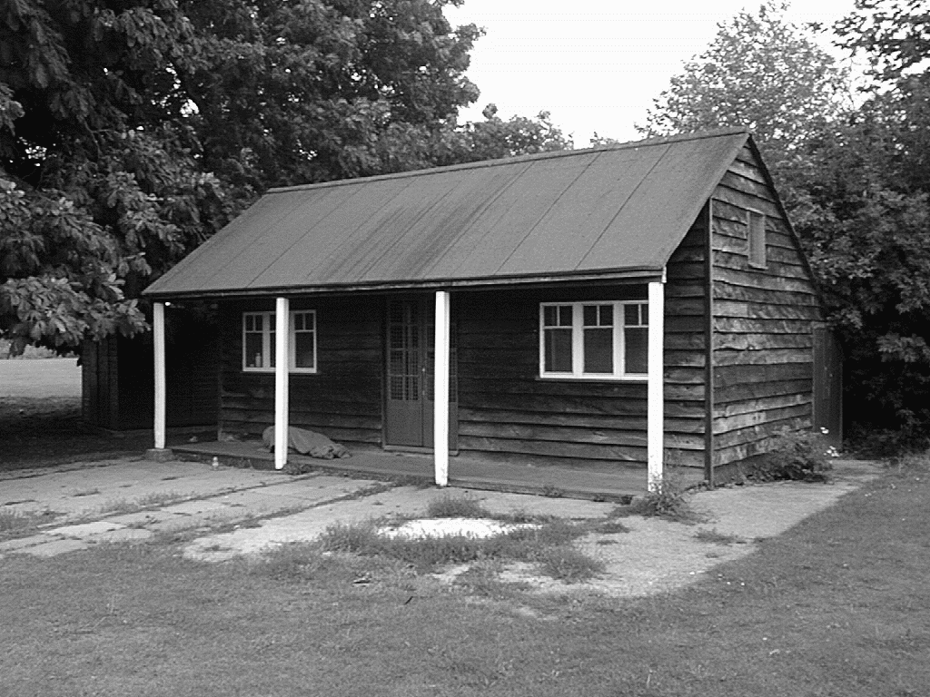
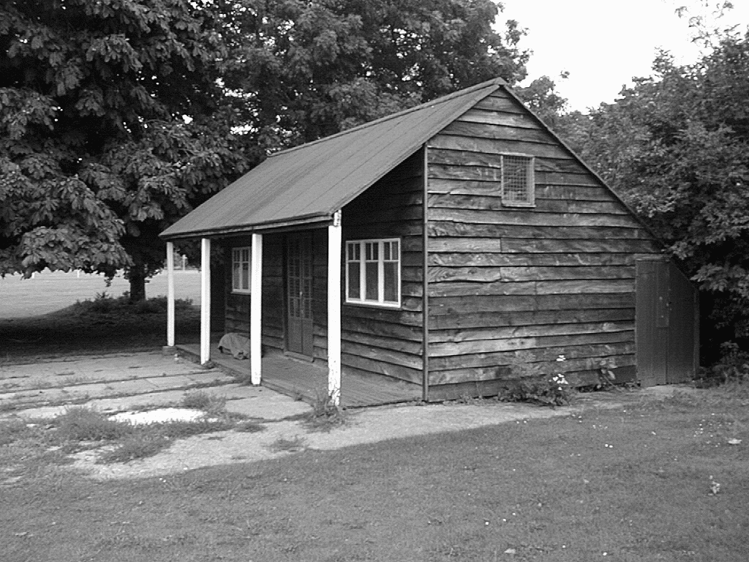
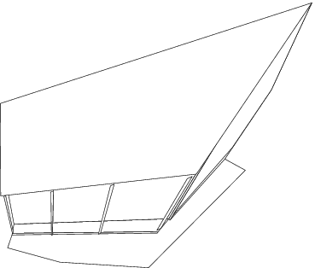
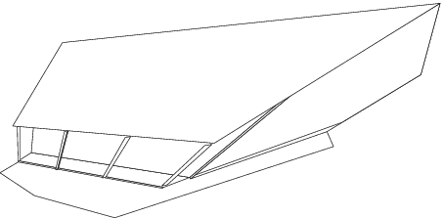
Projective ambiguity

Slide 27
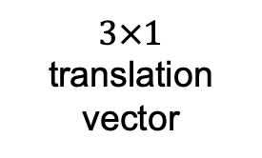
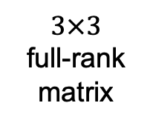
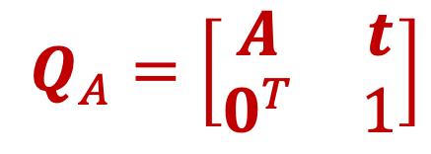
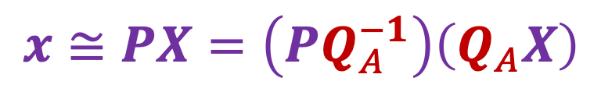
Affine ambiguity
If we impose parallelism constraints, we can get a reconstruction up to an affine ambiguity:
$$x≅PX=\left(PQ_{A}^{−1}\right)\left(Q_{A}X\right)$$
$3×3$
full-rank matrix
$3×1$ translation vector
Affine
$$Q_{A}=\left[\begin{matrix}A & t \\ 0^{T} & 1\end{matrix}\right]$$

Slide 28
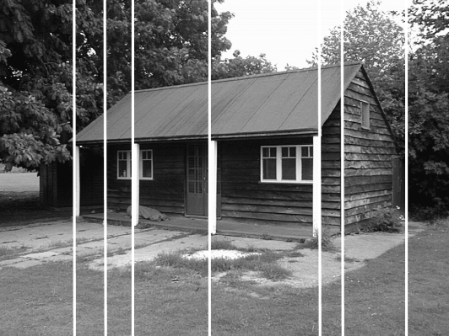
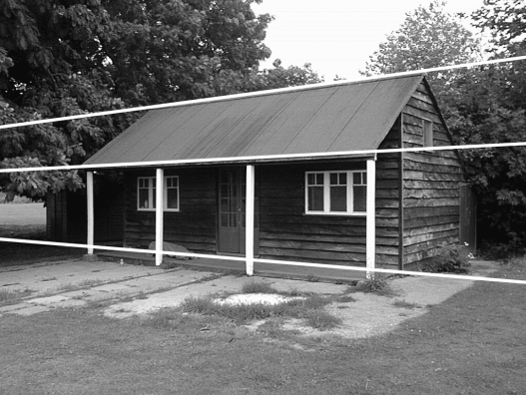
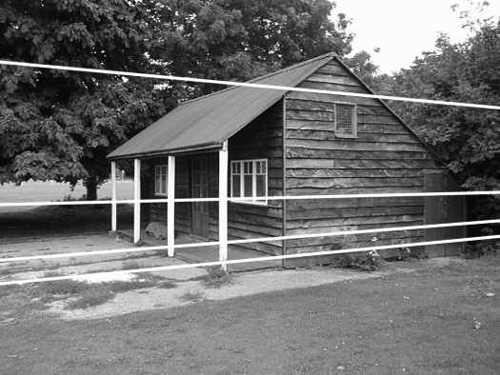
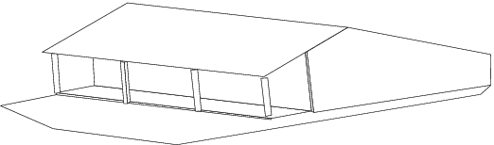
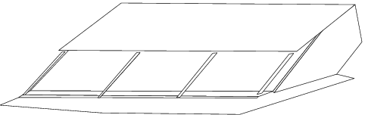
Affine ambiguity

Slide 29
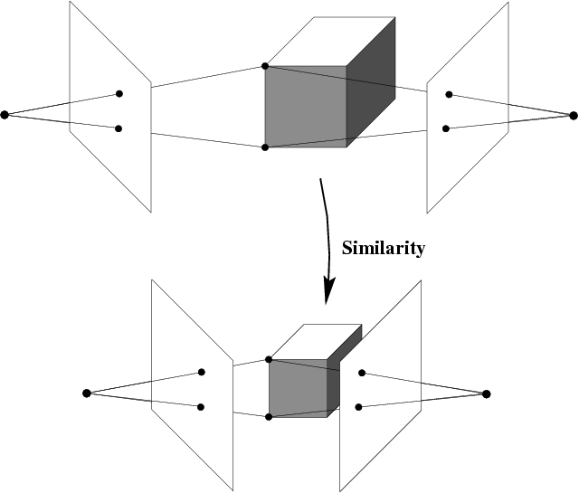
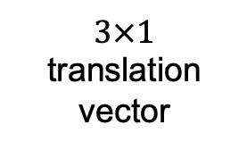
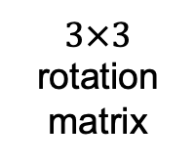
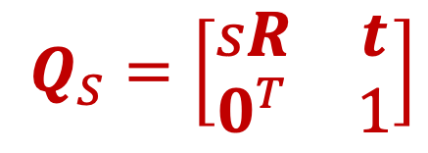
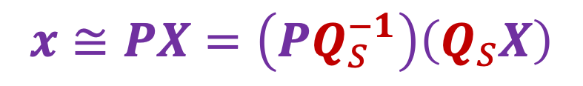
Similarity ambiguity
A reconstruction that obeys orthogonality constraints on camera parameters and/or scene
$$x≅PX=\left(PQ_{S}^{−1}\right)\left(Q_{S}X\right)$$
$3×3$
rotation matrix
$3×1$ translation vector
$$Q_{S}=\left[\begin{matrix}sR & t \\ 0^{T} & 1\end{matrix}\right]$$

Slide 30
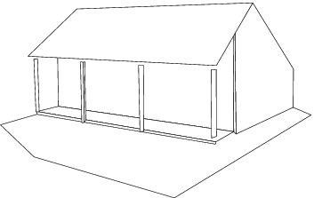
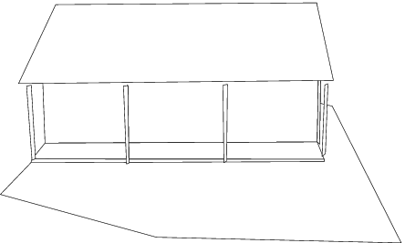
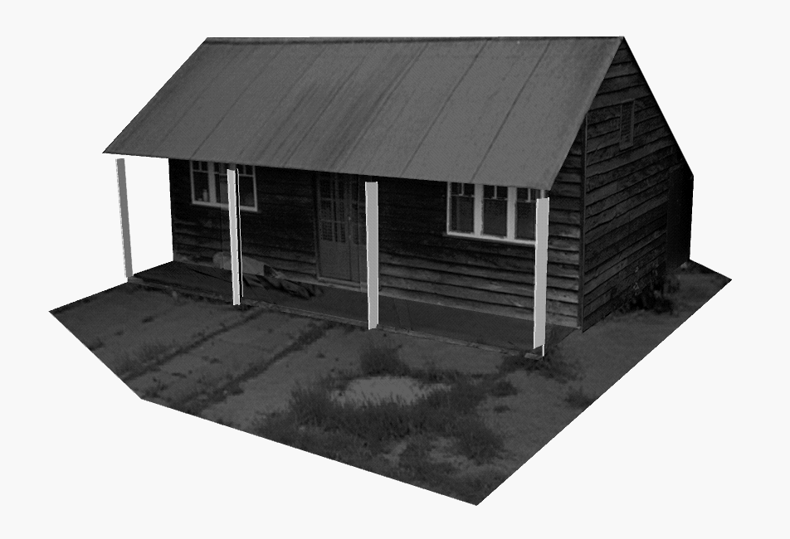
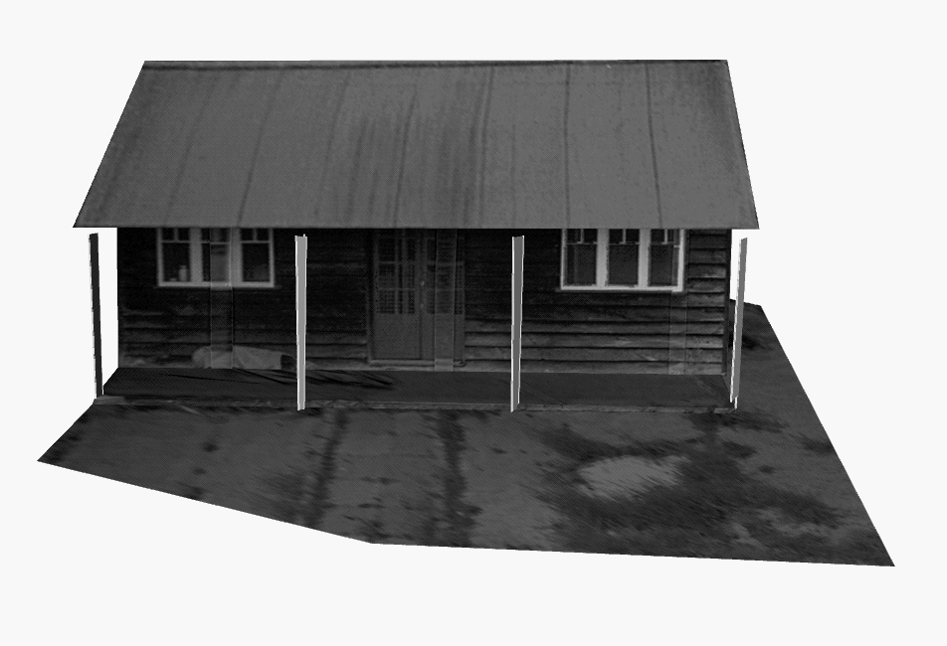
Similarity ambiguity

Slide 31
Outline: Structure from motion
Problem definition and ambiguities
Affine structure from motion
  Factorization

Slide 32
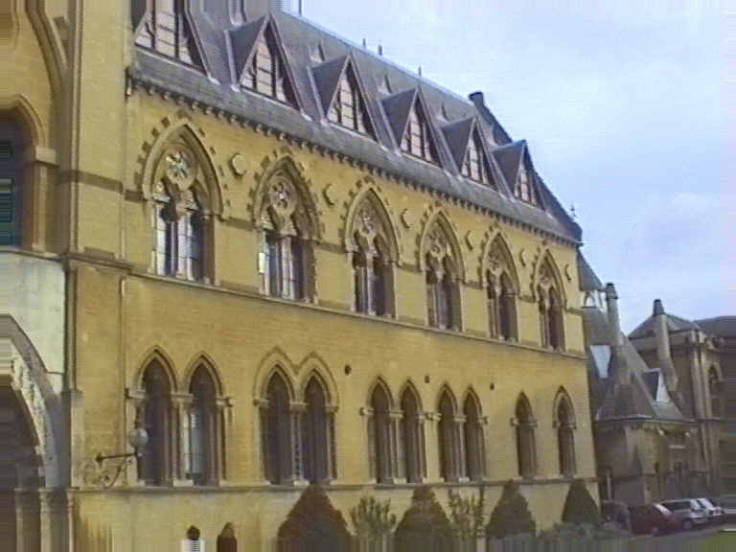


Affine structure from motion
Let’s start with affine or weak perspective cameras
center at
infinity

Slide 33


Recall: Orthographic projection
Image
World
Just drop the $z$ coordinate!
$$\left(\begin{aligned}x \\ y \\ 1\end{aligned}\right)=\left[\begin{matrix}1 & 0 & 0 & 0 \\ 0 & 1 & 0 & 0 \\ 0 & 0 & 0 & 1\end{matrix}\right]\left(\begin{aligned}x \\ y \\ z \\ 1\end{aligned}\right)$$

Slide 34







General affine projection
A general affine projection is a 3D-to-2D linear mapping plus translation:
In non-homogeneous coordinates:
$\left(\begin{aligned}x \\ y\end{aligned}\right)=\left[\begin{matrix}a_{11} & a_{12} & a_{13} \\ a_{21} & a_{22} & a_{23}\end{matrix}\right]\left(\begin{aligned}X \\ Y \\ Z\end{aligned}\right)+\left(\begin{aligned}t_{1} \\ t_{2}\end{aligned}\right)=AX+t$
$$P=\left[\begin{matrix}a_{11} & a_{12} & a_{13} & t_{1} \\ a_{21} & a_{22} & a_{23} & t_{2} \\ 0 & 0 & 0 & 1\end{matrix}\right]=\left[\begin{matrix}A & t \\ 0^{T} & 1\end{matrix}\right]$$
$$x$$
$$a2$$
$$a1$$
$$X$$
$a_{1},a_{2}$: rows of projection matrix
Projection of
world origin

Slide 35

Affine structure from motion
Given: $m$ images of $n$ fixed 3D points such that
$xij = Ai Xj +ti , i = 1,… , m, j = 1, … , n$
Problem: use the $mn$ correspondences $xij$ to estimate $m$ projection matrices $Ai$ and translation vectors $ti$, and $n$ points $Xj$
The reconstruction is defined up to an arbitrary affine transformation $Q$ (12 degrees of freedom):
$\left[\begin{matrix}A & t \\ 0^{T} & 1\end{matrix}\right]→\left[\begin{matrix}A & t \\ 0^{T} & 1\end{matrix}\right]Q^{−1},$ $\left(\begin{aligned}X_{j} \\ 1\end{aligned}\right)→Q\left(\begin{aligned}X_{j} \\ 1\end{aligned}\right)$
How many knowns and unknowns for $m$ images and $n$ points?
  $2mn$ knowns and $8m + 3n$unknowns
  To be able to solve this problem, we must have $2mn ≥ 8m+3n−12$ (affine ambiguity takes away 12 dof)
  E.g., for two views, we need four point correspondences

Slide 36




Affine structure from motion
First, center the data by subtracting the centroid of the image points in each view:
$${\hat{x}}_{ij}=x_{ij}−\frac{1}{n}\sum_{k=1}^{n}{x_{ik}}$$
$$=A_{i}X_{j}+t_{i}−\frac{1}{n}\sum_{k=1}^{n}{\left(A_{i}X_{k}+t_{i}\right)}$$
$$=A_{i}\left(X_{j}−\frac{1}{n}\sum_{k=1}^{n}{X_{k}}\right)$$
$$=A_{i}{\hat{X}}_{j}$$

Slide 37

Affine structure from motion
After centering, each normalized 2D point ${\hat{x}}_{ij}$is related to the 3D point by
${\hat{x}}_{ij}=$ $A_{i}{\hat{X}}_{j}$
We can get rid of the need to center the 3D data (and the translation ambiguity) by defining the origin of the world coordinate system as the centroid of the 3D points

Slide 38




Affine structure from motion
Let’s create a $2m × n$data (measurement) matrix:
$$D=\left[\begin{matrix}{\hat{x}}_{11} & {\hat{x}}_{12} & ⋯ & {\hat{x}}_{1n} \\ {\hat{x}}_{21} & {\hat{x}}_{22} & ⋯ & {\hat{x}}_{2n} \\ ⋮ & ⋮ & ⋱ & ⋮ \\ {\hat{x}}_{m1} & {\hat{x}}_{m2} & ⋯ & {\hat{x}}_{mn}\end{matrix}\right]=\left[\begin{aligned}A_{1} \\ A_{2} \\ ⋮ \\ A_{m}\end{aligned}\right]\left[\begin{matrix}X_{1} & X_{2} & ⋯ & X_{n}\end{matrix}\right]$$
cameras
($2 m$)
${\hat{x}}_{ij}=$ $A_{i}X_{j}$
points ($n$)
C. Tomasi and T. Kanade. Shape and motion from image streams under orthography: A factorization method.
IJCV, 9(2):137-154, November 1992.

Slide 39





Affine structure from motion
Let’s create a $2m × n$data (measurement) matrix:
$$D=\left[\begin{matrix}{\hat{x}}_{11} & {\hat{x}}_{12} & ⋯ & {\hat{x}}_{1n} \\ {\hat{x}}_{21} & {\hat{x}}_{22} & ⋯ & {\hat{x}}_{2n} \\ ⋮ & ⋮ & ⋱ & ⋮ \\ {\hat{x}}_{m1} & {\hat{x}}_{m2} & ⋯ & {\hat{x}}_{mn}\end{matrix}\right]=\left[\begin{aligned}A_{1} \\ A_{2} \\ ⋮ \\ A_{m}\end{aligned}\right]\left[\begin{matrix}X_{1} & X_{2} & ⋯ & X_{n}\end{matrix}\right]$$
What must be the rank of the measurement matrix $D=MS$?
$$S$$
points ($3 × n$)
$$M$$
cameras
($2 m × 3$)
C. Tomasi and T. Kanade. Shape and motion from image streams under orthography: A factorization method.
IJCV, 9(2):137-154, November 1992.

Slide 40






Factorizing the measurement matrix
We want:
$$D$$
$$M$$
=
$$×$$
$$S$$
$$2m$$
$$n$$
3

Slide 41







Factorizing the measurement matrix
Perform SVD of $D$:
$$D$$
$$2m×n$$
$$=$$
$$U$$
$$2m×n$$
$$×$$
$$Σ$$
$$n×n$$
$$×$$
$$V^{T}$$
$$n×n$$

Slide 42





Factorizing the measurement matrix
Keep top 3 singular values:
This is the closest approximation of $D$ with a rank-3 matrix in terms of Frobenius norm
$$Σ_{3}$$
$$3×3$$
$$V_{3}^{T}$$
$$3×n$$
$$D$$
$$2m×n$$
$$=$$
$$U_{3}$$
$$2m×3$$
$$×$$
$$×$$
What to do about $Σ_{3}$?
  One solution: $M=U_{3}Σ_{3}^{\frac{1}{2}}, {S=Σ}_{3}^{\frac{1}{2}}V_{3}^{T}$

Slide 43





Factorizing the measurement matrix
One possible solution:
$$D$$
$$2m×n$$
$$=$$
$$M$$
$$2m×3$$
$$×$$
$$S$$
$$3×n$$
${S=Σ}_{3}^{\frac{1}{2}}V_{3}^{T}$
$$M=U_{3}Σ_{3}^{\frac{1}{2}}$$
Are there other solutions?

Slide 44







Factorizing the measurement matrix
Other possible solutions:
$$D$$
$$2m×n$$
$$=$$
$$M$$
$$2m×3$$
$$×$$
$$Q$$
$$3×3$$
$$×$$
$$Q^{−1}$$
$$3×3$$
$$×$$
$$S$$
$$3×n$$
We can estimate $Q$ to give the camera matrices in $M$ desirable properties, like orthographic projection

Slide 45



Eliminating the affine ambiguity
So far, we have obtained one solution:
$$D=\left[\begin{aligned}A_{1} \\ A_{2} \\ ⋮ \\ A_{m}\end{aligned}\right]\left[\begin{matrix}X_{1} & X_{2} & ⋯ & X_{n}\end{matrix}\right]$$
We want:
$$D=\left[\begin{aligned}A_{1}Q \\ A_{2}Q \\ ⋮ \\ A_{m}Q\end{aligned}\right]\left[\begin{matrix}Q^{−1}X_{1} & Q^{−1}X_{2} & ⋯ & {Q^{−1}X}_{n}\end{matrix}\right]$$
such that each camera matrix $A_{i}Q$ represents orthographic projection, i.e., has orthonormal axes (rows)
$$3×n$$
$$2m×3$$

Slide 46






Eliminating the affine ambiguity
Let $a_{1}$ and $a_{2}$ be the rows of a $2×3$ orthographic projection matrix. Then
This translates into $3m$ constraints on the 9 entries of $Q$:
$$\left(A_{i}Q\right){\left(A_{i}Q\right)}^{T}=A_{i}\left(QQ^{T}\right)A_{i}^{T}=I_{2×2}, i=1, …, m$$
  Are the constraints linear?
  First, solve for $L =QQ^{T}$
  Recover $Q$ from $L$ by Cholesky decomposition
  Update $M$ to $MQ$, $S$ to $Q^{−1}S$
$$a1·a2 =0$$
$${\left\|a_{1}\right\|}^{2}={\left\|a_{2}\right\|}^{2}=1$$
$$x$$
$$a2$$
$$a1$$
$$X$$

Slide 47
Reconstruction results
C. Tomasi and T. Kanade, Shape and motion from image streams under orthography:
A factorization method, IJCV 1992

Slide 48

Dealing with missing data
So far, we have assumed that all points are visible in all views
In reality, the measurement matrix typically looks something like this:
Possible solution: decompose matrix into dense sub-blocks, factorize each sub-block, and fuse the results
  Unfortunately, finding dense maximal sub-blocks of the matrix is
  NP-complete (equivalent to finding maximal cliques in a graph)
cameras
points

Slide 49

Dealing with missing data
Incremental bilinear refinement:
Perform factorization on a dense sub-block
Solve for a new 3D point visible by at least two known cameras – triangulation
Solve for a new camera that sees at least three known 3D points – calibration
F. Rothganger et al. Segmenting, Modeling, and Matching Video Clips Containing Multiple Moving Objects. PAMI 2007.

Slide 50
There is an optimization problem here
Point matrix
Data matrix
Camera matrix

Slide 51
Outline: Structure from motion
Problem definition and ambiguities
Affine structure from motion
  Factorization
Projective structure from motion

Slide 52








Projective structure from motion
Given: $m$images of $n$ fixed 3D points such that (ignoring visibility):
$xij≅Pi Xj$, $i = 1, … , m, j = 1, … , n$
Problem: estimate $m$ projection matrices $Pi$ and $n$ 3D points $Xj$ from the $mn$ correspondences $xij$
$$Xj$$
$$x1j$$
$$x3j$$
$$x2j$$
$$P1$$
$$P3$$
$$P2$$

Slide 53

Projective structure from motion
Given: $m$images of $n$ fixed 3D points such that (ignoring visibility):
$xij≅Pi Xj$, $i = 1, … , m, j = 1, … , n$
Problem: estimate $m$ projection matrices $Pi$ and $n$ 3D points $Xj$ from the $mn$ correspondences $xij$
With no calibration info, cameras and points can only be recovered up to a $4×4$ projective transformation $Q$:
$$X → QX, P → PQ^{−1}$$
We can solve for structure and motion when $2mn≥11m+3n −15$
For two cameras, at least 7 points are needed

Slide 54

Projective SFM: Two-camera case
Estimate fundamental matrix $F$ between the two views
Set first camera matrix to $[I | 0]$
Then the second camera matrix is given by $[A | t]$ where $t$ is the epipole ($FTt=0$) and $A=−[t×]F$
In practice, SFM pipelines use guesses of intrinsic parameters and the five-point algorithm
F&P sec. 8.3.2

Slide 55

Incremental structure from motion
Initialize motion from two images using fundamental matrix
Initialize structure by triangulation
For each additional view:
  Determine projection matrix of new camera using all the known 3D points that are visible in its image – calibration
points
cameras

Slide 56

Incremental structure from motion
Initialize motion from two images using fundamental matrix
Initialize structure by triangulation
For each additional view:
  Determine projection matrix of new camera using all the known 3D points that are visible in its image – calibration
  Refine and extend structure: compute new 3D points, re-optimize existing points that are also seen by this camera – triangulation
points
cameras

Slide 57

Incremental structure from motion
Initialize motion from two images using fundamental matrix
Initialize structure by triangulation
For each additional view:
  Determine projection matrix of new camera using all the known 3D points that are visible in its image – calibration
  Refine and extend structure: compute new 3D points, re-optimize existing points that are also seen by this camera – triangulation
Refine structure and motion: bundle adjustment
points
cameras

Slide 58












Bundle adjustment
Non-linear method for refining structure and motion
Minimize reprojection error (with lots of bells and whistles):
$$\sum_{i=1}^{m}{\sum_{j=1}^{n}{w_{ij}d{\left(x_{ij}−proj\left(P_{i}X_{j}\right)\right)}^{2}}}$$
$$Xj$$
visibility flag: is point $j$ visible in
view $i$?
$$P1Xj$$
$$x1j$$
$$x3j$$
$$P3Xj$$
$$P2Xj$$
$$x2j$$
$$P1$$
$$P3$$
$$P2$$
B. Triggs et al. Bundle adjustment – A modern synthesis. International Workshop on Vision Algorithms, 1999

Slide 59
Outline: Structure from motion
Problem definition and ambiguities
Affine structure from motion
  Factorization
Projective structure from motion
  Incremental reconstruction, bundle adjustment
Modern structure from motion pipeline

Slide 60

Representative SFM pipeline
N. Snavely, S. Seitz, and R. Szeliski. Photo tourism: Exploring photo collections in 3D. SIGGRAPH 2006
http://phototour.cs.washington.edu/
Notes:
Here’s how the same set of photos appear in our photo explorer. Our system takes the set of photos and automatically determines the relative positions and orientations from which each photo was taken. We can then load the photos into our immersive 3D browser where the user can visualize and explore the photos using spatial relationships.

Slide 61
















Feature detection
Detect SIFT features
Source: N. Snavely
Notes:
So, we begin by detecting SIFT features in each photo.
[We detect SIFT features in each photo, resulting in a set of feature locations and 128-byte feature descriptors…]

Slide 62







Feature detection
Detect SIFT features
Other popular feature types: SURF, ORB, BRISK, …
Source: N. Snavely

Slide 63





Feature matching
Match features between each pair of images
Source: N. Snavely
Notes:
Next, we match features across each pair of photos using approximate nearest neighbor matching.

Slide 64


Feature matching
Use RANSAC to estimate fundamental matrix between each pair
Source: N. Snavely
Notes:
The matches are refined by using RANSAC, which is a robust model-fitting technique, to estimate a fundamental matrix between each pair of matching images and keeping only matches consistent with that fundamental matrix.
We then link connected components of pairwise feature matches together to form correspondences across multiple images.
Once we have correspondences, we run structure from motion to recover the camera and scene geometry. Structure from motion solves the following problem:

Slide 65

Feature matching
Use RANSAC to estimate fundamental matrix between each pair
Image source
Notes:
The matches are refined by using RANSAC, which is a robust model-fitting technique, to estimate a fundamental matrix between each pair of matching images and keeping only matches consistent with that fundamental matrix.
We then link connected components of pairwise feature matches together to form correspondences across multiple images.
Once we have correspondences, we run structure from motion to recover the camera and scene geometry. Structure from motion solves the following problem:

Slide 66
Feature matching
Use RANSAC to estimate fundamental matrix between each pair
Source: N. Snavely
Notes:
The matches are refined by using RANSAC, which is a robust model-fitting technique, to estimate a fundamental matrix between each pair of matching images and keeping only matches consistent with that fundamental matrix.
We then link connected components of pairwise feature matches together to form correspondences across multiple images.
Once we have correspondences, we run structure from motion to recover the camera and scene geometry. Structure from motion solves the following problem:

Slide 67

Image connectivity graph
(graph layout produced using the Graphviz toolkit: http://www.graphviz.org/)
Source: N. Snavely

Slide 68

Incremental SFM
Pick a pair of images with lots of inliers (and preferably, good EXIF data)
  Initialize intrinsic parameters (focal length, principal point) from EXIF
  Estimate extrinsic parameters ($R$ and $t$) using five-point algorithm
  Use triangulation to initialize model points
While remaining images exist
  Find an image with many feature matches with images in the model
  Run RANSAC on feature matches to register new image to model
  Triangulate new points
  Perform bundle adjustment to re-optimize everything
  Optionally, align with GPS from EXIF data or ground control points

Slide 69
The devil is in the details
Handling degenerate configurations (e.g., homographies)
Filtering out incorrect matches
Dealing with repetitions and symmetries

Slide 70




Repetitive structures cause catastrophic failures
https://demuc.de/tutorials/cvpr2017/sparse-modeling.pdf

Slide 71


Repetitive structures cause catastrophic failures
R. Kataria et al. Improving Structure from Motion with Reliable Resectioning. 3DV 2020
Notes:
A common cause of failure in structure-from-motion is misregistration of images due to repeated structures. Here, we observe 840 matches on two different sides of the temple which leads to a catastrophic failure. To understand this problem, let’s briefly discuss resectioning.

Slide 72

Repetitive structures cause catastrophic failures
R. Kataria et al. Improving Structure from Motion with Reliable Resectioning. 3DV 2020
Notes:
A common cause of failure in structure-from-motion is misregistration of images due to repeated structures. Here, we observe 840 matches on two different sides of the temple which leads to a catastrophic failure. To understand this problem, let’s briefly discuss resectioning.

Slide 73
The devil is in the details
Handling degenerate configurations (e.g., homographies)
Filtering out incorrect matches
Dealing with repetitions and symmetries
Reducing error accumulation and closing loops

Slide 74

Reducing error accumulation and closing loops
A. Holynski et al. Reducing Drift in Structure From Motion Using Extended Features. arXiv 2020

Slide 75

Reducing error accumulation and closing loops
A. Holynski et al. Reducing Drift in Structure From Motion Using Extended Features. arXiv 2020

Slide 76
The devil is in the details
Handling degenerate configurations (e.g., homographies)
Filtering out incorrect matches
Dealing with repetitions and symmetries
Reducing error accumulation and closing loops
Making the whole thing efficient!
  See, e.g., Towards Linear-Time Incremental Structure from Motion

Slide 77
SFM software
Bundler
OpenSfM
OpenMVG
VisualSFM
COLMAP
See also Wikipedia’s list of toolboxes

