Slide 1
Recognition: Past, present, future?
Benozzo Gozzoli, Journey of the Magi, c. 1459

Slide 2
Classification vs detection
Classification:
  there is an X in this image
    what
Detection:
  there is an X HERE in this image
    what AND where
Key issues
  how to specify where
  relationship between what and where
    efficiency, etc
  evaluation
    surprisingly fiddly

Slide 3
Two threads
Localize then classify
  find boxes that likely contain objects
  decide what is in the box
YOLO: Localize while classifying
  in parallel, score
    boxes for “goodness of box”
    boxes for “what is in it”
  combine

Slide 4
Start simple
Where = axis aligned box

Slide 5
Which window
Astonishing fact
  Easy to tell whether a region is likely to be an object
    even if you don’t know what object (Endres+Hoiem, 10; Uijlings et al 12)
    if it’s an object
      there’s contrast with surroundings in texture, etc
    if not
      often neighbor region is similar

Slide 7
Selective Search
Construct hierarchy of image regions
  using a hierarchical segmenter
Rank regions using a learned score
Make boxes out of high-ranking regions

Slide 8
Selective search pipeline
Uijlings et al, 12

Slide 9
This sort of thing works well

Slide 10
You need to search at multiple scales

Slide 11
Simplest detector
Use selective search to propose boxes
Check boxes with classifier
BUT
  boxes likely overlap - non-maximum suppression
  boxes likely in poor location - bounding box regression

Slide 13
Non maximum suppression

Slide 14
Bounding box regression

Slide 17
Configuration spaces
You should think of a box as a point in a 4D space
  configuration space of the boxes
Selective search is weird
  networks don’t do lists much
Alternative
  sample the configuration space on some form of grid
    eg three aspect ratios, three scales, grid of locations
    important: many possible sampling schemes
  check each sample with rank score
Anchor boxes

Slide 19
Evaluating detectors
Compare detected boxes w ground truth boxes
Favor
  right number of boxes with right label in right place
Penalize
  awful lot of boxes
  multiple detections of the same thing

Slide 20
Strategy
Strategy:
  Detector makes a ranked list of boxes
  GT is a list of boxes
  Mark detector boxes with relevant/irrelevant
  summarize lists
Marking boxes:
  All are irrelevant, then
  For each GT box:
    Overlap measured as IOU (intersection over union)
    Find highest ranking box with largest overlap
    – mark relevant if IOU> threshold

Slide 21
Average precision
Plot curve by computing recall, precision
Obtained by taking top k boxes in list for
Different values of k
Average precision is area under curve
Precision =
(number of relevant boxes marked)/(total number of boxes marked)
Recall = (Number of relevant boxes marked)/(Total number of relevant boxes)

Slide 22
Strategy
Strategy:
  Detector makes a ranked list of boxes
  GT is a list of boxes
  Mark detector boxes with relevant/irrelevant
  summarize lists
Summarize lists:
  Sort by box ranking
  Compute AP per class
  Compute average of AP
  MAP at IOU 0.5 has been standard for a while
  Higher IOU’s are harder.

Slide 23
YOLO
YOLO v8 is about as fast and accurate as you can get
link on webpage
key idea
  look at box scores, label values independently

Slide 38
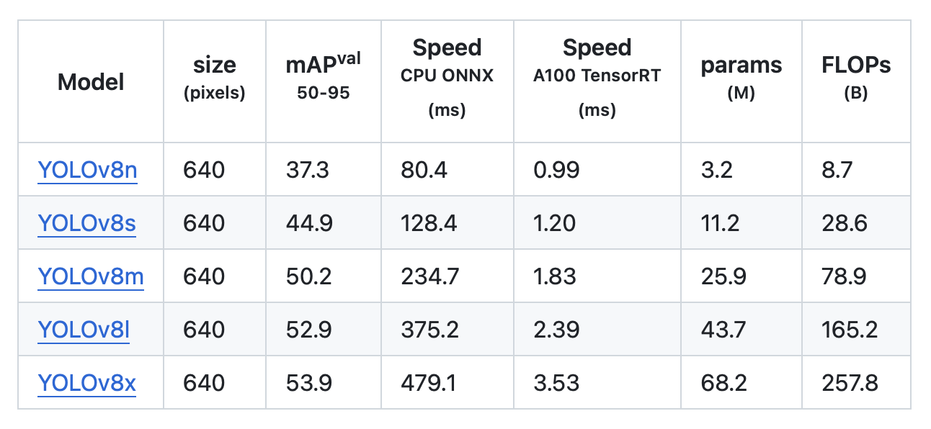
Evaluation, YOLOv8
https://github.com/ultralytics/ultralytics

Slide 39
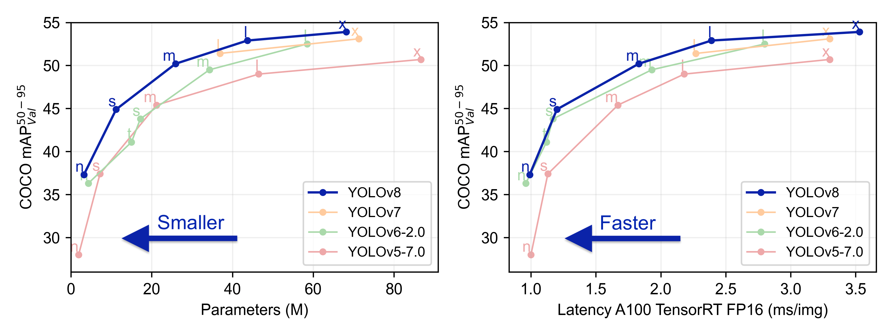
YOLOv8 Tuning

Slide 41
SOA and variants: rough summary
Very accurate detection for hundreds of categories
  with enough training data
  important variations in training data available
    you don’t have to put a box on everything
YOLO allows a tradeoff between speed and accuracy
  and can be very fast
Variants
  Localization more accurate than boxes
  Incorporate LIDAR, etc.
  Boxes in 3D rather than 2D
  Variant feature constructions are very important

Slide 42
Ghost(s) at the party
Tremblay et al 20

