Slide 1
Recognition: Past, present, future?
Benozzo Gozzoli, Journey of the Magi, c. 1459

Slide 2
Straightforward image classification
We know basics for two class classification
Image encoder + Logistic regression
train encoder parameters, lr parameters with training data
evaluate with test data
Open:
more than two classes
best encoder

Slide 3
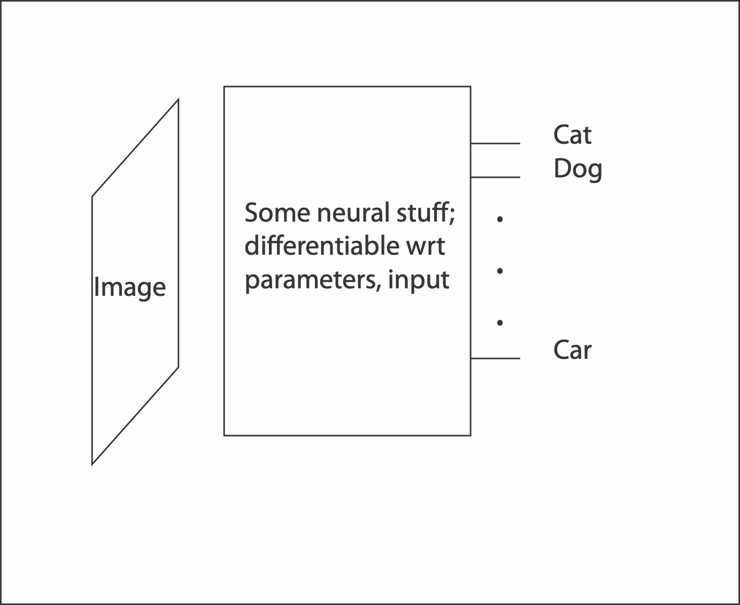
Image classification

Slide 4
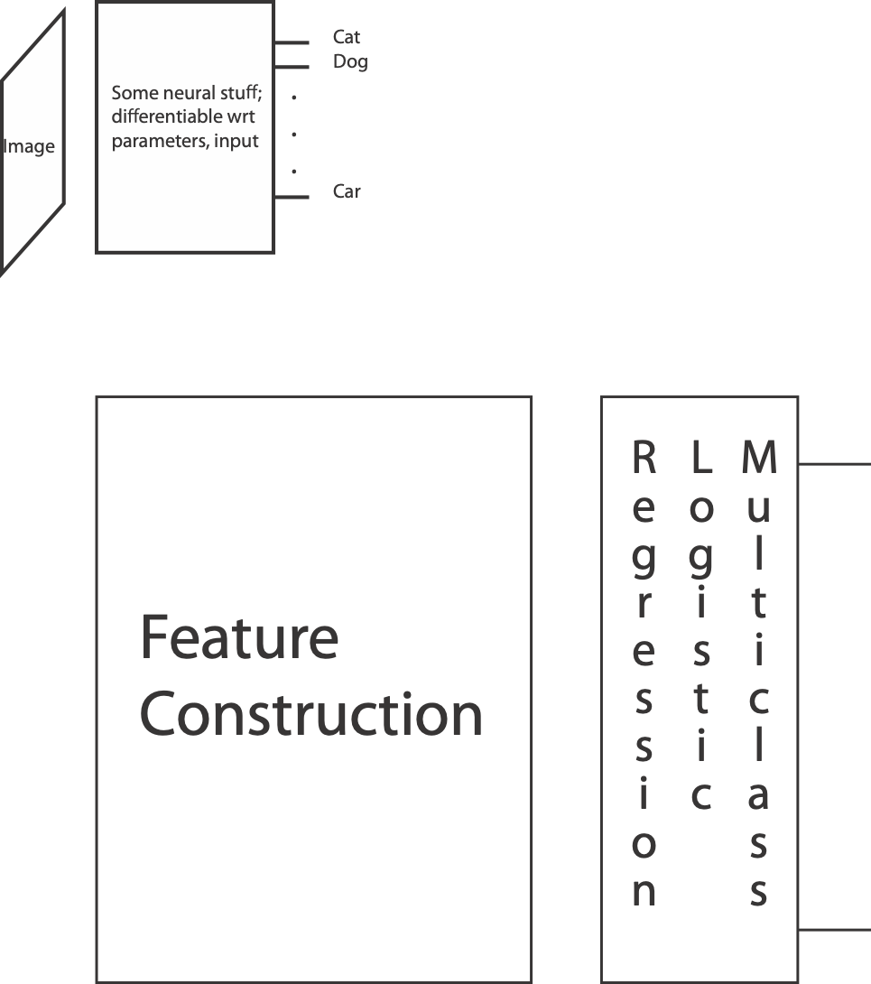
Under the hood

Slide 5


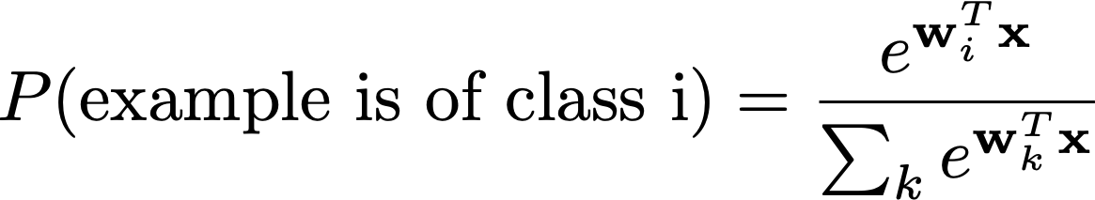
Multiclass logistic regression
For classes 1, .., C
Given a feature vector
Form
Interpret by

Slide 8
Classification variants
Predict more labels with complex semantics
Predict a cost function from the image
  report the minimum
This allows
  Visual question answering
    function accepts question, offered answers and takes min at best
  Writing sentences
    choose sentence that minimizes cost

Slide 9
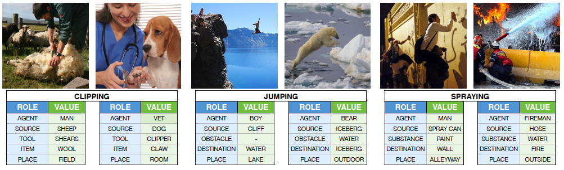
Situations
Yatskar+Zettlemoyer+Farhadi 2016

Slide 10
Visual Question Answering

Slide 11
doesn’t always work…

Slide 12
Sentence generation
Decode features into sentence (with LSTM, etc)
  essentially classification with funky taxonomy
Aneja et al, 2018

Slide 13
doesn’t always work…
And scoring system is easily subverted!
Aneja et al, 2018

Slide 14
Can train encoder *without labels*
Encoder yields embedding of the image
Exploit data augmentation
  take image and
    crop+resize; adjust colormap; etc
Strategy: Contrastive learning
  Adjust embedding so that
    A and Augment(A) should be close
    A and B should be far
Then multiclass logistic regression when you have labels

Slide 15
SOA - rough summary
Very high accuracy with 1000’s of classes
  Using
    very deep residual networks
      clever trick to improve training convergence
    alternative feature construction methods
Classification wrt
  Object present
  Scene type
  Etc
Challenges
  tough with little training data (but encoders are somewhat interchangeable)
  change in dataset presents problems

Slide 16
Open questions
Rules of machine learning
  It all works when test data is “like” training data
    IID samples from the same distribution
  All bets are off otherwise; very little theoretical support
Practice in computer vision
  It is tough to tell when this condition occurs
  Mostly, it isn’t imposed
    instead, we say that there was a generalization failure when classifier doesn’t work
Q: Why don’t we get in trouble when we break the rules?
Q: Tell when datasets A, B are “compatible”
  In a crisp, formal way (rather than try and see)

Slide 17
Exploiting registration and classification
Use a classifier to tell:
  how far to the next intersection?
  what is it like?
  is there a bike lane?
  etc.

Slide 18
Road layout maps
Potential cues
  streetview
  openmaps

Slide 19
Partially supervised cues
Open Street Maps (OSM)
Seff+Xiao

Slide 20
Seff+Xiao

Slide 21
Partially supervised cues
Google street view
Seff+Xiao

Slide 22
Labelling - I
Match panoramas to roads
  panorama center location, orientation is known
  (essentially) project to plane
  thresholded nearest neighbor to road center polyline
    thresholding removes panoramas inside buildings, etc.
  some noise
    under bridges, etc.
Annotations
  Intersections
  Drivable heading
  Heading angle
  Bike lane
  Speed limit, wrong way, etc.

Slide 23
Seff+Xiao

Slide 24
Seff+Xiao

Slide 25
Seff+Xiao

Slide 26
Seff+Xiao

Slide 27
Seff+Xiao

Slide 28
Seff+Xiao

Slide 29
Seff+Xiao

Slide 30
Seff+Xiao

Slide 31
Seff+Xiao

Slide 32
At this point
I can tell from an image whether
  I’m pointing in the right direction
  going the right way
  facing an intersection
  available turns, etc.
  what and where street signs are
  …
Can I build a reliable controller?

Slide 33
BIG GOOD QUESTIONS
Mashup of openmaps and street view
  it could predict drivable directions, steering directions, lanes, signs, etc.
Q: WHY IS THIS NOT DRIVING AROUND NOW?
  A: (pretty obviously) because it doesn’t work
Q: WHY NOT?
  A: interesting

Slide 34
Fragkiadaki, ND

Slide 35
Imitation learning
Approaches
  Imitation learning:
    Train a policy that does “the same thing” as an expert

Slide 36
Fragkiadaki, ND

