Slide 1
Recognition: Past, present, future?
Benozzo Gozzoli, Journey of the Magi, c. 1459

Slide 2
Last time: Overview of recognition
Brief history of recognition
Different “dimensions” of recognition
  What type of content?
  What type of output?
  What type of supervision?
Trends
  Saturation of supervised learning
  Transformers
  Vision-language models
  “Universal” recognition systems
  Text-to-image generation
  From vision to action

Slide 3
Recognition: What type of supervision?
Semi-supervised:
labels for a small portion of training data
Weakly supervised: noisy labels, labels not exactly for the task of interest
Supervised:
clean, complete training labels for the task of interest
Unsupervised: no labels
Self-supervised:
same as unsupervised?

Slide 4
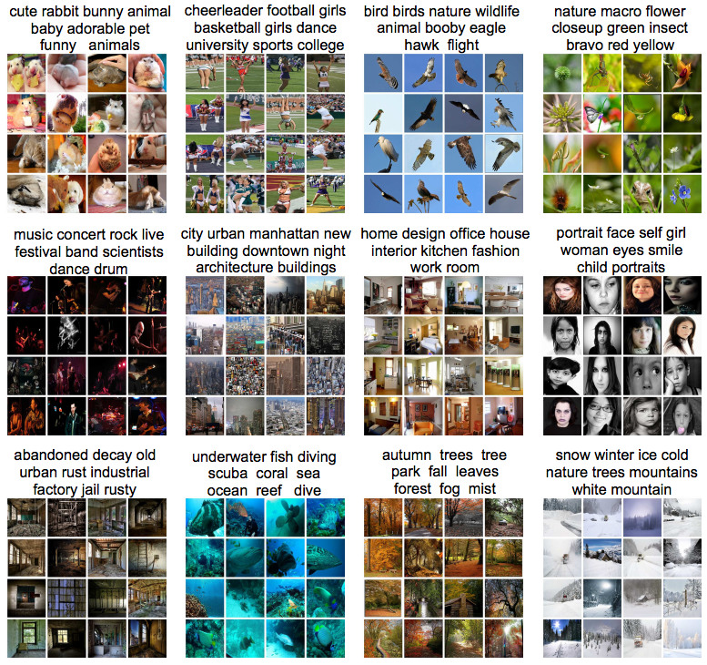
Unsupervised learning
Clustering
  Discover groups of “similar” data points
Y. Gong, Q. Ke, M. Isard, and S. Lazebnik. A Multi-View Embedding Space for Modeling Internet Images, Tags, and Their Semantics. IJCV 2014

Slide 5
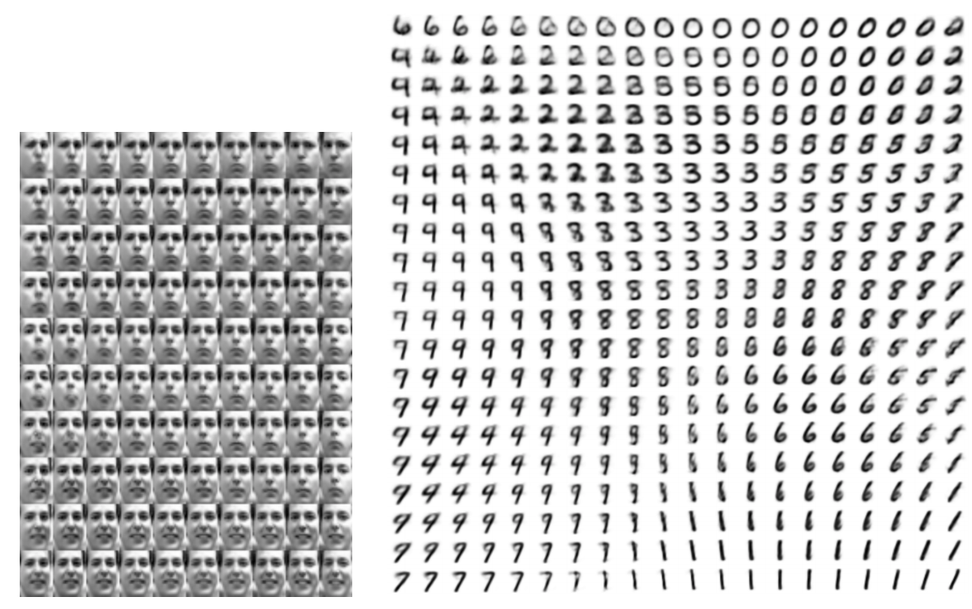
Unsupervised learning
Dimensionality reduction, manifold learning
  Discover a lower-dimensional surface on which the data lives
D. Kingma and M. Welling, Auto-Encoding Variational Bayes, ICLR 2014

Slide 6
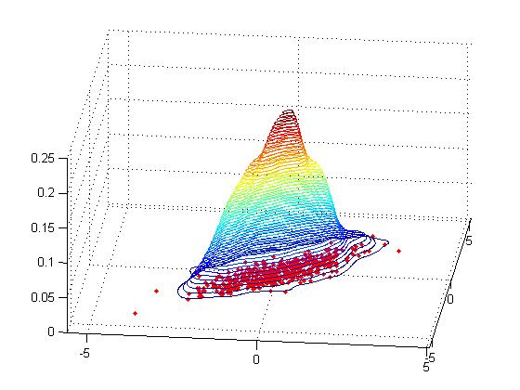
Unsupervised learning
Learning the data distribution
  Density estimation: Find a function that approximates the probability density of the data (i.e., value of the function is high for “typical” points and low for “atypical” points)
  An extremely hard problem for high-dimensional data…

Slide 7
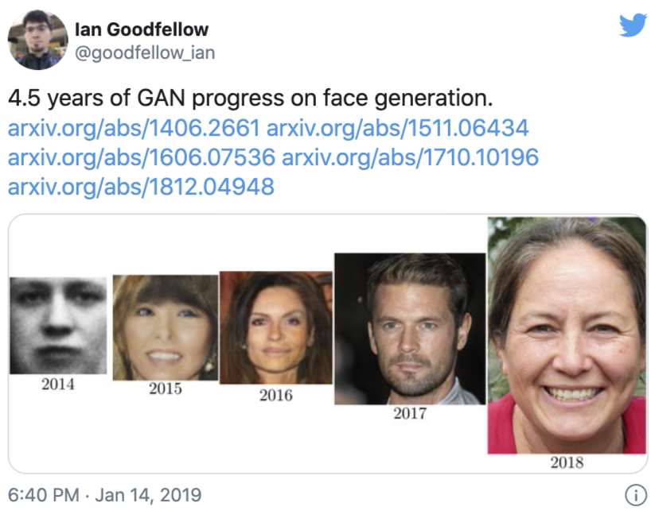
Unsupervised learning
Learning the data distribution
  Learning to sample: Produce samples from a data distribution that mimics the training set
Generative adversarial networks (GANs)

Slide 8
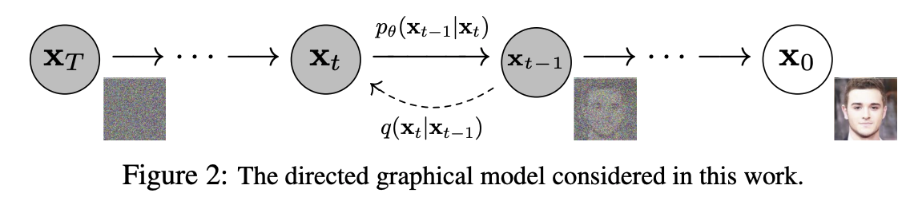
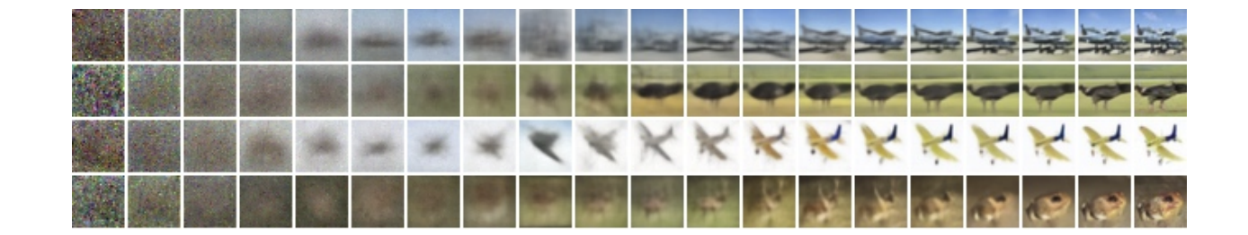
Unsupervised learning
Learning the data distribution
  Learning to sample: Produce samples from a data distribution that mimics the training set
Denoising diffusion probabilistic models (DDPMs)

Slide 9
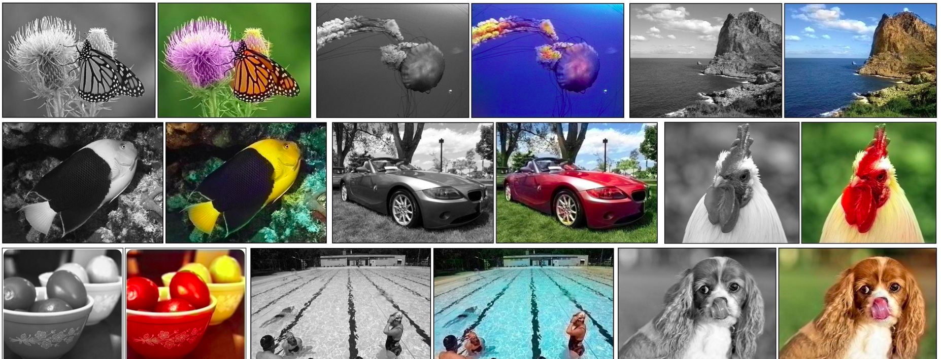
Self-supervised or predictive learning
Use part of the data to predict other parts of the data
  Example: Image colorization
R. Zhang et al., Colorful Image Colorization, ECCV 2016

Slide 10
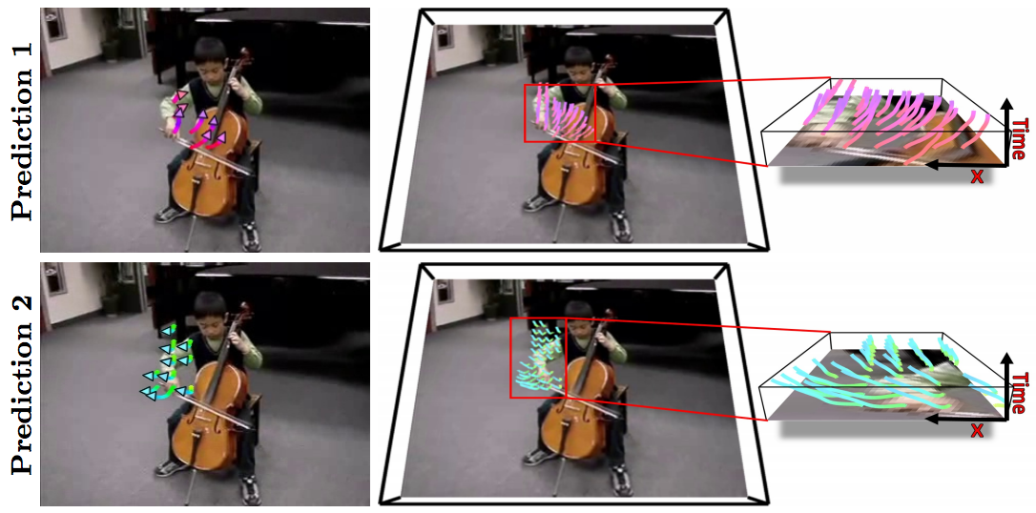
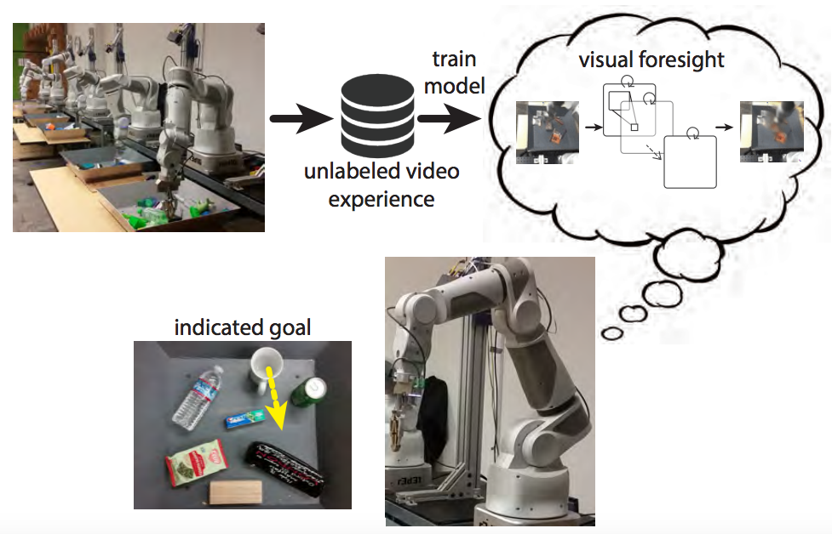
Self-supervised or predictive learning
Use part of the data to predict other parts of the data
  Example: Future prediction
J. Walker et al. An Uncertain Future: Forecasting from Static Images Using Variational Autoencoders. ECCV 2016
C. Finn and S. Levine. Deep Visual Foresight for Planning Robot Motion. ICRA 2017. YouTube video

Slide 11
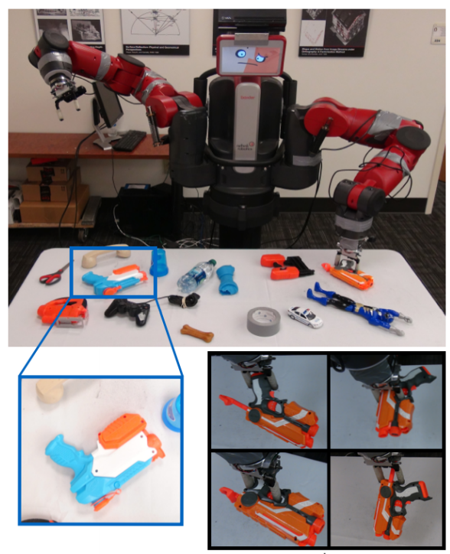
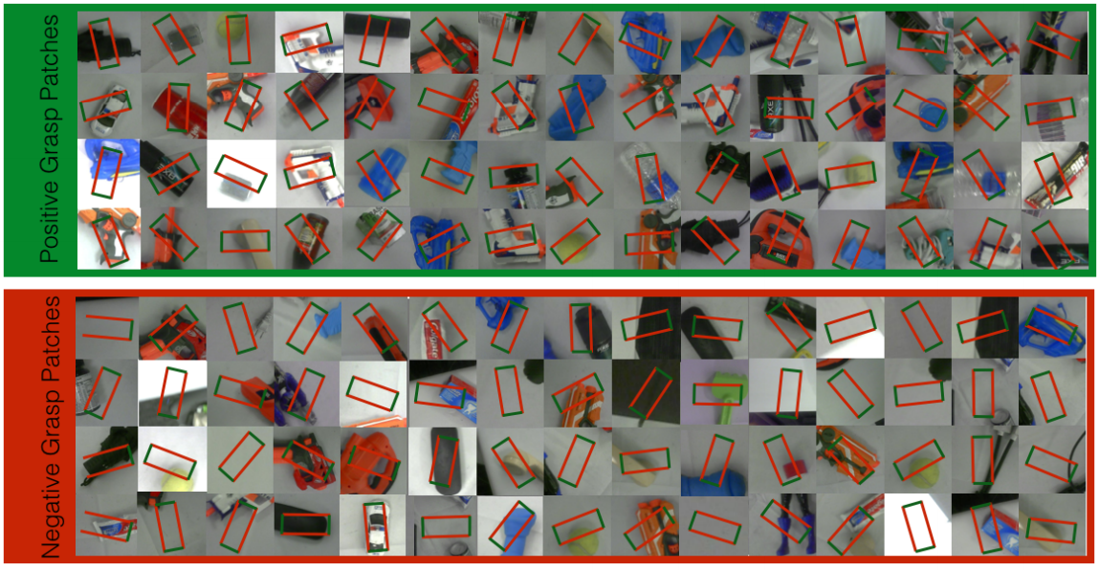
Self-supervised or predictive learning
Use part of the data to predict other parts of the data
  Example: Grasp prediction
L. Pinto and A. Gupta. Supersizing self-supervision: Learning to grasp from 50K tries and 700 robot hours. ICRA 2016
YouTube video

Slide 12
Beyond batch offline learning
Reinforcement learning
Active learning
Lifelong learning

Slide 13
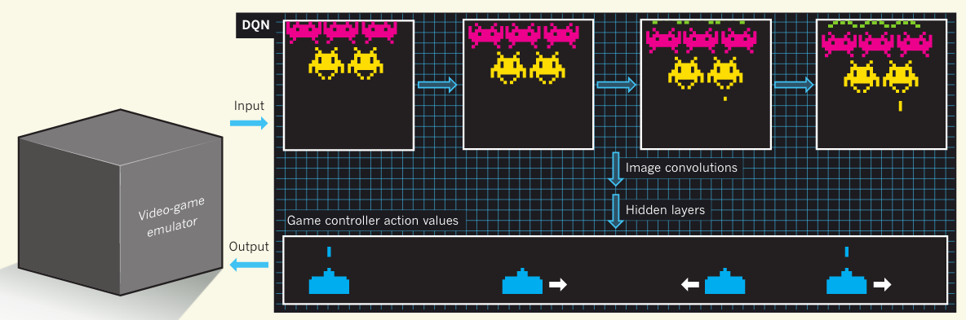
Reinforcement learning
Learn from (possibly sparse) rewards in a sequential environment
Playing video games
Video
V. Mnih, K. Kavukcuoglu, D. Silver, A. Graves, I. Antonoglou, D. Wierstra, M. Riedmiller, Human-level control through deep reinforcement learning, Nature 2015

Slide 14
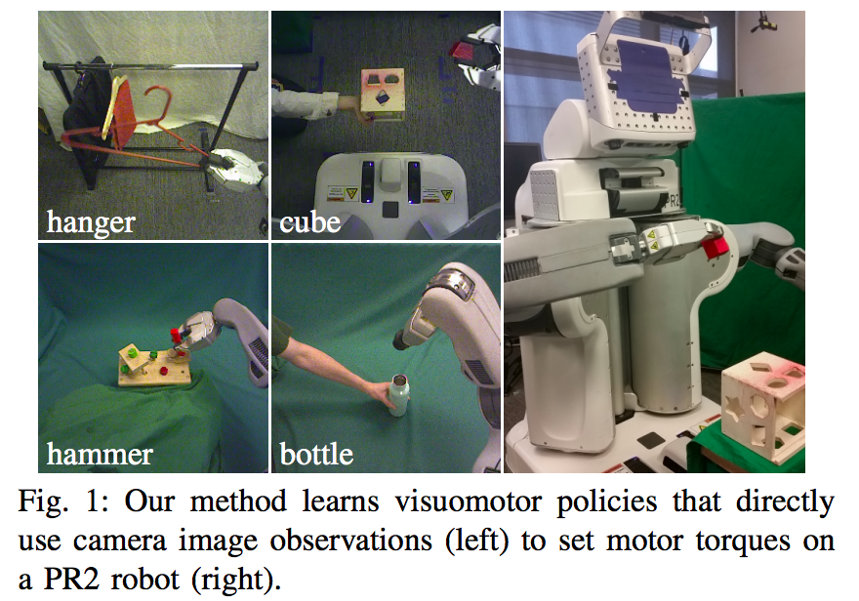
Reinforcement learning
Learn from (possibly sparse) rewards in a sequential environment
Sensorimotor learning
Video
S. Levine, C. Finn, T. Darrell and P. Abbeel, End-to-End Training of Deep Visuomotor Policies, JMLR 2016

Slide 15
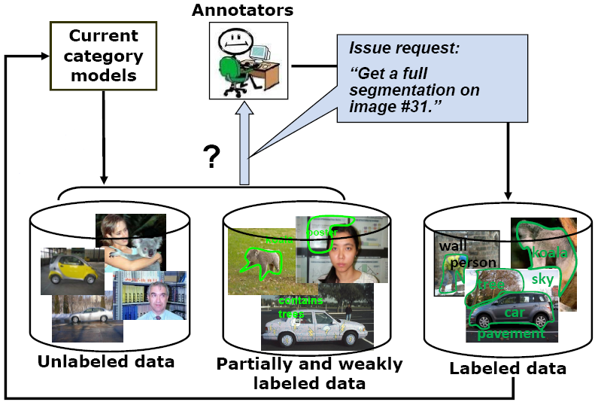
Active learning
The learning algorithm can choose its own training examples, or ask a “teacher” for an answer on selected inputs
S. Vijayanarasimhan and K. Grauman. Cost-Sensitive Active Visual Category Learning. IJCV 2010

Slide 16
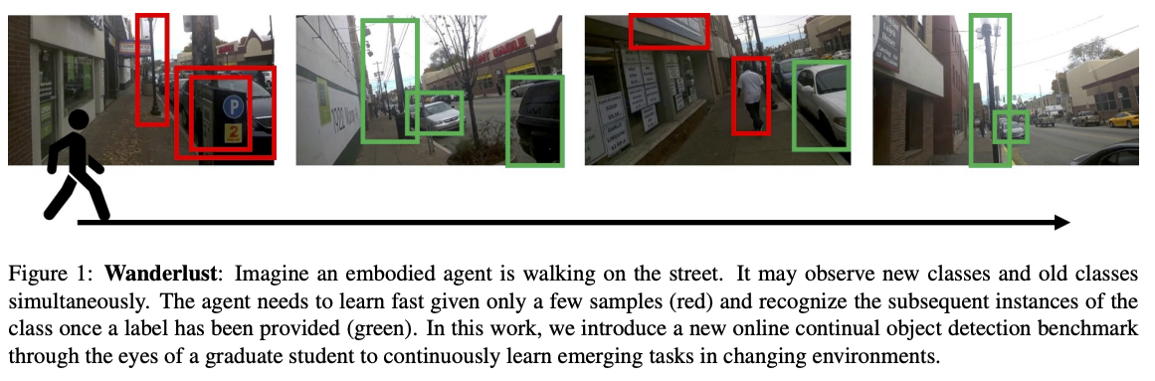
Lifelong or continual learning
J. Wang et al. Wanderlust: Online Continual Object Detection in the Real World. ICCV 2021

Slide 17
Outline
Brief history of recognition
Different “dimensions” of recognition
  What type of content?
  What type of output?
  What type of supervision?
Trends
  Saturation of supervised learning
  Transformers
  Vision-language models
  “Universal” recognition systems
  Text-to-image generation
  From vision to action

Slide 18
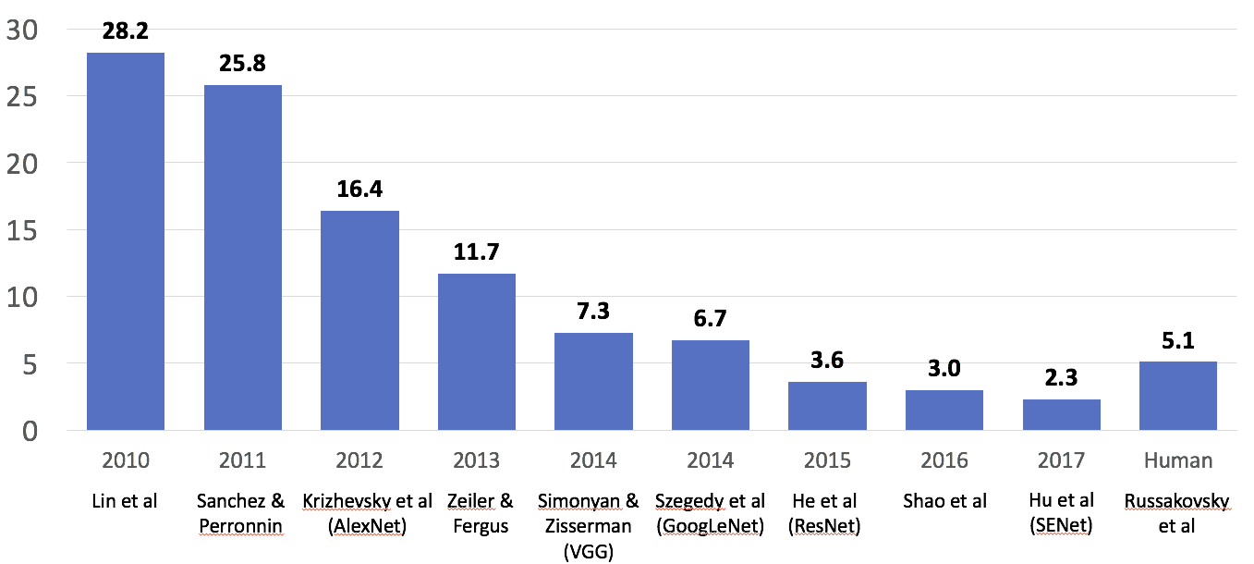
Outgrowing ImageNet
ILSVRC
Enter deep learning
Figure source

Slide 19
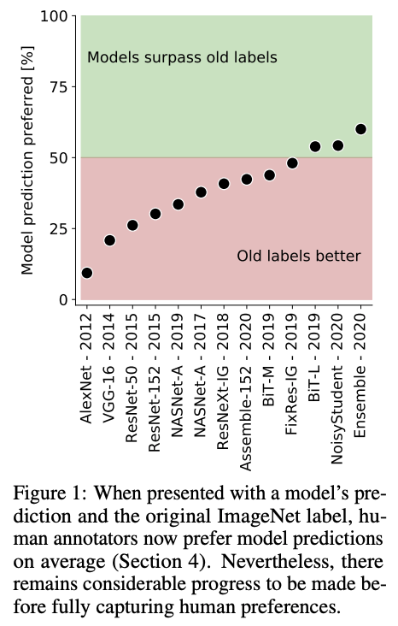
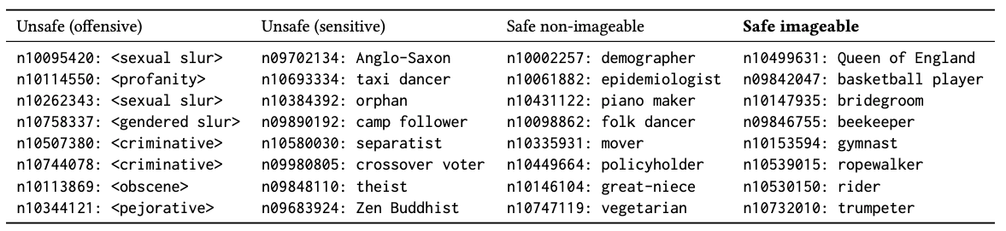
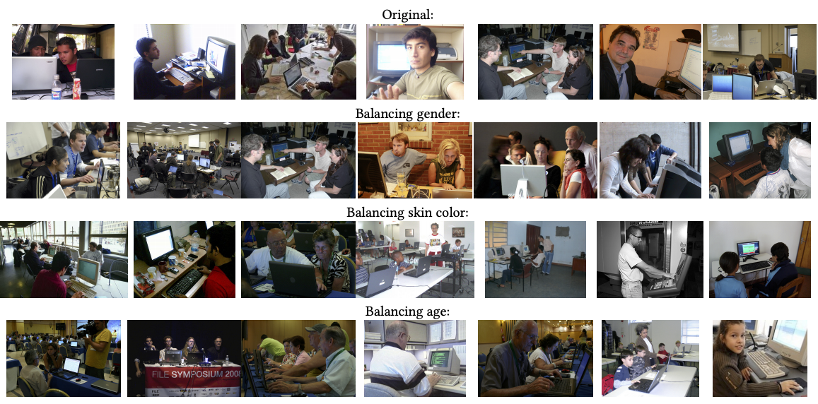
Outgrowing ImageNet
“Programmer”
K. Yang, K. Qinami, L. Fei-Fei, J. Deng, O. Russakovsky, Towards Fairer Datasets: Filtering and Balancing the Distribution of the People Subtree in the ImageNet Hierarchy, FAccT 2020
L. Beyer et al. Are we done with ImageNet? arXiv 2020

Slide 20
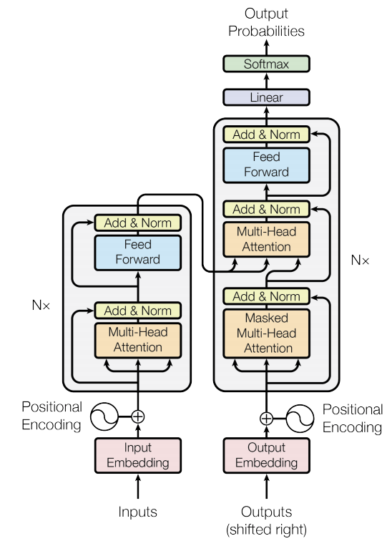
Transformers
A. Vaswani et al., Attention is all you need, NeurIPS 2017
Image source

Slide 21
Transformers
A. Vaswani et al., Attention is all you need, NeurIPS 2017
Image source

Slide 22
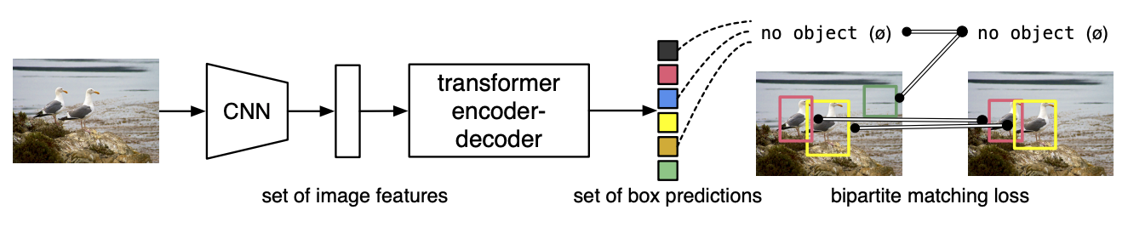
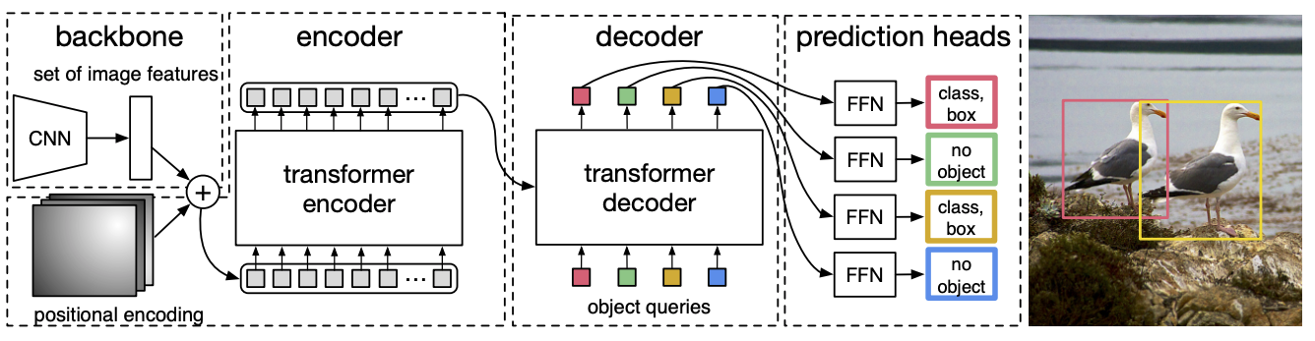
Transformers for everything: Detection transformer
N. Carion et al. End-to-end object detection with transformers. ECCV 2020
Notes:
DETR uses a conventional CNN backbone to learn a 2D representation of an input image. The model flattens it and supplements it with a positional encoding before passing it into a transformer encoder. A transformer decoder then takes as input a small fixed number of learned positional embeddings, which we call object queries, and additionally attends to the encoder output. We pass each output embedding of the decoder to a shared feed forward network (FFN) that predicts either a detection (class and bounding box) or a “no object” class.

Slide 23
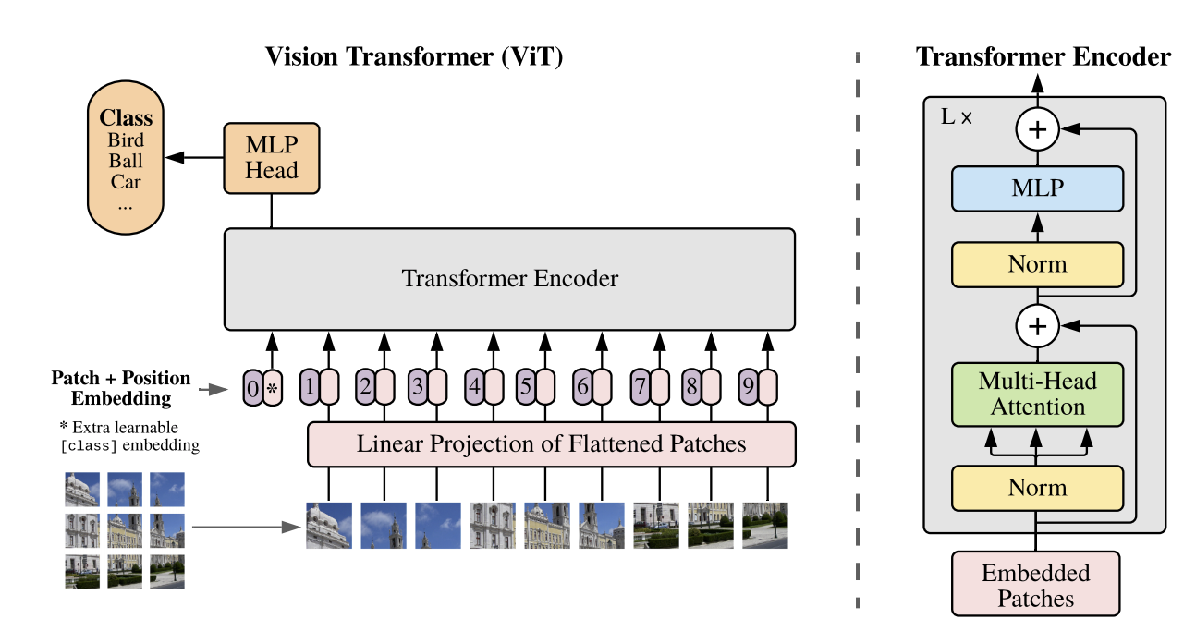
Vision transformer (ViT) – Google
Split an image into patches, feed linearly projected patches into standard transformer encoder
  With patches of 14x14 pixels, you need 16x16=256 patches to represent 224x224 images
  Self-supervised task: masked prediction (similar to BERT)
A. Dosovitskiy et al. An image is worth 16x16 words: Transformers for image recognition at scale. ICLR 2021
Notes:
Abstract: While the Transformer architecture has become the de-facto standard for natural language processing tasks, its applications to computer vision remain limited. In vision, attention is either applied in conjunction with convolutional networks, or used to replace certain components of convolutional networks while keeping their overall structure in place. We show that this reliance on CNNs is not necessary and a pure transformer applied directly to sequences of image patches can perform very well on image classification tasks. When pre-trained on large amounts of data and transferred to multiple mid-sized or small image recognition benchmarks (ImageNet, CIFAR-100, VTAB, etc.), Vision Transformer (ViT) attains excellent results compared to state-of-the-art convolutional networks while requiring substantially fewer computational resources to train

Slide 24
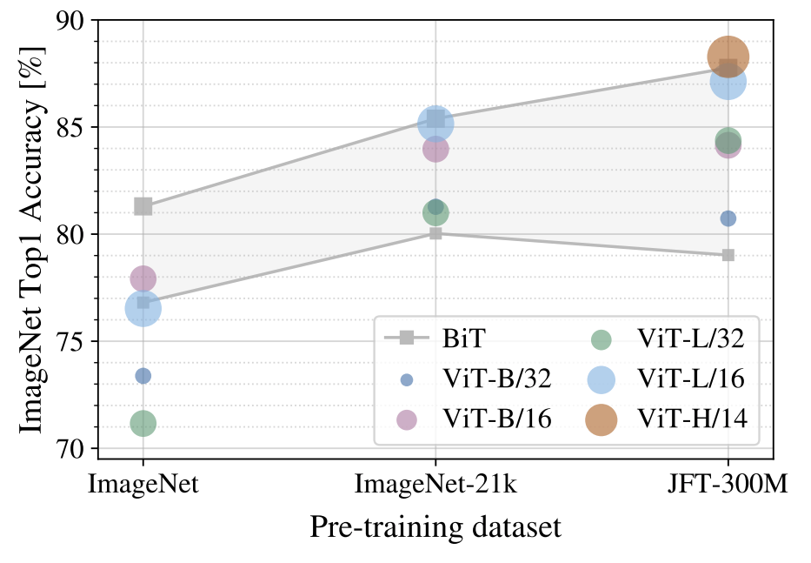
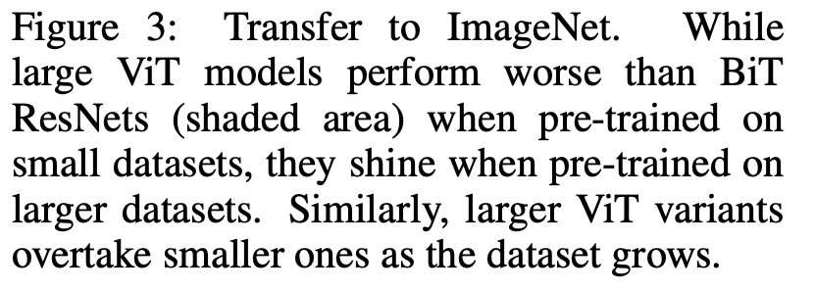
Vision transformer (ViT)
BiT: Big Transfer (ResNet)
ViT: Vision Transformer (Base/Large/Huge,
patch size of 14x14, 16x16, or 32x32)
Internal Google dataset (not public)
A. Dosovitskiy et al. An image is worth 16x16 words: Transformers for image recognition at scale. ICLR 2021
Notes:
Patches of size 14x14 = 16x16 patches to represent 224x224 images (sequence length = 256)

Slide 25
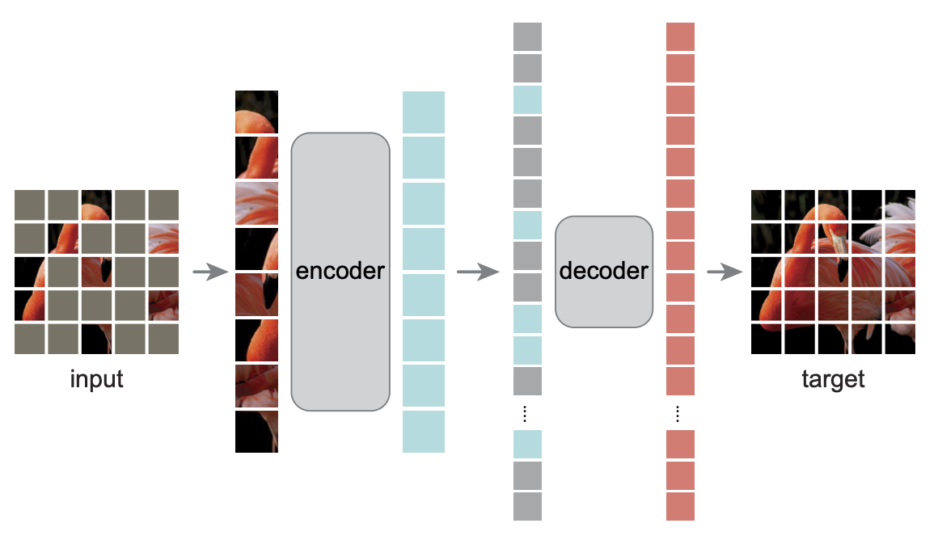
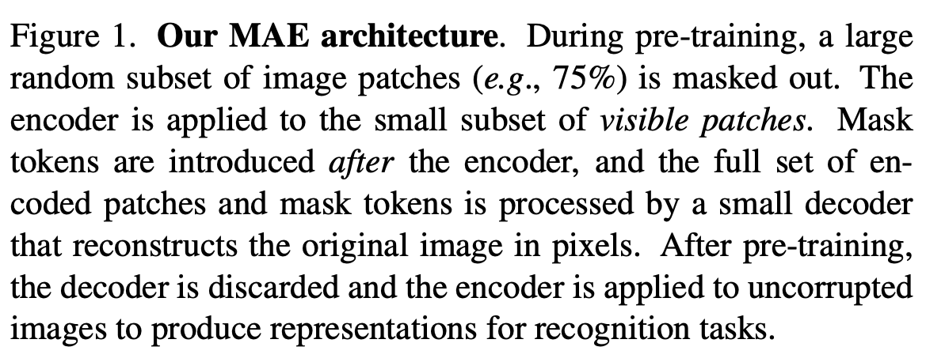
Masked autoencoders
K. He et al. Masked autoencoders are scalable vision learners. CVPR 2022

Slide 26
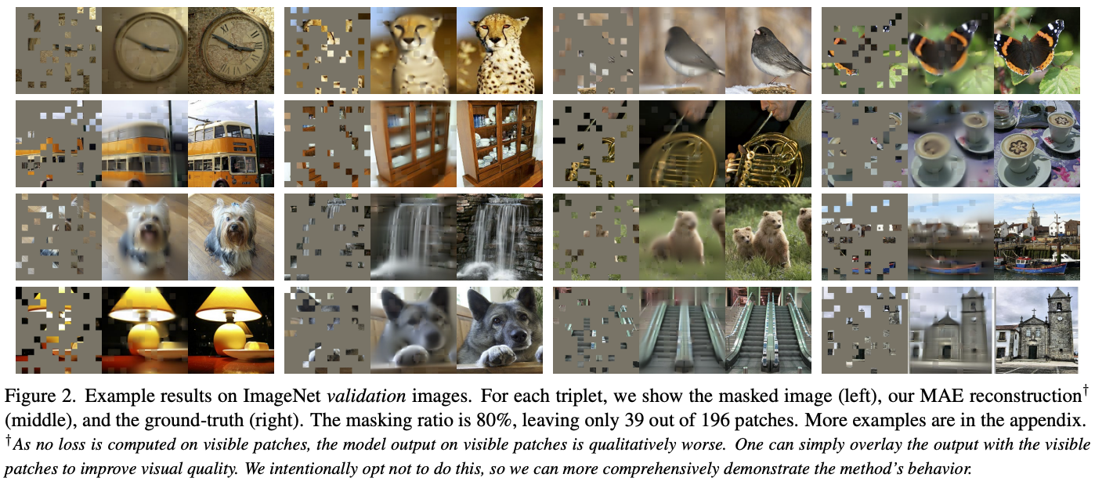
Masked autoencoders
K. He et al. Masked autoencoders are scalable vision learners. CVPR 2022

Slide 27
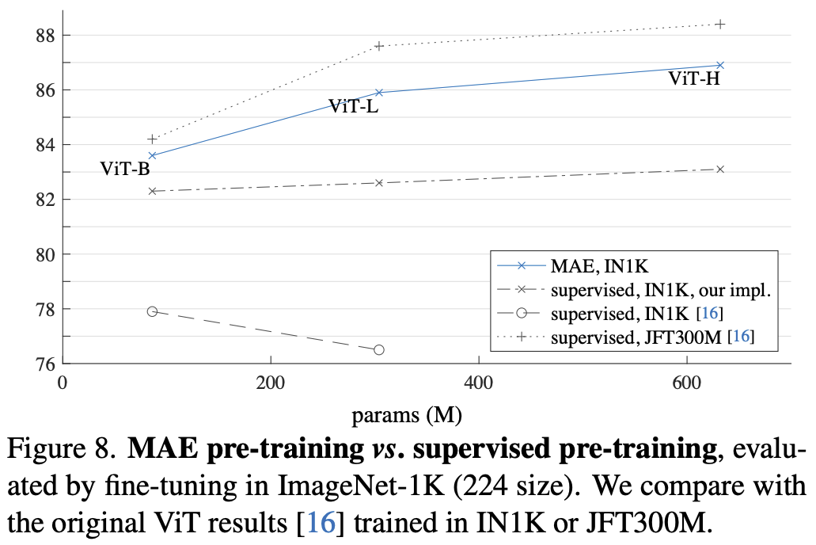
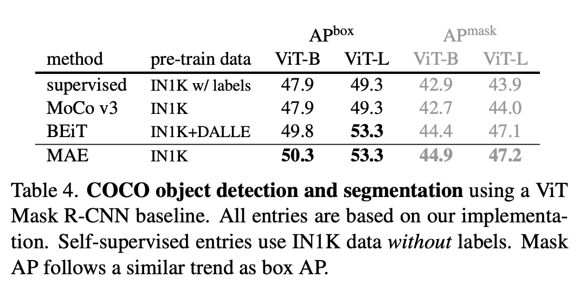
Masked autoencoders
K. He et al. Masked autoencoders are scalable vision learners. CVPR 2022

Slide 28
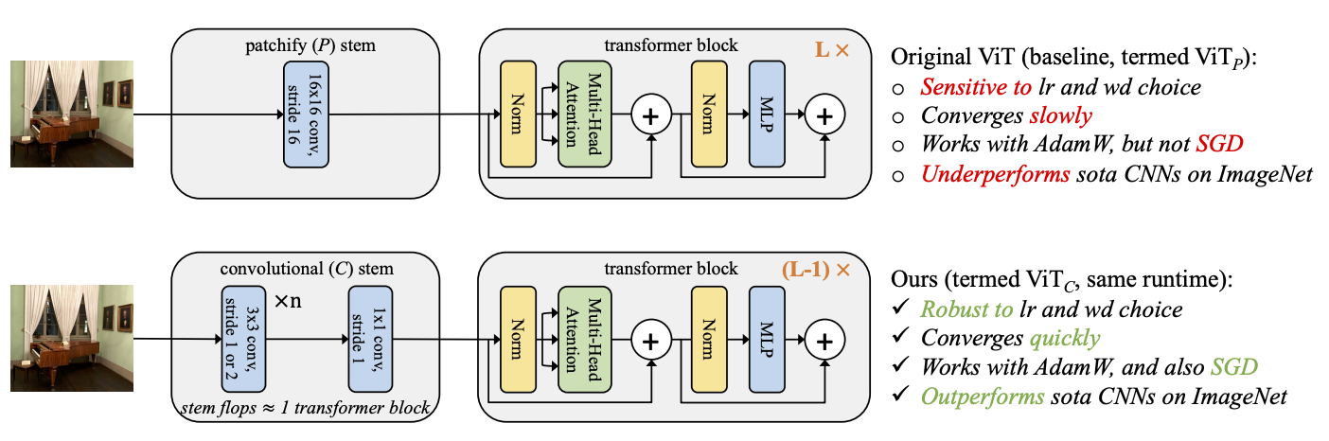
Convolutional networks or transformers?
T. Xiao et al. Early convolutions help transformers see better. NeurIPS 2021
Notes:
Abstract: Vision transformer (ViT) models exhibit substandard optimizability. In particular, they are sensitive to the choice of optimizer (AdamW vs. SGD), optimizer hyperparameters, and training schedule length. In comparison, modern convolutional neural networks are easier to optimize. Why is this the case? In this work, we conjecture that the issue lies with the patchify stem of ViT models, which is implemented by a stride-p p×p convolution (p = 16 by default) applied to the input image. This large-kernel plus large-stride convolution runs counter to typical design choices of convolutional layers in neural networks. To test whether this atypical design choice causes an issue, we analyze the optimization behavior of ViT models with their original patchify stem versus a simple counterpart where we replace the ViT stem by a small number of stacked stride-two 3×3 convolutions. While the vast majority of computation in the two ViT designs is identical, we find that this small change in early visual processing results in markedly different training behavior in terms of the sensitivity to optimization settings as well as the final model accuracy. Using a convolutional stem in ViT dramatically increases optimization stability and also improves peak performance (by ∼1-2% top-1 accuracy on ImageNet-1k), while maintaining flops and runtime. The improvement can be observed across the wide spectrum of model complexities (from 1G to 36G flops) and dataset scales (from ImageNet-1k to ImageNet-21k). These findings lead us to recommend using a standard, lightweight convolutional stem for ViT models in this regime as a more robust architectural choice compared to the original ViT model design.

Slide 29
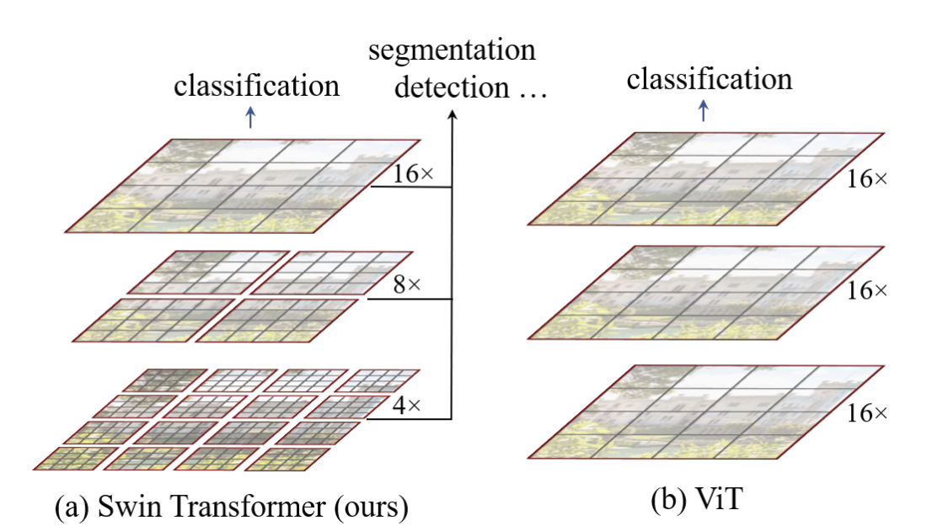
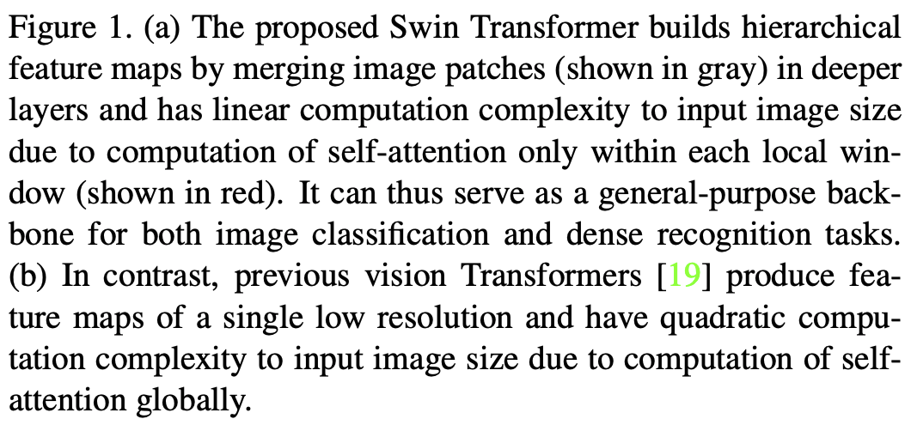
Hierarchical transformer: Swin
Z. Liu et al. Swin Transformer: Hierarchical Vision Transformer using Shifted Windows. ICCV 2021

Slide 30
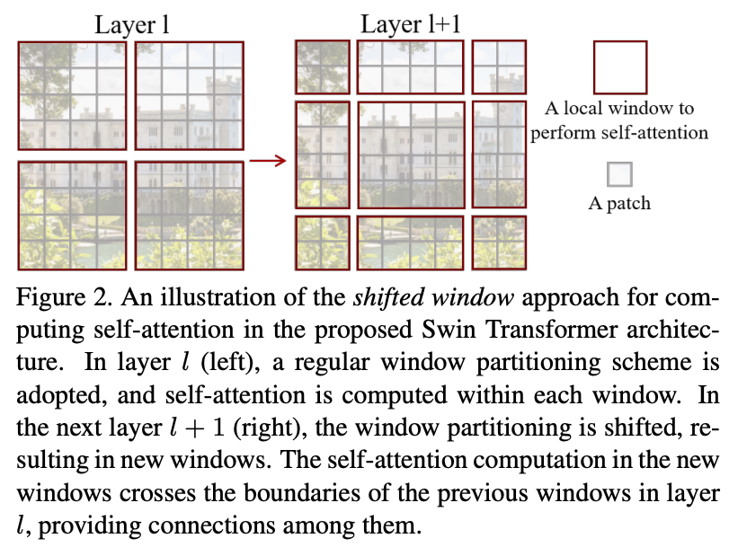
Hierarchical transformer: Swin
Z. Liu et al. Swin Transformer: Hierarchical Vision Transformer using Shifted Windows. ICCV 2021

Slide 31
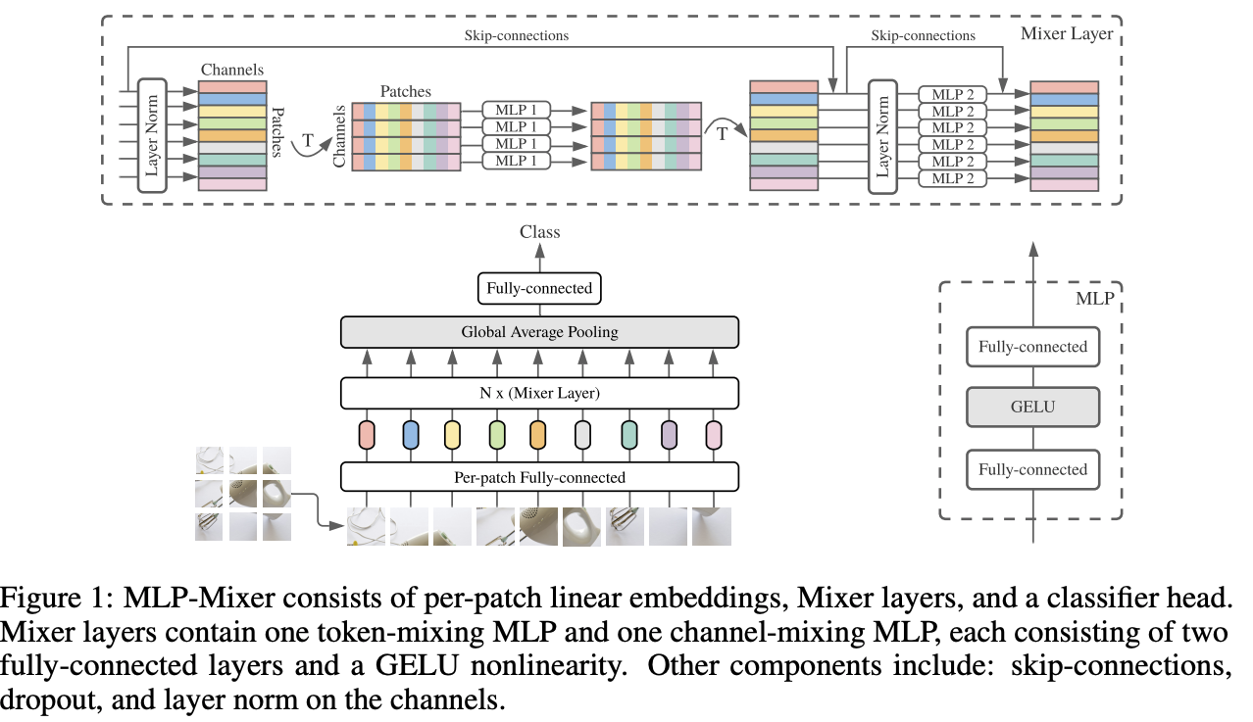
Beyond transformers?
I. Tolstikhin et al. MLP-Mixer: An all-MLP Architecture for Vision. NeurIPS 2021

Slide 32
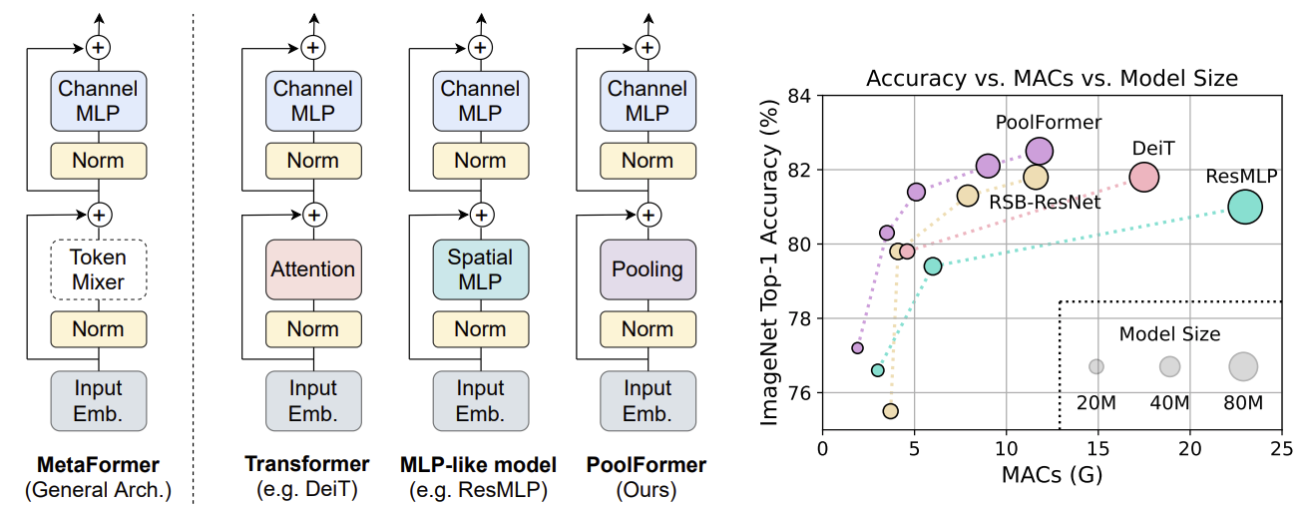
Beyond transformers?
W. Yu et al. MetaFormer is Actually What You Need for Vision. CVPR 2022

Slide 33
Outline
Brief history of recognition
Different “dimensions” of recognition
  What type of content?
  What type of output?
  What type of supervision?
Trends
  Saturation of supervised learning
  Transformers
  Vision-language models

Slide 34
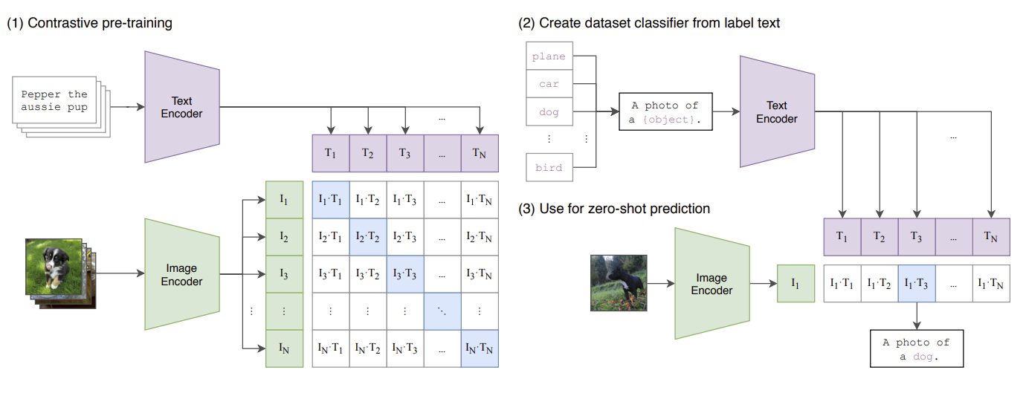
Giant vision-language models: CLIP
Contrastive language-image pretraining: in a batch of N image-text pairs, classify each text string to the correct image and vice versa
Radford et al., Learning Transferable Visual Models From Natural Language Supervision, ICML 2021
https://openai.com/blog/clip/

Slide 35
Giant vision-language models: CLIP
Radford et al., Learning Transferable Visual Models From Natural Language Supervision, ICML 2021
https://openai.com/blog/clip/

Slide 36
CLIP: Details
Image encoders
  ResNet-50 with self-attention layer on top of global average pooling
  Vision transformer (ViT)
Language encoder: GPT-style transformer with 63M parameters
Dataset: 400M image-text pairs from the Web

Slide 37
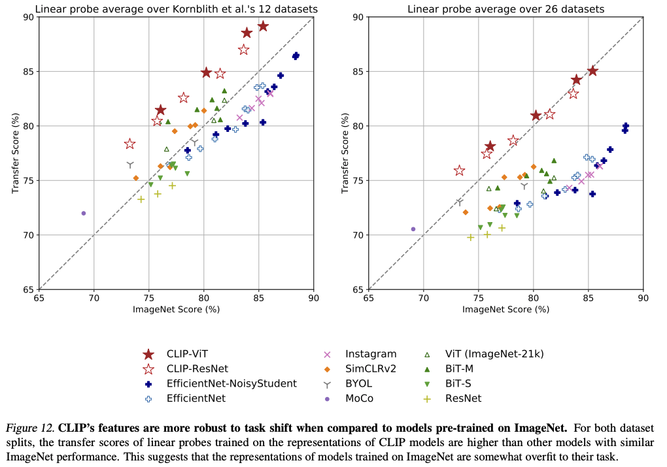
CLIP: Results

Slide 38
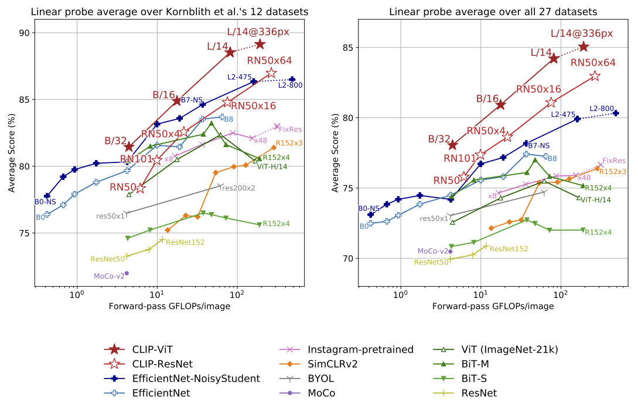
CLIP: Results

Slide 39
“Universal” recognition systems: DeepMind GATO
S. Reed et al. A generalist agent. TMLR 2022

Slide 40
“Universal” recognition systems: DeepMind GATO
S. Reed et al. A generalist agent. TMLR 2022

Slide 41
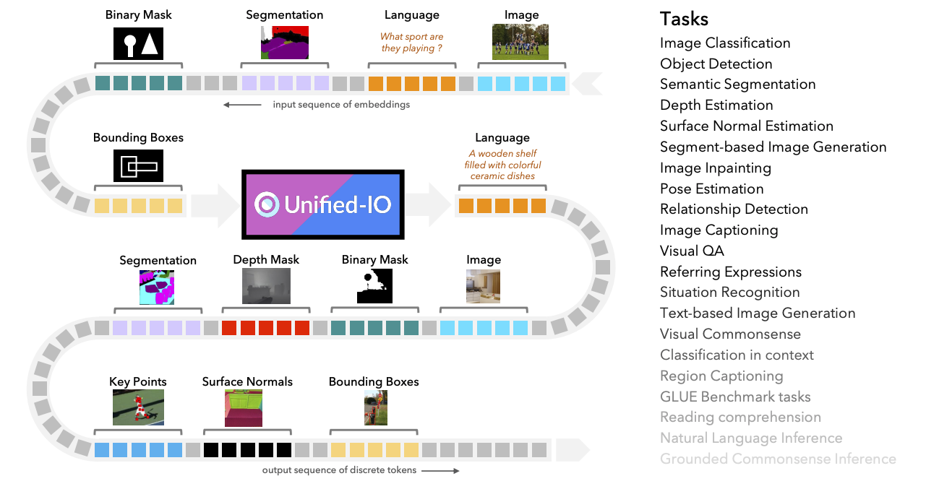
“Universal” recognition systems: UnifiedIO
J. Lu et al. A unified model for vision, language, and multi-modal tasks. arXiv 2022
https://unified-io.allenai.org/

Slide 42
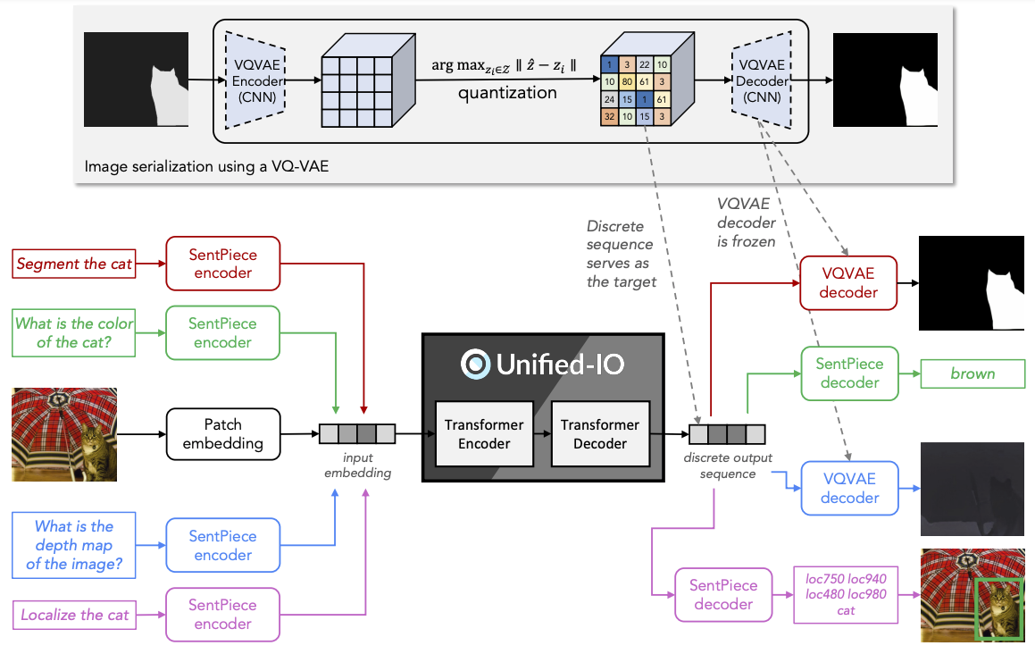
“Universal” recognition systems: UnifiedIO

Slide 43
Outline
Brief history of recognition
Different “dimensions” of recognition
  What type of content?
  What type of output?
  What type of supervision?
Trends
  Saturation of supervised learning
  Transformers
  Vision-language models
  “Universal” recognition systems
  Text-to-image generation

Slide 44
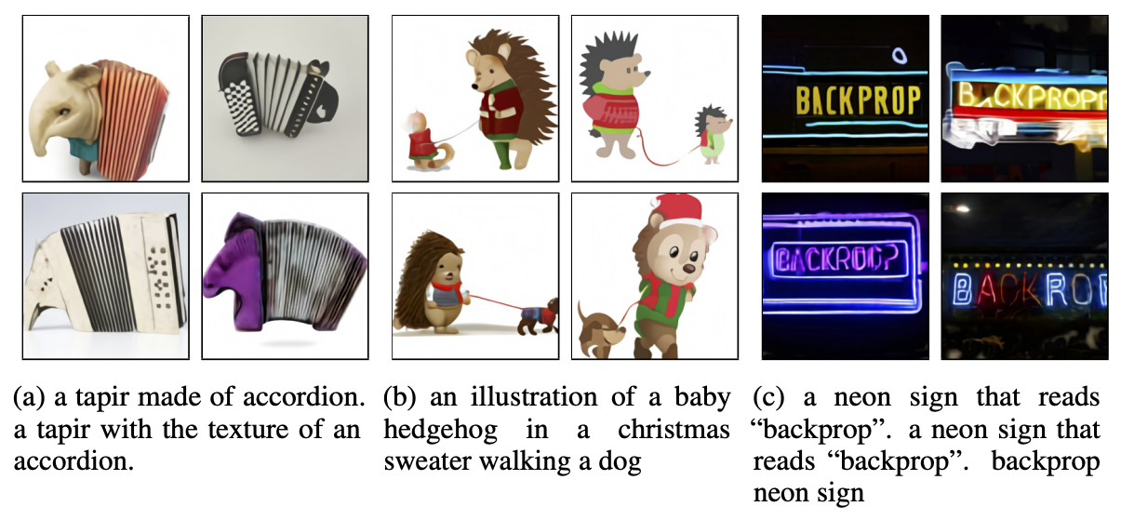
DALL-E: Text-to-image generation using transformers
Train an encoder similar to VQ-VAE to compress images to 32x32 grids of discrete tokens (each assuming 8192 values)
Concatenate with text strings, learn a joint sequential transformer model that can be used to generate image based on text prompt
A. Ramesh et al., Zero-Shot Text-to-Image Generation, ICML 2021
https://openai.com/blog/dall-e/

Slide 45
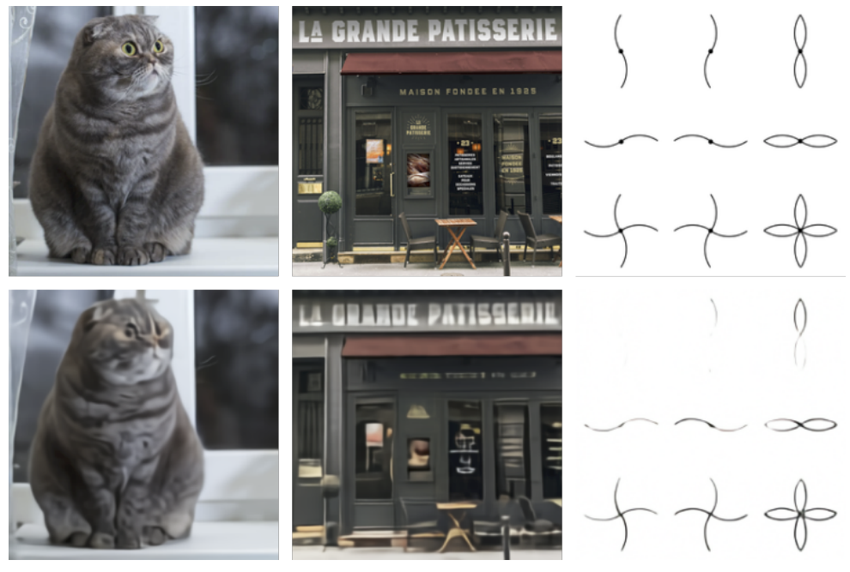
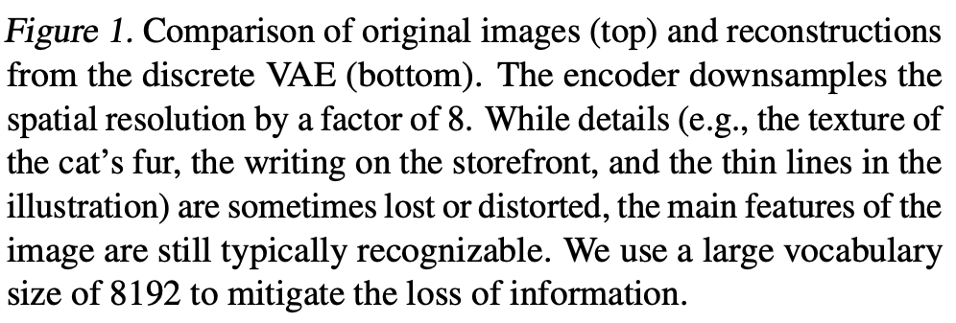
DALL-E: Image encoding
Train convolutional encoder and decoder to compress images to 32x32 grids of discrete tokens (each assuming 8192 values)

Slide 46
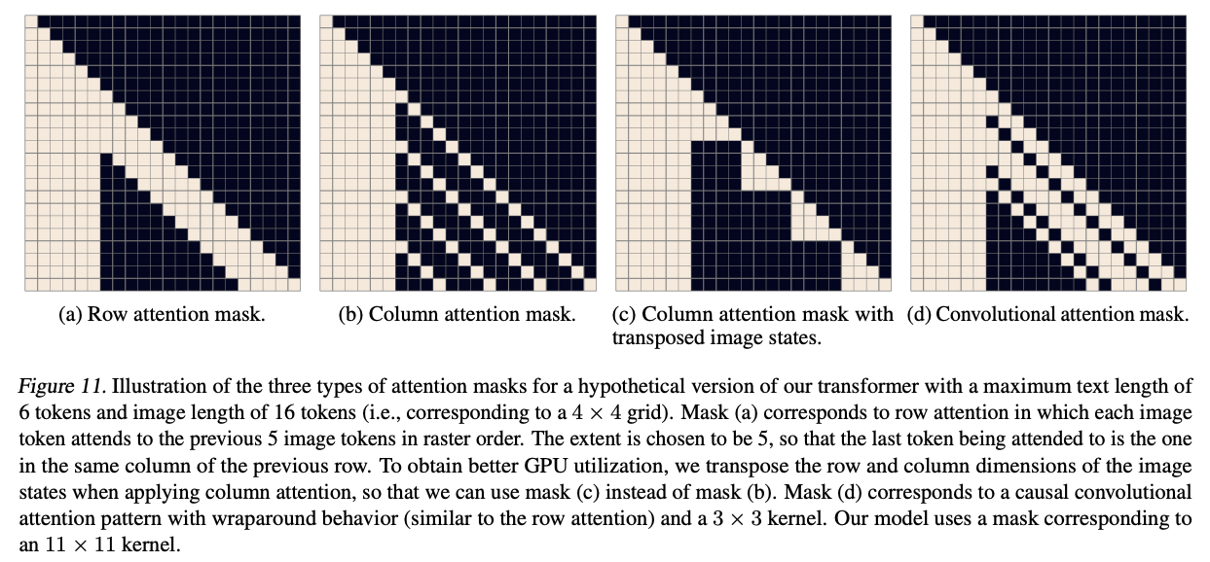
DALL-E: Transformer architecture and training
Concatenate up to 256 text tokens with 32x32=1024 image tokens, learn a transformer model with 64 layers and 12B parameters
Dataset: 250M image-text pairs from the Internet (similar scale to
JFT-300M, apparently different from data used to train CLIP)
Transformer model details
  Decoder-only architecture
  64 self-attention layers,
  62 attention heads,
  sparse attention patterns
  Mixed-precision training,
  distributed optimization

Slide 47
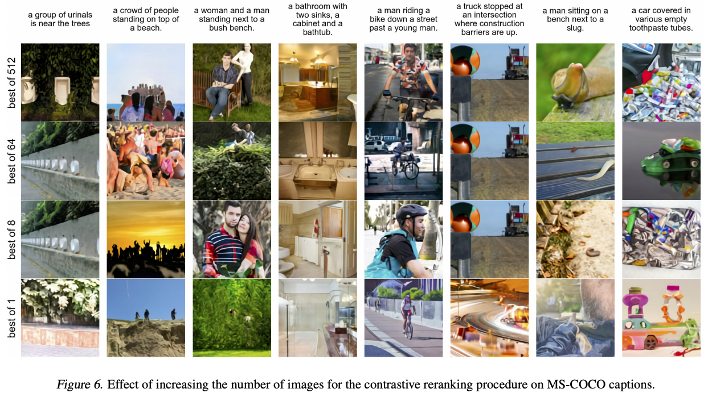
DALL-E: Generating images given text
Re-rank samples using CLIP

Slide 48
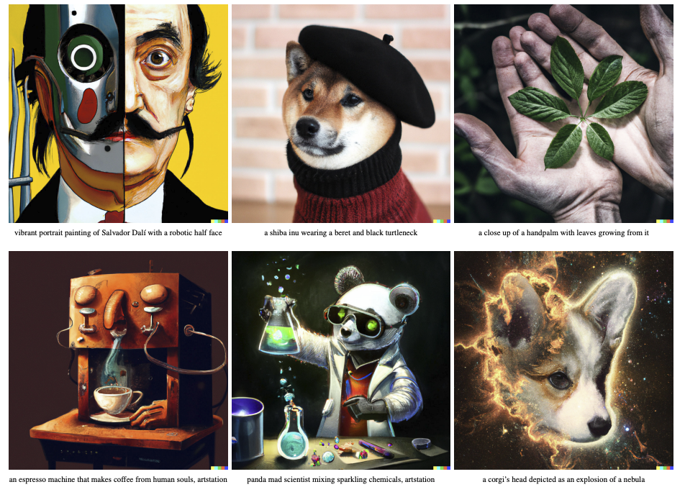
DALL-E 2: Text-to-image generation using diffusion models
A. Ramesh et al. Hierarchical text-conditional image generation with CLIP latents. 2022

Slide 49
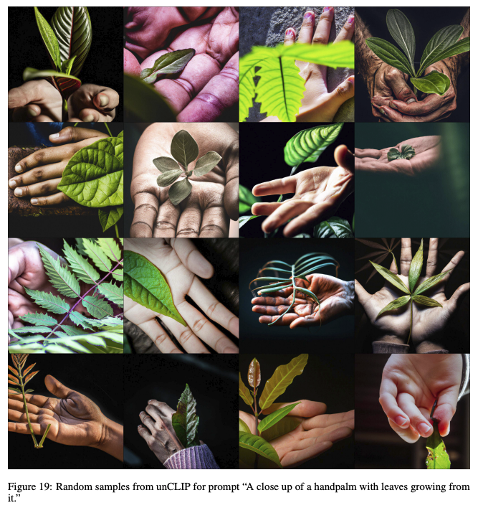
DALL-E 2

Slide 50
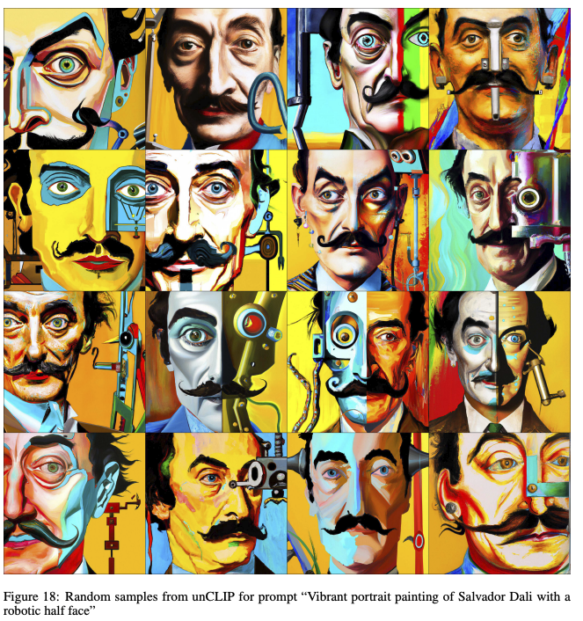
DALL-E 2

Slide 51
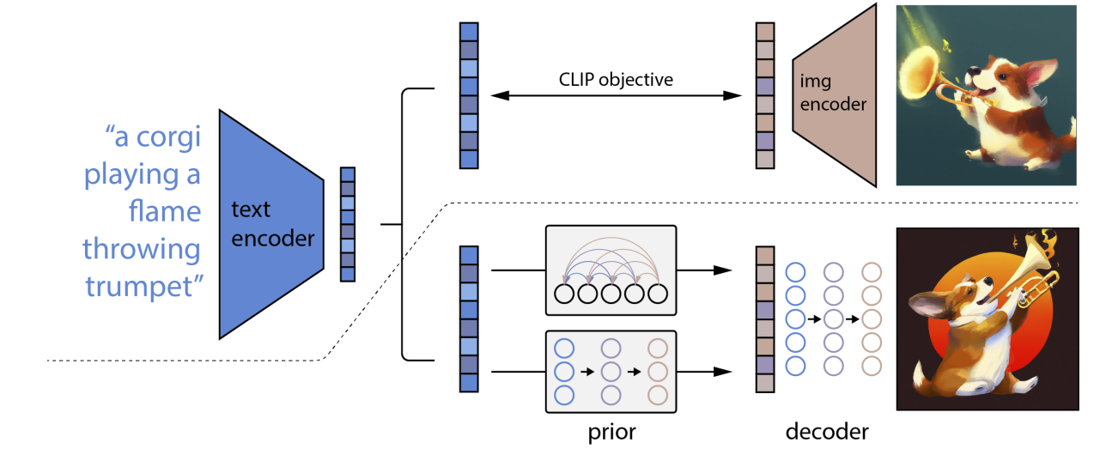

DALL-E 2

Slide 52

DALL-E 2

Slide 53
Diffusion models
Unconditional CIFAR10 sample generation
J. Ho et al. Denoising diffusion probabilistic models. NeurIPS 2020
Blog introduction: https://lilianweng.github.io/posts/2021-07-11-diffusion-models/

Slide 54

DALL-E 2 limitations

Slide 55

DreamFusion: Diffusion models + NeRFs
B. Poole, A. Jain, J. Barron, B. Mildenhall. DreamFusion: Text-to-3D using 2D Diffusion. arXiv 2022

Slide 56

DreamFusion: Diffusion models + NeRFs
B. Poole, A. Jain, J. Barron, B. Mildenhall. DreamFusion: Text-to-3D using 2D Diffusion. arXiv 2022
Notes:
DreamFusion generates 3D objects from a natural language caption such as “a DSLR photo of a peacock on a surfboard.” The scene is represented by a Neural Radiance Field that is randomly initialized and trained from scratch for each caption. Our NeRF parameterizes volumetric density and albedo (color) with an MLP. We render the NeRF from a random camera, using normals computed from gradients of the density to shade the scene with a random lighting direction. Shading reveals geometric details that are ambiguous from a single viewpoint. To compute parameter updates, DreamFusion diffuses the rendering and reconstructs it with a (frozen) conditional Imagen model to predict the injected noise εˆφ(zt|y; t). This contains structure that should improve fidelity, but is high variance. Subtracting the injected noise produces a low variance update direction stopgrad[εˆφ − ε] that is backpropagated through the rendering process to update the NeRF MLP parameters.

Slide 57
Just what is going on here?
Q: What are image generators for?
A: who knows, but they expose very deep mysteries.
Q: Why are they interesting?
A: They know things they haven’t been trained to know,
AND they don’t know things that they should know

Slide 58

Applications: make commercial art cheaper
(Inverse Willie Sutton argument)

Slide 59

and political discourse nastier

Slide 60
Articles of faith
There is a probability distribution on all images
A diffusion model produces a fair sample from that dist
Articles of faith because:
  they’re believed in the face of inconvenient facts
    obvious falsification below
    you can’t do two-sample testing in high dimensions and get the answer right
    metrics: absurd (FID); ineffectual (ask people); inaccurate (ask VLMs)
  bad things might happen to unbelievers

Slide 61

Relightings are realistic
Bhattad et al, 23, 24: StyLitGAN: Prompting StyleGAN to Produce New Illumination Conditions

Slide 62




















Simple tricks can recover intrinsics from generators
Image
Normals
Depth
Albedo
Shading
Image
Normals
Depth
Albedo
Shading
VQGAN FFHQ (Autoregressive)
StyleGAN-XL FFHQ (GAN)
Image
Normals
Depth
Albedo
Shading
StyleGAN-v2 LSUN Bedroom (GAN)
Image
Normals
Depth
Albedo
Shading
Du, … , Bhattad. CVPR-W 2024
Stable Diffusion 2.1 (Diffusion)

Slide 63



Idea
Translate:
Forward 5m,
Right 10m
Rotate: 20° left,
5° Upward
Generative Model
Latent
Diffusion Model
Starting Image
Noisy Target
Target
Camera
Transformation
Wallingford, Bhattad et al. NeurIPS 2024 360-1M: Learning to Imagine the world from 1M 360 videos

Slide 64


Slide 65


Slide 66

Iffy projective geometry
https://huggingface.co/spaces/stabilityai/stable-diffusion/discussions/1593

Slide 67

https://huggingface.co/spaces/stabilityai/stable-diffusion/discussions/1593

Slide 68

https://huggingface.co/spaces/stabilityai/stable-diffusion/discussions/1593

Slide 69
Real or generated?

Slide 70

Synthesizing clothing
Zhu et al 23: Tryondiffusion: A tale of two unets

Slide 71
Zhu et al 23: Tryondiffusion: A tale of two unets

Slide 72
Scale
relative to
bear

Slide 73
He’s got
someone
else’s nose!
Scale
relative to
politician

Slide 74
Outline
Brief history of recognition
Different “dimensions” of recognition
  What type of content?
  What type of output?
  What type of supervision?
Trends
  Saturation of supervised learning
  Transformers
  Vision-language models
  “Universal” recognition systems
  Text-to-image generation
  From vision to action

Slide 75

From vision to action
A. Agarwal, A. Kumar, J. Malik, and D. Pathak. Legged Locomotion in Challenging Terrains
using Egocentric Vision. CoRL 2022

Slide 76

From vision to action

