Slide 1
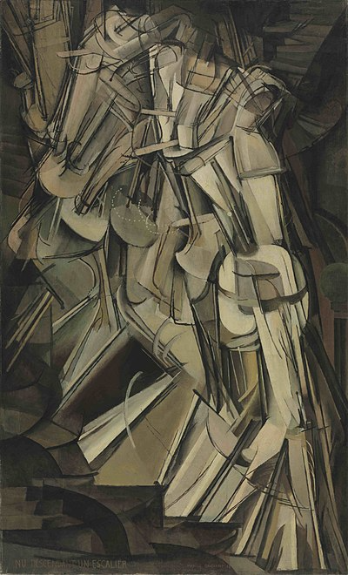
Simple tracking
Marcel Duchamp, Nude
Descending a staircase

Slide 2
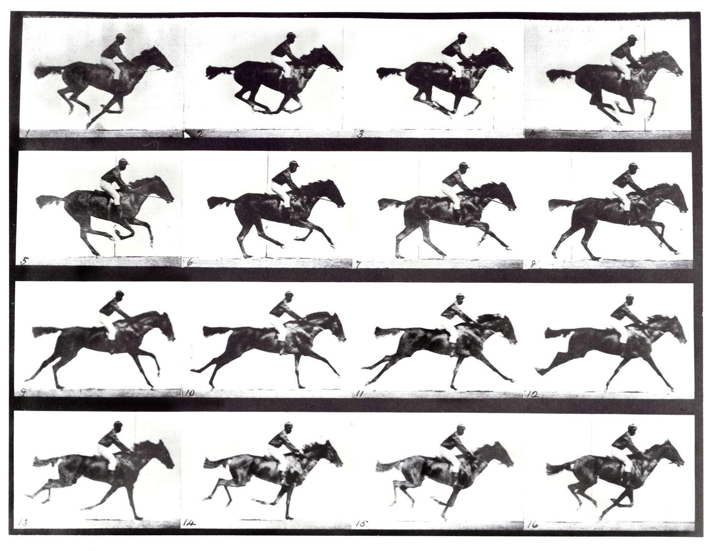
Follow an object from frame to frame
Eadweard Muybridge

Slide 3
Tracking – Why?
Motion capture
  build models of moving people from video
Recognition from motion
  eg cyclists move differently than runners
Surveillance
  who is doing what?
    for security (eg keep people out of sensitive areas in airports)
    for HCI (eg kinect, eyetoy, etc.)

Slide 4
Tracking - What
Establish state of object using time sequence
  state could be:
    position; position+velocity; position+velocity+acceleration
    or more complex, eg all joint angles for a person
  Biggest problem -- Data Association
    which image pixels are informative, which are not?
Key ideas
  Tracking by detection
    if we know what an object looks like, that selects the pixels to use
  Tracking through flow
    if we know how an object moves, that selects the pixels to use

Slide 5
Tracking by detection
Assume
  a very reliable detector (e.g. faces; back of heads)
  detections that are well spaced in images (or have distinctive properties)
    e.g. news anchors; heads in public
Link detects across time
  only one – easy
  More – weighted bipartite matching
Image i
Image i+1

Slide 6
Point tracks reveal public behaviour
Yan+Forsyth, 04

Slide 7
Some detections might fail…
Match measurements to abstract “tracks”
Strategy
  detect in each frame
  link detects to tracks using matching algorithm
    measurements with no track? create new track
    tracks with no measurement? wait, then reap
  (perhaps) join tracks over time with global considerations
Link detects to tracks?

Slide 9
Issues
What detection and how to detect?
  Interest points
  Detector boxes (but you need to know the category)
  Other kinds of detector report
    Eg full kinematic body configuration
  Semantic search regions
  User delineated regions
  “Salient” regions
Using both detection and motion information
  Many moving objects move in quite predictable ways
  Use motion and detection together to predict state

Slide 10
Tracking by detection for interest points
Find interest points
Know window (say) in image (n)
Want to find corresponding window in (n+1)
Search over nearby windows
  to find one that minimizes SSD error (Sum of Squared Differences)
  where sum is over pixels in rectangle

Slide 11
Matching
Patch is at u, t; moves to u+h, t+1; h is small
Error is sum of squared differences
This is minimized when
substitute
get

Slide 12
Matching, II
We can tell if the match is good by looking at
  which will be poorly conditioned if matching is poor
    eg featureless region
    eg flow region

Slide 13
Matching, III
Previous test compares i and i+1
But the patch should be “well behaved” over long time scales
Compare N’th frame with first by
Compute affine transform M, c that minimizes LSE
Check value of LSE; too big? Reject track

Slide 14
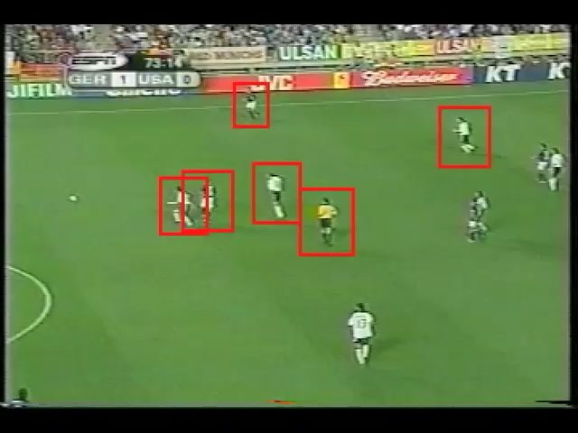
Efros et al, 03

Slide 15
Interest points yield tracker and matcher
Combine:
Collect multiple frames of person A
Track person B in video
For each box, match to best person A frame
Blend that in

Slide 16

Efros et al, 03

Slide 17
Track by flow (simple form)
Assume
  appearance unknown (but domain, parametric flow model known)
  optic flow assumptions, as before
Initialize
  mark out domain
Track
  choose flow model parameters that align domain in pic n with n+1 best
  push domain through flow model to get new domain

Slide 18
Issues
What detection and how to detect?
  Interest points
  Detector boxes (but you need to know the category)
  Other kinds of detector report
    Eg full kinematic body configuration
  Semantic search regions
  User delineated regions
  “Salient” regions
Using both detection and motion information
  Many moving objects move in quite predictable ways
  Use motion and detection together to predict state
These work like
Interest points
Issues: how do you describe a region? Region deforms

Slide 19
Using a motion model
Many objects move quite predictably
  Movement is slow wrt frame rate, OR
  Acceleration is small, OR
  Acceleration is fixed (eg movement under gravity)
So we know a lot about where the object is in the next frame
this should help our estimate
Imagine detector is noisy, and movement is predictable

Slide 20







A 1-D problem
Drop a measuring device on a cable down a hole
  where is it?
Setup:
  measurement of depth
  actual distance down the hole
  known which will be normal,
  known which will be normal,
Q: what is ?

Slide 21
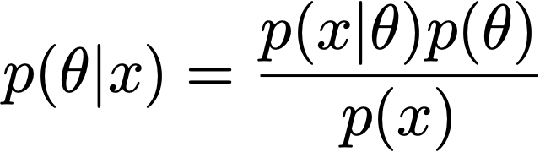

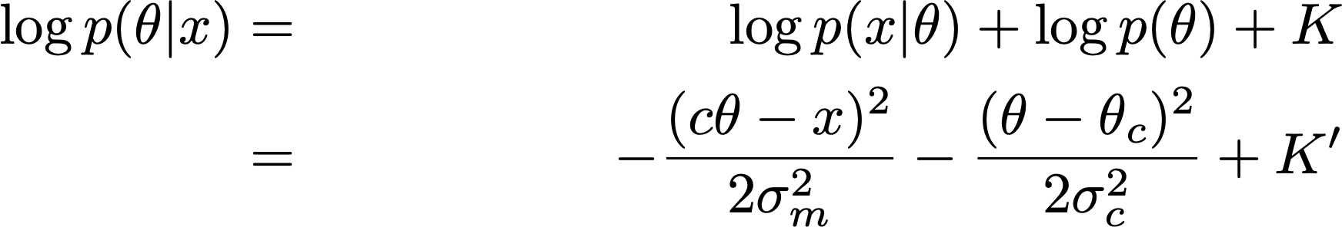
A 1D problem, II
(Bayes rule), so that:
And:

Slide 22
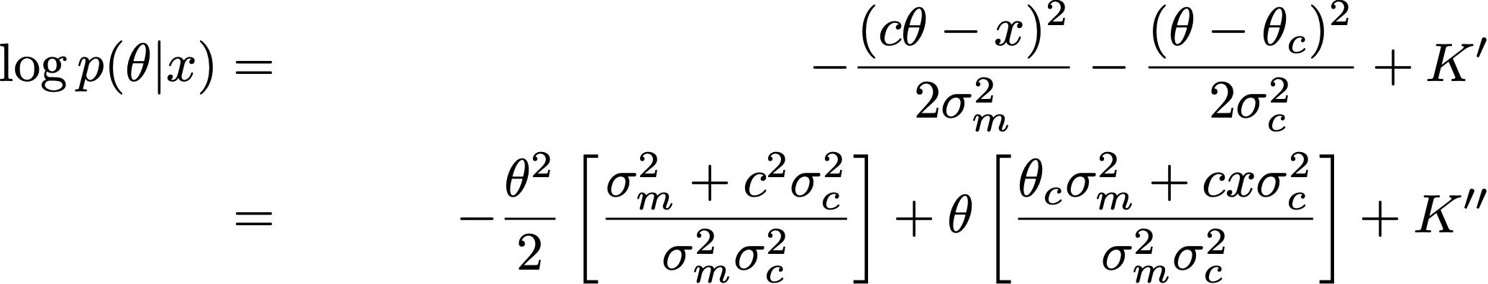
A 1D problem, III
Notice that this is a normal distribution! (check that the log is quadratic in theta)

Slide 23

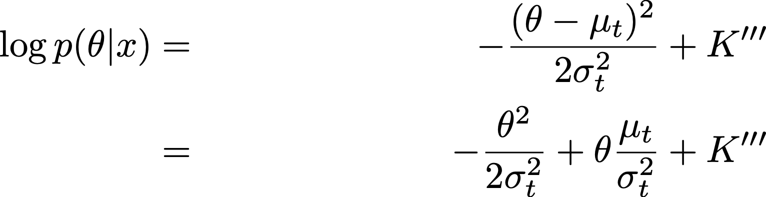
A 1D problem, IV
Now we can recover parameters for
Write

Slide 24
Pattern matching
Compare
and

Slide 25
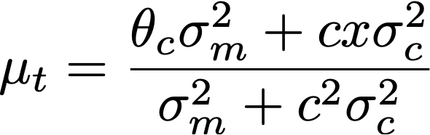
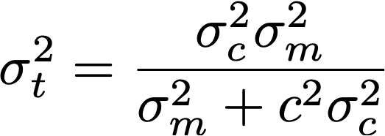
A 1D problem, V
Important checks
  What happens when the measurement is unreliable?
  What happens when the prior is very diffuse?

Slide 26
Summary, with change of notation

Slide 27


Now a second measurement arrives…
We know that is normal
  think of this as the prior
We know that is normal
  think of this as the likelihood
So:
  the posterior must be normal
  and we can update as before!
Key points:
Can represent posteriors easily, cause they’re normal
Updates are easy
True in higher
dimensions,
too, and very
Important. We’ll
cover in some
detail.

Slide 28
The 1D Example is too simple…
Notice we had multiple measurements, but the object didn’t move
Typical object:
  Start state then iterate
    Move
    Generate measurement
Typical tracking/filtering:
  Start with prior
    Predict new state resulting from movement
    Update prediction using new measurement

Slide 29
Filtering
The moving object has a state
  Position
  Position and velocity
  Position, velocity, acceleration
  Etc.
Every tick of time (eg at each frame)
  State is updated by a known (but possibly noisy) procedure
  Equivalently, the object moves
  There is a measurement of state, possibly noisy
Filtering
  Update some representation of state, using measurement and motion information
The big engine: the Kalman Filter

Slide 30
Filtering In the world
Object in state X_{i-1},
seen measurements Y_0, … Y_{i-1}
Represent P(X_{i-1}|Y_0, … Y_{i-1})
State updates
Represent P(X_i|Y_0, … Y_{i-1})
Object in state X_i,
seen measurements Y_0, … Y_{i-1}
Generate measurement
Object in state X_i,
seen measurements Y_0, … Y_i
Represent P(X_i|Y_0, … Y_i)

Slide 31


Assumption: Linear dynamics and measurement
Square matrix of full rank
State changes as:
Measurements are:
This is a normal random variable with zero mean and known covariance
Any matrix whose dimensions are OK
This is a (different!) normal random variable with zero mean and known covariance

Slide 32
Examples
Dynamical models
  Drifting points
    new state = old state + gaussian noise
  Points moving with constant velocity
    new position=old position + (dt) old velocity + gaussian noise
    new velocity= old velocity+gaussian noise
  Points moving with constant acceleration
    etc
Measurement models
  state=position; measurement=position+gaussian noise
  state=position and velocity; measurement=position+gaussian noise
    but we could infer velocity
  state=position and velocity and acceleration; measurement=position+gaussian noise

Slide 33


Other notation
Read this as: x_i is normally distributed. The mean is a linear function of x_i-1 and
whose variance is known (and can depend on i).
Read this as: y_i is normally distributed. The mean is a linear function of x_i and
whose variance is known (and can depend on i)

Slide 34




Important facts
is normal, by construction
Assume that is normal
Then and are normal
But this means that if P(X_0) is normal, all distributions are normal (induction!)
Important, because normal distributions are easy to represent

Slide 35
In the world
Object in state X_i,
seen measurements Y_1, … Y_i
Represent P(X_i|Y_1, … Y_i)
State updates
Represent P(X_{i+1}|Y_1, … Y_i)
Object in state X_{i+1},
seen measurements Y_1, … Y_i
Generate measurement
Object in state X_{i+1},
seen measurements Y_1, … Y_{i+1}
Represent P(X_{i+1}|Y_1, … Y_{i+1})

Slide 36
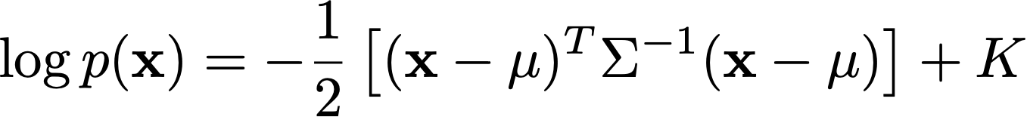
Checking…
Probability distribution is normal iff it has the form:
  and you can check this for each of the relevant dists.

Slide 37
The steps
Represent P(X_{i-1}|Y_1, … Y_{i-1})
Have:
Mean and covariance of posterior
after i-1’th measurement
Construct:
Mean and covariance of predictive
distribution just before i’th measurement
Represent P(X_i|Y_1, … Y_{i-1})
Measurement arrives:
Now construct:
Represent P(X_i|Y_1, … Y_i)
Mean and covariance of posterior
distribution just after i’th measurement

Slide 38


The Kalman Filter
Dynamic Model
Notation

Slide 39


Prediction
We have:
This is a normal random variable with zero mean and known covariance

Slide 40
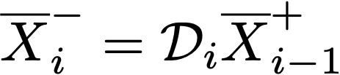

Prediction
We have:
This is a normal random variable with zero mean and known covariance
Which yields….

Slide 41
Summary, with change of notation
posterior mean is weighted combo
of prior mean and measurement
posterior covar is weighted combo
of prior covar, measurement
matrix and measurement covar

Slide 42

posterior mean is weighted combo
of prior mean and measurement
posterior covar is weighted combo
of prior covar, measurement
matrix and measurement covar
posterior mean is weighted combo
of prior mean and measurement
posterior covar is weighted combo
of prior covar, measurement
matrix and measurement covar

Slide 43
The steps
Have:
Mean and covariance of posterior
after i-1’th measurement
Represent P(X_{i-1}|Y_1, … Y_{i-1})
Construct:
Mean and covariance of predictive
distribution just before i’th measurement
Represent P(X_i|Y_1, … Y_{i-1})
Measurement arrives:
Now construct:
Mean and covariance of posterior
distribution just after i’th measurement
Represent P(X_i|Y_1, … Y_i)
posterior mean is weighted combo
of prior mean and measurement
posterior covar is weighted combo
of prior covar, measurement
matrix and measurement covar

Slide 44
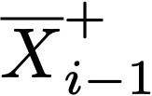

The steps
Have
Represent P(X_{i-1}|Y_1, … Y_{i-1})
Construct:
Represent P(X_i|Y_1, … Y_{i-1})
Measurement arrives:
Now construct:
Represent P(X_i|Y_1, … Y_i)

Slide 45
Simple example: tracking a ballistic object
Assumptions:
Orthographic image, camera oriented so vertical (y) is gravity
Object is falling freely under gravity
Detector measures object position + noise

Slide 46
The object
State:
position, velocity, acceleration

Slide 47
The object
Prior:
position and velocity could be pretty much anything
acceleration should be very close to gravity vector
Mean: Covariance
Where w is big and s is small

Slide 48
Measurements
At i’th frame, we see:
x and z components of position + noise
So
Choose noise model, and we are done!

Slide 49
The steps
Have
Represent P(X_{i-1}|Y_1, … Y_{i-1})
Construct:
Represent P(X_i|Y_1, … Y_{i-1})
Measurement arrives:
Now construct:
Represent P(X_i|Y_1, … Y_i)

Slide 50
Questions:
Can we estimate p_2 like this?
Why can we estimate velocity and acceleration?
Why go to all this trouble?

Slide 51
The steps
Have
Represent P(X_{i-1}|Y_1, … Y_{i-1})
Construct:
Represent P(X_i|Y_1, … Y_{i-1})
Measurement arrives:
Now construct:
Represent P(X_i|Y_1, … Y_i)

Slide 52
Example II:
A simple translating car
  we supply a known demand to the accelerator,
    changing at each time step
  it sees 2 beacons (which are in its coordinate system)
    beacon 1 measured in car x but not y
    beacon 2 measured in car y but not x
Q:
  recover filtered estimates of:
    position, velocity and acceleration in world coords

Slide 53
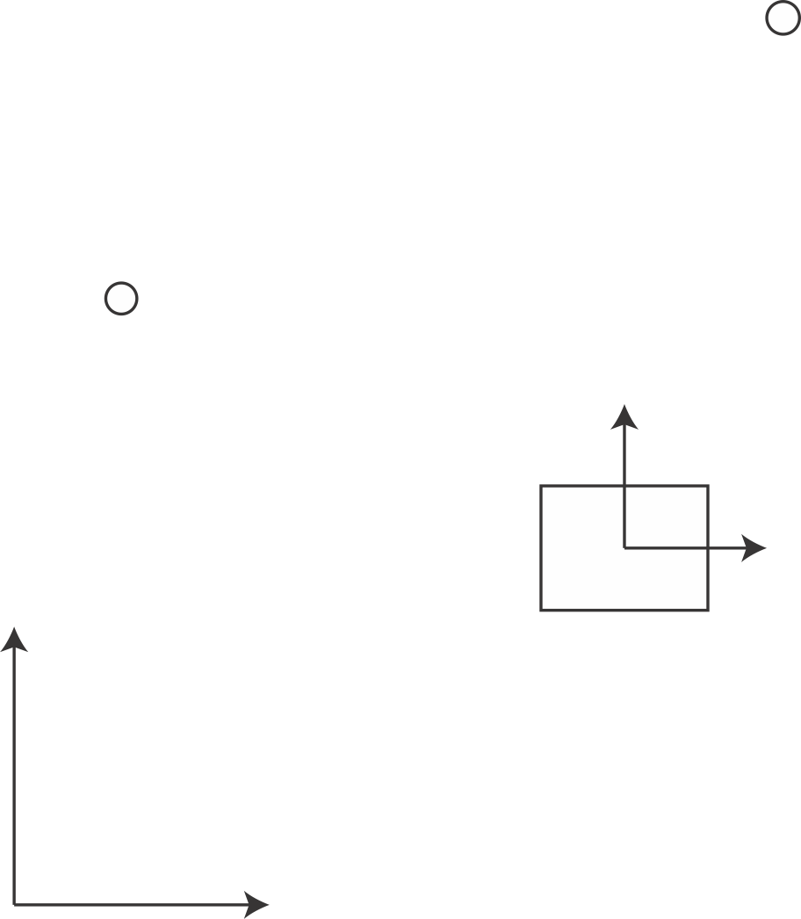







In world coordinates, car is at:
In car coordinates, beacon 1 measurement is:
In car coordinates, beacon 2 measurement is:

Slide 54

Dynamical model
We supply a demand to the accelerator
  acceleration updates as noise (measured to be about the same as demand!)
  velocity by integrating acceleration
  position by integrating velocity

Slide 55
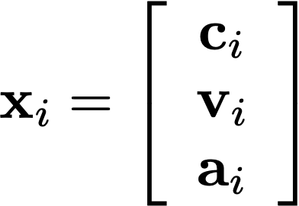
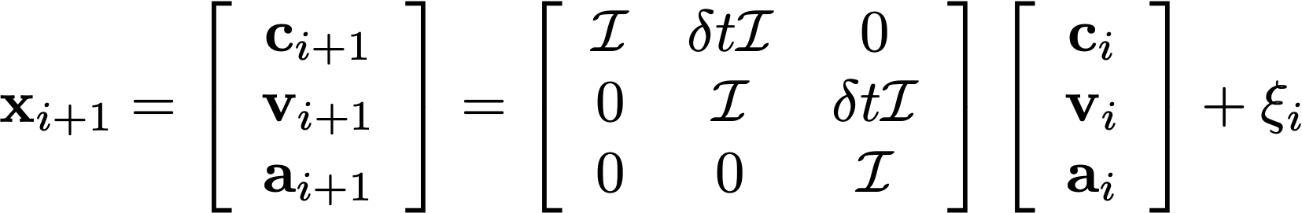

Stack the vectors to get:
Which gives:
Where:

Slide 56
Measurement model
The acceleration at i should be demand
  +noise
Beacons are in car coordinate system)
  beacon 1 measured in car x but not y
  beacon 2 measured in car y but not x

Slide 57
In world coordinates, car is at:
In car coordinates, beacon 1 measurement is:
In car coordinates, beacon 2 measurement is:

Slide 58
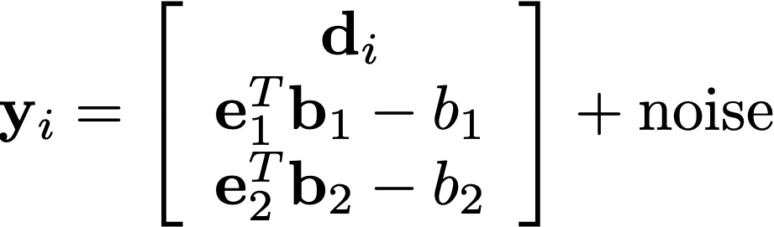
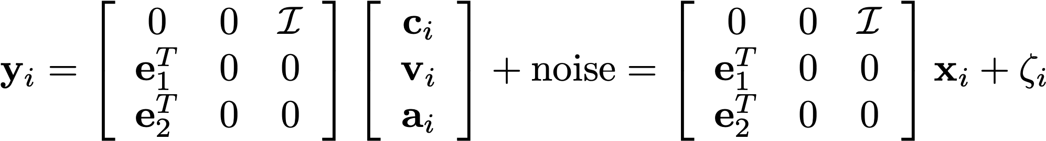

The acceleration demand
These are known constants
Measurements from the beacons

Slide 59
The steps
Have
Represent P(X_{i-1}|Y_1, … Y_{i-1})
Construct:
Represent P(X_i|Y_1, … Y_{i-1})
Measurement arrives:
Now construct:
Represent P(X_i|Y_1, … Y_i)

Slide 60
Questions:
Why can we estimate position and velocity?
Why go to all this trouble?

Slide 61
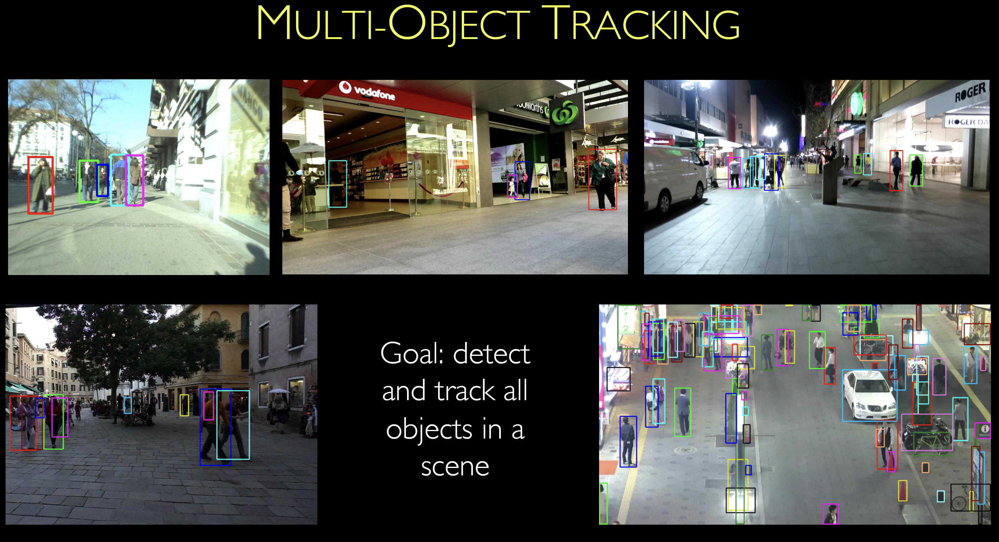
Multiple slides lifted from L. Leal-Taixe’s slides at ICVSS 2022

Slide 62
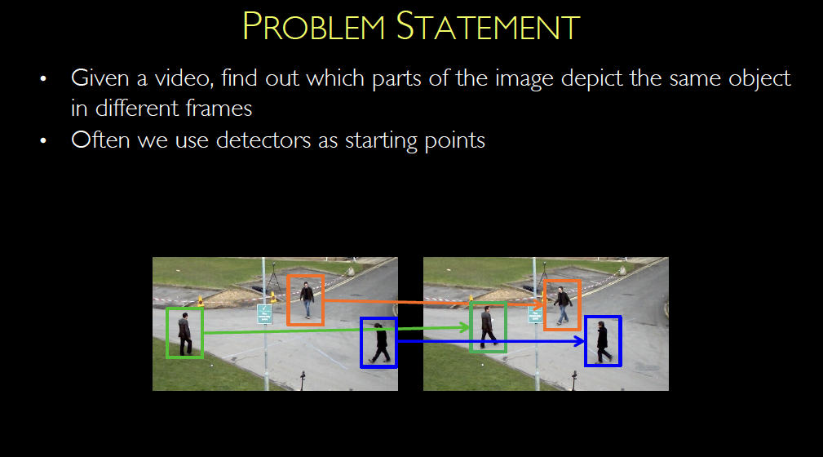

Slide 63
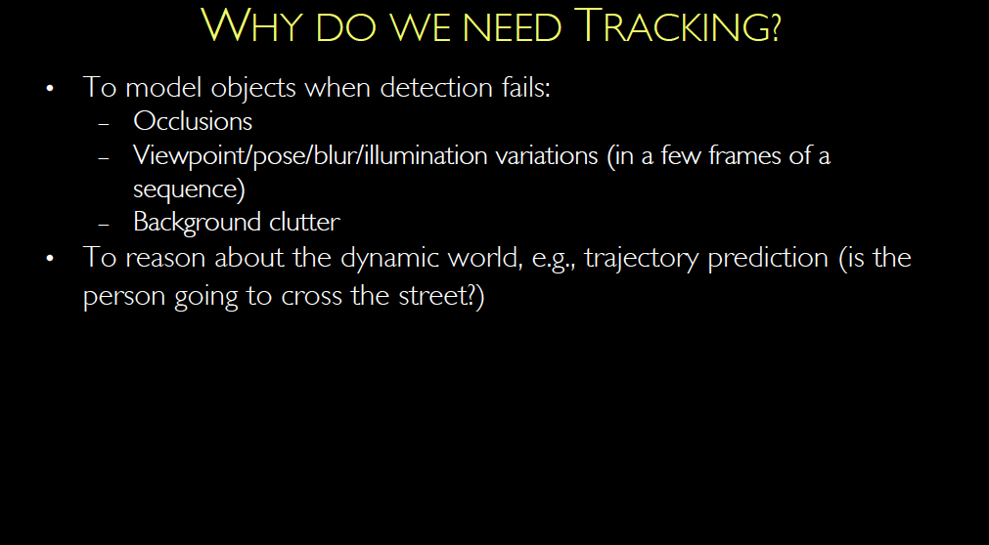

Slide 64
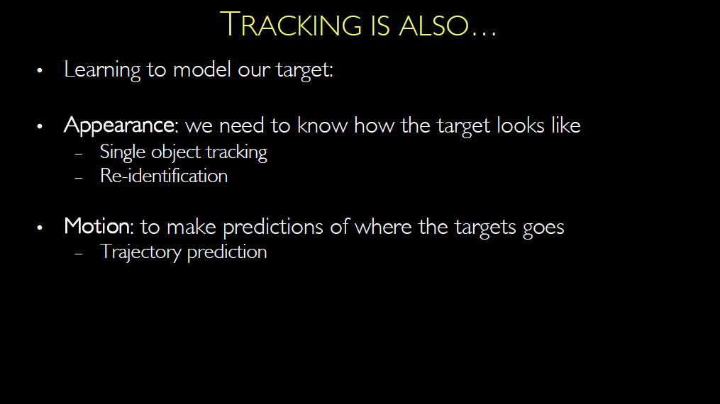

Slide 65
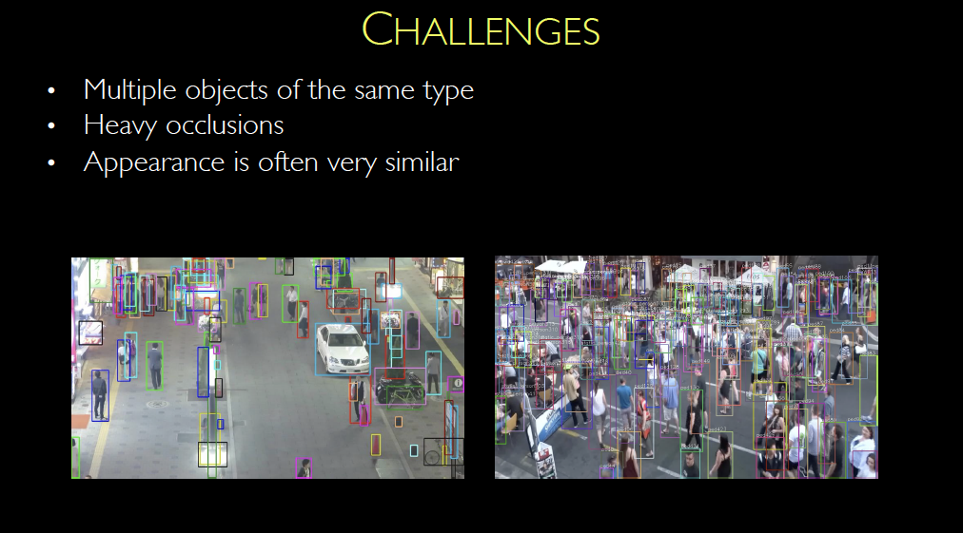

Slide 66
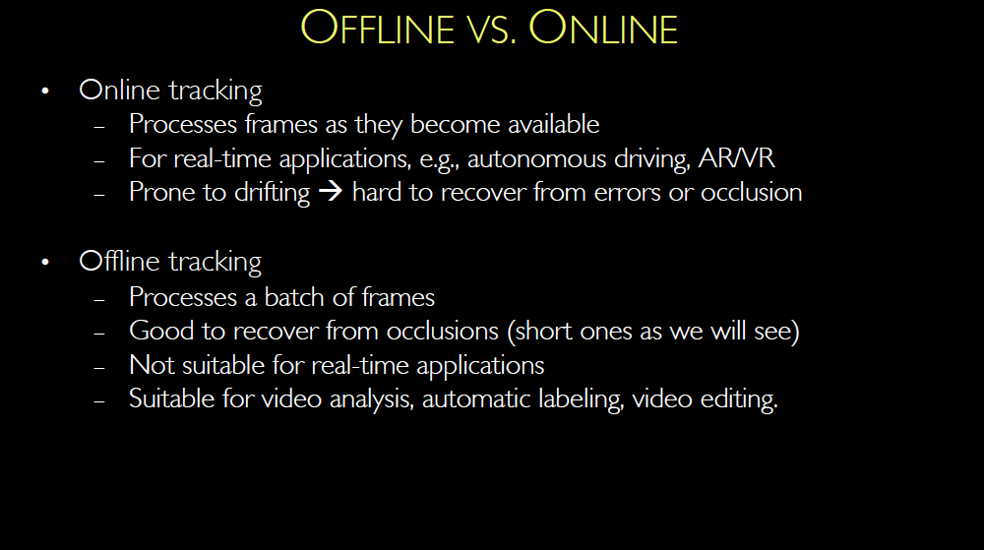
Sometimes “causal”

Slide 67
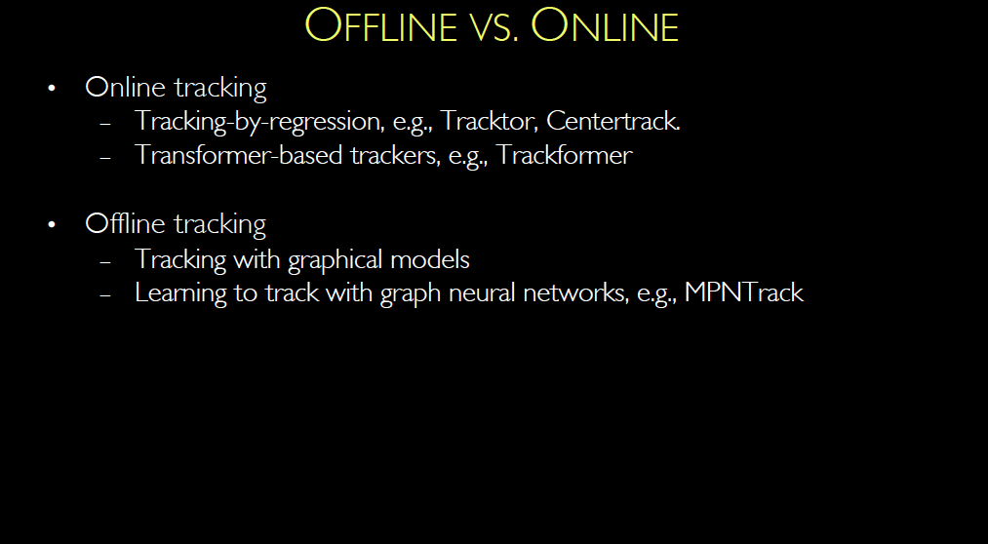

Slide 68
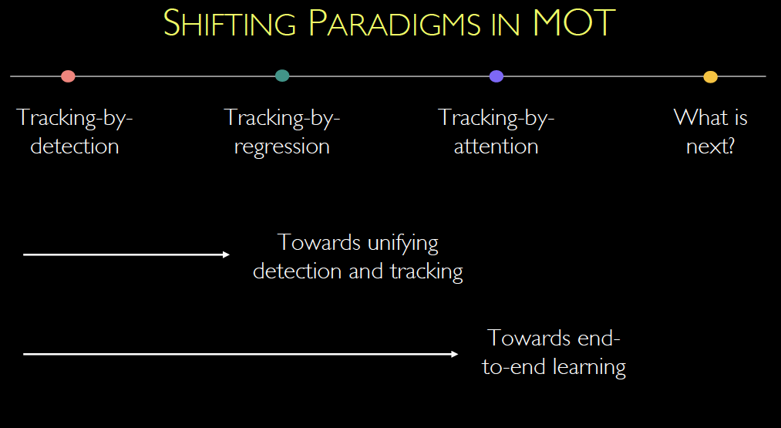

Slide 69
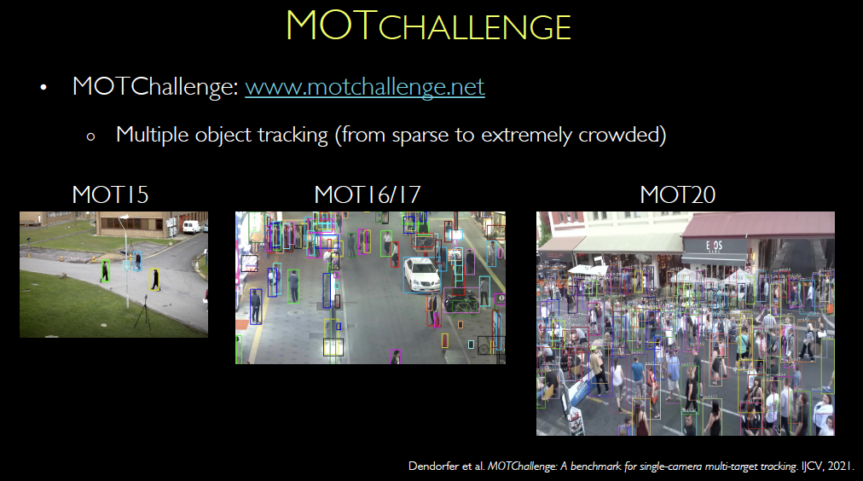

Slide 70


Slide 71
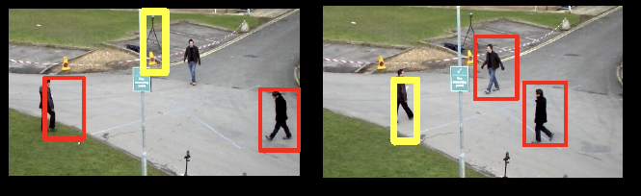
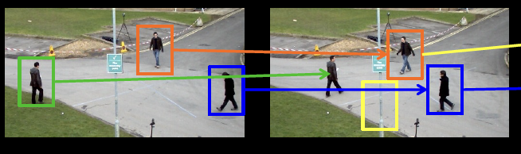

Slide 72
TBD (to date)
Questions:
can we use dynamics to simplify matching?
how do we represent similarity?

Slide 73
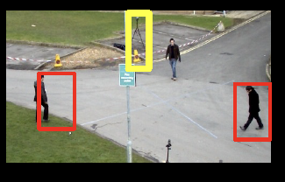
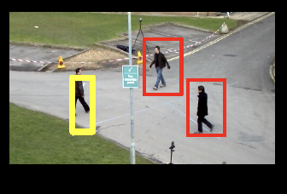
Recall Kalman Filter story
Have:
Mean and covariance of posterior
after i-1’th measurement
Construct:
This predicts where
Boxes might be in
Next frame
Mean and covariance of predictive
distribution just before i’th measurement
Measurement arrives:
Now construct:
Mean and covariance of posterior
distribution just after i’th measurement
posterior mean is weighted combo
of prior mean and measurement

Slide 74
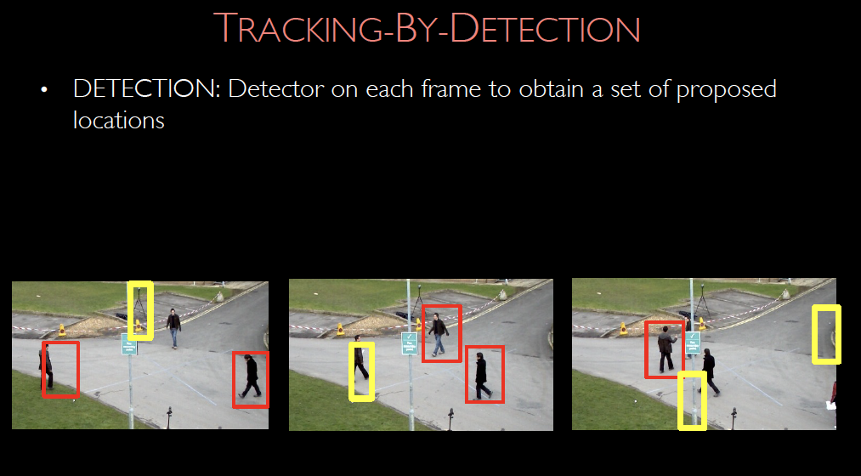

Slide 75
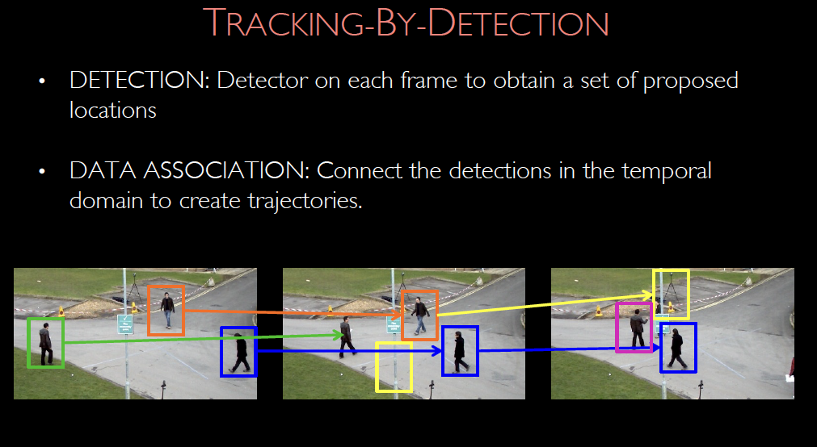

Slide 77
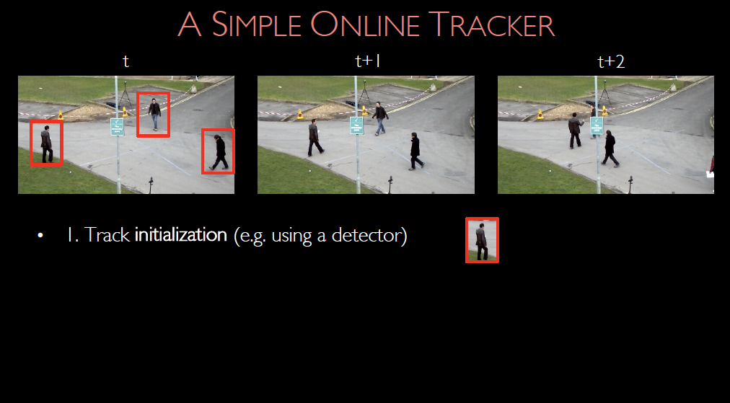

Slide 78
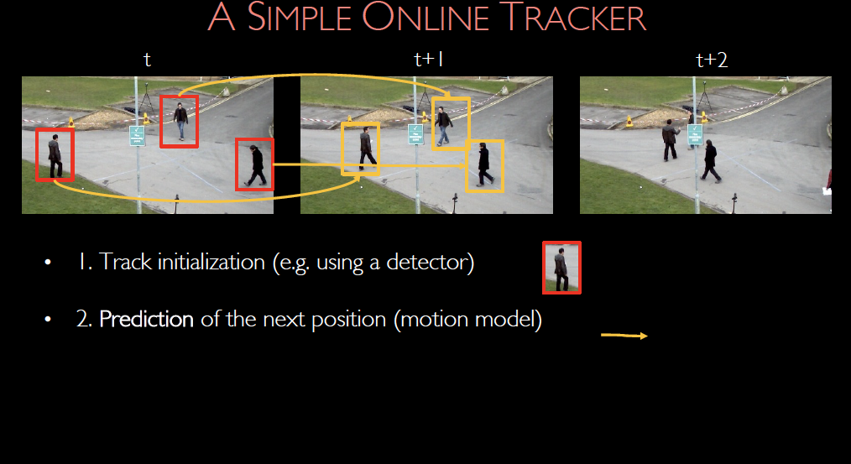

Slide 79
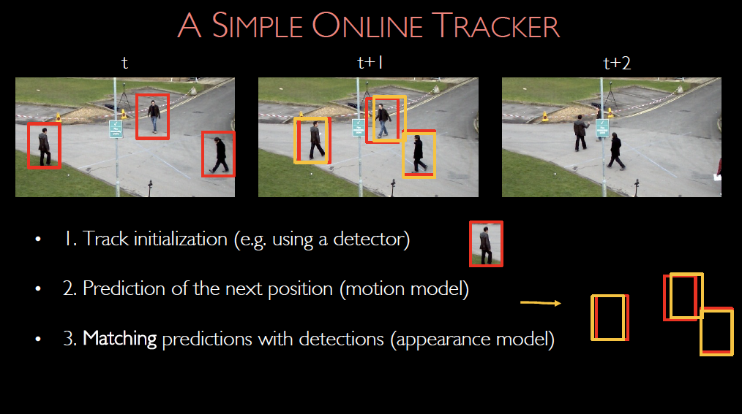

Slide 80
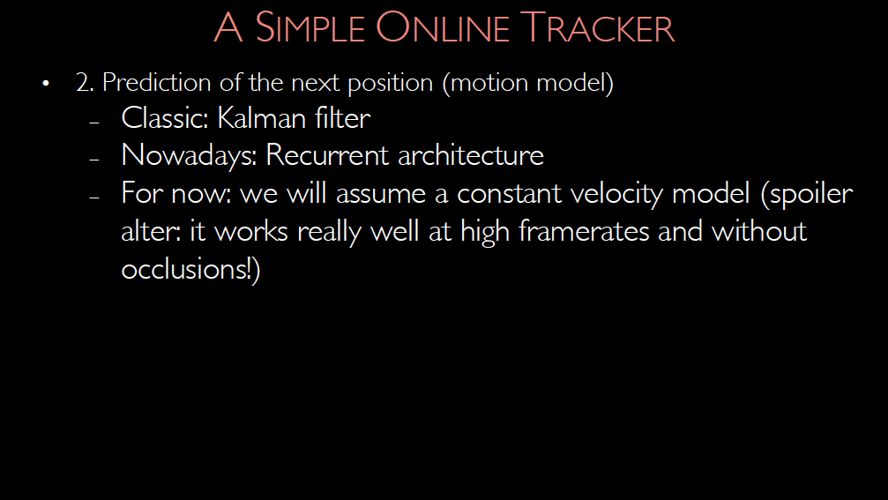
XXXXXXXXXXXXXXXXXXXXXXX
Builld this into detector

Slide 81
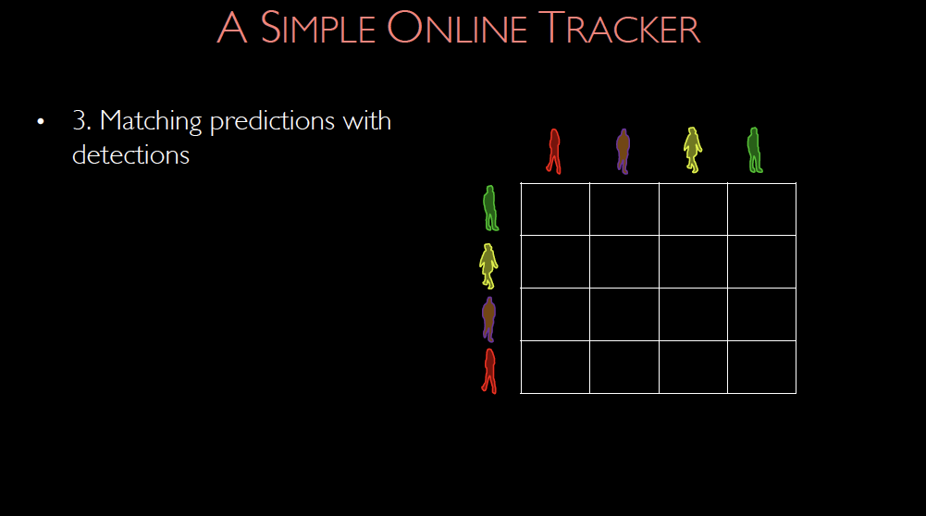

Slide 82
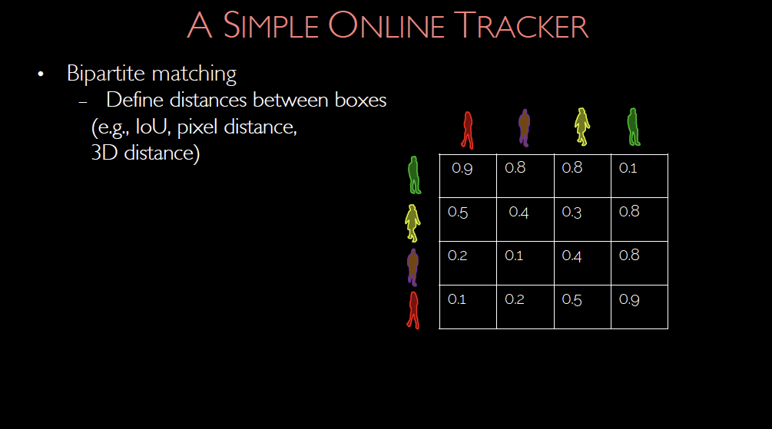

Slide 83
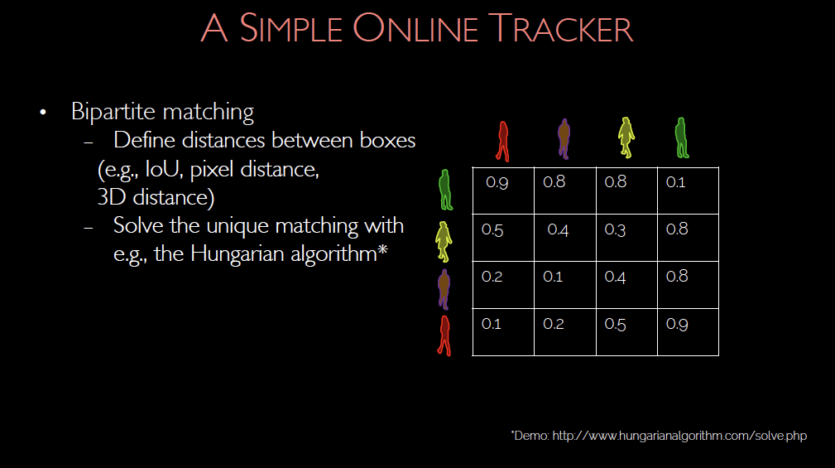

Slide 84
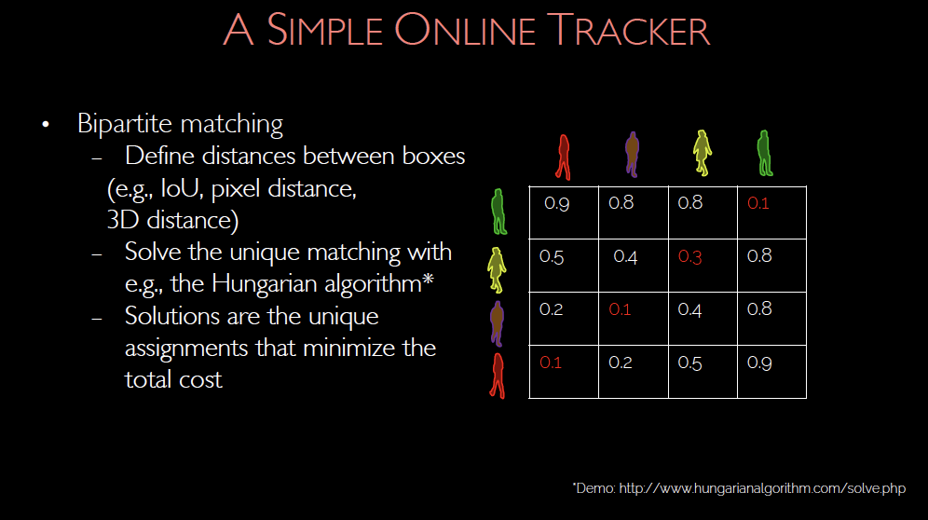

Slide 85
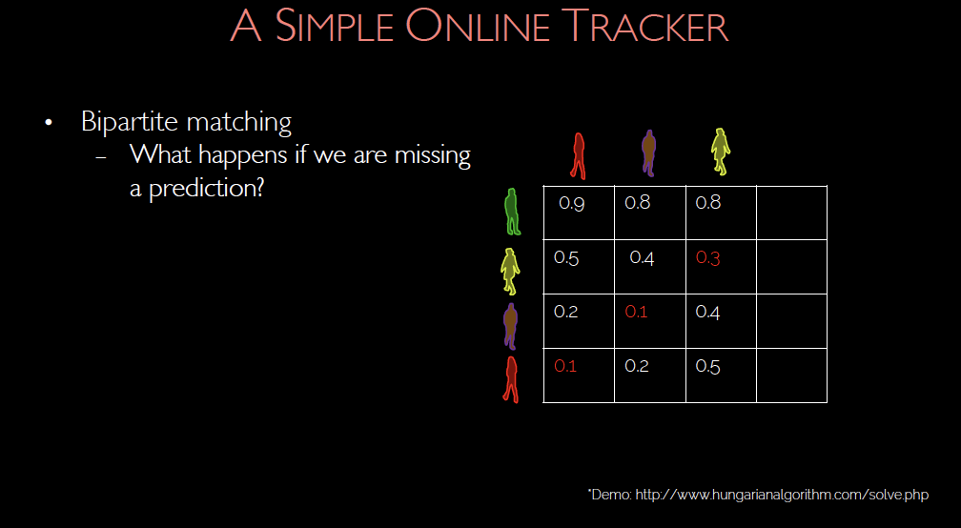

Slide 86
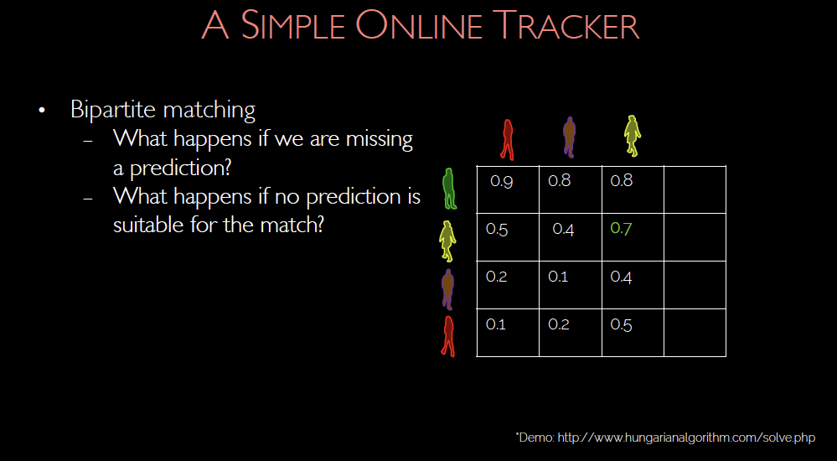

Slide 87
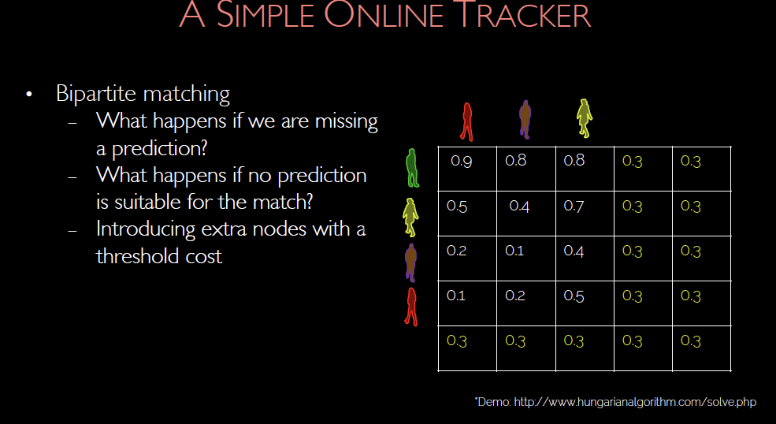

Slide 88
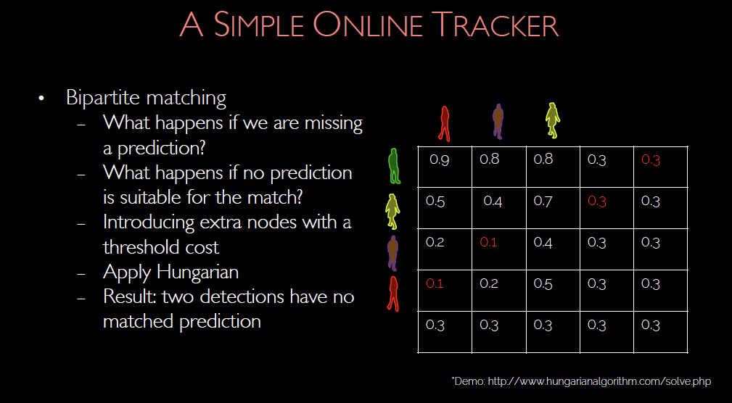

Slide 89
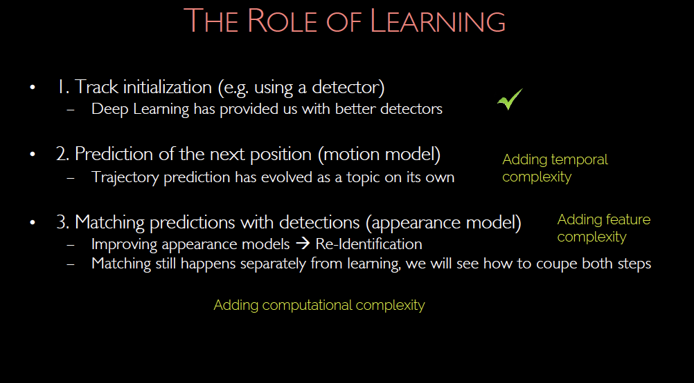

Slide 90
Improvements
Adjust detector to predict next object location
Learn feature representations of boxes that get the tracks right

Slide 92
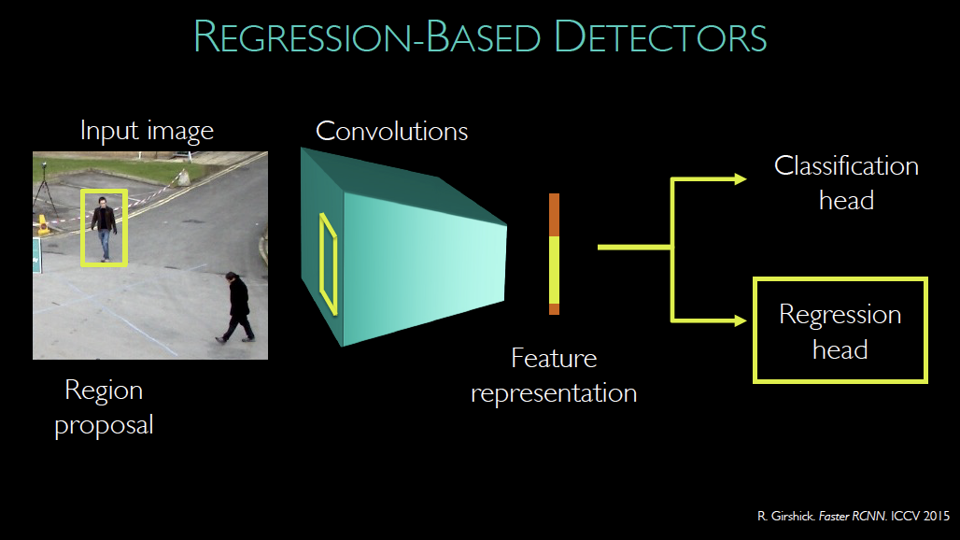

Slide 93
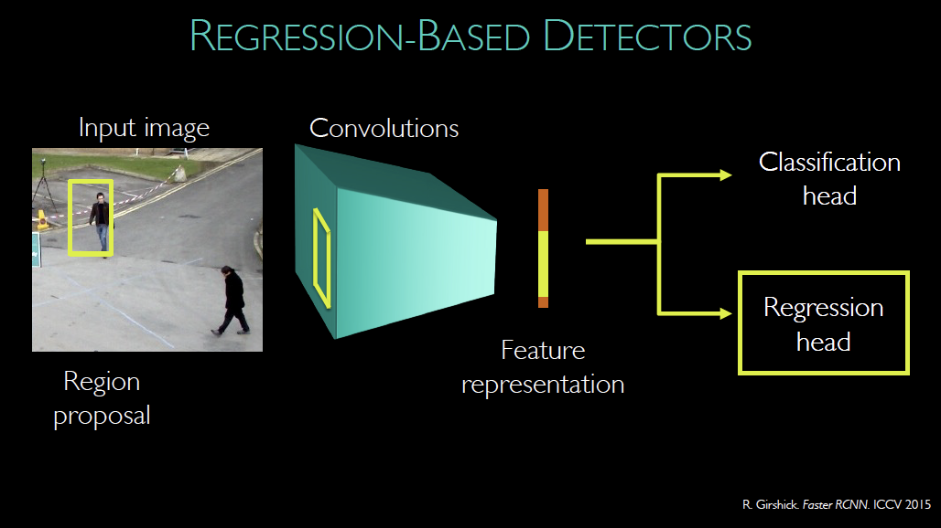

Slide 94


Slide 95
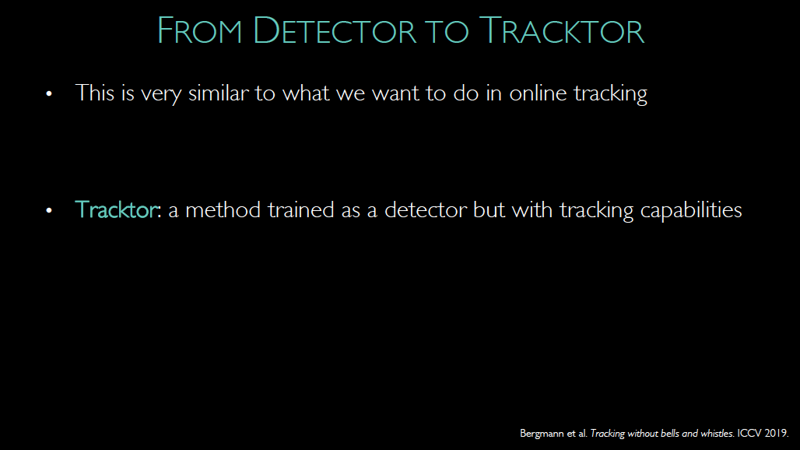

Slide 96
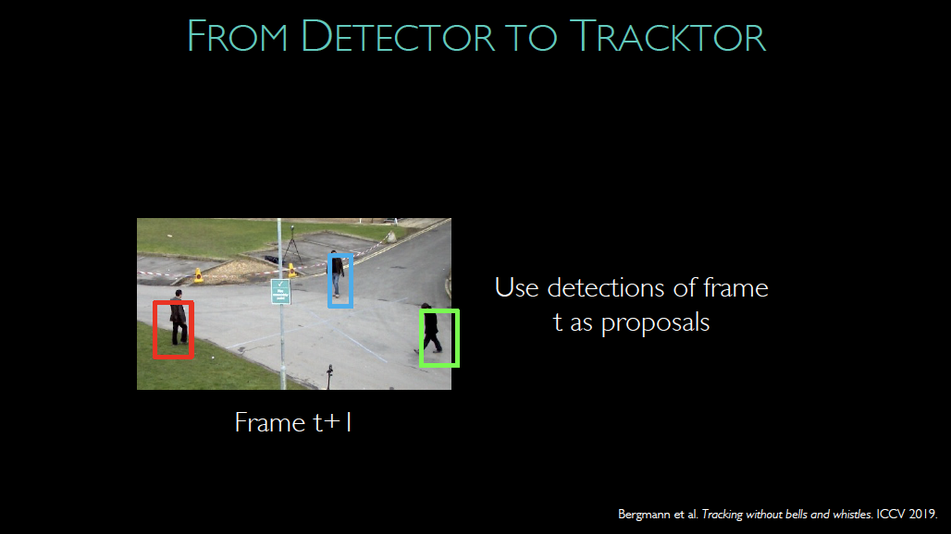

Slide 97
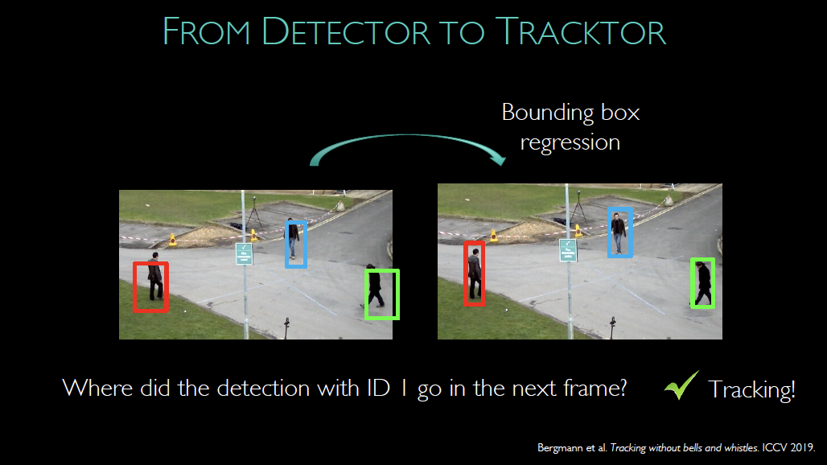

Slide 98


Slide 99


Slide 100
Improvements
Adjust detector to predict next object location
Learn feature representations of boxes that get the tracks right

Slide 101


Slide 102
Simplest version
Train so that
embeddings for correct matches are similar
embeddings for wrong matches are different
More complicated
set up long term matching process (Graph neural network)

Slide 103


Slide 104


Slide 105


Slide 106


Slide 107


Slide 108


Slide 109


Slide 110


Slide 111


Slide 112


Slide 113


Slide 114


Slide 115


Slide 116


Slide 117


Slide 118


Slide 119


Slide 128
Major problems remain
Long term occlusions present problems

Slide 129


Slide 130


Slide 131


Slide 132


Slide 133


Slide 135


Slide 136


Slide 137


Slide 138
Quick and (very) dirty guide to transformers - I
Mapping a sequence to a sequence is an important problem
eg machine translation
seq. of Latin words -> seq. of English words
but words affect other words, and are mangled as to order

Slide 139
Gallia est omnis divisa in partes tres; quarum unam incolunt Belgae,
All Gaul is divided into three parts; of which the Belgians inhabit one, the Aquitanians
aliam Aquitani, tertiam qui ipsorum linguā Celtae, nostrā Galli,
(inhabit) another (part), (those) who are called Celts in their language, in ours Gauls,
appellantur. Hi omnes linguā, institutīs, legibus inter se differunt.
(inhabit) the third (part). All these differ amongst themselves in language, customs, (and) laws.

Slide 140
Quick and (very) dirty guide to transformers - II
Idea:
build architecture ensuring rep’n of pred word
is affected by long range of inputs
*attention*
word rep’n is weighted average of other word rep’ns
weights depend on “similarity” score
Outcome:
revolutionary improvements in machine translation accuracies

Slide 141

But images aren’t sequences…

Slide 142


Slide 143


Slide 144


Slide 145


Slide 146


Slide 147


Slide 148


Slide 149


Slide 150


Slide 151


Slide 152


Slide 153


Slide 154


Slide 155


