Slide 1
Convolution in more detail
Some definitions and properties
Application: Suppressing noise in derivatives
Skate over:
  Shift invariant + linear = convolution
Application: Understanding interpolation and sampling

Slide 2
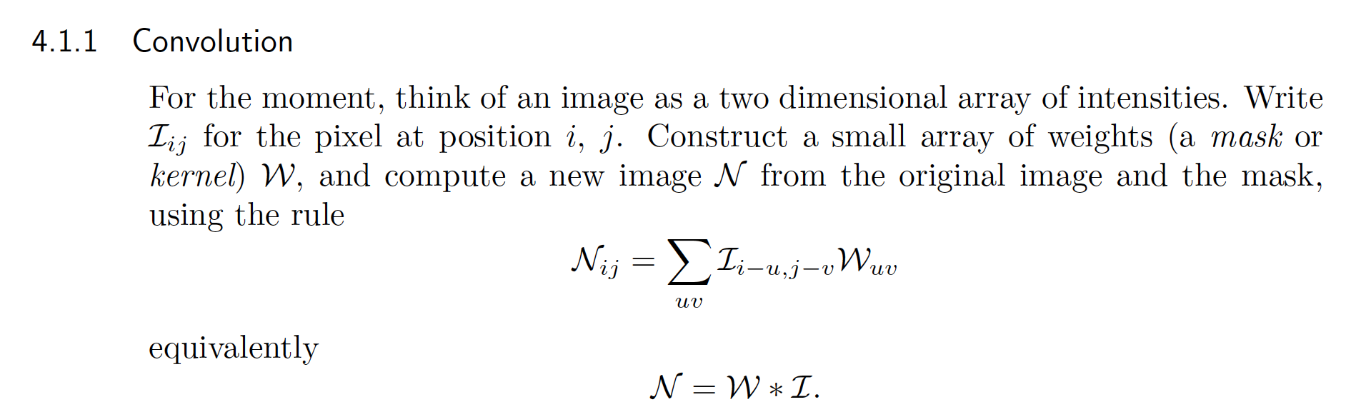
Some definitions
Discrete convolution
In these slides, I really am talking about convolution
(not correlation or filtering – matters for unit impulse)

Slide 3


Some definitions
Continous convolution
In these slides, I really am talking about convolution
(not correlation or filtering – matters for unit impulse)

Slide 4
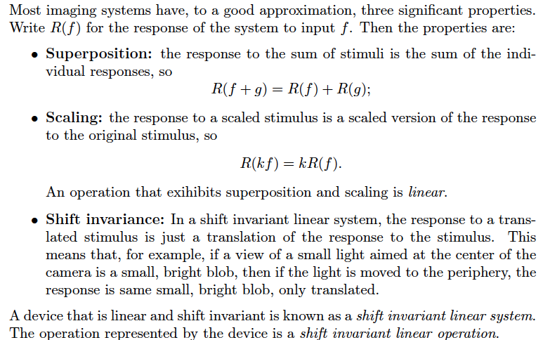
Some definitions

Slide 5
Example: a lens
Superposition: yes
Scaling: yes
So linear
Shift invariant: yes
  (ish – think about the edges of the field of view)

Slide 6
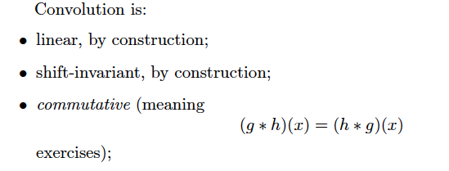
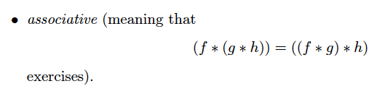
Properties

Slide 7
Important facts
A shift invariant linear operator is equivalent to a convolution
  In all cases
    Discrete 1D
    Discrete 2D
    Discrete ND
    Continuous 1D
    Continuous 2D
    Continuous ND
Interesting thought experiment:
  Differentiation in 1D is linear and shift invariant – what is the convolution kernel
  Discrete – easy
  Continuous – bit weird, but fairly easy

Slide 8
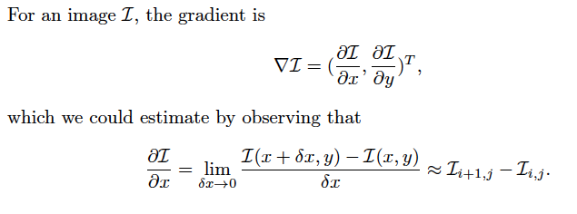
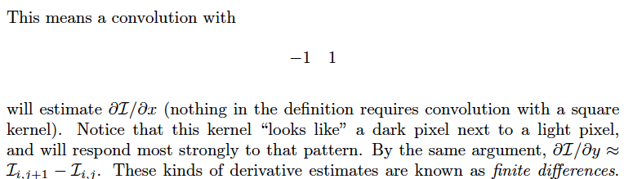
Applications: Gradient estimates

Slide 9
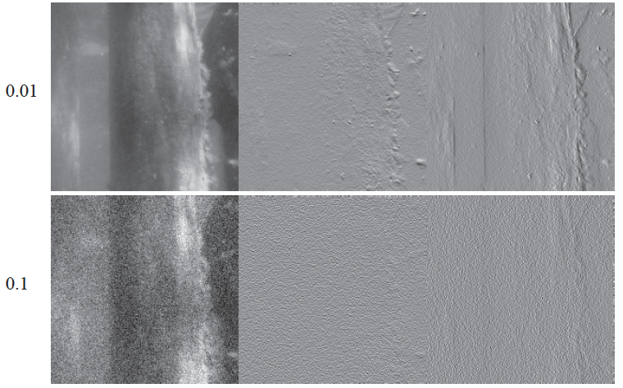
Finite differences are overexcited by noise

Slide 10
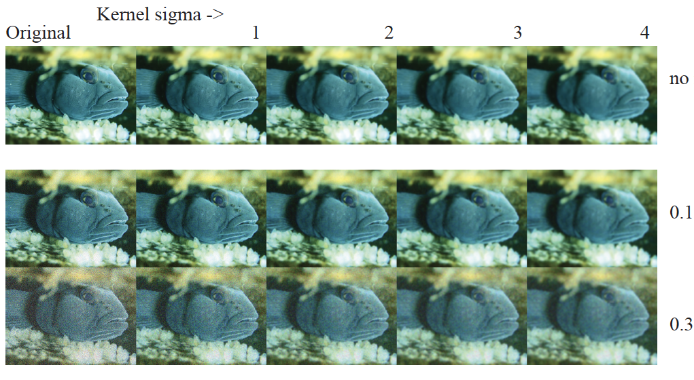
Gaussian smoothing of Gaussian noise

Slide 11
So…
Suppress noise by smoothing image
Then convolve with derivative
Two convolutions – but convolution is associative

Slide 12
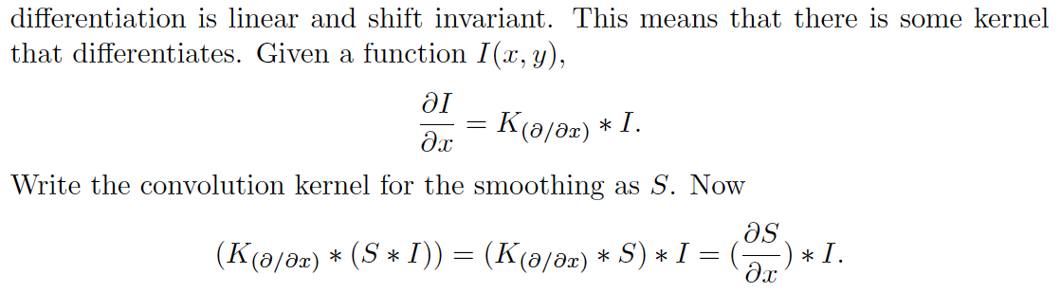
Application: Derivative of Gaussian Filters

Slide 13
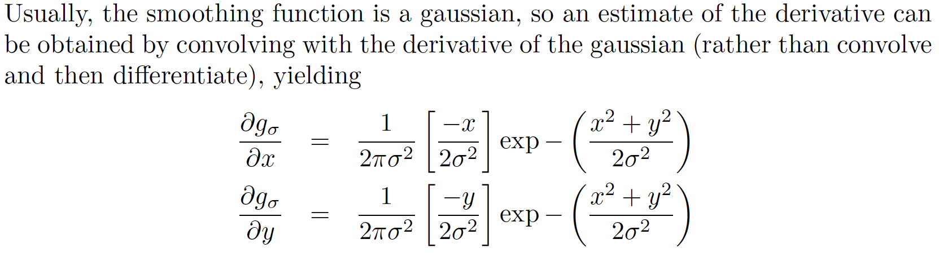
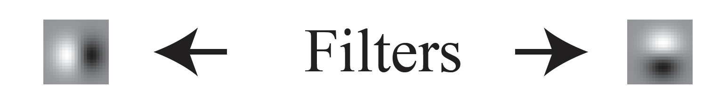
Derivative of Gaussian Filters

Slide 14
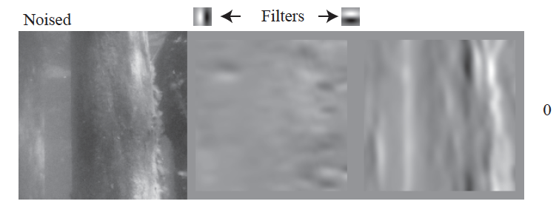

Slide 15
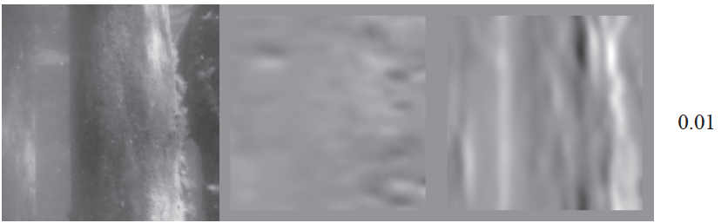

Slide 16
DOG filters are not excited by noise

Slide 17
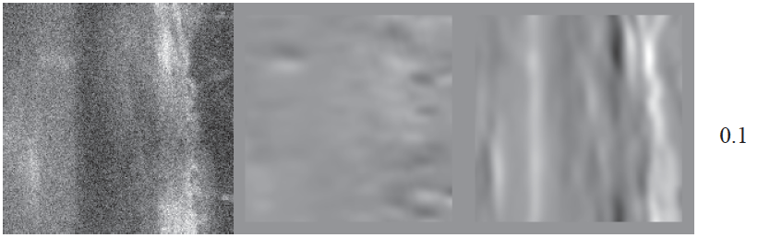

Slide 18
DOG filters are not excited by noise

Slide 19
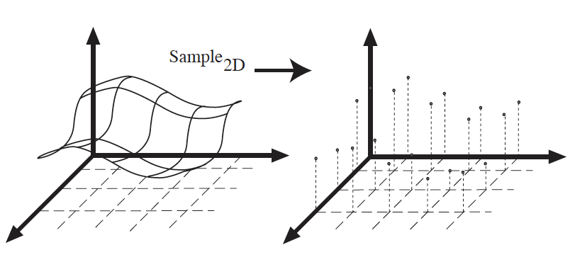
Sampling

Slide 20
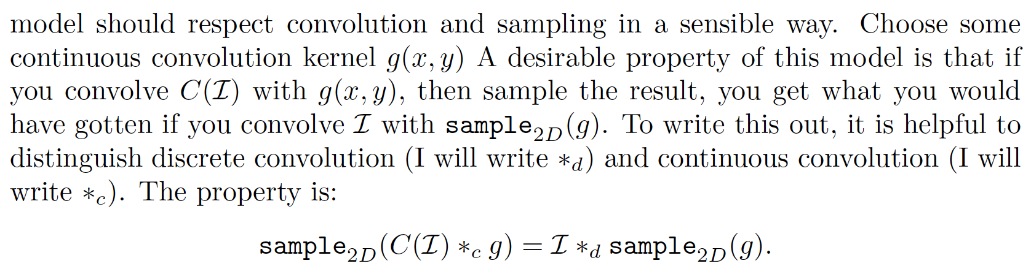
But…
How to represent the sampled signal as a continuous function?
Continuous convolution
Discrete convolution
Continuous model of sampled image
Discrete image

Slide 21
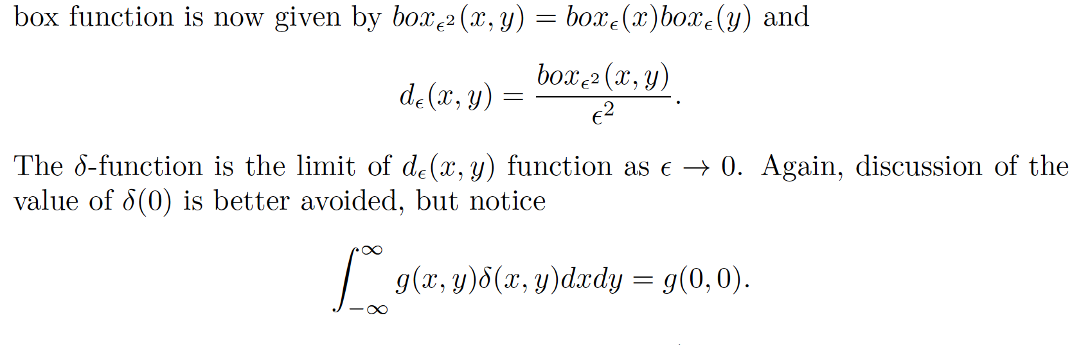
The delta function

Slide 22
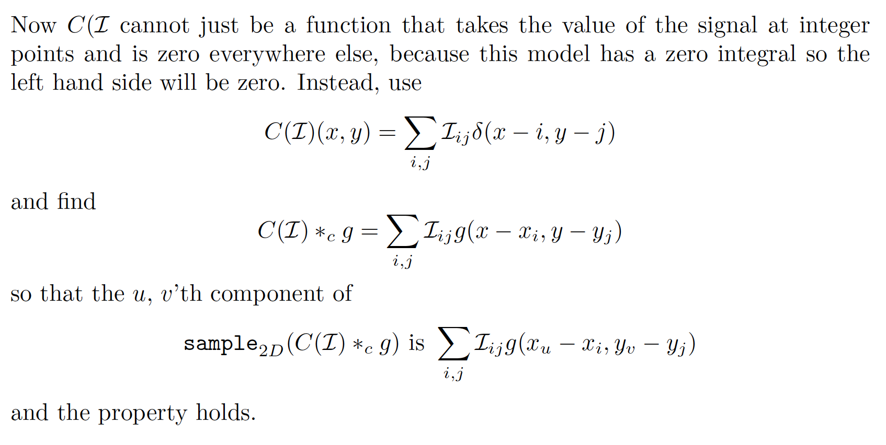
The right continuous model of a sampled signal

Slide 23
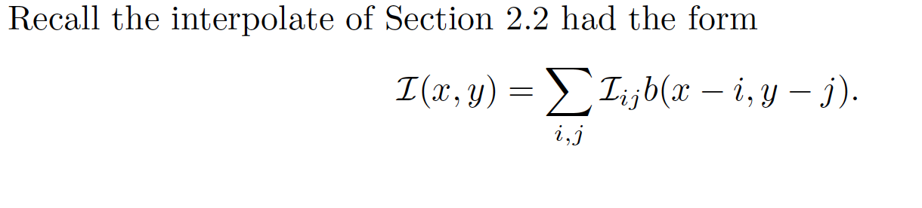
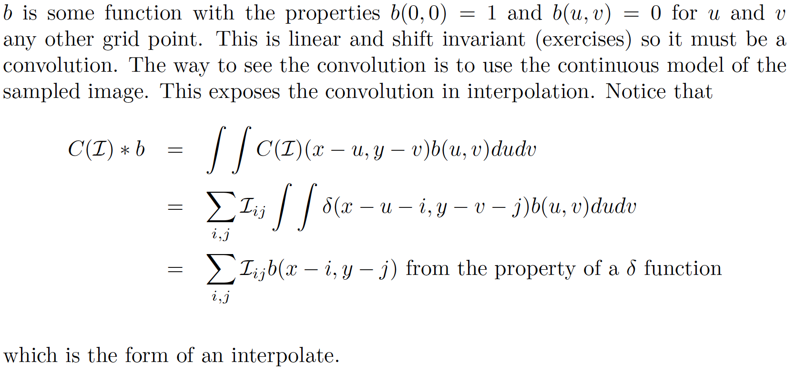
Interpolation

