Slide 1
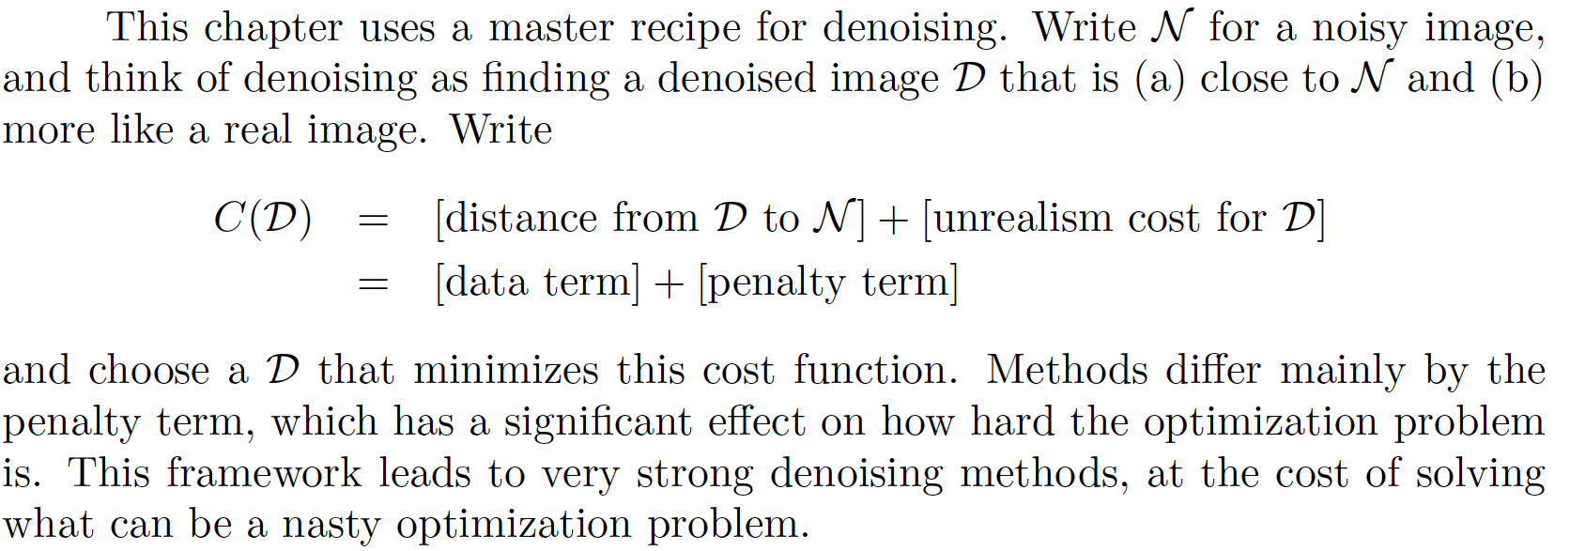
Denoising Images using Optimization

Slide 2
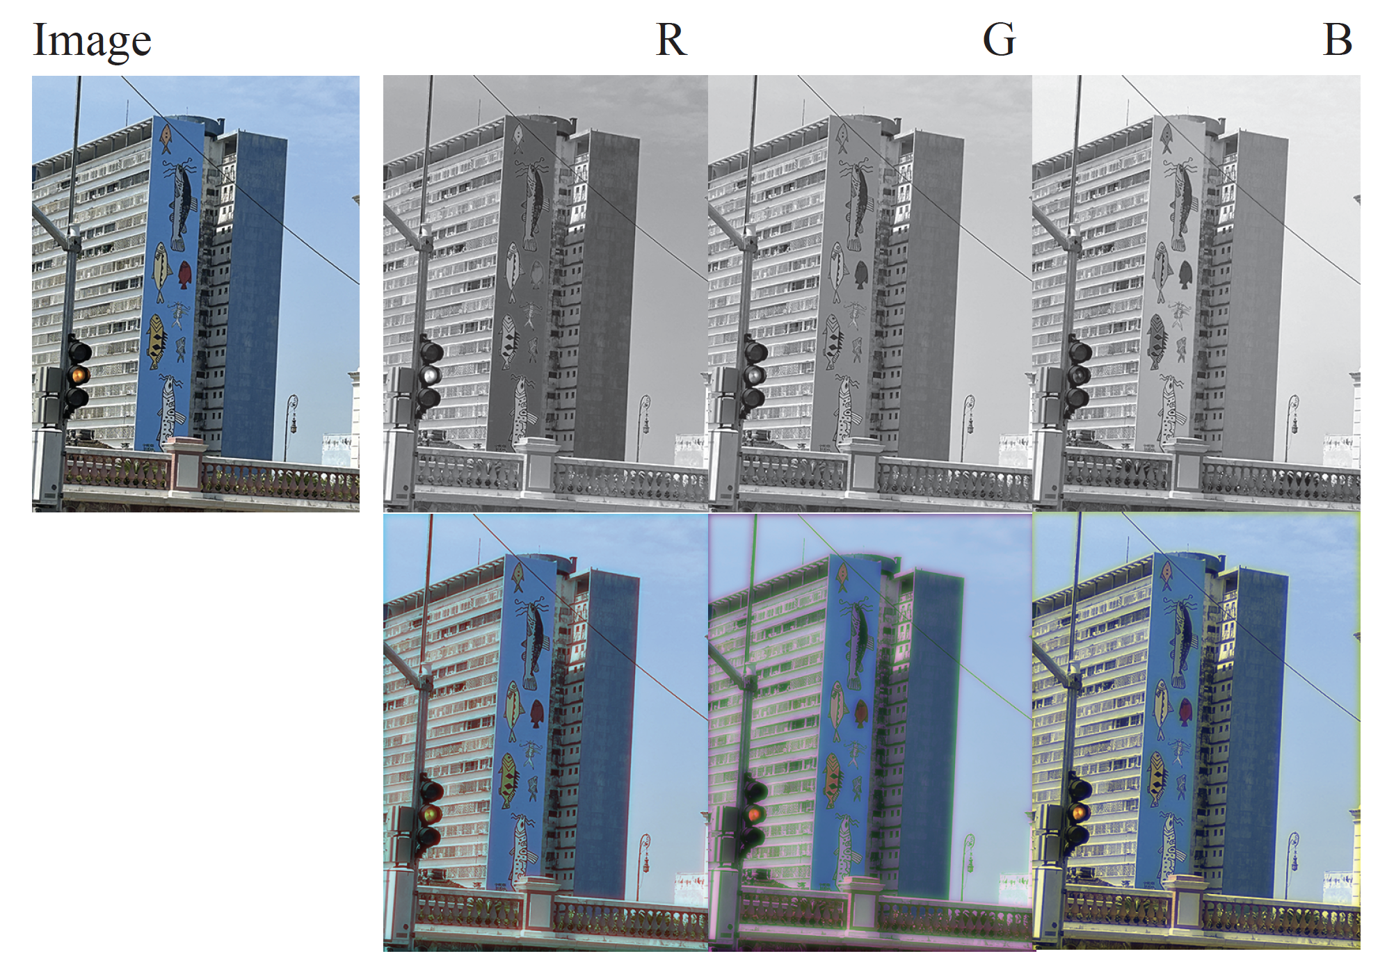
Color images – R, G, and B are strongly correlated

Slide 3
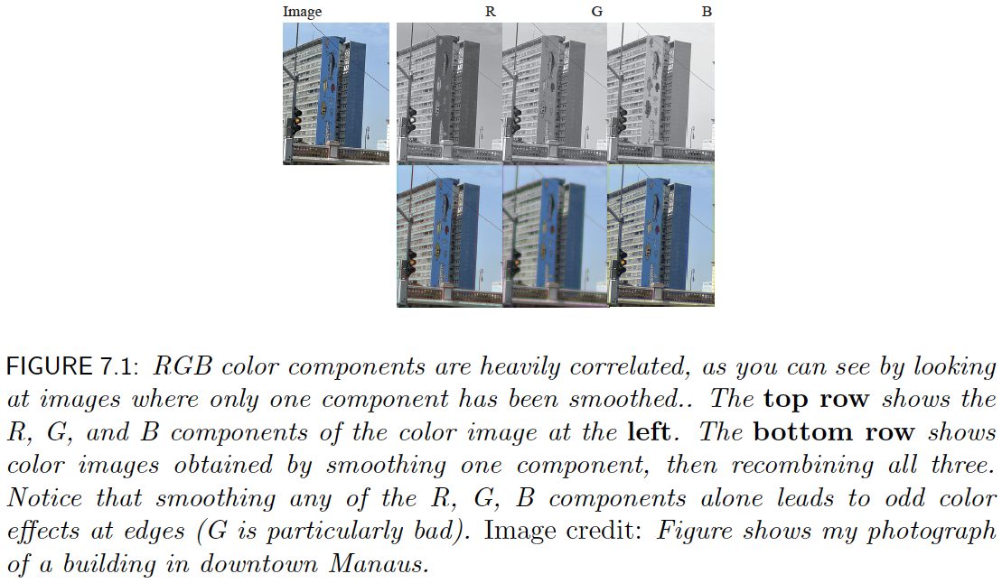
Color images – R, G, and B are strongly correlated

Slide 4
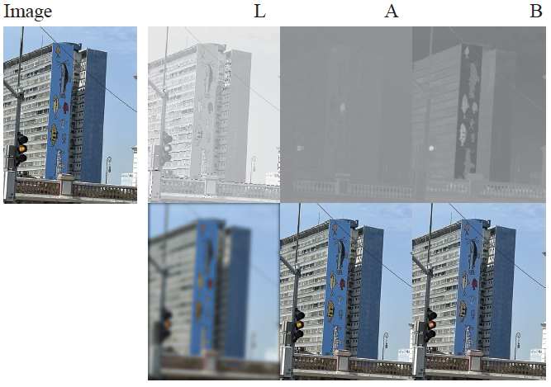
LAB and smoothing

Slide 5
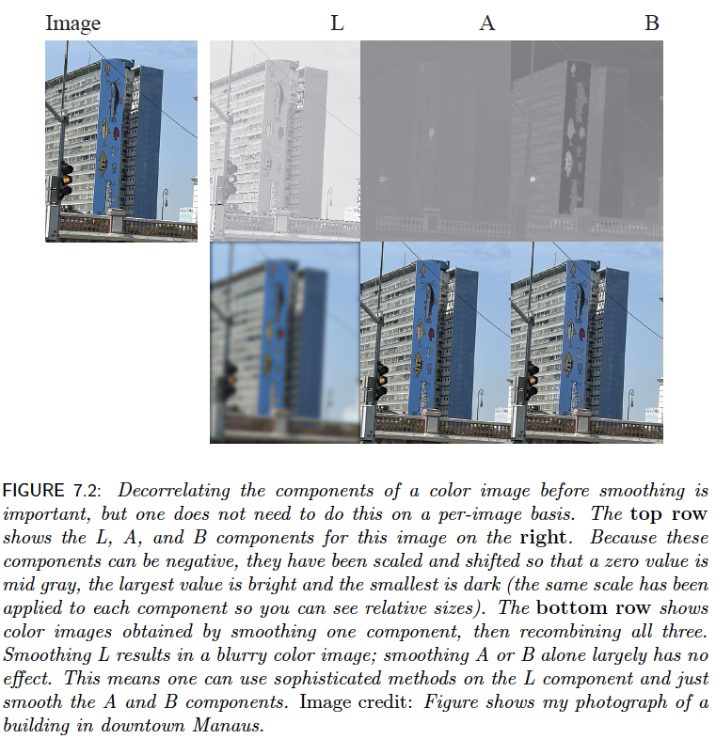

Slide 6
This means you can
Convert to LAB
Apply sophisticated denoising to L
Smooth A, B
Convert back

Slide 7
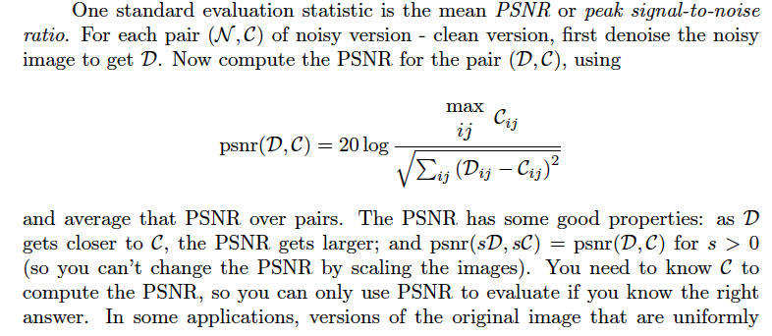
Evaluation: PSNR

Slide 8
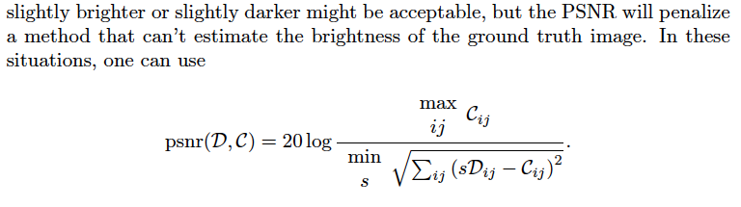
Scaled PSNR

Slide 9
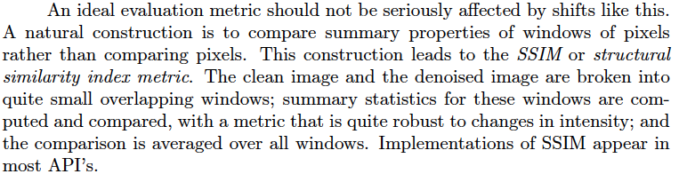
SSIM
PSNR doesn’t account for small shifts, etc

Slide 10
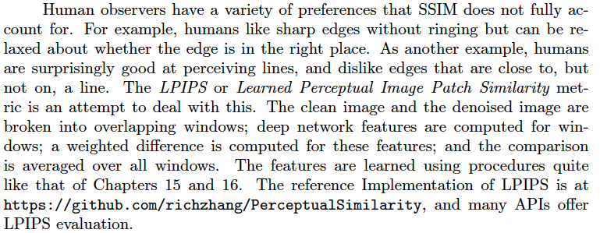
LPIPS

Slide 11
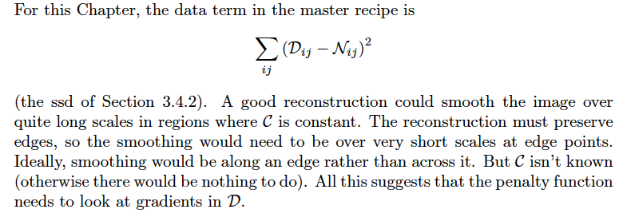
Denoising by weighted least squares - I

Slide 12

Denoising by WLS - II
Straighten
noisy image N into vector n
reconstructed image U into vector u
Cost becomes

Slide 13
Denoising by WLS - III
Idea:
reconstructed image should have large gradients only where there is strong evidence in support
(version of ”pixels are like their neighbors”)
Strong evidence:
Use DOG filters to get smoothed gradient of noisy image
Where this is big, gradients in reconstruction should be cheap

Slide 14
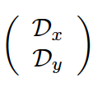
Denoising by WLS - IV
Differentiation is linear, so can write matrices so that gradient of u is given by
What comes out is stacked x and y derivatives
u

Slide 15
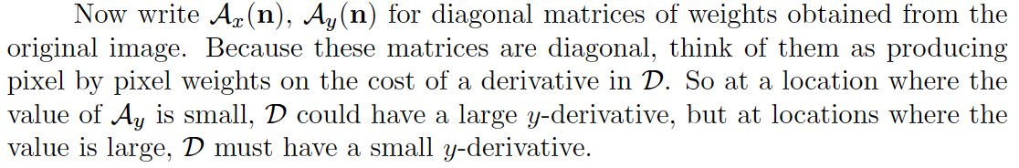
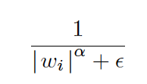
Denoising by WLS -V
Weights could be
Where w_i is either x or y derivative at i’th location, eps is small

Slide 16
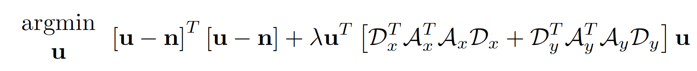
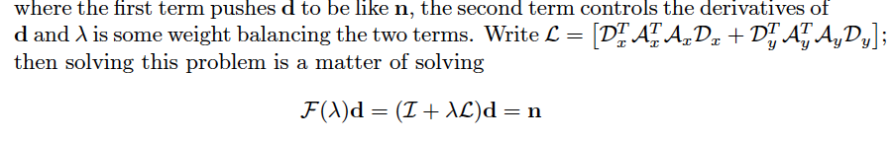
Denoising by WLS - VI
Be close to noisy image
Have big derivatives only if good evidence

Slide 17
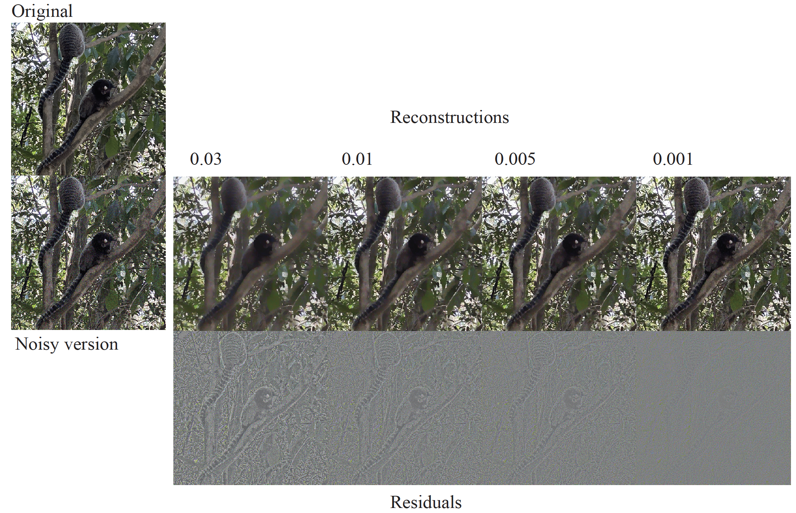

Slide 18

Norms - I
Q: how to measure the ”size” of the penalty?

Slide 19
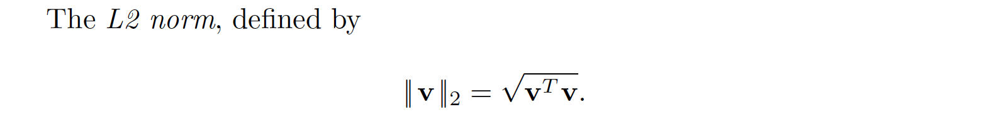
Norms -II
This is squared L2 norm (of what?)

Slide 20
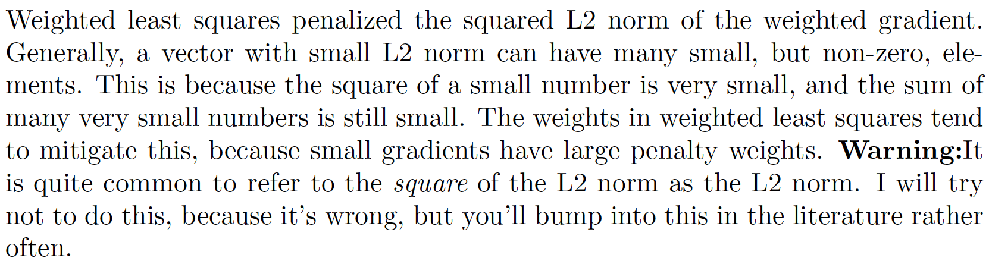
Norms - III

Slide 21
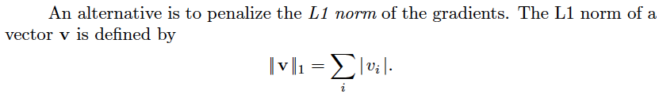
The L1 Norm

Slide 22
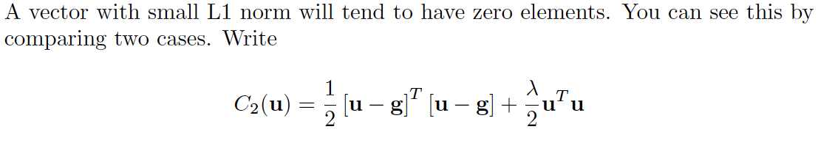
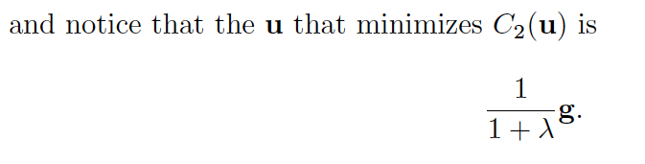
Behavior of L2 norm
Notice – even if lambda is very big, g ISN’T zero
(it’s just small)

Slide 23
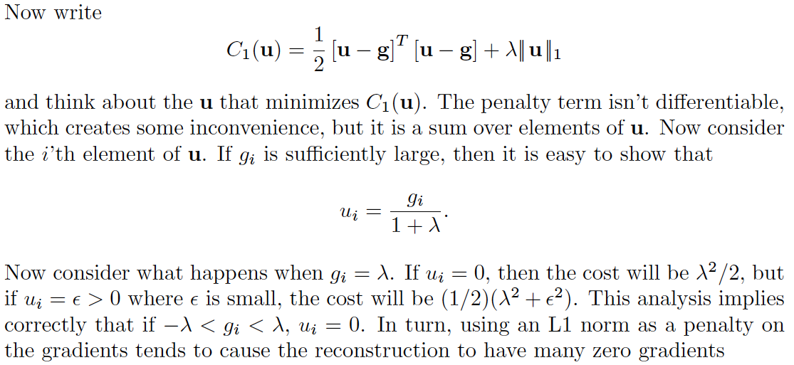
Behavior of L1 norm
The L1 norm encourages g to have zeros in it!

Slide 24
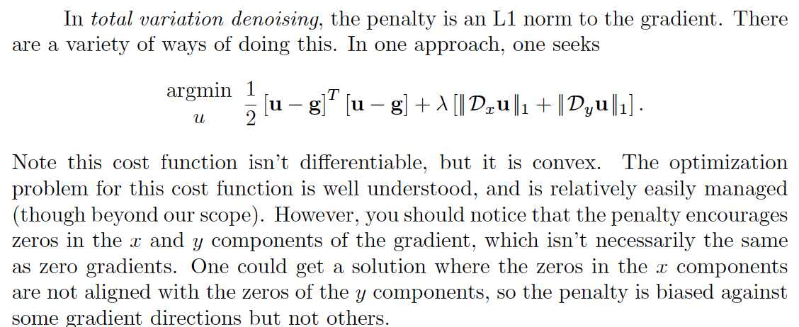
Total variation denoising - I

Slide 25
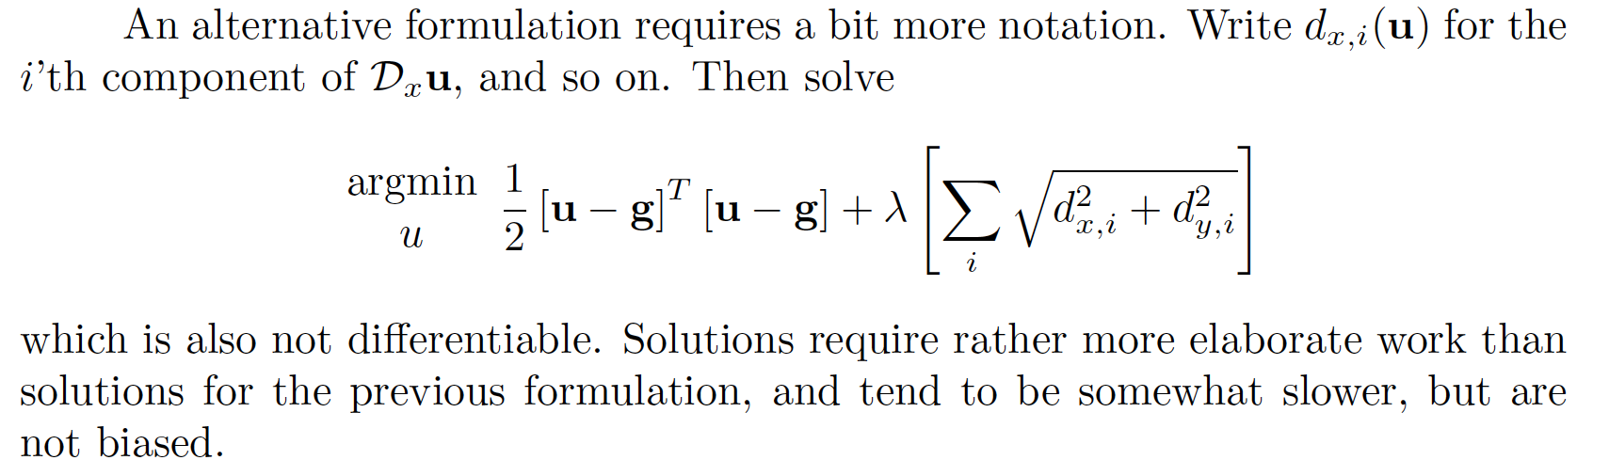
Total variation denoising - II

Slide 26
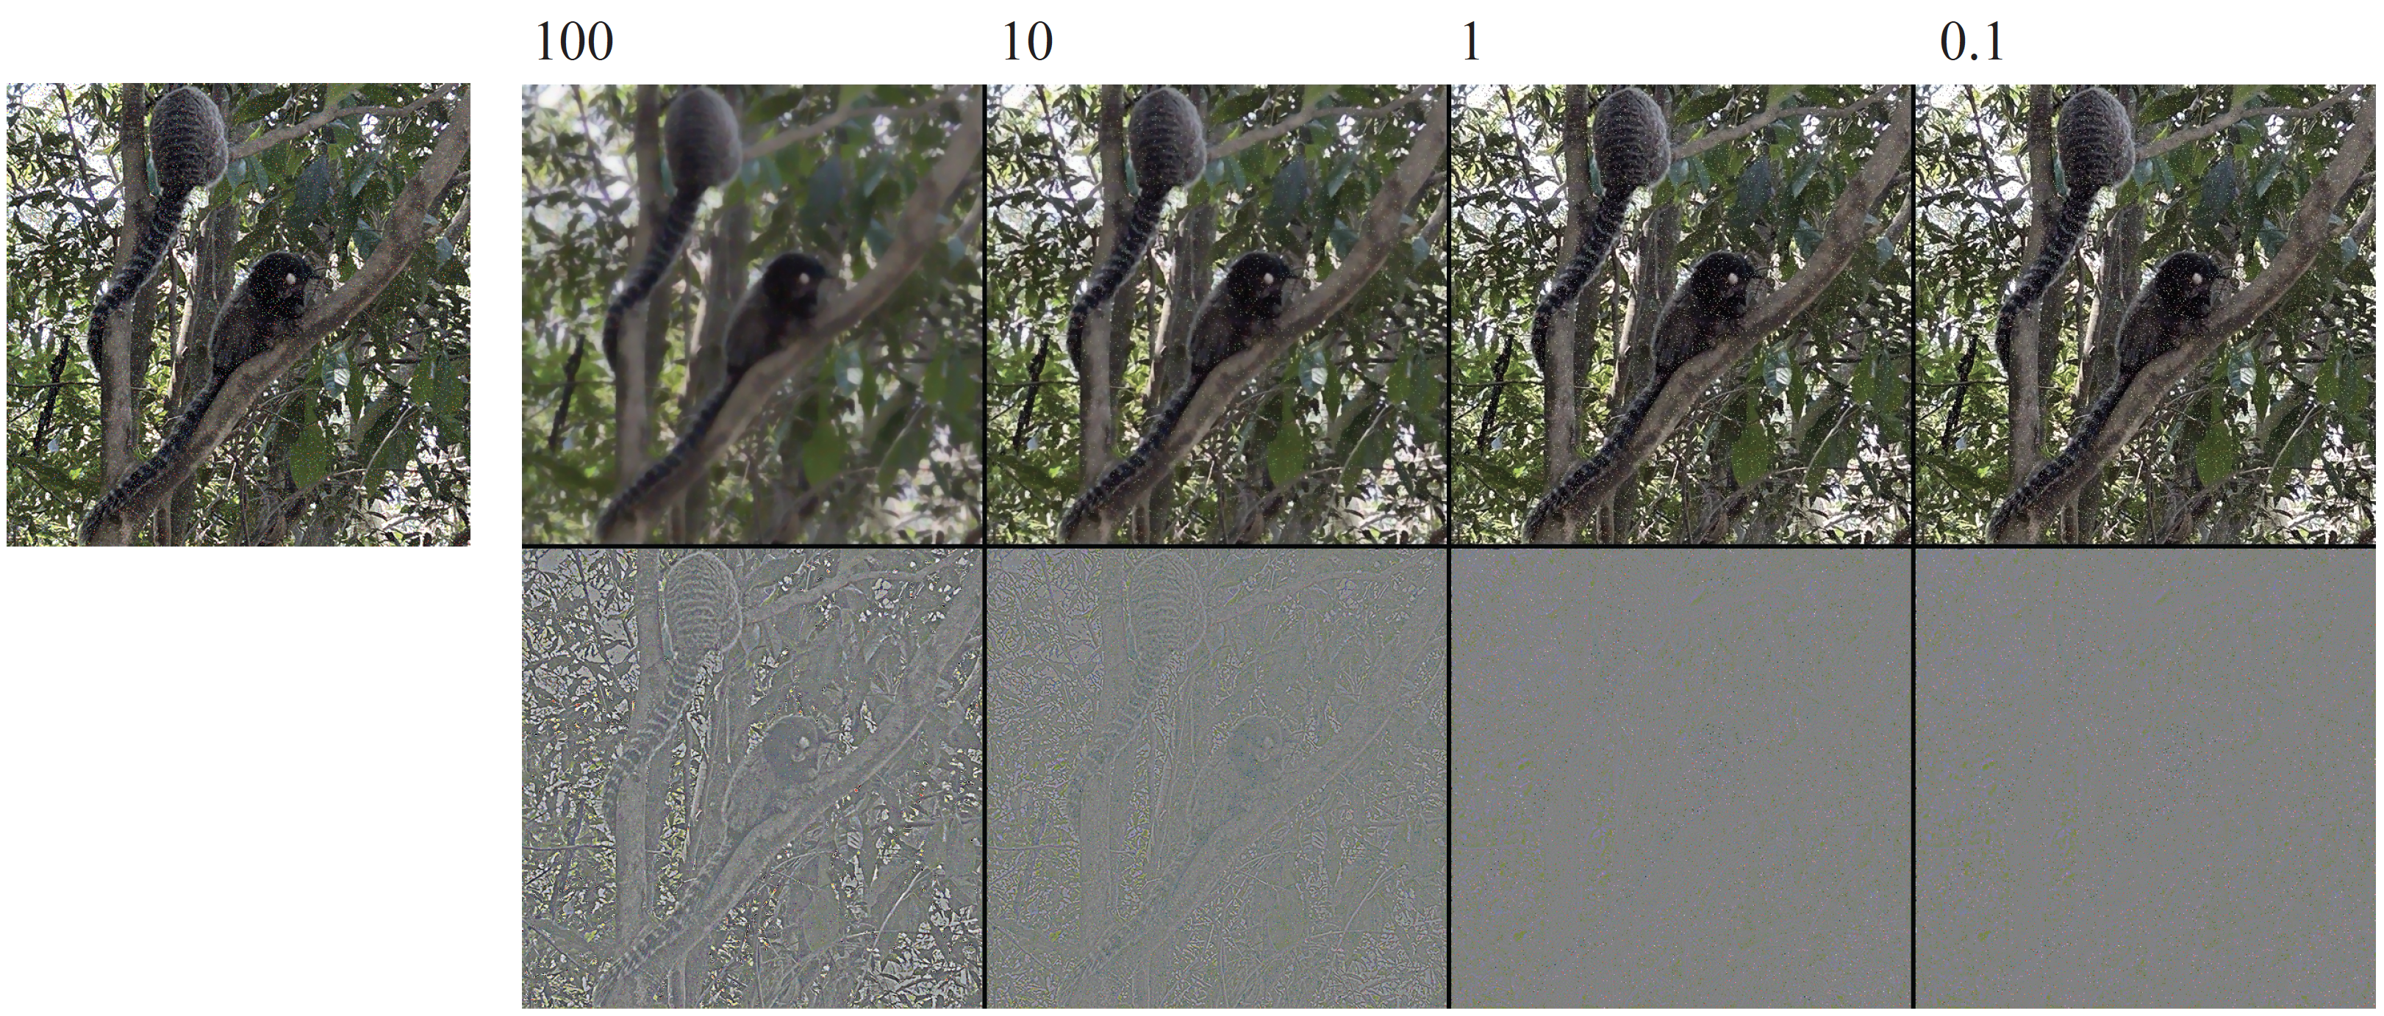

Slide 27
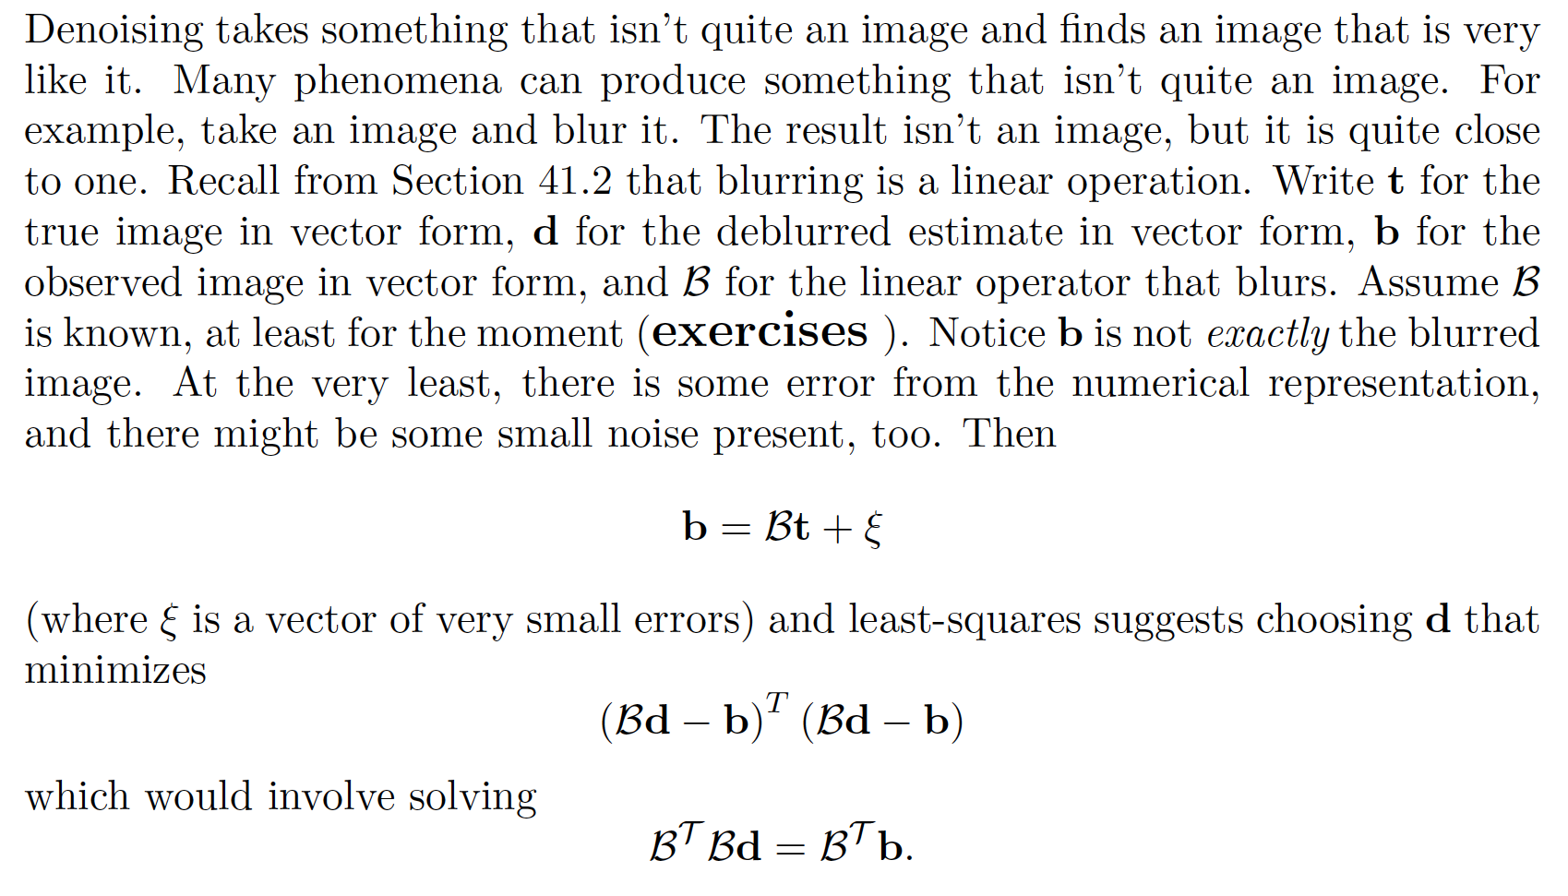
Deblurring - I

Slide 28
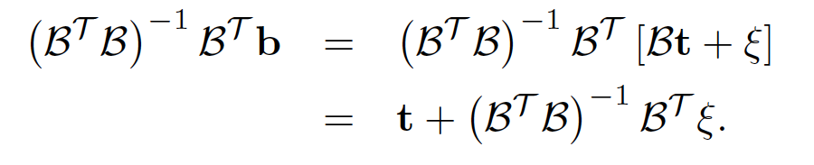
Deblurring - II
But this has some really big eigenvalues!

Slide 29
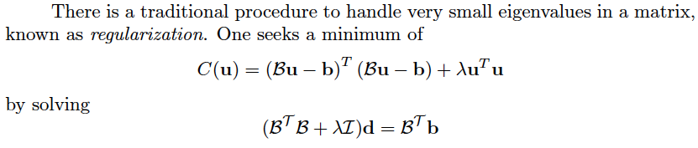
Regularization

Slide 30
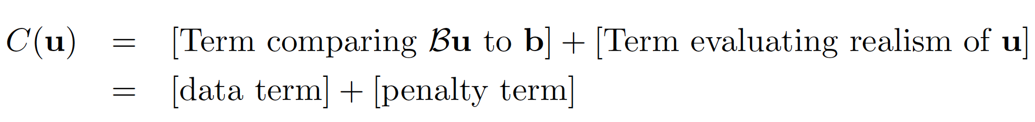
MLS and TVD
Penalty term we used before for MLS or TVD

Slide 31
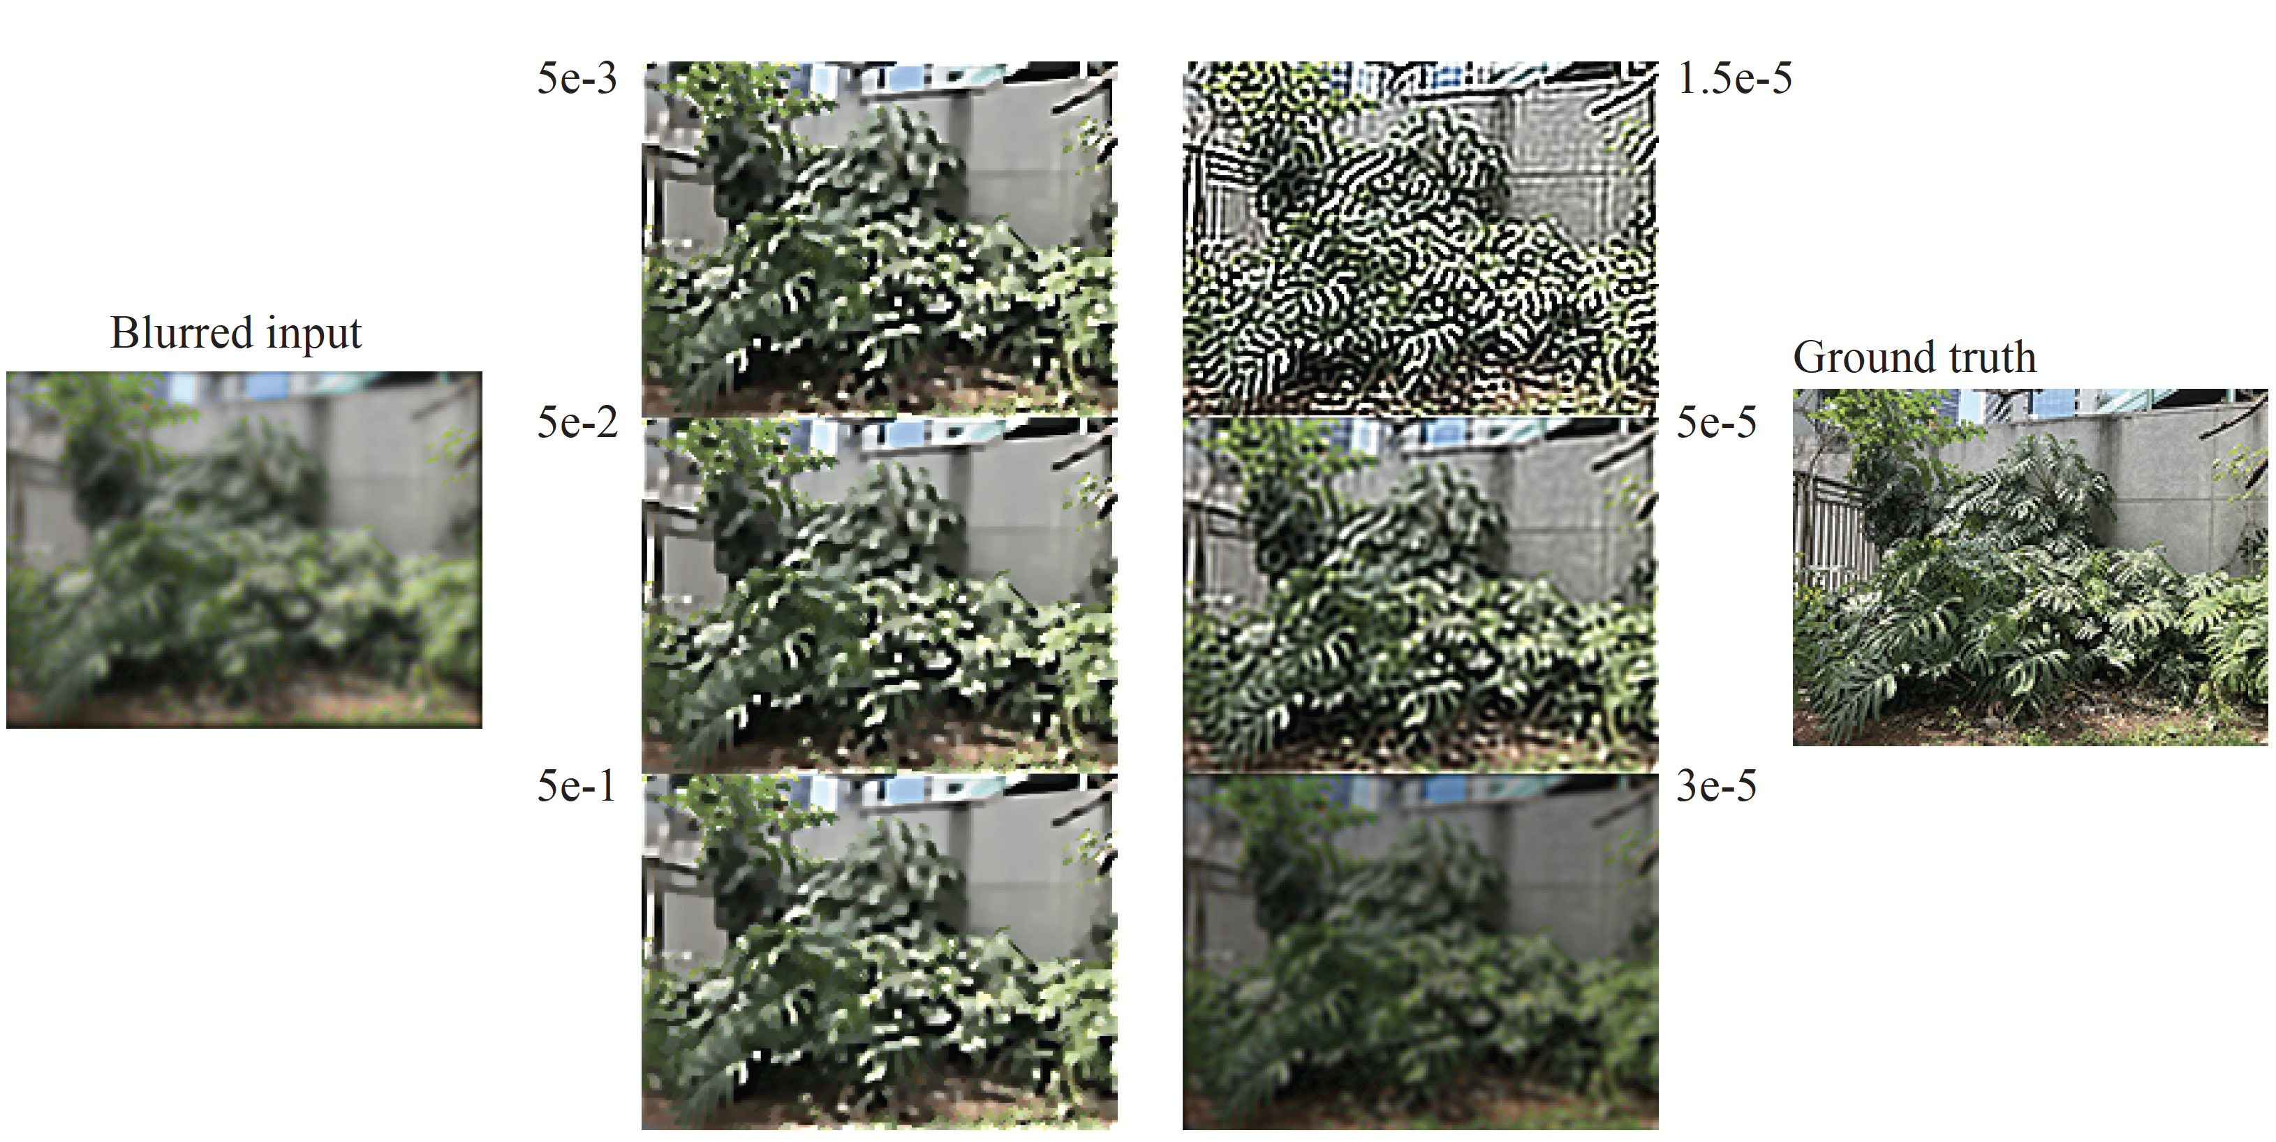
Regularized
WLS

Slide 32
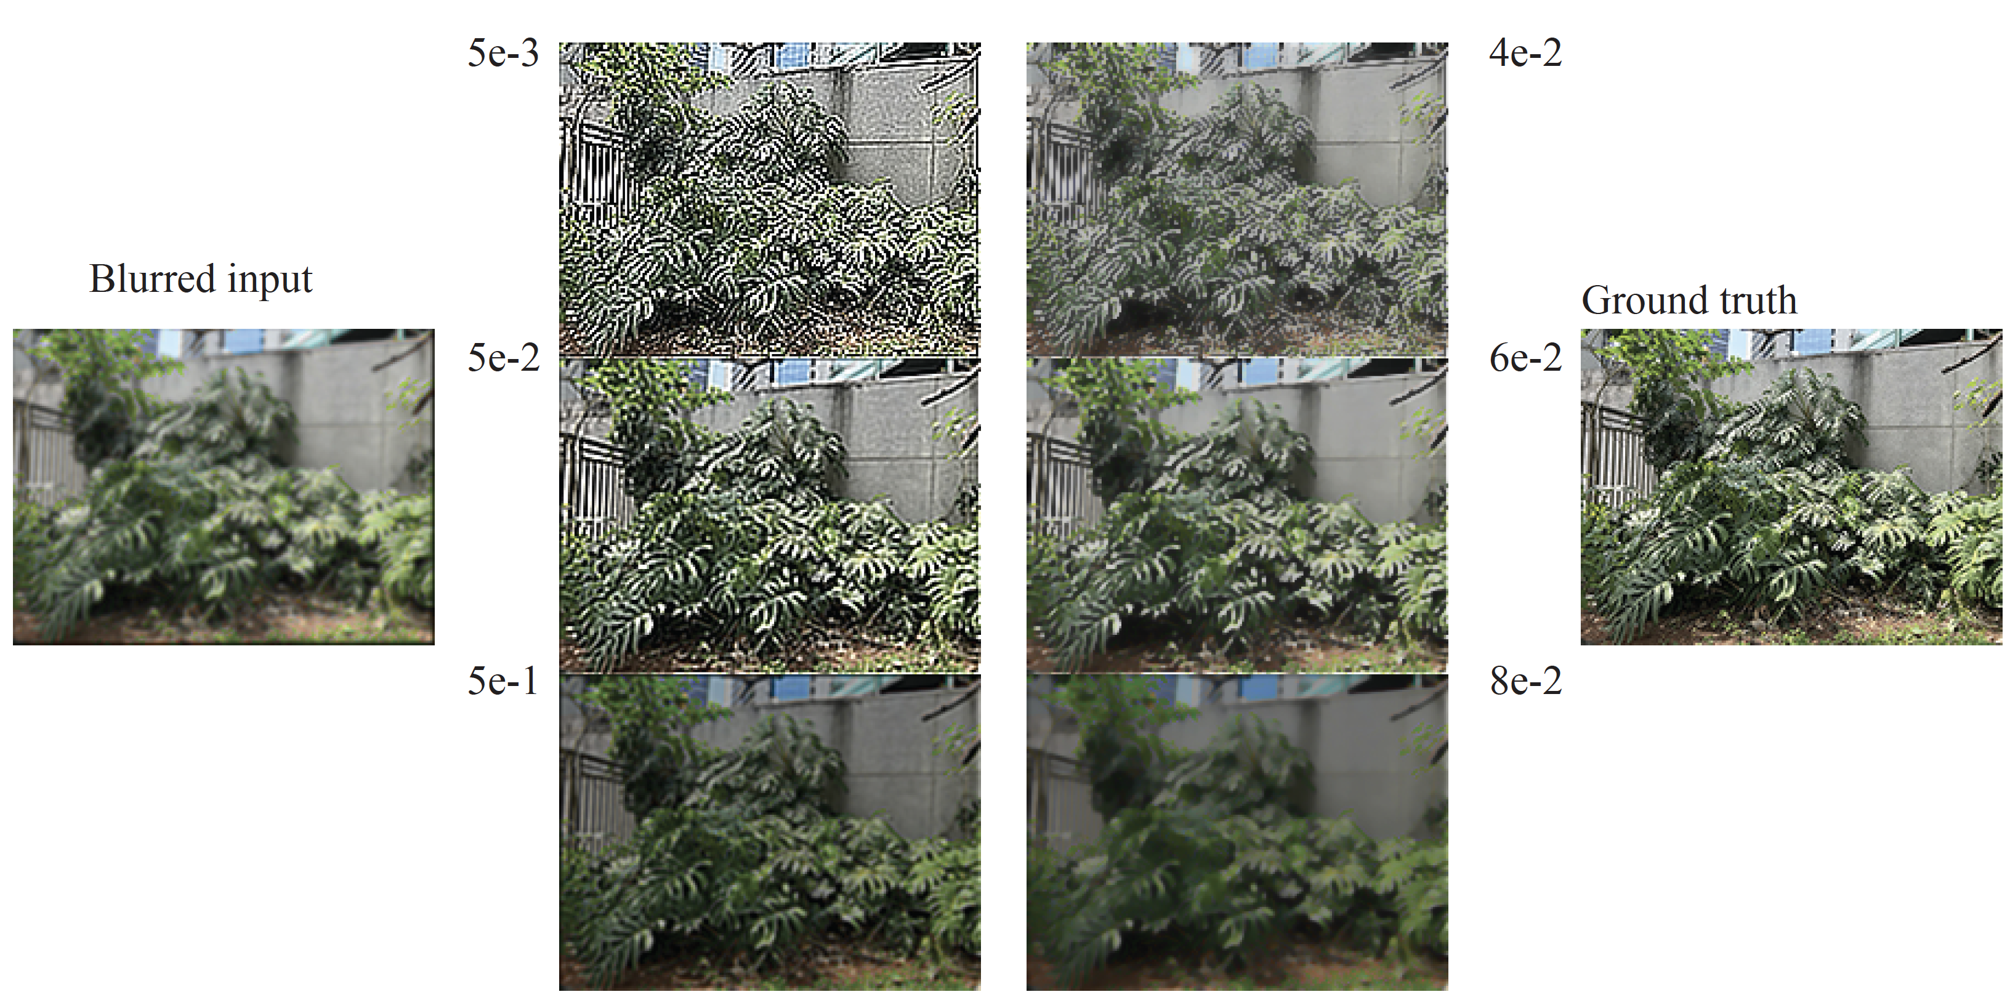
Regularized
TVD

Slide 33
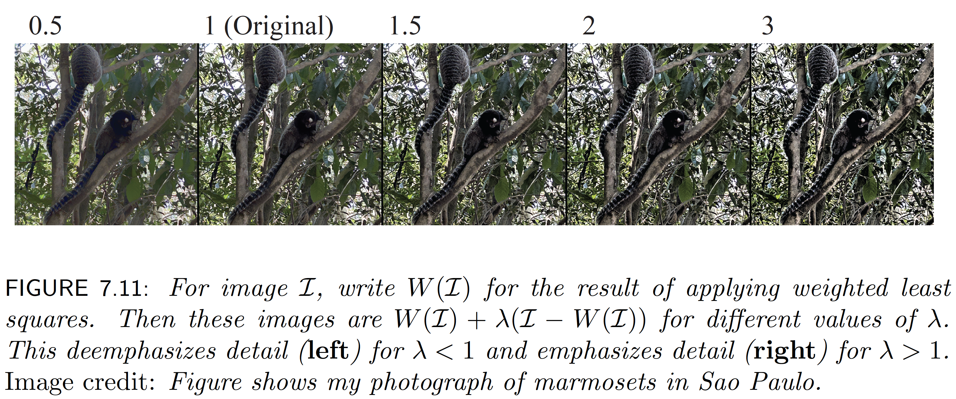
Adding detail with WLS

Slide 34
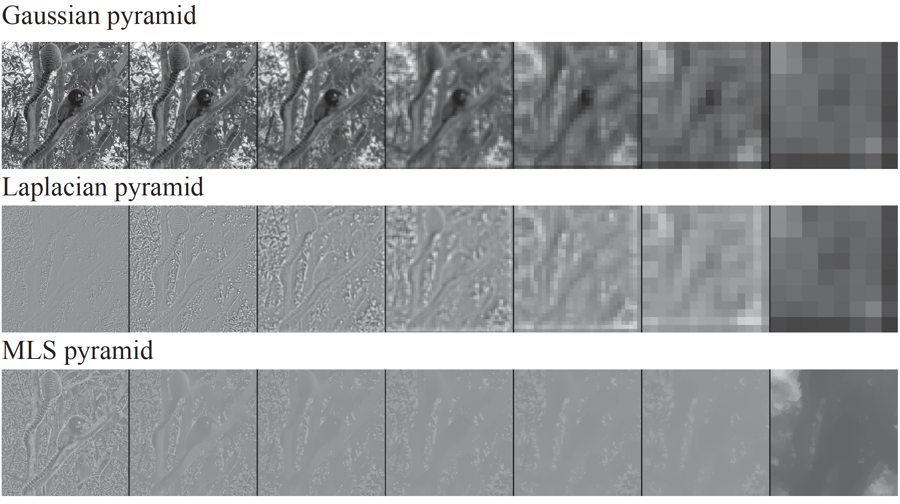
Trend and detail representations

