Slide 1
A gentle introduction to Fourier analysis
Image source
Many slides borrowed from S. Seitz, A. Efros, D. Hoiem, B. Freeman, A. Zisserman

Slide 2
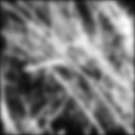

Mystery 1
Why does filtering with a Gaussian give a nice smooth image, but filtering with a box filter gives artifacts?
Gaussian
Box filter
Notes:
Things we can’t understand without thinking in frequency
2

Slide 3
Mystery 2
Why can downsampling sometimes lead to aliasing?

Slide 4
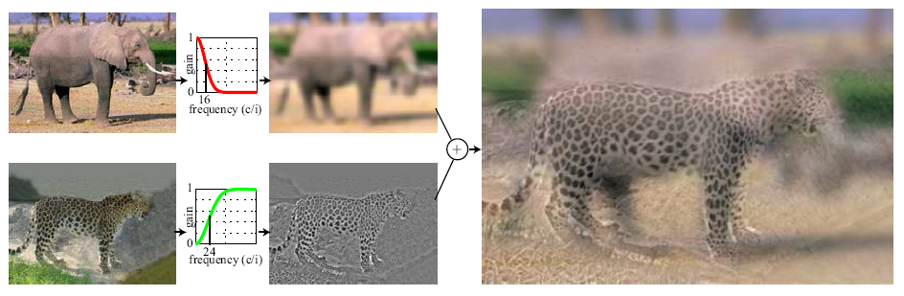
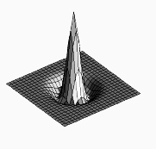
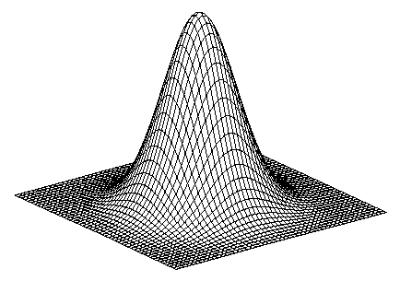
Mystery 3
How do hybrid images work?
“Low frequencies”
“High frequencies”
A. Oliva, A. Torralba, P.G. Schyns, Hybrid Images, SIGGRAPH 2006

Slide 5
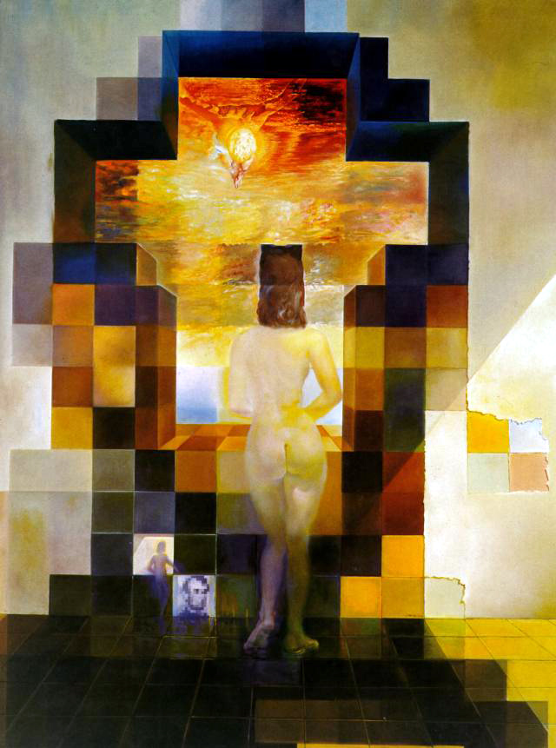
Salvador Dali
“Gala Contemplating the Mediterranean Sea,
which at 30 meters becomes the portrait
of Abraham Lincoln”, 1976

Slide 6
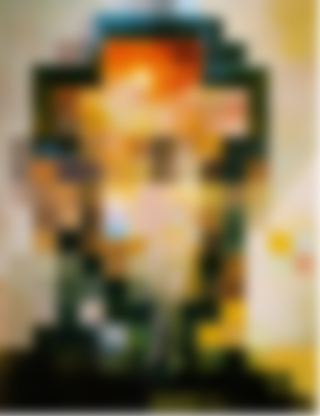

Slide 8
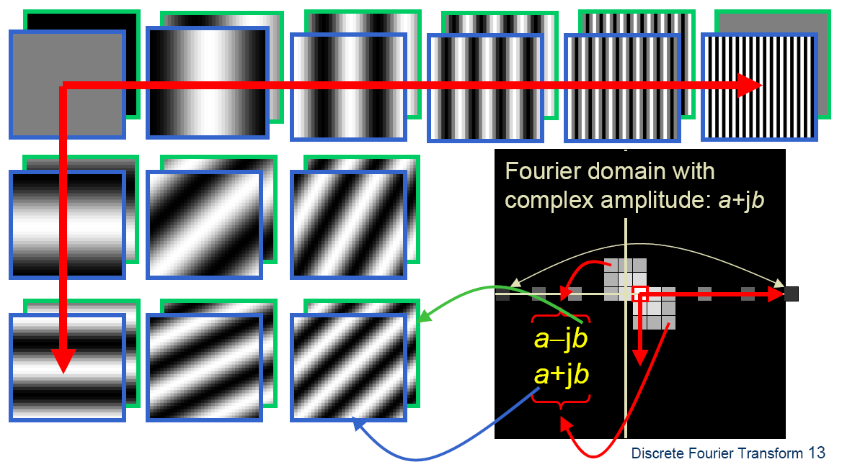

Fourier analysis
To understand such phenomena, we need a representation of images that allows us to tease apart slow and fast changes

Slide 9
Outline
Fourier series
1D Fourier transform
  Definition and properties
  Discrete Fourier transform
2D Fourier transform
  Definition
  Examples and properties
Convolution theorem
Understanding the sampling theorem

Slide 10
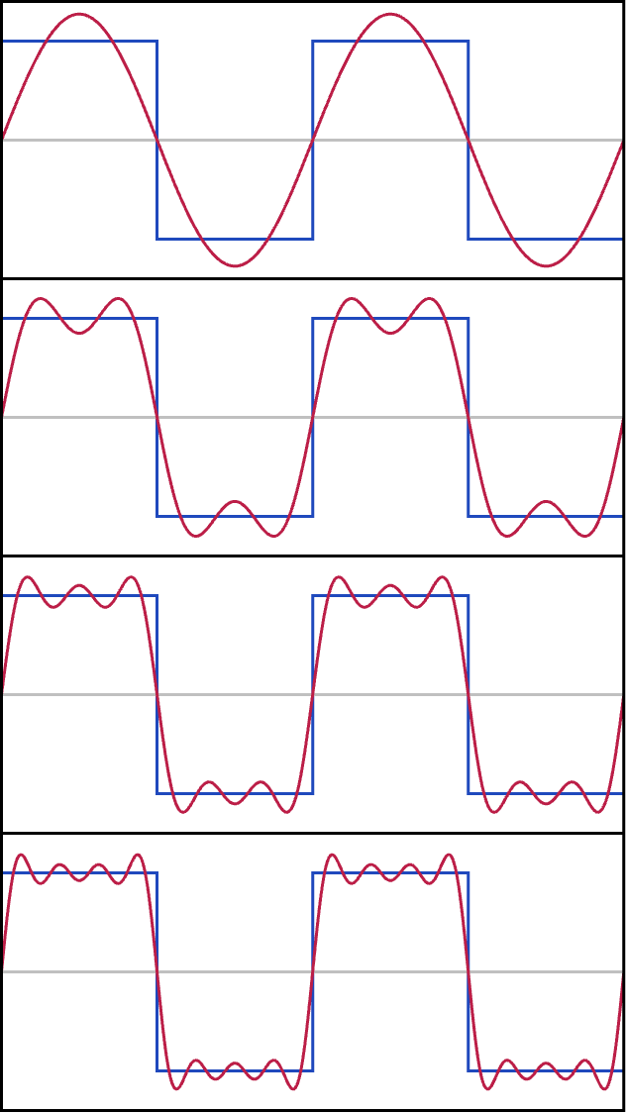
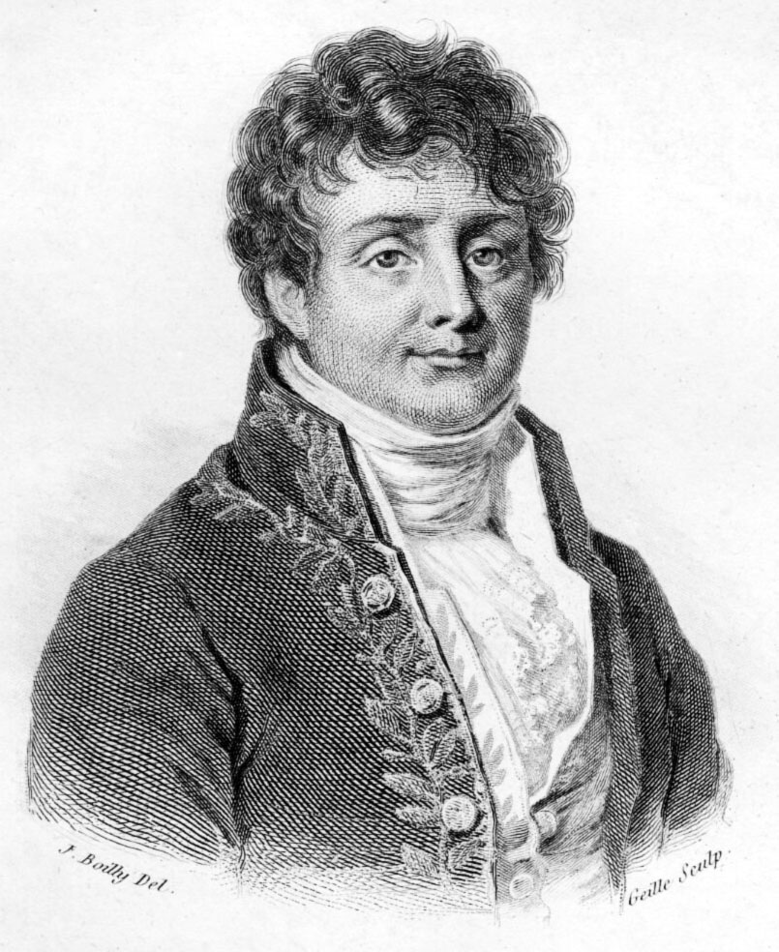
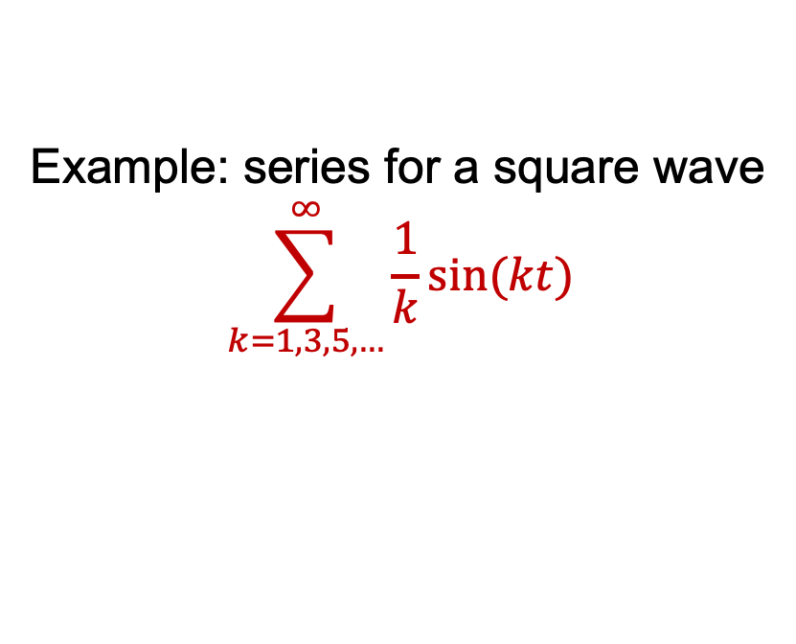
Fourier series
Any(**) periodic function on
[0, 1] can be expressed as a weighted sum of sinusoids of different frequencies (1807)
Example: series for a square wave
$$\sum_{k=1,3,5,…}^{∞}{\frac{1}{k}sin⁡(kt)}$$
**=bunch of
important details
here
Periodic means f(0)=f(1)
Jean-Baptiste Joseph Fourier (1768-1830)
Image: Wikipedia

Slide 11
Fourier series
Generally, we have for a (reasonable) periodic f(t)
And we need to figure out the weights for a given f(t).

Slide 12
Fourier series: useful facts
Fact 1
Fact 2
Fact 3

Slide 13
Fourier series: using facts
If:
(fact 1 makes all the cosine/sine terms go away!)
(fact 2 makes all the other terms go away!
And fact 3 sets the scale)

Slide 14
Fourier series: issues
A’s and B’s are inelegant -> complex exponentials
Did NOT show that the series converges to the function
  Read Korner’s wonderful book Fourier Analysis
  We’re OK for anything we care about
In principle, we can go forward
  Function -> A’s, B’s
Or backward
  A’s, B’s -> Function
Is this right? (mostly yes, but details…)

Slide 15
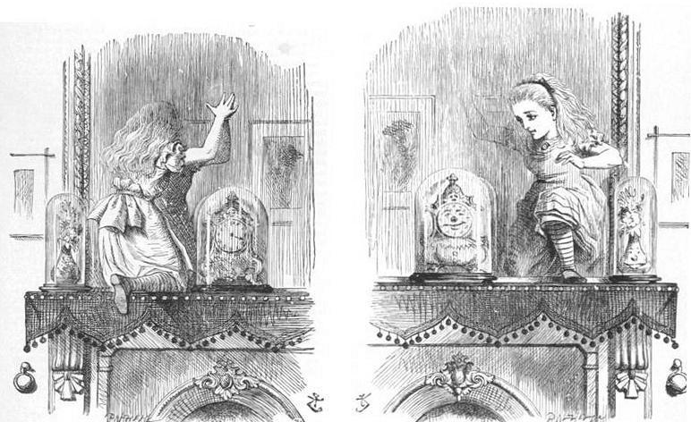
Complex exponentials
This i is the square root of -1 !!!
Advantage:
if the function is complex, can represent cleanly
don’t need to remember which is A, which B

Slide 16
Complex exponentials: compact facts
k, n integers
This minus sign matters!

Slide 17
Fourier series with complex exponentials: using fact
If:
Using the fact! (this is analogous
to an orthonormal basis in linear
algebra)

Slide 18
Fourier series with complex exponentials: issues
But this is just for a periodic function on [0, 1]
  Easy to extend to other intervals
  Easy to extend to the circle
But what about functions on [-infinity, infinity]?
  These could wiggle often in numerous places
  IDEA: use “more” basis elements
The Fourier transform

