Slide 1
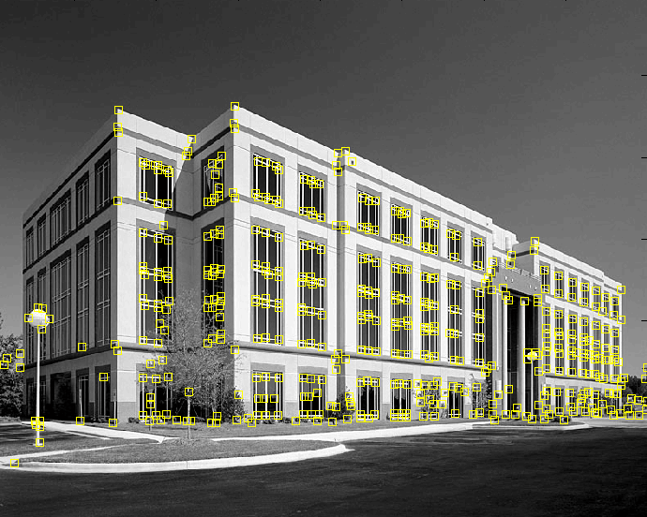
Corner detection
9300 Harris Corners Pkwy, Charlotte, NC

Slide 2
Outline
Keypoint detection: Motivation
Deriving a corner detection criterion
The Harris corner detector
Invariance properties of corners

Slide 3
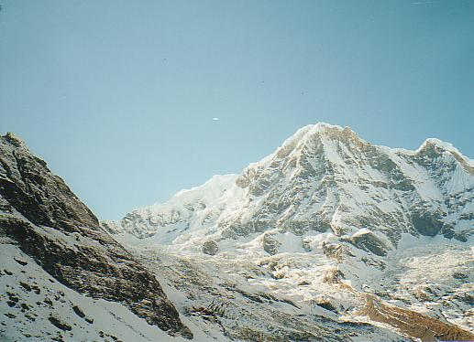
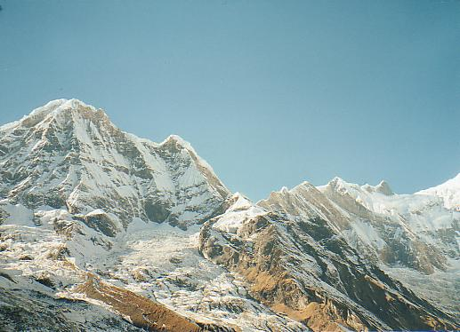
Why extract keypoints?
Motivation: image alignment
  We have two images – how do we combine them?

Slide 4
Why extract keypoints?
Motivation: image alignment
  We have two images – how do we combine them?

Slide 5
Why extract keypoints?
Motivation: image alignment
  We have two images – how do we combine them?

Slide 6


Why extract keypoints?
Motivation: image alignment
  We have two images – how do we combine them?
Step 1: extract keypoints
Step 2: match keypoint features

Slide 7
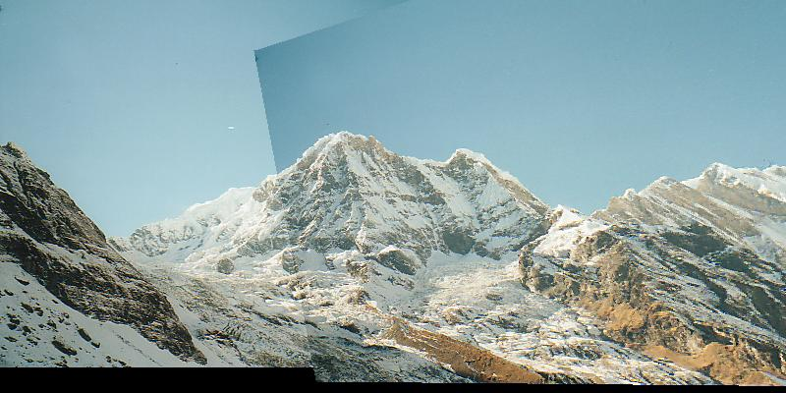
Why extract keypoints?
Motivation: image alignment
  We have two images – how do we combine them?
Step 1: extract keypoints
Step 2: match keypoint features
Step 3: align images

Slide 8
Keypoint representations support very fast methods
In some applications, GPU just isn’t available
-too heavy; too much power; etc
And there isn’t much CPU either
Idea: reduce image to keypoints, work with those

Slide 9
Need to find
Where is it:
What scale its at:
What orientation its at:
In a way that is (mostly) unaffected by
image transformations

Slide 10
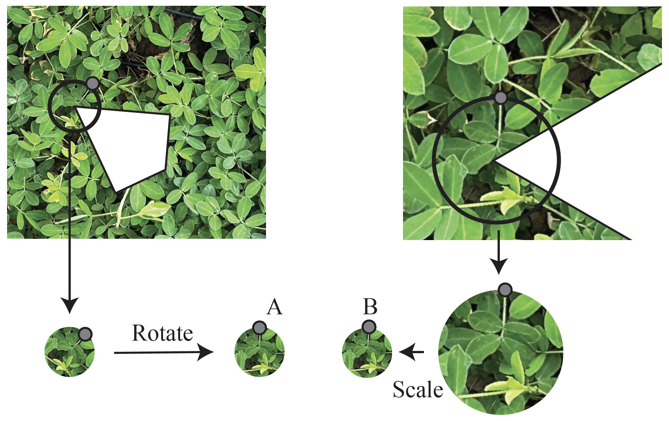

Slide 11
Need to find
Where is it:
What scale its at:
What orientation its at:
Description of contents:
In a way that is (mostly) unaffected by
image transformations

Slide 12
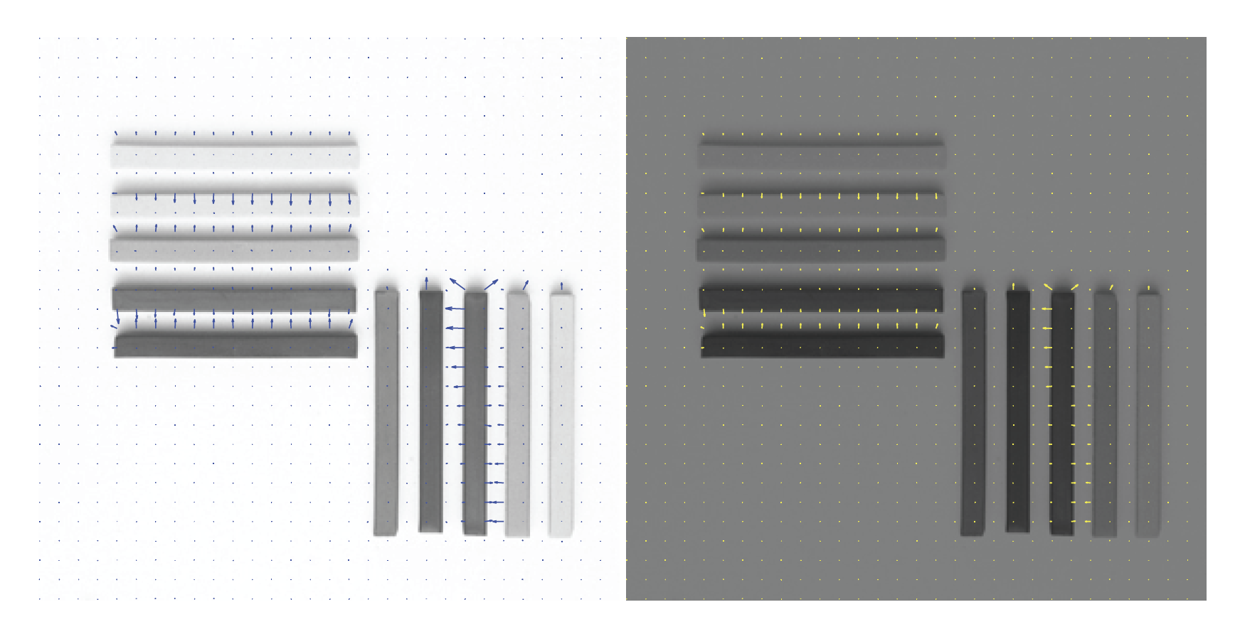

Slide 13
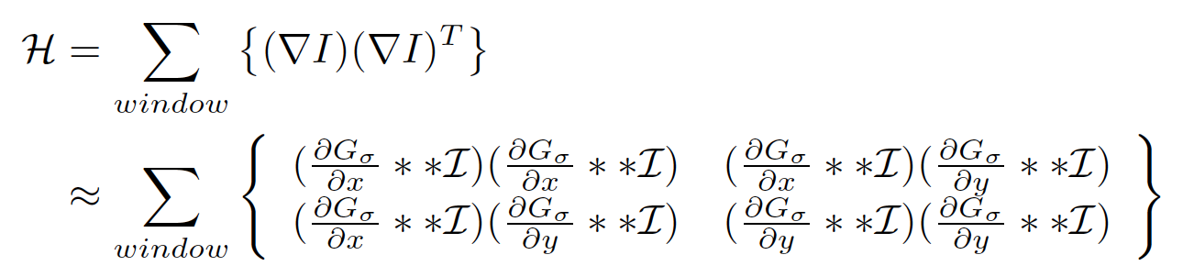
Corner detection matrix
This is very like a covariance matrix
Also, it’s a second order approximation to the image
Intensity (later slides)

Slide 14

Deriving a corner detection criterion
Basic idea: we should easily recognize the point by looking through a small window
Shifting a window in any direction should give a large change in intensity
“flat” region:
no change in all directions
“edge”:
no change along the edge direction
“corner”:
significant change in all directions

Slide 15
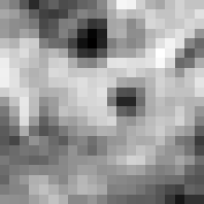


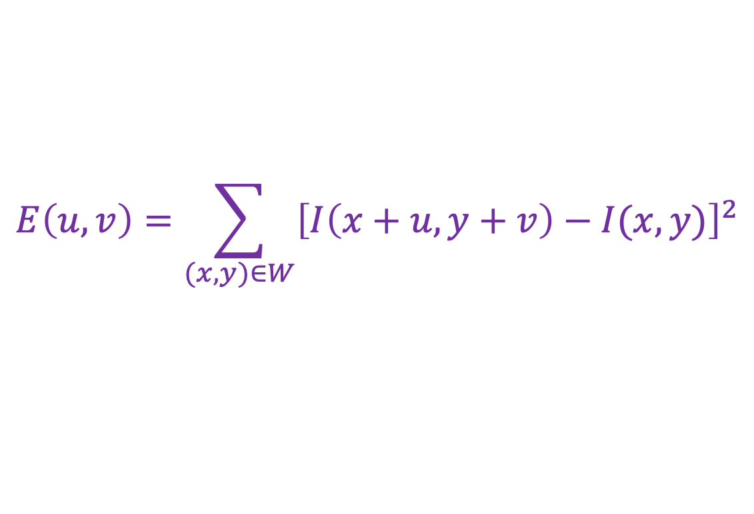
Deriving a corner detection criterion
Change in appearance of window $W$ for the shift $(u,v)$:
$$E\left(u,v\right)=\sum_{(x,y)∈W}{{\left[I\left(x+u,y+v\right)−I(x,y)\right]}^{2}}$$
I(x, y)
E(u, v)
E(3,2)

Slide 16
Deriving a corner detection criterion
Change in appearance of window $W$ for the shift $(u,v)$:
$$E\left(u,v\right)=\sum_{(x,y)∈W}{{\left[I\left(x+u,y+v\right)−I(x,y)\right]}^{2}}$$
I(x, y)
E(u, v)
E(0,0)

Slide 17

Deriving a corner detection criterion
Change in appearance of window $W$ for the shift $(u,v)$:
We want to find out how this function behaves for small shifts
$$E\left(u,v\right)=\sum_{(x,y)∈W}{{\left[I\left(x+u,y+v\right)−I(x,y)\right]}^{2}}$$
E(u, v)
Notes:
Specifically, E has to have a unique minimum at (0,0)

Slide 18




Deriving a corner detection criterion
First-order Taylor approximation for small shifts $(u, v)$:
$$I\left(x+u,y+v\right)≈I\left(x,y\right)+I_{x}u+I_{y}v$$
Recall: first-order Taylor approximation for a 1D function:
$$f\left(x+u\right)≈f\left(x\right)+f^{′}\left(x\right)u$$
$$x$$
$$x+u$$

Slide 19
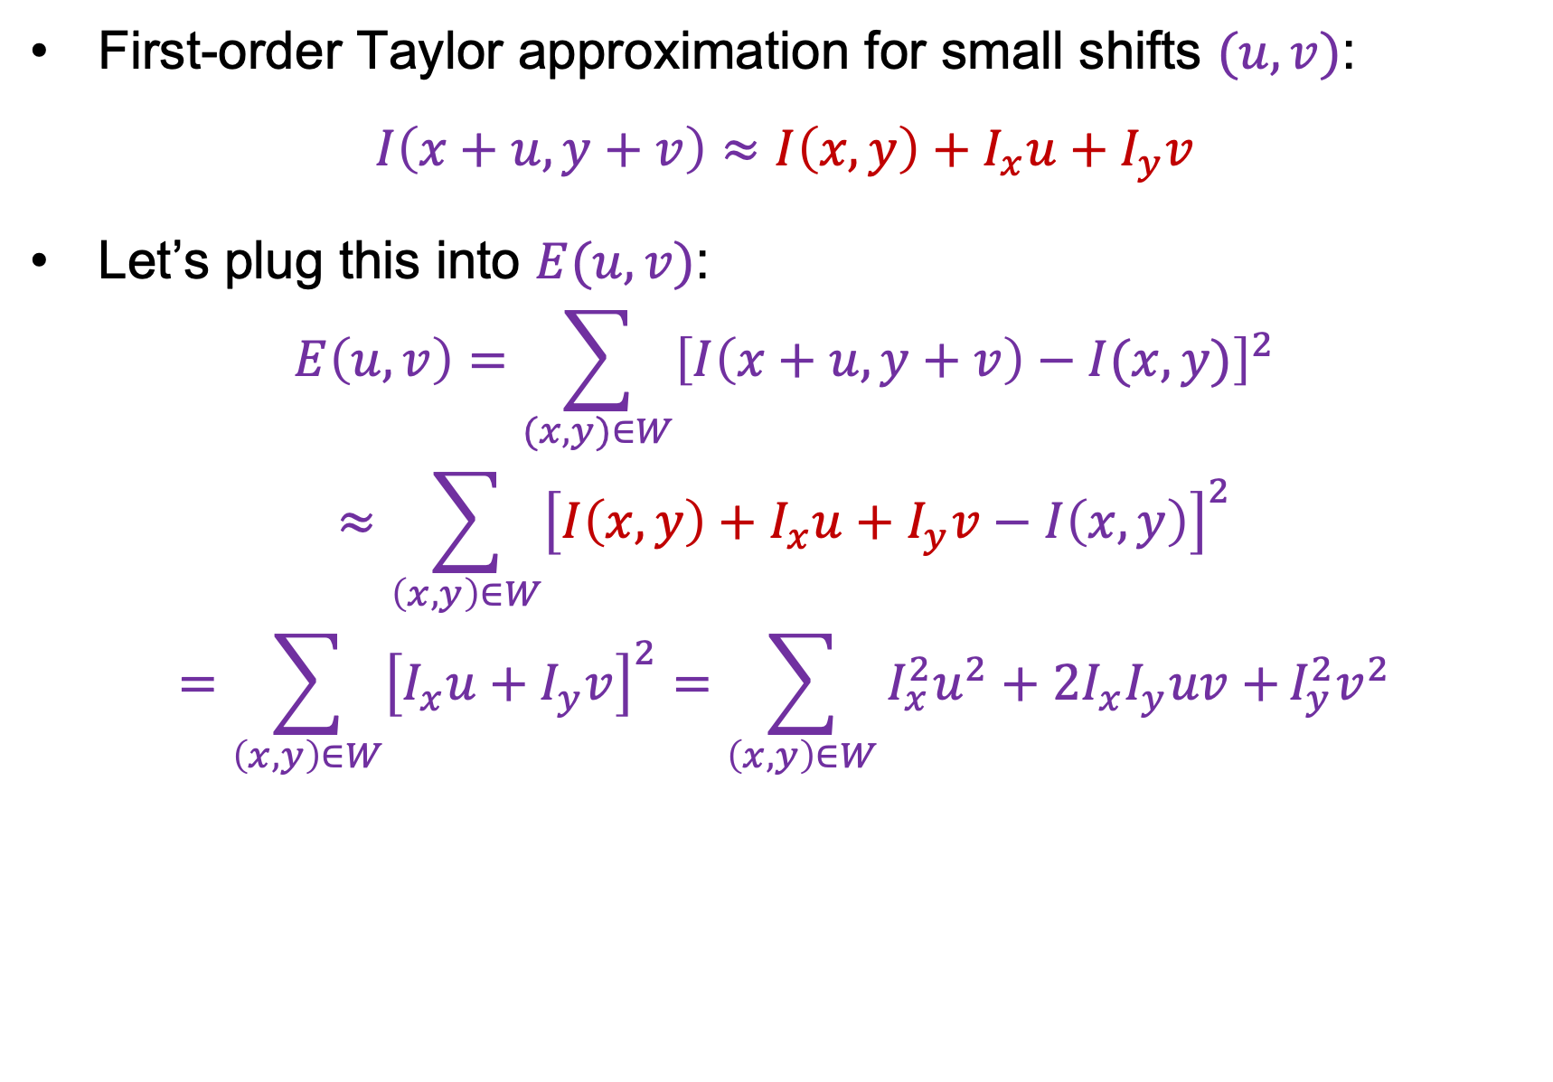
Deriving a corner detection criterion
First-order Taylor approximation for small shifts $(u, v)$:
$$I\left(x+u,y+v\right)≈I\left(x,y\right)+I_{x}u+I_{y}v$$
Let’s plug this into $E(u,v)$:
$$E\left(u,v\right)=\sum_{(x,y)∈W}{{\left[I\left(x+u,y+v\right)−I(x,y)\right]}^{2}}$$
$$≈\sum_{\left(x,y\right)∈W}{{\left[I\left(x,y\right)+I_{x}u+I_{y}v−I\left(x,y\right)\right]}^{2}}$$
$$=\sum_{\left(x,y\right)∈W}{{\left[I_{x}u+I_{y}v\right]}^{2}}=\sum_{\left(x,y\right)∈W}{I_{x}^{2}u^{2}+2I_{x}I_{y}uv+}I_{y}^{2}v^{2}$$

Slide 20
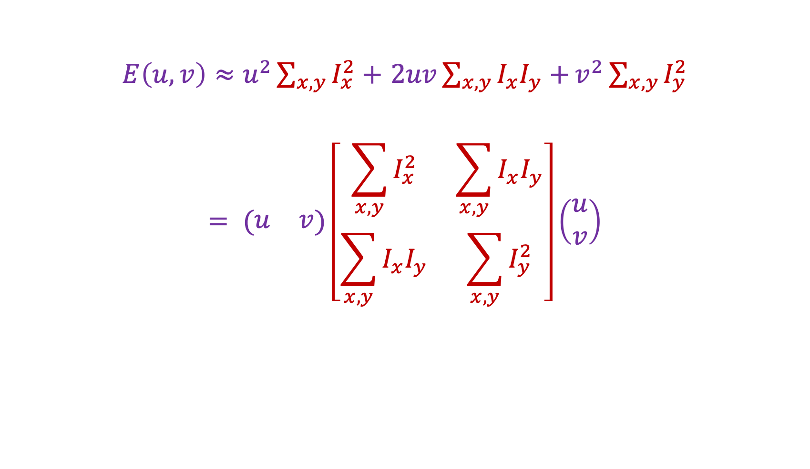

Deriving a corner detection criterion
$E\left(u,v\right)≈u^{2}\sum_{x,y}{I_{x}^{2}}+$ $2uv\sum_{x,y}{I_{x}I_{y}+}v^{2}\sum_{x,y}{I_{y}^{2}}$
$$= (\begin{matrix}u & v\end{matrix})\left[\begin{matrix}\sum_{x,y}{I_{x}^{2}} & \sum_{x,y}{I_{x}I_{y}} \\ \sum_{x,y}{I_{x}I_{y}} & \sum_{x,y}{I_{y}^{2}}\end{matrix}\right]\left(\begin{aligned}u \\ v\end{aligned}\right)$$
Second moment matrix $M$

Slide 21
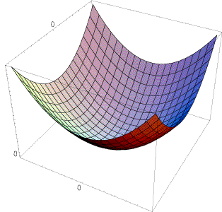
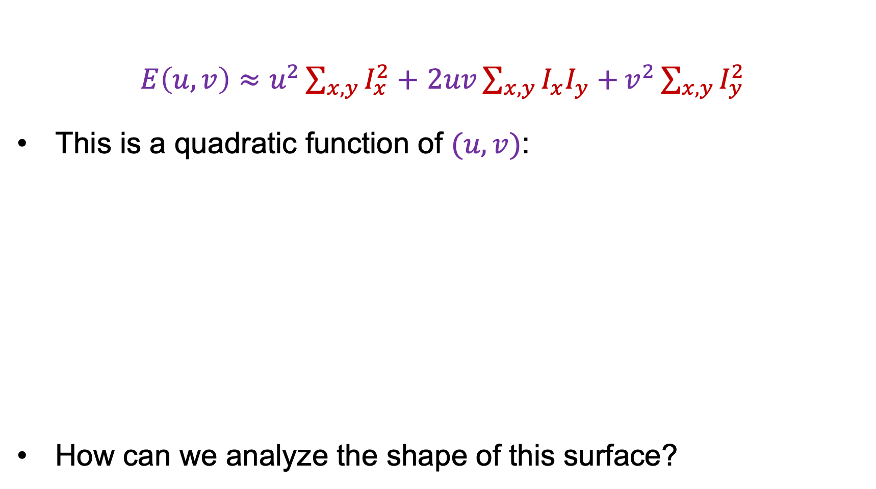

Deriving a corner detection criterion
$E\left(u,v\right)≈u^{2}\sum_{x,y}{I_{x}^{2}}+$ $2uv\sum_{x,y}{I_{x}I_{y}+}v^{2}\sum_{x,y}{I_{y}^{2}}$
This is a quadratic function of $(u,v)$:
How can we analyze the shape of this surface?
E(u, v)
$$≈$$

Slide 22
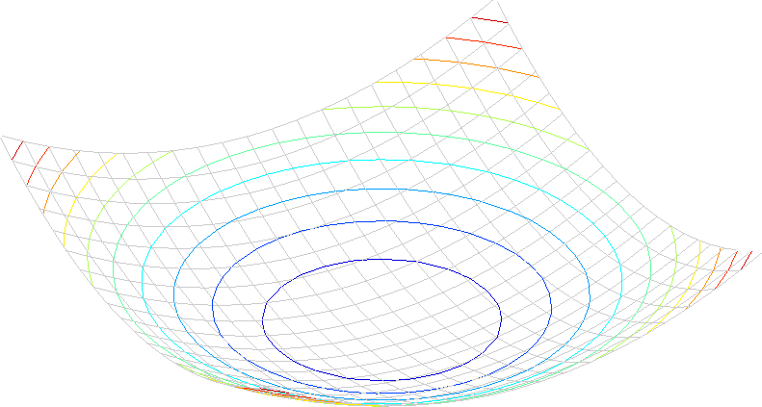

Interpreting the second moment matrix
A horizontal “slice” of $E(u, v)$ is given by the equation of an ellipse:
$$\left(\begin{matrix}u & v\end{matrix}\right)M\left(\begin{aligned}u \\ v\end{aligned}\right)=const.$$

Slide 23
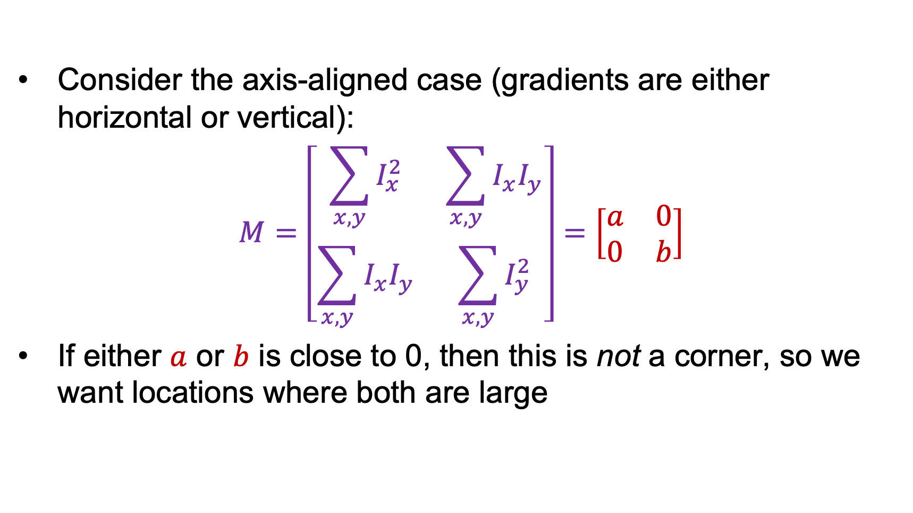




Interpreting the second moment matrix
Consider the axis-aligned case (gradients are either horizontal or vertical):
$$M=\left[\begin{matrix}\sum_{x,y}{I_{x}^{2}} & \sum_{x,y}{I_{x}I_{y}} \\ \sum_{x,y}{I_{x}I_{y}} & \sum_{x,y}{I_{y}^{2}}\end{matrix}\right]=\left[\begin{matrix}a & 0 \\ 0 & b\end{matrix}\right]$$
If either $a$ or $b$ is close to 0, then this is not a corner, so we want locations where both are large
$$a=0,b=0$$
$$b=0$$
$$a=0$$
$$a>0,b>0$$

Slide 24
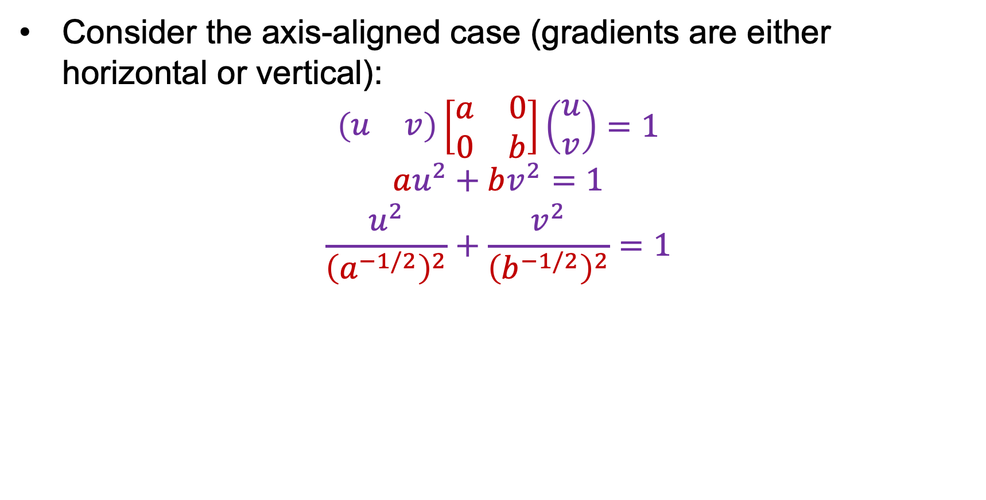
Interpreting the second moment matrix
Consider the axis-aligned case (gradients are either horizontal or vertical):
$$\left(\begin{matrix}u & v\end{matrix}\right)\left[\begin{matrix}a & 0 \\ 0 & b\end{matrix}\right]\left(\begin{aligned}u \\ v\end{aligned}\right)=1$$
$$au^{2}+bv^{2}=1$$
$$\frac{u^{2}}{{\left(a^{−1/2}\right)}^{2}}+\frac{v^{2}}{{\left(b^{−1/2}\right)}^{2}}=1$$
a^{-1/2}
Minor axis
Major axis
b^{-1/2}

Slide 25

Interpreting the second moment matrix
In general, need to diagonalize $M$:
$$M=R^{−1}\left[\begin{matrix}λ_{1} & 0 \\ 0 & λ_{2}\end{matrix}\right]R$$
The axis lengths of the ellipse are determined by the eigenvalues and the orientation is determined by $R$
direction of the fastest change
direction of the slowest change
(λ_{max})^{-1/2}
(λ_{min})^{-1/2}

Slide 26
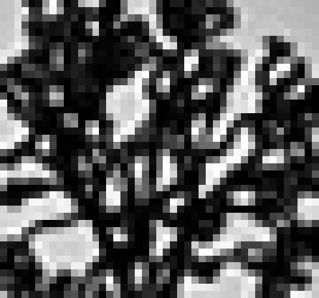
Visualization of second moment matrices

Slide 27
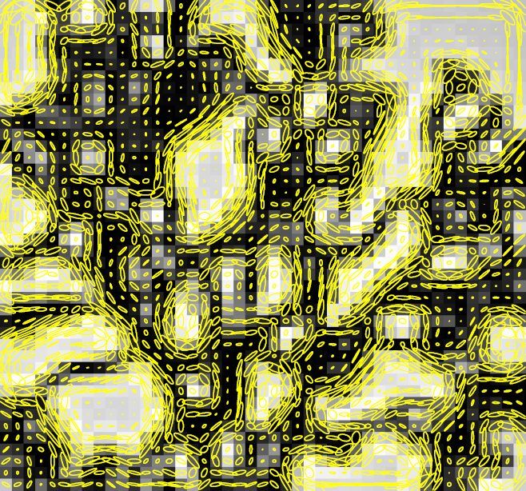
Visualization of second moment matrices
Note: axes are rescaled so ellipse areas are proportional to edge energy (i.e., bigger ellipses correspond to stronger edges)

Slide 28

Interpreting the eigenvalues
Classification of image points using eigenvalues of $M$:
λ₂
“Edge”
λ₂ >> λ₁
“Corner”
λ₁ and λ₂ are large,
λ₁ ~ λ₂;
E increases in all directions
λ₁ and λ₂ are small;
E is almost constant in all directions
“Flat” region
“Edge”
λ₁ >> λ₂
λ₁

Slide 29

Corner response function
$$R=\det\left(M\right)−α trace{\left(M\right)}^{2}=λ_{1}λ_{2}−α{(λ_{1}+λ_{2})}^{2}$$
$α$: constant (0.04 to 0.06)
“Edge”
R < 0
“Corner”
R > 0
|R| small
“Flat” region
“Edge”
R < 0

Slide 30
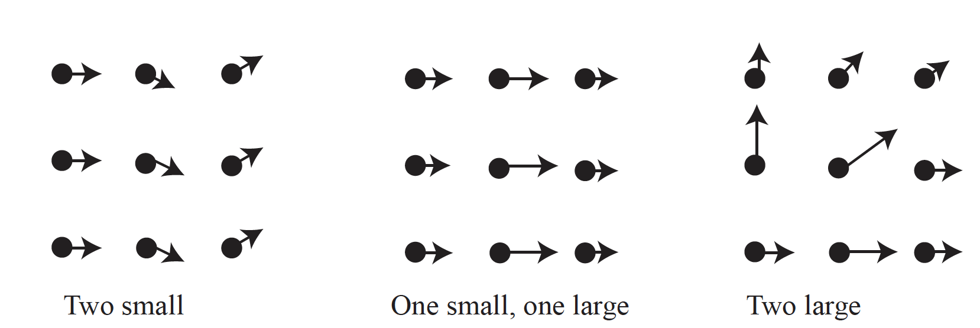

Slide 31
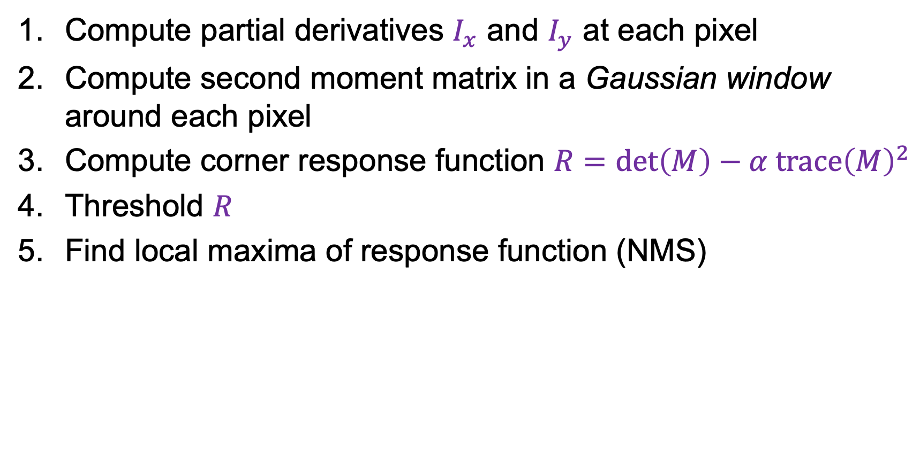
The Harris corner detector
Compute partial derivatives $I_{x}$ and $I_{y}$ at each pixel
Compute second moment matrix in a Gaussian window around each pixel
Compute corner response function $R=\det\left(M\right)−α trace{\left(M\right)}^{2}$
Threshold $R$
Find local maxima of response function (NMS)
C.Harris and M.Stephens, A Combined Corner and Edge Detector, Proceedings of the 4th Alvey Vision Conference: pages 147—151, 1988.

Slide 32
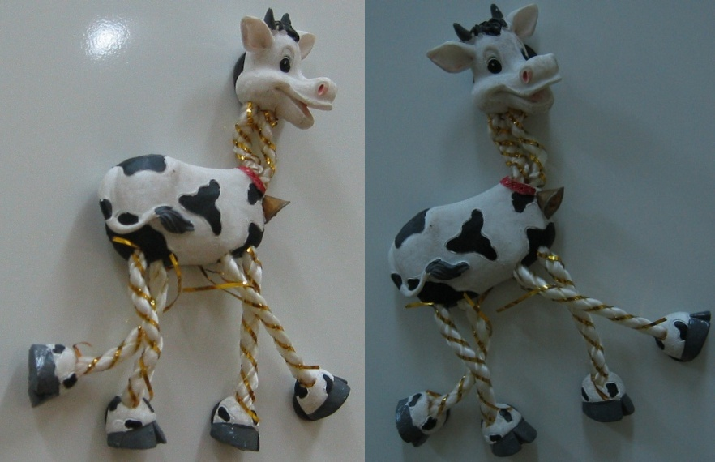
Harris Detector: Example

Slide 33
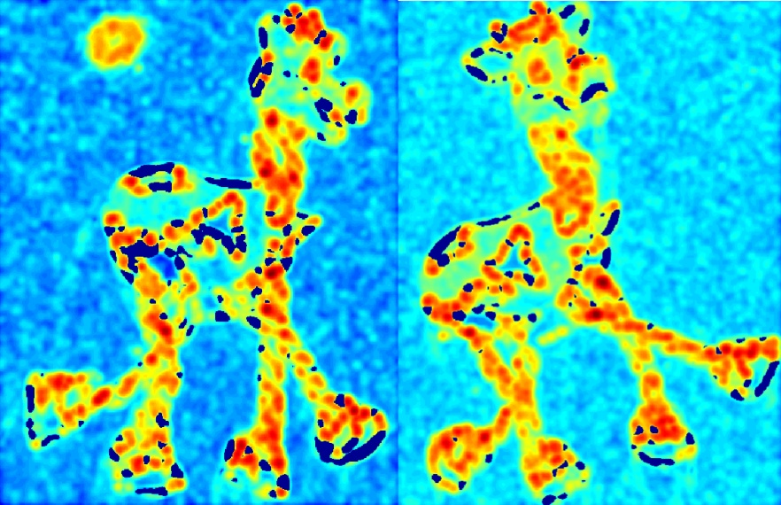

Harris Detector: Example
Compute corner response $R$

Slide 34
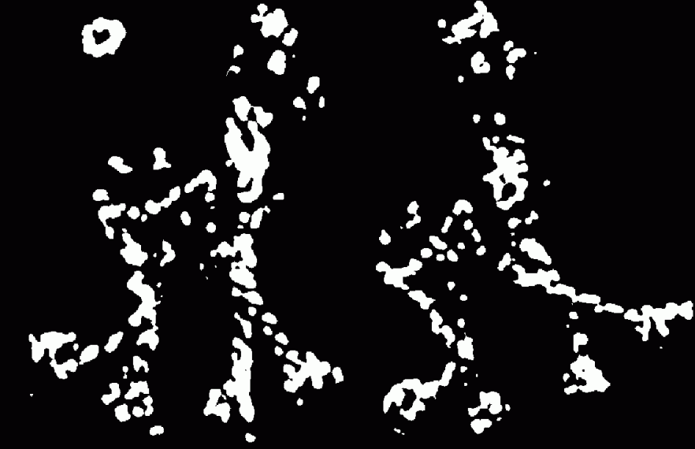
Harris Detector: Example
Find points with large corner response: $R$ > threshold

Slide 35
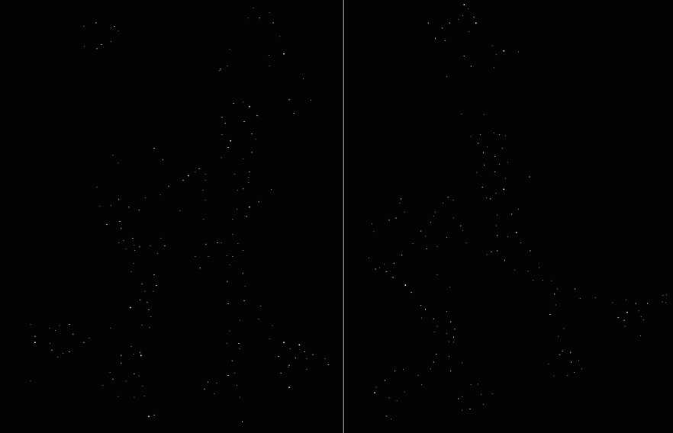

Harris Detector: Example
Take only the points of local maxima of $R$

Slide 36

Harris Detector: Example

Slide 37
Behavior w.r.t. image transformations
To be useful for image matching, “the same” corner features need to show up despite geometric and photometric transformations
We need to analyze how
the corner response function and the corner locations change in response to various transformations

Slide 38
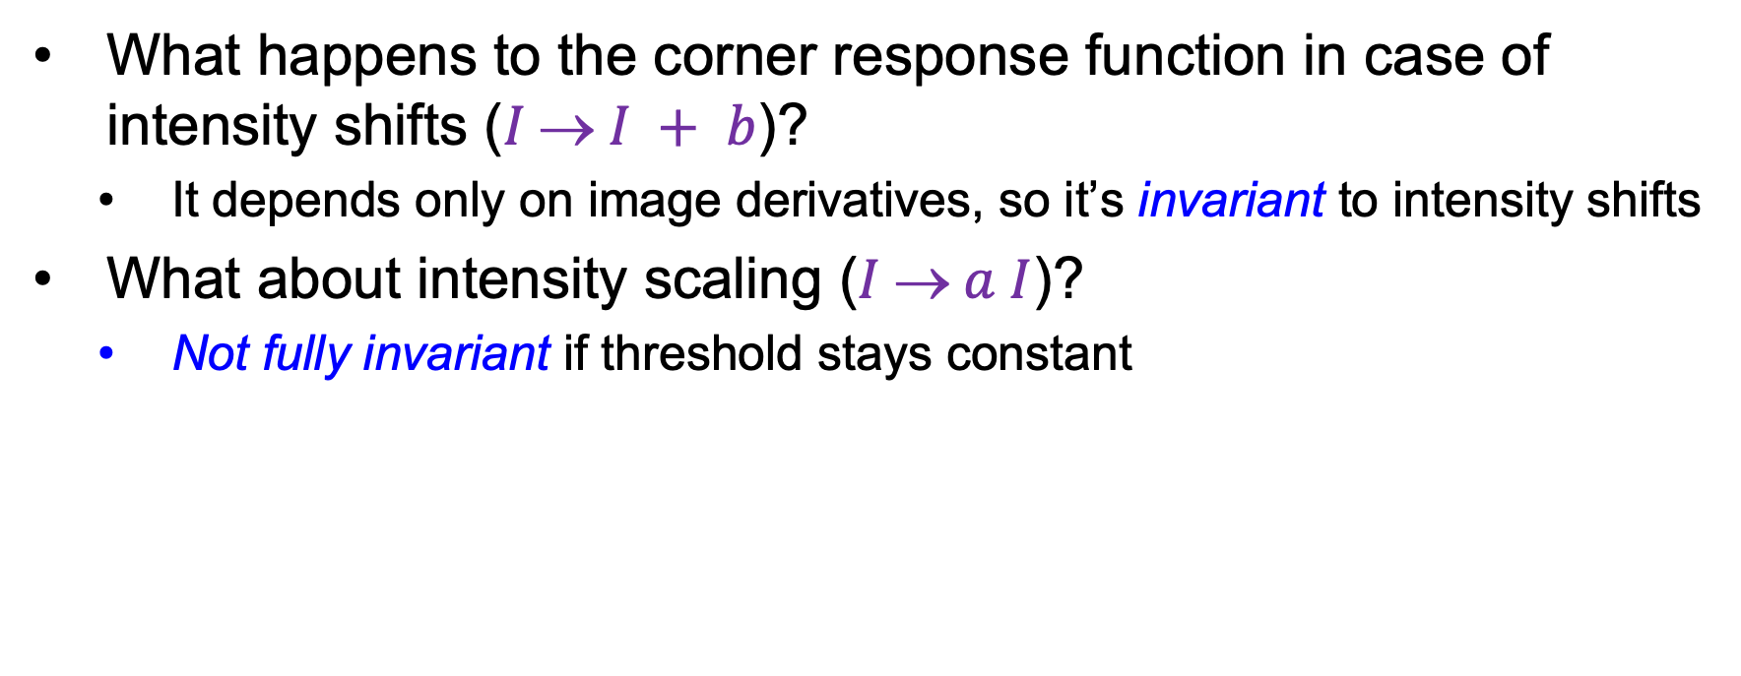
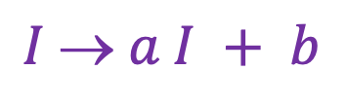
Affine intensity change
$$I  a I + b$$
What happens to the corner response function in case of intensity shifts ($I  I + b$)?
  It depends only on image derivatives, so it’s invariant to intensity shifts
What about intensity scaling ($I  a I$)?
  Not fully invariant if threshold stays constant
R
R
threshold
x (image coordinate)
x (image coordinate)

Slide 39
Image translation
How do the detected corner locations change if the image pattern is translated?
  All the ingredients of the second moment matrix are shift-invariant, and so is the corner response function
  However, the locations of the corners are equivariant (or covariant) w.r.t. shifts
Translate the image – the corners translate

Slide 40
Image rotation
How do the detected corner locations change if the image pattern is rotated?
  Assuming the second moment matrix is calculated over a circular neighborhood (and ignoring resampling issues), the rotation changes but the eigenvalues stay the same, so the response function is invariant
  The locations of the corners are equivariant (or covariant) w.r.t. rotations
Rotate the image – the corners rotate

Slide 41
Image scaling
Not corners!
Corner
How do the detected corner locations change if the image pattern is scaled?
  Assuming fixed-size neighborhoods for calculating the second moment matrix, the corner response function is not invariant and the corner locations are not equivariant w.r.t. scaling
Scale the image – lose/gain some corners (but not too bad)

Slide 42
Need to find
Where is it:
What scale its at:
What orientation its at:
Description of contents:
In a way that is (mostly) unaffected by
image transformations

Slide 43
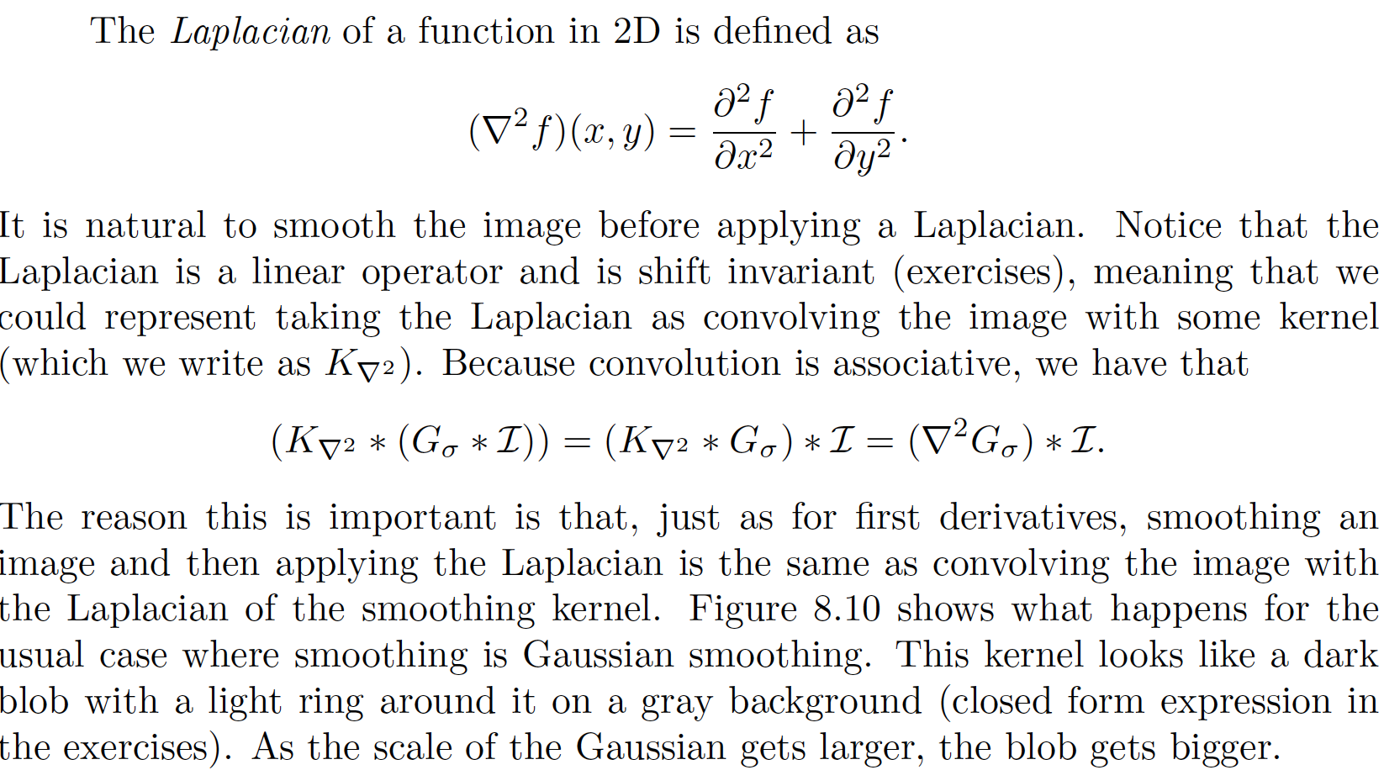
Laplacian of Gaussian

Slide 44
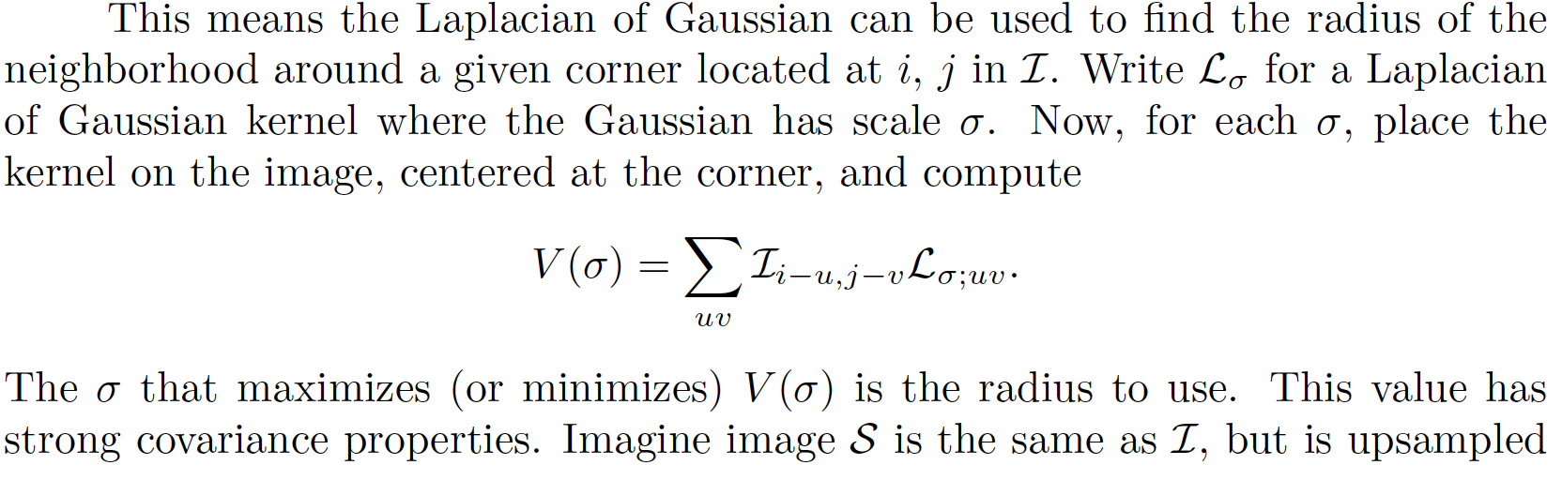
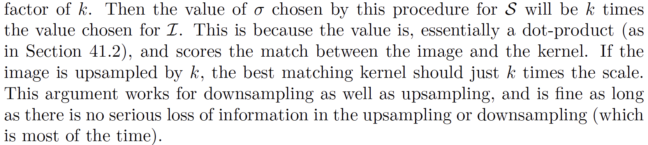

Slide 45
Need to find
Where is it:
What scale its at:
What orientation its at:
Description of contents:
In a way that is (mostly) unaffected by
image transformations

Slide 46
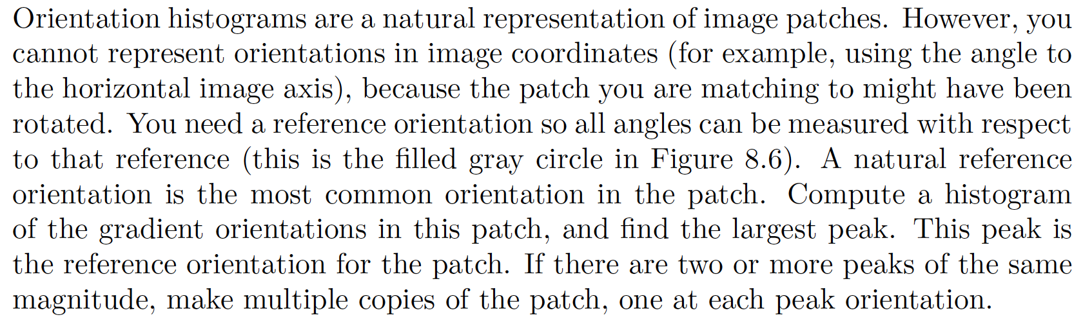
Orientation histogram peak for orientation

Slide 47
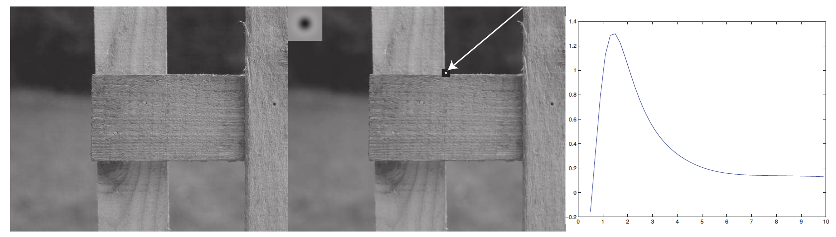
Notice how useful a Gaussian pyramid could be here

Slide 48
Need to find
Where is it:
What scale its at:
What orientation its at:
Description of contents:
In a way that is (mostly) unaffected by
image transformations

Slide 49
SIFT features
SIFT features
  SIFT=Scale Invariant Feature Transform
  Very strong record of effectiveness in matching applications
  SIFT features behave very well using nearest neighbors matching
    i.e. the nearest neighbor to a query patch is usually a matching patch

Slide 50
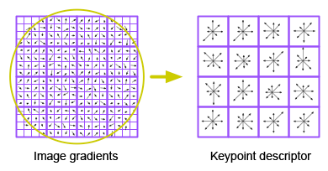
Describing a window’s contents
We want description to be:
  Invariant to changes in image brightness: - use orientations
  Robust to noise: - ignore orientations with small magnitude
  Distinctive: - use lots of local orientations
  Invariant to small errors in location:
    “bucket” the orientations in image
    Use a histogram for each bucket

Slide 52
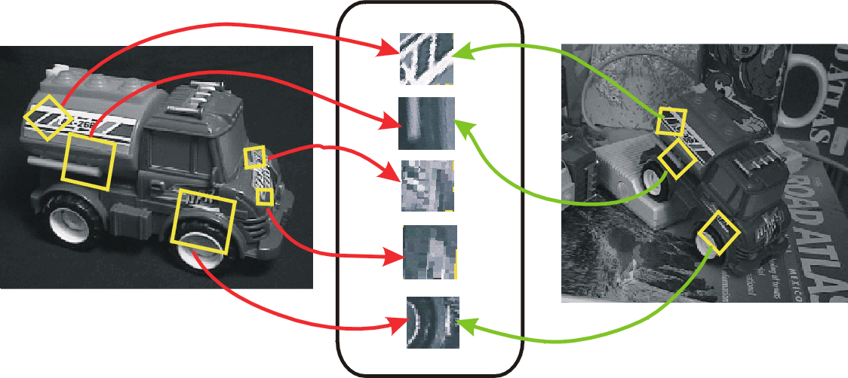
SIFT for matching
The main goal of SIFT is to enable image matching in the presence of significant transformations
  To recognize the same keypoint in multiple images, we need to match appearance descriptors or “signatures” in their neighborhoods
  Descriptors that are locally invariant w.r.t. scale and rotation can handle a wide range of global transformations

Slide 53
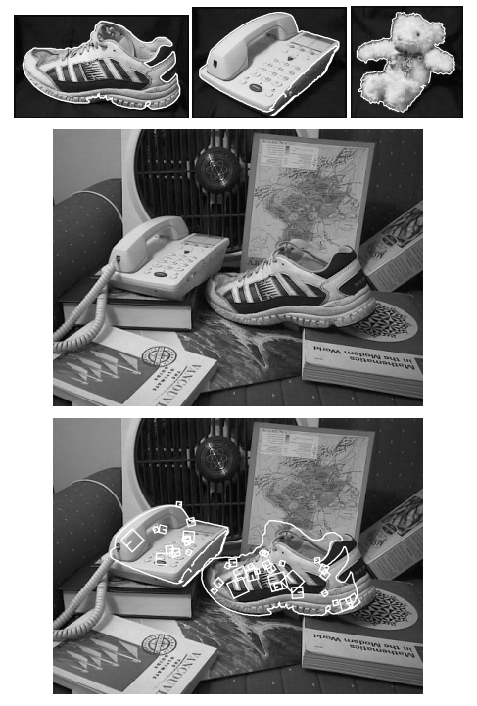
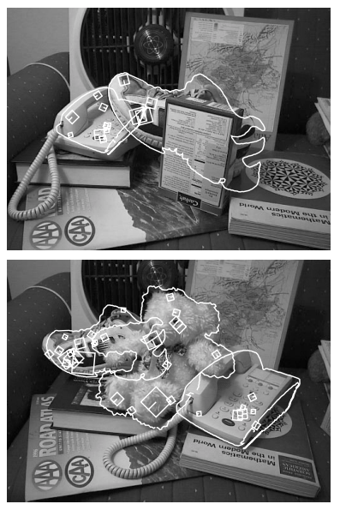
SIFT: Scale-invariant feature transform
D. Lowe. Object recognition from local scale-invariant features. ICCV 1999
D. Lowe. Distinctive image features from scale-invariant keypoints. IJCV 60 (2), pp. 91-110, 2004

Slide 54
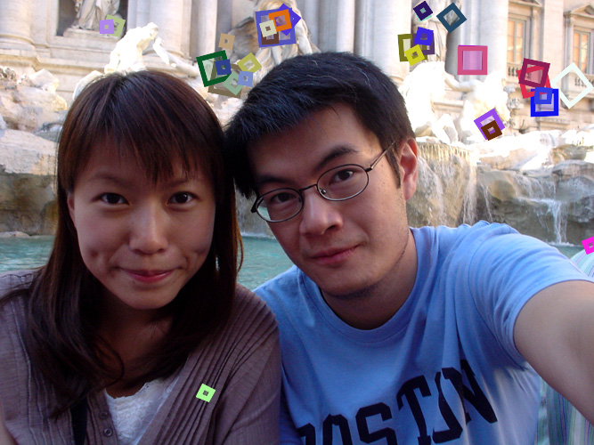
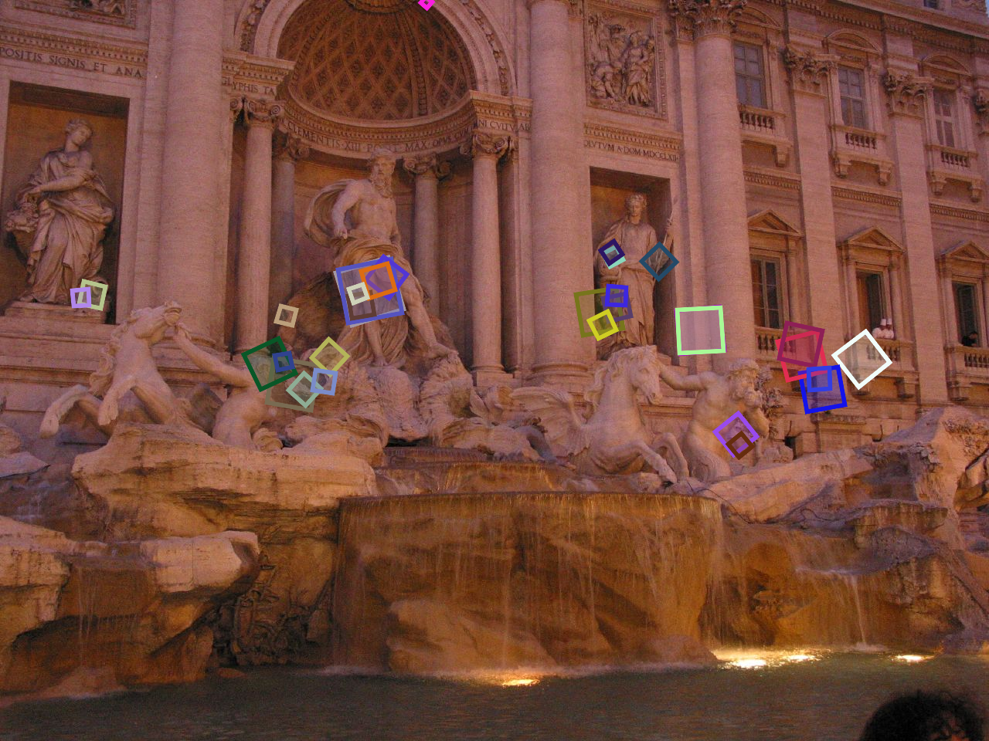
SIFT for matching
Extraordinarily robust detection and description technique
  Can handle changes in viewpoint
    Up to about 60 degree out-of-plane rotation
  Can handle significant changes in illumination
    Sometimes even day vs. night
  Fast and efficient—can run in real time
  Lots of code available
Source: N. Snavely

Slide 55
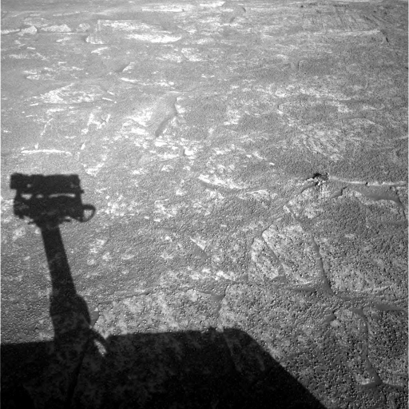
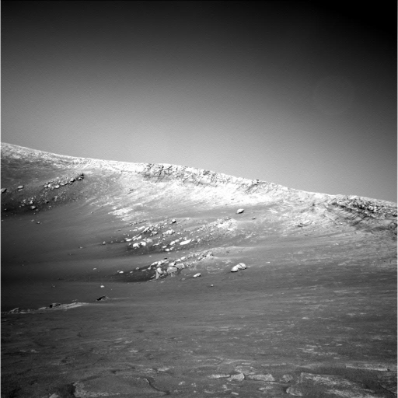
A hard matching problem
NASA Mars Rover images

Slide 56
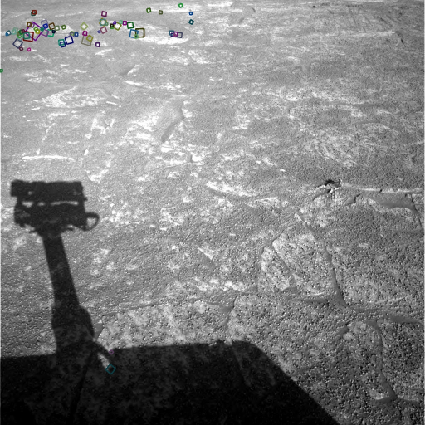
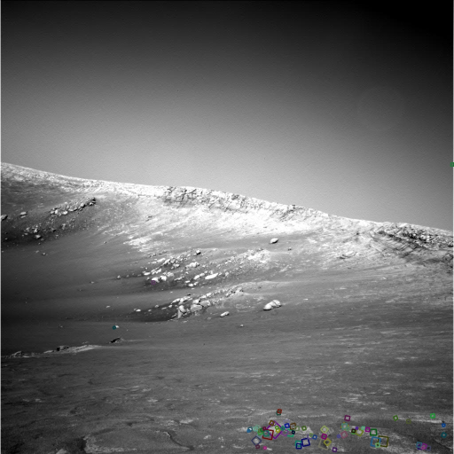
Answer below (look for tiny colored squares…)
NASA Mars Rover images
with SIFT feature matches
Figure by Noah Snavely

