Slide 1
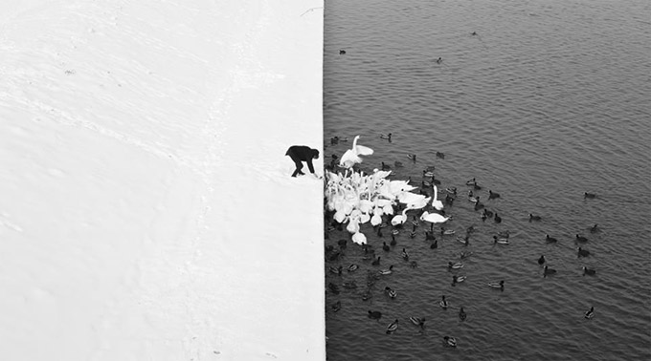
Edge detection
Winter in Kraków photographed by Marcin Ryczek

Slide 2
Overview
Motivating edge detection
Image gradients
Derivative of Gaussian filters
Canny edge detector
Role of edge detection in image understanding
Orientations

Slide 3
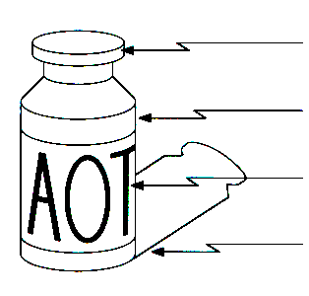
Edge detection
Goal: Identify sudden changes (discontinuities) in an image
Intuitively, edges carry most of the semantic and shape information from the image
surface normal discontinuity
depth discontinuity
surface color discontinuity
illumination discontinuity
Sources: D. Lowe and S. Seitz

Slide 4
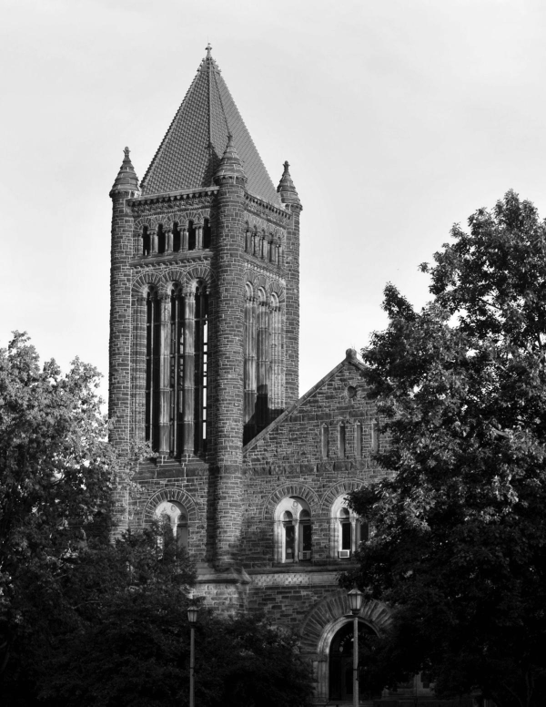

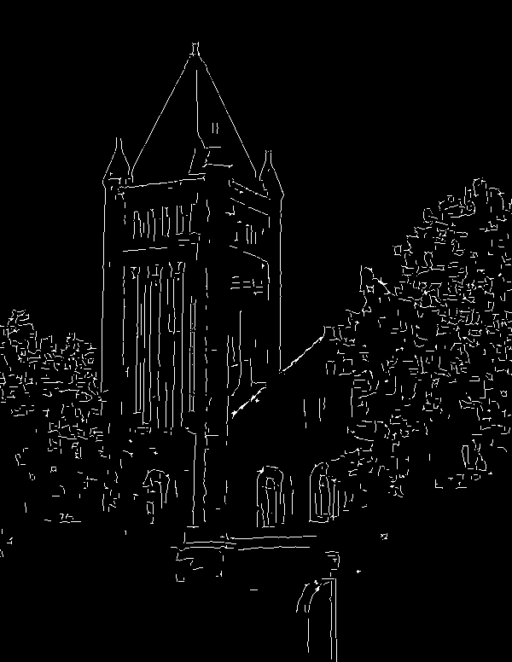
Edge detection
Input photo
Ideal: artist’s line drawing
Reality
Image source
Source: S. Gupta

Slide 5

Edge detection
An edge is a place of rapid change in the image intensity function
intensity function
(along horizontal scanline)
image
first derivative
edges correspond to
extrema of derivative

Slide 6

Partial derivatives of an image
For 2D function $f(x,y)$, the partial derivative w.r.t. $x$ is
$$\frac{∂f(x,y)}{∂x}=\lim_{h→0}{\frac{f\left(x+h,y\right)−f(x,y)}{h}}$$
Image source

Slide 7
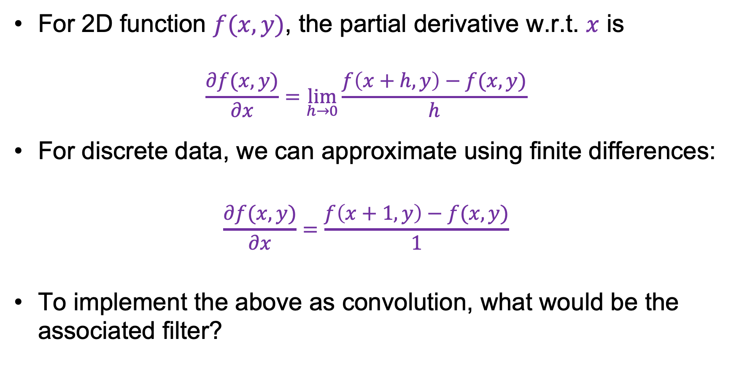
Partial derivatives of an image
For 2D function $f(x,y)$, the partial derivative w.r.t. $x$ is
$$\frac{∂f(x,y)}{∂x}=\lim_{h→0}{\frac{f\left(x+h,y\right)−f(x,y)}{h}}$$
For discrete data, we can approximate using finite differences:
$$\frac{∂f(x,y)}{∂x}=\frac{f\left(x+1,y\right)−f(x,y)}{1}$$
To implement the above as convolution, what would be the associated filter?
Source: K. Grauman

Slide 8
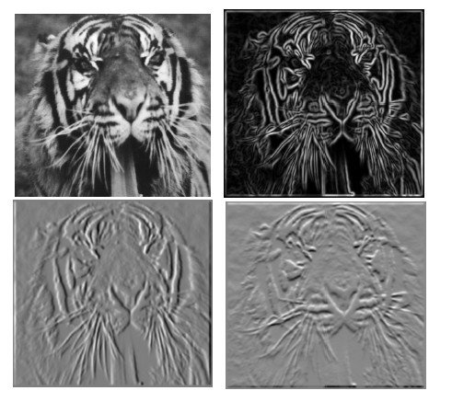


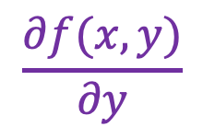

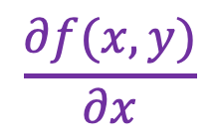
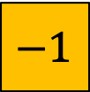
Partial derivatives of an image
$$\frac{∂f(x,y)}{∂x}$$
$$\frac{∂f(x,y)}{∂y}$$
$$−1$$
$$−1$$
$$1$$
$$1$$

Slide 9
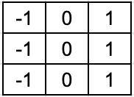
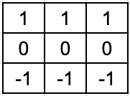
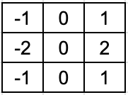
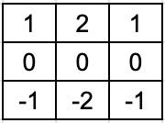


Finite difference filters
Other approximations of derivative filters exist:
Prewitt
Sobel
Roberts
Source: K. Grauman

Slide 10
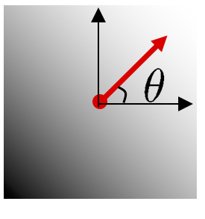

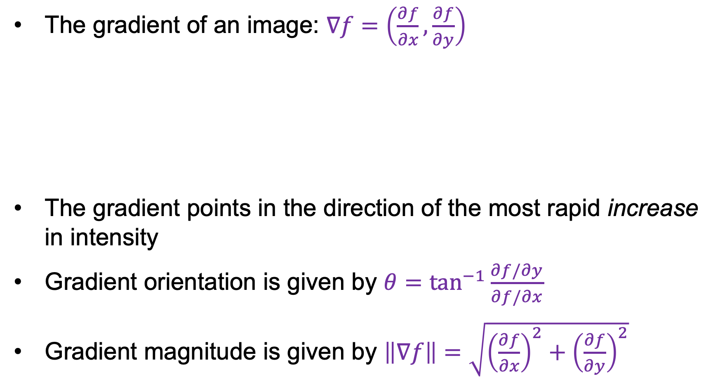

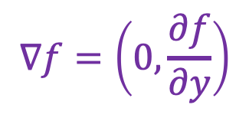
Image gradient
The gradient of an image: $∇f=\left(\frac{∂f}{∂x},\frac{∂f}{∂y}\right)$
The gradient points in the direction of the most rapid increase in intensity
Gradient orientation is given by $θ=\tan^{−1}{\frac{∂f/∂y}{∂f/∂x}}$
Gradient magnitude is given by $\left\|∇f\right\|=\sqrt{{\left(\frac{∂f}{∂x}\right)}^{2}+{\left(\frac{∂f}{∂y}\right)}^{2}}$
$$∇f=\left(\frac{∂f}{∂x},\frac{∂f}{∂y}\right)$$
$$∇f=\left(\frac{∂f}{∂x},0\right)$$
$$∇f=\left(0,\frac{∂f}{∂y}\right)$$

Slide 11
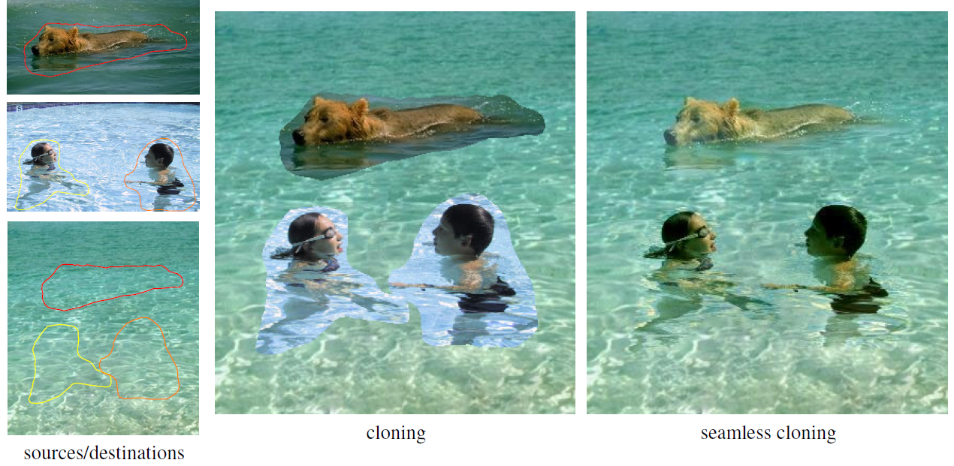
Application: Gradient-domain image editing
Goal: solve for pixel values in the target region to match gradients of the source region while keeping background pixels the same
P. Perez, M. Gangnet, A. Blake, Poisson Image Editing, SIGGRAPH 2003

Slide 12
Overview
Motivating edge detection
Image gradients
Derivative of Gaussian filters

Slide 13
“Fun” facts
Convolution is commutative
f*g=g*f
(easy proof: use the convolution theorem, multiplication commutes!)
Differentiation can be represented with convolution
there is some k so that
(Won’t prove this, but we’ve sort of seen it already)

Slide 14

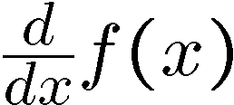
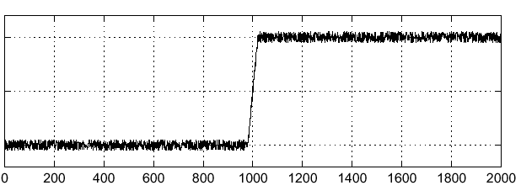
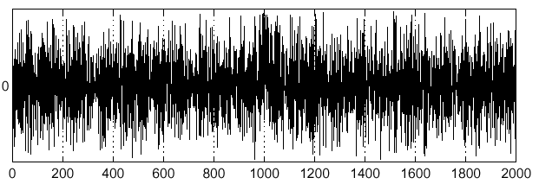
Finding noisy edges
Consider a single row or column of the image:
Where is the edge?
Source: S. Seitz
Notes:
How to fix?

Slide 15



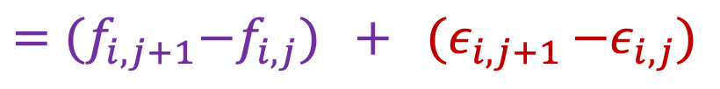
Noisy pixel differences
Suppose pixels of the “true” image $f_{i,j}$ are corrupted by additive Gaussian noise $ε_{i,j}∼N(0,σ^{2})$
What happens when we compute pixel differences?
$$D_{i,j}={(f}_{i,j+1}+ε_{i,j+1})−{(f}_{i,j}+ε_{i,j })$$
$$={(f}_{i,j+1}−f_{i,j}) + {(ε}_{i,j+1 }−ε_{i,j})$$
True difference
Difference of two zero-mean Gaussian random variables (same as sum)
$$ε_{i,j+1}−ε_{i,j}∼N\left(0,{2σ}^{2}\right)→$$
Variance doubles!
Adapted from D. Fouhey and J. Johnson

Slide 16
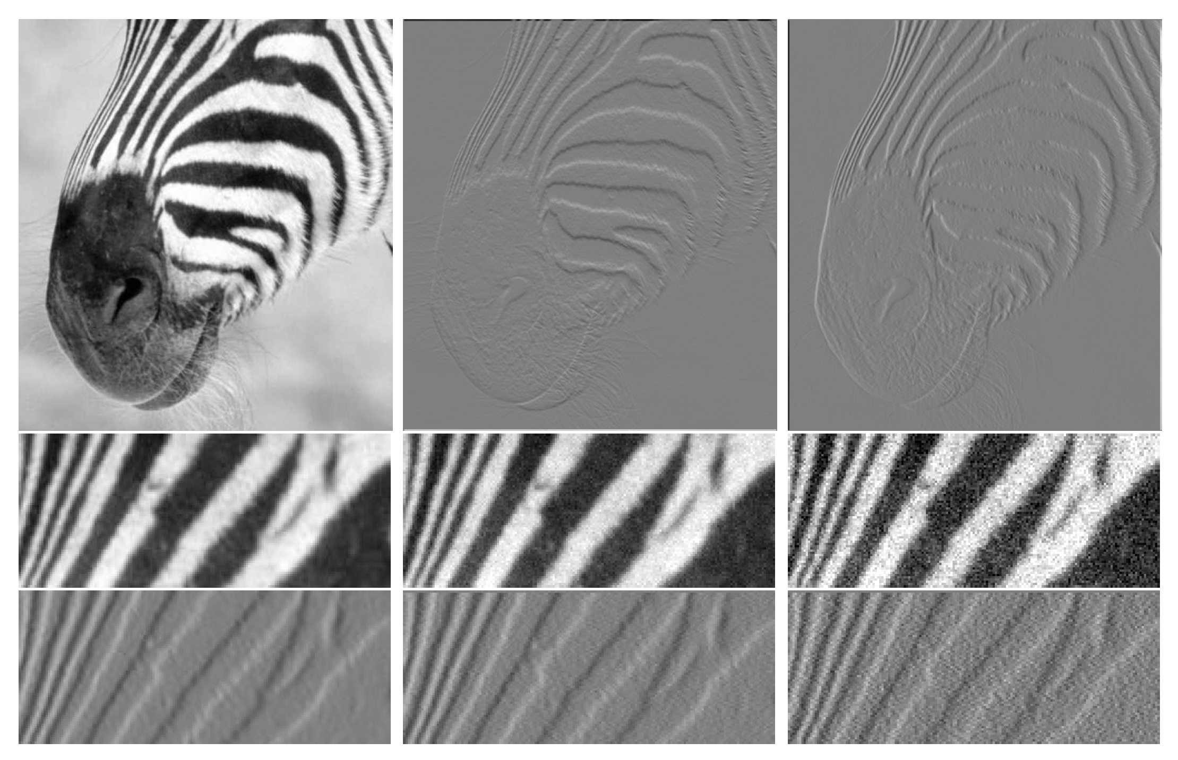

Slide 17
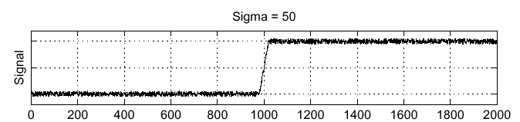
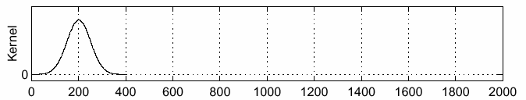
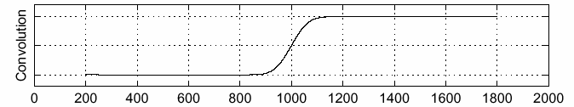
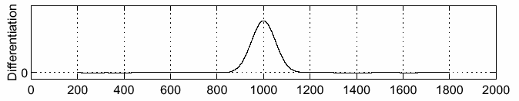
Finding noisy edges: Smooth first
f
g
f * g
To find edges, look for peaks in $\frac{d}{dx}\left(f∗g\right)$
Source: S. Seitz

Slide 18
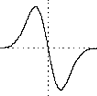

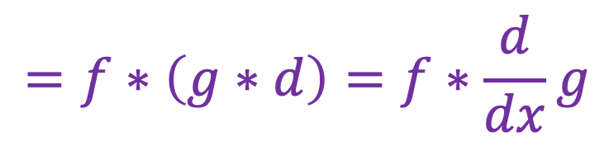
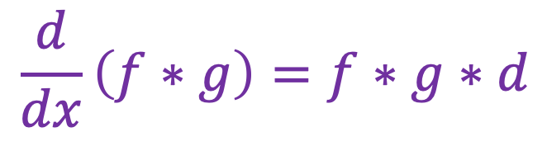
Finding noisy edges: Smooth first
Let $d$ denote the derivative filter, e.g., $[−1 0 1]$
$$\frac{d}{dx}\left(f∗g\right)=f∗g∗d$$
$$=f∗\left(g∗d\right)=f∗\frac{d}{dx}g$$
Derivative of Gaussian filter

Slide 19
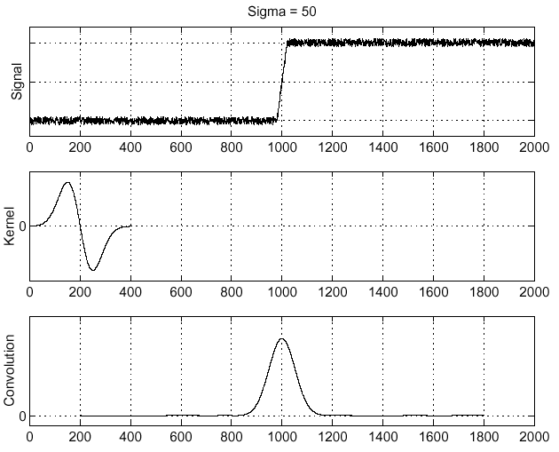
Filtering with derivative of Gaussian
f
Source: S. Seitz

Slide 20
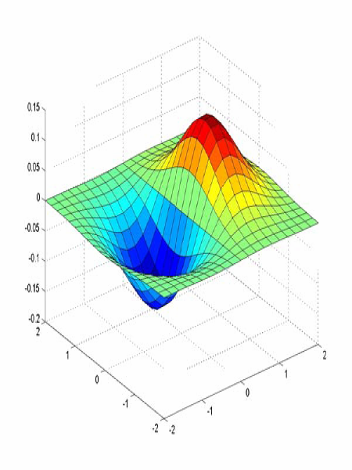
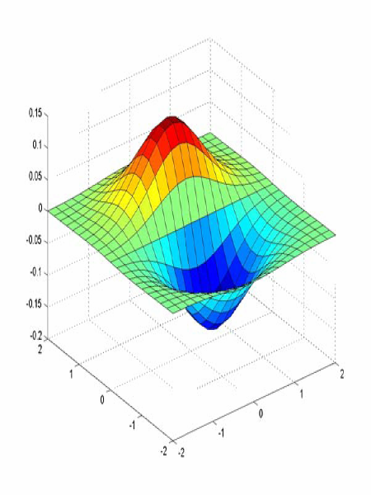
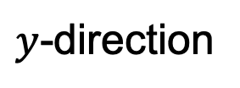
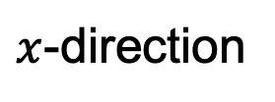
2D Derivative of Gaussian (d.o.g. or dog) filters
$x$-direction
$y$-direction

Slide 21
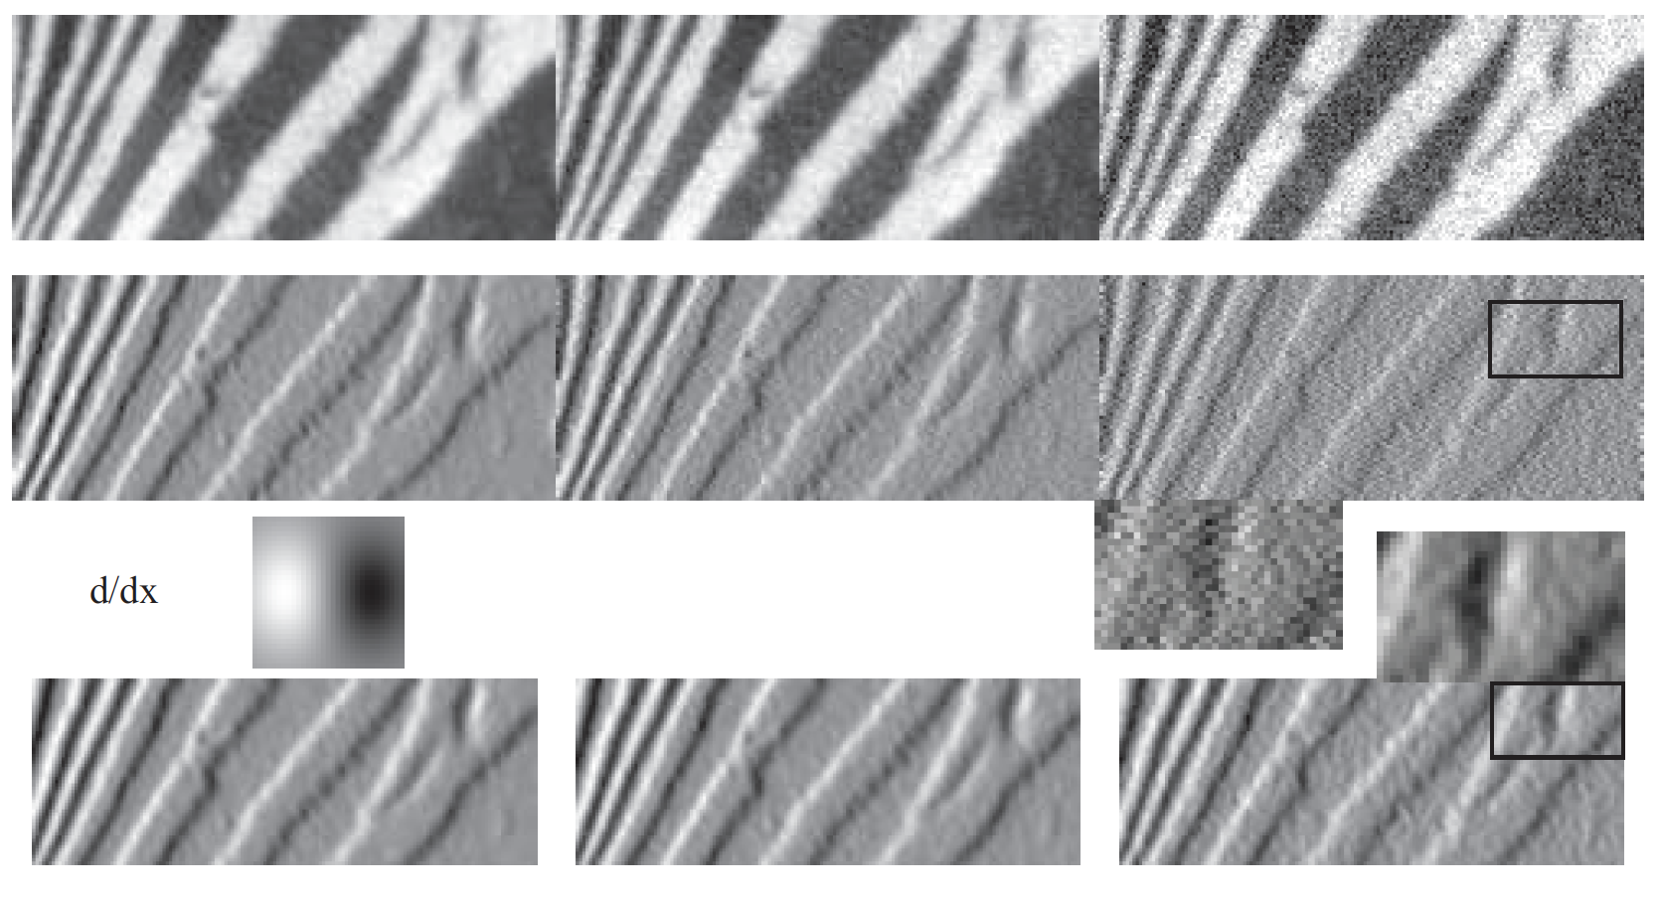
Finite differences
d.o.g

Slide 22

Separability of the Gaussian filter
$$\frac{1}{2πσ^{2}}\exp\left(−\frac{x^{2}+y^{2}}{{2σ}^{2}}\right)=$$
$$\frac{1}{\sqrt{2π}σ}\exp\left(−\frac{x^{2}}{{2σ}^{2}}\right) \frac{1}{\sqrt{2π}σ}exp⁡\left(−\frac{y^{2}}{2σ^{2}}\right)$$
=
⁎
Note: matrix multiplication (outer product) and full convolution are the same in this special case
Adapted from D. Fouhey and J. Johnson

Slide 23

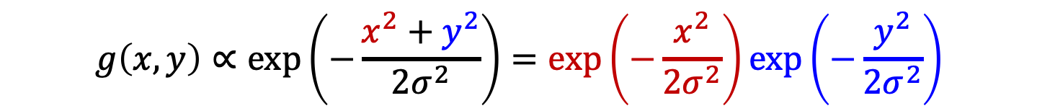

2D Derivative of Gaussian filters
(Unnormalized) 2D Gaussian:
$$g\left(x,y\right)∝\exp\left(−\frac{x^{2}+y^{2}}{{2σ}^{2}}\right)=\exp\left(−\frac{x^{2}}{{2σ}^{2}}\right)exp⁡\left(−\frac{y^{2}}{2σ^{2}}\right)$$
(Unnormalized) Gaussian derivatives:
$$\frac{∂g}{∂x}∝−x exp\left(−\frac{x^{2}}{{2σ}^{2}}\right)exp⁡\left(−\frac{y^{2}}{2σ^{2}}\right)$$
$$\frac{∂g}{∂y}∝−y exp\left(−\frac{y^{2}}{{2σ}^{2}}\right)exp⁡\left(−\frac{x^{2}}{2σ^{2}}\right)$$
These are products of a 1D Gaussian in one direction and 1D derivative of Gaussian in the other direction!

Slide 24
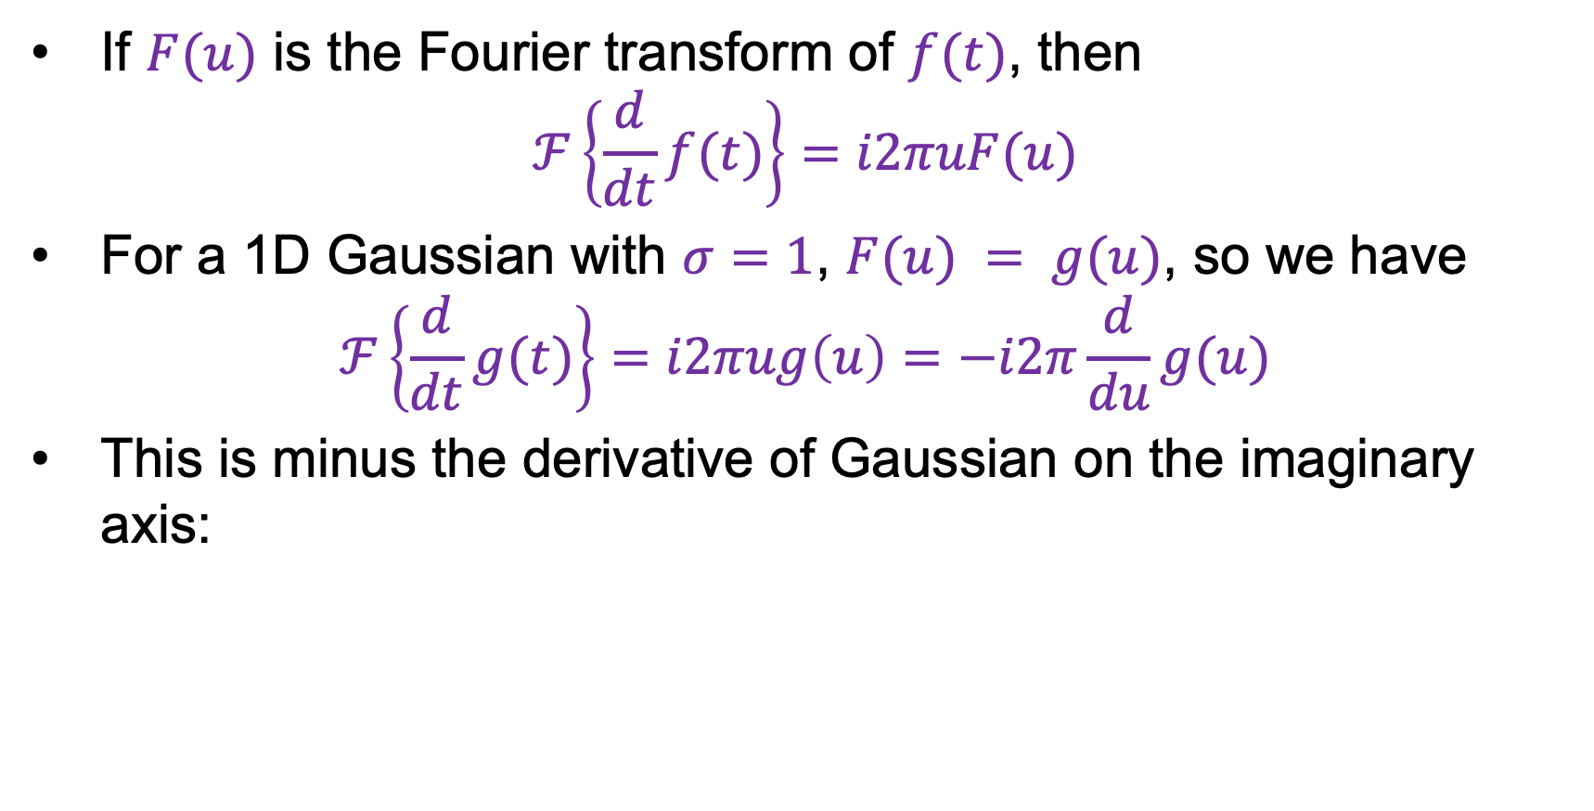
Derivative of Gaussian: Frequency domain
If $F(u)$ is the Fourier transform of $f(t)$, then
$$ℱ\left\{\frac{d}{dt}f(t)\right\}=i2πuF(u)$$
For a 1D Gaussian with $σ=1$, $F(u) = g(u)$, so we have
$$ℱ\left\{\frac{d}{dt}g(t)\right\}=i2πug\left(u\right)=−i2π\frac{d}{du}g(u)$$
This is minus the derivative of Gaussian on the imaginary axis:
(should be flipped upside down)
Image source

Slide 25
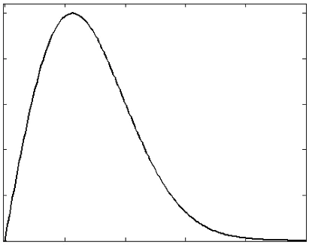
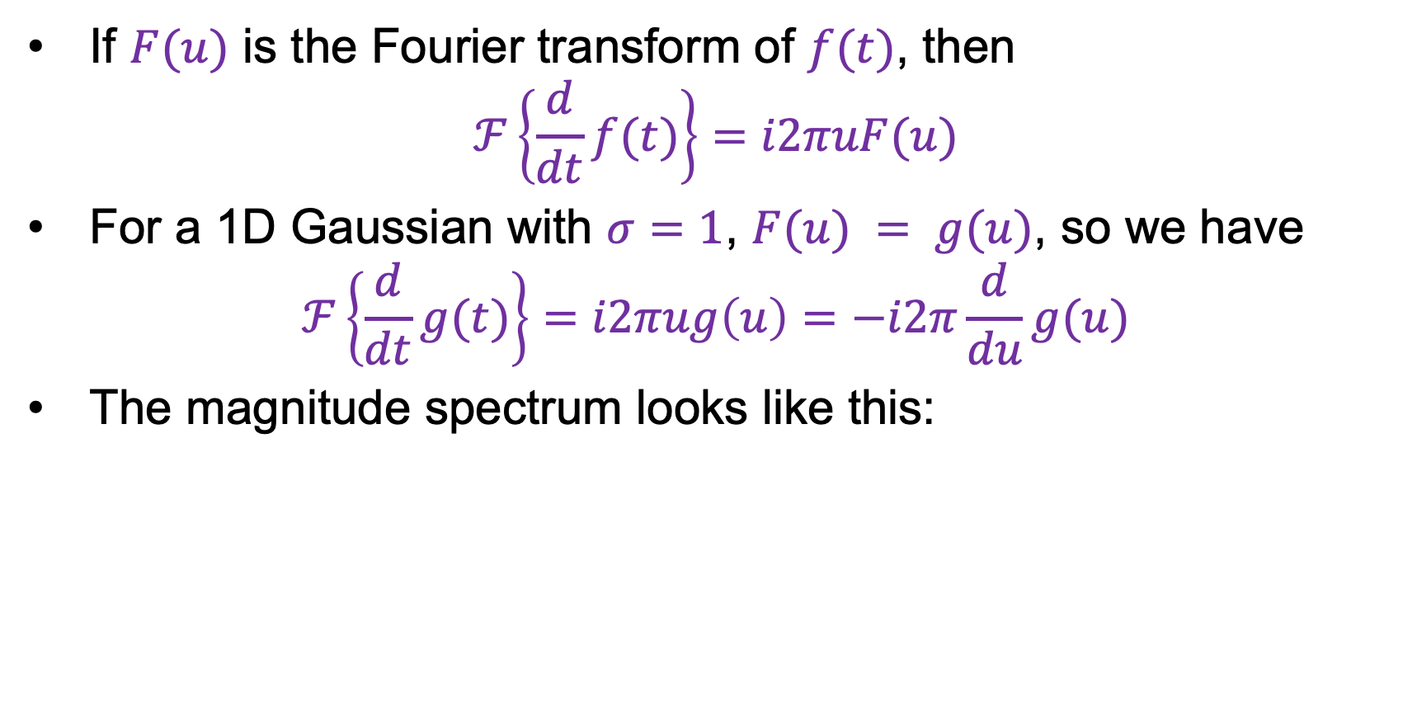
Derivative of Gaussian: Frequency domain
If $F(u)$ is the Fourier transform of $f(t)$, then
$$ℱ\left\{\frac{d}{dt}f(t)\right\}=i2πuF(u)$$
For a 1D Gaussian with $σ=1$, $F(u) = g(u)$, so we have
$$ℱ\left\{\frac{d}{dt}g(t)\right\}=i2πug\left(u\right)=−i2π\frac{d}{du}g(u)$$
The magnitude spectrum looks like this:
Functions as a band-pass filter!

Slide 26
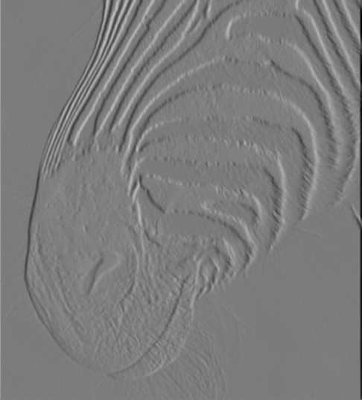
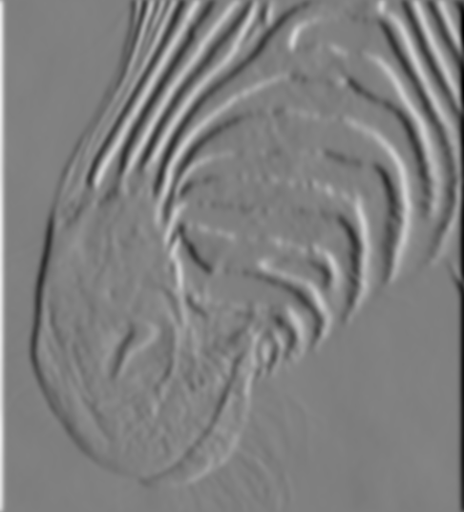
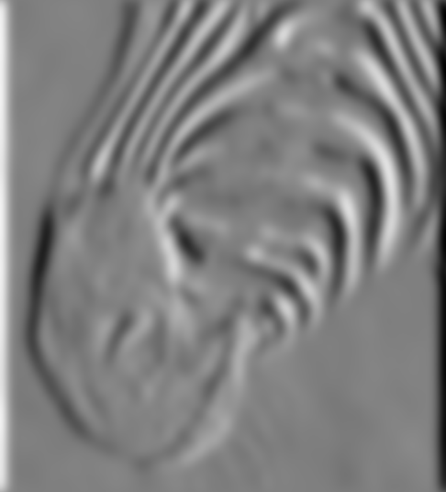




Derivative of Gaussian: Scale
Using Gaussian derivatives with different values of $σ$ finds structures at different scales or frequencies
$σ=1$
$σ=3$
$σ=7$
Source: D. Forsyth

Slide 27
Summing up: Types of filters
Smoothing filters
  Gaussian: remove “high-frequency” components;
  “low-pass” filter
  Can the values of a smoothing filter be negative?
  What should the values sum to?
    One: constant regions are not affected by the filter
Derivative filters
  Derivatives of Gaussian: compute smoothed
  differences; “band-pass” filters
  Can the values of a derivative filter be negative?
  What should the values sum to?
    Zero: no response in constant regions

Slide 28
Edge detection: Overview
Motivating edge detection
Image gradients
Derivative of Gaussian filters
Canny edge detector

Slide 29
Building an edge detector
original image
final output
J. Canny, A Computational Approach To Edge Detection, IEEE Trans. PAMI, 8:679-714, 1986

Slide 30
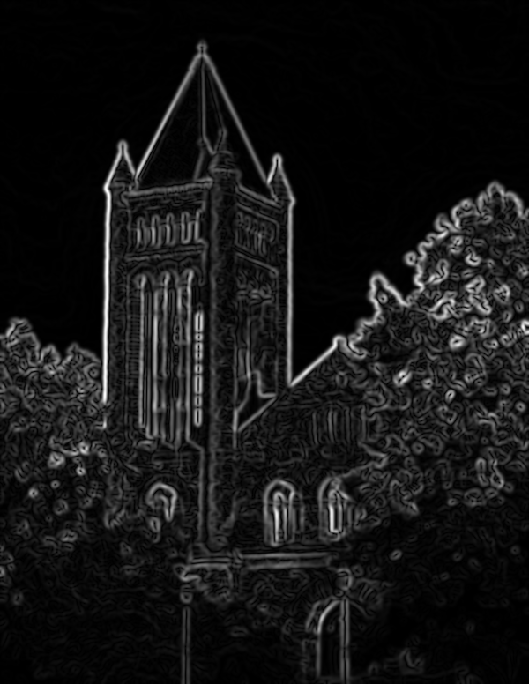
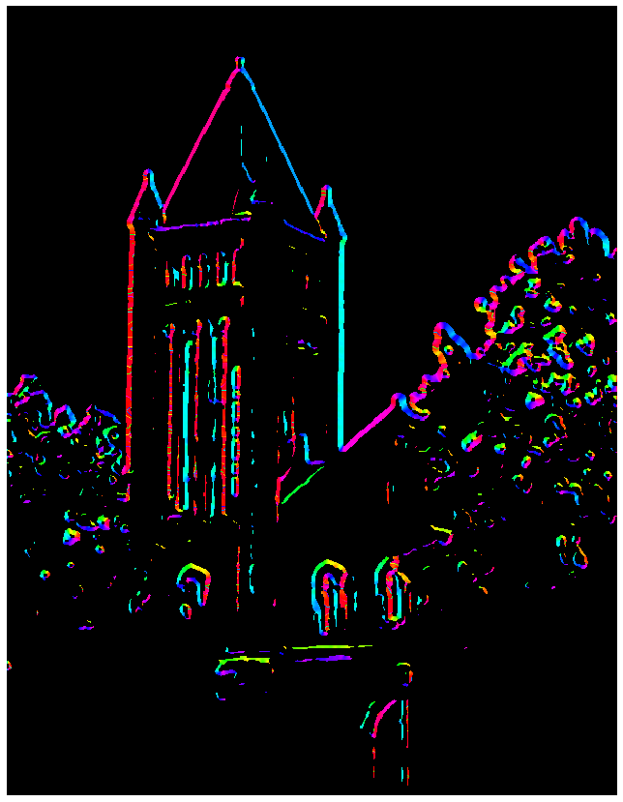


Building an edge detector
Compute$x$and $y$ derivative images
Find magnitude and orientation of the gradient
Source: S. Gupta

Slide 31
Building an edge detector
Compute$x$and $y$ derivative images
Find magnitude and orientation of the gradient
Let’s threshold the gradient magnitude
Source: S. Gupta

Slide 32

Building an edge detector
Compute$x$and $y$ derivative images
Find magnitude and orientation of the gradient
We get thick trails, not neat edge curves
Let’s threshold the gradient magnitude
Source: S. Gupta

Slide 33









Non-maximum suppression
$$q$$
$$r$$
$$q$$
$$p$$
$$p$$
$$q$$
$$r$$
1D image “slice” normal to the edge
For each location $q$ above threshold, check that the gradient magnitude is higher than at adjacent points $p$ and $r$ along the direction of the gradient
  Need to interpolate to get the gradient magnitude values at $p$ and $r$
  Can even use nonlinear interpolation to get sub-pixel edge localization!

Slide 34


Non-maximum suppression
NMS
NMS > threshold
Another problem: pixels along this edge didn’t survive the thresholding
Source: S. Gupta

Slide 35
Hysteresis thresholding
Use a high threshold to start edge curves, and a low threshold to continue them
Source: Steve Seitz

Slide 36

Hysteresis thresholding
high threshold
(strong edges)
low threshold
(weak edges)
hysteresis threshold
Source: S. Gupta

Slide 37

Recap: Canny edge detector
Compute$x$and $y$ derivative images
Find magnitude and orientation of the gradient
Non-maximum suppression:
  Thin wide “ridges” down to single pixel width
Linking and thresholding (hysteresis):
  Define two thresholds: low and high
  Use the high threshold to start edge curves and the low threshold to continue them
J. Canny, A Computational Approach To Edge Detection, IEEE Trans. PAMI, 8:679-714, 1986.

Slide 38
Overview
Motivating edge detection
Image gradients
Derivative of Gaussian filters
Canny edge detector
What is the role of edge detection in image understanding?

Slide 39

Are edges an “input” or an “output”?
Figure from Marr (1982), attributed to R. C. James

Slide 40






Image gradients vs. meaningful contours
Human segmentation
Gradient magnitude
Image
D. Martin, C. Fowlkes, D. Tal, and J. Malik. A Database of Human Segmented Natural Images and its Application to Evaluating Segmentation Algorithms and Measuring Ecological Statistics. ICCV 2001

Slide 41


Data-driven edge detection
Input images
Training data
Ground truth
Output
P. Dollar and L. Zitnick, Structured forests for fast edge detection, ICCV 2013

Slide 42

Data-driven edge detection
S. Xie and Z. Tu, Holistically-nested edge detection, ICCV 2015

Slide 43

Most successful approach in practice: Top-down segmentation
Classification+regression branch
Mask branch: output binary segmentation for each instance
K. He, G. Gkioxari, P. Dollar, and R. Girshick, Mask R-CNN, ICCV 2017 (Best Paper Award)

Slide 44
Overview
Motivating edge detection
Image gradients
Derivative of Gaussian filters
Canny edge detector
Role of edge detection in image understanding
Orientations

Slide 45
Problem:
Scaling the image scales gradient magnitude
Which causes problems with thresholds, etc
- image gets darker, some edges disappear
- image gets lighter, some edges appear
Hysteresis helps, but doesn’t cure

Slide 46
Gradient orientations don’t change with illumination
Q: build a representation out of orientations?

Slide 47


Slide 48

Orientation histograms
Rose plot, which shows
number of vectors at each range of angles

Slide 49

Orientation histogram depends on scale

Slide 50

Different patterns have different orientation histograms

Slide 51
Notice something important…

