Slide 1
Voting and its applications
Recall:
Idea: vector quantization and voting
There are a variety of uses for voting

Slide 2

Voting for lines
Data: $(x1, y1), …, (xn, yn)$
Line equation: $y = m x + b$
Parameters of line

Slide 3
Hough transform
Possibly the earliest voting scheme – but still useful!
  Discretize parameter space into bins
  For each feature point in the image, put a vote in every bin in the parameter space that could have generated this point
  Find bins that have the most votes
Image space
Hough parameter space
P.V.C. Hough, Machine Analysis of Bubble Chamber Pictures, Proc. Int. Conf. High Energy Accelerators and Instrumentation, 1959

Slide 4





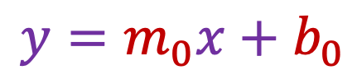
Hough transform
What does a line in the image space correspond to?
  A point in the parameter space
$$y$$
$$m$$
$$y=m_{0}x+b_{0}$$
$$\left(m_{0},b_{0}\right)$$
$$x$$
$$b$$
Image space
Parameter space

Slide 5
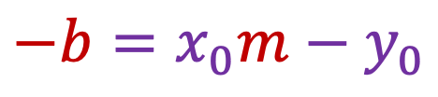

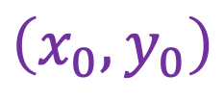
Hough transform
What does a point in the image space correspond to?
  A line in the parameter space: all $(m,b)$ that satisfy $−b=x_{0}m−y_{0}$
$$y$$
$$m$$
$$−b=x_{0}m−y_{0}$$
$$\left(x_{0},y_{0}\right)$$
$$x$$
$$b$$
Image space
Parameter space

Slide 6

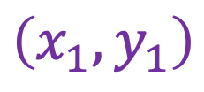
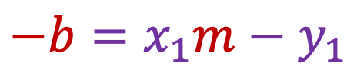
Hough transform
What about two points in the image space?
  A point in the parameter space, corresponding to the unique line that passes through both points
$$y$$
$$m$$
$$\left(x_{1},y_{1}\right)$$
$$−b=x_{0}m−y_{0}$$
$$−b=x_{1}m−y_{1}$$
$$\left(x_{0},y_{0}\right)$$
$$x$$
$$b$$
Image space
Parameter space

Slide 7
Hough transform
What about many points in the image space?
  Plot all the lines in the parameter space and try to find a spot where a large number of them intersect
$$y$$
$$m$$
$$x$$
$$b$$
Image space
Parameter space

Slide 8
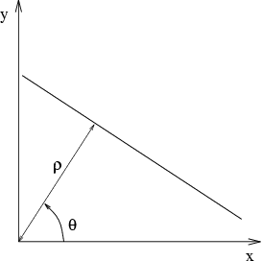
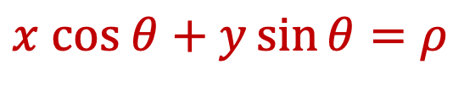

Parameter space representation
In practice, we don’t want to use the $(m,b)$ space!
  Unbounded parameter domains
  Vertical lines require infinite $m$
Alternative: polar representation
  Each image point $(x,y)$ yields a sinusoid in the $(θ,ρ)$ parameter space
$$x cos θ+y\sin{θ}=ρ$$

Slide 9


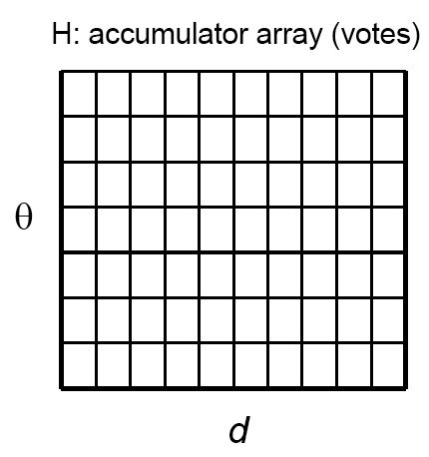
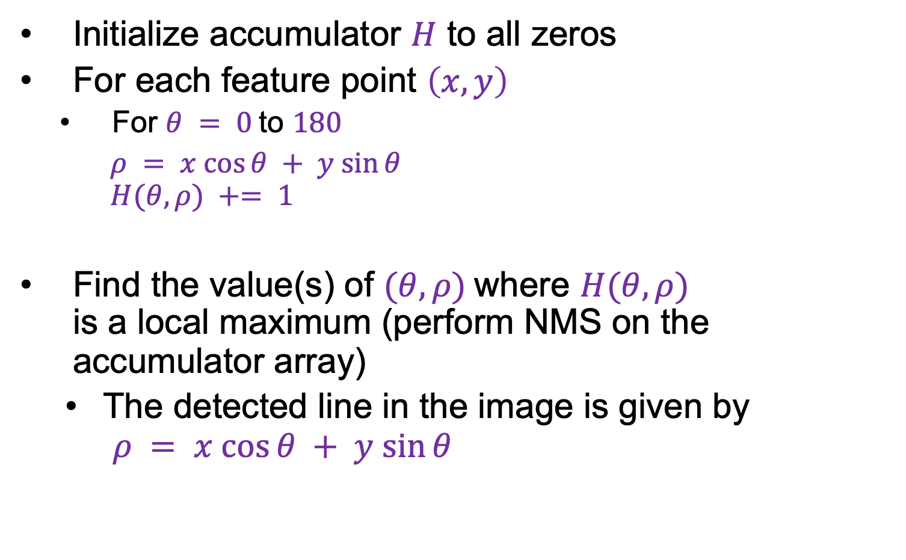
Algorithm outline
Initialize accumulator $H$ to all zeros
For each feature point $\left(x,y\right)$
  For $θ = 0$to $180$
  $ρ = x cos⁡θ + y sin⁡θ$
  $H(θ, ρ) += 1$
Find the value(s) of $(θ, ρ)$where $H(θ, ρ)$
is a local maximum (perform NMS on the accumulator array)
  The detected line in the image is given by
  $ρ = x cos⁡θ + y sin⁡θ$
$$ρ$$
$$θ$$

Slide 10
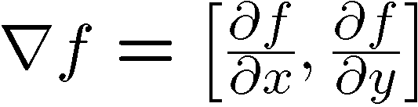


Incorporating image gradients
For each edge point $(x,y)$
$θ =$ gradient orientation at $(x,y)$
$ρ = x cos⁡θ + y sin⁡θ$
$H(θ, ρ) += 1$

Slide 11
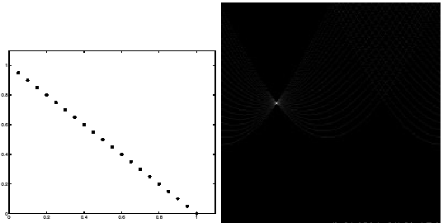
Basic illustration
features
votes
Hough transform demo
Notes:
Figure 15.1, top half. Note that most points in the vote array are very dark, because they
get only one vote.

Slide 12
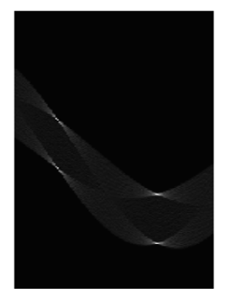
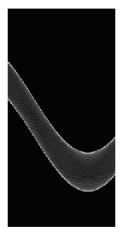
Other shapes
Square
Circle

Slide 13
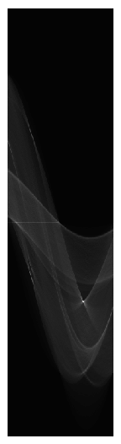
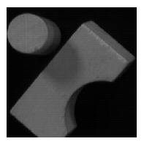
Several lines

Slide 14
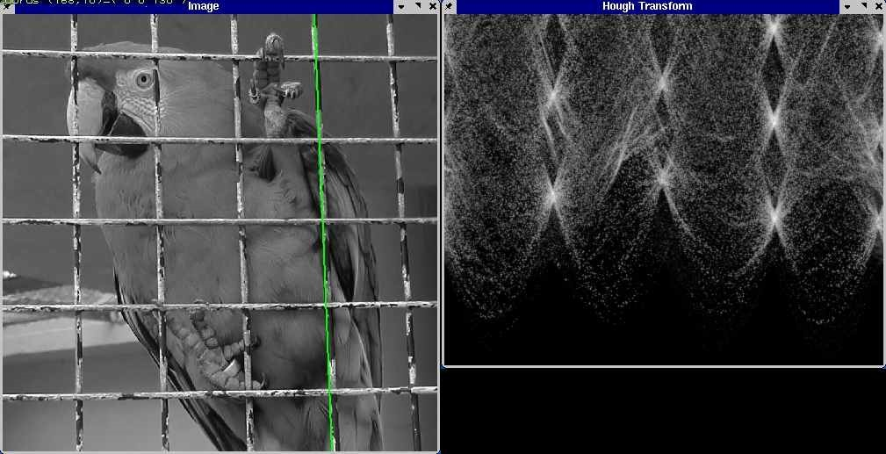
A more complicated image
Source

Slide 15
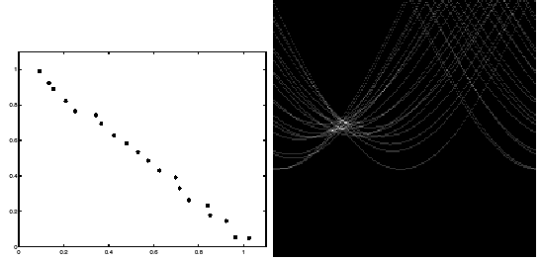
Effect of noise
features
votes
Notes:
This is 15.1 lower half

Slide 16
Effect of noise
features
votes
Peak gets fuzzy and hard to locate
Notes:
This is 15.1 lower half

Slide 17
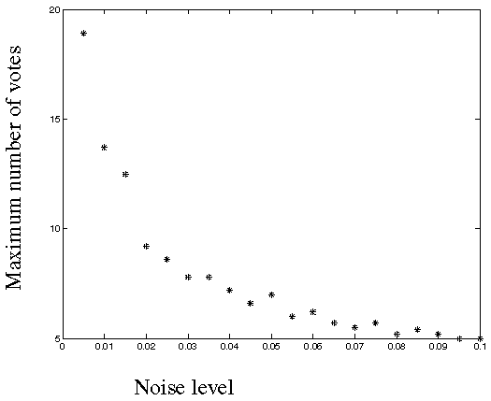
Effect of noise
Number of votes for a line of 20 points with increasing noise:
Notes:
This is the number of votes that the real line of 20 points gets with increasing noise (figure15.3)

Slide 18
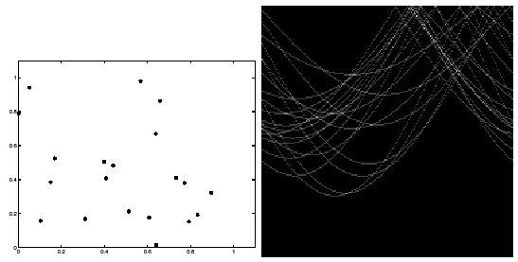
Effect of outliers
features
votes
Uniform noise can lead to spurious peaks in the array
Notes:
15.2; main point is that lots of noise can lead to large peaks in the array

Slide 19
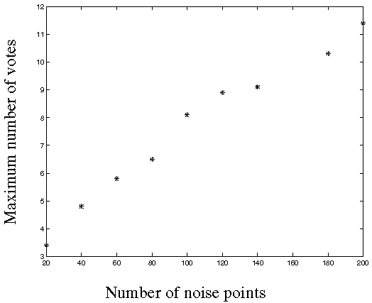
Effect of outliers
As the level of uniform noise increases, the maximum number of votes increases too:
Notes:
Figure 15.4; as the noise increases in a picture without a line, the number of points in the max cell goes
up, too

Slide 20
Dealing with noise
How to choose a good grid discretization?
  Too coarse: large votes obtained when too many different lines correspond to a single bucket
  Too fine: miss lines because some points that are not exactly collinear cast votes for different buckets
Increment neighboring bins (smoothing in accumulator array)
Try to get rid of irrelevant features
  E.g., take only edge points with significant gradient magnitude

Slide 21
Hough transform for circles
How many dimensions will the parameter space have?
Given an unoriented edge point, what are all possible bins that it can vote for?
What about an oriented edge point?

Slide 22
Hough transform for circles
image space
Hough parameter space
r
y
(x,y)
x
x
y

Slide 23
Hough transform: Pros and cons
Pros
  Can deal with non-locality and occlusion
  Can detect multiple instances of a model
  Some robustness to noise: noise points unlikely to contribute consistently to any single bin
  Leads to a surprisingly general strategy for shape localization
  (more on this next)
Cons
  Complexity increases exponentially with the number of model parameters – in practice, not used beyond three or four dimensions
  Non-target shapes can produce spurious peaks in parameter space
  It’s hard to pick a good grid size

Slide 24
Fitting: Overview
Least squares line fitting
Robust fitting
RANSAC
Hough transform
Generalized Hough transform

Slide 25
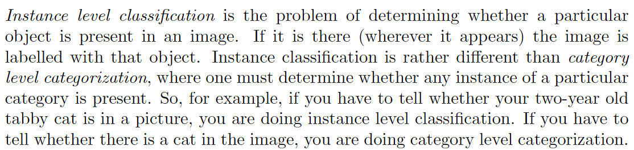
Instance level classification (and detection)

Slide 26
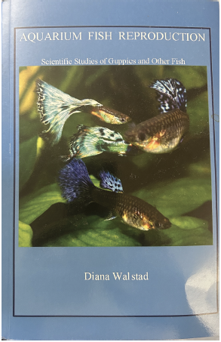
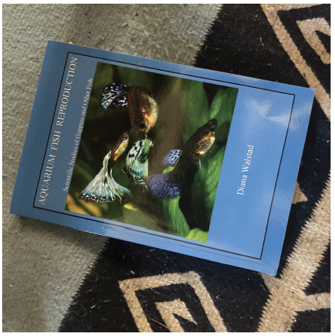
Example: Find the book
Get pictures of book covers, and attach book name
Now find the book cover in some other image

Slide 27
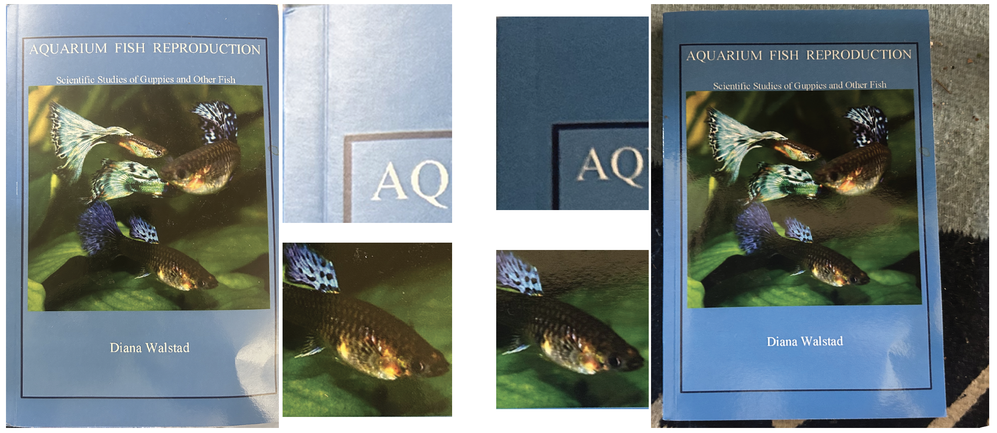
Can’t do this with SSD; patches might work
Notice changes in color caused by changes in lighting

Slide 28
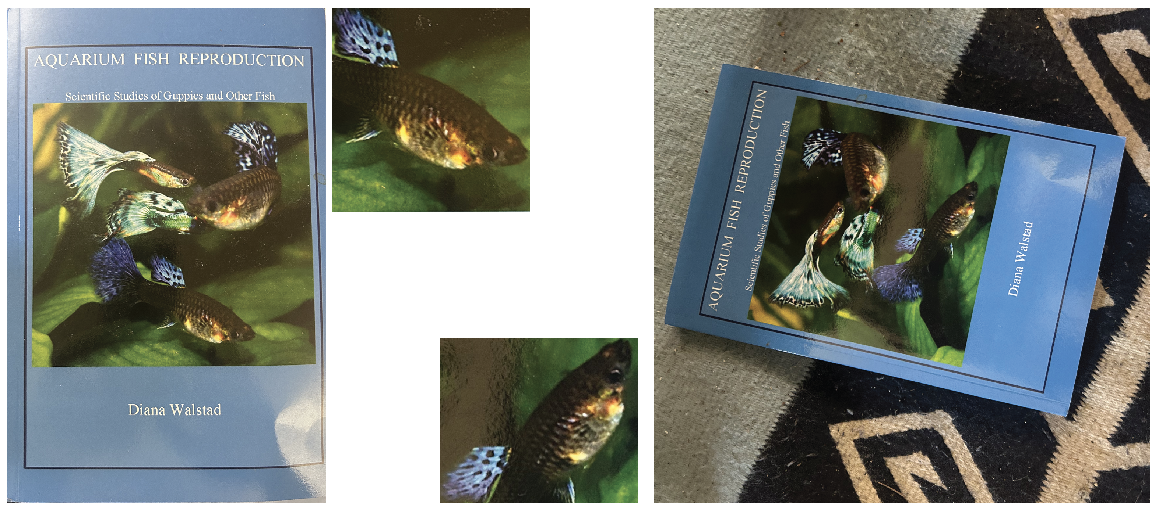
Can’t do this with SSD; patches might work
Notice changes in appearance caused by rotation

Slide 29
Simplest patch algorithm (not much good)
Make a tree of cover image patches (with labels)
For test image, pass patches down tree, vote
Vote how?:
most common book in leaf
one vote for each book in leaf
vote for ANN patches label
Issues:
every patch votes, so there must be junk votes (easily fixed)
tree doesn’t know you’re using it for labelling, may not be efficient
rotation (perhaps insert patches at many rotations?)

Slide 30
Using interest points
Make a tree of cover image interest points (with labels)
You can do this cause interest point descriptors are vectors of fixed length. They’re nearby when interest points are similar.
For test image, pass interest points down tree, vote
Vote how?:
most common book in leaf
one vote for each book in leaf
vote for ANN interest point label
Issues:
every patch votes, so there must be junk votes (easily fixed)
tree doesn’t know you’re using it for labelling, may not be efficient
rotation (perhaps insert patches at many rotations?)

Slide 31
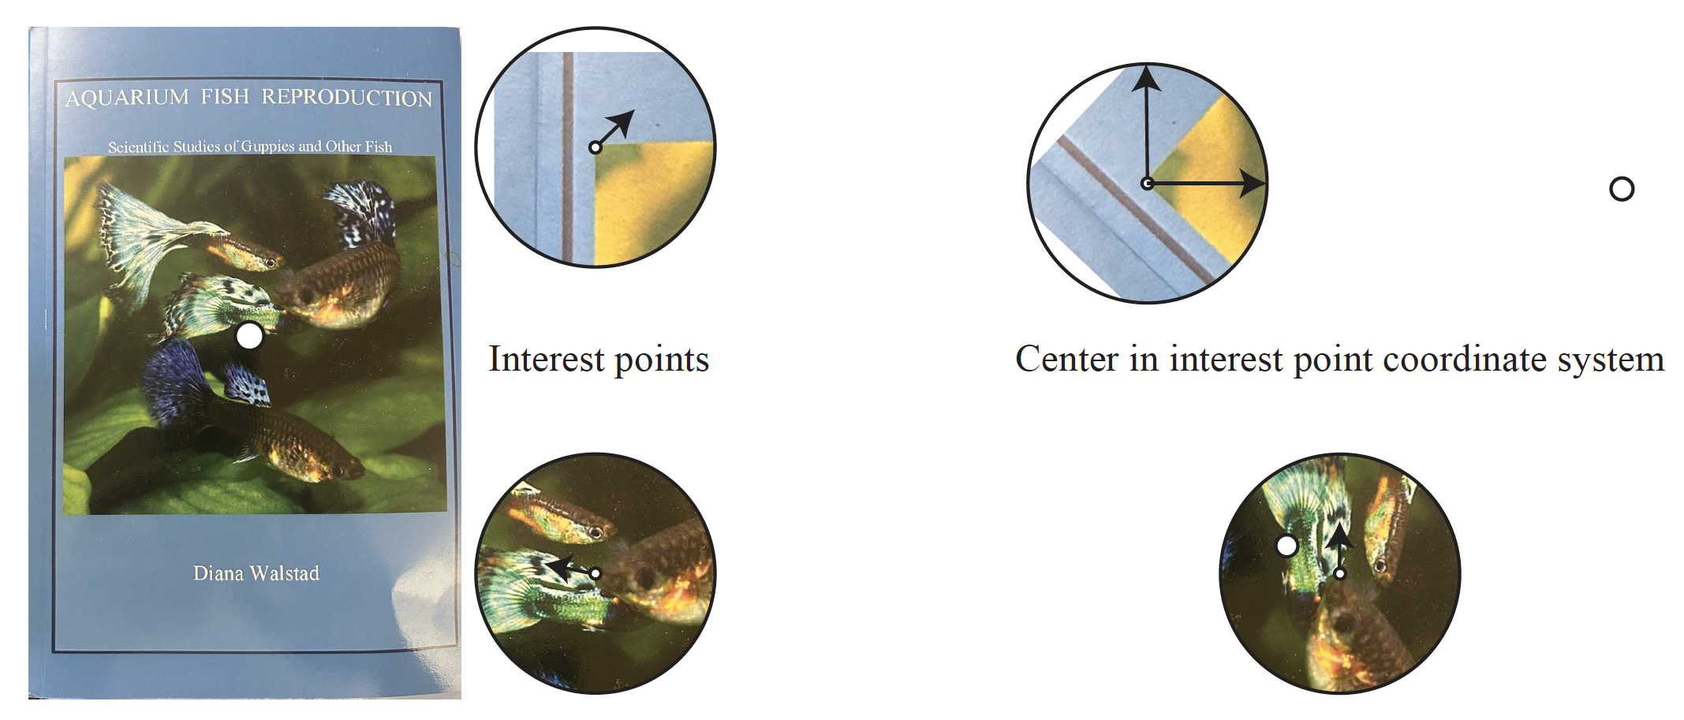
Every patch votes – generalized Hough transform
Each interest point has a coordinate system,
so it “knows” where the center of the book is

Slide 32
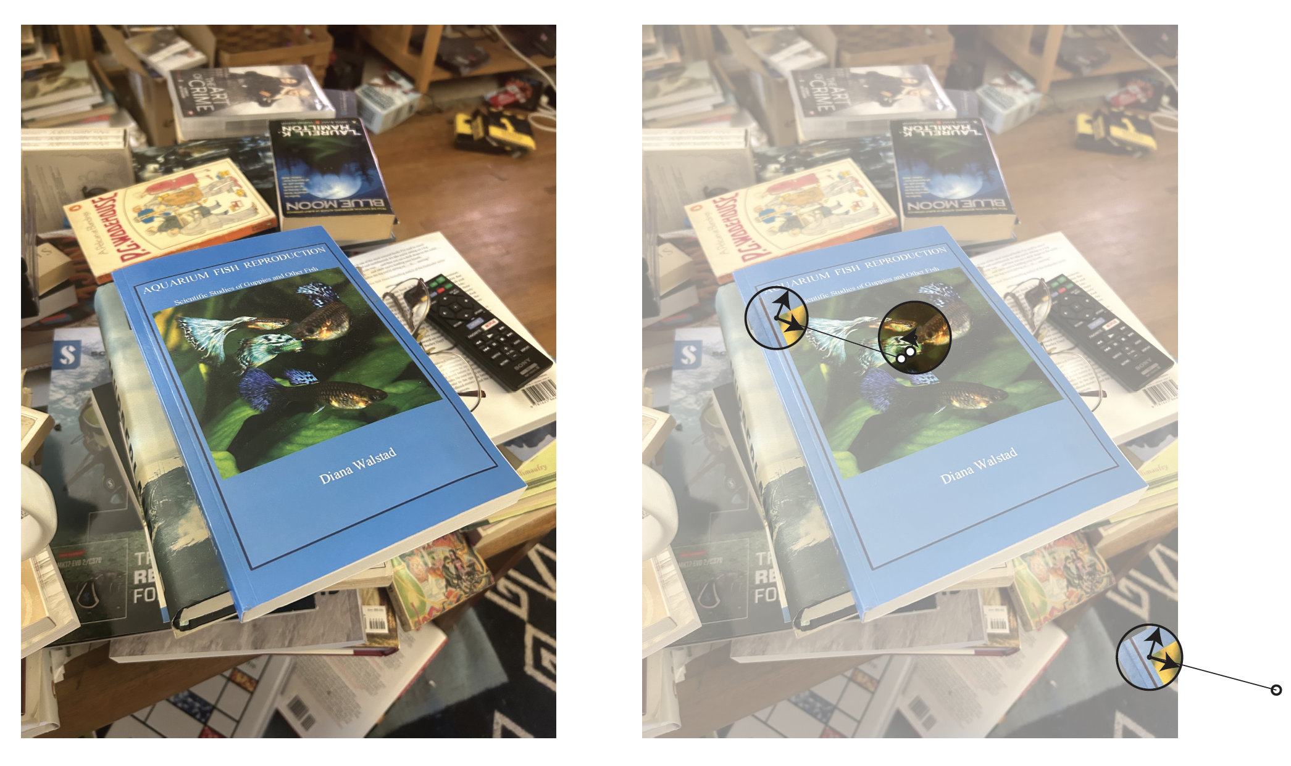
Every patch votes – generalized Hough transform
Allow an interest point to vote for a book only if another one agrees with center

Slide 33
Every patch votes – generalized Hough transform
Allow an interest point to vote for a book only if another one agrees with center
How?
build an accumulator array for book centers,
accumulate votes
scan it to check for “big” votes – do they agree on book label?

Slide 34
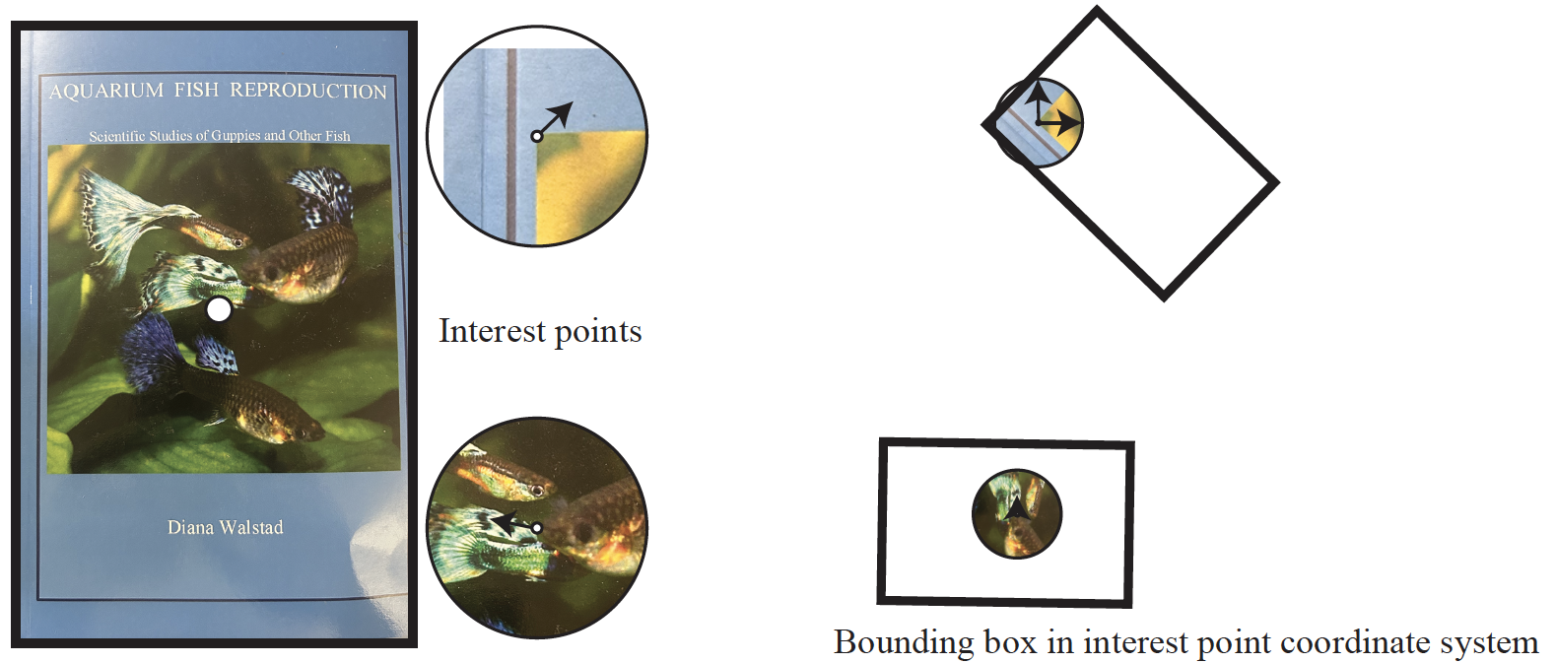
Every patch votes – generalized Hough transform
Interest points know other stuff – the outline of the book

Slide 35
We now have…
A primitive classifier
What book is in this image?
A primitive detector
What books are in this image, and where are they?
There are more accurate technologies,
tend to be slower, require more compute
This one is extremely fast and very efficient, particularly with an improved tree

Slide 36
The tree
Current construction:
Hierarchical k-means
This breaks up each node into leaves whose elements are close to one another.
But this isn’t what we want
Decision tree:
Break each node into leaves where leaves are “informative” about label
eg in binary tree, labels on the left are all different from labels on the right

Slide 37
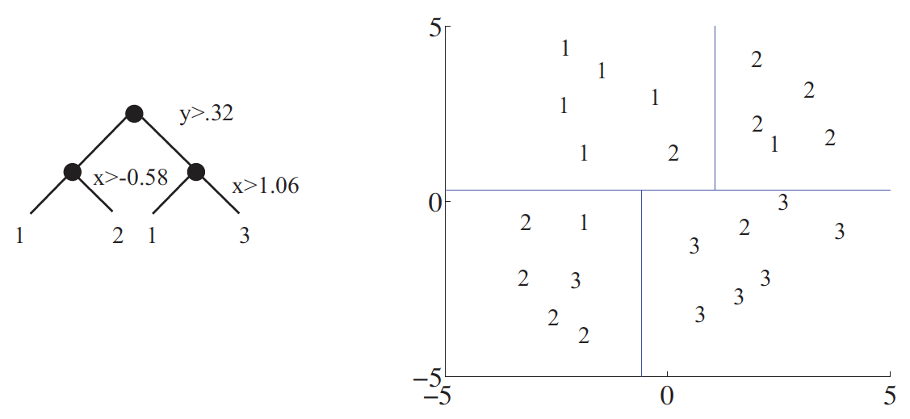
Decision trees
For us:
tree is now binary
split is test a single dimension against a threshold
As cells in 2D
As tree

Slide 38
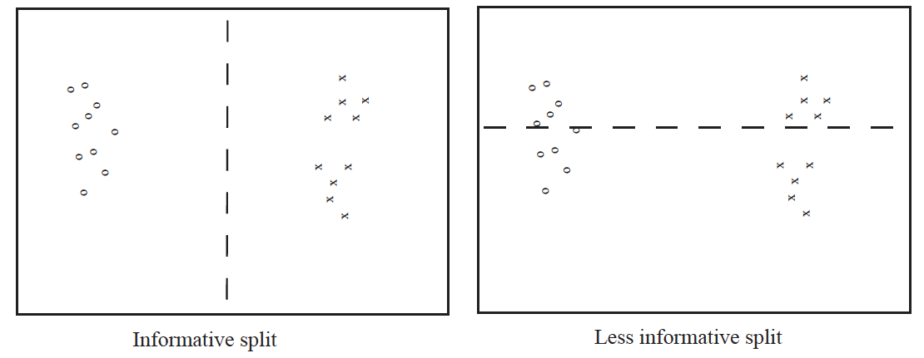
Idea: randomized search for informative splits
Informative split:
We know more about the likely label if we know which side we’re on

Slide 39
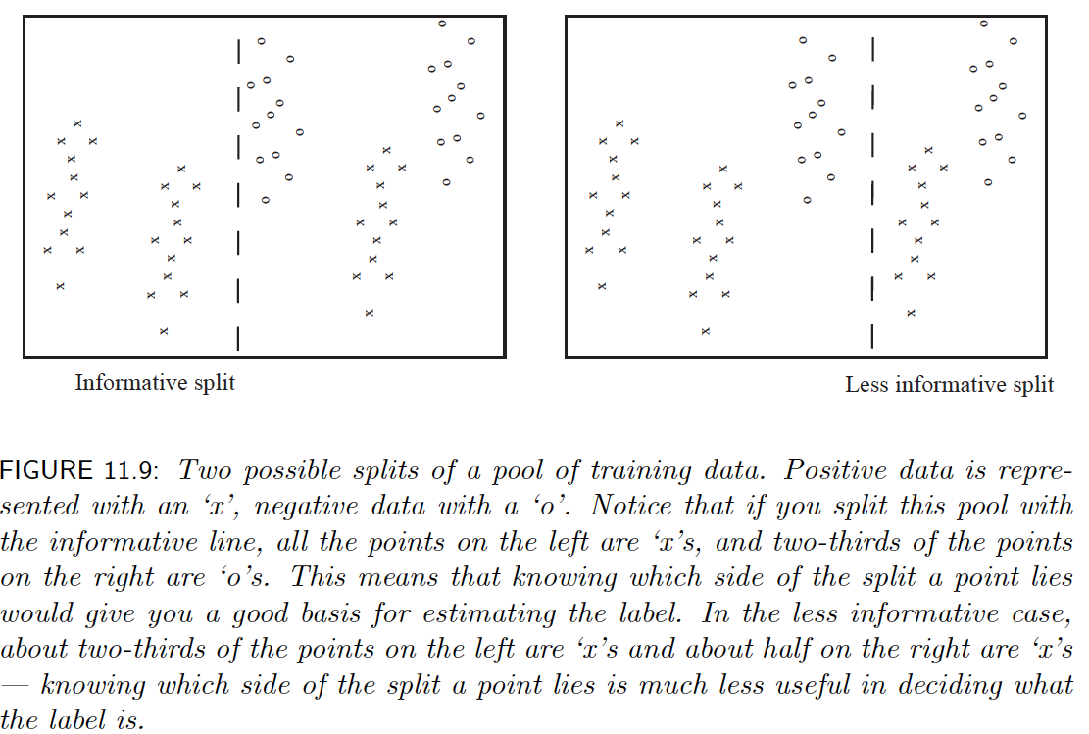
Harder case

Slide 40
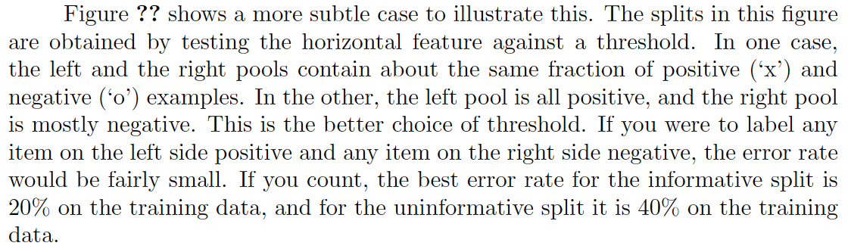
Harder case

Slide 41
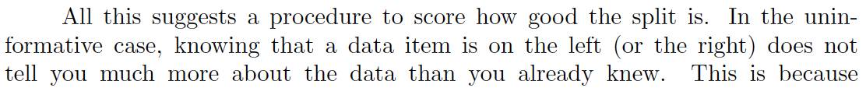
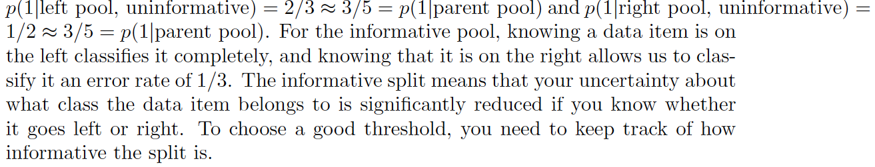
Harder case

Slide 42
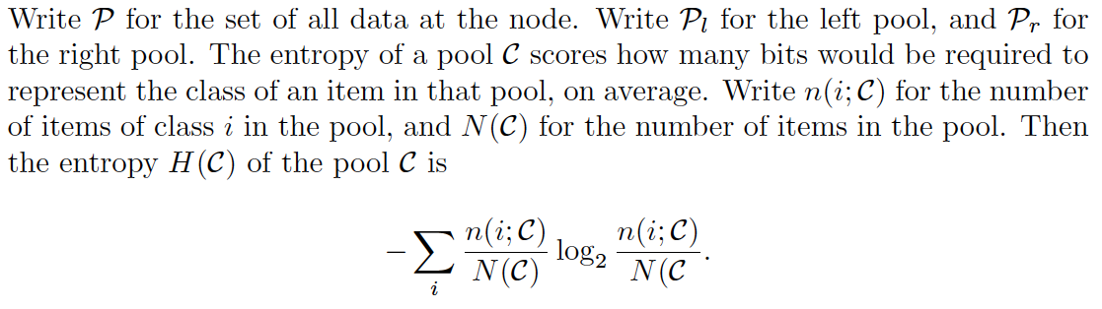
The entropy of a labelled pool of data
Q: how much information do I need to supply to know the label of a randomly selected example?
A: Entropy
could be as small as 0 (all labels the same)

Slide 43
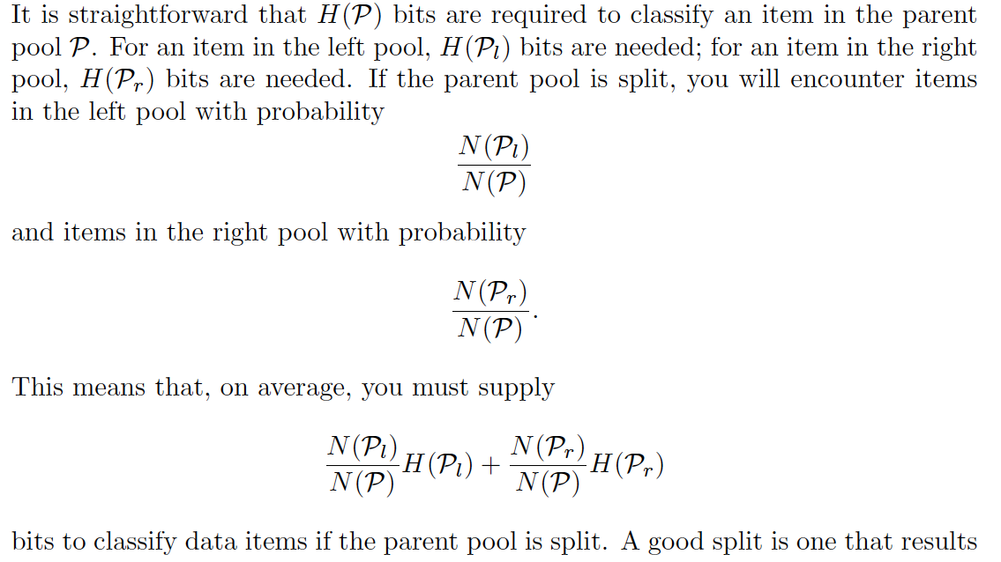
What does a split do?

Slide 44
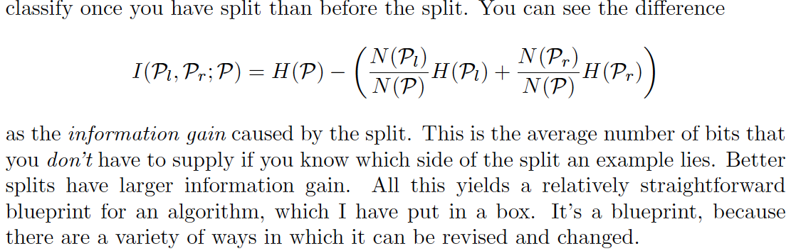
Scoring a split

Slide 45
Scoring a split

Slide 46
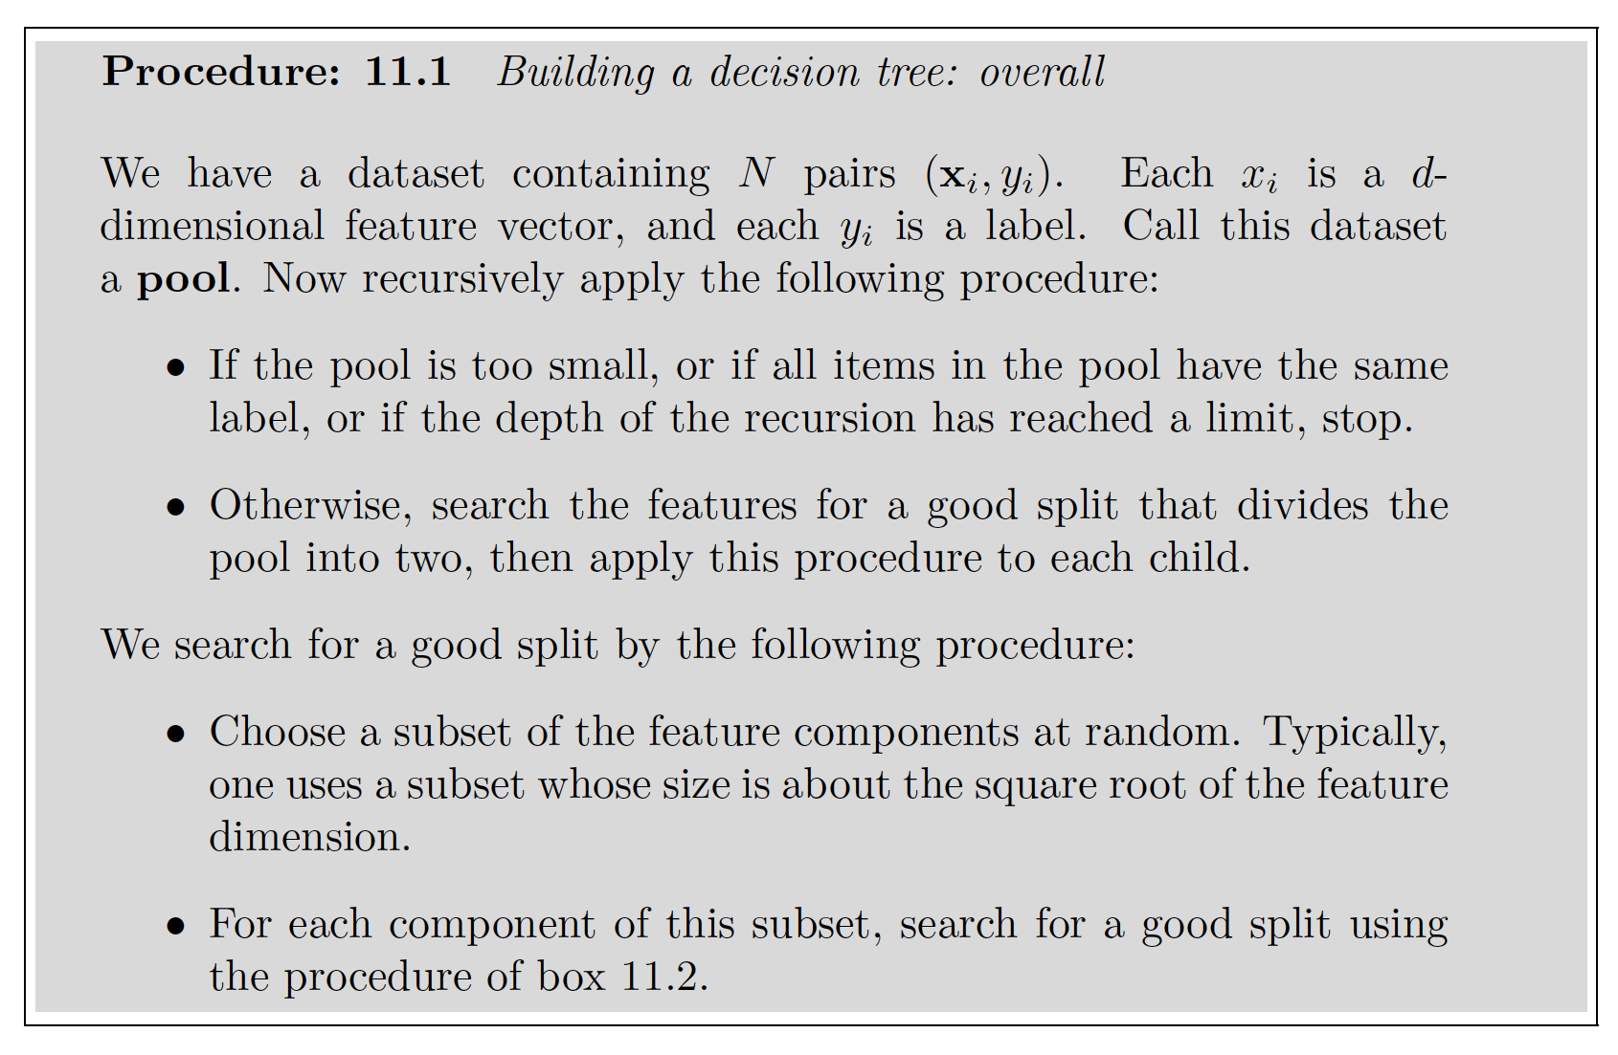
Building a tree

Slide 47
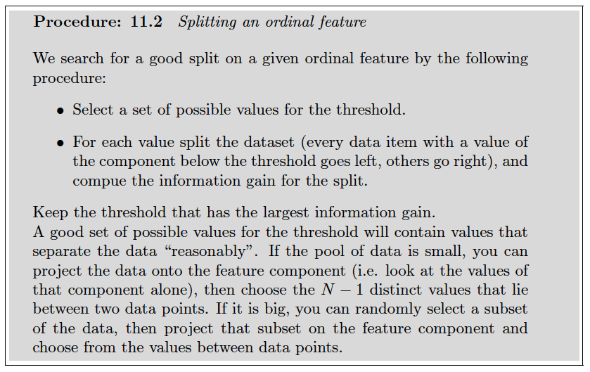
Building a tree - II

Slide 48
Forests
Use this tree the same way you’d use the HKM tree
pass interest points down, pick up votes at leaves
It isn’t spectacular, and it can’t be the best tree
random components in construction
Idea:
build multiple trees and vote over them, too – a decision forest
Variants:
subsample training dataset and train each tree on a different sample (bagging)

Slide 49
Why bother?
Quite accurate classifiers that are fantastically fast at run-time
Can use very little compute
Used in consumer devices
eg Kinect body configuration detection (now gone)

