Slide 1
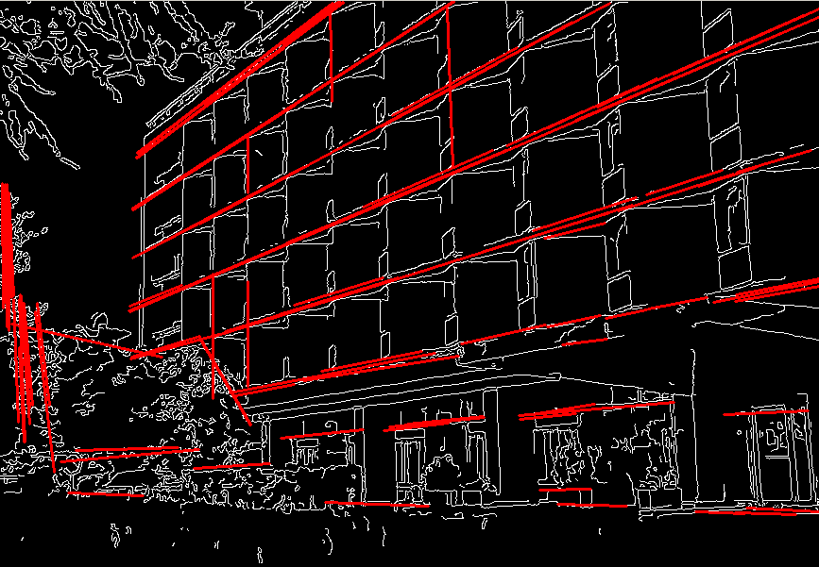
Fitting

Slide 2
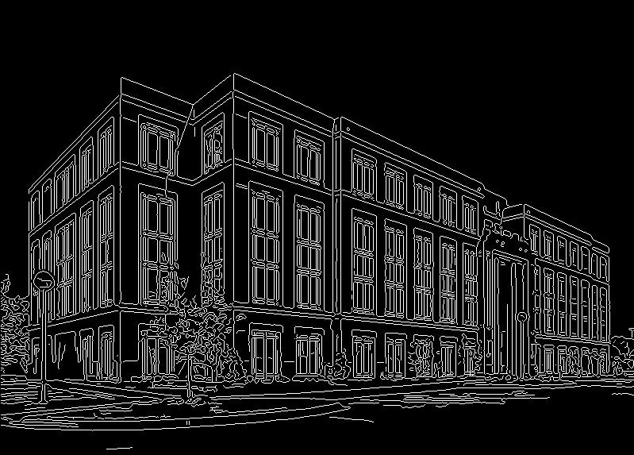
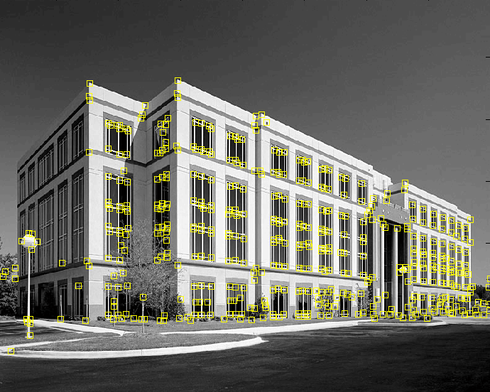
Fitting
We’ve learned how to detect edges, corners, blobs. Now what?
We would like to form a higher-level, more compact representation of the features in the image by grouping multiple features according to a simple model

Slide 3
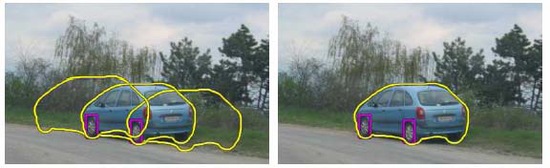
Fitting
Choose a parametric model to represent a set of features
simple model: lines
simple model: circles
complicated model: car
Source: K. Grauman

Slide 4
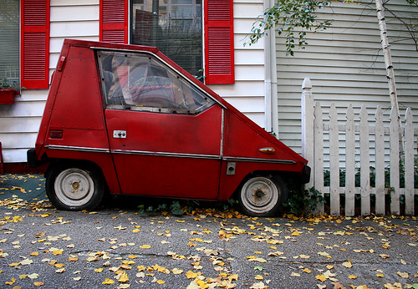
Fitting: Challenges
Case study: Line detection
Noise in the measured feature locations
Extraneous data: clutter (outliers), multiple lines
Missing data: occlusions

Slide 5
Fitting: Overview
Least squares line fitting
Robust fitting
RANSAC

Slide 6
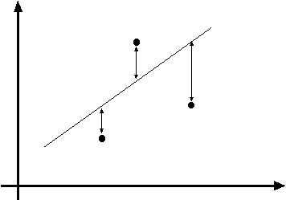

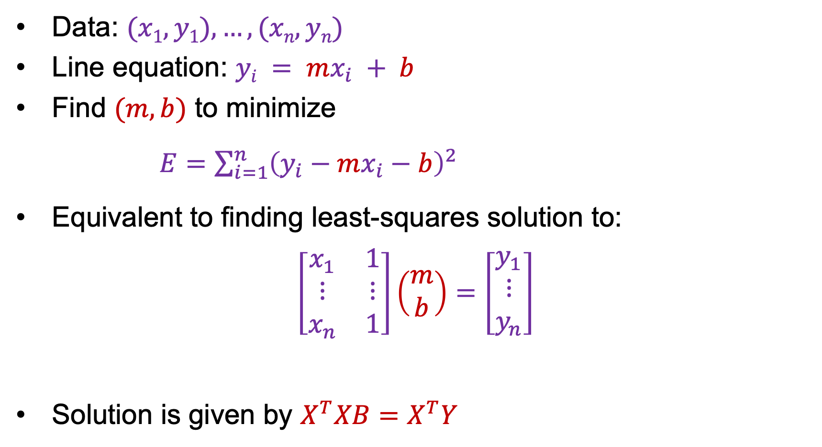




Least squares line fitting: First attempt
Data: $(x1, y1), …, (xn, yn)$
Line equation: $yi = mx_{i} + b$
Find $(m, b)$ to minimize
$E=\sum_{i=1}^{n}{{\left(y_{i}−mx_{i}−b\right)}^{2}}$
Equivalent to finding least-squares solution to:
$$\left[\begin{matrix}x_{1} & 1 \\ ⋮ & ⋮ \\ x_{n} & 1\end{matrix}\right]\left(\begin{aligned}m \\ b\end{aligned}\right)=\left[\begin{aligned}y_{1} \\ ⋮ \\ y_{n}\end{aligned}\right]$$
Solution is given by $X^{T}XB=X^{T}Y$
$$y=mx+b$$
$$(x_{i}, yi)$$
$$X$$
$$B$$
$$Y$$

Slide 7
Is this a good solution?
Slope-intercept parametrization fails for vertical lines
Solution is not equivariant w.r.t. rotation

Slide 8
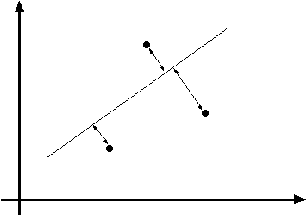
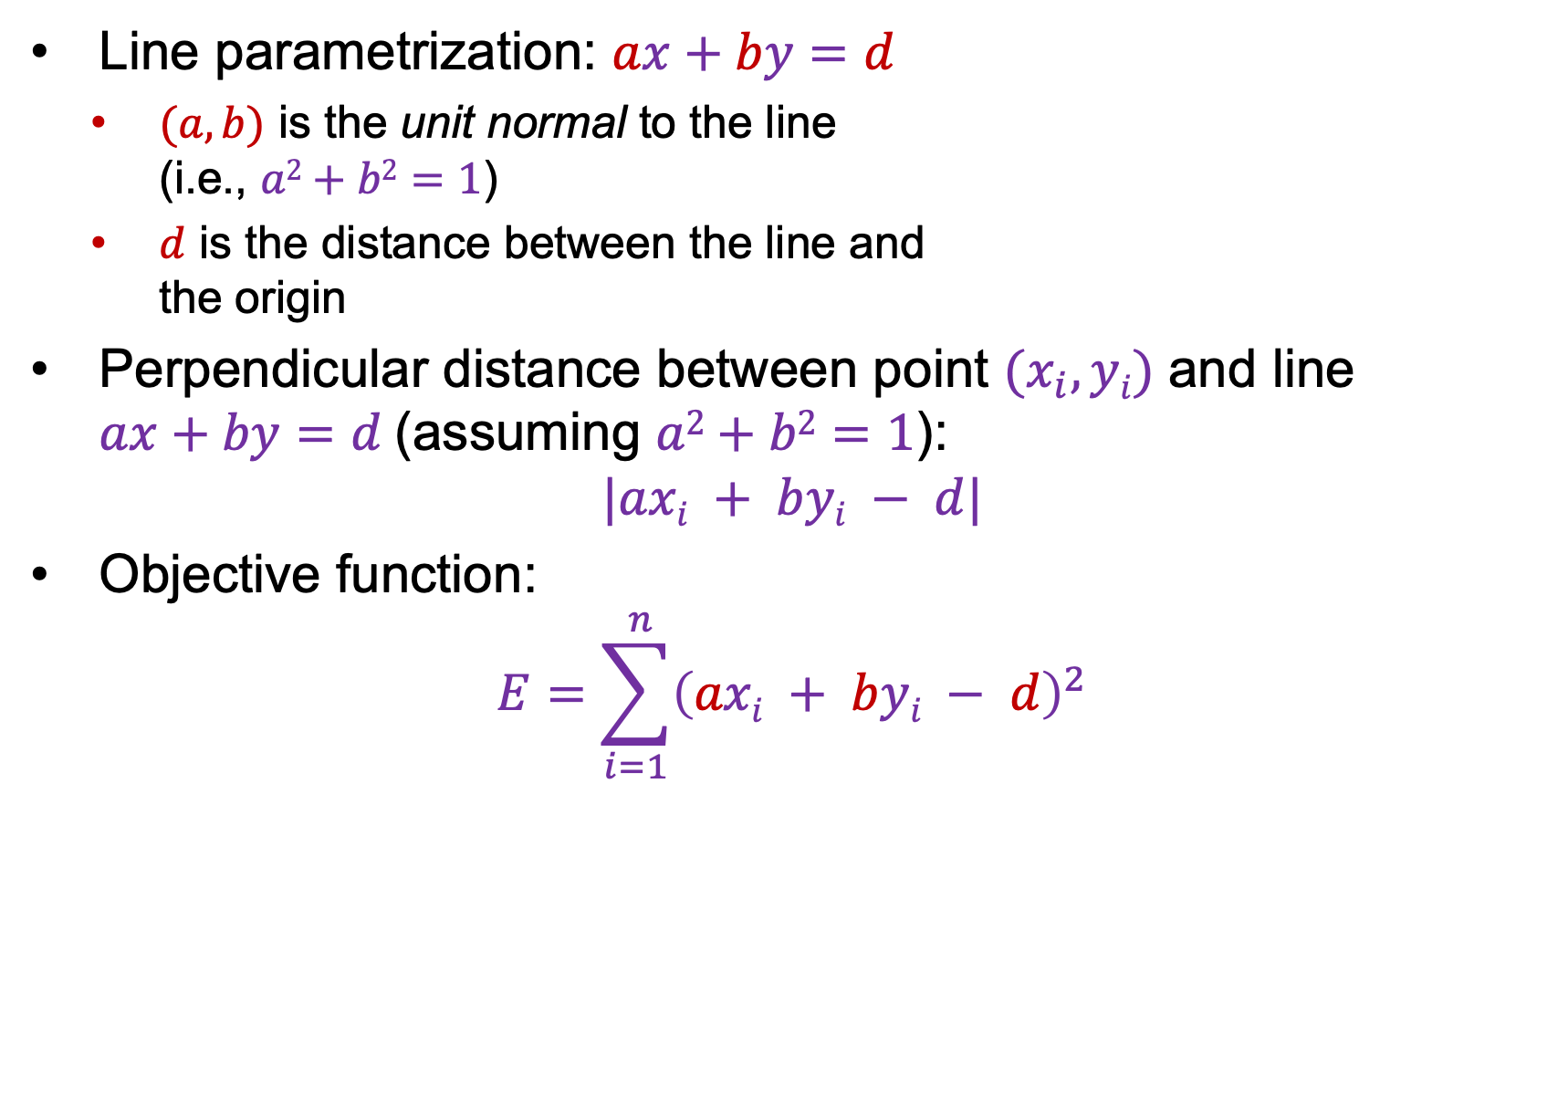


Total least squares
$$ax+by=d$$
Line parametrization: $ax+by=d$
  $(a,b)$ is the unit normal to the line
  (i.e., $a2+b2=1$)
  $d$ is the distance between the line and
  the origin
Perpendicular distance between point $(x_{i}, yi)$ and line
$ax+by=d$ (assuming $a2+b2=1$):
$$|axi + byi − d|$$
Objective function:
$$E=\sum_{i=1}^{ n}{{\left(axi + byi − d\right)}^{2}}$$
$$(x_{i}, yi)$$

Slide 9

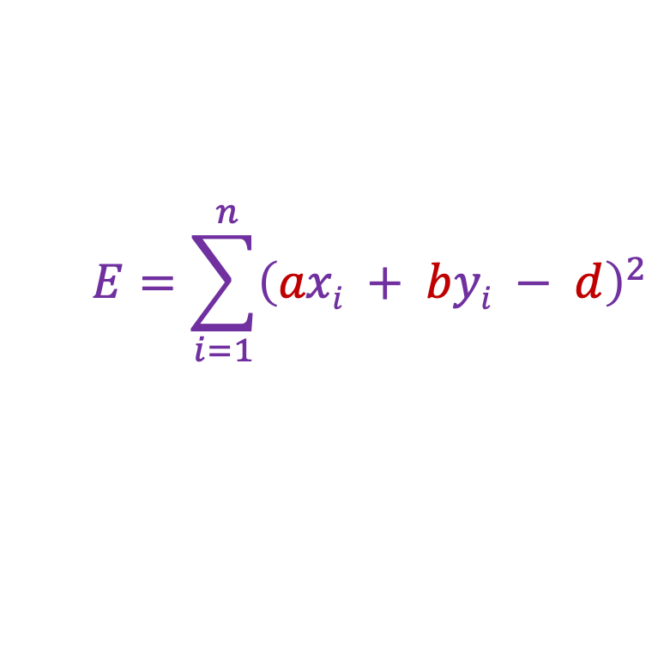
Total least squares
$$E=\sum_{i=1}^{ n}{{\left(axi + byi − d\right)}^{2}}$$
$$ax+by=d$$
$$(x_{i}, yi)$$
Solve for $d$ first:
$\frac{∂E}{∂d}=−2\sum_{i=1}^{ n}{\left(axi + byi − d\right)}=0$
$d=\frac{a}{n}\sum_{i=1}^{ n}{xi}+\frac{b}{n}\sum_{i=1}^{ n}{yi}$ $=a\overline{x}+b\overline{y}$

Slide 10
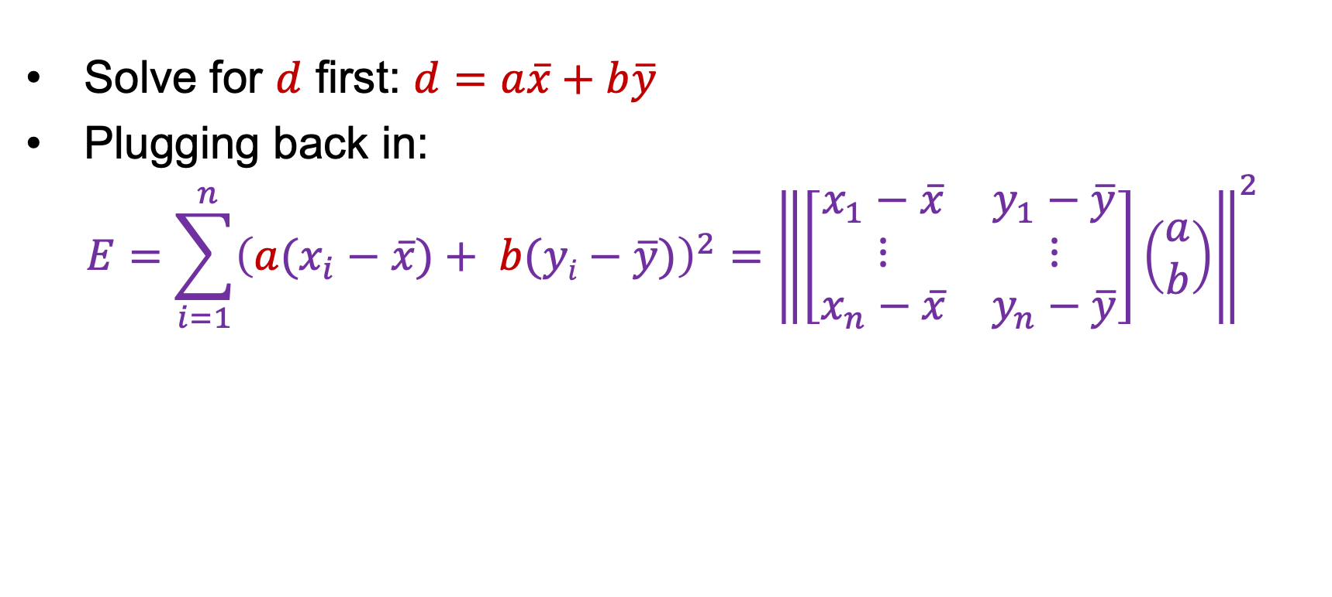
Total least squares
$$E=\sum_{i=1}^{ n}{{\left(axi + byi − d\right)}^{2}}$$
$$ax+by=d$$
$$(x_{i}, yi)$$
Solve for $d$ first: $d$ $=a\overline{x}+b\overline{y}$
Plugging back in:
$$E=\sum_{i=1}^{ n}{{\left(a(x_{i}−\overline{x})+ b(yi−\overline{y})\right)}^{2}}={\left\|\left[\begin{matrix}x_{1}−\overline{x} & y_{1}−\overline{y} \\ ⋮ & ⋮ \\ x_{n}−\overline{x} & y_{n}−\overline{y}\end{matrix}\right]\left(\begin{aligned}a \\ b\end{aligned}\right)\right\|}^{2}$$

Slide 11

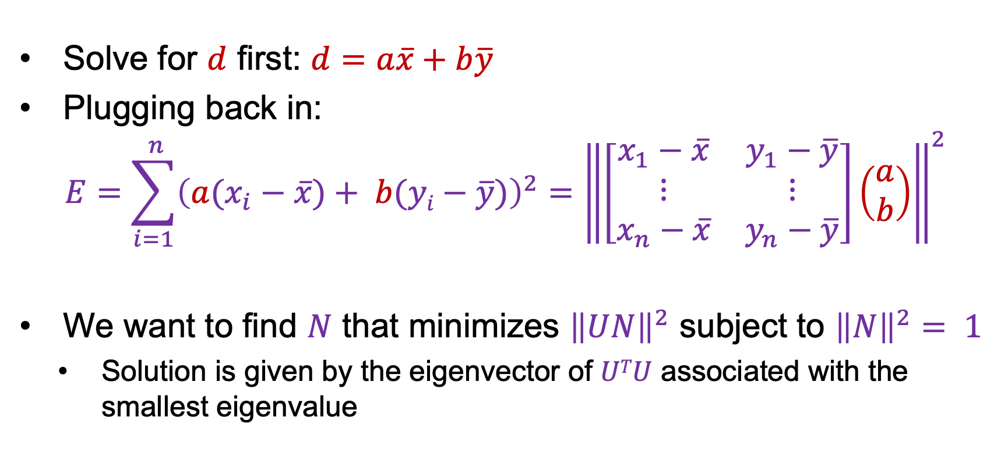


Total least squares
$$E=\sum_{i=1}^{ n}{{\left(axi + byi − d\right)}^{2}}$$
$$ax+by=d$$
$$(x_{i}, yi)$$
Solve for $d$ first: $d$ $=a\overline{x}+b\overline{y}$
Plugging back in:
$$E=\sum_{i=1}^{ n}{{\left(a(x_{i}−\overline{x})+ b(yi−\overline{y})\right)}^{2}}={\left\|\left[\begin{matrix}x_{1}−\overline{x} & y_{1}−\overline{y} \\ ⋮ & ⋮ \\ x_{n}−\overline{x} & y_{n}−\overline{y}\end{matrix}\right]\left(\begin{aligned}a \\ b\end{aligned}\right)\right\|}^{2}$$
We want to find $N$ that minimizes ${\left\|UN\right\|}^{2}$ subject to ${\left\|N\right\|}^{2}= 1$
  Solution is given by the eigenvector of $UTU$ associated with the smallest eigenvalue
$$U$$
$$N$$

Slide 12
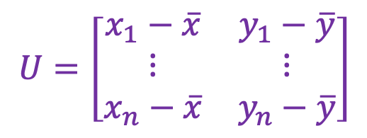
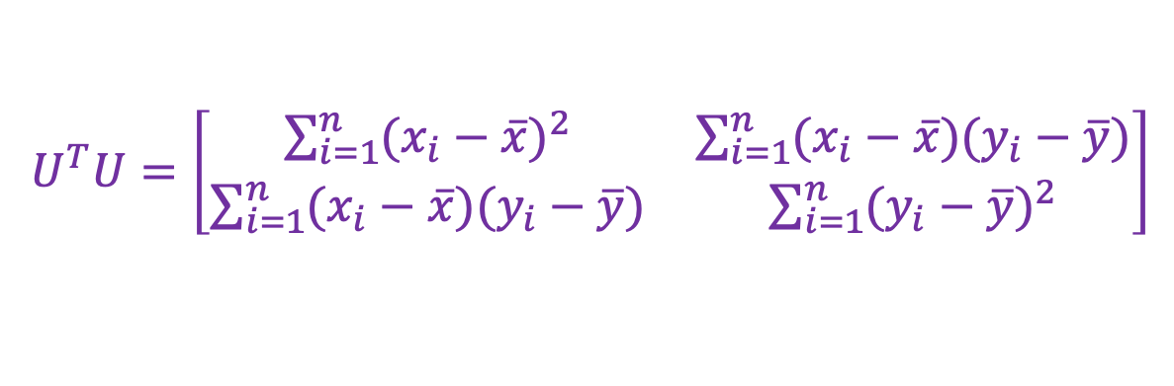
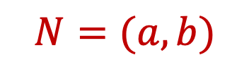
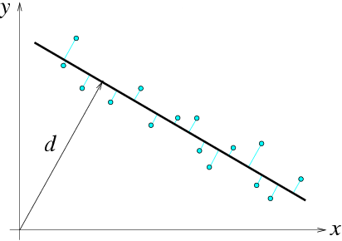
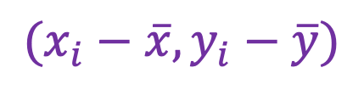
Total least squares
$$U=\left[\begin{matrix}x_{1}−\overline{x} & y_{1}−\overline{y} \\ ⋮ & ⋮ \\ x_{n}−\overline{x} & y_{n}−\overline{y}\end{matrix}\right]$$
$U^{T}U=\left[\begin{matrix}\sum_{i=1}^{n}{{(x_{i}−\overline{x})}^{2}} & \sum_{i=1}^{n}{(x_{i}−\overline{x})(y_{i}−\overline{y})} \\ \sum_{i=1}^{n}{(x_{i}−\overline{x})(y_{i}−\overline{y})} & \sum_{i=1}^{n}{{(y_{i}−\overline{y})}^{2}}\end{matrix}\right]$
second moment matrix
$$N=(a, b)$$
$$(x_{i}−\overline{x},y_{i}−\overline{y})$$
F&P (2nd ed.) sec. 22.1

Slide 13
Application: Computing surface normals
Assume at every pixel you have distance to the 3D point (depth)
write: d(i, j)
You would like to know the surface normal at each point.
Strategy:
fit a plane to the a group of points in 3D
use the normal of that plane

Slide 14
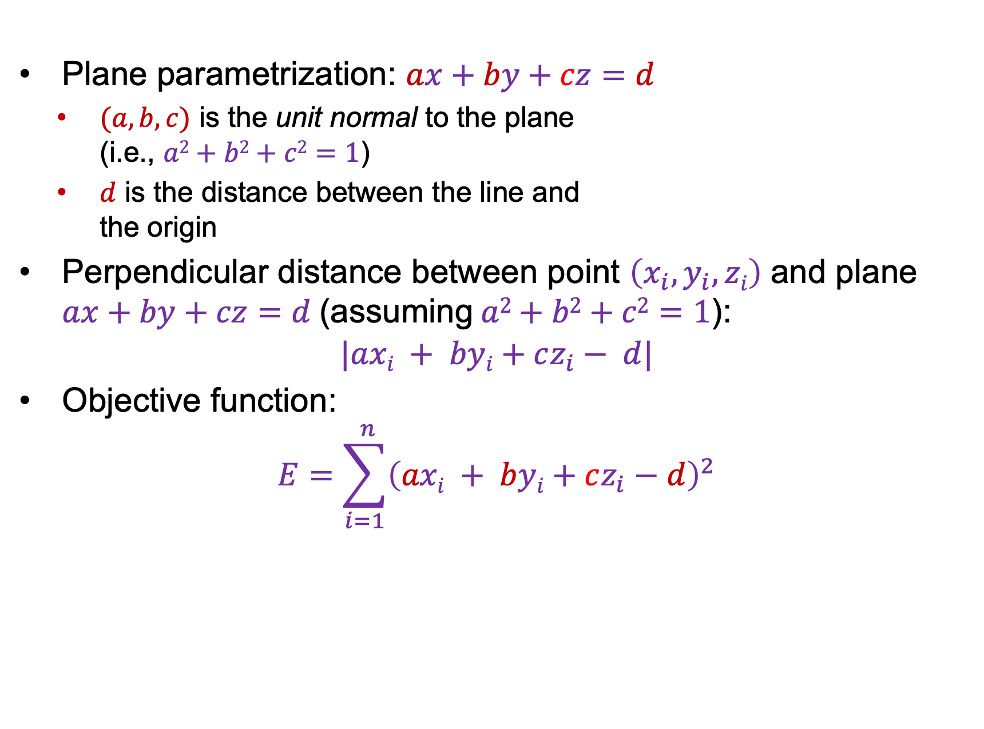
Fitting a plane in 3D (Very much like fitting a line in 2D)
Plane parametrization: $ax+by+cz=d$
  $(a,b, c)$ is the unit normal to the plane
  (i.e., $a2+b2+c2=1$)
  $d$ is the distance between the line and
  the origin
Perpendicular distance between point $\left(x_{i}, y_{i},zi\right)$ and plane
$ax+by+cz=d$ (assuming$a2+b2+c2=1$):
$$|axi + byi+cz_{i}− d|$$
Objective function:
$$E=\sum_{i=1}^{ n}{{\left(axi + byi+cz_{i}−d\right)}^{2}}$$

Slide 15
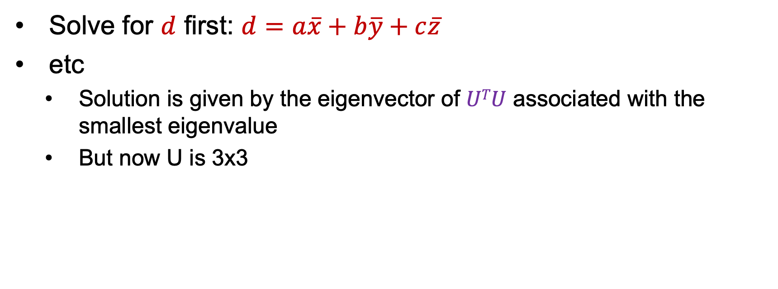
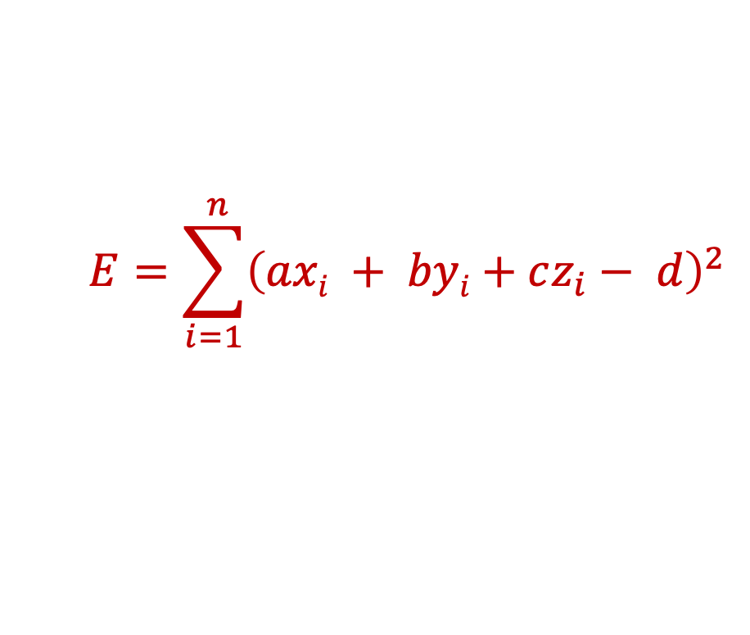
Total least squares
$$E=\sum_{i=1}^{ n}{{\left(axi + byi+cz_{i}− d\right)}^{2}}$$
Solve for $d$ first: $d$ $=a\overline{x}+b\overline{y}+c\overline{z}$
etc
  Solution is given by the eigenvector of $UTU$ associated with the smallest eigenvalue
  But now U is 3x3

Slide 16
Least squares as likelihood maximization
Generative model: line points are sampled independently and corrupted by Gaussian noise in the direction perpendicular to the line
ax+by=d
(u, v)
ε
(x, y)
point on the line
normal
direction
noise:
sampled from
zero-mean
Gaussian with
std. dev. σ

Slide 17
Least squares as likelihood maximization
Generative model: line points are sampled independently and corrupted by Gaussian noise in the direction perpendicular to the line
ax+by=d
(u, v)
ε
(x, y)
Likelihood of points given line parameters (a, b, d):
Log-likelihood:

Slide 18
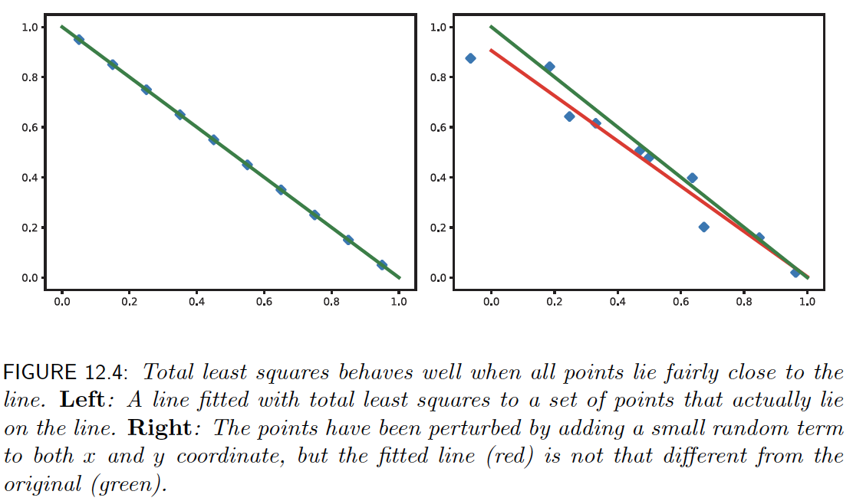
Points close to line -> TLS behaves well

Slide 19
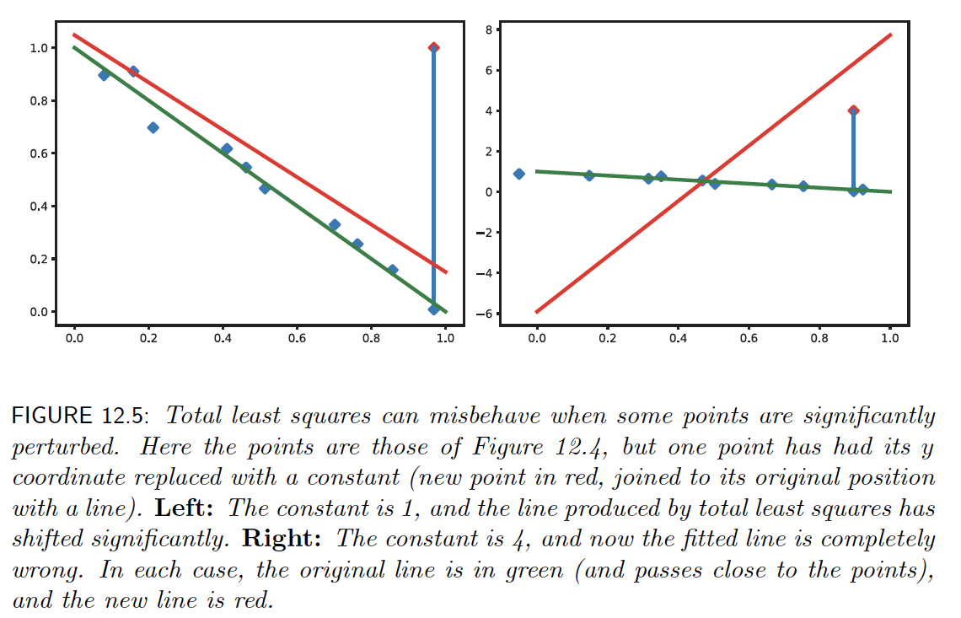
Large errors – TLS behaves badly

Slide 20
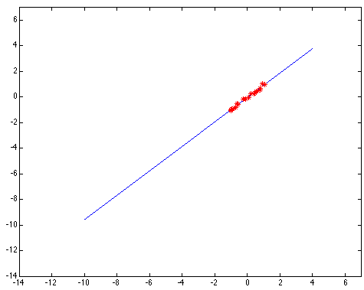
Least squares: Robustness to noise
Least squares fit to the red points:

Slide 21
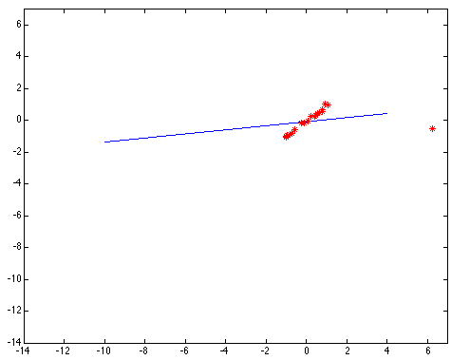
Least squares: Robustness to noise
Least squares fit with an outlier:
Problem: squared error heavily penalizes outliers

Slide 22
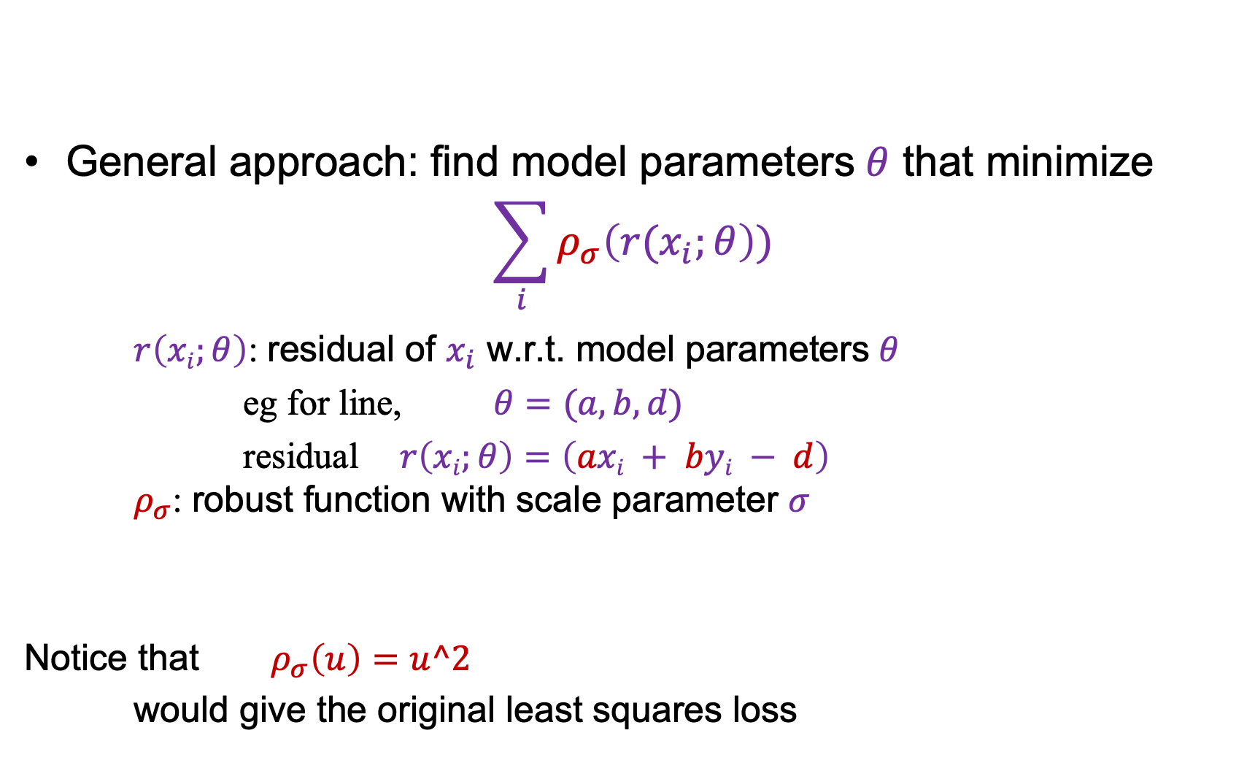
Robust estimators
General approach: find model parameters $θ$ that minimize
$$\sum_{i}{ρ_{σ}\left(r(x_{i};θ\right))}$$
$r\left(xi;θ\right)$: residual of $x_{i}$ w.r.t. model parameters $θ$
eg for line, $θ=(a, b, d)$
residual $r\left(xi;θ\right)=\left(axi + byi − d\right)$
$ρ_{σ}$: robust function with scale parameter $σ$
Notice that $ρ_{σ}\left(u\right)=u^2$
would give the original least squares loss

Slide 23
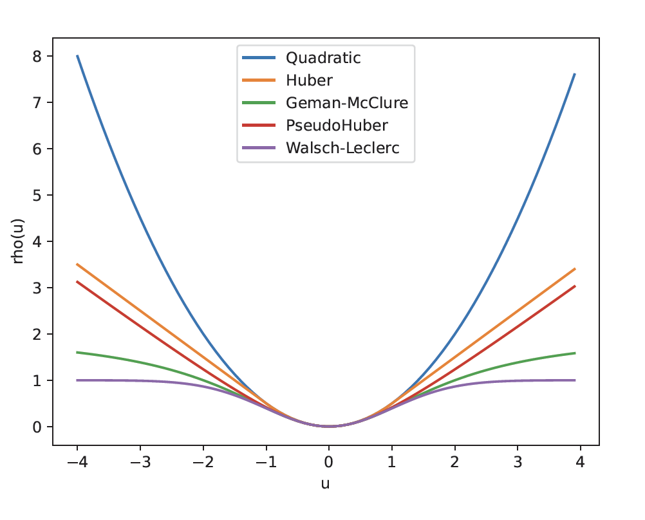
Robust estimators

Slide 24
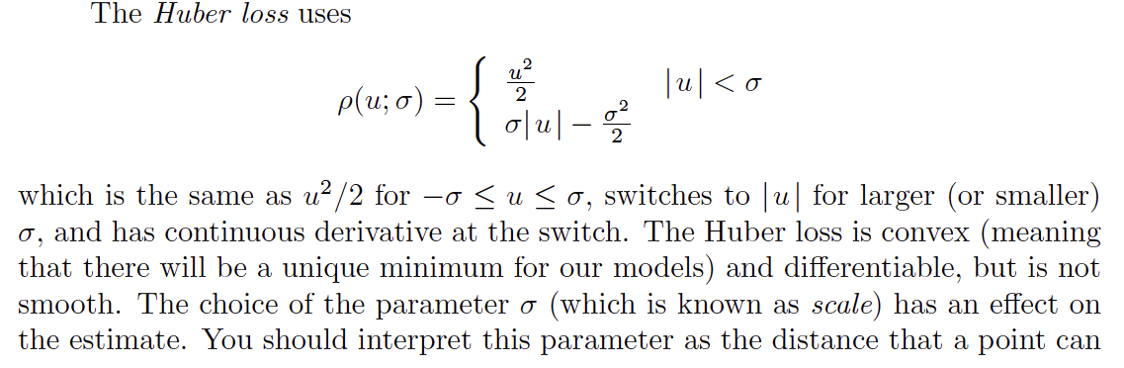
The Huber loss
Scale

Slide 25

Choosing the scale: Just right
The effect of the outlier is minimized
Notes:
Fit to earlier data with an appropriate choice of s

Slide 26
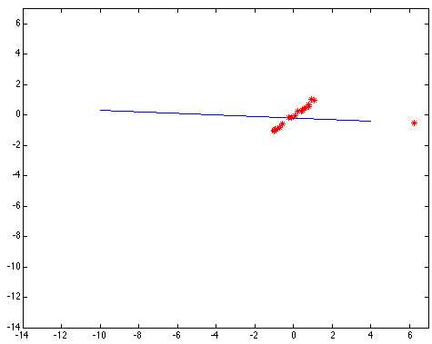
Choosing the scale: Too small
The error value is almost the same for every
point and the fit is very poor

Slide 27

Choosing the scale: Too large
Behaves much the same as least squares

Slide 28
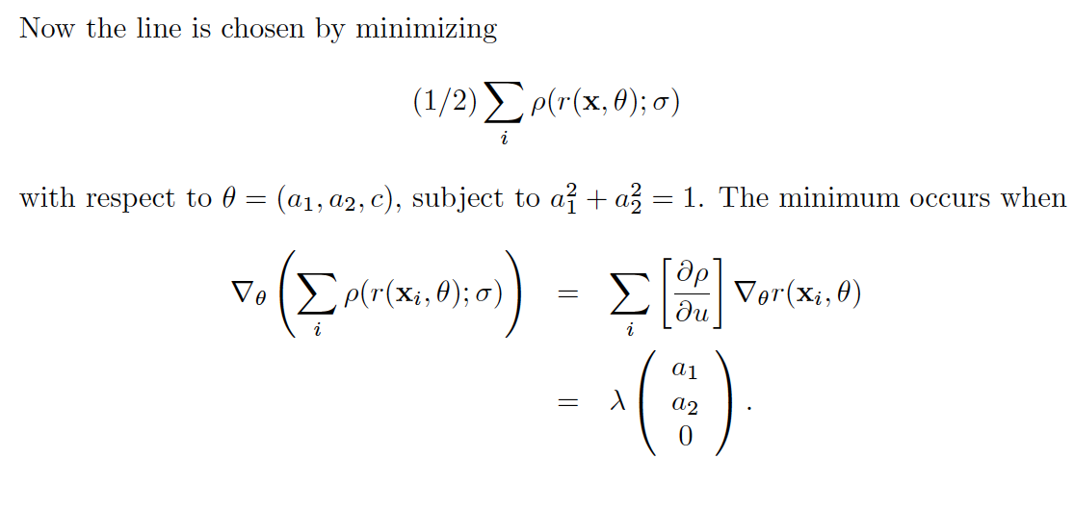
Finding the line

Slide 29
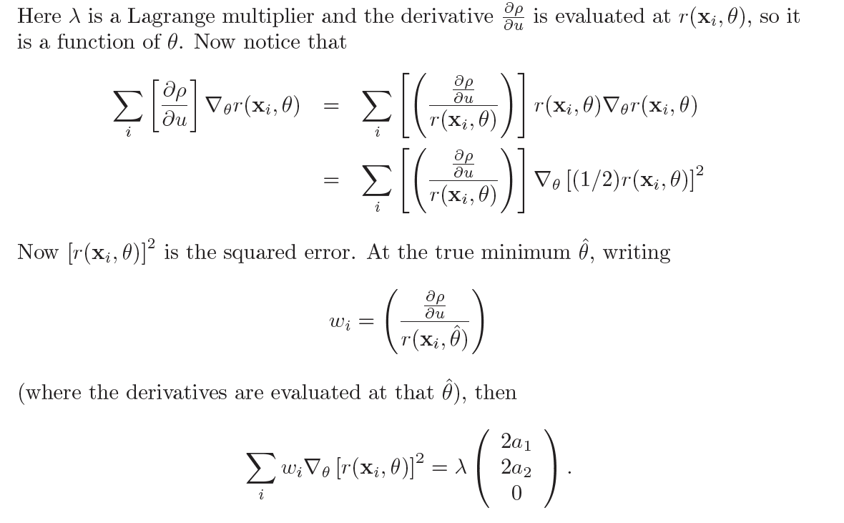
Finding the line - II

Slide 30
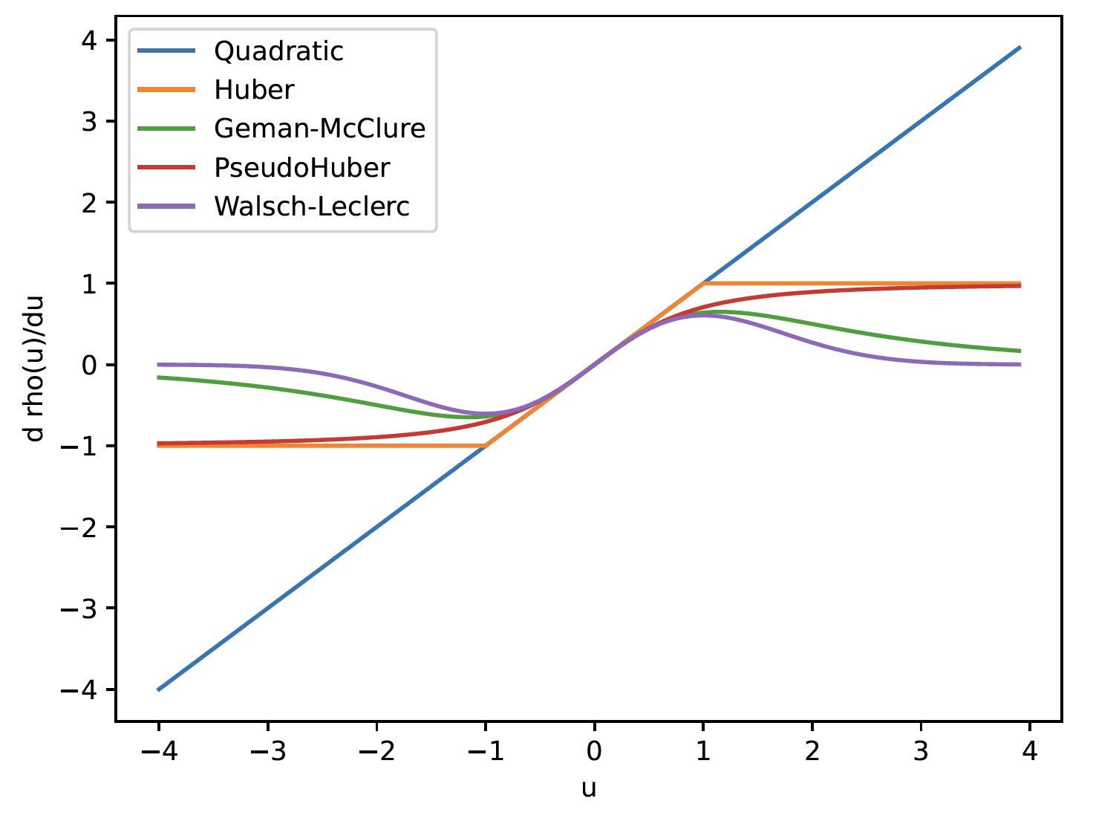
Robust estimators – influence functions

Slide 31
Idea – iteratively reweighted least squares
Start with initial line
get weights, scale from line
Iterate:
estimate line using weights, scale
estimate scale using line
estimate weights using scale, line
We *know* that one stationary point is the true minimum
No other guarantees I’m aware of, but quite well behaved

Slide 32
Starting iteratively reweighted least squares
Iterate:
Initial line:
Draw two points at random from dataset
Pass line through them
Fit line with IRLS
Use the best you encounter

Slide 33
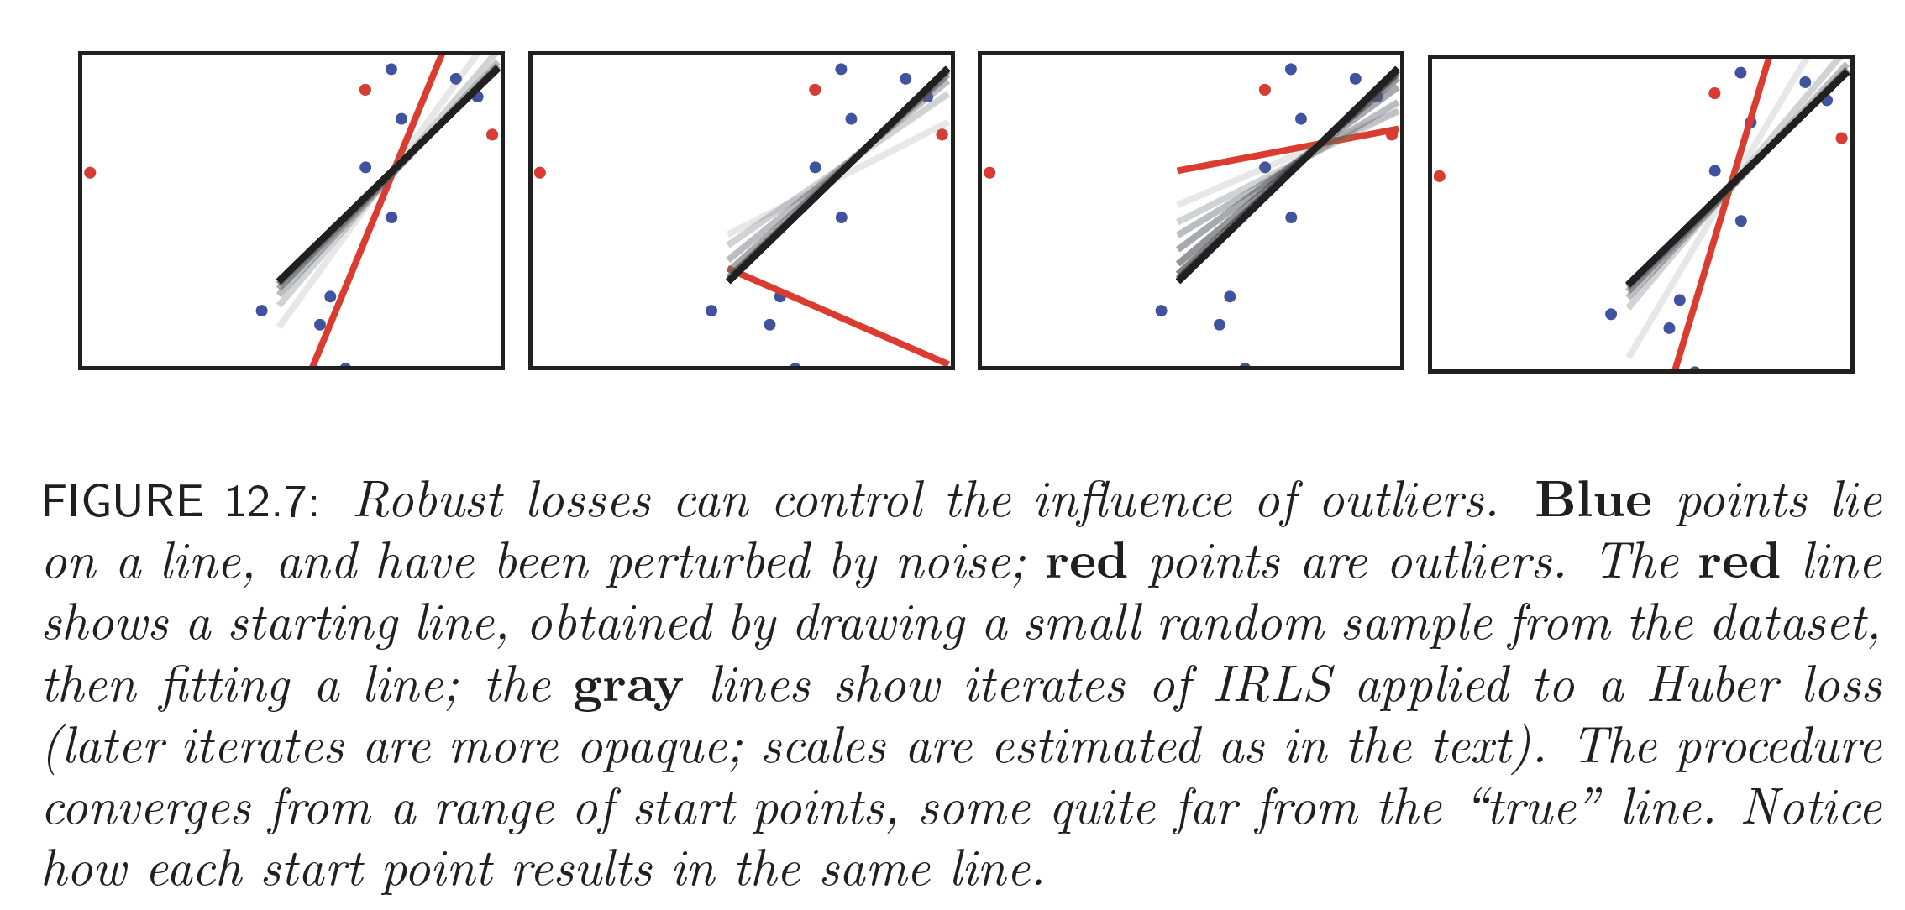
IRLS

Slide 34
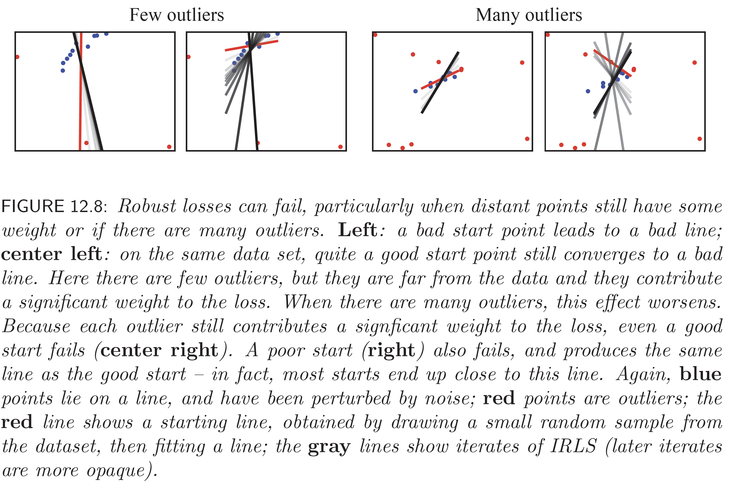
IRLS isn’t perfect…

Slide 35
Fitting: Overview
Least squares line fitting
Robust fitting
RANSAC

Slide 36
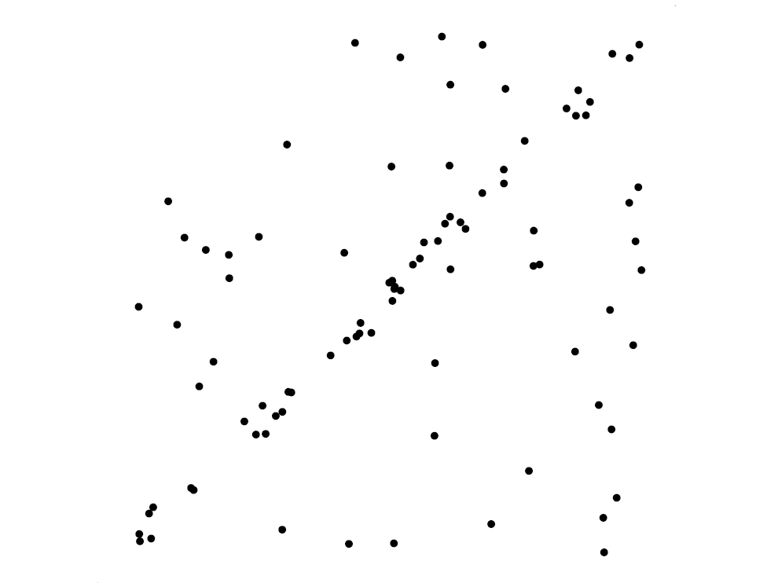
Voting schemes
Robust fitting can deal with a few outliers – what if we have very many?
Basic idea: let each point vote for all the models that are
compatible with it
  Hopefully the outliers will not vote consistently for any single model
  The model that receives the most votes is the best fit to the image

Slide 37
RANSAC
Random sample consensus: very general framework for model fitting in the presence of outliers
Outline:
  Randomly choose a small initial subset of points
  Fit a model to that subset
  Find all inlier points that are “close” to the model and reject the rest as outliers
  Do this many times and choose the model with the most inliers
M. Fischler and R. Bolles. Random Sample Consensus: A Paradigm for Model Fitting with Applications to Image Analysis and Automated Cartography. Comm. of the ACM, Vol 24, pp 381-395, 1981

Slide 38
RANSAC for line fitting example
Source: R. Raguram

Slide 39
RANSAC for line fitting example
Least-squares fit
Source: R. Raguram

Slide 40
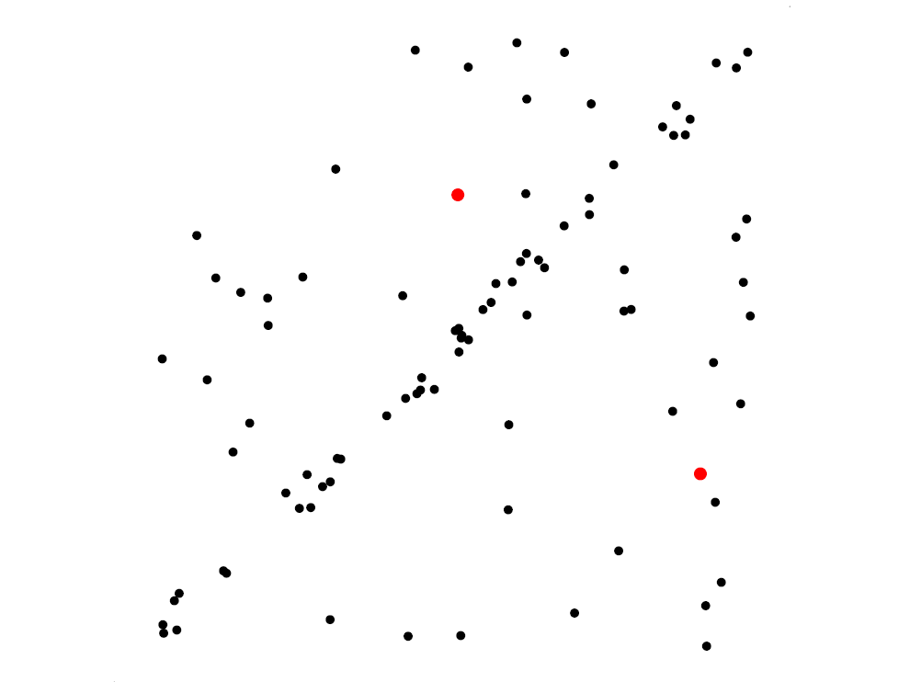
RANSAC for line fitting example
Randomly select minimal subset of points
Source: R. Raguram

Slide 41
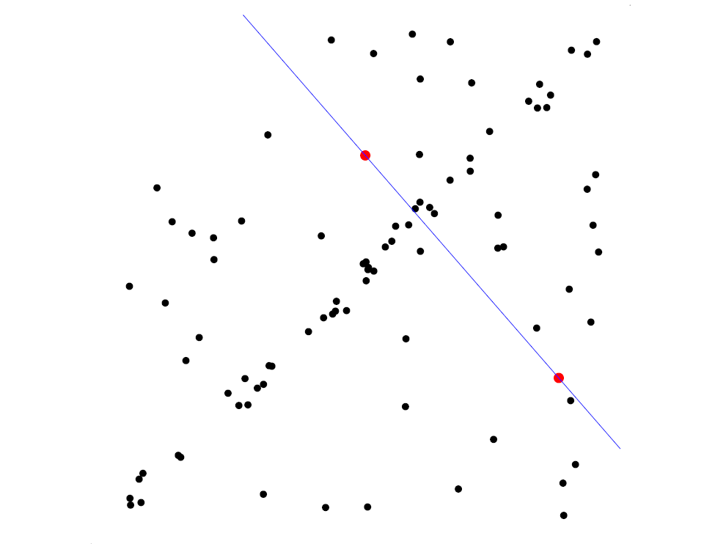
RANSAC for line fitting example
Randomly select minimal subset of points
Hypothesize a model
Source: R. Raguram

Slide 42
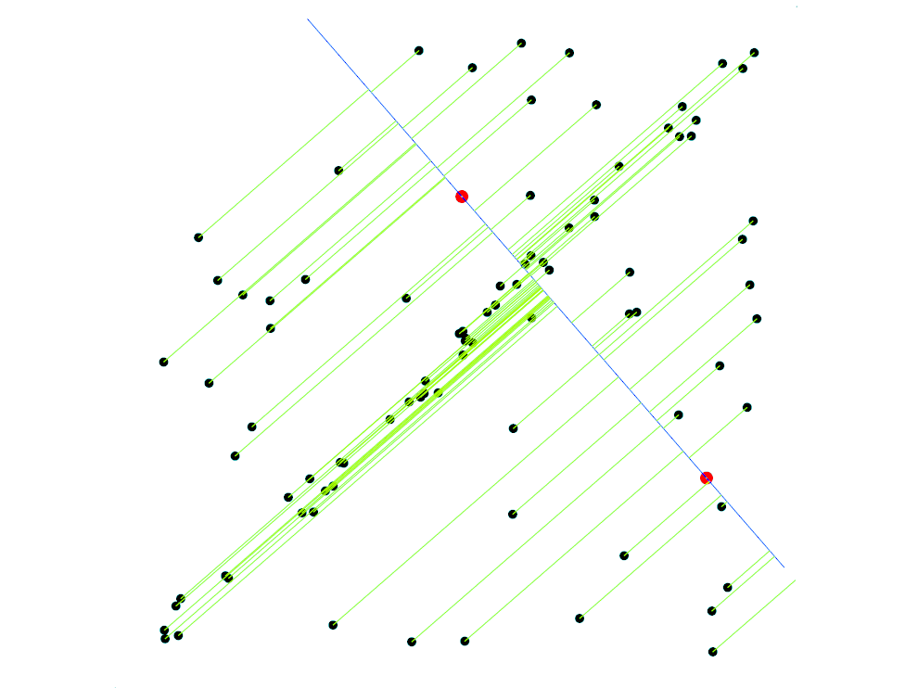
RANSAC for line fitting example
Randomly select minimal subset of points
Hypothesize a model
Compute error function
Source: R. Raguram

Slide 43
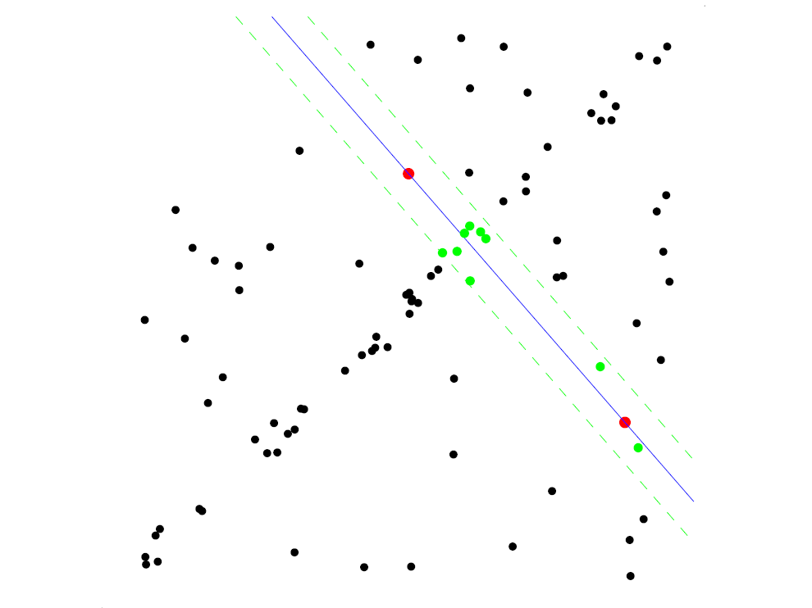
RANSAC for line fitting example
Randomly select minimal subset of points
Hypothesize a model
Compute error function
Select points consistent with model
Source: R. Raguram

Slide 44
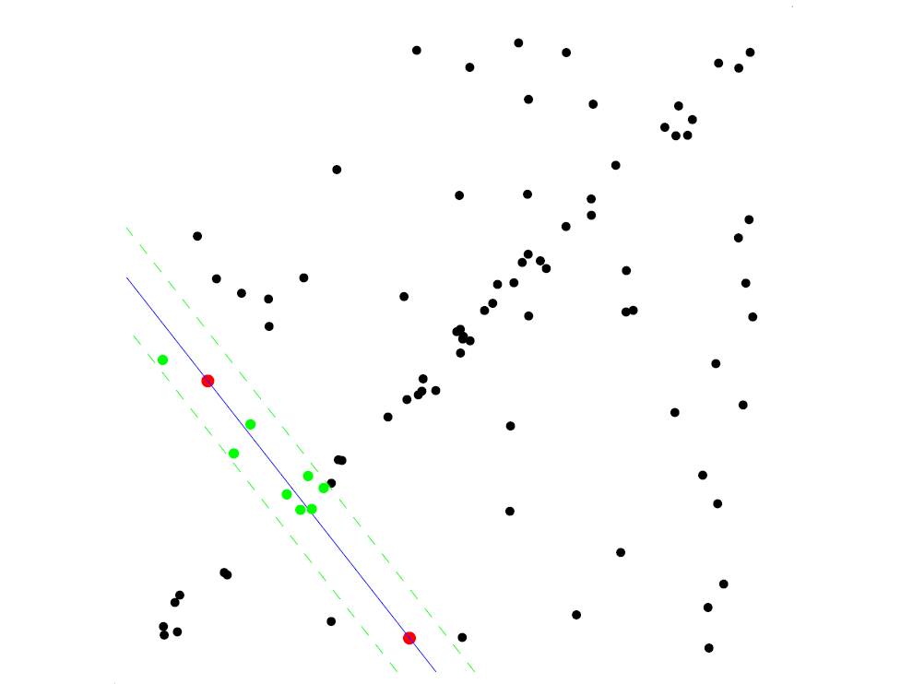
RANSAC for line fitting example
Randomly select minimal subset of points
Hypothesize a model
Compute error function
Select points consistent with model
Repeat hypothesize-and-verify loop
Source: R. Raguram

Slide 45
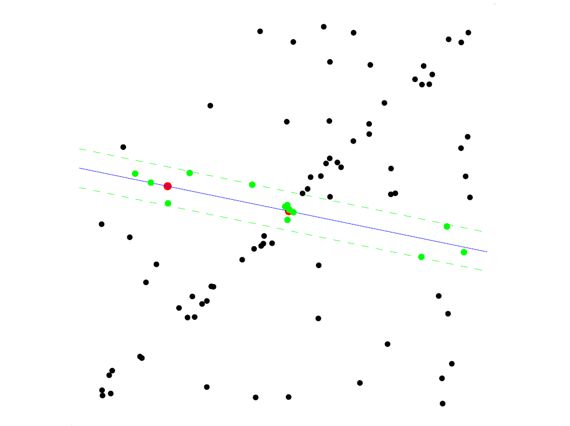
RANSAC for line fitting example
Randomly select minimal subset of points
Hypothesize a model
Compute error function
Select points consistent with model
Repeat hypothesize-and-verify loop
Source: R. Raguram

Slide 46
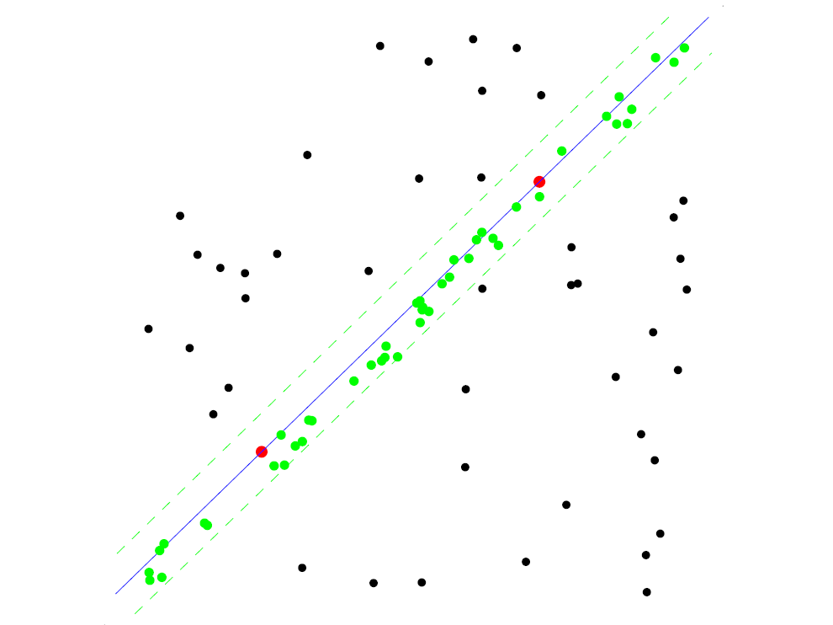
RANSAC for line fitting example
Uncontaminated sample
Randomly select minimal subset of points
Hypothesize a model
Compute error function
Select points consistent with model
Repeat hypothesize-and-verify loop
Source: R. Raguram

Slide 47
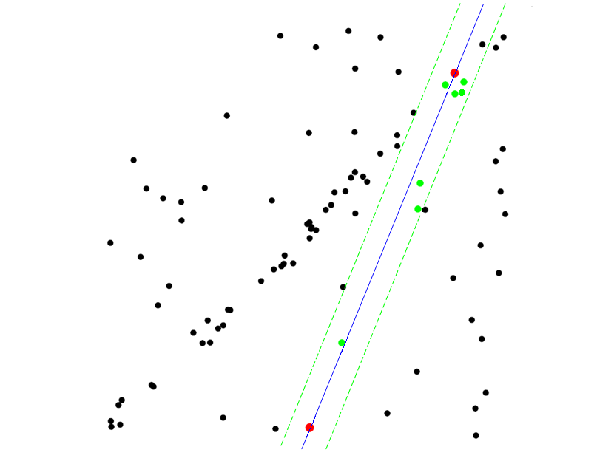
RANSAC for line fitting example
Randomly select minimal subset of points
Hypothesize a model
Compute error function
Select points consistent with model
Repeat hypothesize-and-verify loop
Source: R. Raguram
Notes:
47

Slide 48
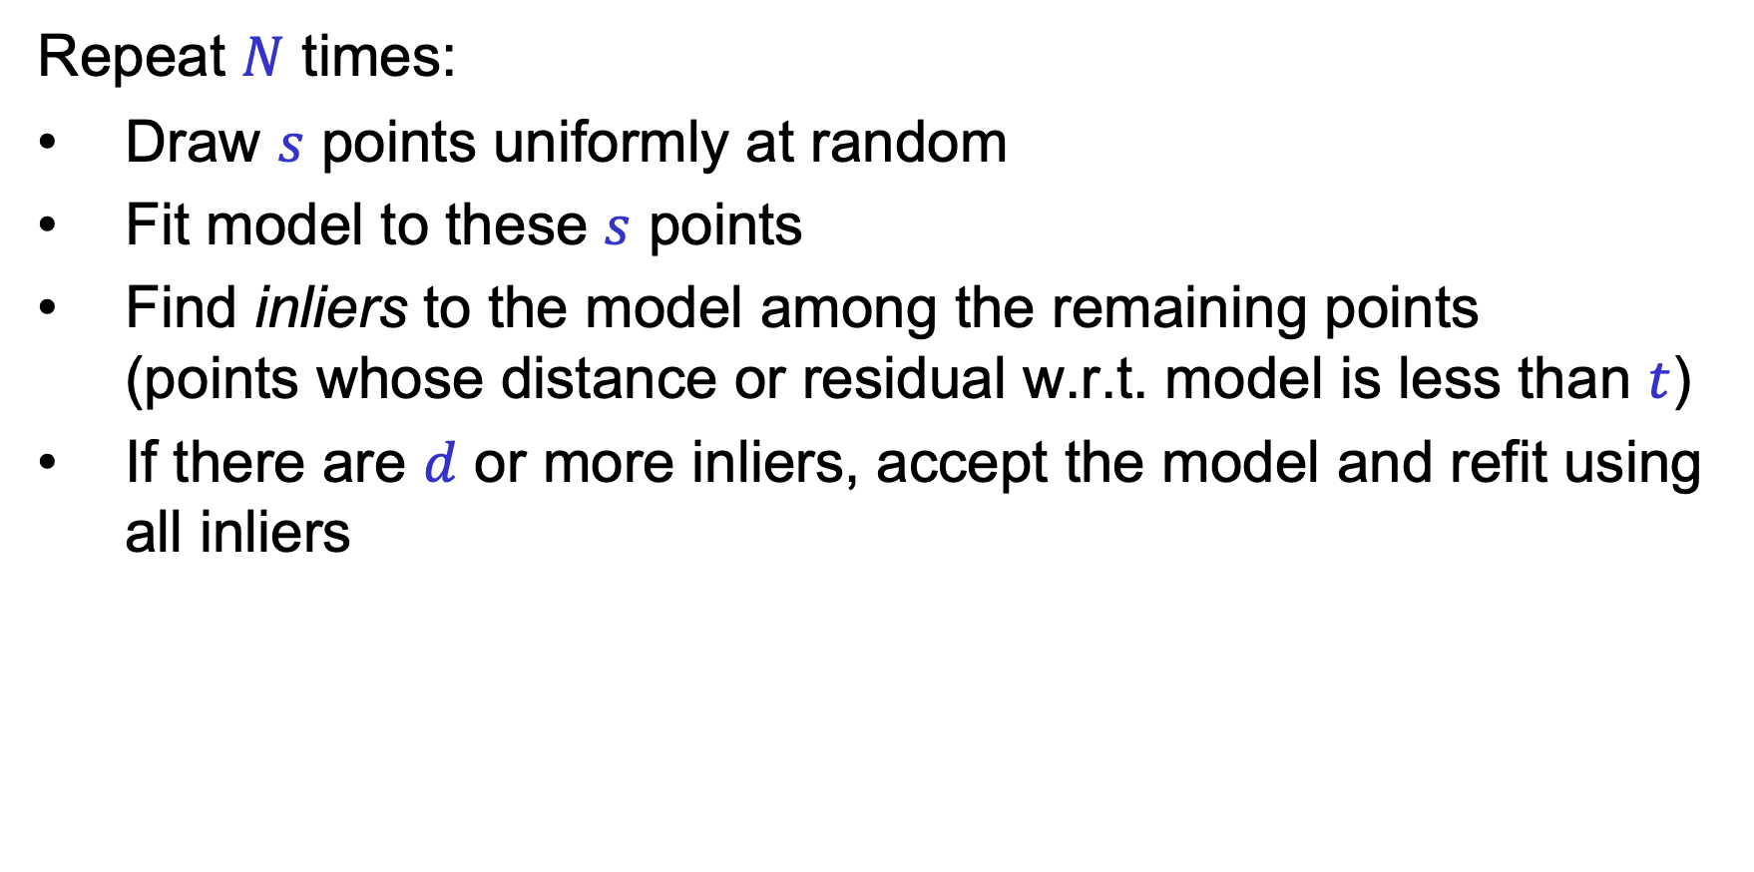
RANSAC loop
Repeat $N$ times:
Draw $s$ points uniformly at random
Fit model to these $s$ points
Find inliers to the model among the remaining points
(points whose distance or residual w.r.t. model is less than $t$)
If there are $d$ or more inliers, accept the model and refit using all inliers

Slide 49
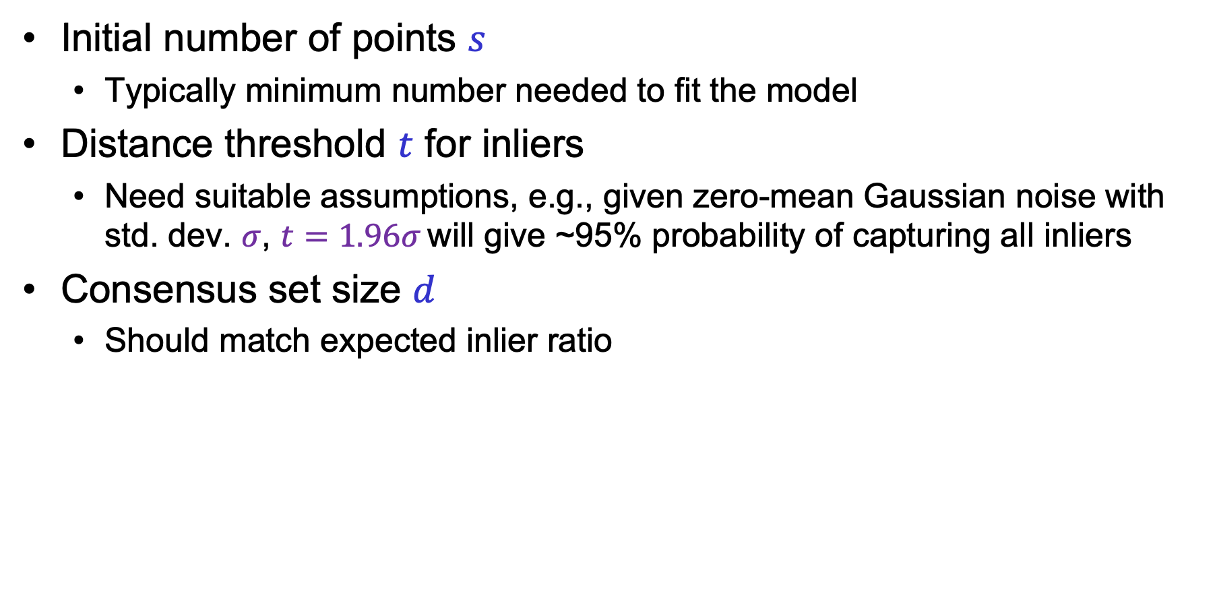
RANSAC: Choosing the parameters
Initial number of points $s$
  Typically minimum number needed to fit the model
Distance threshold $t$ for inliers
  Need suitable assumptions, e.g., given zero-mean Gaussian noise with std. dev. $σ$, $t=1.96σ$ will give ~95% probability of capturing all inliers
Consensus set size $d$
  Should match expected inlier ratio
Adapted from M. Pollefeys

Slide 50
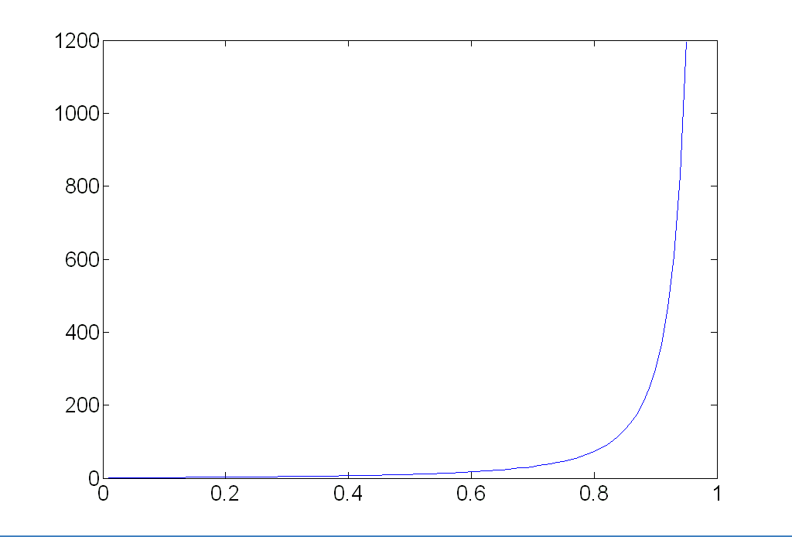

RANSAC: Choosing the parameters
Choosing the number of iterations (initial samples) $N$:
  Choose $N$ so that, with probability $p$ (e.g. 99%), at least one initial sample is free from outliers
  Assuming an outlier ratio of $e$:
  $${\left(1−{\left(1−e\right)}^{s}\right)}^{N}=1−p$$
  $$N=\log\left(1−p\right)/log⁡(1−{\left(1−e\right)}^{s})$$
 | proportion of outliers e
s | 5% | 10% | 20% | 25% | 30% | 40% | 50%
2 | 2 | 3 | 5 | 6 | 7 | 11 | 17
3 | 3 | 4 | 7 | 9 | 11 | 19 | 35
4 | 3 | 5 | 9 | 13 | 17 | 34 | 72
5 | 4 | 6 | 12 | 17 | 26 | 57 | 146
6 | 4 | 7 | 16 | 24 | 37 | 97 | 293
7 | 4 | 8 | 20 | 33 | 54 | 163 | 588
8 | 5 | 9 | 26 | 44 | 78 | 272 | 1177
Source: M. Pollefeys

Slide 51
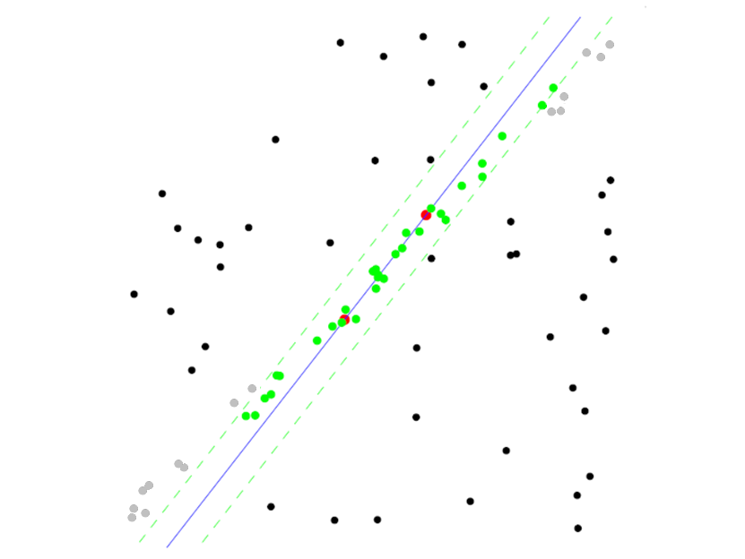
RANSAC pros and cons
Pros
  Simple and general
  Applicable to many different problems
  Often works well in practice
Cons
  Lots of parameters to set
  Number of iterations grows exponentially as outlier ratio increases
  Can’t always get a good initialization
  of the model based on the minimum
  number of samples

Slide 52
Incremental RANSAC
To fit many lines to a dataset:
Iterate:
Fit a line with RANSAC
using IRLS (crucial!)
Remove inliers from dataset
Q: when to stop?
A: when you have the right number of lines
when too little data is left
when the last line has few inliers
Depends on
application!

Slide 53
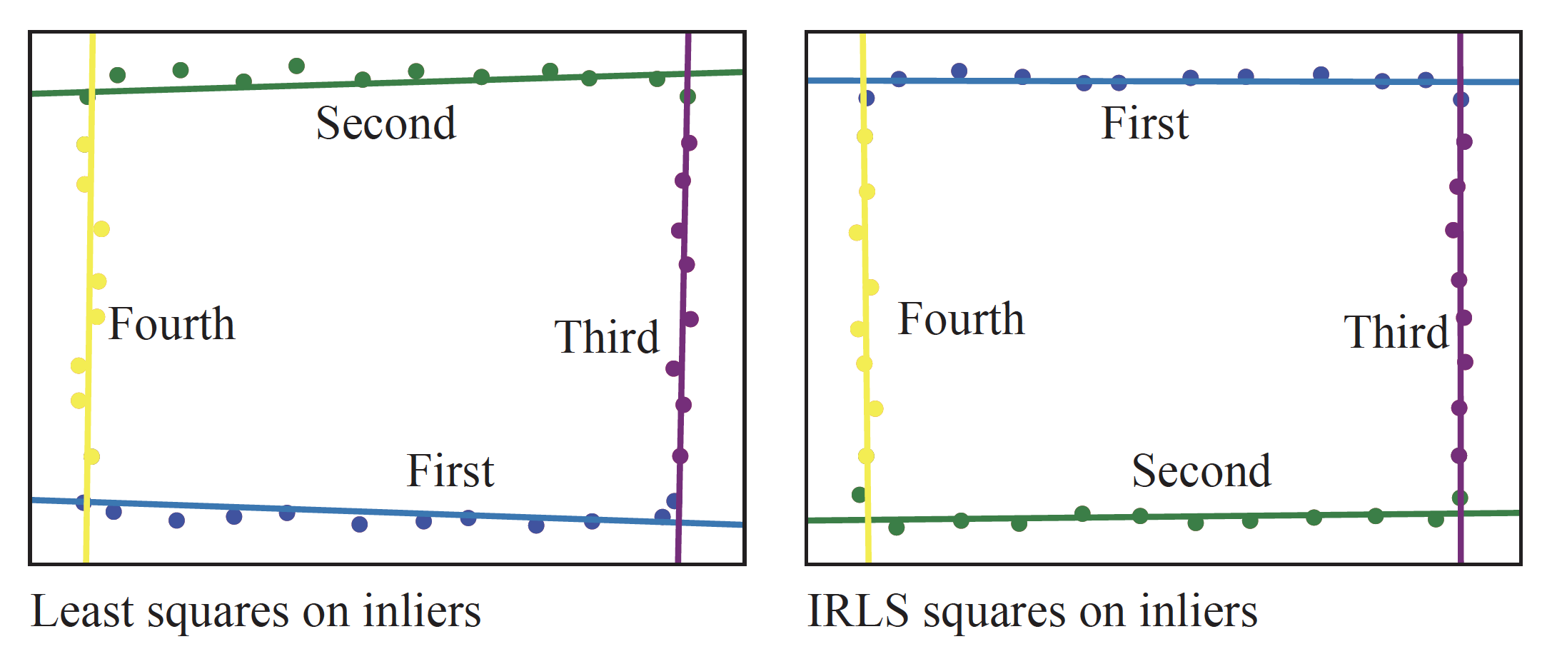
IRLS matters…

Slide 54


