Slide 1
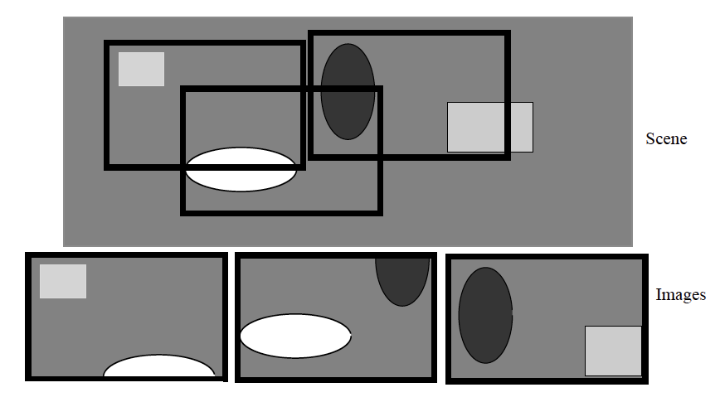
Forming Mosaics of Images
Idea:
Given multiple images of a big thing, transform the images so matching bits lie on top of one another
Combine these images to a single image

Slide 2
Currently
We know how to translate
(eg color separation exercises)
later, other transformations

Slide 3
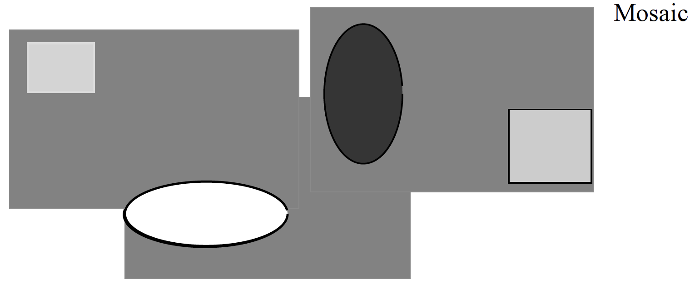

Slide 4
Procedure
Start:
Choose a root image (it isn’t translated)
and set mosaic to contain root only
All others get offset of zero
Iterate:
Choose an image that has an overlap with images already in the mosaic
Search for offset with best overlap between that image and mosaic
Insert into mosaic at that offset
Summarize registered images into a single image

Slide 5
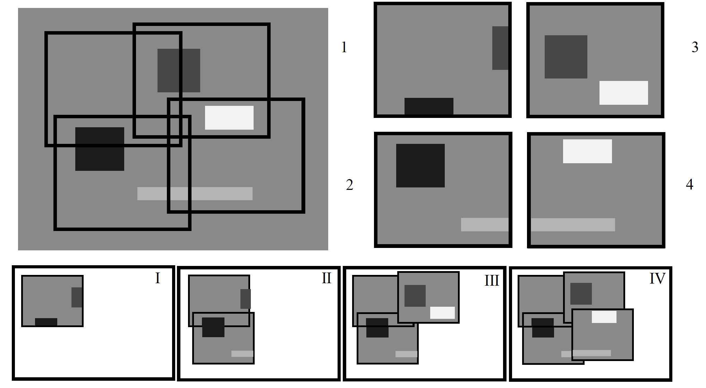

Slide 6
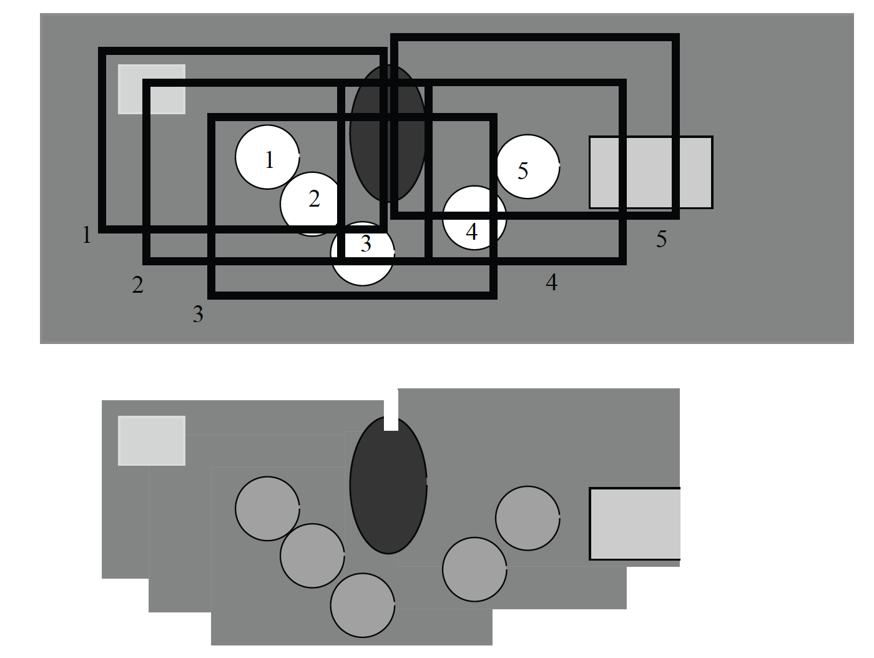
Using a mean gives ghostly trails on moving objects

Slide 7
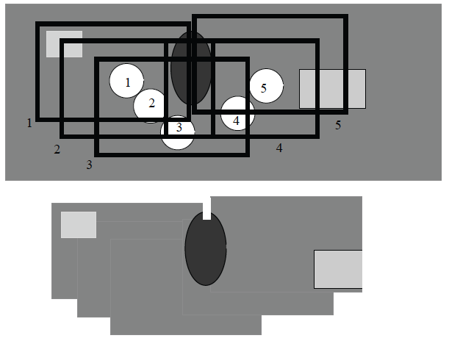
Using a median removes moving objects

Slide 8
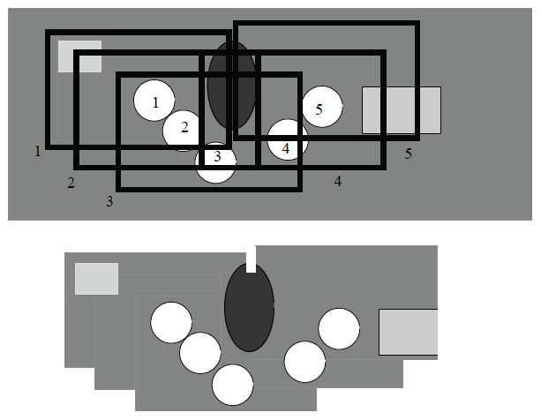
Most different from median shows moving objects

Slide 9
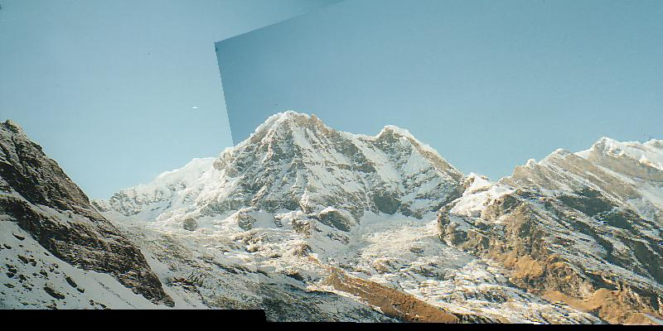
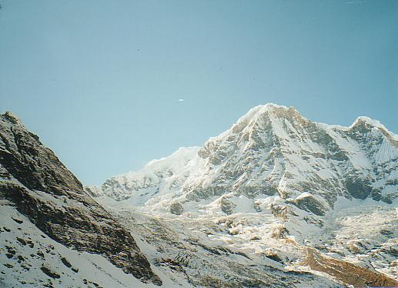
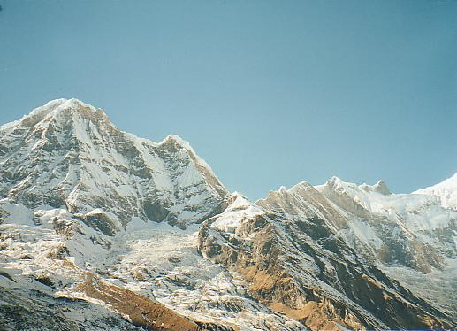
Important variants
If you interpolate the cost function, you could register with sub-pixel accuracy (bilinear won’t work)
Wider range of transformations
but how to estimate tx?

Slide 10
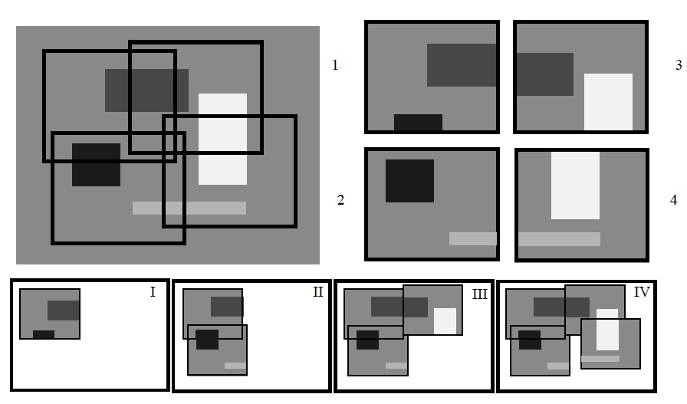
Bundle adjustment
Example: Register II to I, III to II, IV to III
and discover IV doesn’t register well with II
Loop does not close

Slide 11
Why is there a problem?
Error = Cost(I, II)+Cost(I, III)+Cost(I, IV)+Cost(II, III)+
Cost(II, IV)+Cost(III, IV)
Procedure DOESN’T deal with Cost(I, IV) or Cost(II, IV)
Idea:
Build mosaic
Now adjust one image at a time to improve
Not ideal, more complex strategies may be needed.

