Slide 1
Registration
Compute the best transformation between two point clouds
Cases:
You know which point in P corresponds to which in Q exactly
You know correspondence, but with errors
You don’t know correspondence
Unstructured collections of points in N dimensions

Slide 2
Application: building image mosaics
Find interest points in image A and image B
Build correspondences:
For each a in A find best matching b in B using descriptor
For each b in B find best matching a in A using descriptor
For consistent pairs, if descriptors are sufficiently similar
declare correspondence
Notice: you should get many correspondences BUT some are wrong

Slide 3
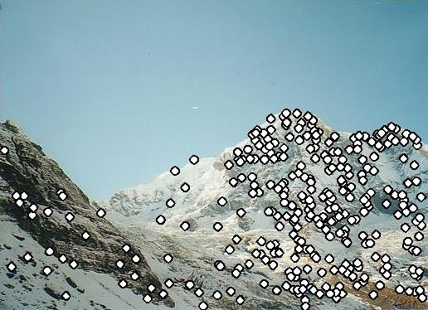
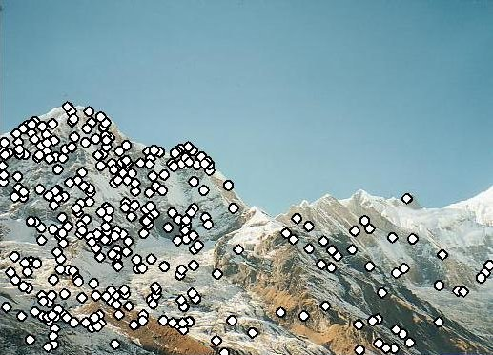
Recall…

Slide 4
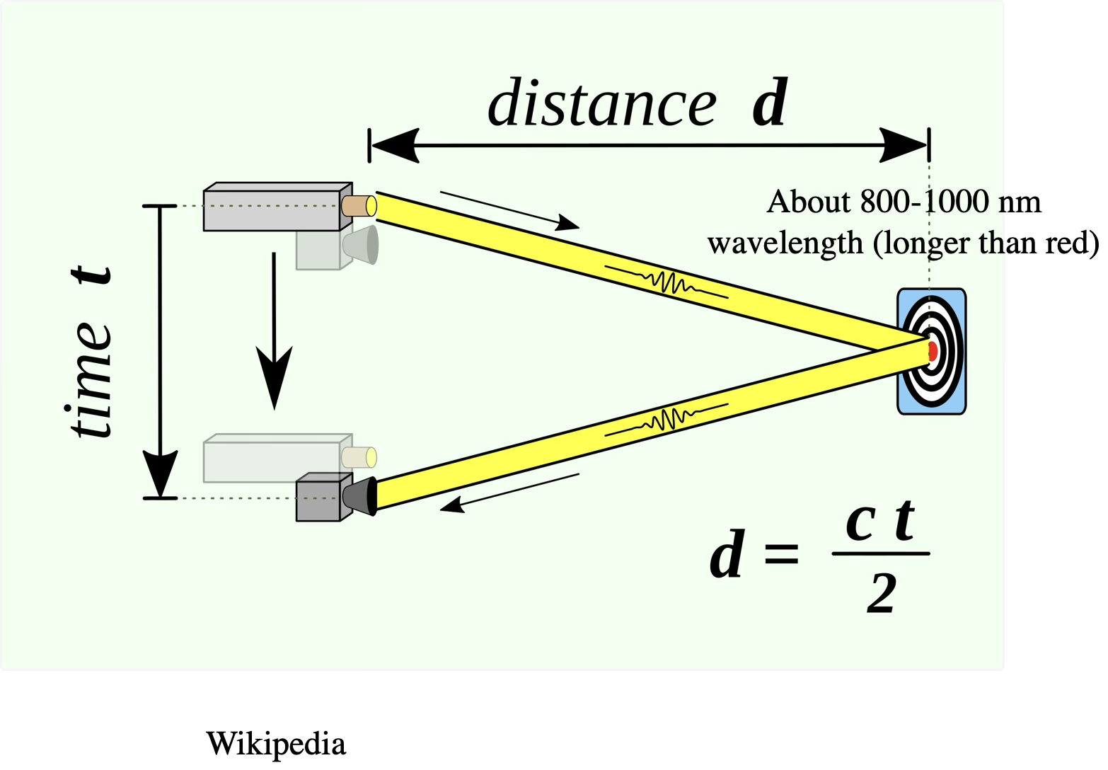
LIDAR produces point clouds

Slide 5
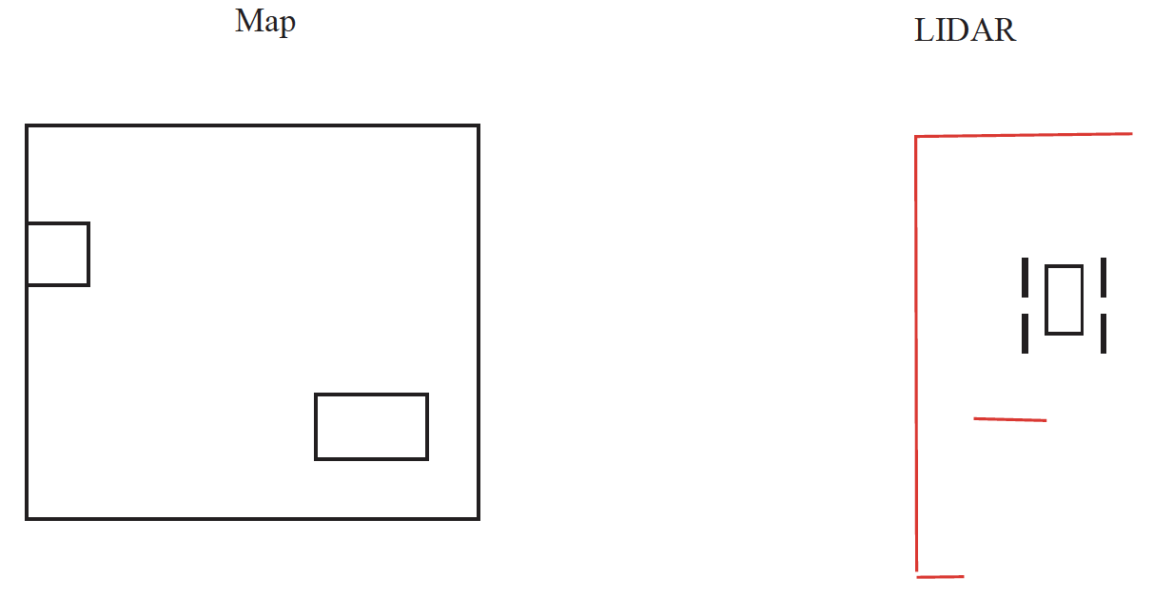
LIDAR observations registered to map

Slide 6
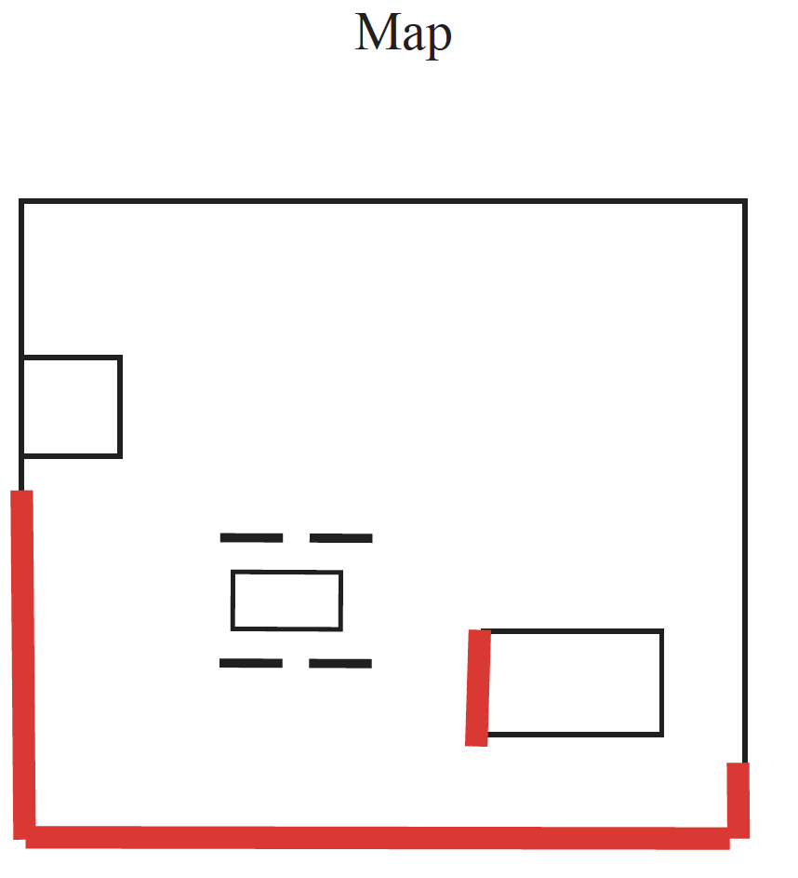
Yield your location

Slide 7
Registering meshes to LIDAR
I have a CAD model of a car
(large triangular mesh)
Where is this car in LIDAR data?
registration problem
How is a mesh a point cloud?
sample points on the mesh
vertices

Slide 8
General remarks
Very like line fitting and line fitting recipes apply
The objects we are working with are now corresponding pairs
(point in A, point in B)
Outliers are usually correspondences that are wrong
there could be lots

Slide 9
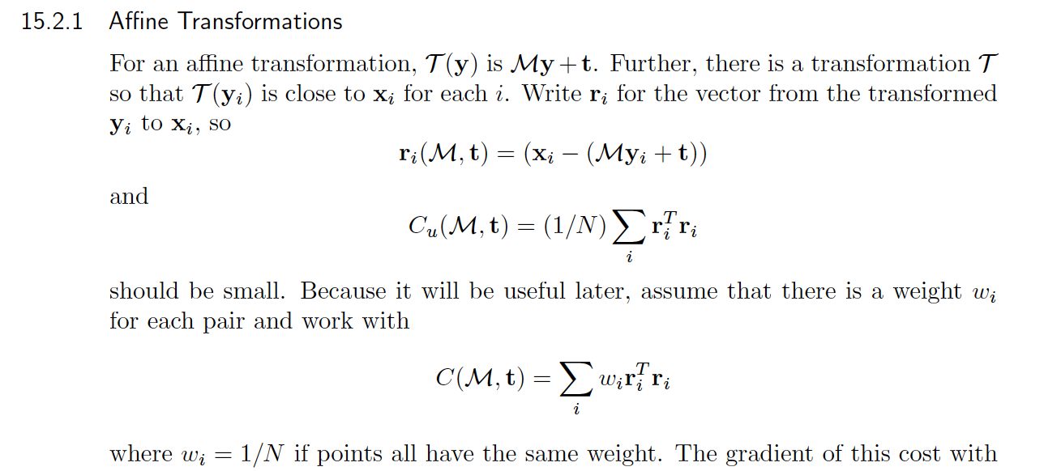
Weighted least squares, affine tx, known csp

Slide 10
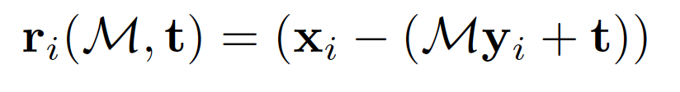

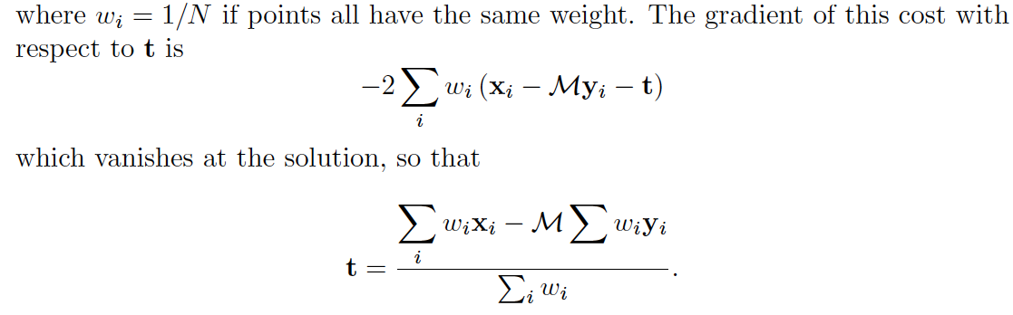
Solving for translation

Slide 11
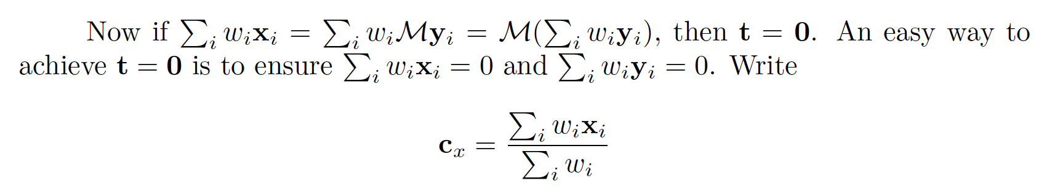
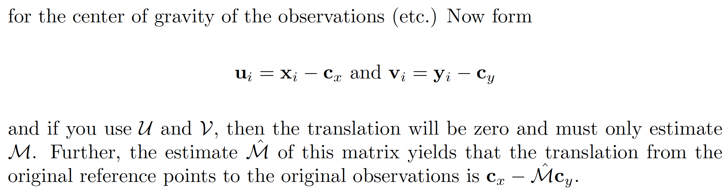
Solving for translation

Slide 12
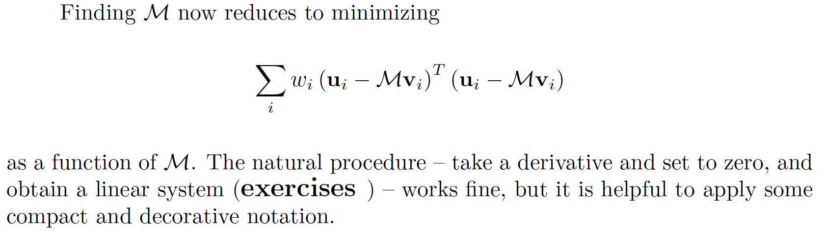
Finding M (compact form)

Slide 13
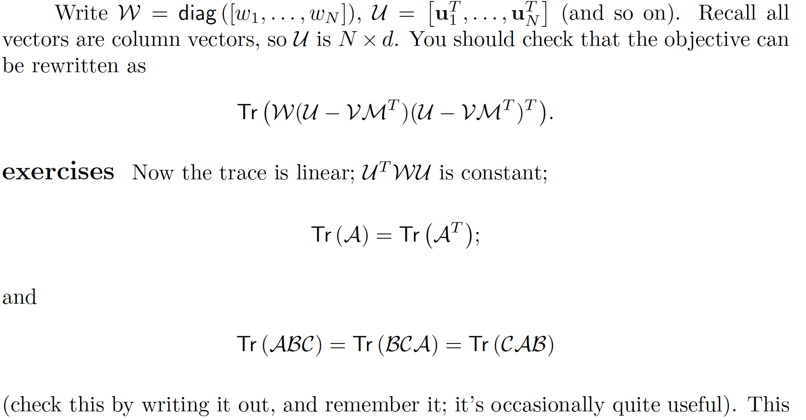
Finding M (long form)

Slide 14
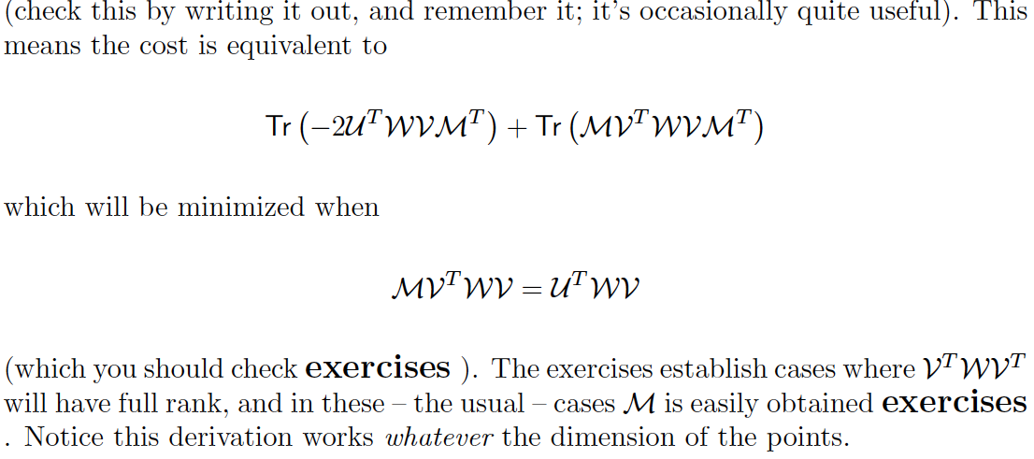
Finding M (long form)

Slide 15
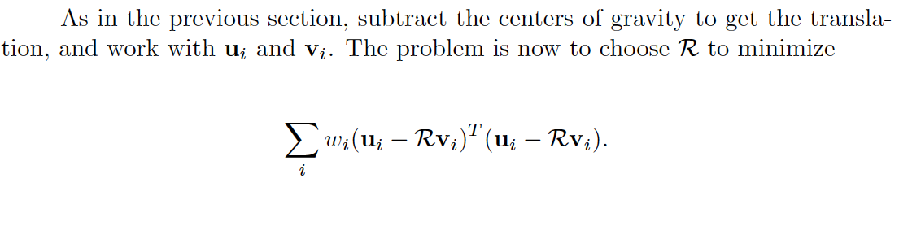
Euclidean motion
Most interesting in 2D or 3D
The matrix is a rotation matrix
You can do this in closed form (not widely known)
Use centers of gravity, as above.

Slide 16
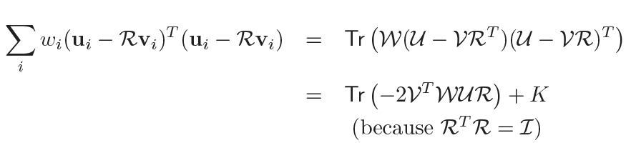
Euclidean motion
Terms not involving R, so of no interest

Slide 17

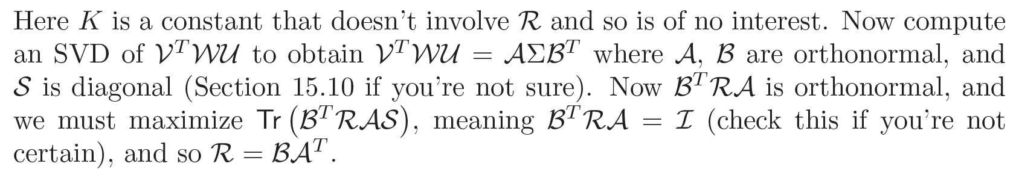
Euclidean motion

Slide 18
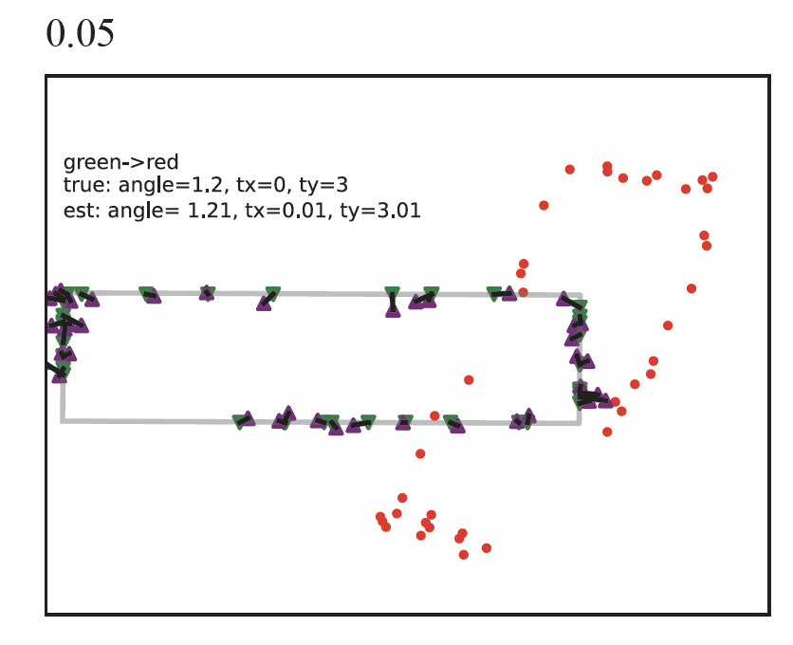
Euclidean est. well behaved under noise
Green triangles – target pts lying on gray rectangle
Red dots – source
(target points transformed, then noise added)
Purple triangles – apply estimated transformation to red points
Gray rectangle – transformation applied to true rectangle underlying red points
Notice:
transformation is about right, not massively disrupted by noise

Slide 19
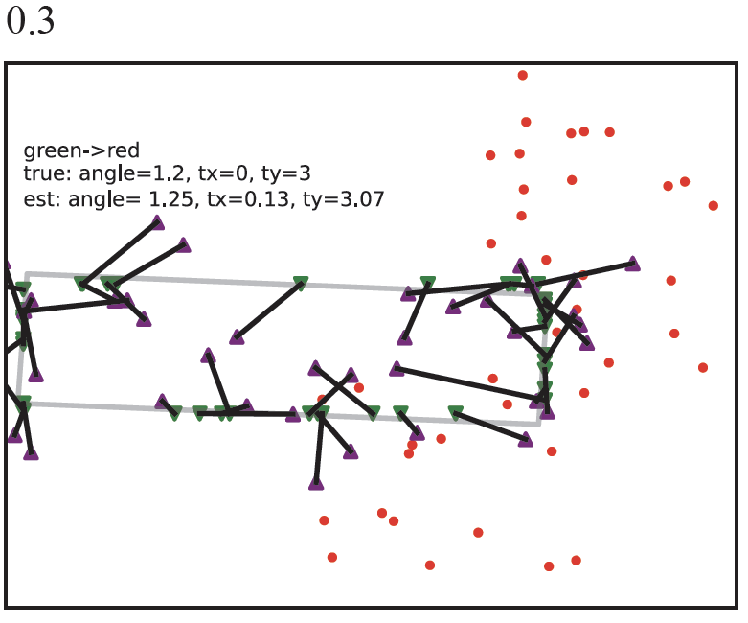
Euclidean est. well behaved under noise
Green triangles – target pts lying on gray rectangle
Red dots – source
(target points transformed, then noise added)
Purple triangles – apply estimated transformation to red points
Gray rectangle – transformation applied to true rectangle underlying red points
Notice:
transformation is about right, only somewhat disrupted by noise

Slide 20
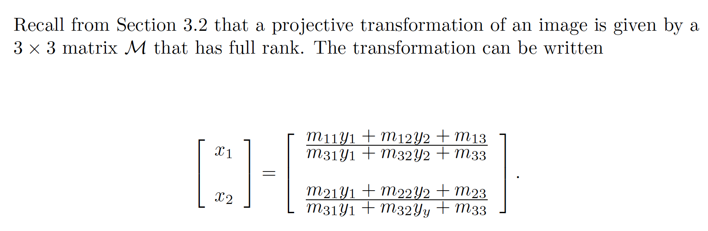
Projective transformations – 2D

Slide 21
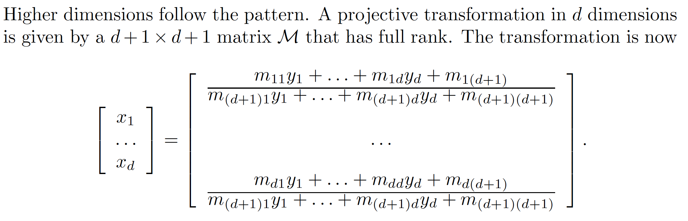
Projective transformations – dD

Slide 22
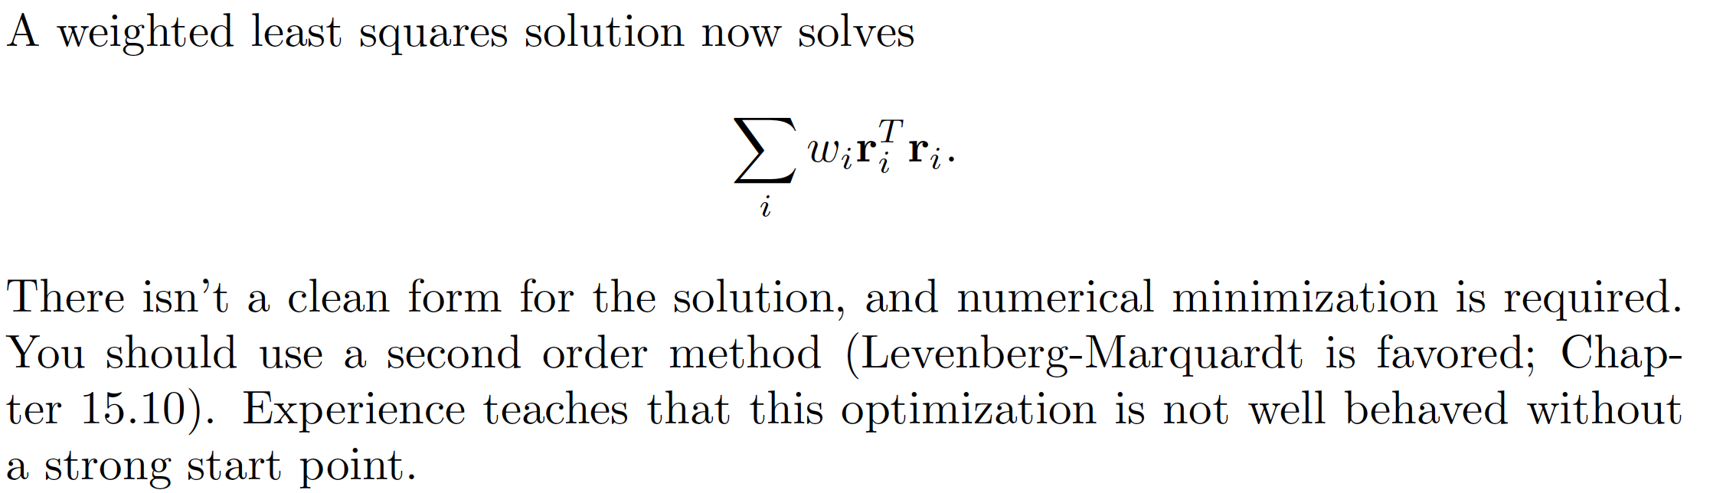
Projective transformations - solving

Slide 23
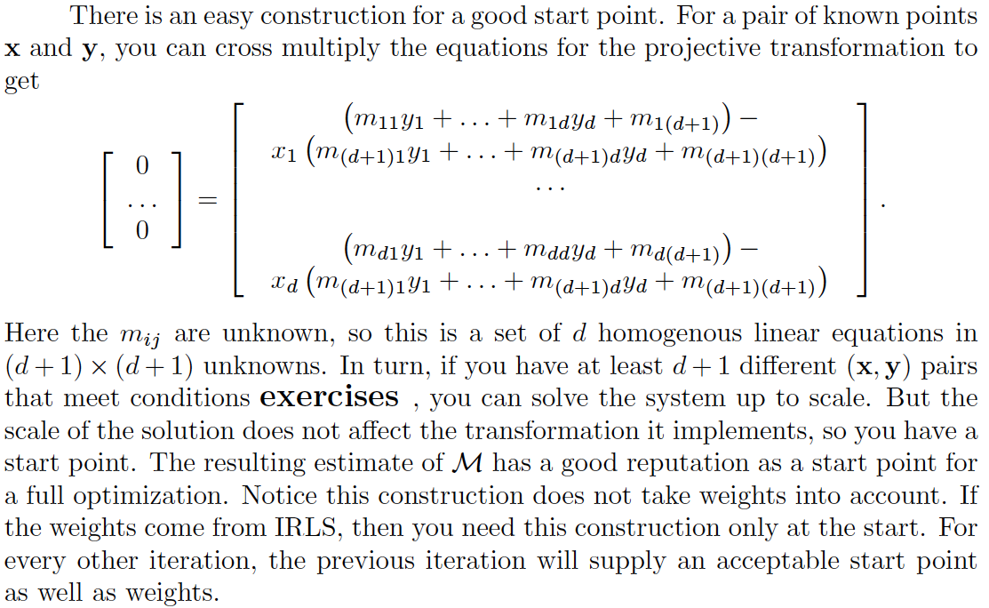
A start point

Slide 24
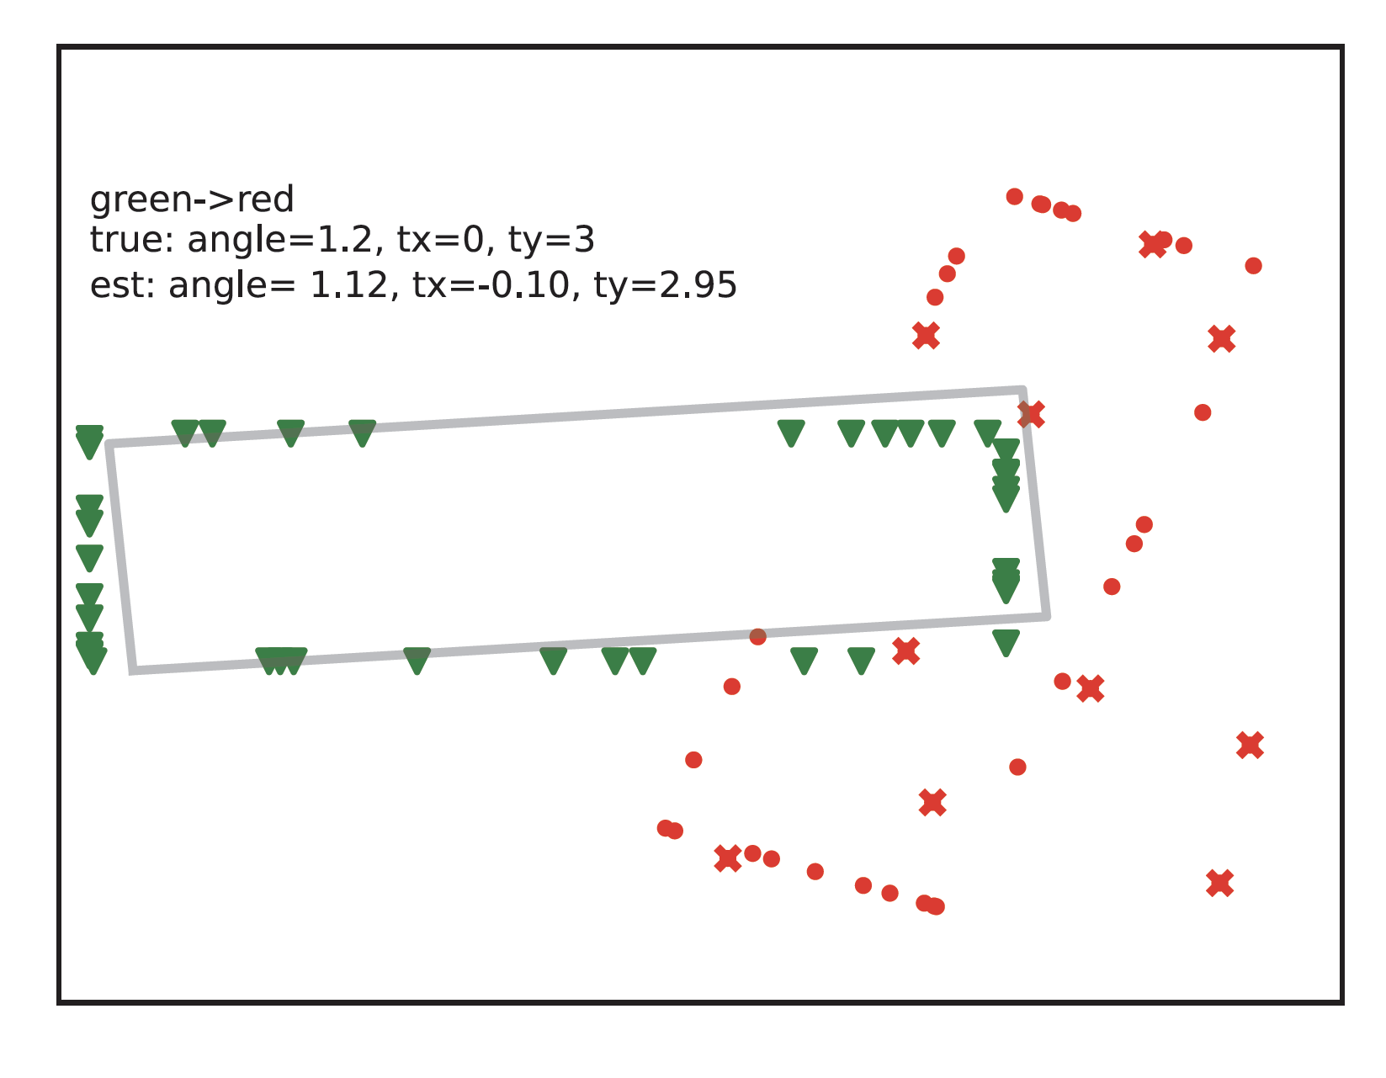
Outliers
Green triangles – target pts lying on gray rectangle
Red dots – source
(target points transformed, then noise added)
Red x – outliers on source
Gray rectangle – transformation applied to true rectangle underlying red points
Notice:
transformation is disrupted by outliers

Slide 25
IRLS
Start with initial transformation
get weights, scale from transformation
Iterate:
estimate transformation using weights, scale
estimate scale using transformation
estimate weights using scale, transformation
We *know* that one stationary point is the true minimum
No other guarantees I’m aware of, but quite well behaved

Slide 26
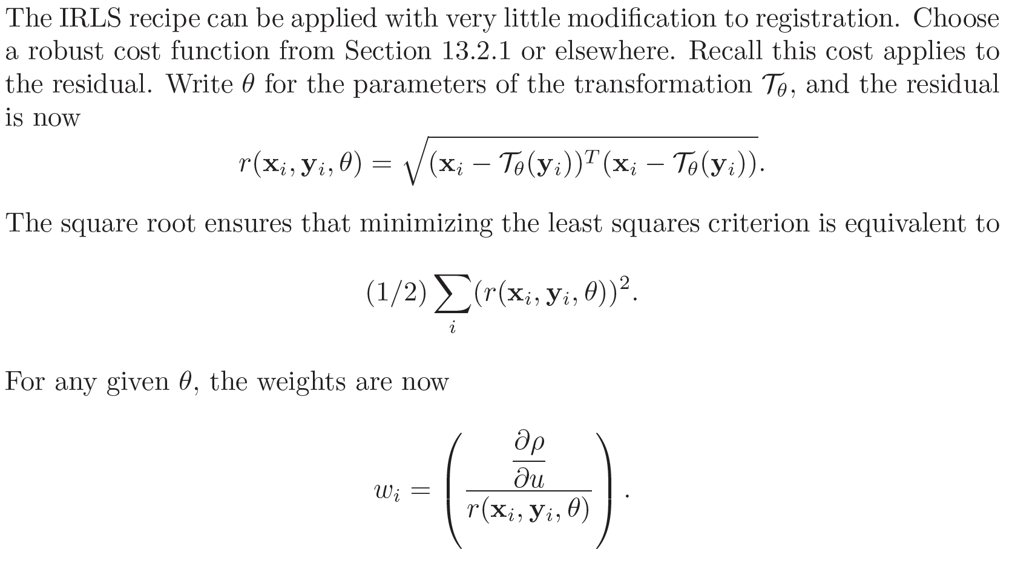
IRLS applies

Slide 27
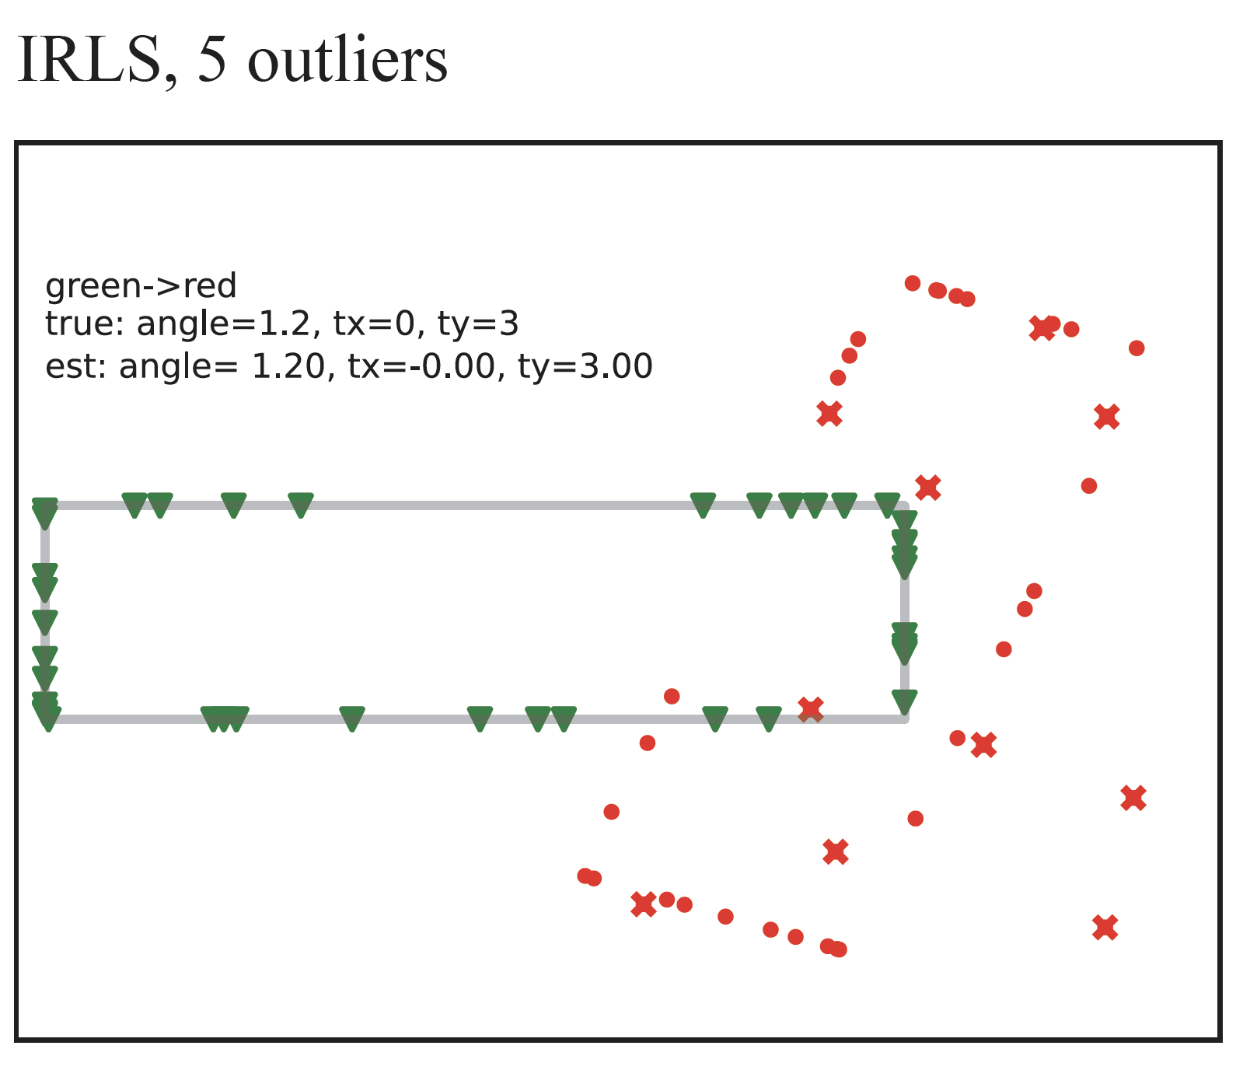
Outliers
Green triangles – target pts lying on gray rectangle
Red dots – source
(target points transformed, then noise added)
Red x – outliers on source
Gray rectangle – transformation applied to true rectangle underlying red points
Notice:
transformation is NOT disrupted by outliers

Slide 28
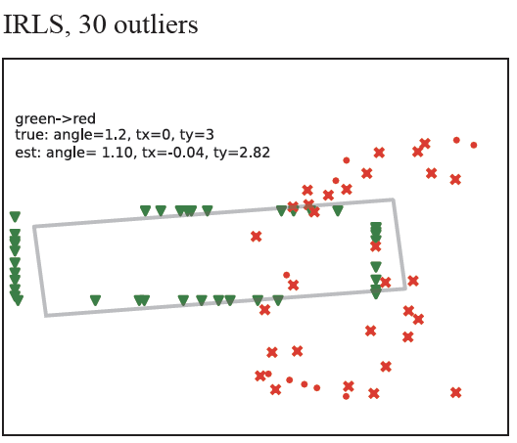
IRLS breaks down when there are too many outliers
Green triangles – target pts lying on gray rectangle
Red dots – source
(target points transformed, then noise added)
Red x – outliers on source
Gray rectangle – transformation applied to true rectangle underlying red points
Notice:
transformation IS
disrupted by outliers

Slide 29
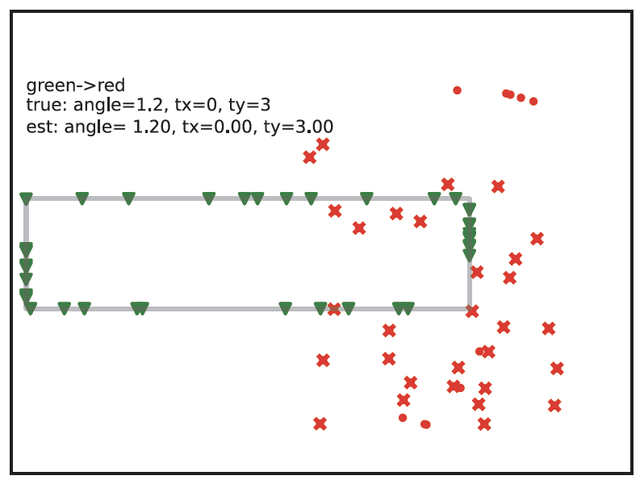
RANSAC to the rescue
Green triangles – target pts lying on gray rectangle
Red dots – source
(target points transformed, then noise added)
Red x – outliers on source
Gray rectangle – transformation applied to true rectangle underlying red points
Notice:
transformation IS
disrupted by outliers

Slide 30
RANSAC
Affine transformation: d+1 correspondences in d dim
Projective transformation: d+2 correspondences in d dim
Euclidean:
use 2 for plane (2D)
use 3 for 3D
BUT some such are obvious outliers
Key Issue: there can be a lot of outliers

Slide 31
What if you don’t know correspondences?
RANSAC isn’t usually enough

Slide 32
Registration produces very large quantities of outliers
Image A has N points
Image B has M points
Idea:
use every pair, and accept you have outliers
Problem:
M N pairs
but only at most min(M, N) are good
-- this is unwise!
A very important reason to care about interest points and descriptors

Slide 33
Iterated closest points or ICP
Idea:
If the transformation is nearly the identity,
then nearest point is likely correspondence
Strategy:
Start with good transformation
Iterate:
Estimate correspondences assuming tx is right
Re-estimate tx

Slide 34
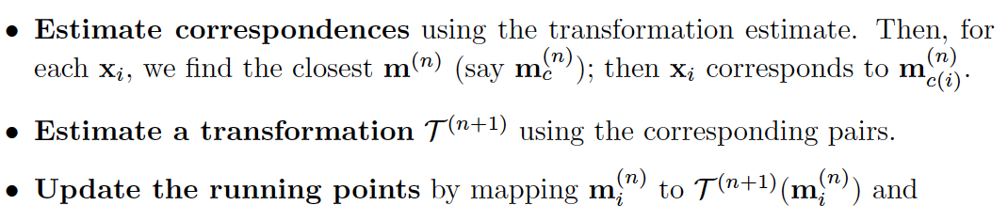
ICP

Slide 35
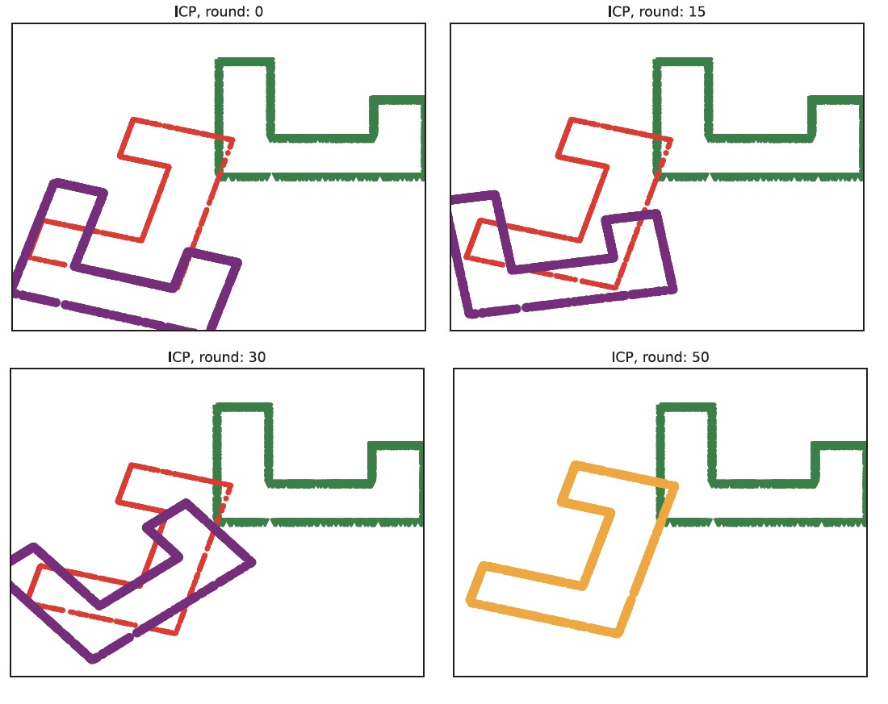
Can converge quite fast
Red – target
Green – source
Purple – running points
Green at 0 -> Purple at 0 – initial transformation

Slide 36
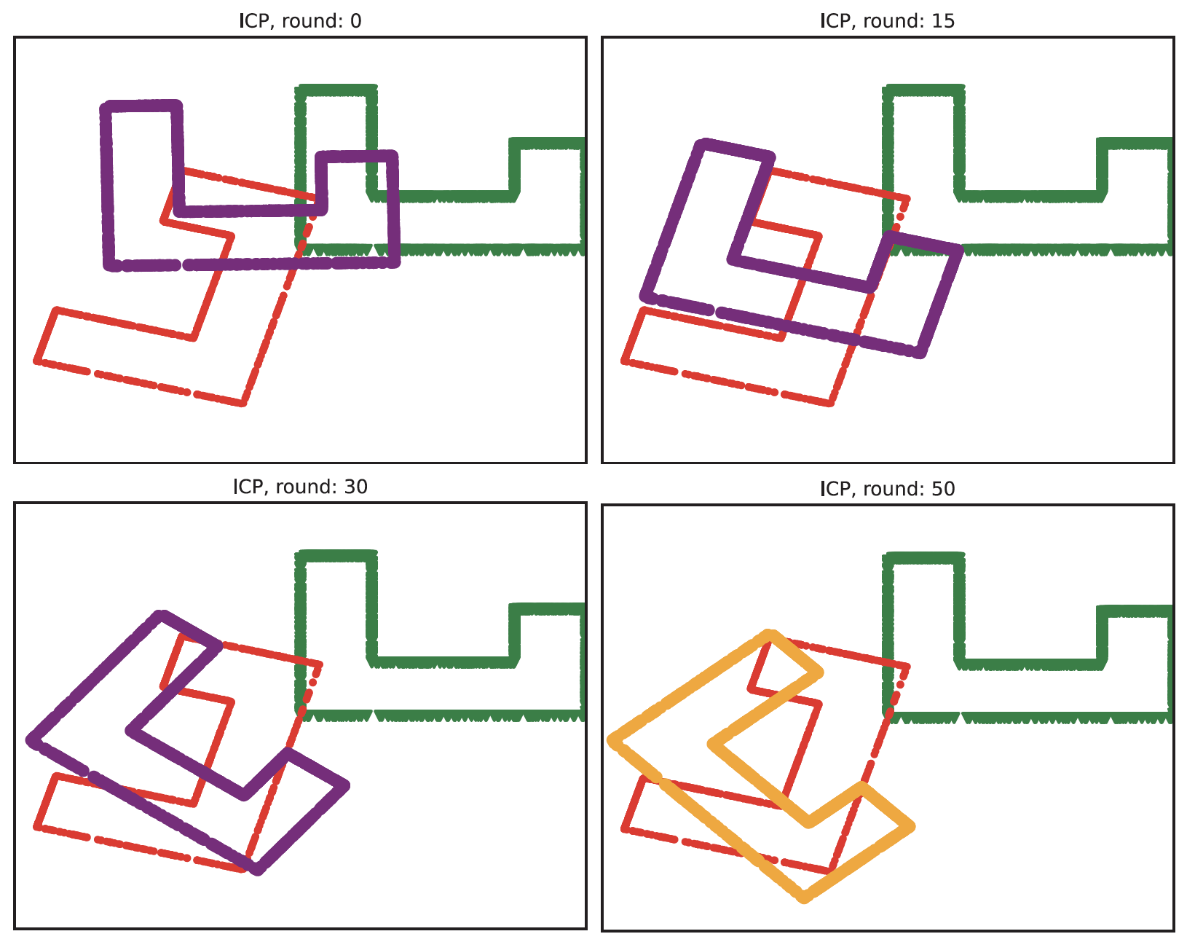
ICP doesn’t always converge
Red – target
Green – source
Purple – running points
Green at 0 -> Purple at 0 – initial transformation

Slide 37
ICP Issues
You have to do an awful lot of nearest neighbors
particularly if the point cloud is big
subsample the point cloud
approximate nearest neighbors
There are still robustness issues
Ideas:
drop correspondences for large distances
use IRLS at each round

Slide 38
Resampling
If the two point clouds are big, resample
Choose some number N of points that is acceptable
Draw N points uniformly and at random from point clouds
Do this with replacement, because its easier

Slide 39
Approximate nearest neighbors
ISSUE:
do you build a new tree for every iteration?
Strategies:
Space is almost always 2D or 3D, so you can grid it
It is easy to test what grid bin a point falls in (truncate, round)
Build a big enough grid and use that

Slide 40
ICP Issues
You have to do an awful lot of nearest neighbors
particularly if the point cloud is big
subsample the point cloud
approximate nearest neighbors
There are still robustness issues
Ideas:
drop correspondences for large distances
use IRLS at each round

Slide 41
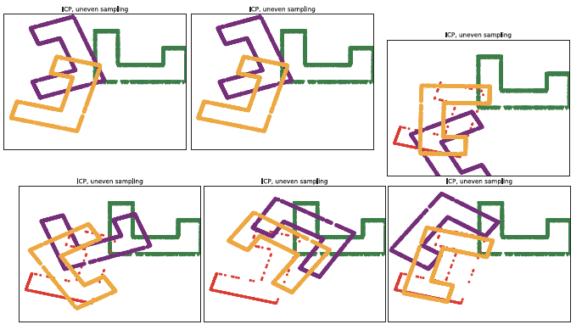
Uneven sampling creates ICP problems
Red – target
Green – source
Purple – running points
Green at 0 -> Purple at 0 – initial transformation

Slide 42
Stratifying a sample
Cut the space into even bins
for example, a grid
Read points into bins
Resample by:
Iterate:
Choose a bin uniformly and at random
Choose a point from that bin uniformly and at random

Slide 43
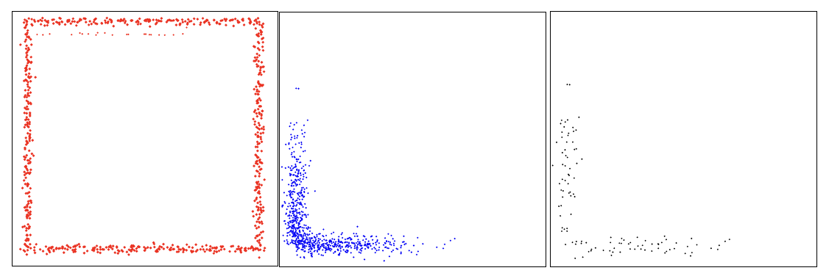
Issue for LIDAR
Map
Vehicle observations
Stratified resample of
observations

Slide 44
Biasing by normal can help
Resample the point cloud so that there are about the same number of points with each normal
How?
cut the unit sphere into bins,
read points into bins
resample by:
sample bin uniformly and at random
sample points in bin uniformly and at random

Slide 45
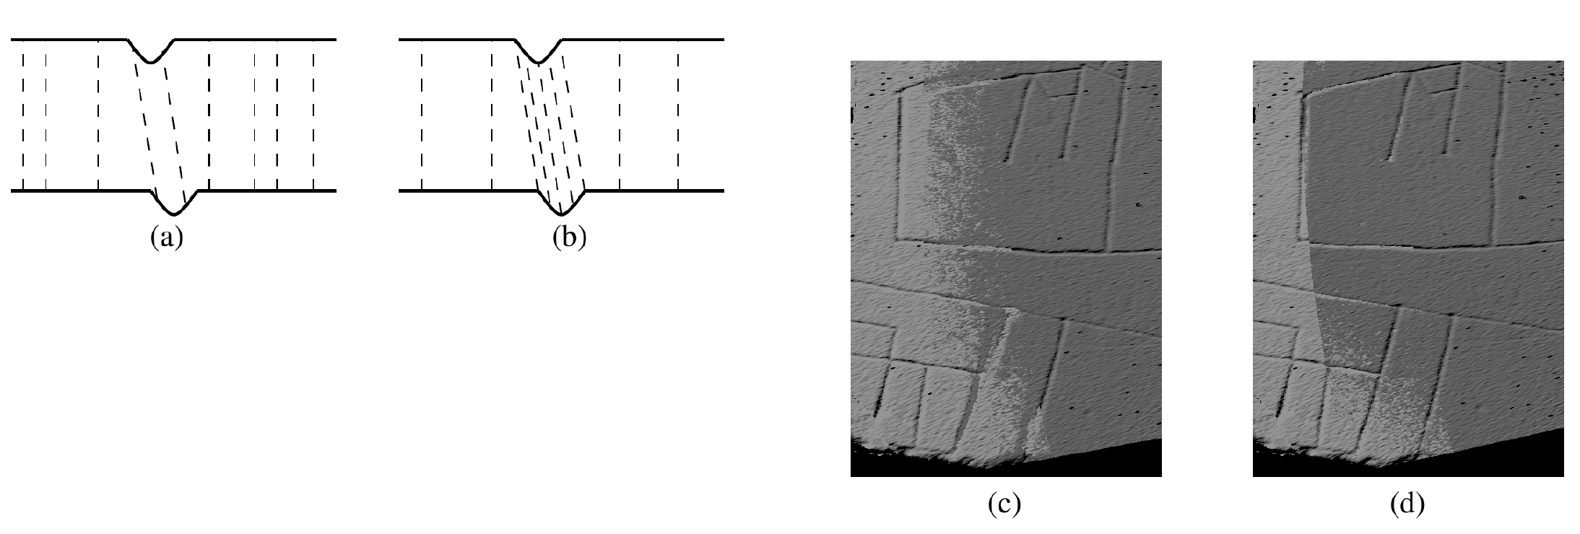
Biasing by normal can help

