Slide 1
Image representations
Idea:
Filter banks + ReLU yield scores for many different patterns
Idea:
You can compose this, so patterns of patterns of …
Idea:
if the filters are well chosen, you could use the representation to:
denoise images
find edges
find interest points
classify images…

Slide 2
Learned Image Representations
Idea:
Filtering an image and applying a ReLU produces a simple pattern detector
It is also, roughly, invertible
Reconstruct filter responses from ReLU outputs
Reconstruct image from responses (conv. Theorem)
Notice:
Last step of reconstruction is filtering

Slide 3
Now apply many different pattern detectors
You have an overcomplete representation
redundant information
one local image patch is scored against many different patterns
downside:
representation is larger
upside:
you can recover image despite some errors in representation

Slide 4
Reconstruction for many different filters+ReLUs
Eg least squares: find the image that produces the representation closest to the one observed
Now imagine input image is noisy:
The least squares reconstruction might not be
(with some care and some luck)
Idea:
Build device that can accept noisy image, produce clean
Denoising autoencoder

Slide 5
Learned Image Representations
Idea:
It might be possible to produce an image representation from a lot of filters
AND reconstruct the image from the representation using a lot more filters

Slide 6
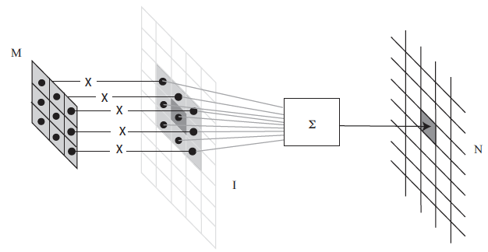
Recall convolution

Slide 7
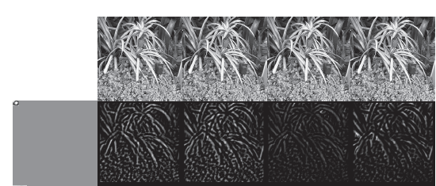
Recall Convolution + ReLU = pattern detector

Slide 8
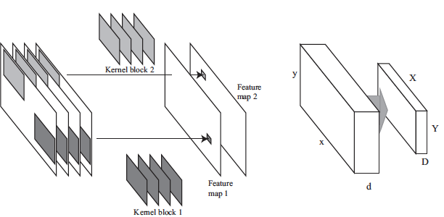
Recall Multi-channel Convolution

Slide 9
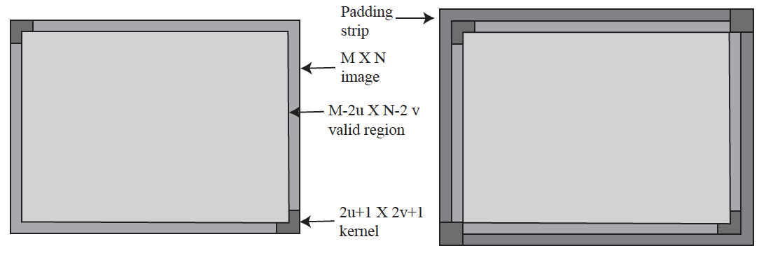
Recall padding

Slide 10
Stride
How far across/down to go to the next pixel?
Stride 1: what we’re used to
Stride 2: place the kernel on every second pixel

Slide 11
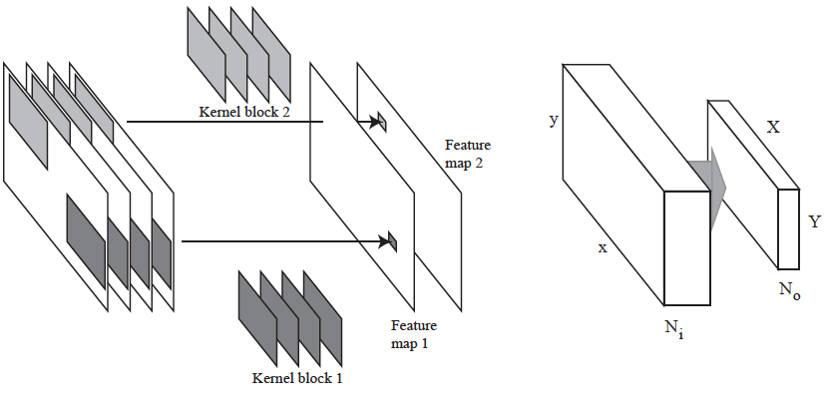
Convolutional Layers

Slide 12
Convolutional Layers
Output number
of features
Input number
of features

Slide 13
Convolutional Layers
Output size will be determined by:
input size,
kernel size,
padding,
stride,

Slide 14
ReLU operates on data block
Trivially – just ReLU at each location

Slide 15
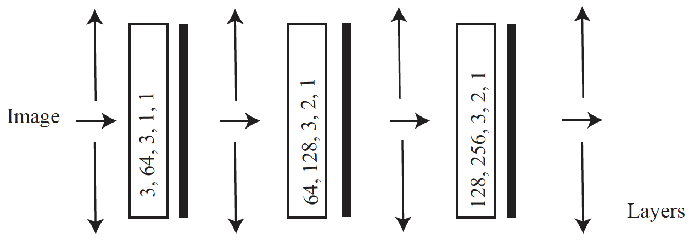
A very simple encoder
ReLU
Patterns of patterns of
patterns
Input number of features, output number of features, kernel size, padding, stride

Slide 16
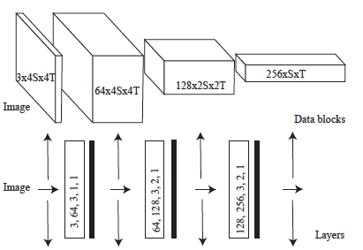
As data blocks
Number of features x Xdim x Ydim

Slide 17
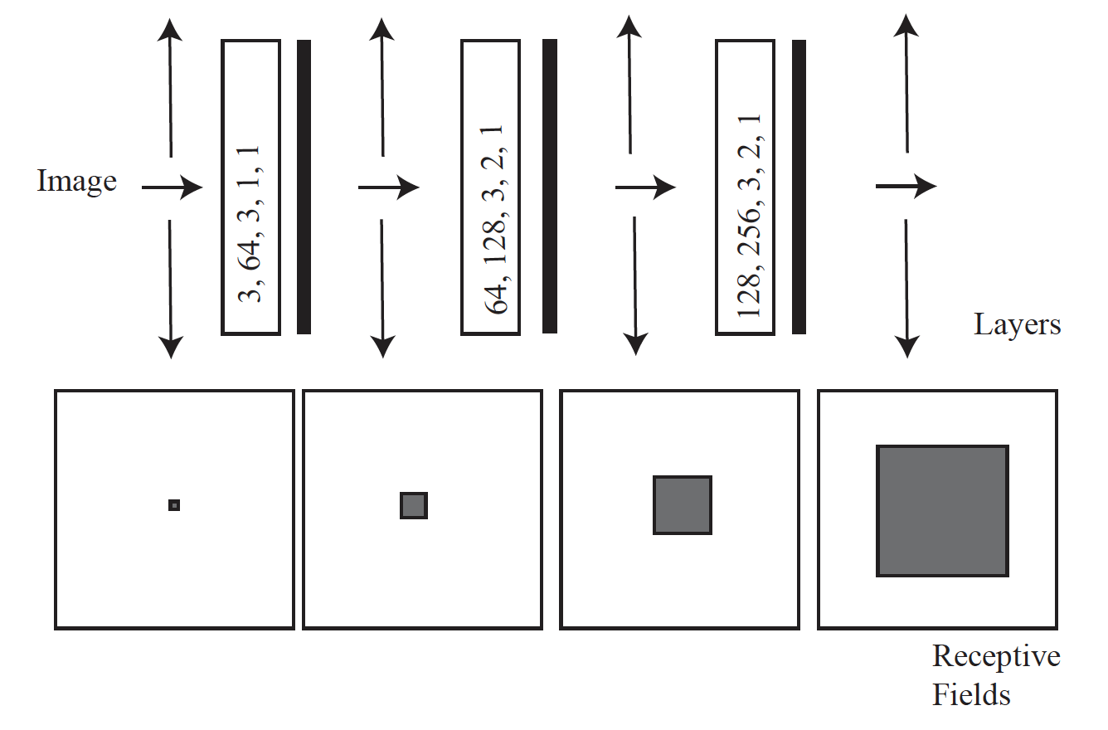
Receptive fields
Support for a value in the feature map

Slide 18
Decoding
Want:
map rep’n (patterns of patterns of patterns…) to image
Have:
If rep’n is filter outputs, convolution is enough
Rep’n is spatially smaller than image
Idea:
Filter+ReLU+upsample on occasion might do it

Slide 19
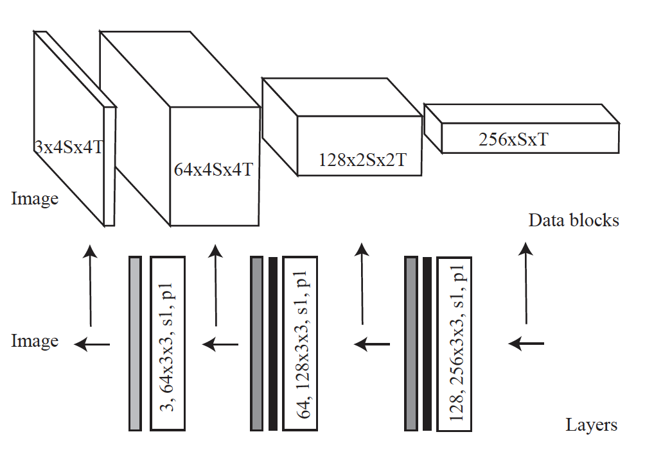
A decoder
Patterns of patterns of
patterns
ReLU
Upsample by 2
Input number of features, output number of features, kernel size, padding, stride

Slide 20
Big idea
With the right choice of filters in encoder and decoder
a decoder could reconstruct an image from an encoders rep’n
The rep’n is overcomplete, and “sees” the image at many scales
so the pair should be able to denoise
But what is the right choice of filters?

Slide 21
Learning the filters
Procedure:
find many training pairs (noisy image, clean image)
adjust filters so that
Decode(Encode(noisy image)) is close to clean image
on average, over pairs
hope that this generalizes to new images
Result:
Denoising autoencoder

Slide 22
Find many training pairs
No noise – system might ”cheat”
Produce a representation that isn’t useful
What noise should you use?
Options:
Gaussian (but a fairly simple filter will deal with this)
Poisson (median filter)
knock out blocks of pixels (more challenging, and helpful)
etc.

Slide 23
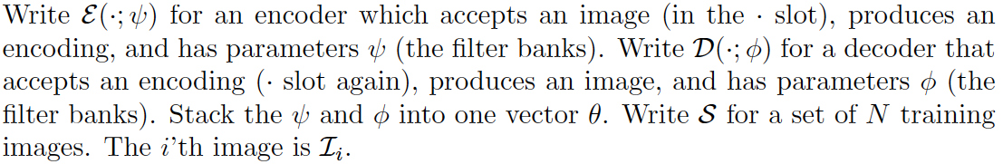
Adjusting the filters: notation

Slide 24
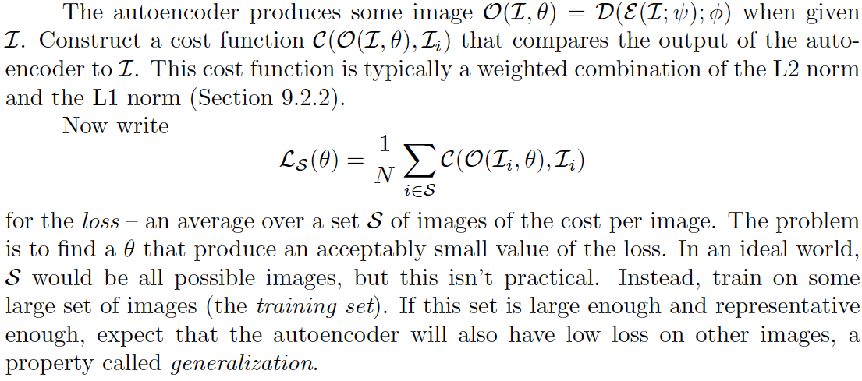
Adjusting the filters: loss

Slide 25

Adjusting the filters: optimization problem, but weird
Issues:
The cost function is very hard to evaluate (N is big)
There are lots of parameters (millions-billions)
so no newton’s method
You don’t actually want an optimum
you want a set of filters that works well on other images

Slide 26
Stochastic gradient descent
Loss is a population mean
you can estimate this quite well with a sample mean
draw a small batch, average over that

Slide 27
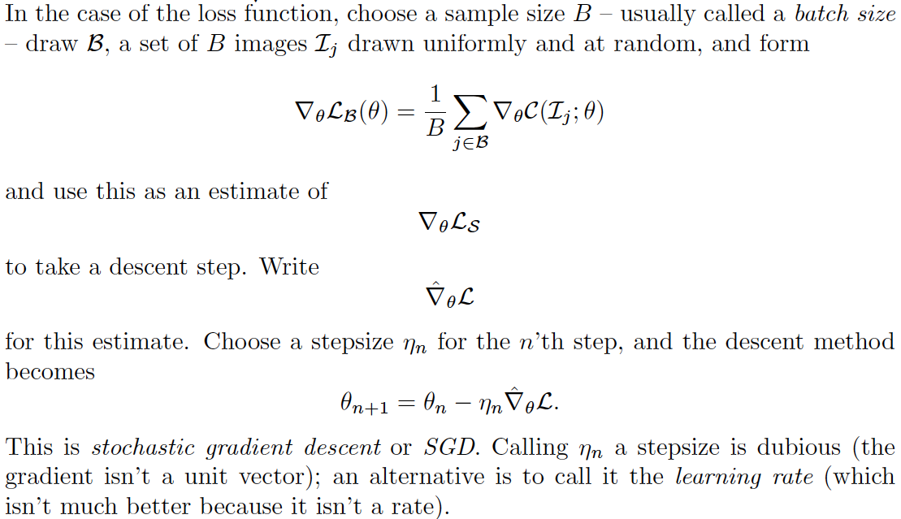
Stochastic gradient descent

Slide 28
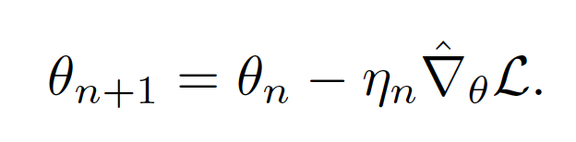
Stochastic gradient descent
How big a step?
Line search
you can’t – N is too big
Fixed length
too big (doesn’t settle down)
too small (no progress)
Learning rate schedule
start biggish, take steps, make smaller
how big is biggish? try

Slide 29
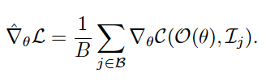
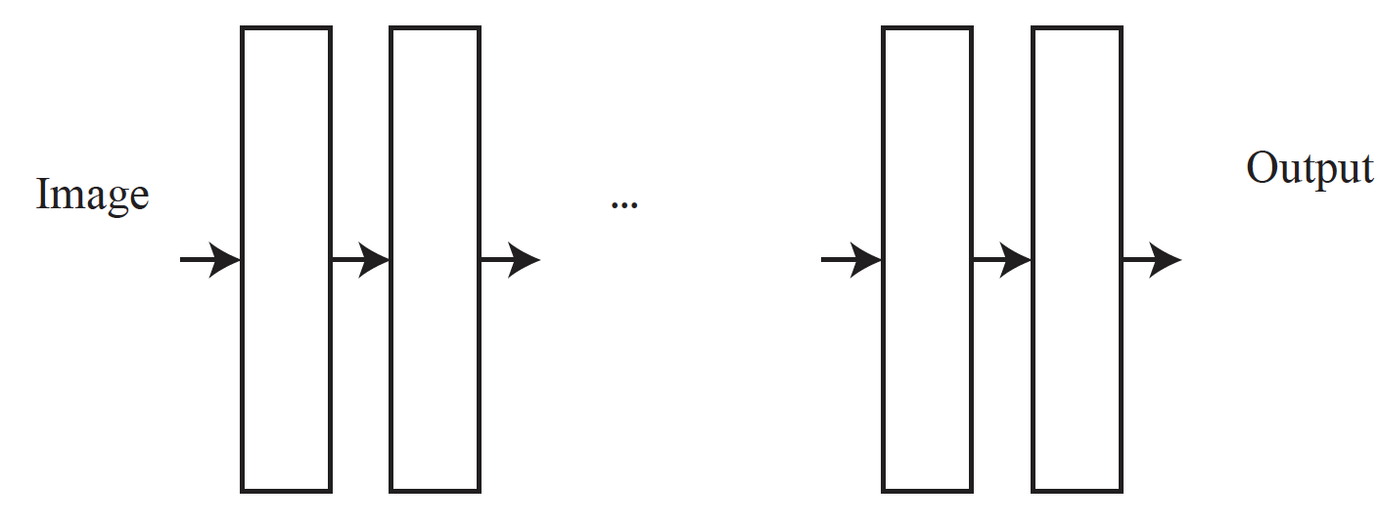
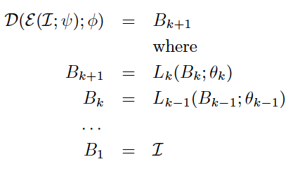
Evaluating the gradient

Slide 30
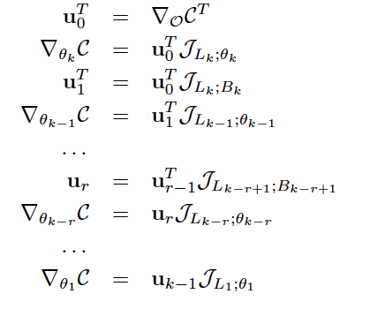
Recursion from chain rule (Backpropagation)
Derivatives of layer outputs
with respect to parameters
Derivatives of layer outputs
with respect to inputs

Slide 31
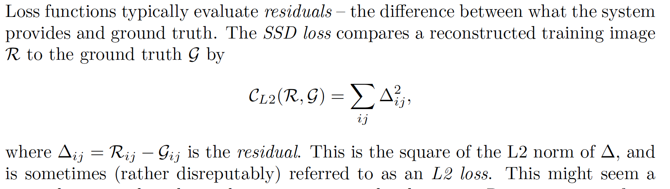
Losses – the L2 loss

Slide 32
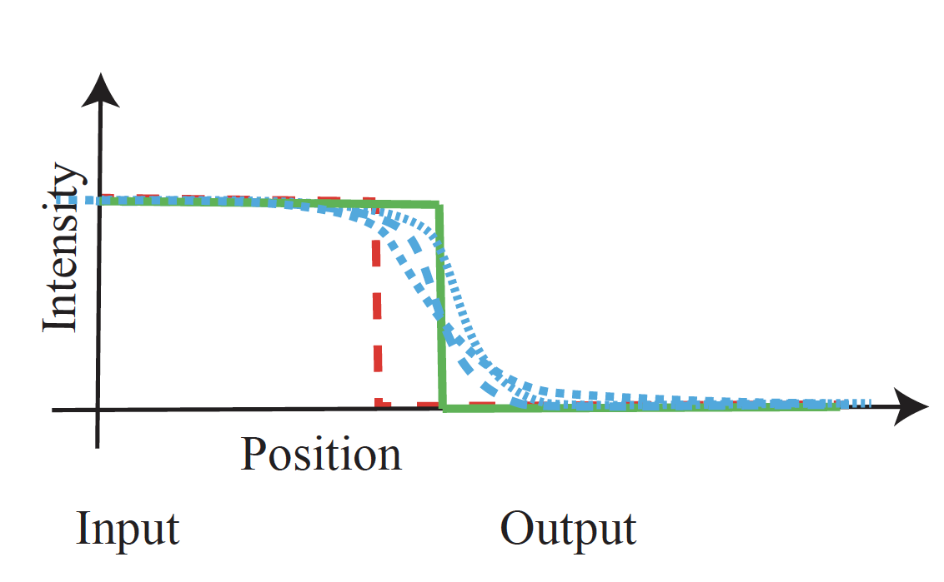
L2 loss creates blur
Sharp edge in the wrong place (red) is expensive
Compared to blurry edge in about the right place (blue)

Slide 33
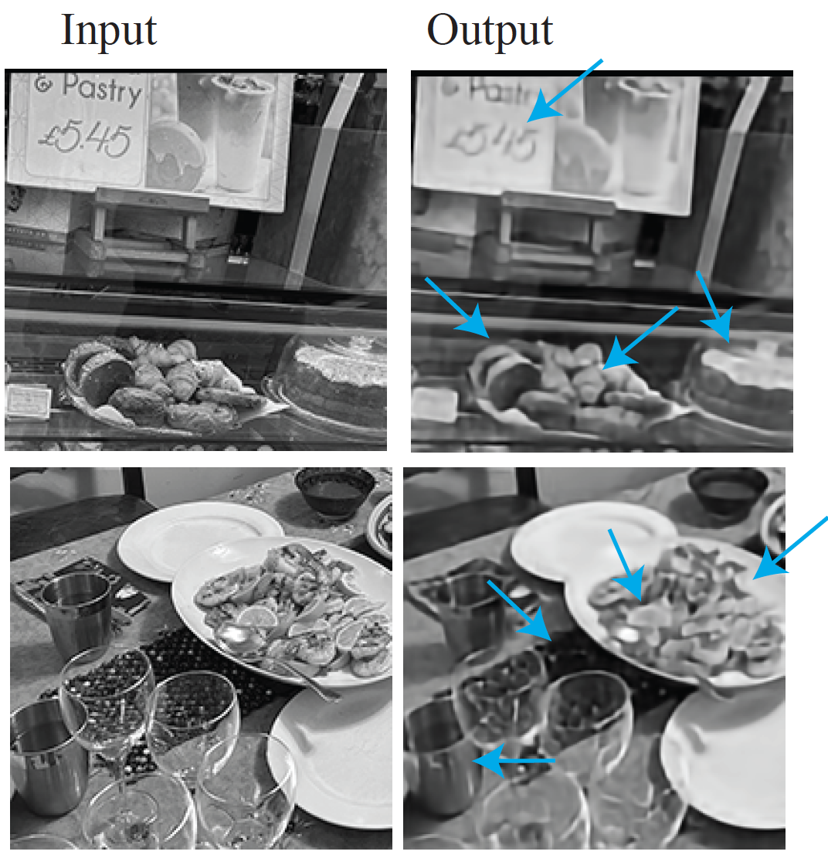

Slide 34
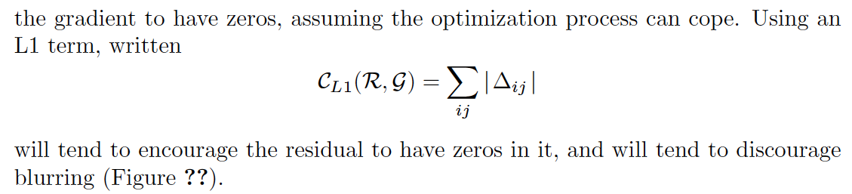
L1 loss
Idea:
penalize absolute value of residual
We saw the L1 norm in denoising
Square of a small number is very small; absolute value of small number isn’t
Tends to discourage blurring

Slide 35
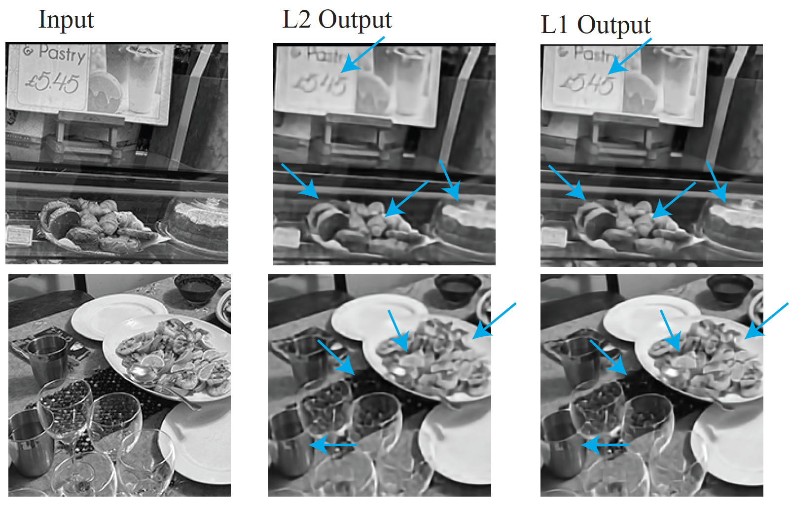
L1 loss

Slide 36
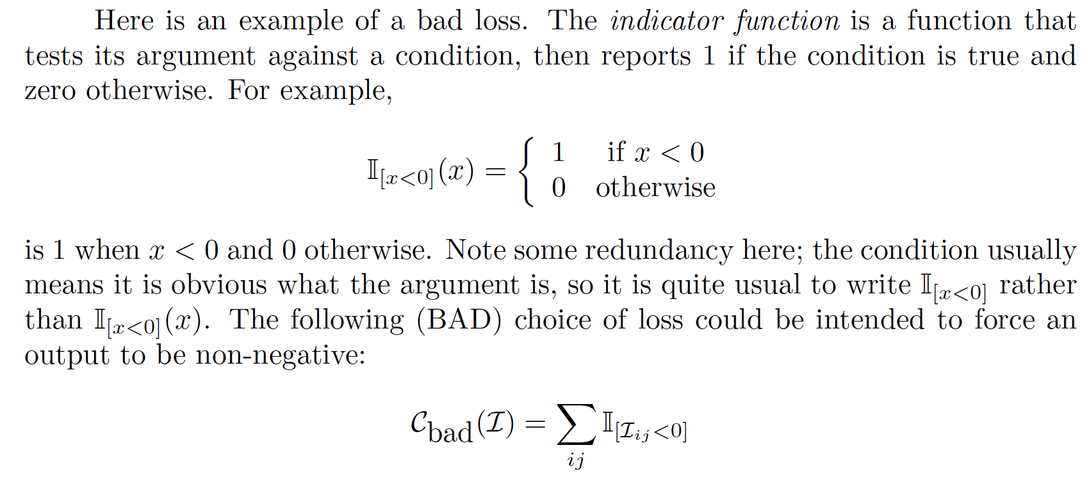
General ideas: Losses and Gradients
Notice that L1 loss, L2 loss DON’T:
Force values to be non-negative
Force values to be less than 1
(VERY BAD) Idea:

Slide 37
General ideas: Losses and Gradients
Bad, because it supplies no gradient
Pixel is +ve: loss and gradient are zero
Pixel is –ve: loss is 1, gradient is zero – no information about how to change filters
CF L1 loss:
Pixel value too large: gradient pushes it down
Pixel value too small: gradient pushes it up
Pixel value just right: non-differentiability doesn’t matter
never happens
choose -1<= gradient <=1: everything works fine

Slide 38
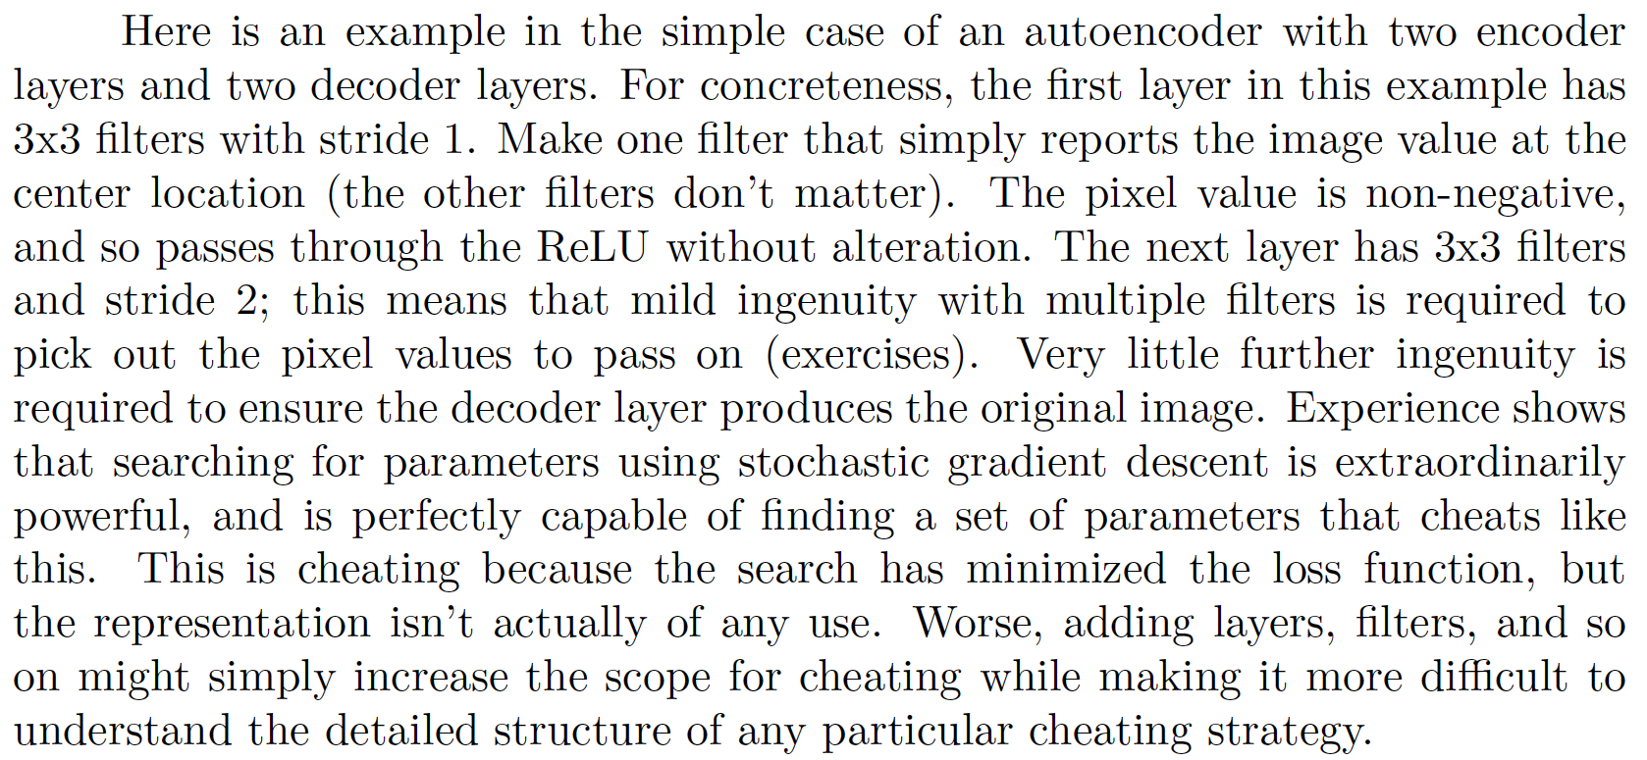
General ideas: Cheating
Stochastic gradient descent is a very effective search
Astonishing, but true
It might find a solution you don’t expect and don’t want
Example:

Slide 39
General ideas: Cheating
Cheating example above won’t denoise
It is important to train representation to denoise images
(Noisy, clean) pairs will produce something useful
(clean, clean) pairs won’t!

Slide 40
General ideas: Generalization
We have no particular interest in denoising training images
We want to denoise new images
Options:
Data augmentation: make training dataset look bigger
Regularization: make it hard to choose filters that are specialized

Slide 41
General ideas: Data Augmentation
Applies to many learned systems
For now:
A left/right flipped image is still an image
An up/down flipped image is still an image
An image crop is still an image
Etc
When forming a batch, randomly
crop, flip, etc. images

Slide 42
General ideas: Regularization
Prefer filters with small coefficients to filters with large coeffs.
A filter with large coeffs that works well on training data might produce an unexpected large response on new data
Discourage filters with large coeffs by penalizing loss
(cost of error on batch) + scale*(penalty for large coeffs)
Known as weight decay
API will do this for you if you ask

Slide 43
General ideas: Regularization
How to choose scale?
Train for many different choices
Evaluate each on held out data to choose
Now re-train using the best value
Evaluate the result on new dataset

