Slide 1
Last block:
Build an encoder and a decoder to:
Accept noisy image, produce clean version
By:
Constructing loss
Applying various tricks for good behavior
Adam/SGD/something to get minimal loss on training data
Idea:
exploit this machinery to classify image; running eg is real vs denoised

Slide 2
Classification
Take a feature representation and apply a label
eg credit card transaction (valid/fraud)
By some procedure
usually, constructed out of training data
crucial point:
classifier should work well on future data
Hugely useful, very broad idea

Slide 3
Evaluating classification
Accuracy:
fraction of classification attempts that result in right label
Error rate:
fraction of classification attempts that result in wrong label
Bayes error:
error rate that the very best possible classifier makes
usually, very hard to know

Slide 4
Evaluating classification
One class is boring:
Binary classifiers:
Two classes (yes/no; real/denoise; valid/fraud) etc.
Error rate never greater than 50%
False positive rate = fraction of negative examples labelled positive (Type I error rate)
False positive rate = fraction of negative examples labelled positive (Type II error rate)
Error rates interact!

Slide 5
Evaluating classification
Always:
evaluate on data not used to train
(otherwise evaluation is biased optimistic)
compare to baselines
(reasonable alternatives)
report TP rate and FP rate

Slide 6
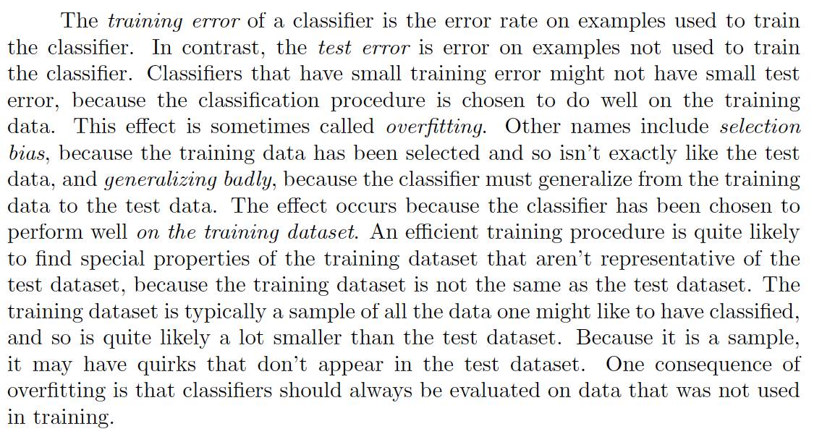
Train error, test error, overfitting

Slide 7
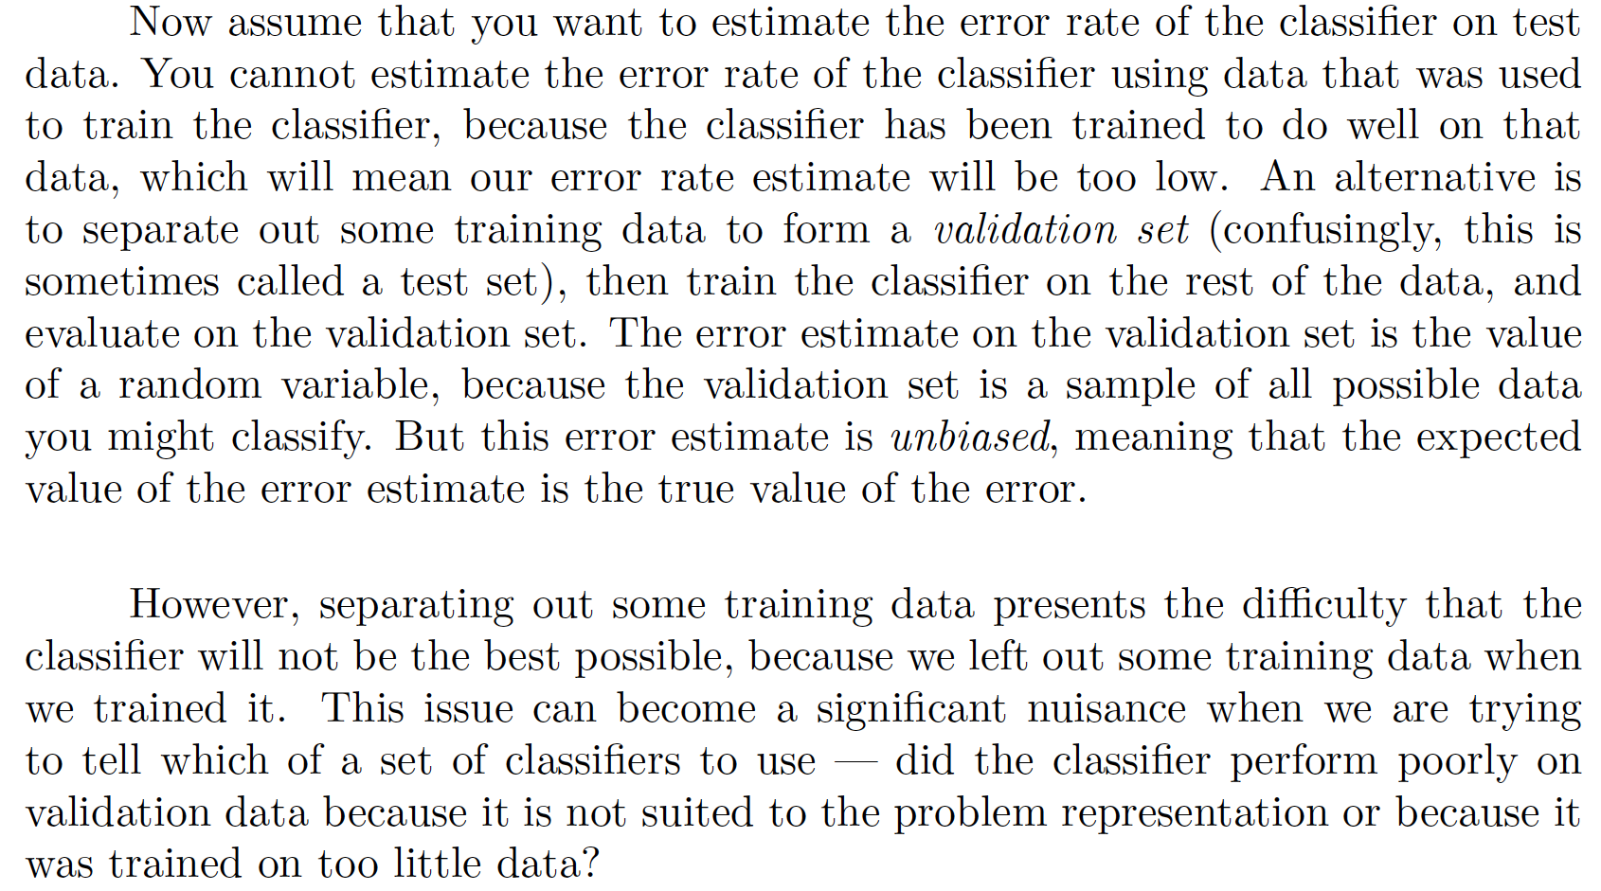
Estimating error rate

Slide 8
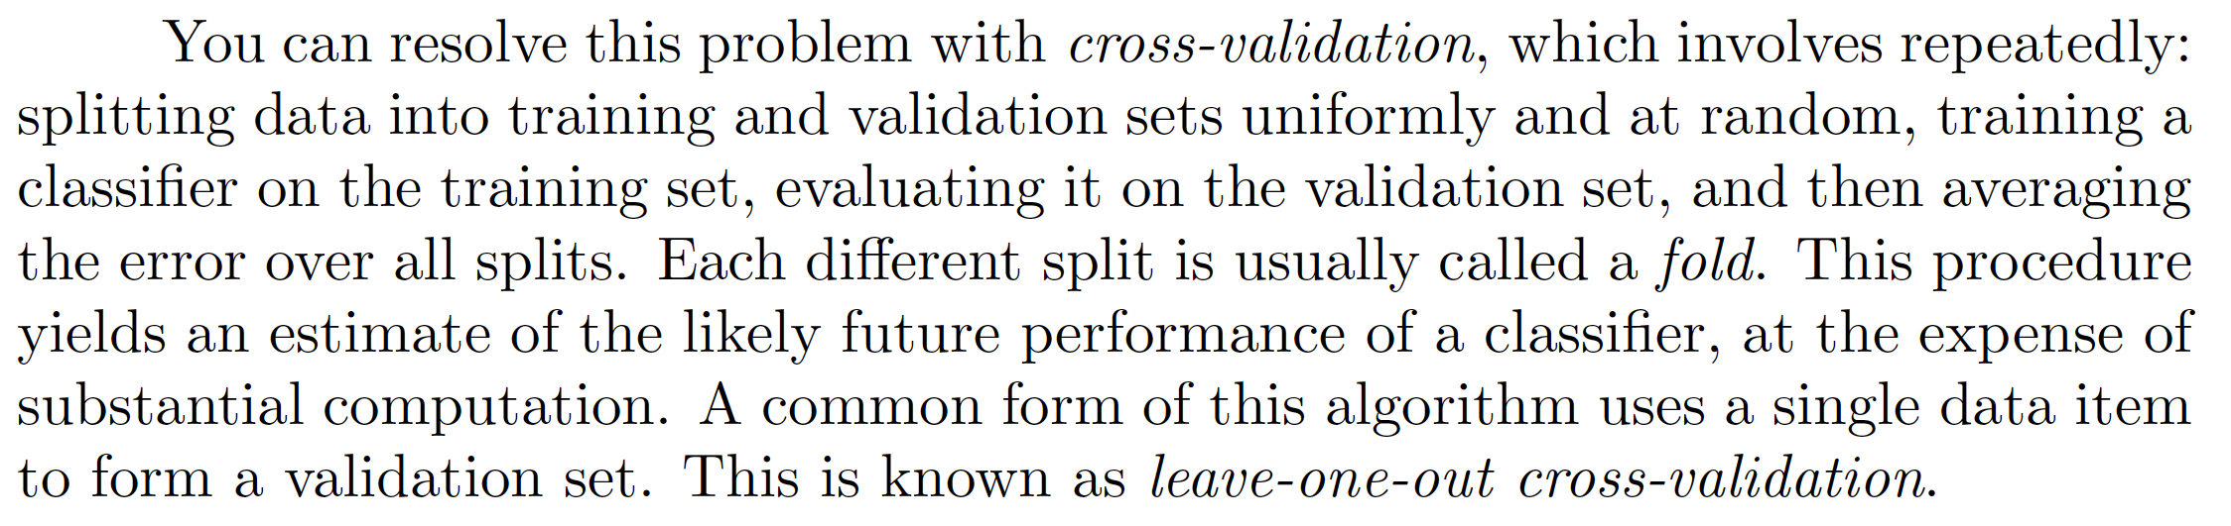
Cross validation

Slide 9
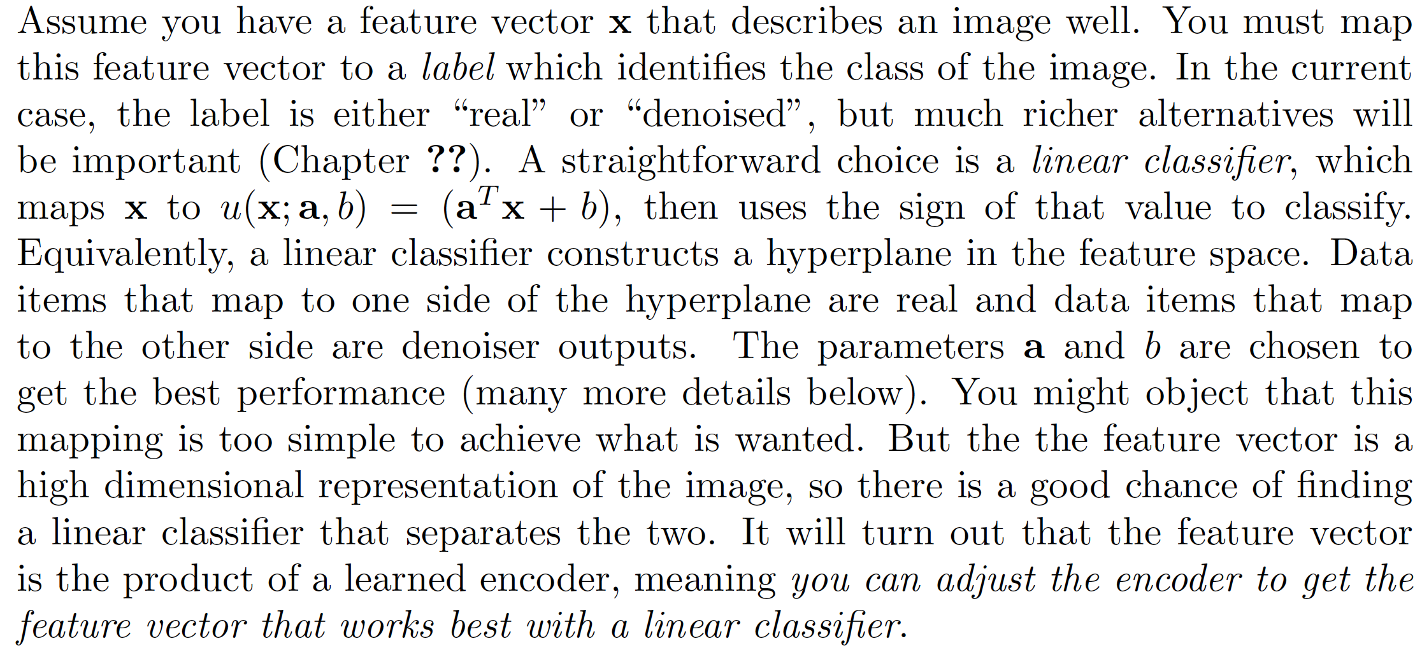
A linear classifier

Slide 10
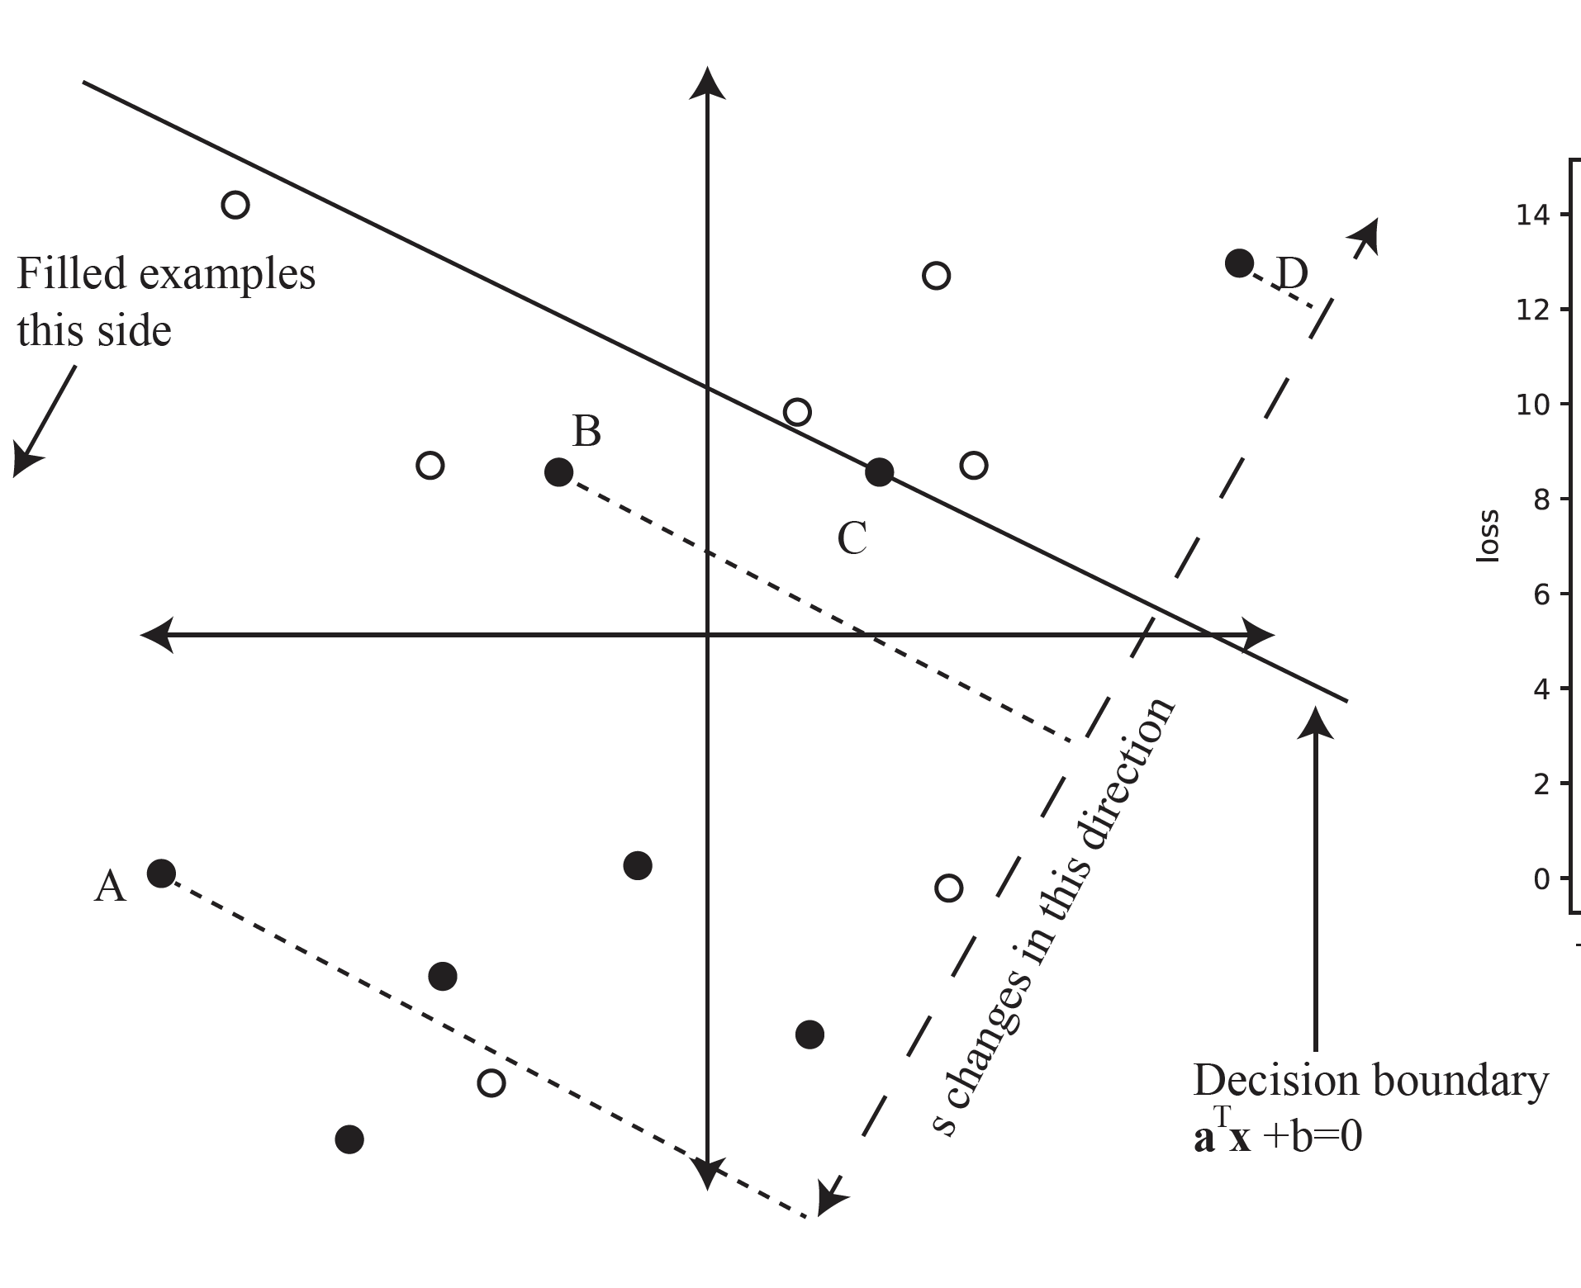
The decision boundary

Slide 11
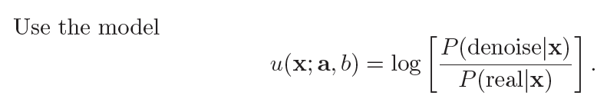
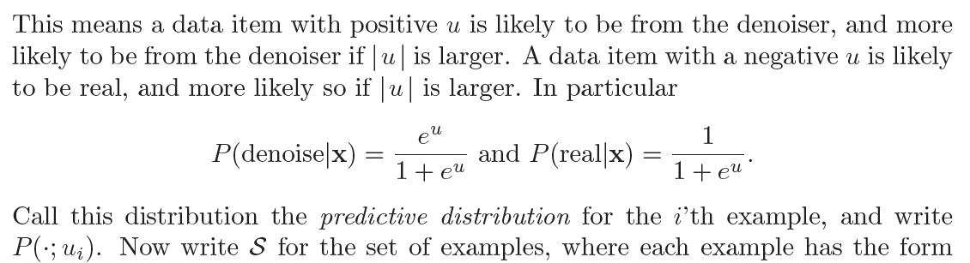
Choosing a, b

Slide 12
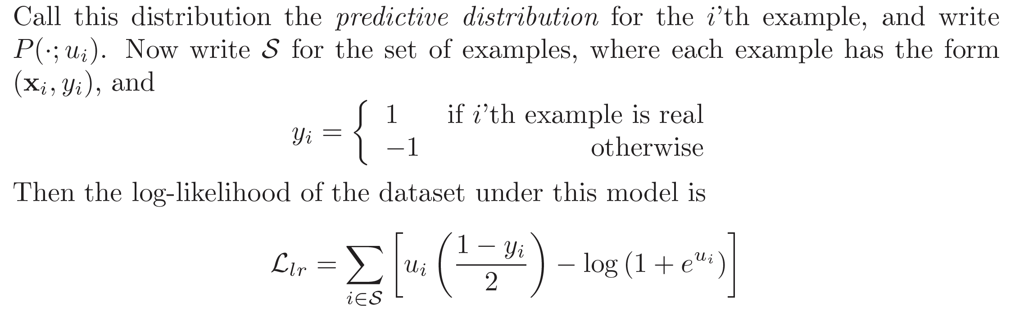
Choosing a, b - II
Choose a, b to maximize log-likelihood
equivalently minimize negative log-likelihood
Logistic regression

Slide 13
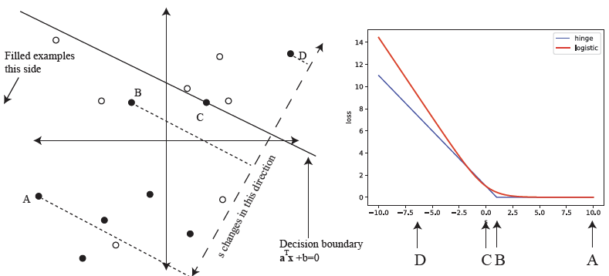
Logistic regression

Slide 14
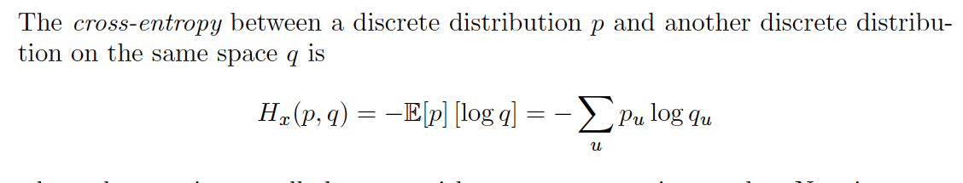
Cross entropy between distributions
If they’re the same, entropy of that dist
If different, bigger

Slide 15
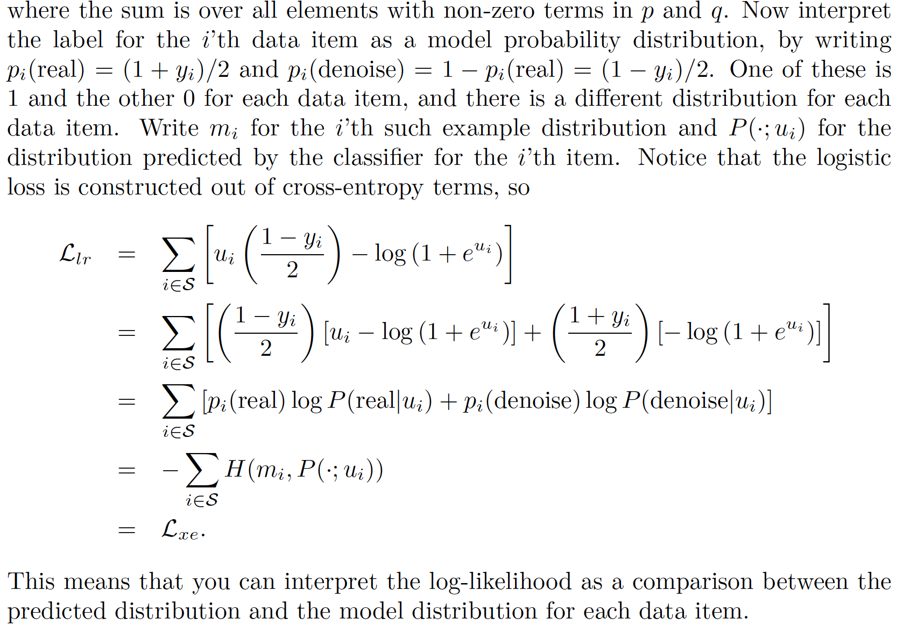
Cross entropy loss

Slide 16
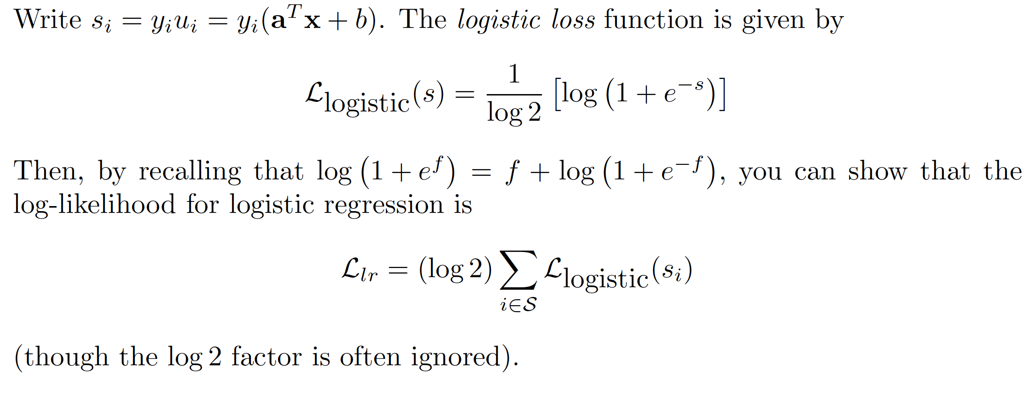
Logistic loss

Slide 17

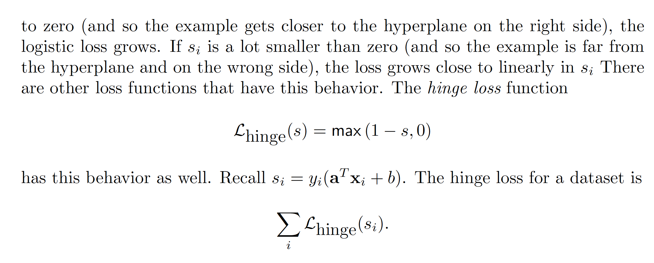
Hinge loss

Slide 18
Hinge loss vs logistic regression

Slide 19
But what should x_i be?
Idea:
get it from an encoder
what encoder?
Idea:
train encoder to produce x_i so that classification is best
Issue:
get from encoder output to vector without too much drama

Slide 20

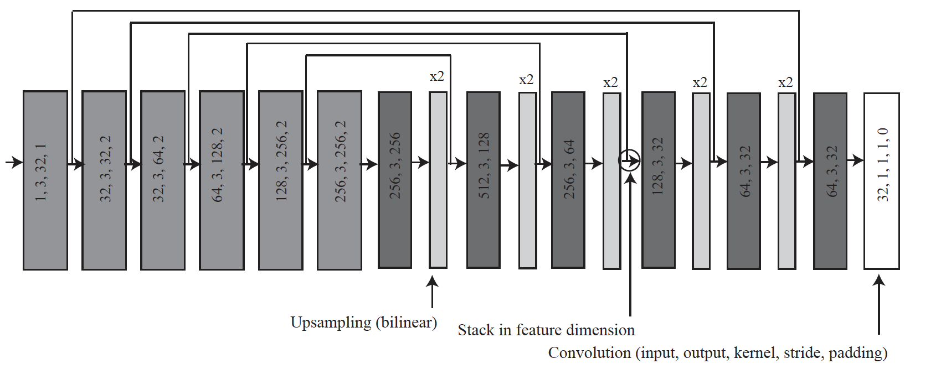
Deeper autoencoder
(FxMxN) block
not Fx1 vector

Slide 21
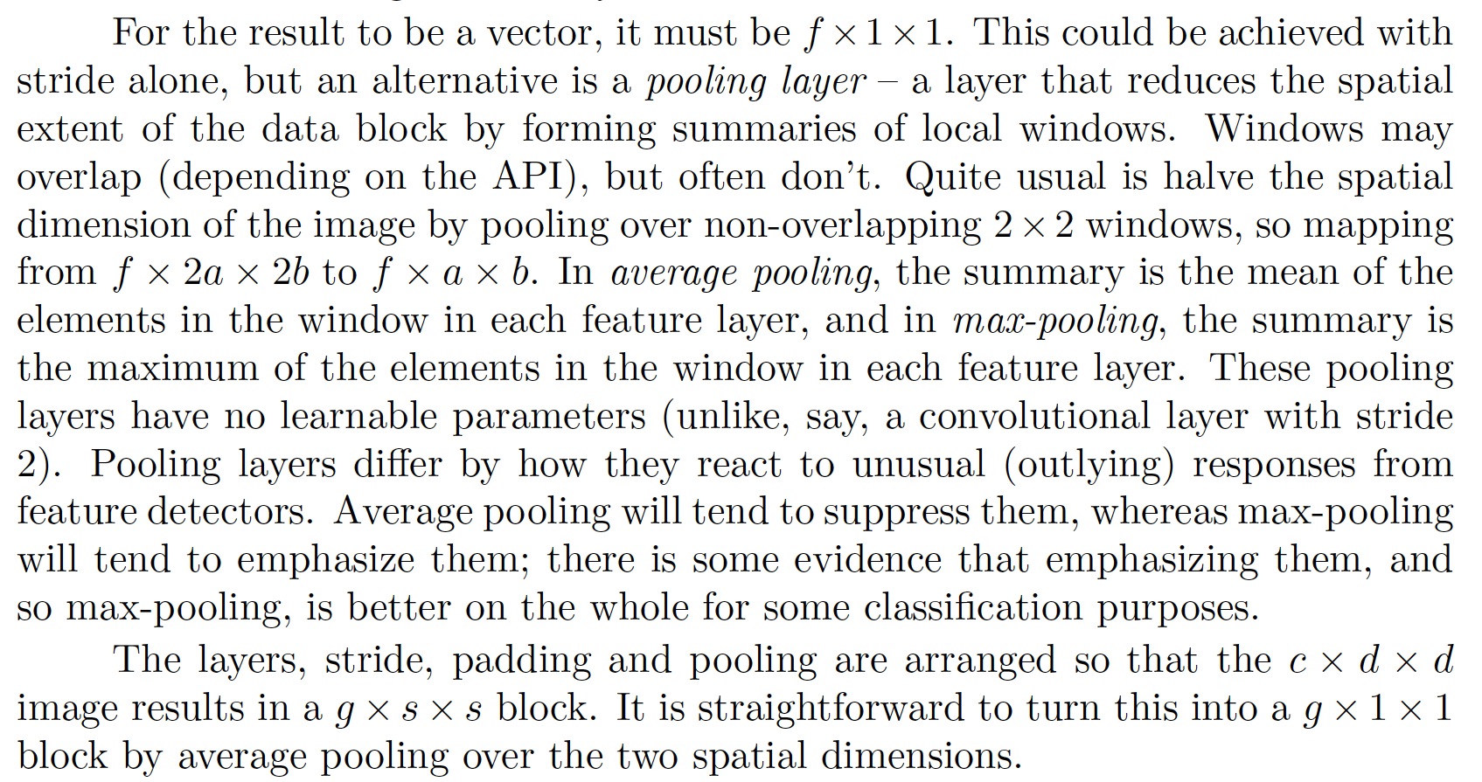
Pooling

Slide 22
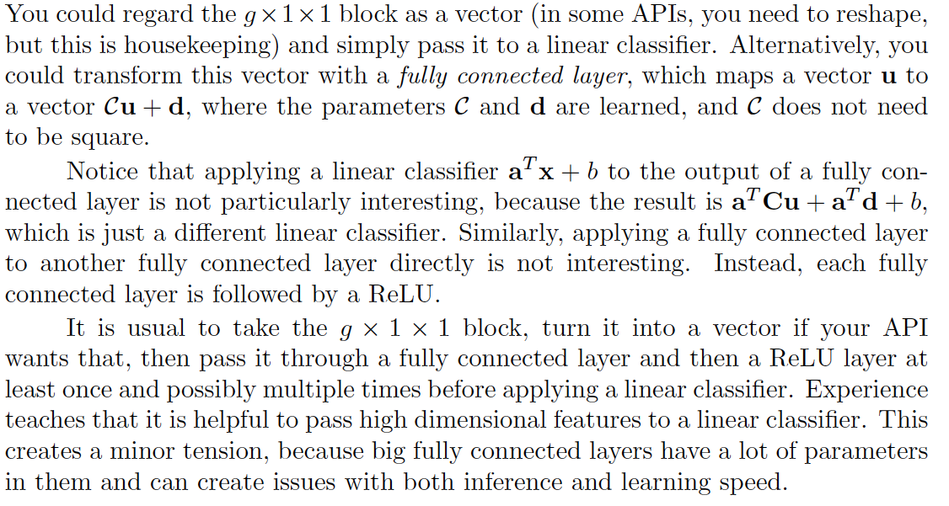
Fully connected layers

Slide 23
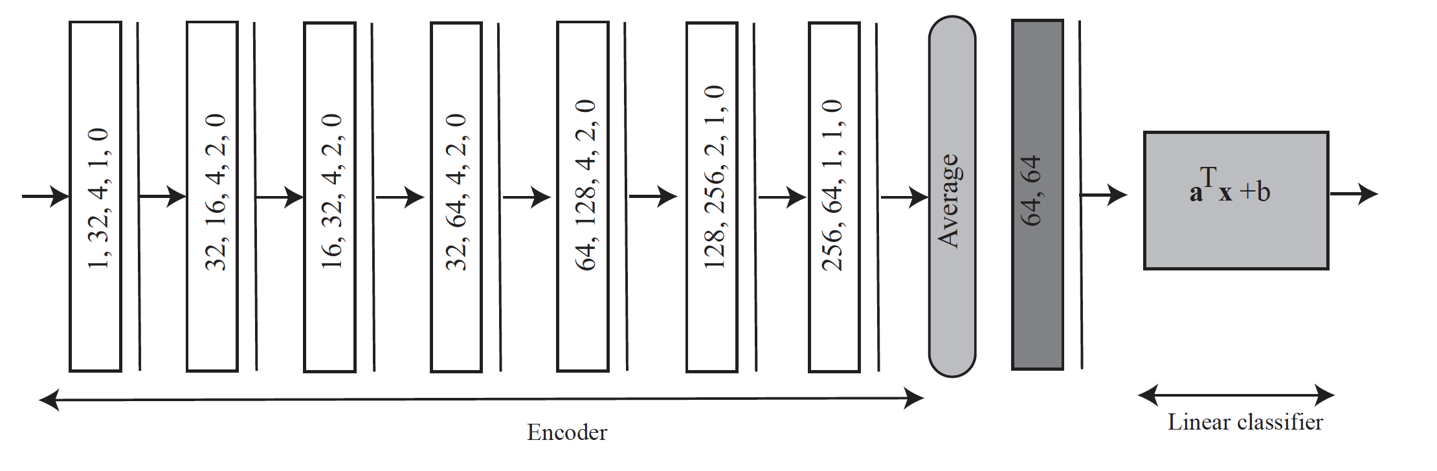
Very simple classifier

Slide 24
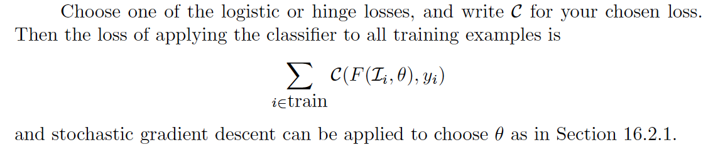
Training the very simple classifier

Slide 25
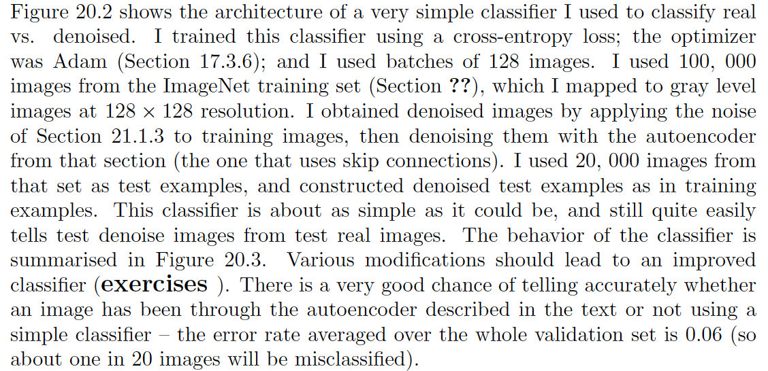
Training the very simple classifier
Example case:
- is image just an image, or the output of a denoiser?

Slide 26
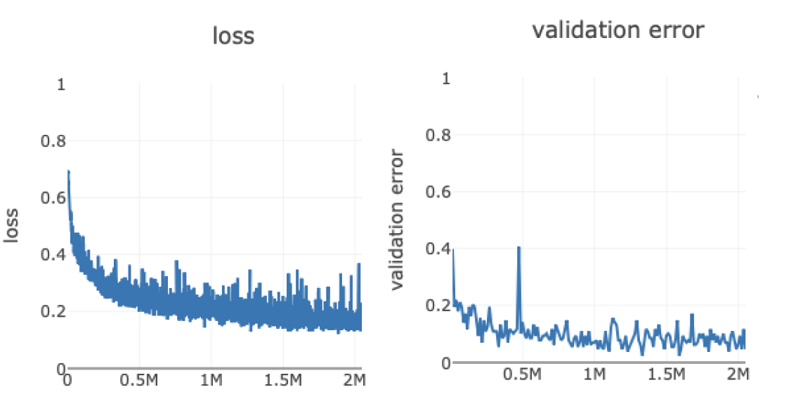
Training the very simple classifier
Number of examples
Number of examples

Slide 27
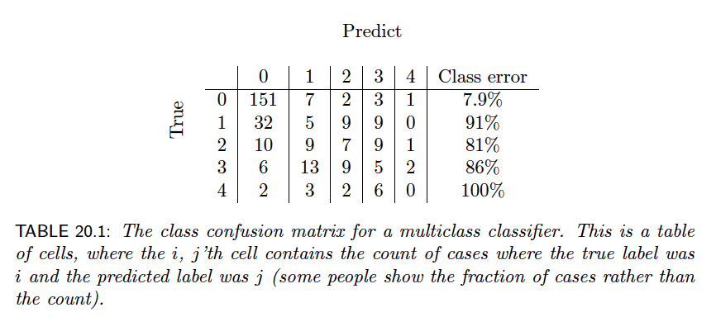
Multiclass classification
More than two classes:
Evaluation:
Accuracy/Error rate
FP/FN is not helpful
Class confusion matrix

Slide 28
Evaluating classification
Always:
evaluate on data not used to train
(otherwise evaluation is biased optimistic)
compare to baselines
(reasonable alternatives)
compare accuracy to chance
if there are K classes evenly distributed
1/K
otherwise error rate if you choose most common class

Slide 29
Multiclass classification pragmatics
For K classes, predict a K dimensional vector
score vector
apply matrix to x add vector
Predict the class with the largest score

Slide 30
Multiclass Loss

