Slide 1
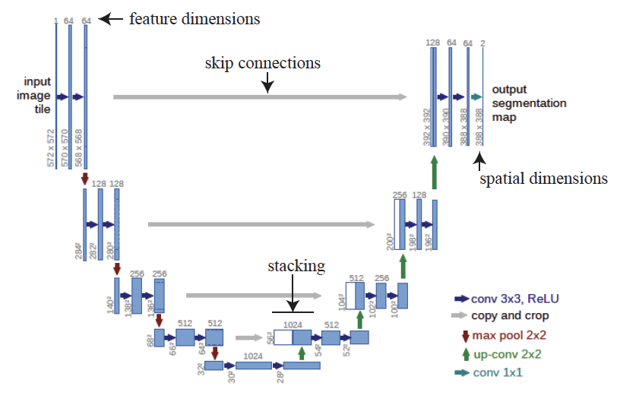
The original U-net
This doesn’t
have to be a
segmentation

Slide 2
Curiosities
The U-Net is fully convolutional
is this a good thing?
Equivariance
harder than it looks
Other encoders are possible
but not now

Slide 3
This U-net is fully convolutional
Consists of convolutional layers, pooling layers, upsampling layers, ReLU’s
Consequence:
You can pass in images of variable size
(as long as they’re big enough)
Advantage:
Images have variable size in real life
Issue:
This can make some problems very hard.

Slide 4
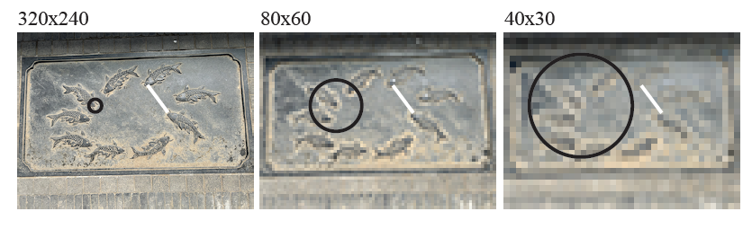
Consequence
The same network feature depends on a different spatial scale in the image for different size images
This can present problems, but doesn’t usually
training data seems to deal with this

Slide 5
Curiosities
The U-Net is fully convolutional
is this a good thing?
Equivariance
harder than it looks
Other encoders are possible
but not now

Slide 6
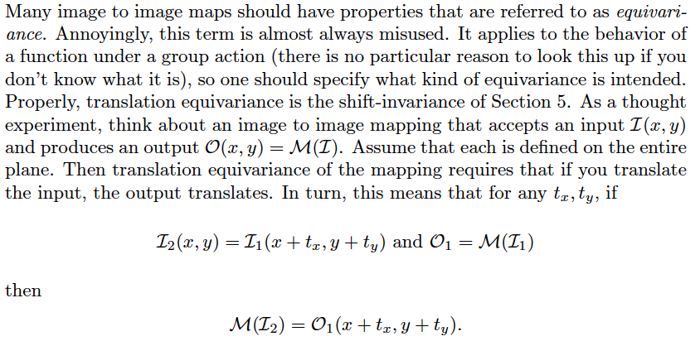
Equivariance
What you want, but
can’t get

Slide 7
You can only get this property if you don’t pad
Which is almost always impractical
Padding makes up for the fact the image isn’t infinite
but means that when you shift, you see new pixels

Slide 8
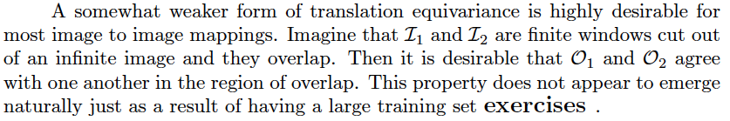
What you might be able to get
In practice, this property doesn’t just appear, and requires special training.
Most SOTA image-image mappers don’t have it!

Slide 9
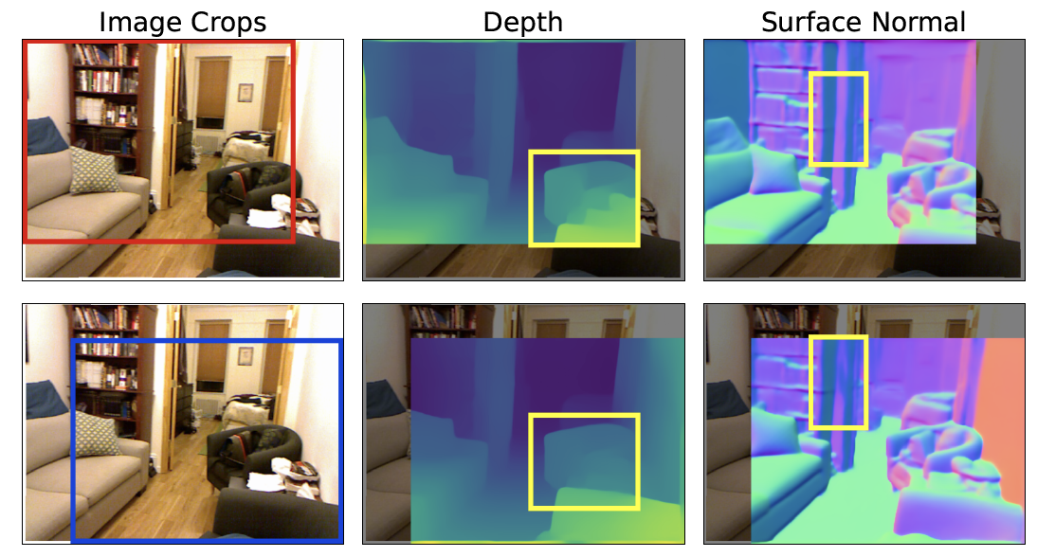

Slide 10
Curiosities
The U-Net is fully convolutional
is this a good thing?
Equivariance
harder than it looks
Other encoders are possible
but not now

