Slide 1
Last blocks:
Build an encoder and a decoder to:
Accept noisy image, produce clean version
By:
Constructing loss
Applying SGD to get minimal loss on training data
Using various tricks to get good behavior

Slide 2
Order
UNET
Depth prediction
Depth and normal are related
Normal Prediction
Equivariance
Other predictors

Slide 3
Now change what the decoder does…
An ”image like” thing
may have the same resolution as the image
continuous
lots of examples
can be predicted from an image (but how do we know?)
Examples:
depth
normal
defogged image
superresolution
lots of others..

Slide 4
New recipe, depth case
Procedure:
find many training pairs (image, depth)
adjust filters so that
Decode(Encode(image)) is close to depth
on average, over pairs
hope that this generalizes to new images
Result:
Single image depth predictor

Slide 5
The U-Net
Originally
a particular architecture
Increasingly
an encoder followed by a decoder

Slide 6
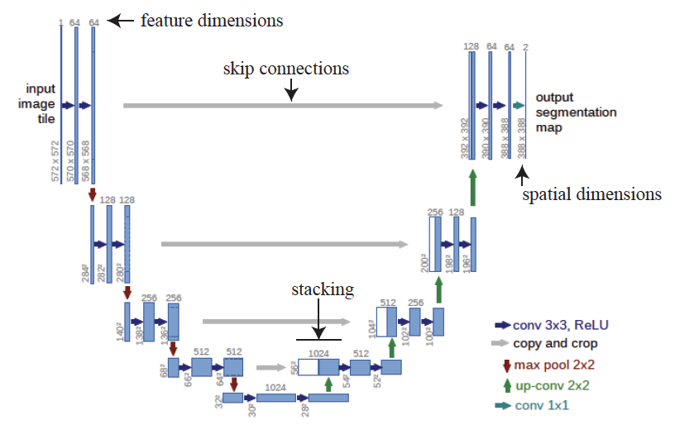
The original U-net
This doesn’t
have to be a
segmentation

Slide 7
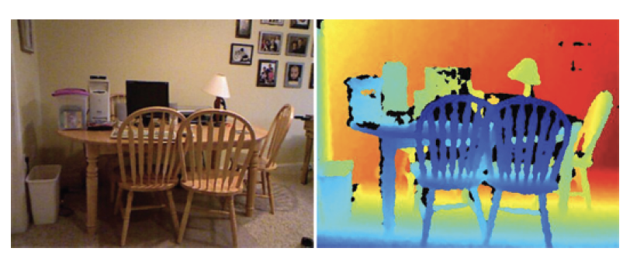
Depth from single image
Data example from NYUV2

Slide 8
What should a depth predictor predict?
Absolute depth:
Might be very difficult to get right
compare:
zoomed picture of a doll-house room
picture of real room
Relative depth:
depth up to per-image scale
more likely to get this right, but harder to use

Slide 9
Scale and error
Nearby objects are more interesting than distant ones
you collide with them first
Want smaller error in small depths than in large depths
squared error tends to yield small errors in large predictions
Relative error = error/(true value)
Want smaller relative error in small depths, too

Slide 10
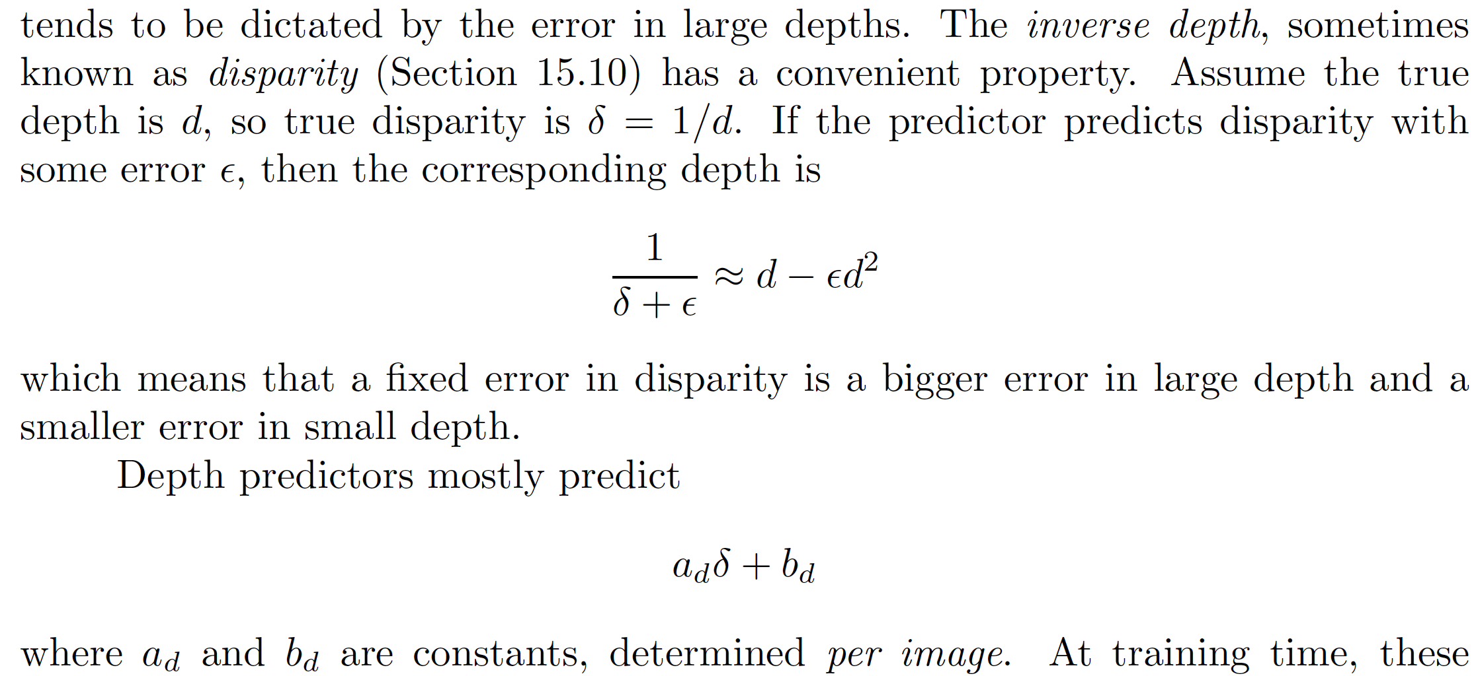
What should a depth predictor predict?
Disparity = (1/depth)

Slide 11
Losses

Slide 12
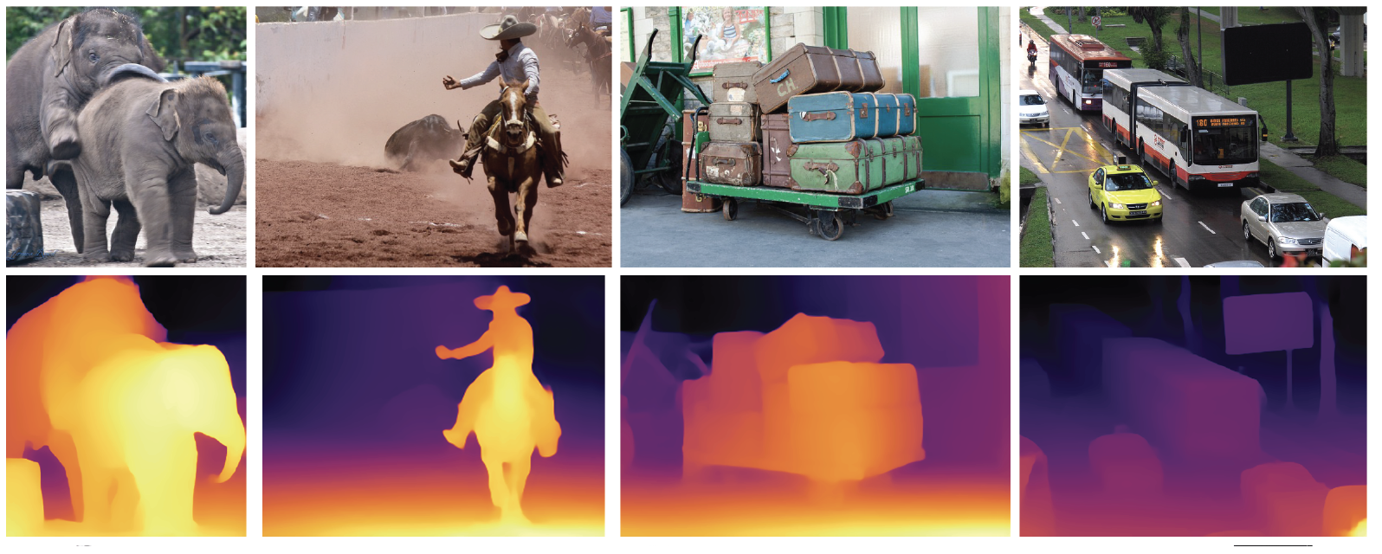
Depth predictors work really well

Slide 13
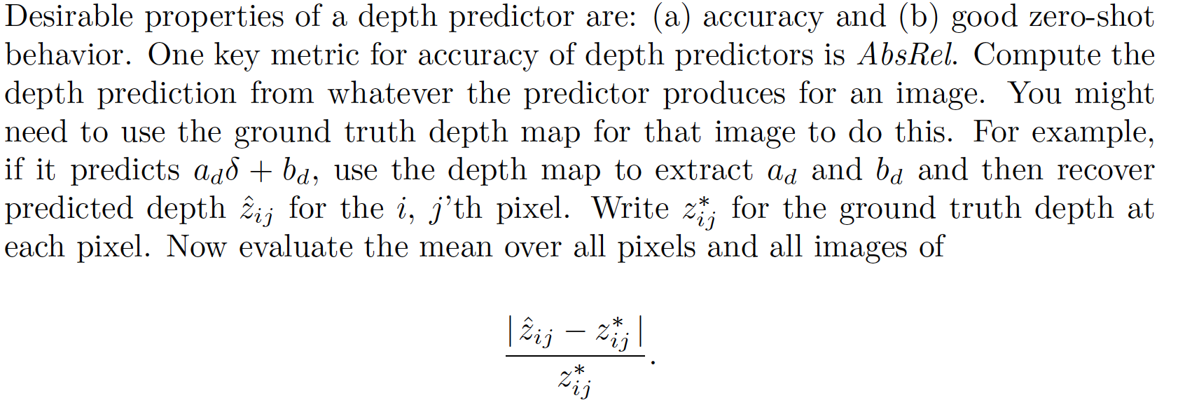
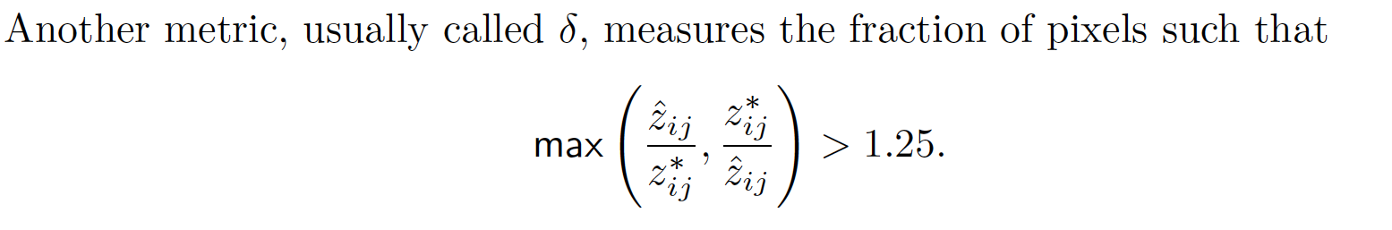
Evaluating depth predictions
Absrel
Delta

Slide 14
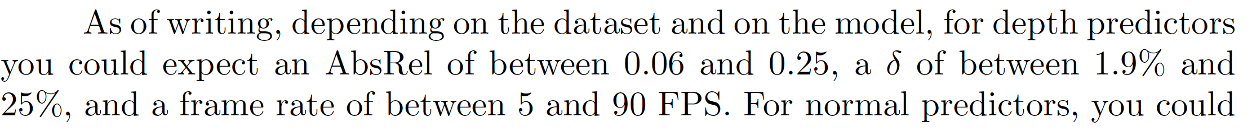
Rough SOTA
Generally, faster is less accurate
(good sign that payoff makes sense)

