Slide 1
Last blocks:
Build an encoder and a decoder to:
Accept noisy image, produce clean version
By:
Constructing loss
Applying SGD to get minimal loss on training data
Using various tricks to get good behavior

Slide 2
Order
UNET
Depth prediction
Depth and normal are related
Normal Prediction
Equivariance
Other predictors

Slide 3
New recipe, normal case
Procedure:
find many training pairs (image, normal)
adjust filters so that
Decode(Encode(image)) is close to normal
on average, over pairs
hope that this generalizes to new images
Result:
Single image normal predictor

Slide 4
Normal from depth
For training:
If you have depth data, fit a plane locally
use the plane’s normal
Alternative:
geometric reasoning

Slide 5
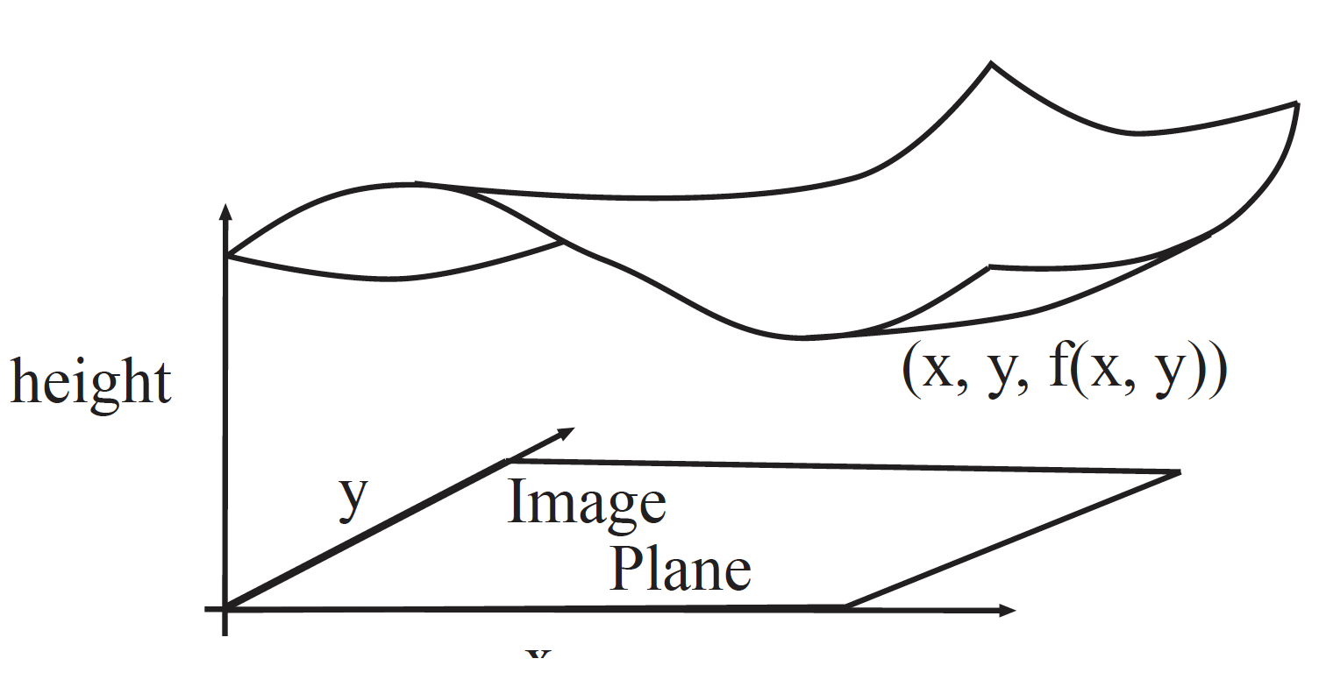
Geometrical model (for now)
At (x, y) in image, depth is f(x, y)
We see a surface (x, y, f(x, y))

Slide 6
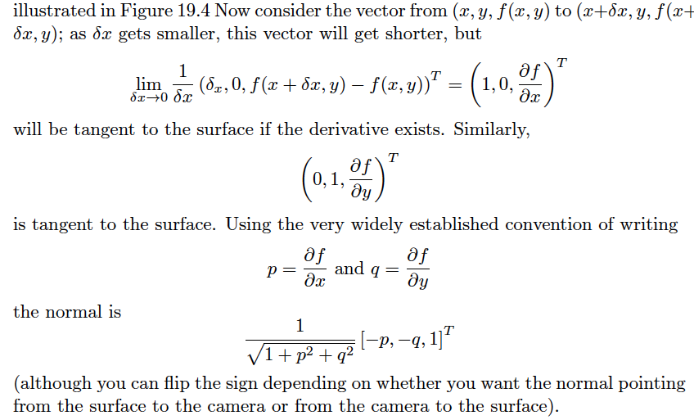
Normal from depth

Slide 7
Normal from depth
Notice that derivatives => noise problems => smoothing
Notice also that there is noise in measured depths
(property of depth cameras)

Slide 8
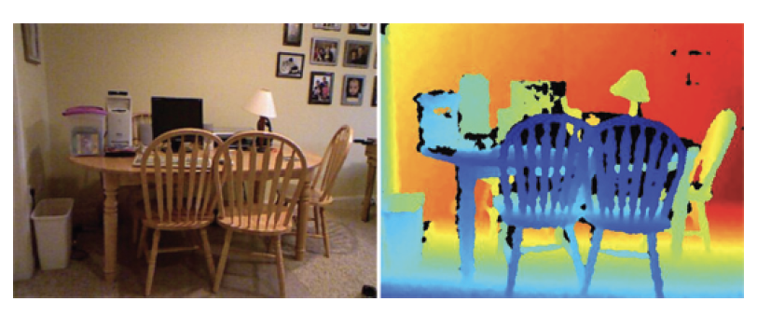
Image and depth
Data example from NYUV2

Slide 9
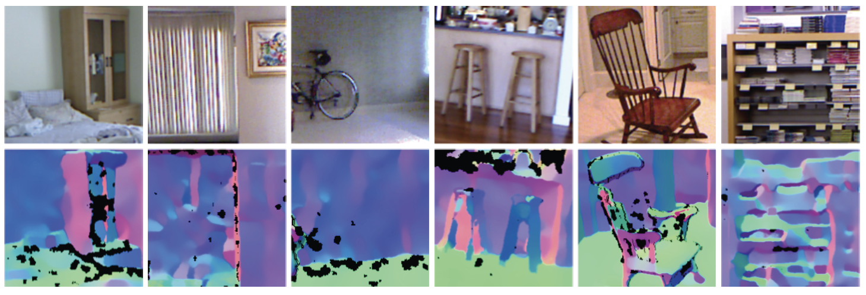
Normal estimates from depth data can be shaky

Slide 10
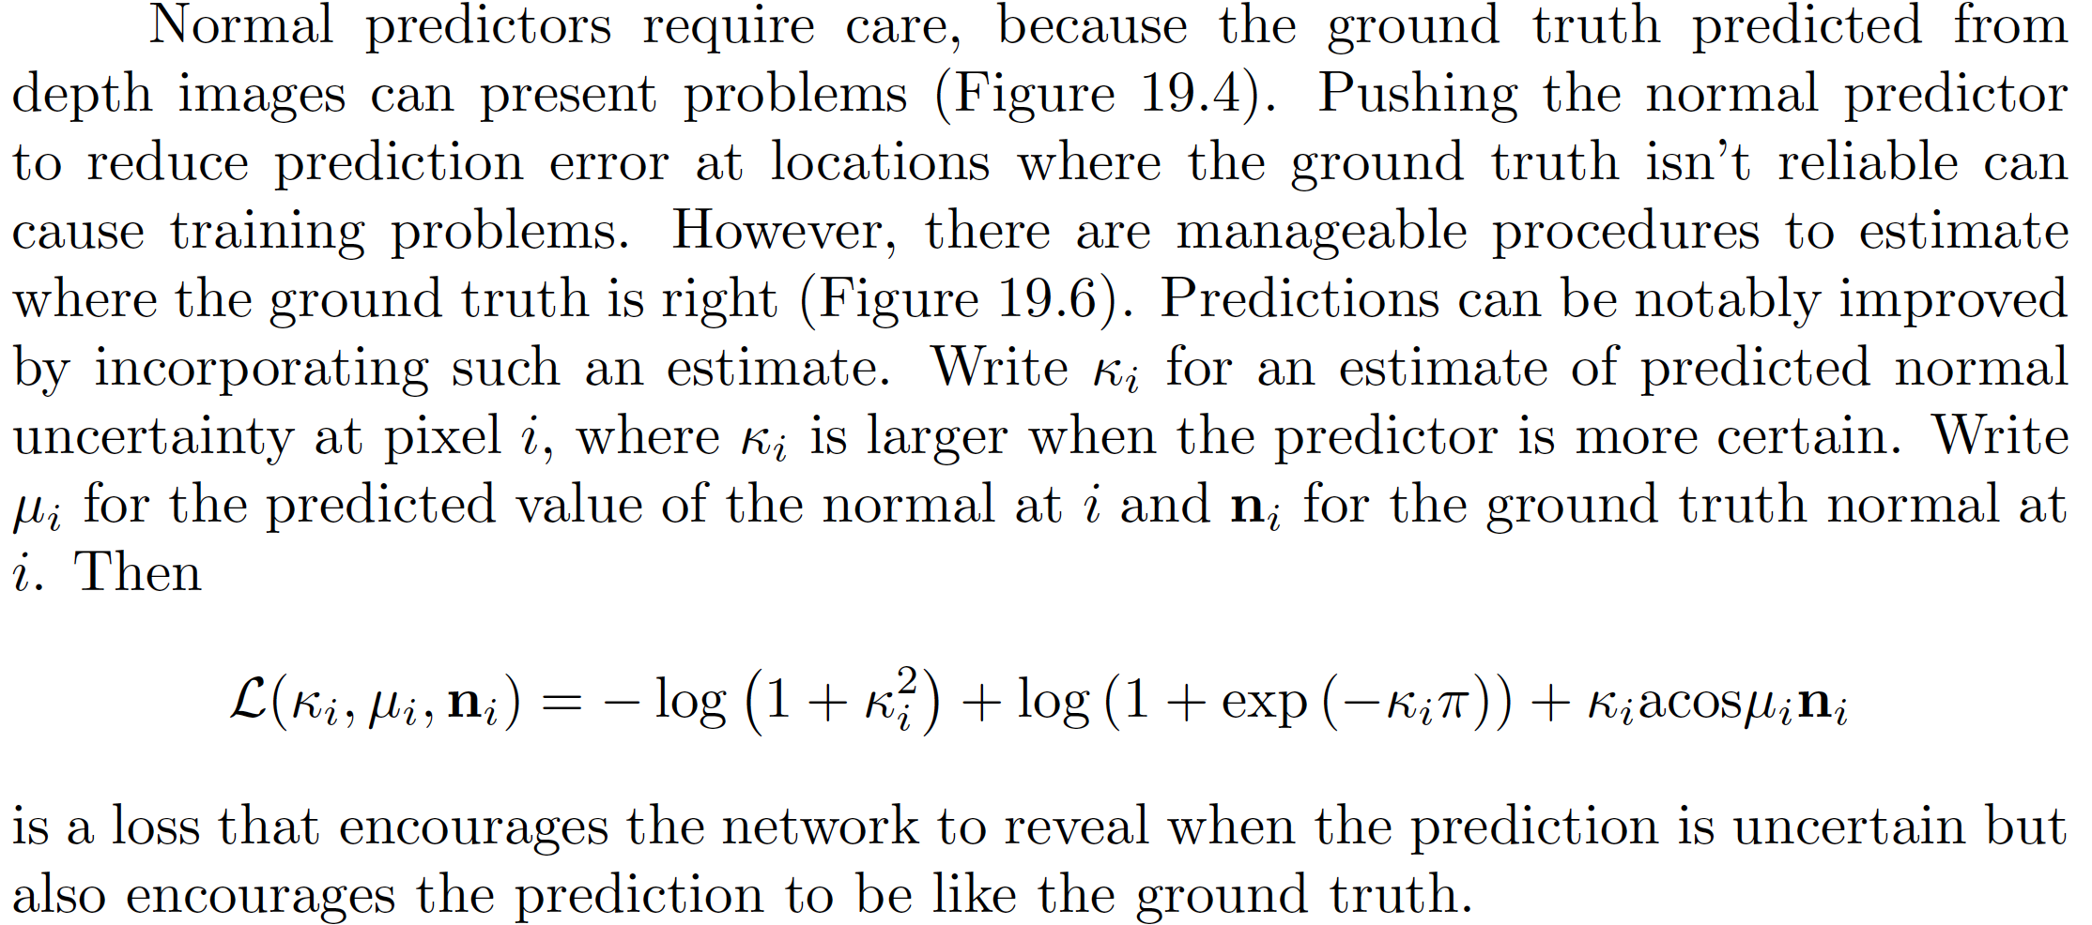
Loss – building in a confidence score

Slide 11
Rough story
If normals associated with similar patches are similar
k can be big
If they’re not
k must be small
Result: you can estimate k

Slide 12
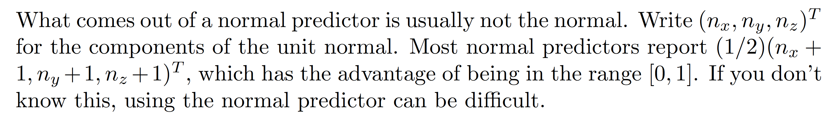
What normal predictors predict

Slide 13
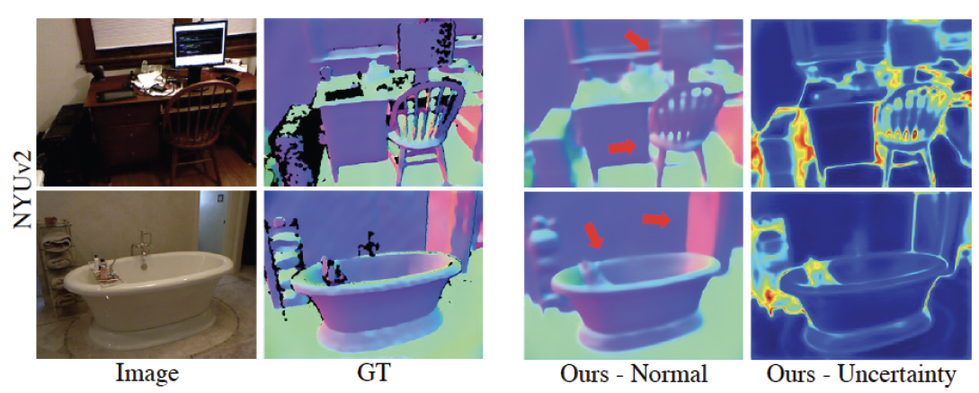
Normal predictors work really well too

Slide 14
Evaluating normal predictors

Slide 15
SOTA

Slide 16
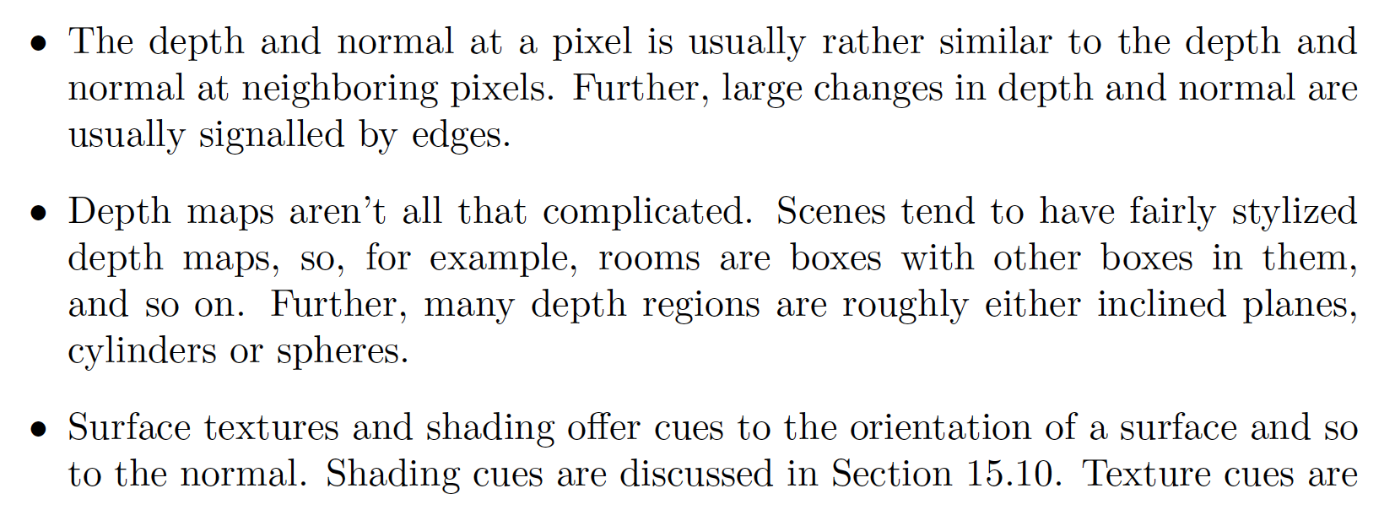
Why does all this work? I

Slide 17
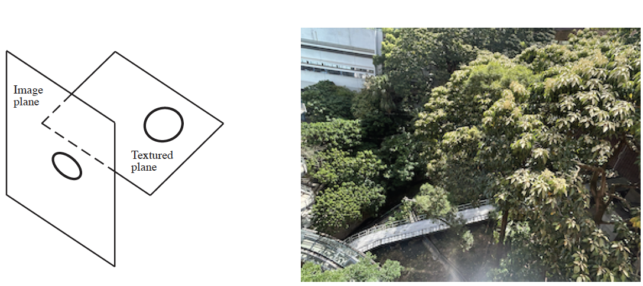
Why does all this work? II
Texture deformations are a cue to normals
(archaic term: shape from texture)

Slide 18
Depth and normal are linked
You can predict normal from depth
You can predict depth from normal (next slide)
Idea:
train depth and normal predictors together
with a consistency loss
improvements manifest

Slide 19
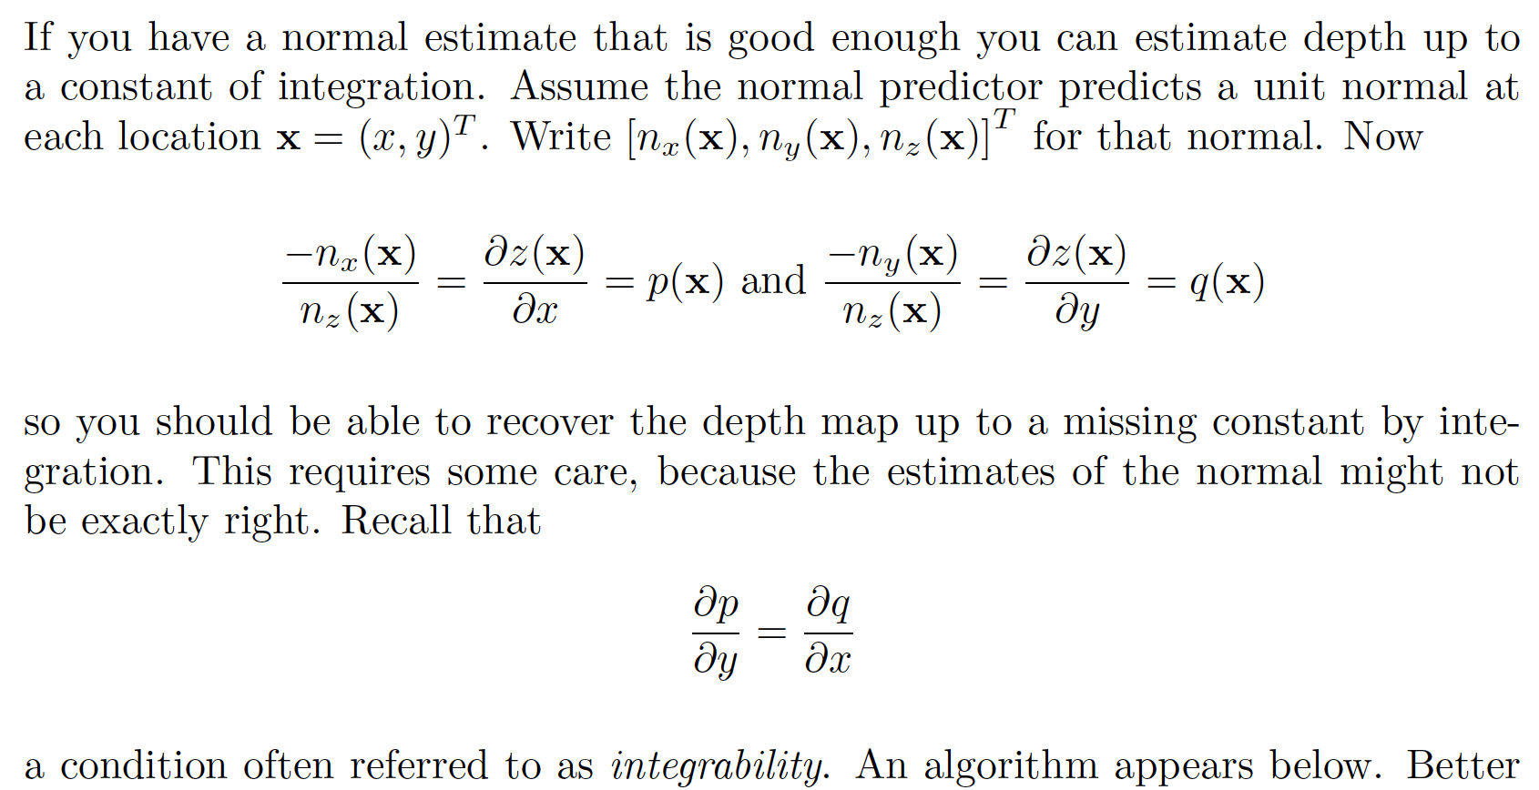
Depth from normal

