Slide 1
Further image to image mapping
Generally, it’s worth trying anything with
image in – image like thing out
Cases here:
Denoising (did this); superresolution; defogging
Other possibilities:
Fix underwater pix; derain; fix color balance; change lighting (?)
Recipe needs changing for...
Edges; semantic segmentation (coming up)

Slide 2
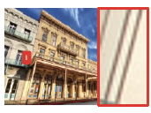
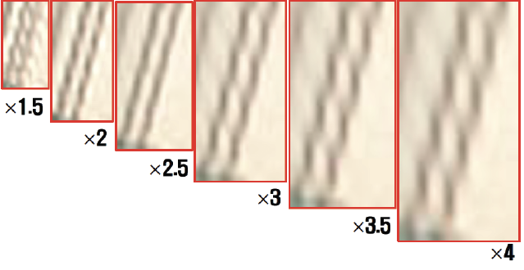
Superresolution
Take low res image, make high res image:
Baseline: upsample and interpolate
Possibly:
Build network for each of 1.5xupsample, 2xupsample, etc.
Ideally, network ”doesn’t know”
by how much you are upsampling
Fully convolutional u-net helps
This was trained for
2x upsampling

Slide 3



Superresolution
In:
Upsampled, interpolated low resolution image
Out:
estimated residual
True high-res image-upsampled interpolated low res
Est true image:

Slide 4
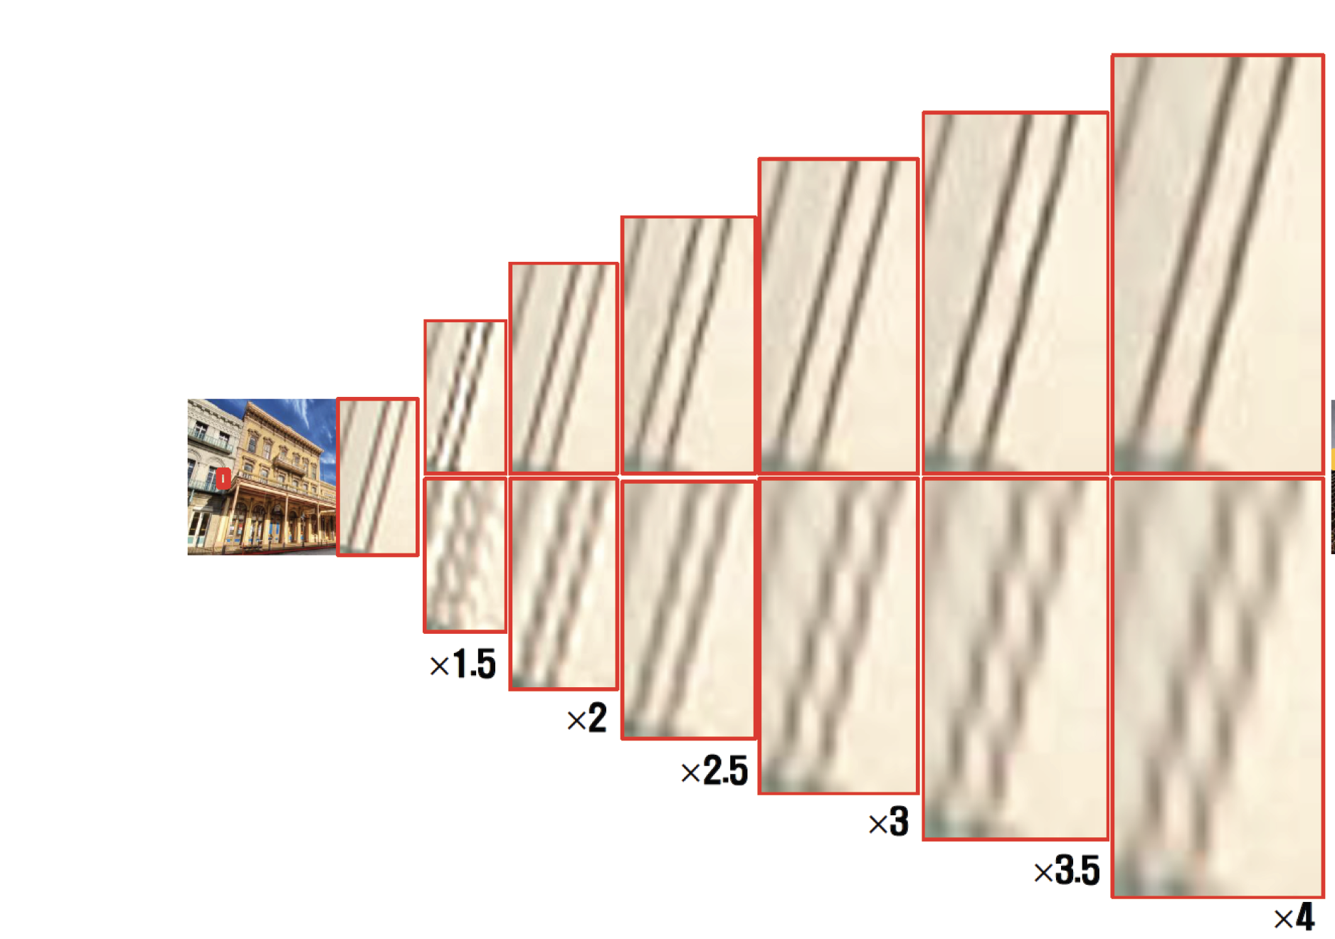
Superresolution works

Slide 5
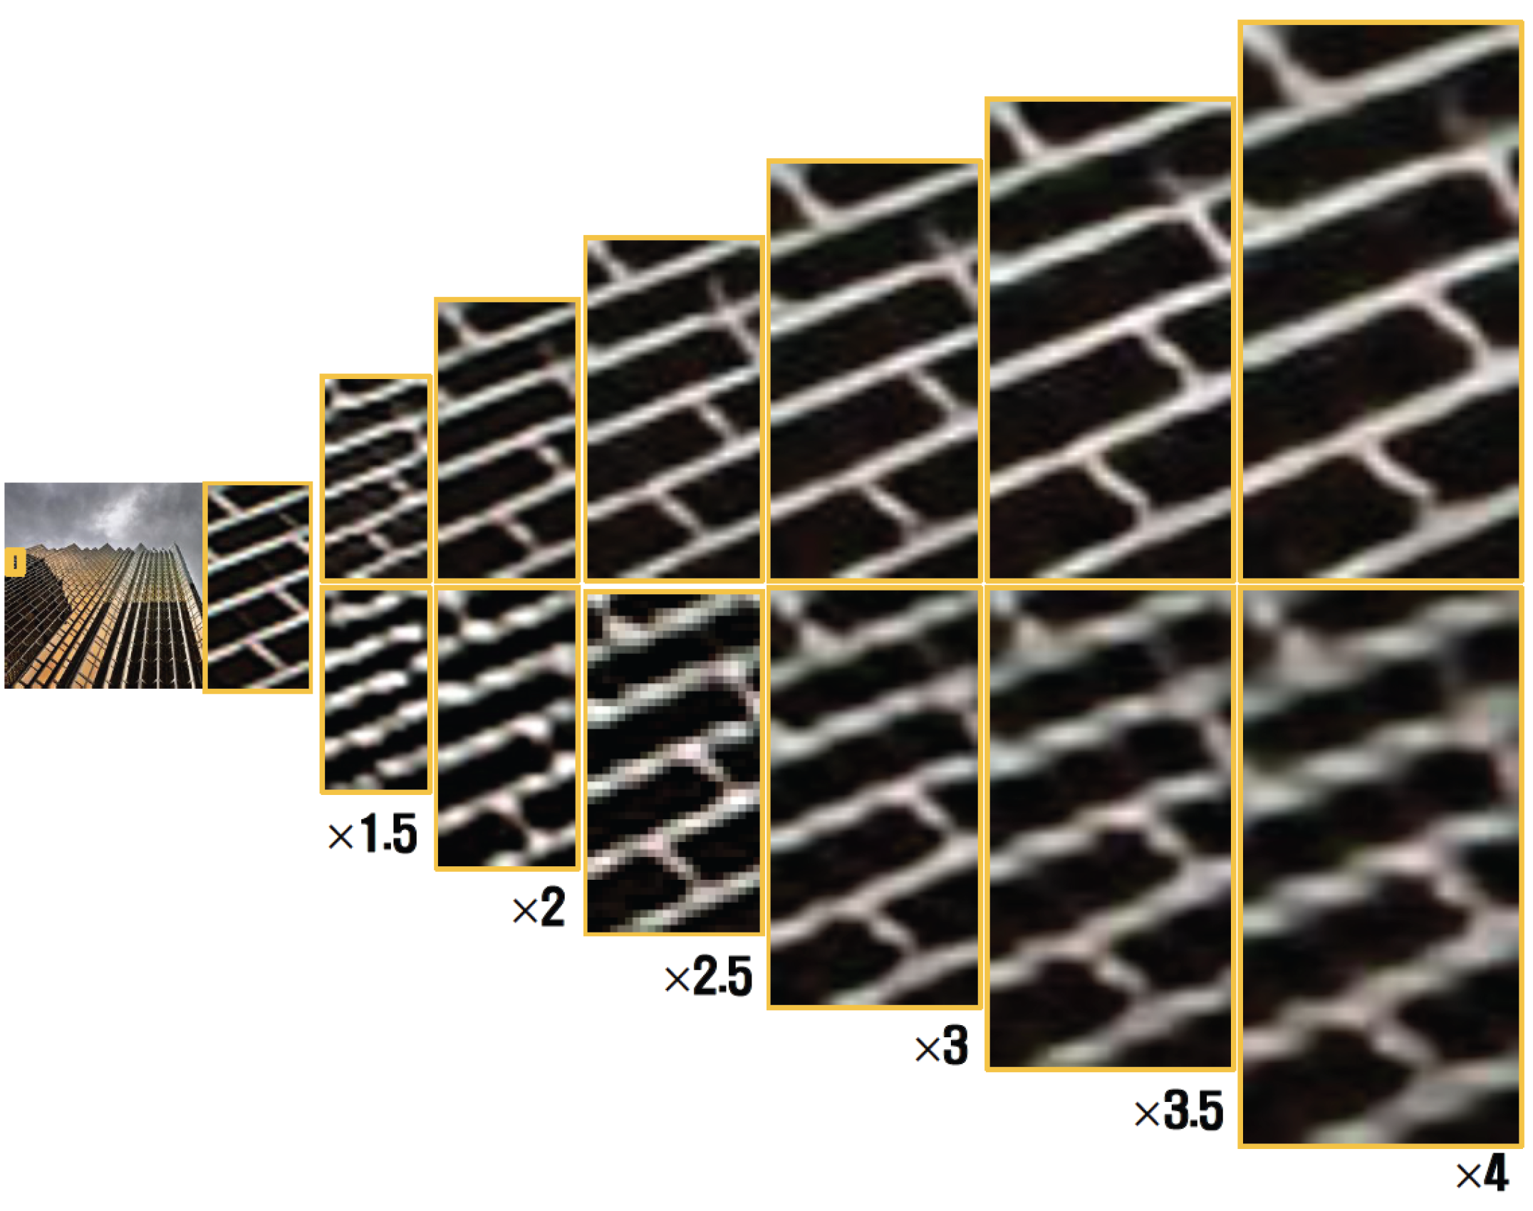
Superresolution works

Slide 6

Training and evaluation
Train on L1/L2 loss
perhaps some more stuff, later...

Slide 7
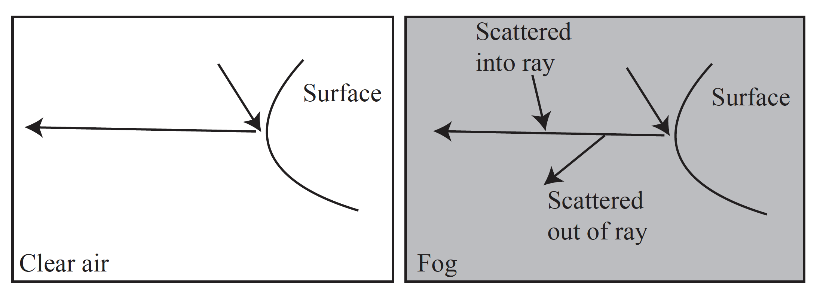
Defogging
Fog scatters light out of and into the ray from surface to eye
results:
distant surfaces experience color shift, depending on depth
image is blurred, blurring depends on depth

Slide 8

Model of defogging
(Doesn’t cover blurring, but..)

Slide 9
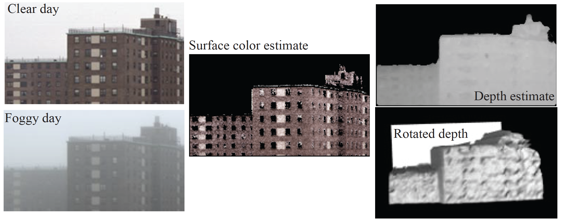
Amusing fact – you can recover depth from fog

Slide 10
Data is hard!
(image of real scene with no fog, image of same scene w/fog)
is very hard to get.
you can get them, but hard to get one and very hard to get many
Simulation is straightforward
(image no fog, image with sim fog)
is easy to get, and works
Evaluation
usually, PSNR on simulated images, sometimes PSNR on real

Slide 11
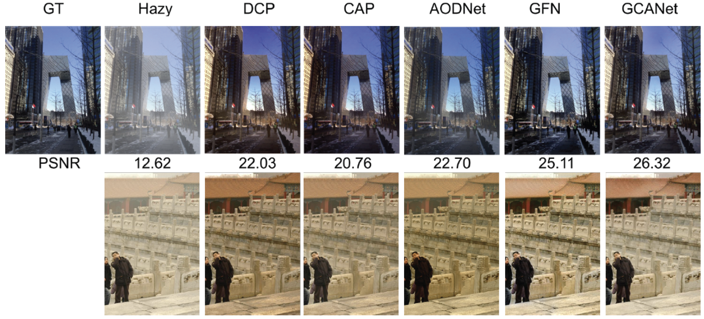
Defogging
This is real foggy
image so original
is unknown

