Slide 1
Last block:
Build an encoder and a decoder to:
Accept noisy image, produce clean version
By:
Constructing loss
Applying SGD to get minimal loss on training data

Slide 2
Housekeeping
There is a great deal of housekeeping:
If you build your own from scratch, you will suffer (but learn)
and it won’t work all that well (missing tricks)
Use an API (list in notes)
Build from someone else’s code (Github, Huggingface)

Slide 3
Missing tricks:
Scales and color
Blurred outputs and skip connections
Bad gradients and residual connections
Optimization tricks

Slide 4
Scale and color
Input scales:
Helpful to scale, offset pixel values so that mean is zero and standard deviation is one
Output scales:
Real pixels are in range [0, 1]
How do we force output to be like this?
Options:
map value to range
penalize over/under
bit of both

Slide 5
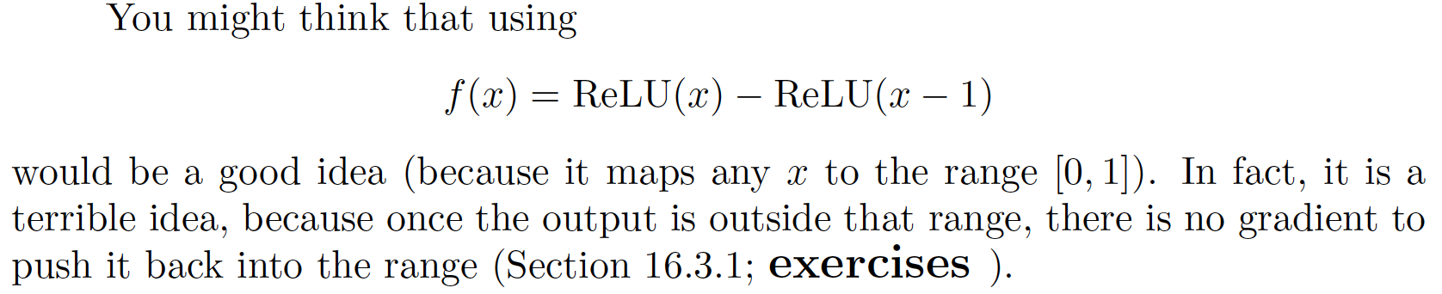
Value to range
Terrible idea:
NO GRADIENT when you need it!

Slide 6

Value to range
Sigmoid:
but this creates gradient problems when output close to zero or one
Tanh:
x -> [-1, 1] and easy to get to [0, 1]
similar gradient problems

Slide 7
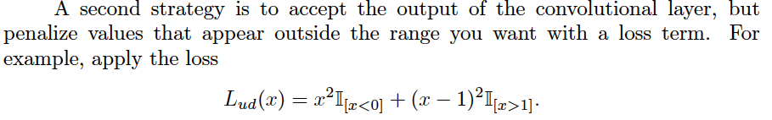
Penalties

Slide 8
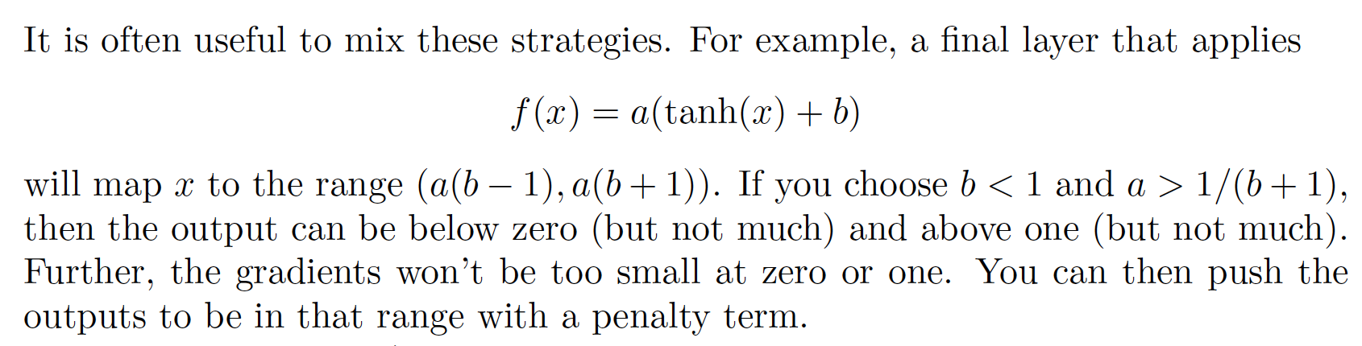
Combination

Slide 9
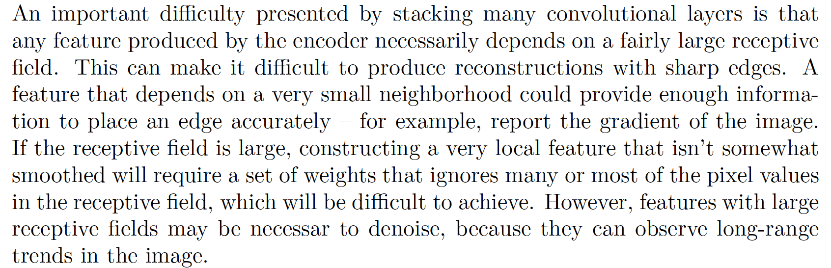
Skip Connections:

Slide 10
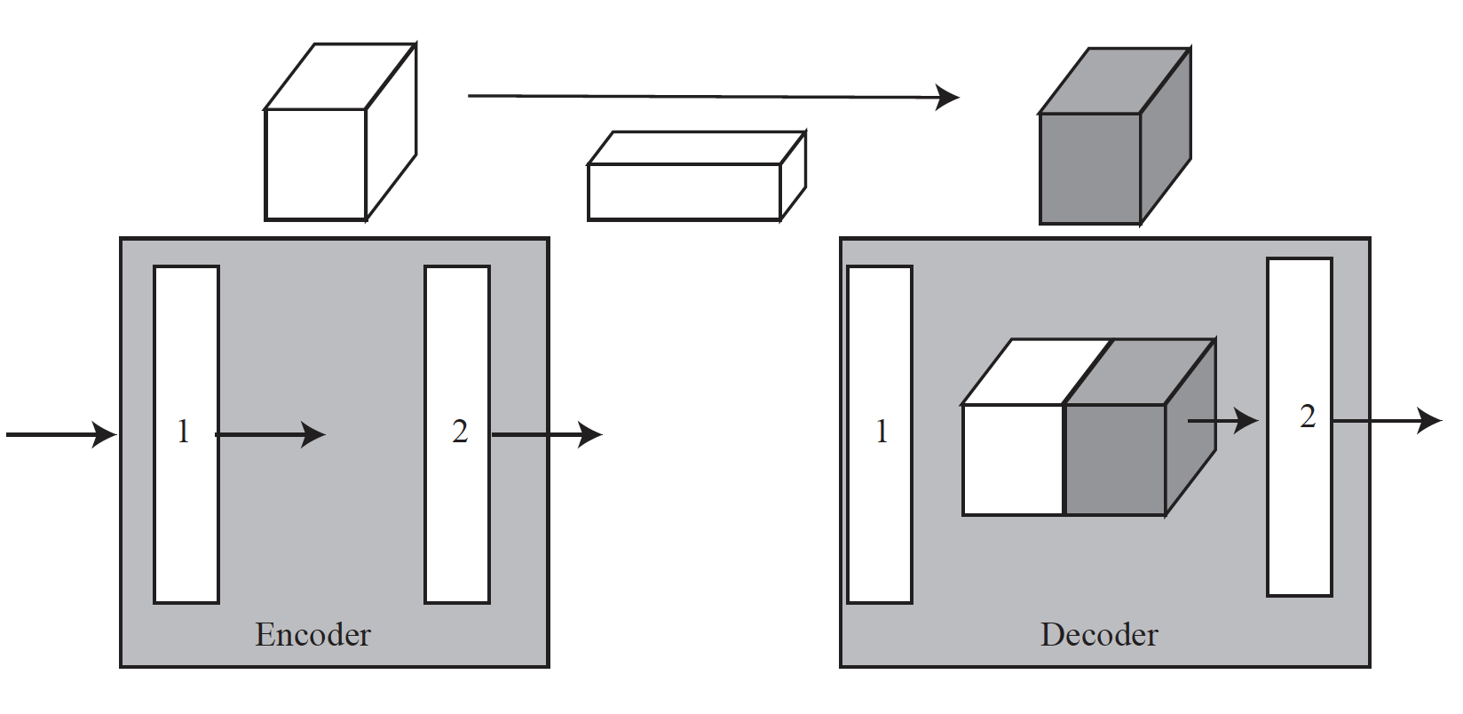
Skip Connections:

Slide 11
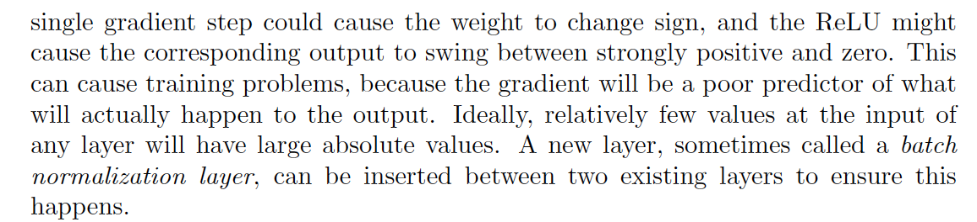
Normalization:

Slide 12
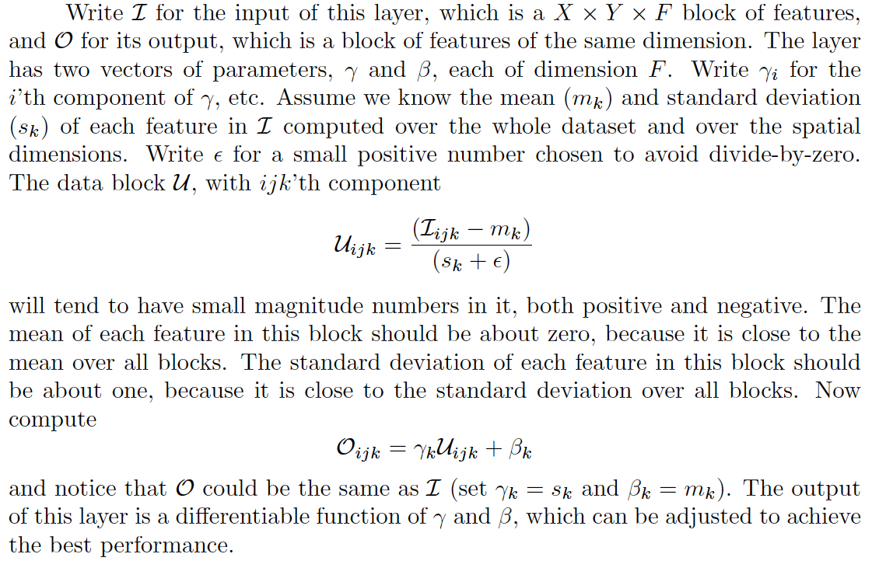
Batch normalization

Slide 13
Batch normalization
But we don’t know the mean and standard deviation!
And it keeps changing during training anyhow!
Strategy:
Use the mean and standard deviation of the last batch at training time
At test time, use constants (last seen mean/sd)
API looks after this housekeeping
Landmine:
You have to tell the networks when you switch from train to test
If you don’t they work badly

Slide 14
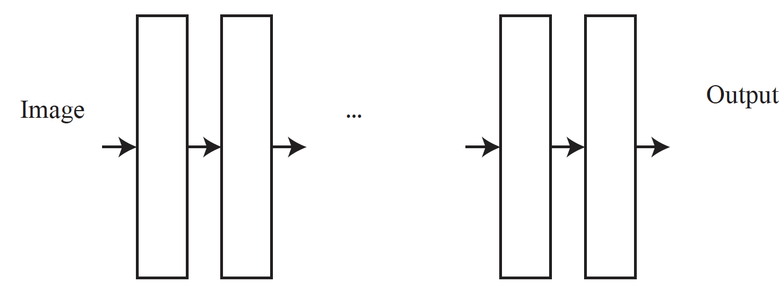
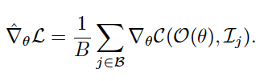
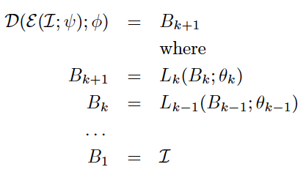
Evaluating the gradient can present problems

Slide 15
Residual connections
Idea:
Allow information to skip layers so there is always some reliable gradient
Procedure:
For some layers, add input to output
Issue: output might be a different size
Response: use a projection

Slide 16
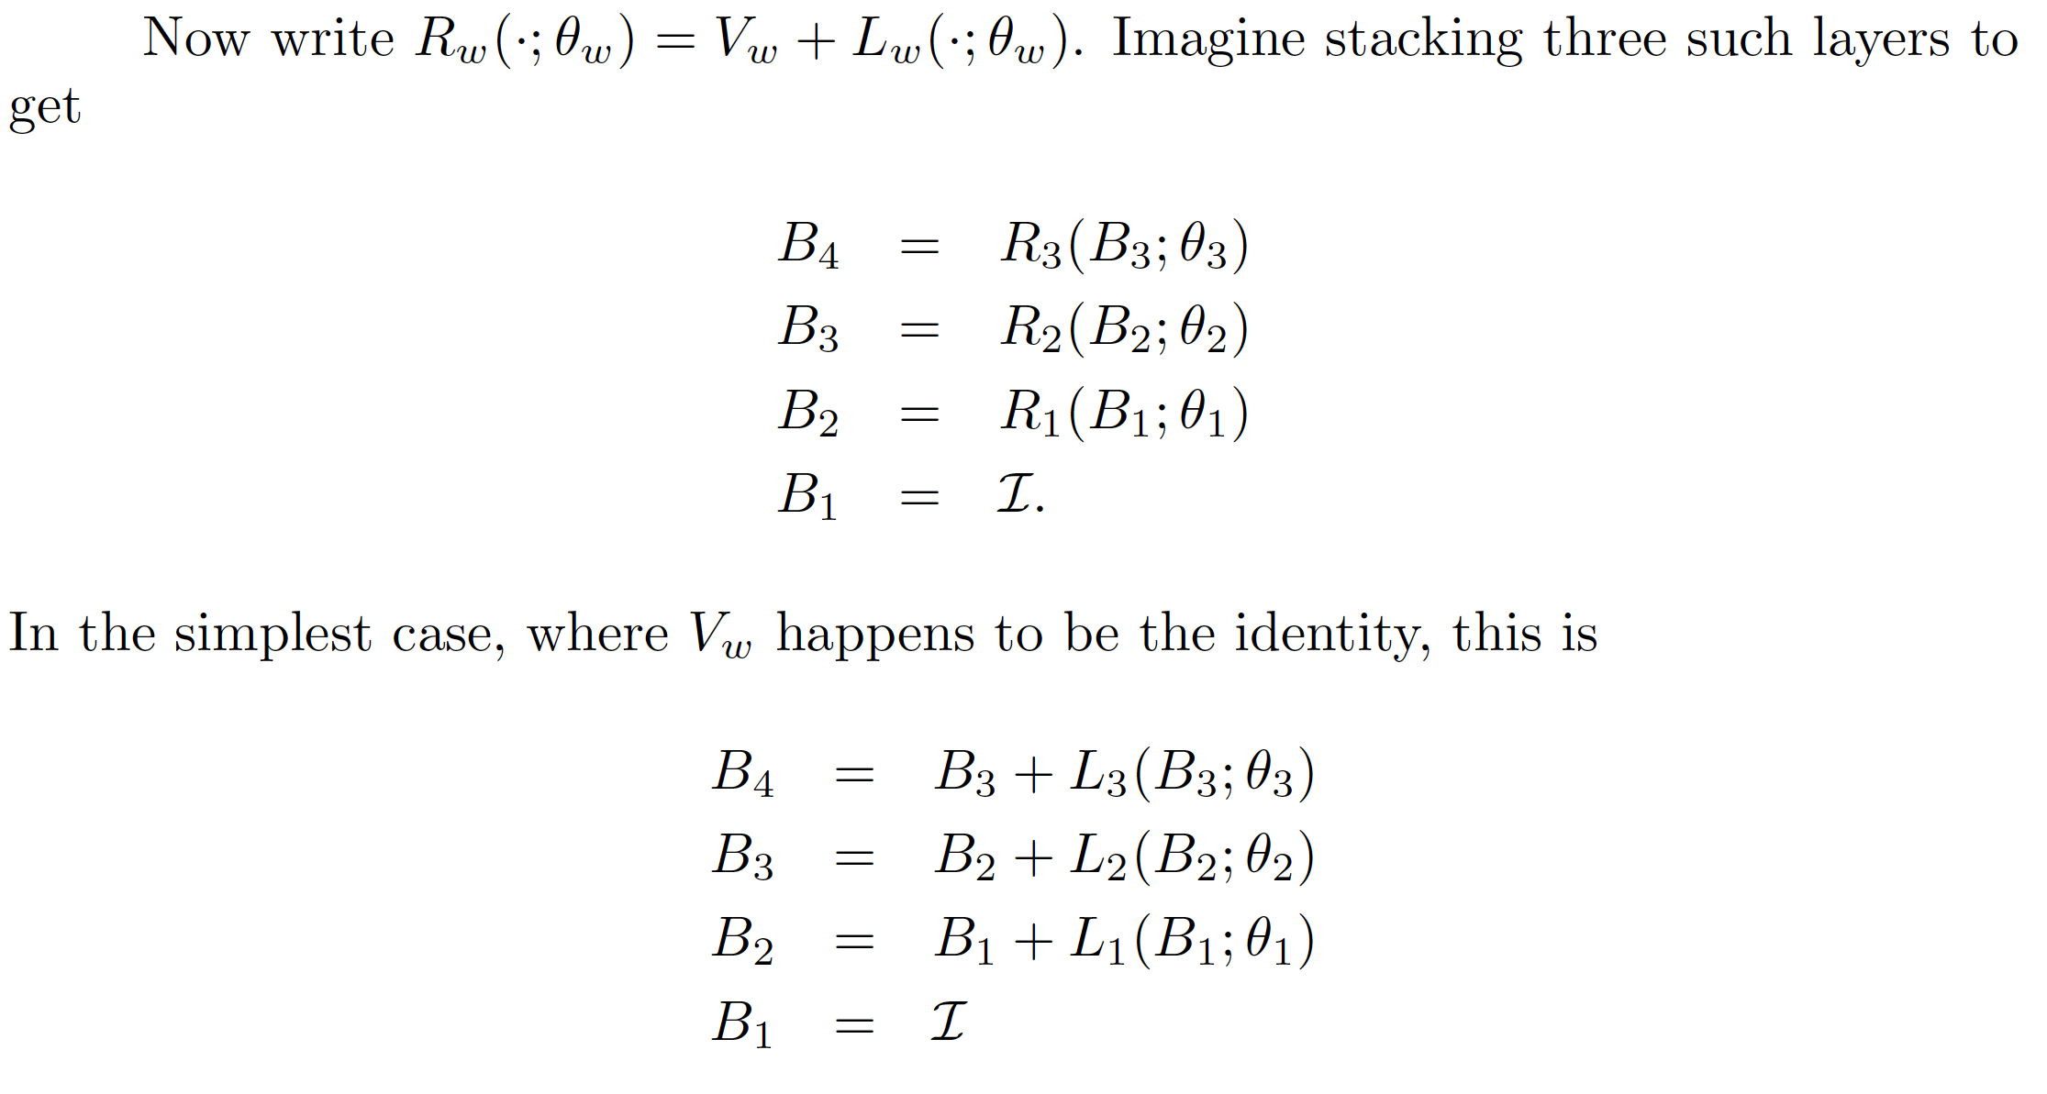
Residual connections: Simple example

Slide 17
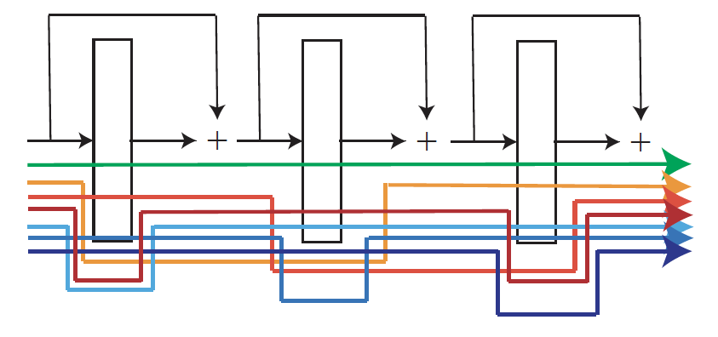
Residual connections: Simple example

Slide 18
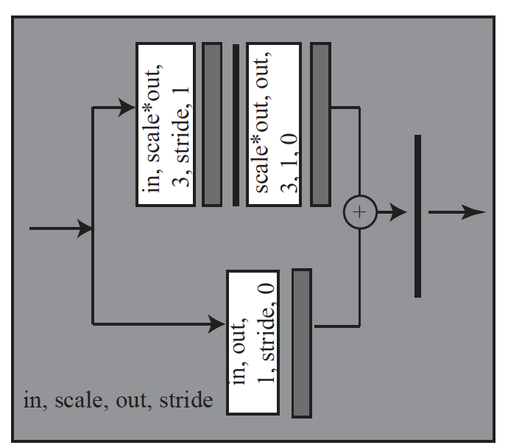
Residual blocks for encoder
in, scale, out, stride are parameters
Convolutional layer
Batch normalization
ReLU

Slide 19
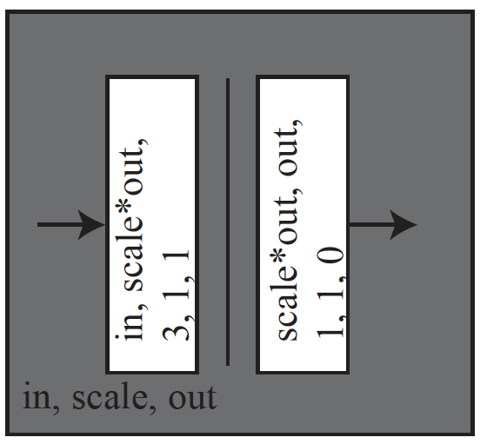
Residual blocks for decoder
in, scale, out are parameters
Convolutional layer
ReLU

Slide 20
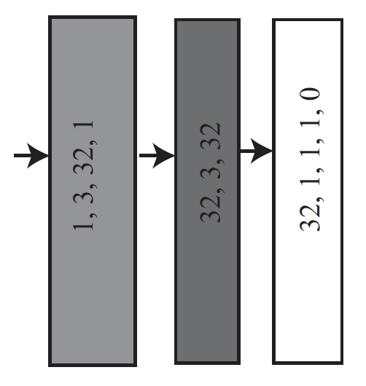
Composing these blocks...
Encoder block
Convolutional layer
Decoder block

Slide 21
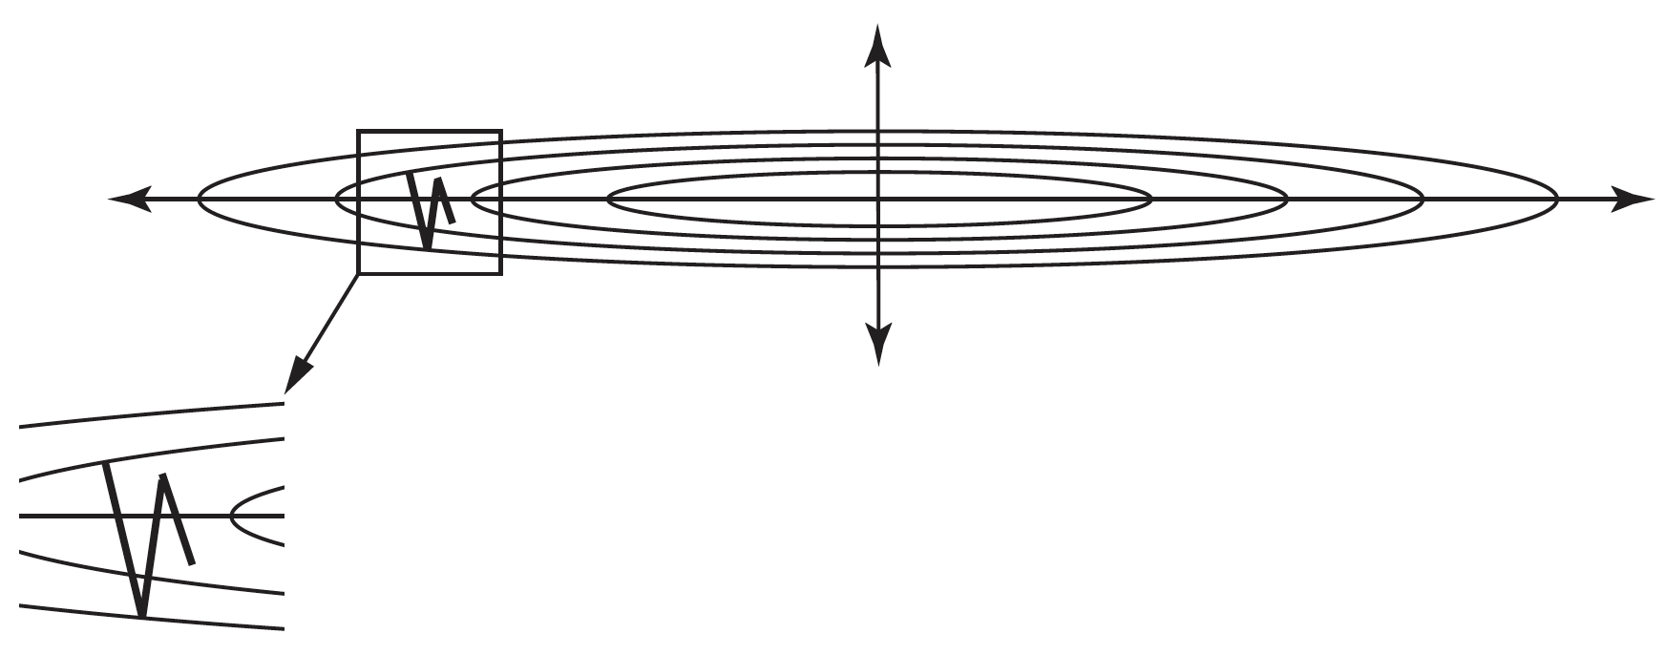
Optimization
Actually, gradient descent is a bad idea....

Slide 22
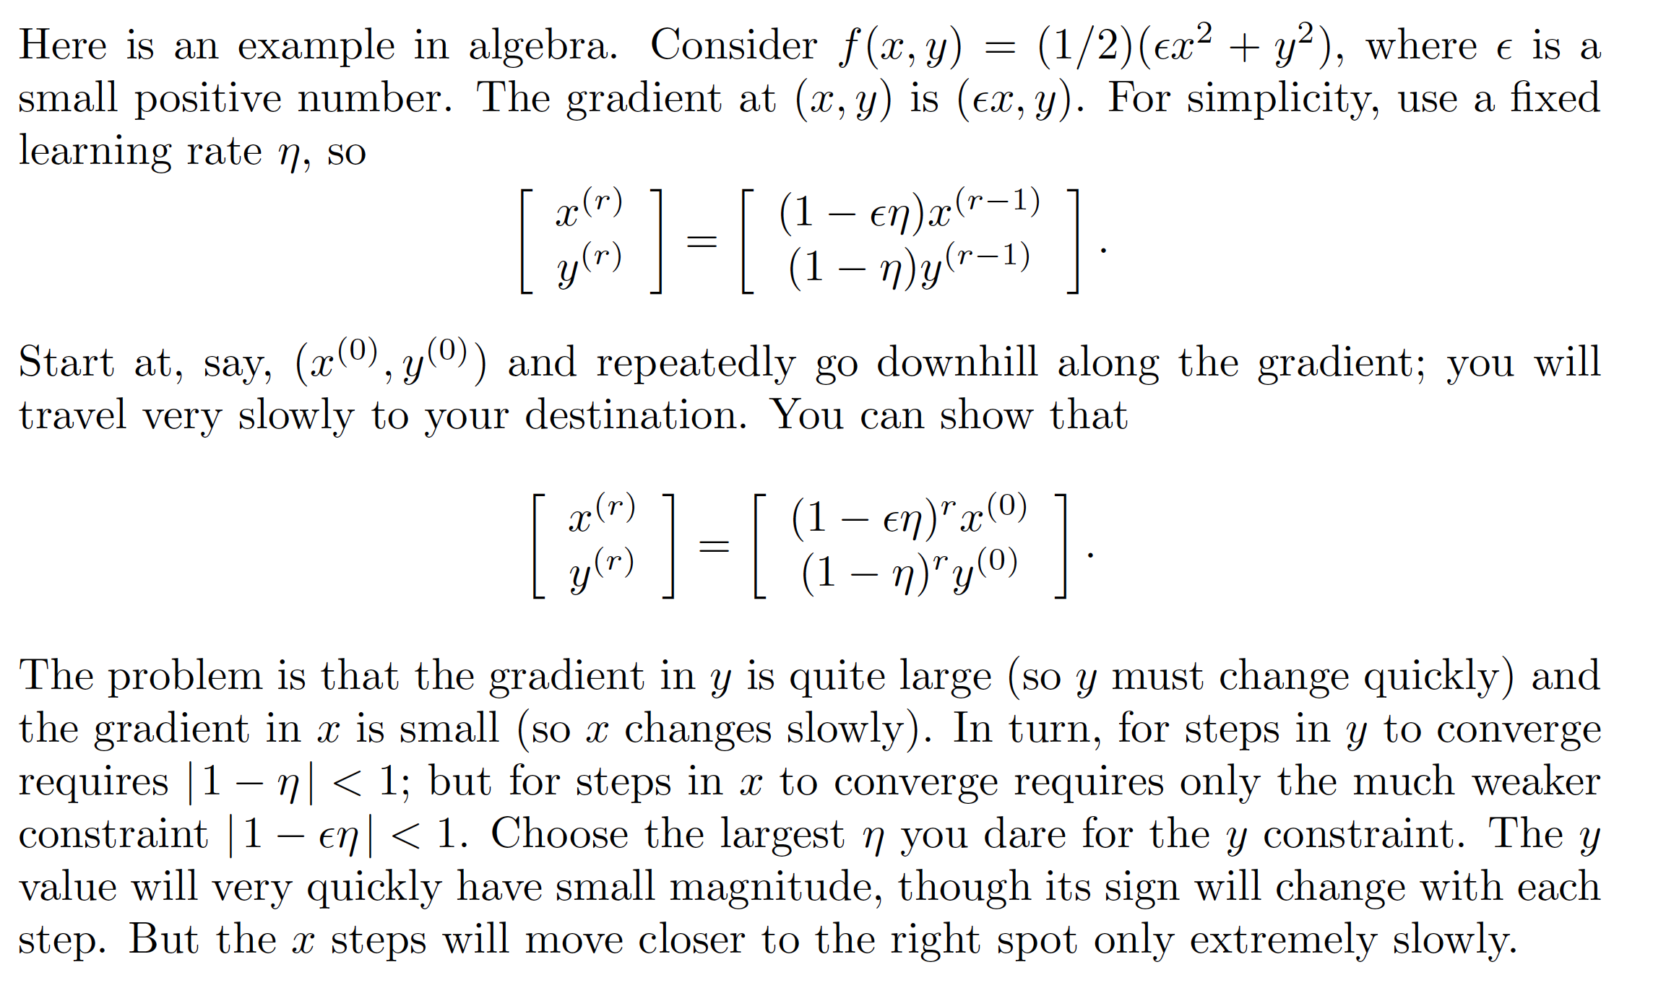
Gradient is bad, algebra

Slide 23
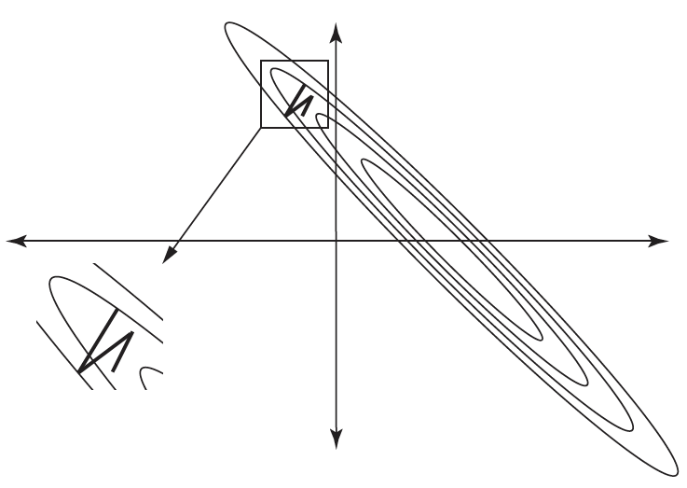
Rotating and translating function doesn’t help

Slide 24
changes in sign of variables, gradients are a sign of trouble.

Slide 25
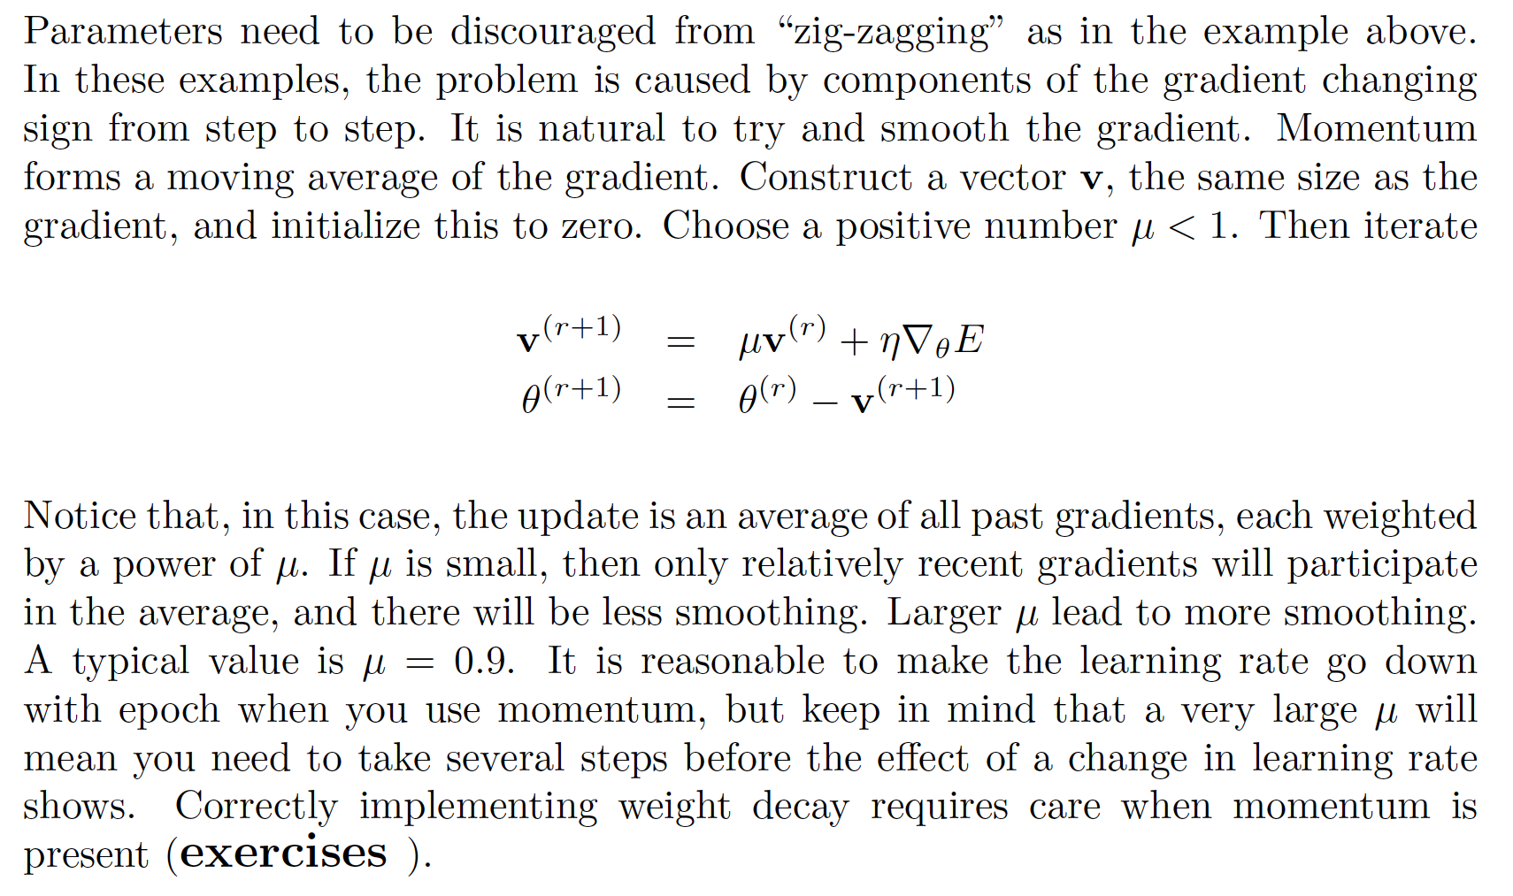
Momentum

Slide 26
A variety of other optimization tricks available
RMSProp
AdaGrad
Adam
Adam is favored.
Experience:
Adam is best for fast descent and quite good models
SGD for robust models, but slow
(Adam for papers, SGD for production models)

Slide 27
Shallow autoencoder
Encoder block
Convolutional layer
Decoder block

Slide 28
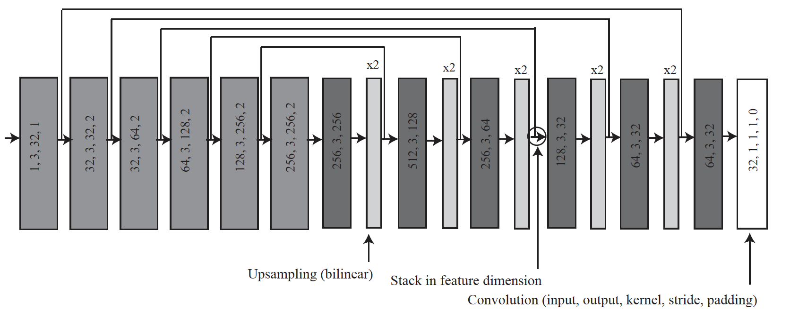
Deeper autoencoder

Slide 29
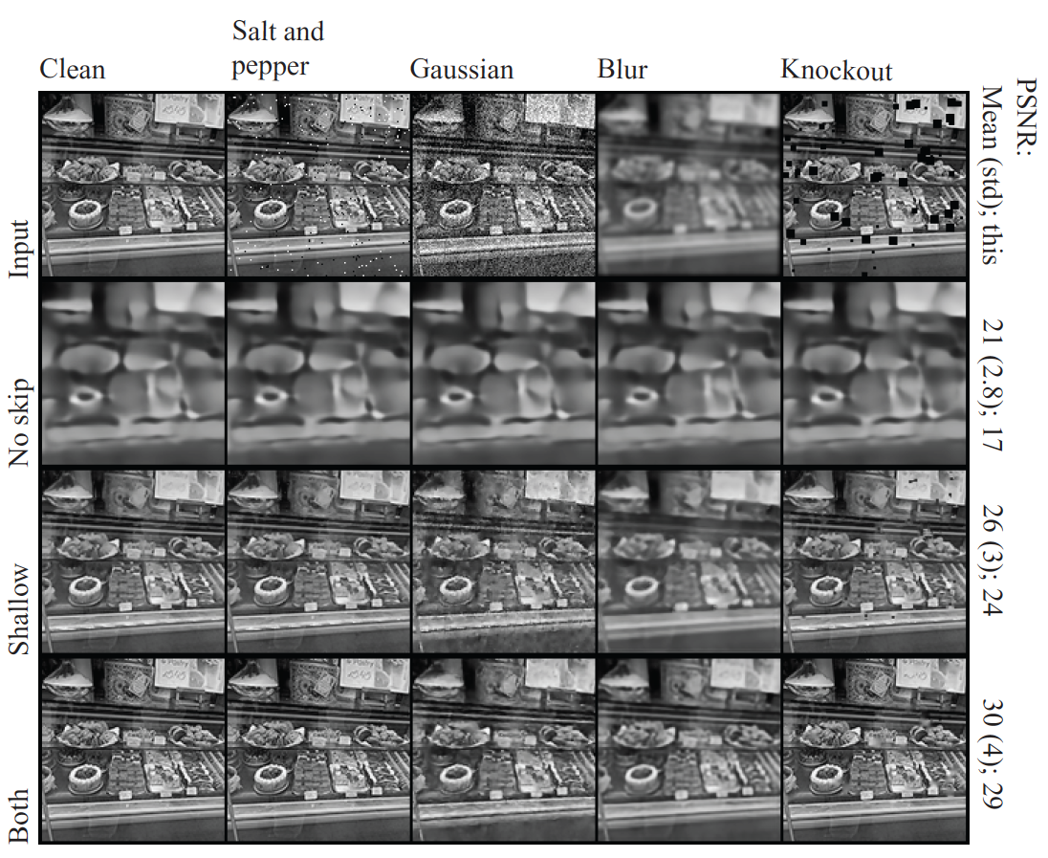
Example
Notice:
skip helps, a lot
deep helps a little

Slide 30
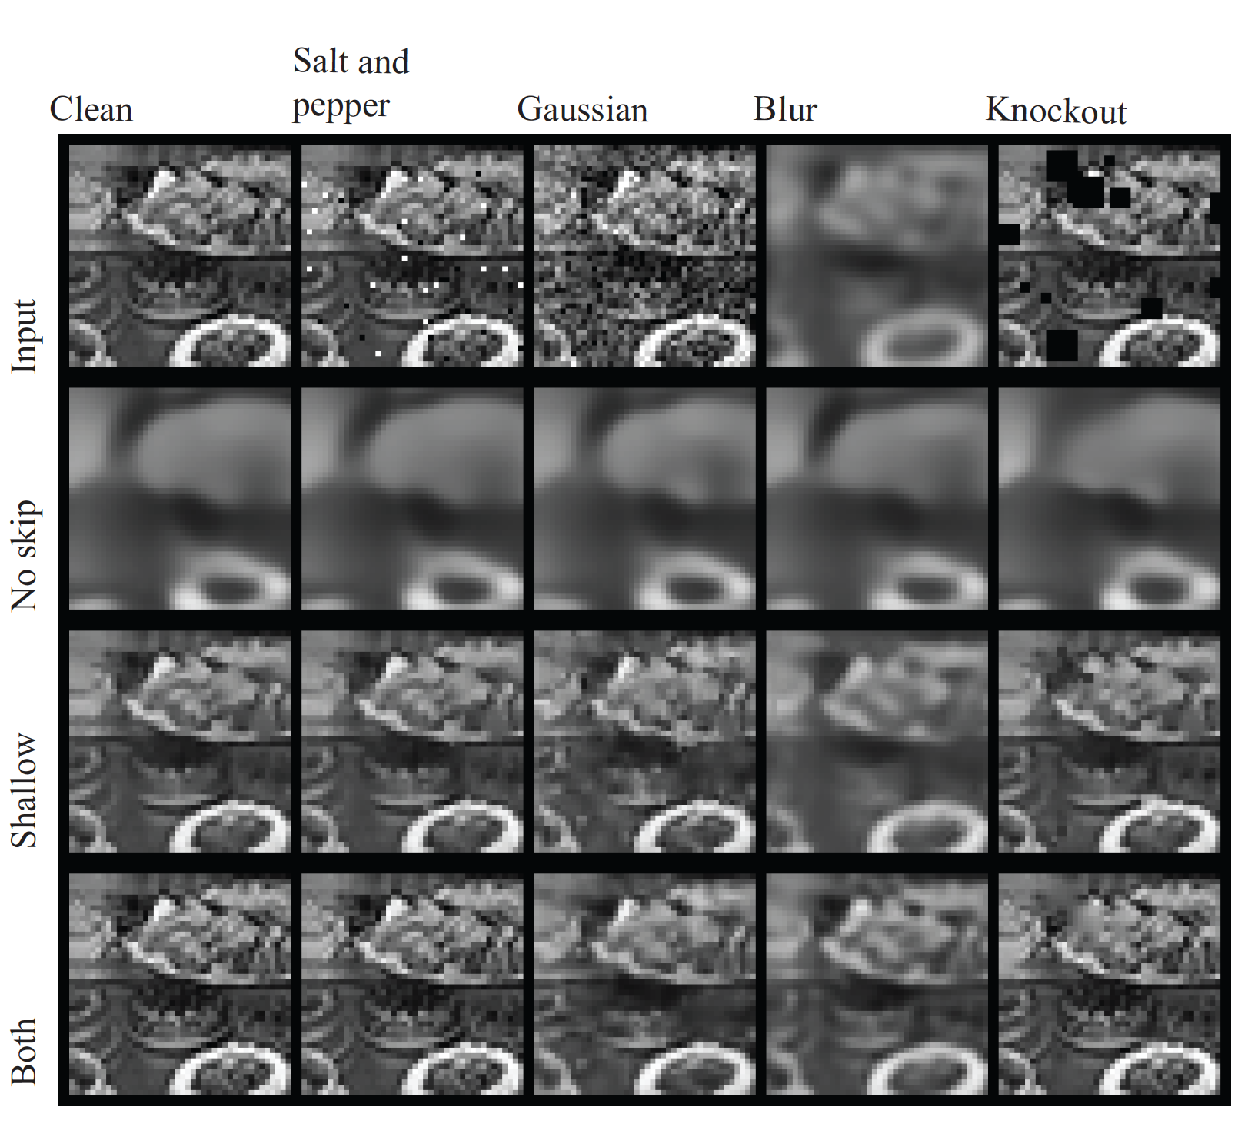
Detail windows
Notice:
skip helps, a lot
deep helps a little

