Slide 1
Geometry and Physics
(at a run)
D.A. Forsyth, University of Illinois at Urbana Champaign
SOME APPLICATION SLIDES MISSING

Slide 2
Main points
Geometry
  camera model
  multi camera relations
Fitting:
  correspondence is reliable
  yields robust fundamental matrix estimation
Physics:
  relegated to notes
Yields
  Mosaics
  3D reconstructions
  Odometry
  SLAM

Slide 3

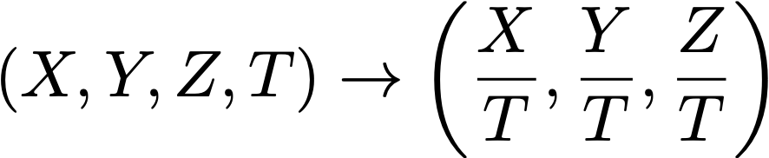
Homogeneous coordinates
Add an extra coordinate and use an equivalence relation
for 2D
  equivalence relation
  k*(X,Y,Z) is the same as (X,Y,Z)
for 3D
  equivalence relation
  k*(X,Y,Z,T) is the same as (X,Y,Z,T)
“Ordinary” or “non-homogeneous” coordinates
  properly called affine coordinates
  in 3D, affine -> homogeneous
  in 3D, homogeneous to affine

Slide 4


Homogeneous coordinates
Notice (0, 0, 0, 0) is meaningless (HC’s for 3D)
  also (0, 0, 0) in 2D
Basic notion
  Possible to represent points “at infinity” by careful use of zero
  Where parallel lines intersect
    eg
  Where parallel planes intersect (etc)
Can write the action of a perspective camera as a matrix
and
intersect at

Slide 5
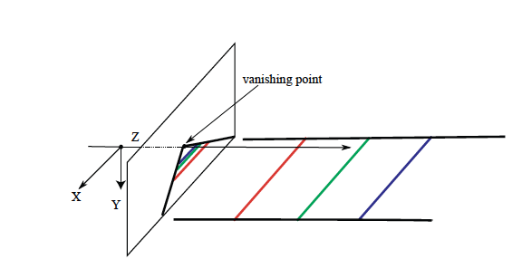
You can see the point at infinity

Slide 6
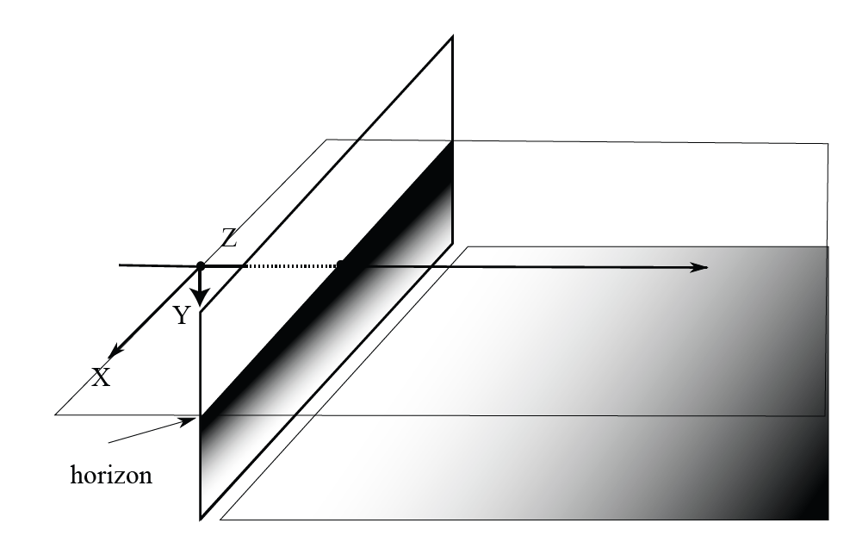
You can see the line at infinity, too!

Slide 7
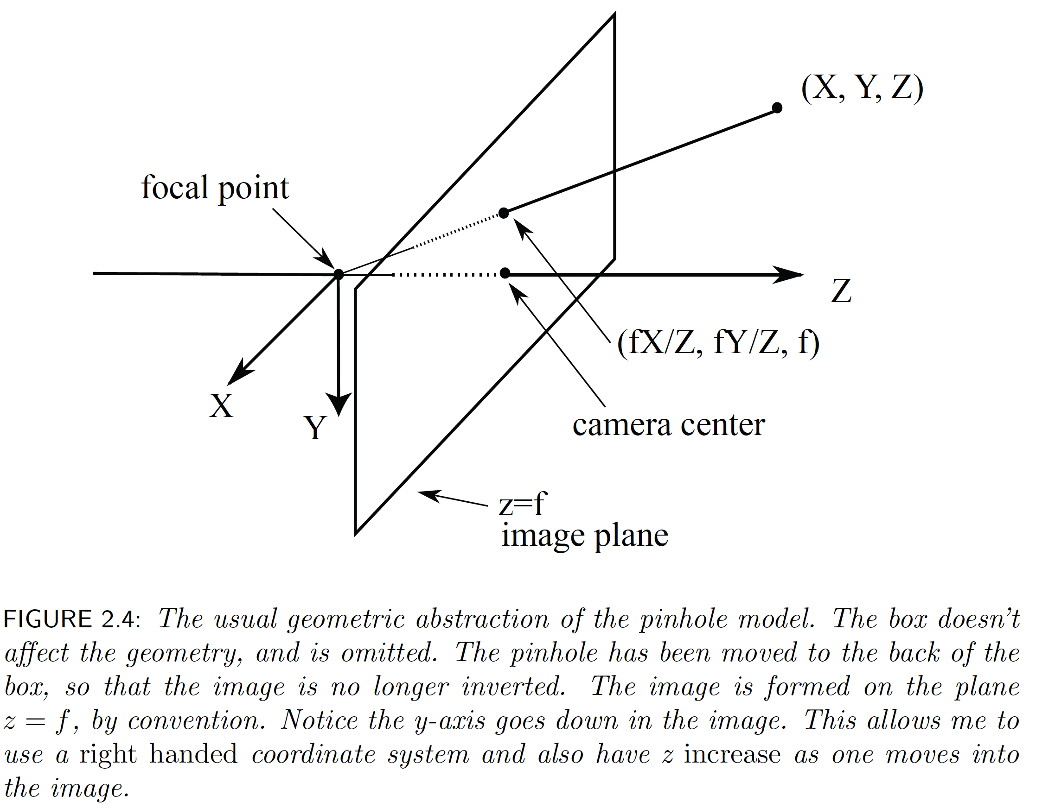
Recall

Slide 8
Notice:
Change in focal length is just a scaling
  deal with this later
  currently, f=1
Now turn into homogenous coordinates
In 3D
Camera
Affine
Homogenous
Affine
Homogenous
and

Slide 9
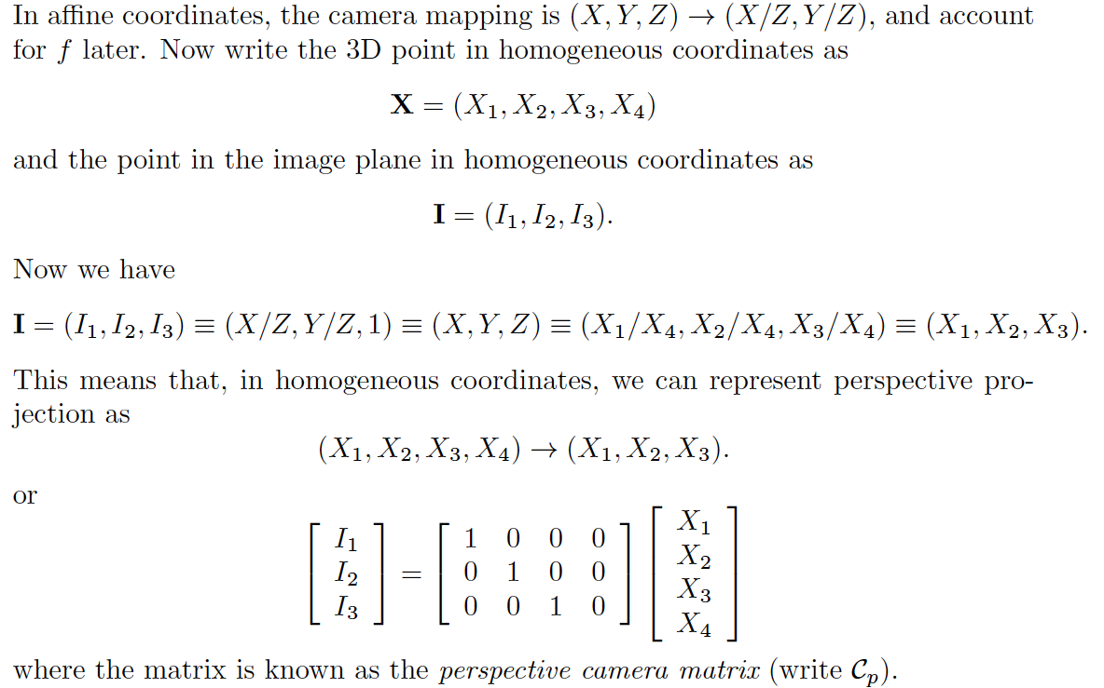
The perspective camera matrix

Slide 10
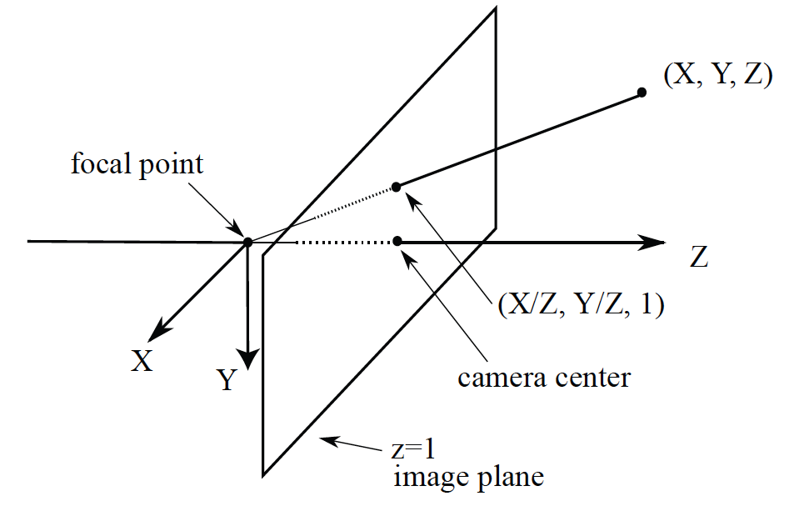
Canonical camera

Slide 11
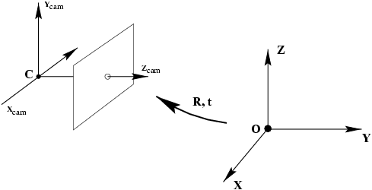
Actual camera

Slide 12
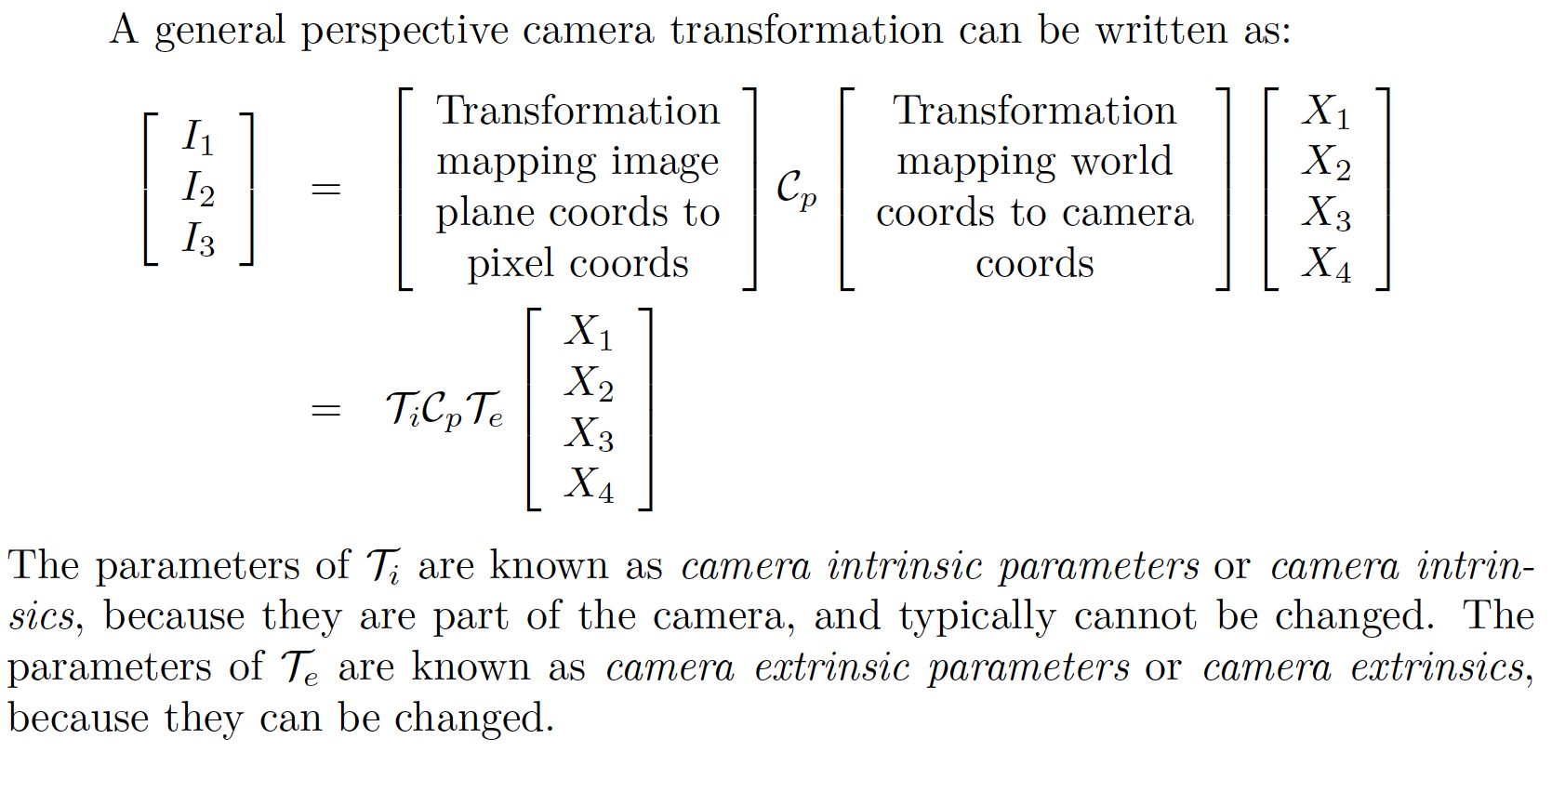
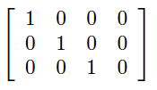

Slide 13
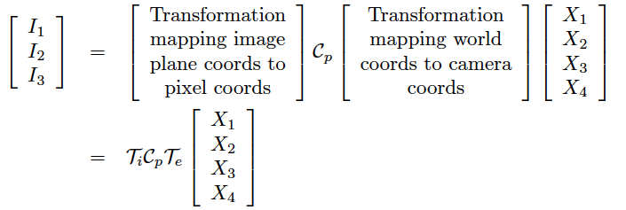
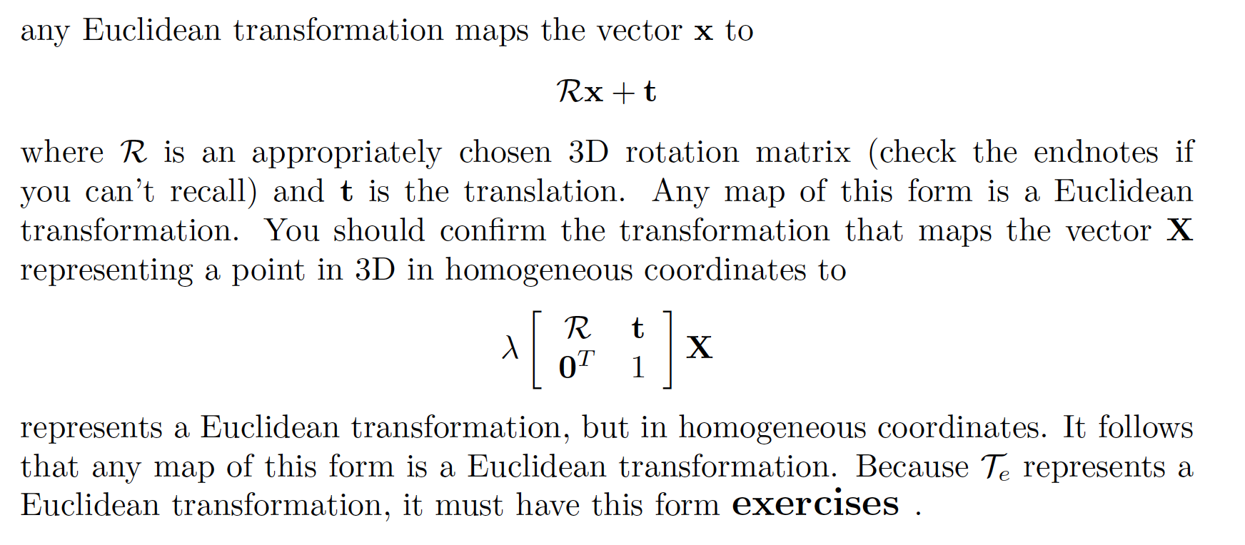
Extrinsics
Extrinsics

Slide 14
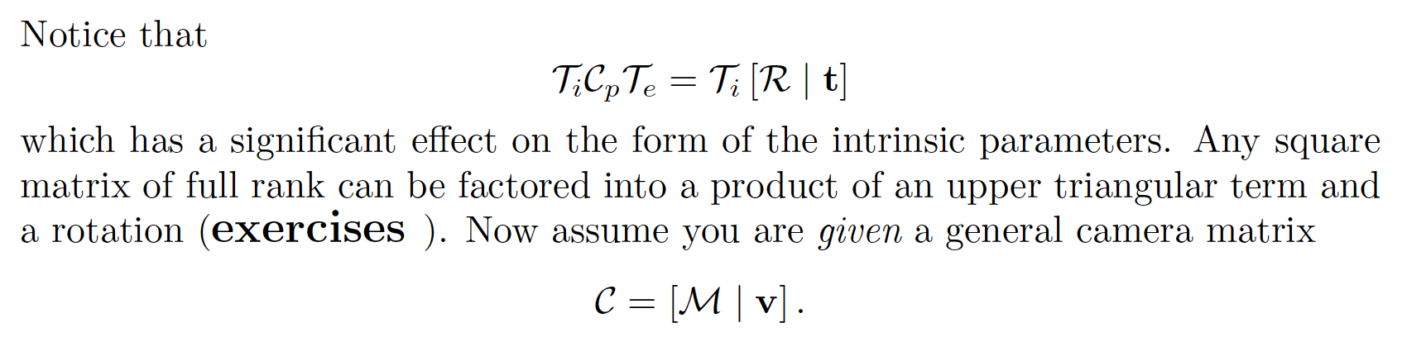
Intrinsics
Intrinsics

Slide 15
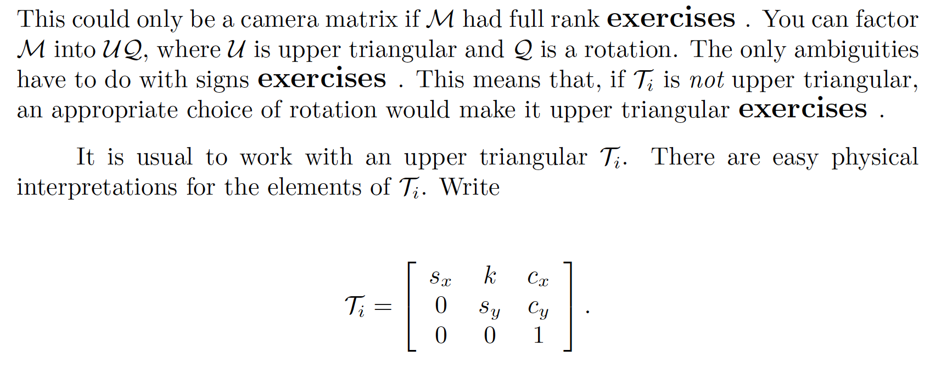
Intrinsics

Slide 16
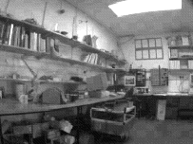
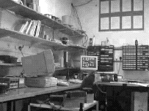
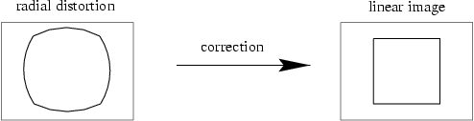
I did not discuss...

Slide 17
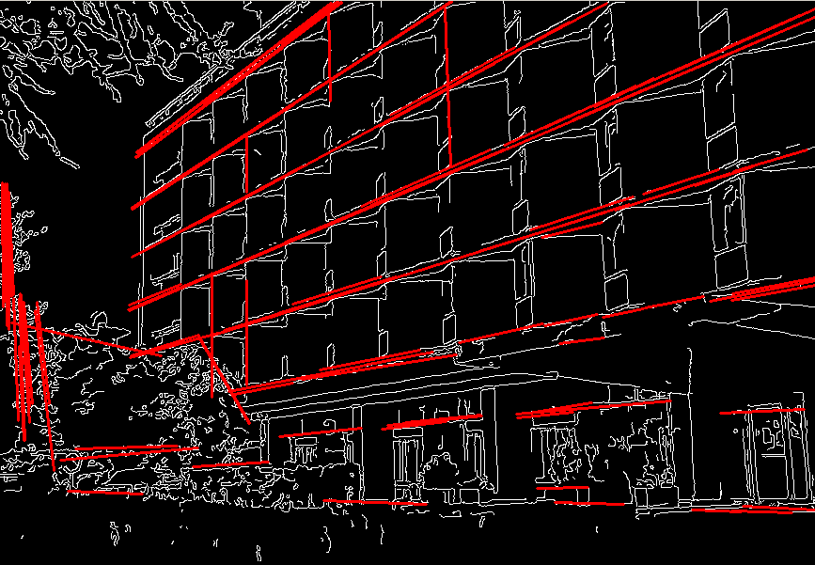
Fitting
Form a higher level, more compact representation of the image features
Model case:
  fit a line

Slide 18
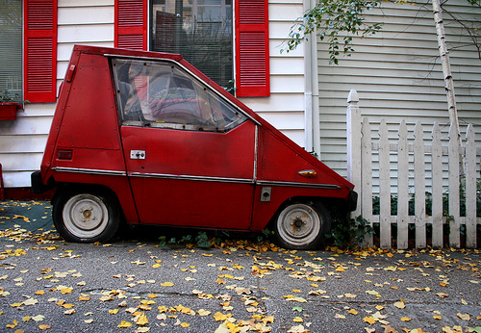
Fitting: Challenges
Case study: Line detection
Noise in the measured feature locations
Extraneous data: clutter (outliers), multiple lines
Missing data: occlusions

Slide 19
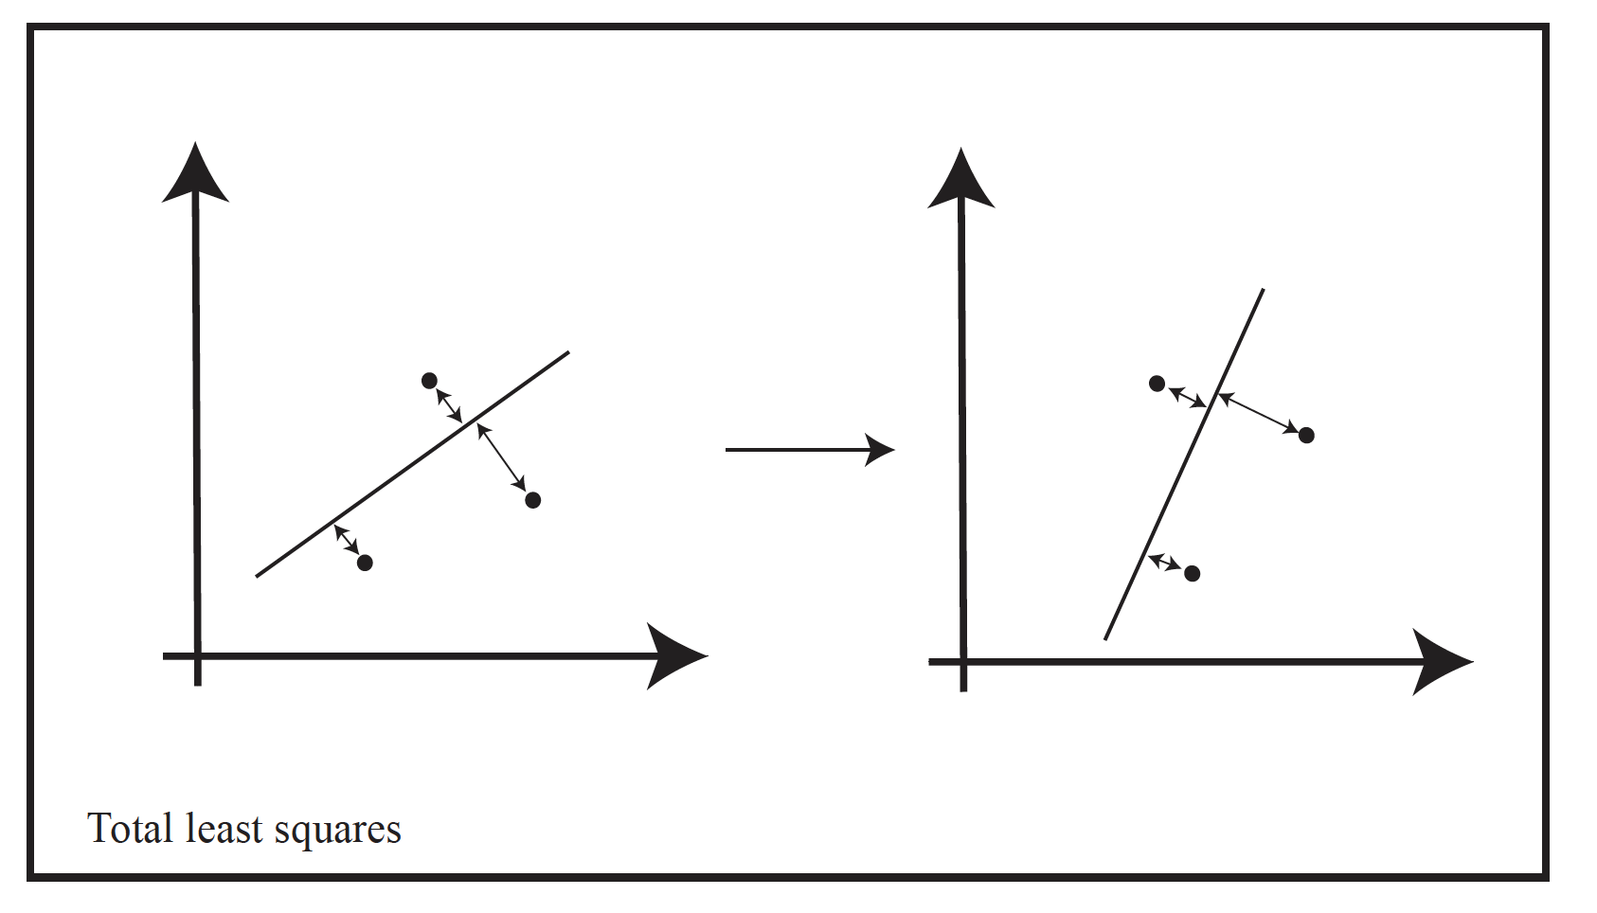
Fitting – some crucial facts of life
Some parametric model explains data
  example: line fitting, explain points by line
  an error/loss measures how well
Fitting: find the parameters
  noise – total least squares
  outliers – RANSAC
These methods are highly effective
  but there isn’t time for detail

Slide 20
Two views of the same 3D scene
Because:
  You have two
    Eyes
    Cameras
  OR the camera moves

Slide 21
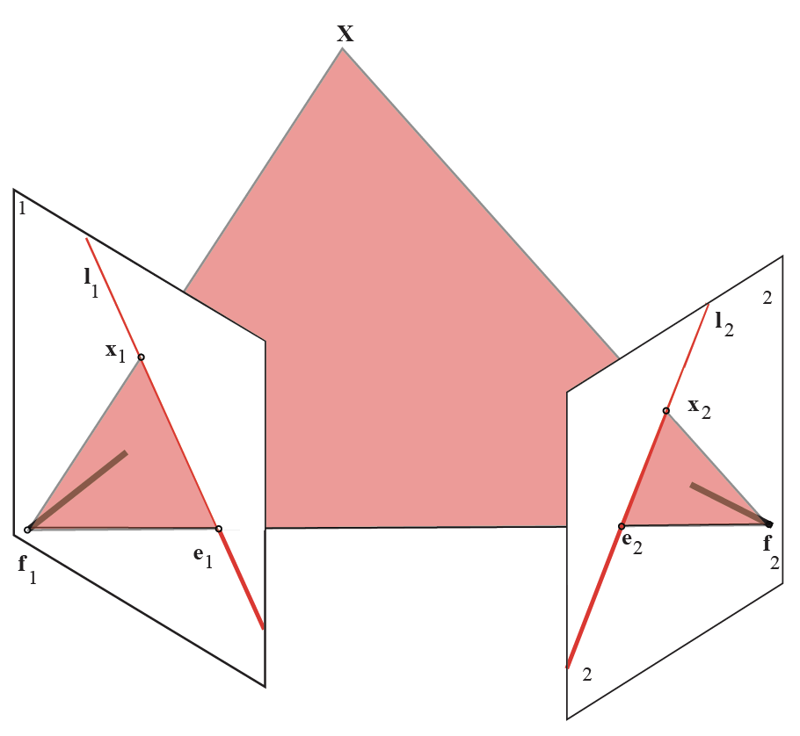

Slide 22
Epipole
Epipole

Slide 23
Epipolar plane
spans X, f_1, f_2

Slide 24
Anything in image 2 that matches x_1 MUST
- lie on epipolar plane
(cause it is in ray f_1 to X)
- lie on intersection of epipolar plane
and image plane 2

Slide 25
Epipolar line in image 2 corresponding
to x_1 in image 1

Slide 26
Epipolar line in image 1 corresponding
to x_2 in image 2

Slide 27
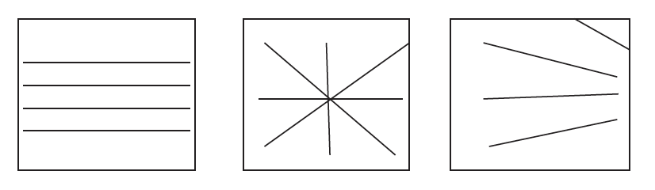
Interpreting epipoles and epipolar lines

Slide 28
Conclude:
x_1, x_2 and focal points are coplanar
It follows there is a matrix F such that
x_1^T F x_2 =0

Slide 29
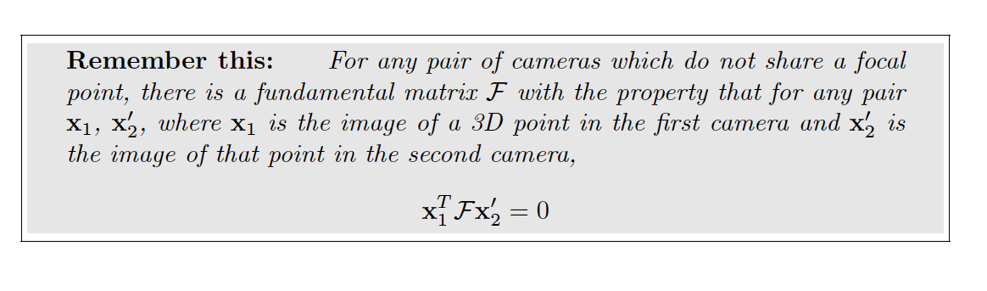
The fundamental matrix

Slide 30
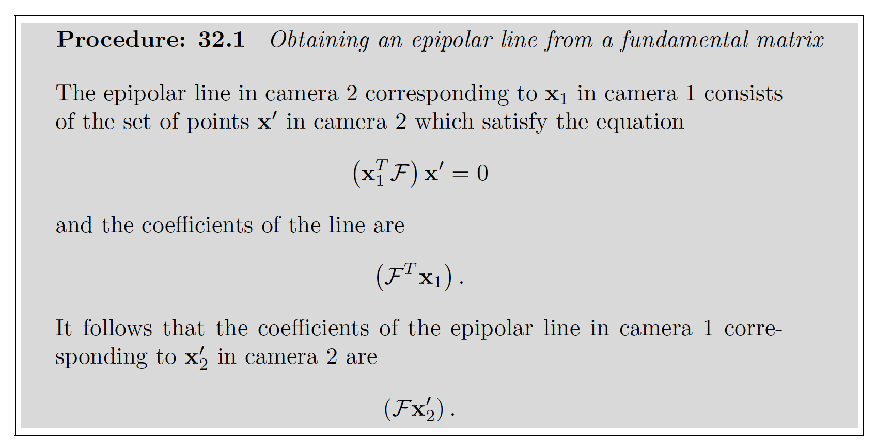

Slide 31
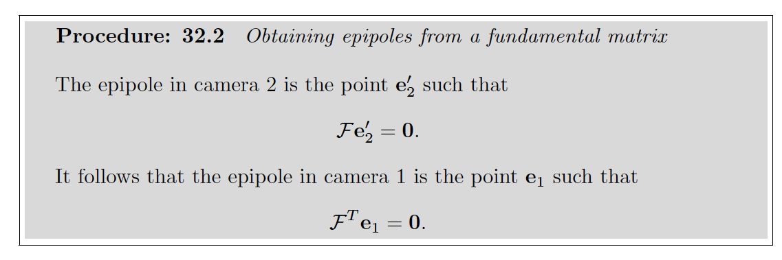
The fundamental matrix

