Slide 1
Regression and Classification
D.A. Forsyth, University of Illinois at Urbana Champaign
SOME APPLICATION SLIDES MISSING

Slide 2
Main points
You can learn comprehensive image encodings
Regression:
  You can learn to decode these into
    denoised images
    other good stuff (depth, normal, etc.)
Classification:
  You can decode into categories
    per pixel
    per image
Detection
  is basically lots of classification

Slide 3
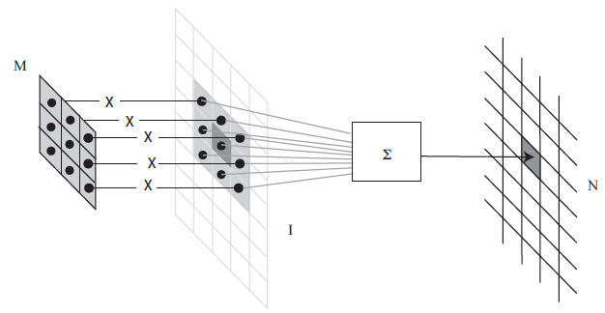
Convolution

Slide 4
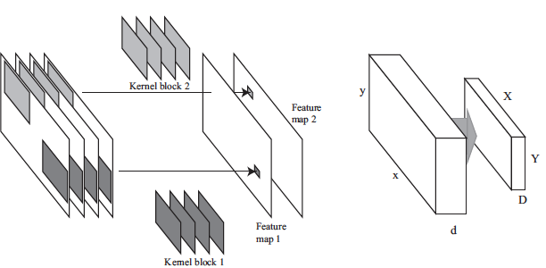
Multi-channel Convolution

Slide 5
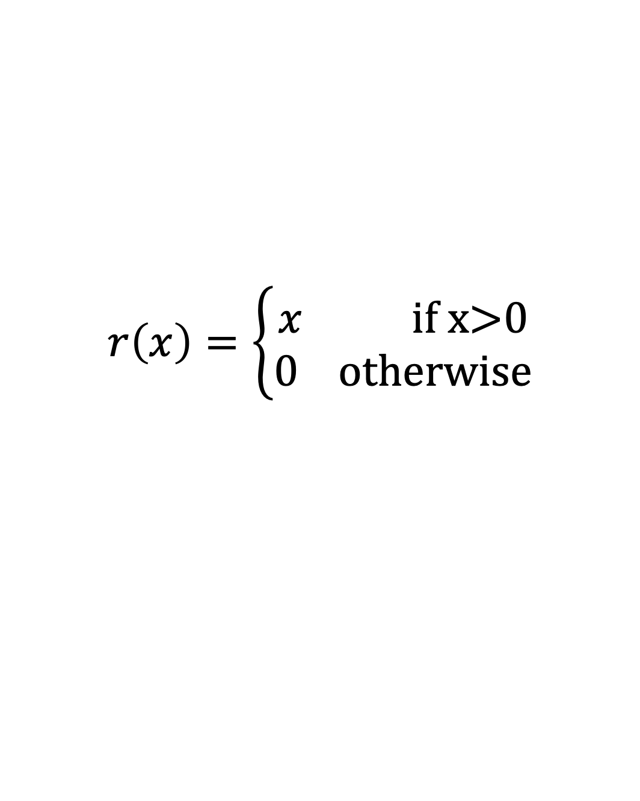
ReLU
$$r\left(x\right)=\left\{\begin{matrix}x \text{if} \text{x}\text{>0} \\ 0 \text{otherwise}\end{matrix}\right.$$

Slide 6
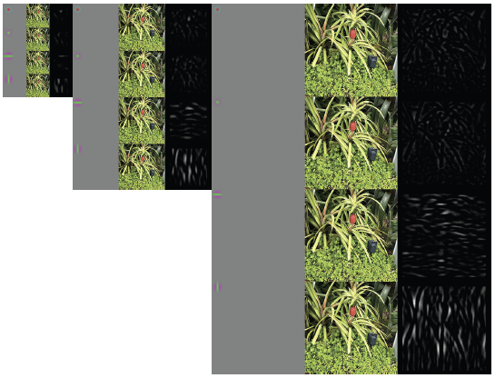
MC Convolution + ReLU = Simple pattern detector

Slide 7
Image representations - Encoding
Idea:
  Filter banks + ReLU yield scores for many different patterns
Idea:
  You can compose this, so patterns of patterns of …
  Result: a code that describes the image
Idea:
  if filters are well chosen, you could use the representation to:
    denoise images
    find edges
    find interest points
    classify images…
BUT what filters/patterns should we use?

Slide 8
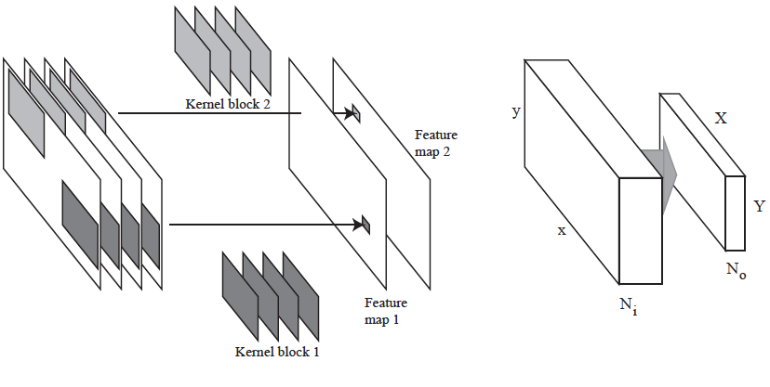
Convolutional Layers
Output number
of features
Input number
of features

Slide 9
ReLU operates on tensor
Trivially – just ReLU at each location

Slide 10
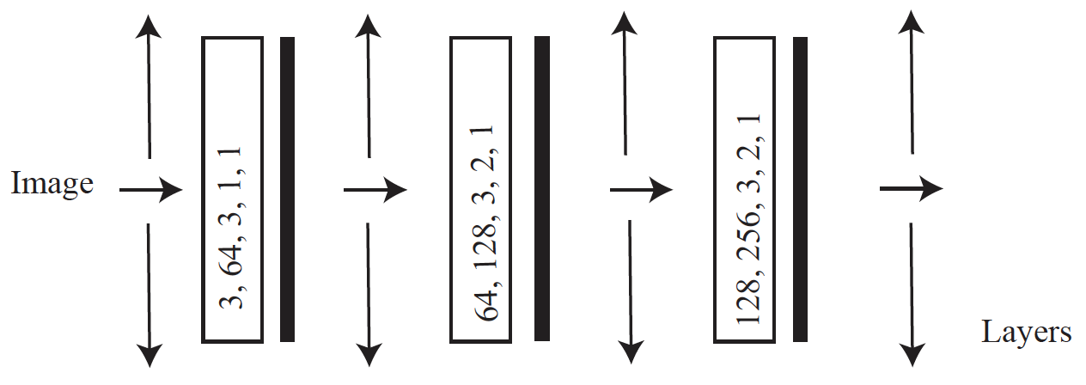
A very simple encoder
ReLU
Patterns of patterns of
patterns
Input number of features, output number of features, kernel size, padding, stride
BUT what filters/patterns should we use?

Slide 11
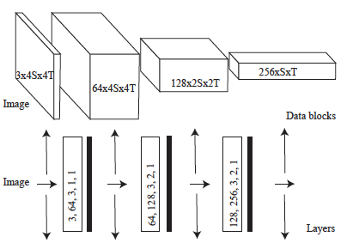
As tensors
Number of features x Xdim x Ydim

Slide 12
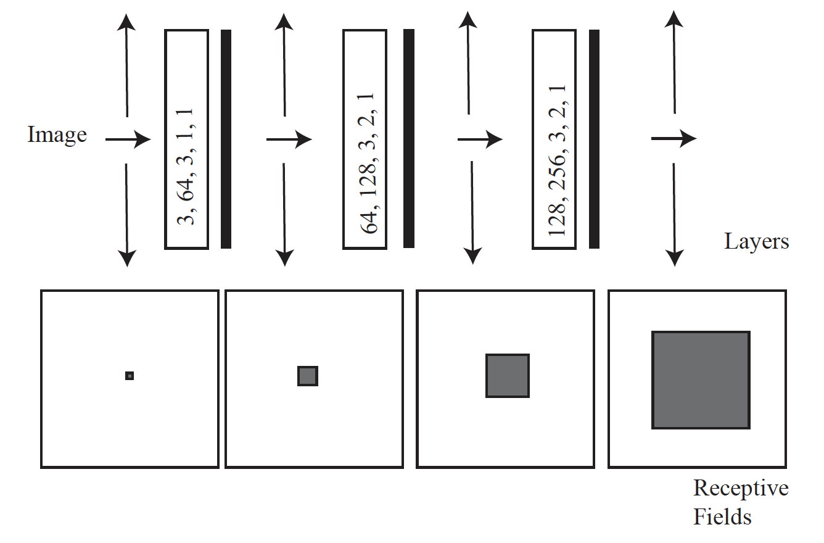
Receptive fields
Support for a value in the feature map

Slide 13
Images from codes - Decoding
Idea:
  Code likely (roughly) invertible
    Reconstruct filter responses from ReLU outputs
    Reconstruct image from responses (conv. Theorem)
Decode by:
  Place down instances of detected patterns
  This is filtering
  Use a ReLU to prevent negative values accumulating
BUT what filters/patterns should we use?

Slide 14
Decoding
Want:
  map rep’n (patterns of patterns of patterns…) to image
Have:
  If rep’n is filter outputs, convolution is enough
  Rep’n is spatially smaller than image
Idea:
  Filter+ReLU+upsample on occasion might do it

Slide 15
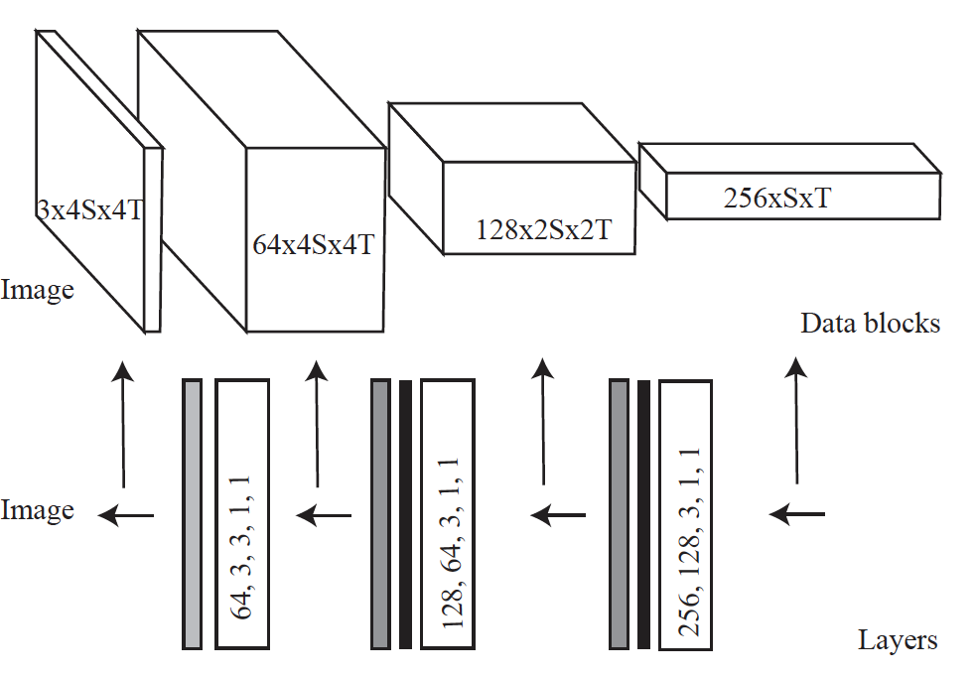
A decoder
Patterns of patterns of
patterns
ReLU
Upsample by 2
Input number of features, output number of features, kernel size, padding, stride

Slide 16
Big idea
With the right choice of filters
  a decoder could reconstruct an image from an encoders rep’n
The rep’n is overcomplete
  “sees” the image at many scales
  so the pair should be able to denoise
But what is the right choice of filters?
Choose filters/patterns that denoise

Slide 17
Denoising Autoencoder
Now imagine input image is noisy:
  The reconstruction might not be
    (with some care and some luck)
Idea:
  Build device that can accept noisy image, produce clean
  Denoising autoencoder
Helps choose filters/patterns – the ones that denoise

Slide 18
Learning the filters
Procedure:
  find many training pairs (noisy image, clean image)
  adjust filters so that
  Decode(Encode(noisy image)) is close to clean image
    on average, over pairs
    hope that this generalizes to new images
Result:
  Denoising autoencoder
  Encoder has codes that represent images well
  Opens the door to a lot of procedures

Slide 19

Adjusting the filters:
Optimization problem, but weird
Issues:
  The cost function is very hard to evaluate (N is big)
  There are lots of parameters (millions-billions)
    so no newton’s method
  You don’t actually want an optimum
    you want a set of filters that works well on other images

Slide 20
Stochastic gradient descent
Loss is a population mean
  you can estimate this quite well with a sample mean
  draw a small batch, average over that

Slide 21
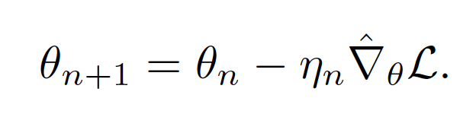
Stochastic gradient descent
How big a step?
  Line search
    you can’t – N is too big
  Fixed length
    too big (doesn’t settle down)
    too small (no progress)
  Learning rate schedule
    start biggish, take steps, make smaller
    how big is biggish? try
Rich range of improvements, variants, modifications available

Slide 22
Transformers: better encoders
Architecture:
  Accepts
    one or more streams of tokens
      very often fixed length
  Produces
    stream of tokens
    OR single learned token
  Origins in NLP
  Apply to images by
    tokenizing image
    getting clever about decoding

Slide 23
Transformers: better encoders
Inductive bias
  Convolution, etc has inductive bias
    mostly, pixels depend on nearby pixels
  Transformers seem not to
    or rather, it hasn’t made a nuisance of itself
Features:
  Admit training in the absence of labels, outputs, etc
  Every token communicates with every other
Strong evidence of better encoders
Issue:
  vilely inefficient (this is why electricity/RAM/disk are now so expensive)
  massive, expensive training demands
  many/most vision transformers are fine-tuned from published weights

Slide 24
The key idea remains
predict good stuff from images by encoding then decoding
  but the plumbing is different...
    different enough to affect the price of electricity/RAM/disk

Slide 25
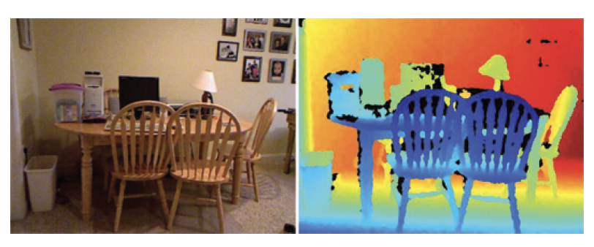
Depth from single image
Data example from NYUV2

Slide 26
How and what?
How: easy
  Get many pairs (image, depth), make decoder produce depth
What:
  Absolute depth:
    Might be very difficult to get right
      compare:
        zoomed picture of a doll-house room
        picture of real room
  Relative depth:
    depth up to per-image scale
    more likely to get this right, but harder to use

Slide 27
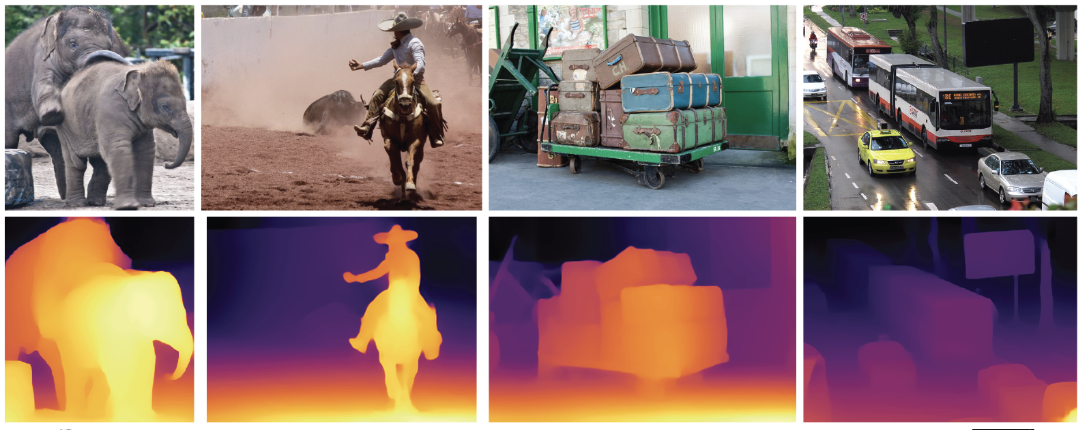
Depth predictors work really well

Slide 28
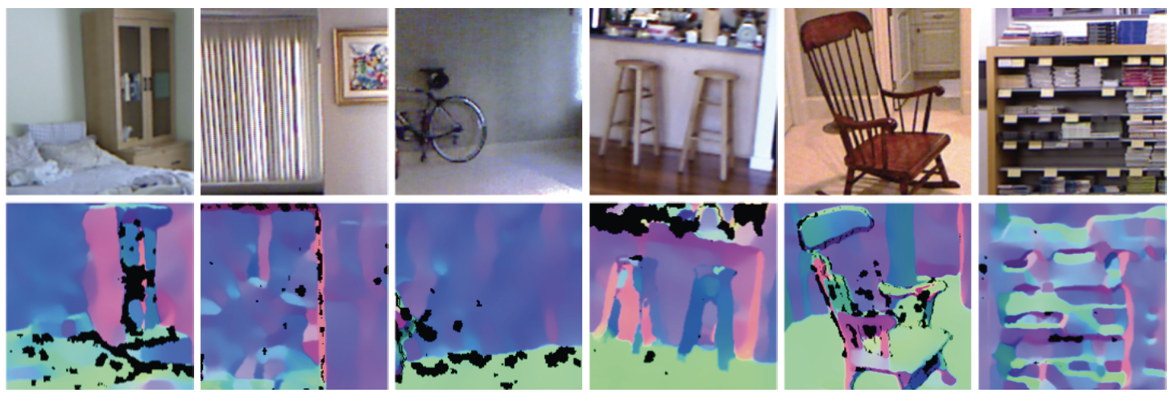
Normal estimates from depth data are shaky

Slide 29
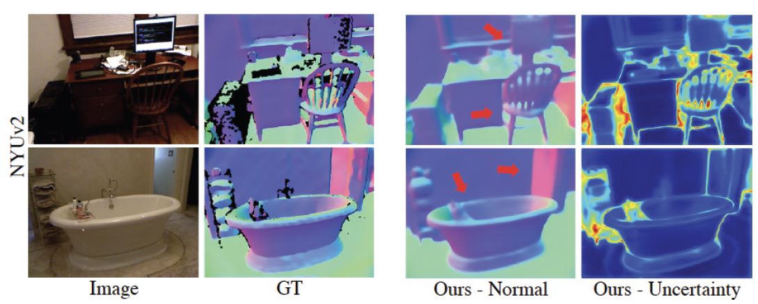
Normal predictors work really well too

Slide 30
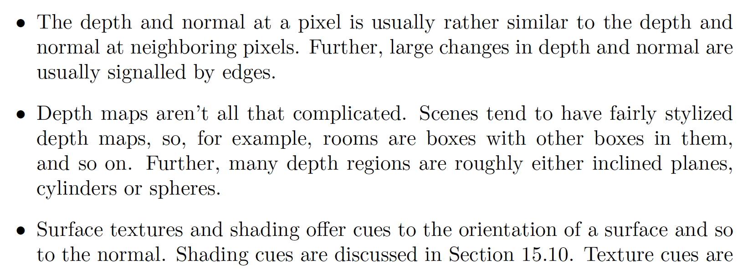
Why does all this work? I

Slide 31
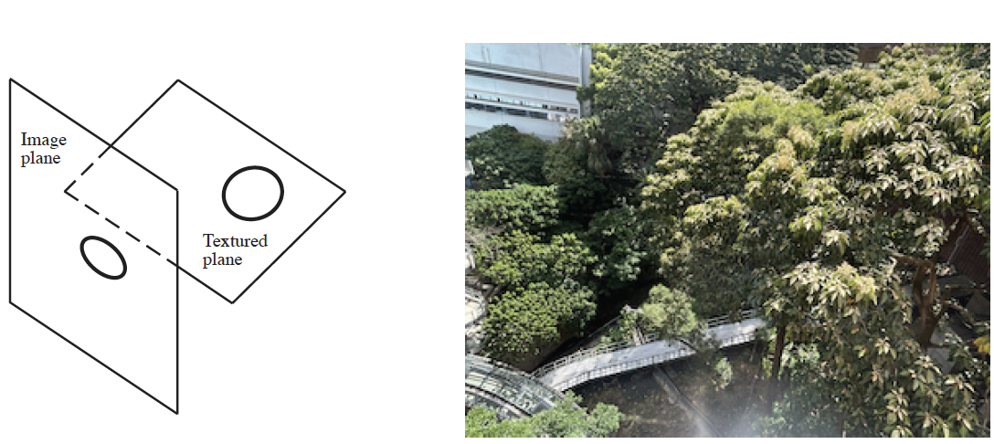
Why does all this work? II
Texture deformations are a cue to normals
  (archaic term: shape from texture)

Slide 32
Further image to image mapping
Generally, it’s worth trying anything with
  image in – image like thing out
Cases here:
  Denoising (did this); superresolution; defogging
Other possibilities:
  Fix underwater pix; derain; fix color balance; change lighting (?)
Recipe needs changing for...
  Edges; semantic segmentation (coming up)

Slide 33
A classifier
Any procedure that
  accepts a set of features
  produces a class
Hugely useful and general idea
  Credit card transaction (good/fraud)
  Should I download this code (secure/insecure)
Number of classes could be big:
  Doctor (well, cold, flu, ... measles, ... etc.)

Slide 34
Summaries of performance
Error rate:
  fraction of classification attempts with wrong answer
Accuracy:
  fraction of classification attempts with right answer
Very best error rate
  Bayes error rate
  Usually, larger than zero
    example: alien tries to determine sex from height
  Usually, very hard to know accurately

Slide 35
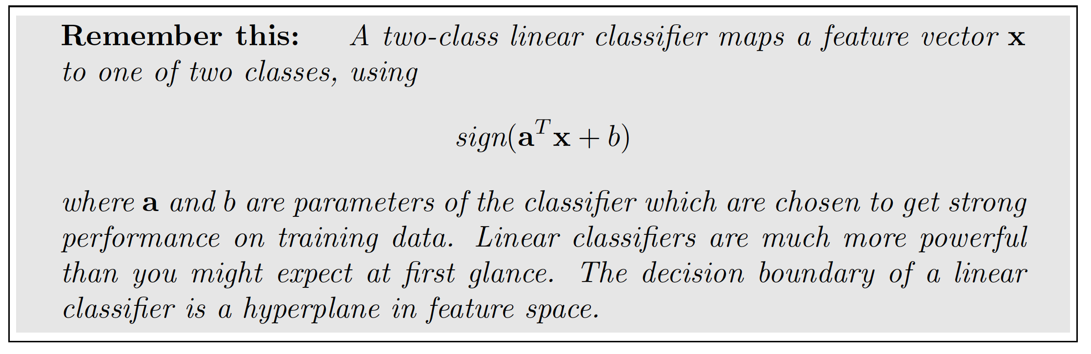
Simple, two-class linear classifier
Assume each data item is (feature vector, label)
  fv is x

Slide 36
Practical issue
Take the block of features from the encoder
  turn them into a vector of fixed size
  (this will mean classifier accepts images of fixed size)
Typically:
  ensure block shrinks spatially as it moves along encoder
    by stride or pooling
  when it is small enough, straighten into vector
Pooling:
  make a data block smaller by max/average within fixed size windows (usually 2x2)

Slide 37
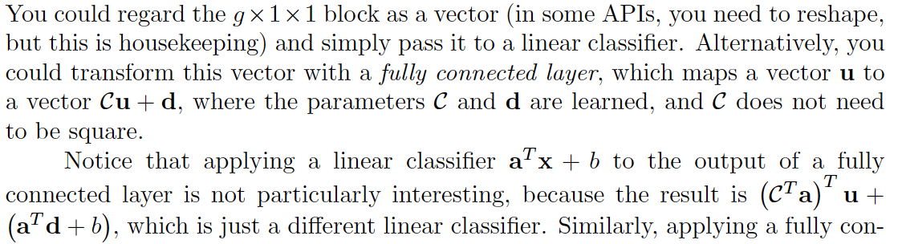
Fully connected layers
Vector describes the whole image

Slide 38
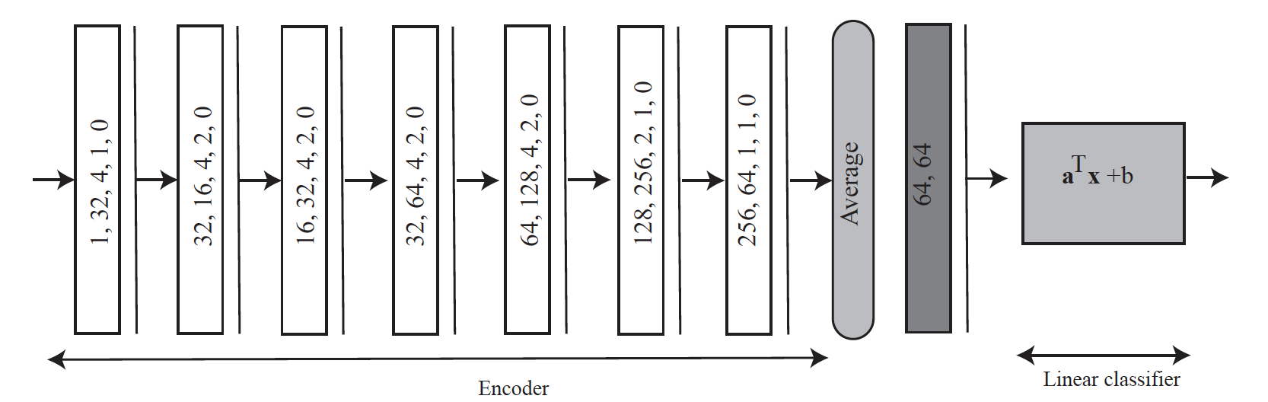
A simple image classifier

Slide 39
Simple Image Classification
Classify an image into one of two classes by
  Stack some pooling, FC layers on an encoder
  Adjust result into a vector
  Pass to linear classifier
Learn all parameters with SGD and various losses
    to get training examples right

Slide 40
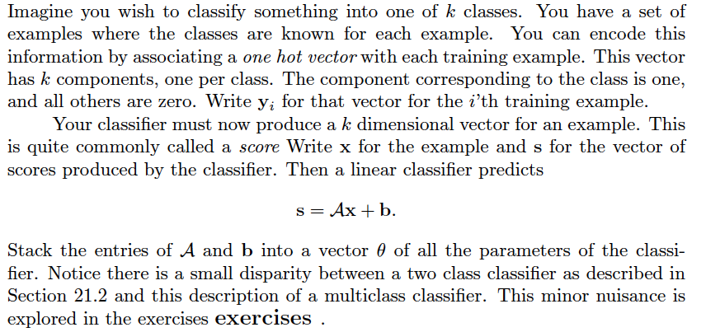
Multiclass classification

Slide 41
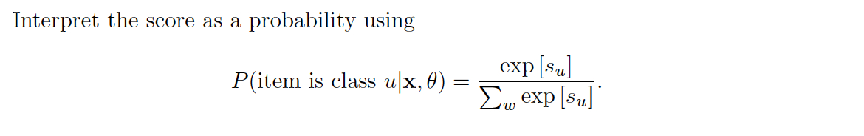
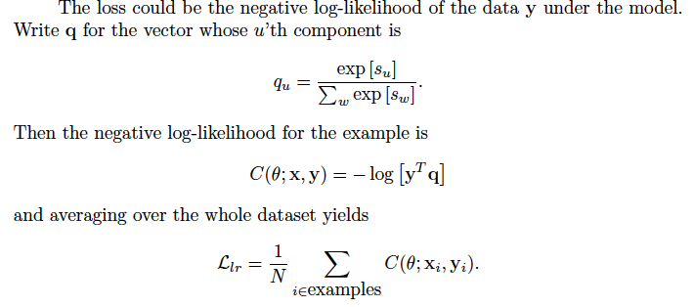
Interpreting the score

Slide 42
Ideas
Simple Image Classification
  Classify an image into one of two classes by
    Stack some pooling, FC layers on an encoder
    Adjust result into a vector
    Pass to linear classifier
  Learn all parameters with SGD and various losses
    to get training examples right
Simple image regression:
  Build U-Net
    input is image
    output is image-like thing (depth,normal, etc)
    train to produce the right answer
Merge these to produce class scores at each pixel
  rather than a depth...

Slide 43
Semantic segmentation
Label pixels in images with labels taken from a vocabulary
Notice there are two kinds of label
  “things” == count nouns == what you can count
    car, pedestrian, bike, dog, ...
  “stuff” == mass nouns == others
    grass, sky, water, cloud, ...

Slide 44
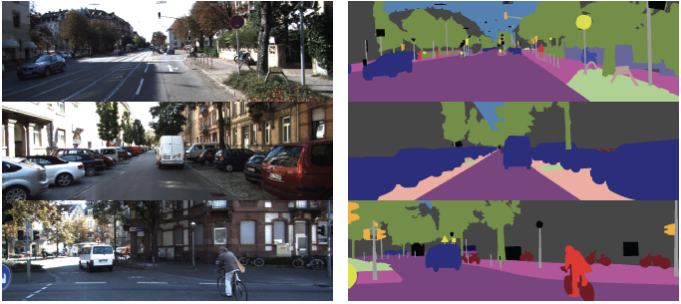
Semantic segmentation on Kitti (labelled data)

Slide 45
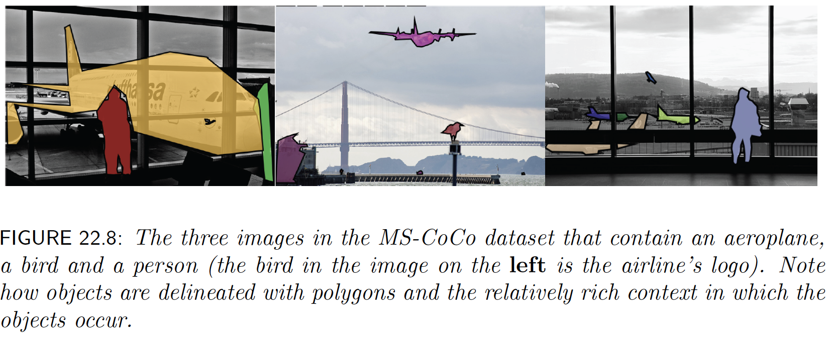
MS-CoCo dataset

Slide 46
Image classification
Label image by:
  Insert image into encoder
  apply multiclass classifier
Variants:
  complexity and training process for encoder
  how encoder is trained
    using labels from your dataset is one of many options
  what kinds of label are predicted
What are the labels?

Slide 47
Recipes for cases
Cheap and cheerful
  obtain small encoder
    likely, small ResNet, possibly pre-trained on ImageNet
  Train this on your labels
    possibly fine-tuning encoder
      small learning rate for encoder, bigger for linear classifier
Luxury high performance
  obtain large encoder
    very likely transformer, heavily pretrained
  fine-tune on your labels
Large specialized
  eg fine-grained recognition
  architectures and processes quite varied

Slide 48
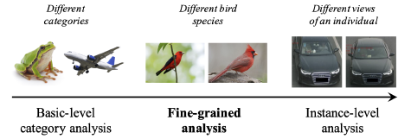
Types of label
Image credit: Figure 3 of Fine-Grained Image Analysis with Deep Learning: A Survey

Slide 49
Types of label: category
predict the category of the “main object”

Slide 50
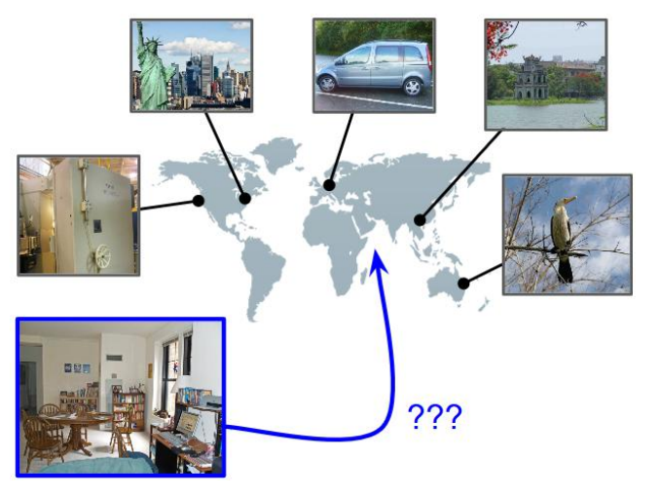
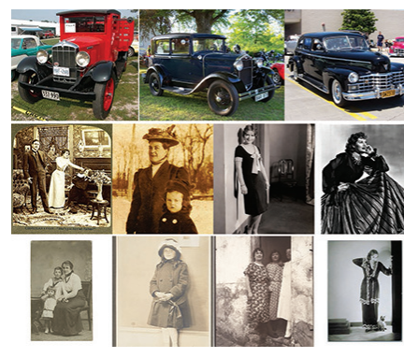
Other types of label...
Date prediction
Location prediction
Vittayakorn et al. (2017)
Vo et al. (2017)

Slide 51
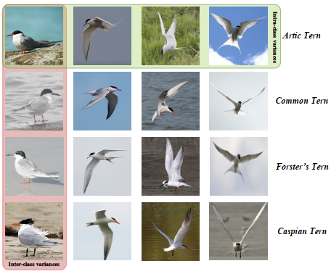
Fine grained category recognition
within class variation
between class variation
Image credit: Figure 4 of Fine-Grained Image Analysis with Deep Learning: A Survey

Slide 52
SOTA - rough summary
Very high accuracy with 1000’s of classes
  Using
    very deep residual networks
    alternative feature construction methods
Challenges
  tough with little training data
    use a pretrained encoder and a classifier
    link to language (later)
  sufficient change in dataset presents problems
FGVC works really well
  see Merlin BirdID, iNaturalist, etc.

Slide 53
Classification vs detection
Classification:
  there is an X in this image
    what
Detection:
  there is an X HERE in this image
    what AND where
Key issues
  how to specify where
  relationship between what and where
  efficiency, etc
  evaluation
    surprisingly fiddly

Slide 54
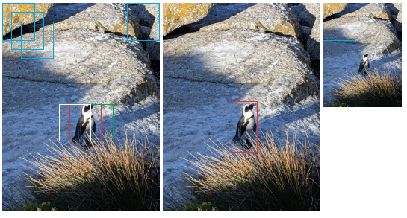
Basic architecture

Slide 55
Need..
to control the number of boxes checked
to manage the classifier
  may see lots of negatives
  must be willing to respond when box isn’t precise
to manage high-scoring boxes
  non-maximum suppression
to refine boxes

Slide 56
Three helpful points
Correlated scores
  boxes overlap, so box scores are correlated
Extrapolating box scores
  manageable, because they are correlated
  bounding box regression
Worthwhile windows
  surprisingly, you can tell whether a box contains an object, even without specifying the object
  means you can reduce the number of boxes you show to classifier

Slide 57
Two threads
YOLO: Localize while classifying
  in parallel, score
    boxes for “goodness of box”
    boxes for “what is in it”
  combine
Localize then classify
  find boxes that likely contain objects
  decide what is in the box

Slide 58
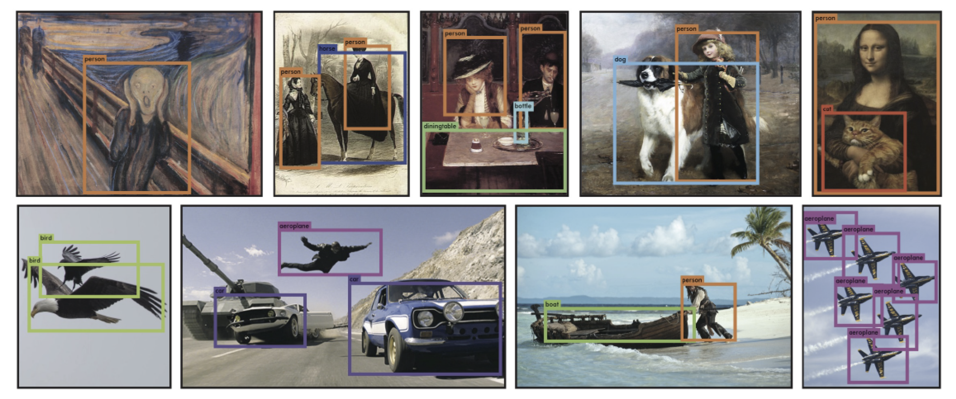
Original caption: “YOLO running on sample artwork and natural images from the internet. It is mostly accurate although it does think one person is an airplane”

Slide 59
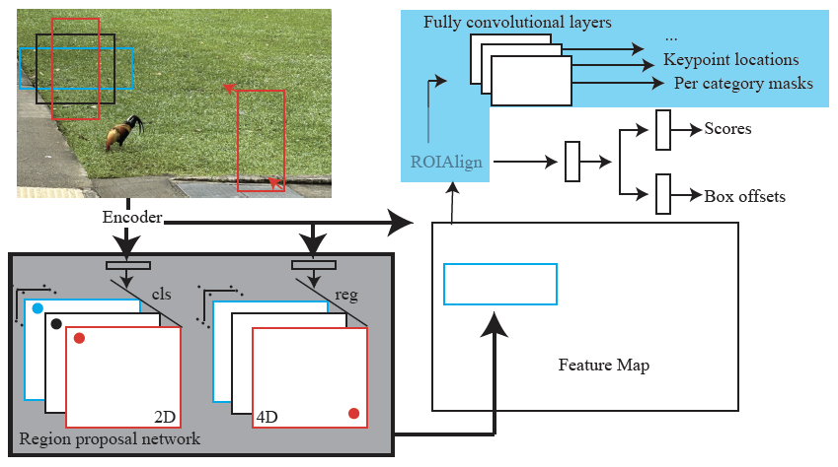
MaskRCNN
New stuff
Adjust feature map
region to fixed size
Cut out feature
map region for
box
Choose some RPN boxes

Slide 60
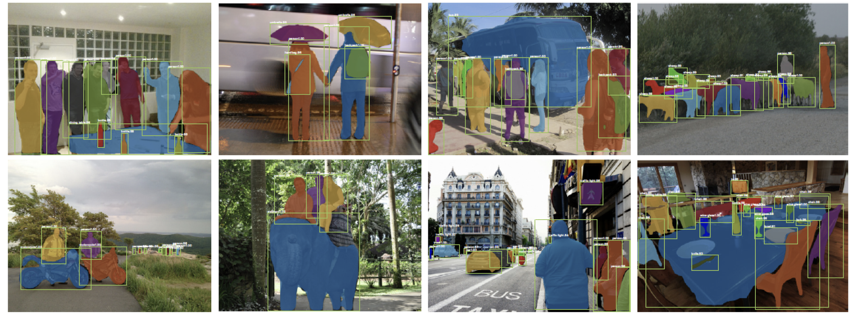
Detection with masks
Evaluation:
  you can compute IoU for masks, too...

Slide 61
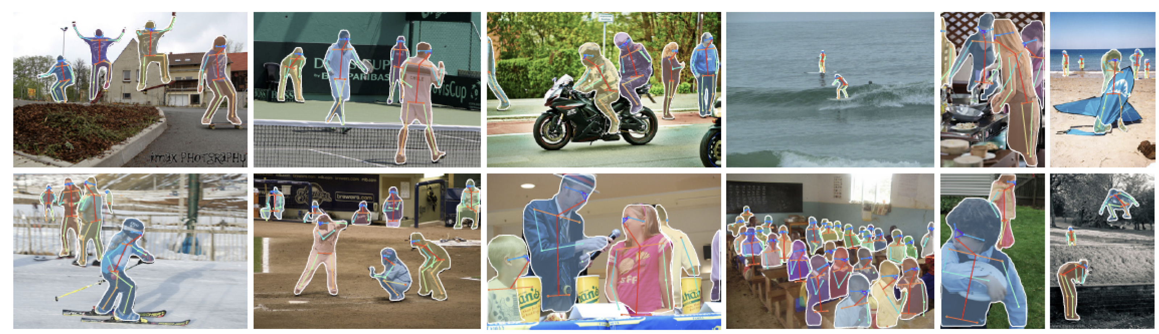
Variants
Predict more stuff from ROI
  eg body keypoints
Bolt onto a semantic segmenter
  to get panoptic segmentation

Slide 62
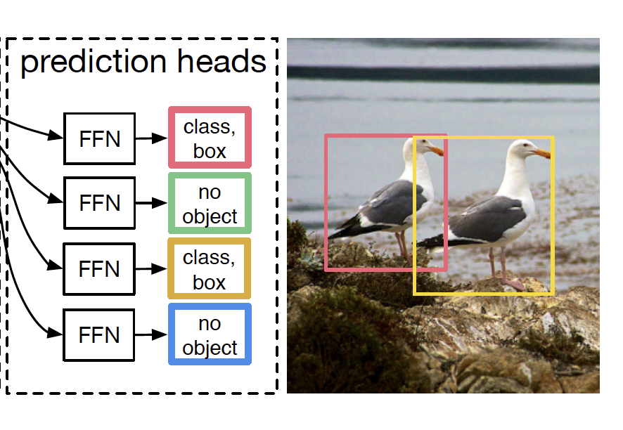
DETR – detection by transformer
prediction head
  accepts output token
  produces
    no object OR
    class scores, box location
Training (roughly!)
  Find large number of images with boxes, classes
  Loss is min over matchings
    from predicted tokens to image boxes
      box loss+class loss
  Use weighted bipartite graph matching to match
  Descent on this
End-to-End Object Detection with Transformers Carion et al, 2020

Slide 63
Evaluating detectors
Compare detected boxes w ground truth boxes
Favor
  right number of boxes with right label in right place
Penalize
  awful lot of boxes
  multiple detections of the same thing
Strategy
  Detector makes a ranked list of boxes
  GT is a list of boxes
  Mark detector boxes with relevant/irrelevant
  summarize lists

