Slide 1
What Images are Like
D.A. Forsyth, University of Illinois at Urbana Champaign
Clean up around dictionary, and shorten

Slide 2
Important facts
Pixels are like their neighbors, so
  you can denoise
  Large changes are interesting, and you can find them
  You can summarize images with interest points
    which have very strong matching properties
Image patches are repetitious
  so you can denoise, inpaint, classify, regress
Knowing whether something is an image is powerful and hard

Slide 3
A crucial property of images
Pixels are like their neighbors
  (mostly, for most pixels)
Imagine you wish to denoise an image. You could do so by averaging neighbors (a filter!). Weighting the neighbors so nearby neighbors get heavier weights is a good move.

Slide 4
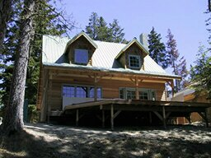
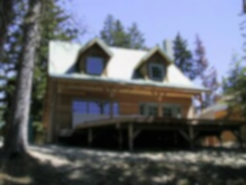
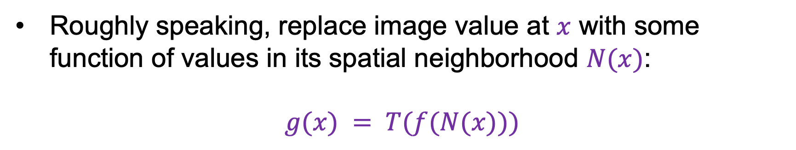
Image filtering
Roughly speaking, replace image value at $x$ with some function of values in its spatial neighborhood $N(x)$:
$$g(x) = T(f(N(x)))$$
f
g
T
Examples: smoothing, sharpening, edge detection, etc.

Slide 5
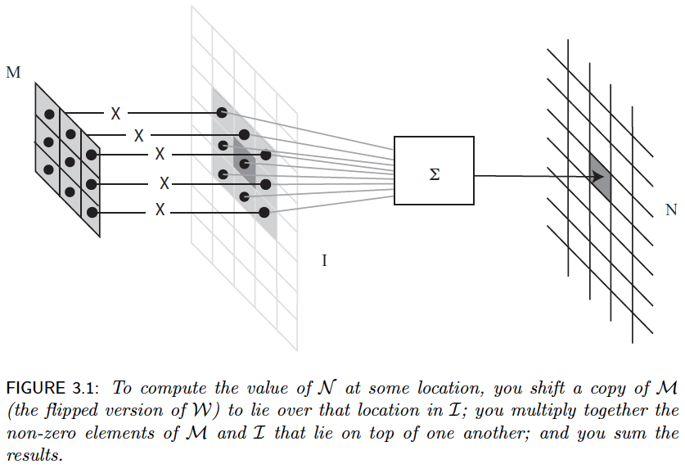

Slide 6
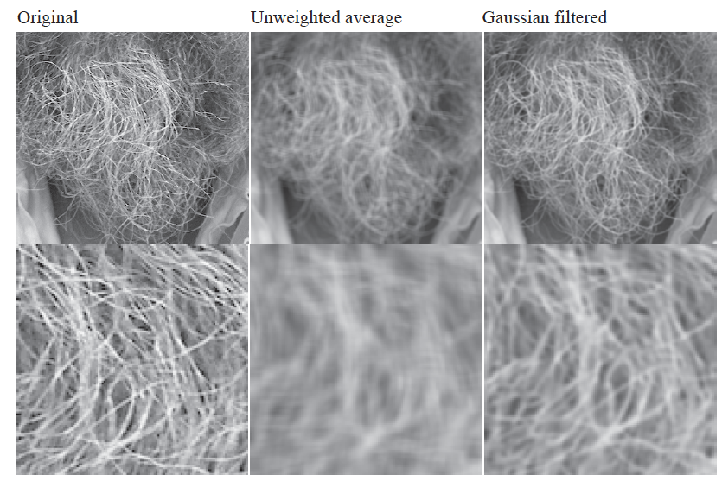
Smoothing
What’s wrong with this picture?
What’s the solution?

Slide 7
Filtering is a (very rough) pattern detector

Slide 8
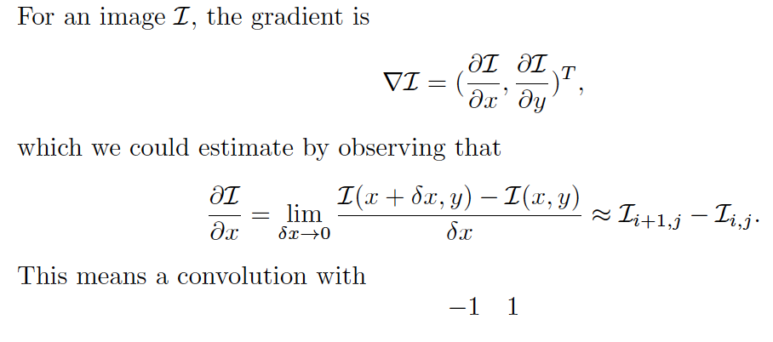
Gradients are patterns

Slide 9
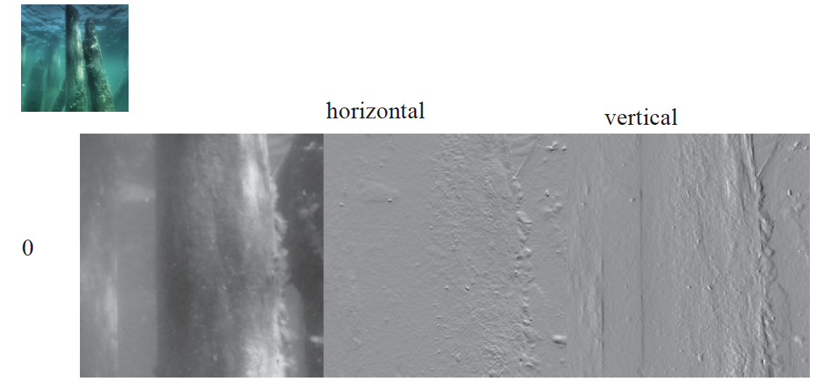
Spot the typo!

Slide 10
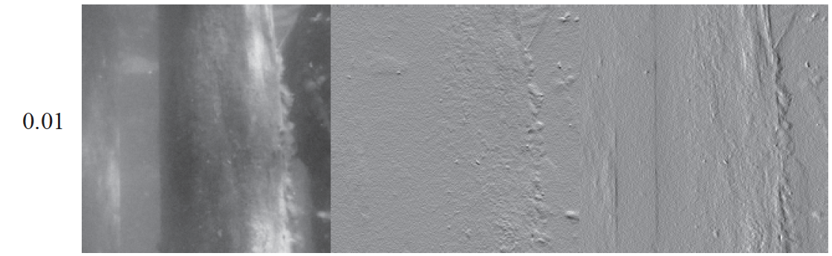
Spot the typo!

Slide 11
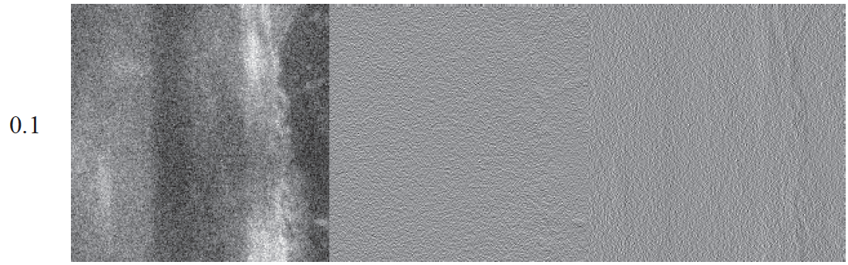
Spot the typo!

Slide 12
Pixels are like their neighbors
so you can denoise images
and gradients are important

Slide 13
You can find gradients reliably
and edges
and other good stuff
Denoise with a smoothing filter
  then find the gradient

Slide 14
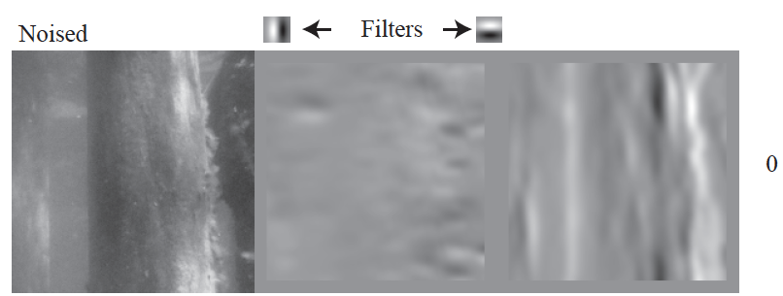
SPOT THE TYPO!

Slide 15
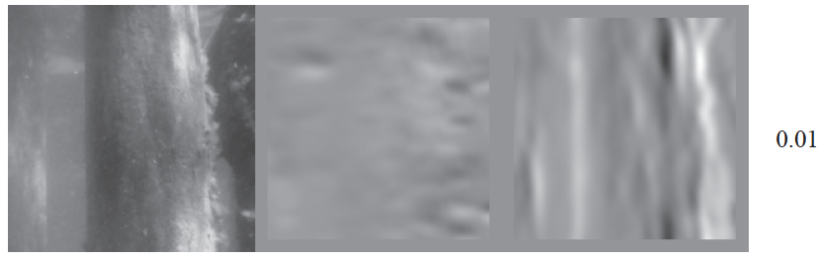

Slide 16
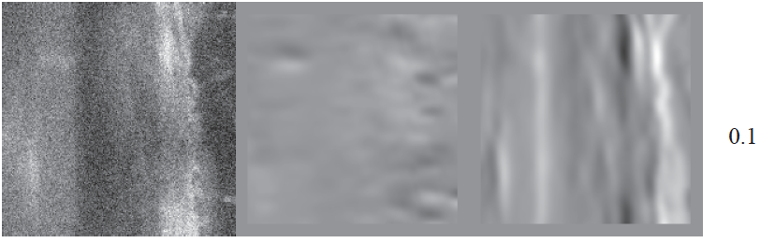

Slide 17
You can build well behaved point descriptors
Pixels are like their neighbors => many pixels are redundant
  Meaning you could “leave them out”
Some pixels are much more important than others
  Keypoints, interest points

Slide 18


Why extract keypoints?
Motivation: image alignment
  We have two images – how do we combine them?
Step 1: extract keypoints
Step 2: match keypoint features

Slide 19
Keypoint representations support very fast methods
In some applications, GPU just isn’t available
  too heavy; too much power; etc
  And there isn’t much CPU either
Idea: reduce image to keypoints, work with those

Slide 20
Need to find
Where is it:
What scale its at:
What orientation its at:
In a way that is (mostly) unaffected by
image transformations

Slide 21
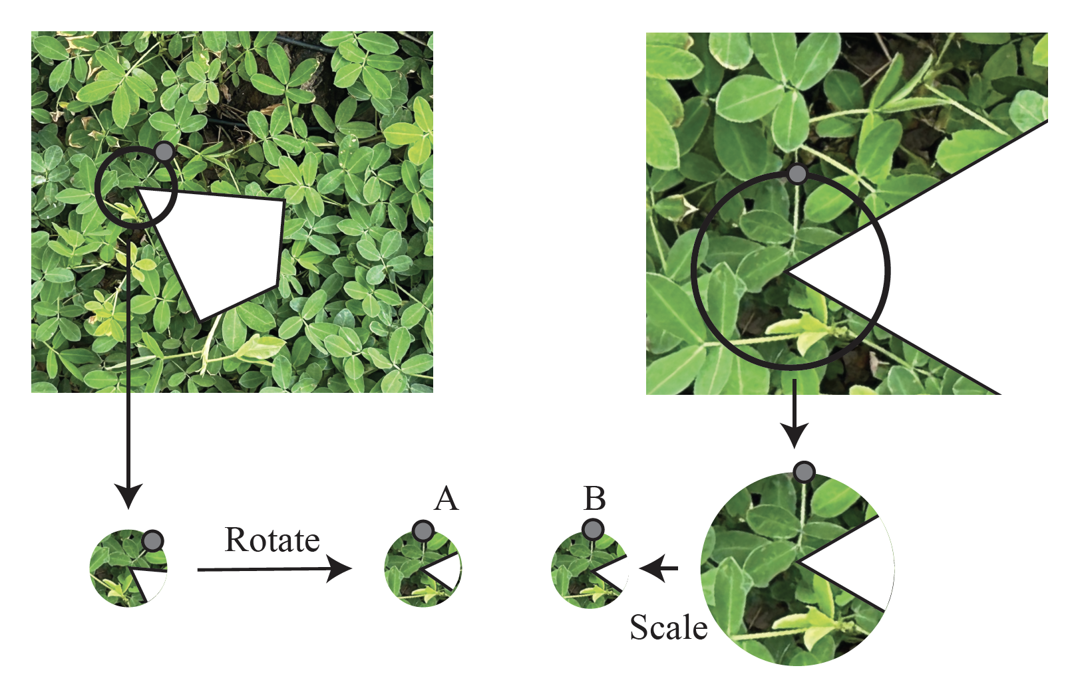

Slide 22
Need to find
Corner detector
Where is it:
What scale its at:
What orientation its at:
Description of contents:
In a way that is (mostly) unaffected by
image transformations

Slide 23
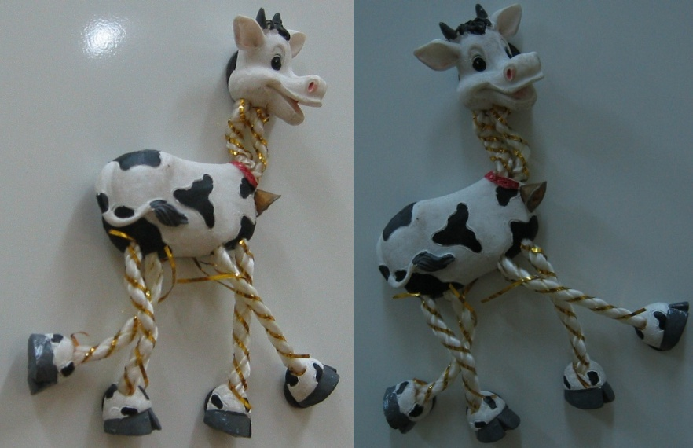
Harris Detector: Example

Slide 24

Harris Detector: Example

Slide 25
Need to find
Where is it:
What scale its at:
What orientation its at:
Description of contents:
LoG filter peak
In a way that is (mostly) unaffected by
image transformations

Slide 26
Need to find
Where is it:
What scale its at:
What orientation its at:
Description of contents:
Direction of most common
gradient in window
In a way that is (mostly) unaffected by
image transformations

Slide 27
Need to find
Where is it:
What scale its at:
What orientation its at:
Description of contents:
Sift features
(or some equivalent)
In a way that is (mostly) unaffected by
image transformations

Slide 28
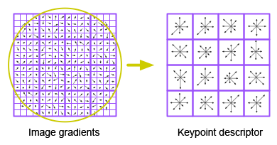
Describing a window’s contents – SIFT
We want description to be:
  Invariant to changes in image brightness: - use orientations
  Robust to noise: - ignore orientations with small magnitude
  Distinctive: - use lots of local orientations
  Invariant to small errors in location:
    “bucket” the orientations in image
    Use a histogram for each bucket
SIFT features behave very well
  the nearest neighbor to a query patch
    is usually a matching patch

Slide 29
Images are made of quite repetitious patches
Because pixels are like their neighbors
So there is often a patch some distance away that looks like the patch you’re looking at
  even for quite big patches
This is hugely useful
  Denoising
  Inpainting
  Classification
  Regression

Slide 30
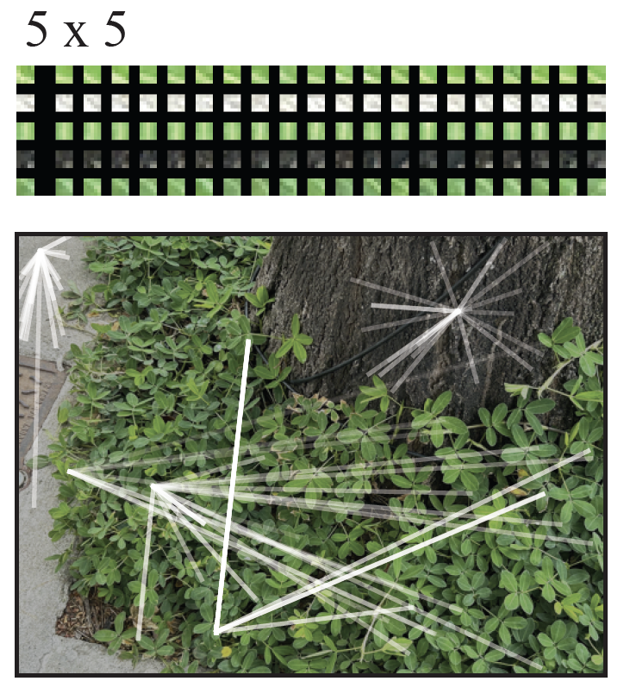
Patch matches

Slide 31
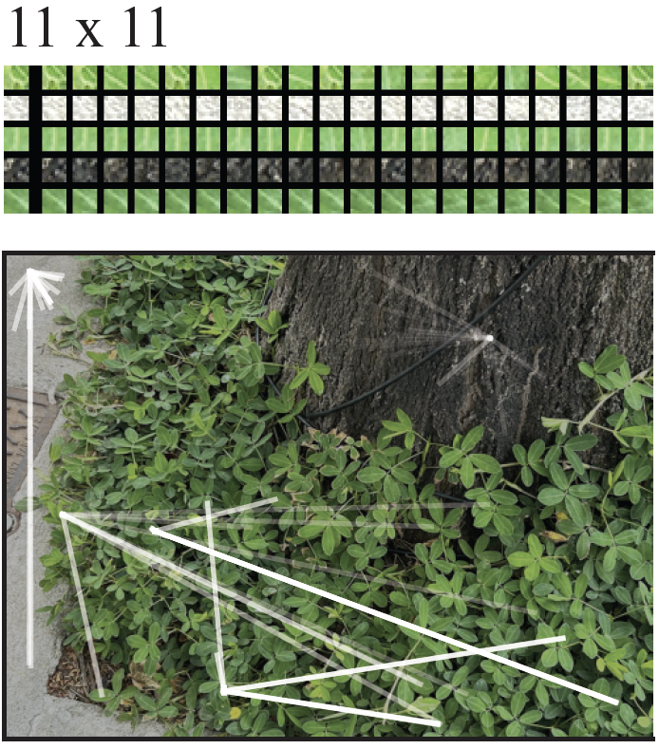
Patch matches

Slide 32
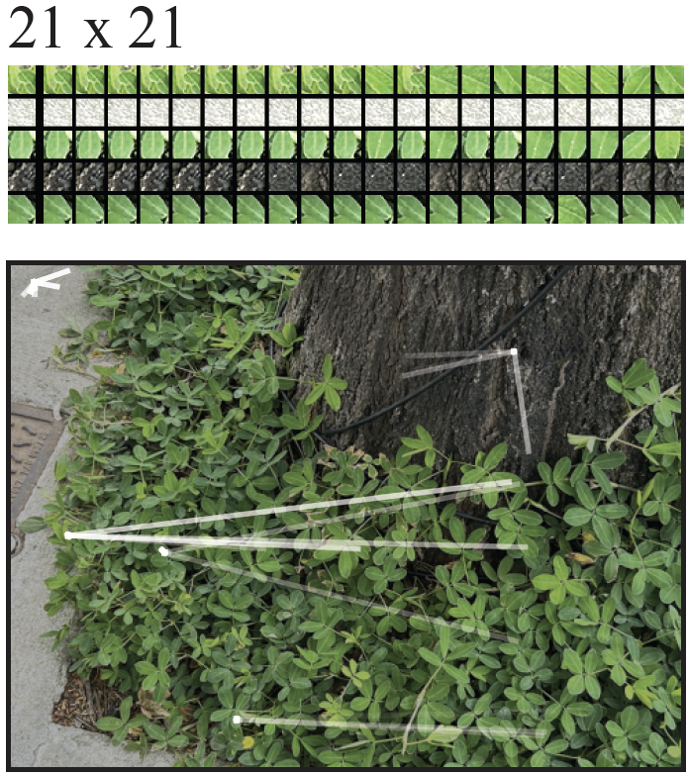
Patch matches

Slide 33
Inpainting
Simplest case:
  some fraction of pixels has been “knocked out” at random
  (perhaps set to zero)
  and you know which pixels
Fix:
  take window around knocked out pixel
  find closest match in the image
  take the center pixel from matching window

Slide 34
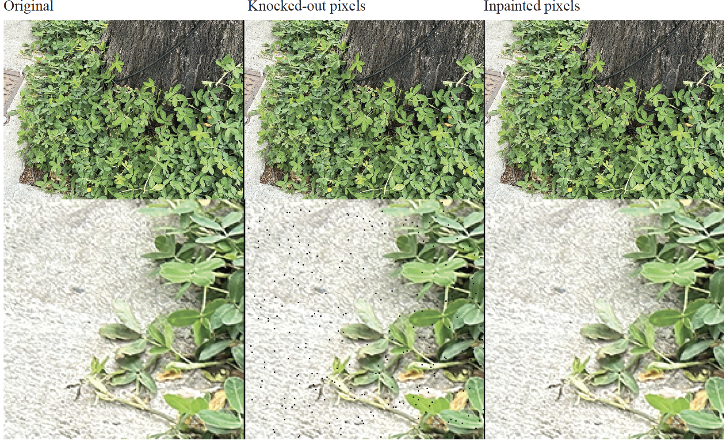

Slide 35
Inpainting for bigger knockouts
Assume a kxk window gets ”knocked out” (k small, but k>1)
Procedure works if you are careful about matching
- eg don’t match to windows that have knocked out pixels

Slide 36
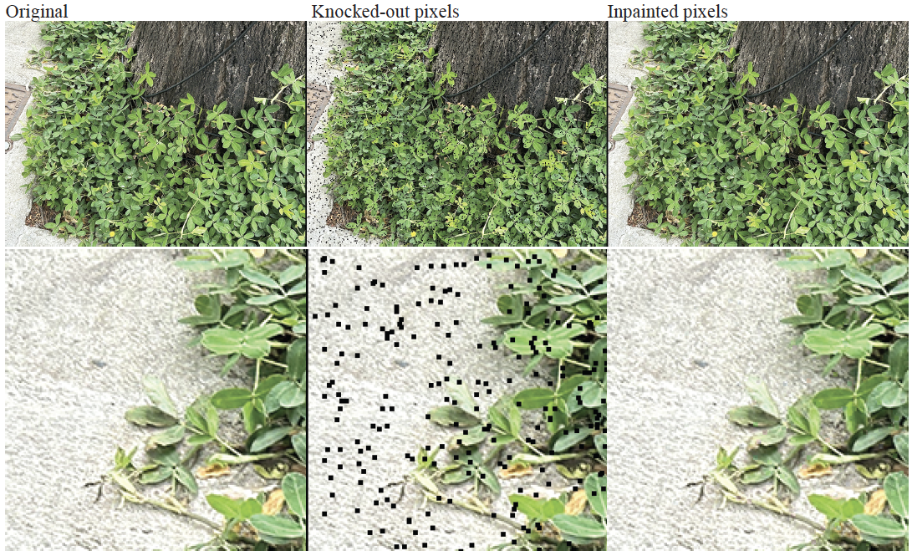

Slide 37
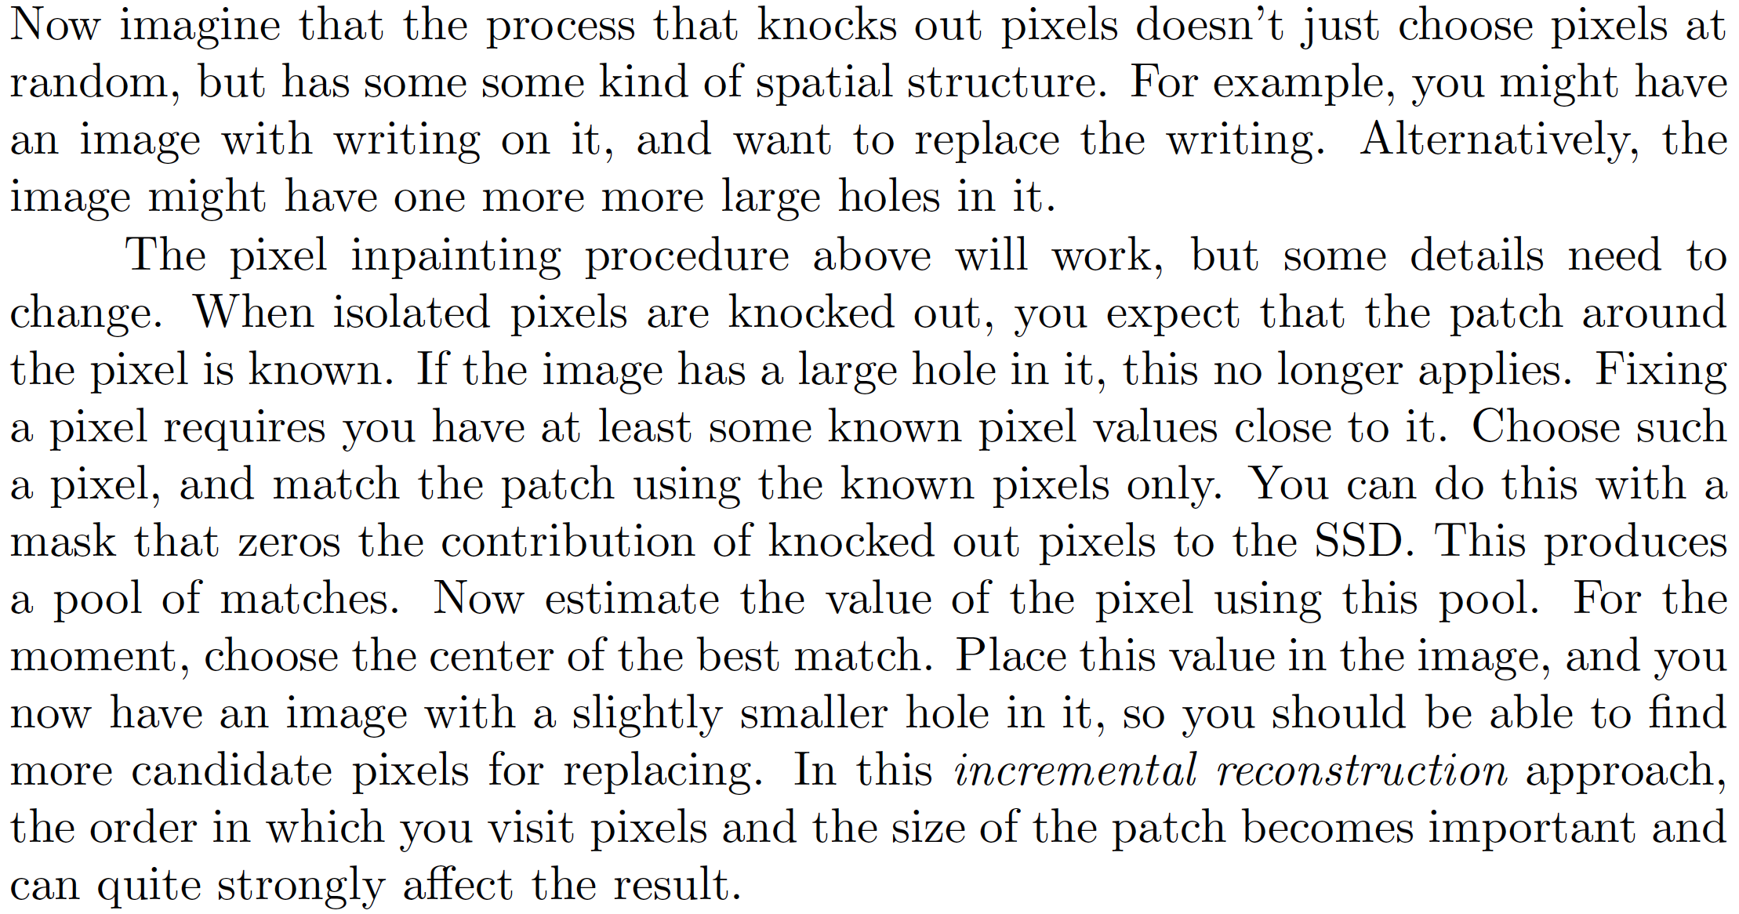
Incremental inpainting

Slide 38
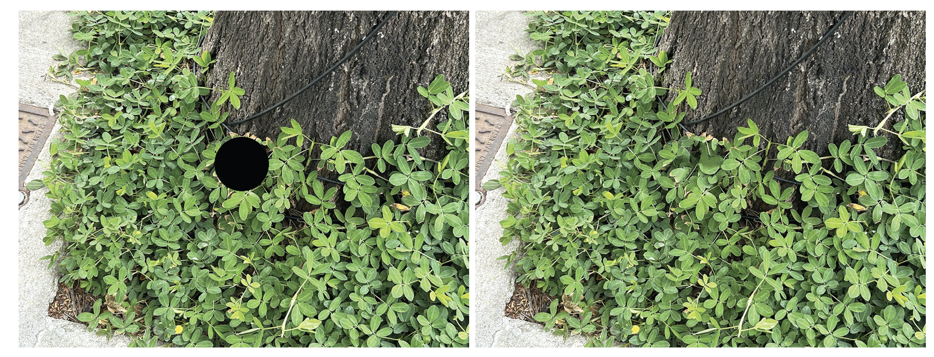

Slide 39
Forming and using patch dictionaries
Idea:
  other patches in an image are good for denoising
  why not use other patches in other images?
Issues:
  how to find the right patch in a very large number of patches?
  redundancy
  many patches are like one another, and so just make work

Slide 40
Desirable outcome
Procedure to
  accept a patch
  produce a patch/some patches that are similar
Built out of very large number of patches

Slide 41
A very simple image classifier
Problem:
you want to classify an image
Strategy:
learning:
get many labelled images
cut into patches
build tree
for each leaf, record the most common label
classifying:
        cut image into patches
        pass patch down tree
        vote for label
Now old-fashioned, but moderately
effective and very good in its time

Slide 42
Denoising from weird noise
Imagine you have very strange noise, and you can simulate it
You want to denoise
Strategy:
  Take many images, and create (noisy – clean) pairs
  Carve into patches and build a HKM tree using only the noisy patches
    (but keep the clean patch – so each data item is (noisy – clean) but the clusters, etc are formed using noisy alone)
To denoise:
      carve up noisy image into patches
      walk the tree with the noisy patches
      at leaf, substitute the clean version of the best match

