Slide 1
Where is this all going?
D.A. Forsyth, University of Illinois at Urbana Champaign
SOME APPLICATION SLIDES MISSING

Slide 2
Budding topics
Generating images, video, etc
The merging of topics in high-compute regimes
Divergence between low-compute and high-compute methods

Slide 3
Main points
You can generate images, video, etc. from random variables
You can train generators without explicit labelling
Generators are intriguing
  They seem to know stuff that isn’t in the training data
  They seem not to know stuff that is in the training data
The technology is very poorly understood
  and is fantastically hard to evaluate

Slide 4
Images from random numbers
Astonishing, recent fact:
  We can generate images from random numbers
    and conditioning information
Two major procedures:
  Generative adversarial network
  Diffusion methods
In Limine: I’m ignoring text/image links, editing, etc.
to talk about scene representation and understanding

Slide 5
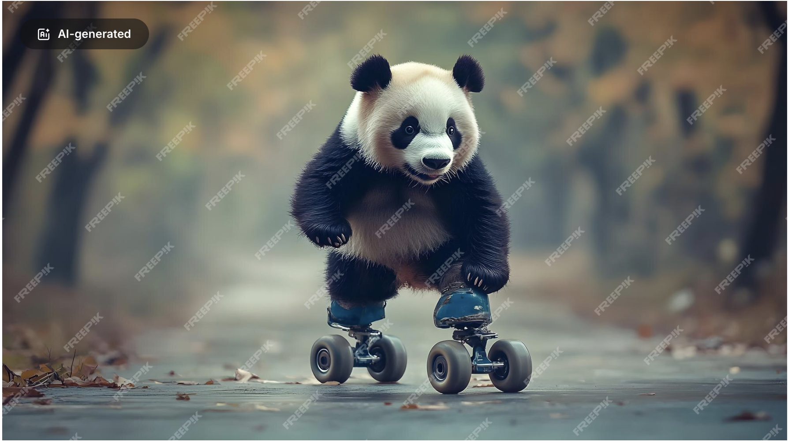
Applications: make commercial art cheaper

Slide 6
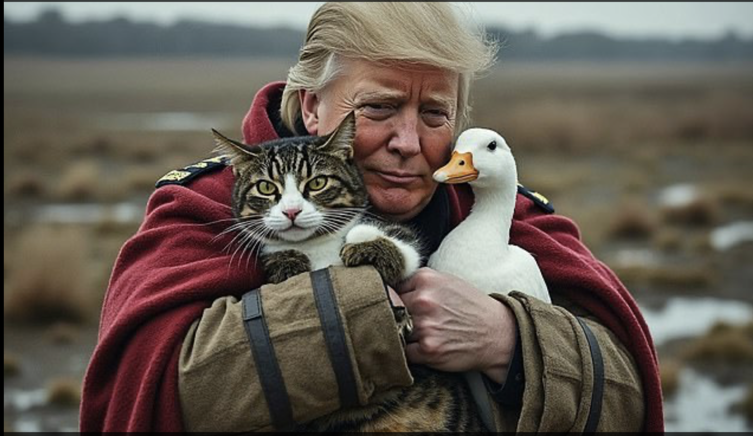
and political discourse nastier

Slide 7
Articles of faith
There is a probability distribution on all images
A diffusion model produces a fair sample from that distribution
Articles of faith because:
  they’re believed in the face of inconvenient facts
    obvious falsification below
    you can’t do two-sample testing in high dimensions and get the answer right
    metrics:
      absurd (FID);
      ineffectual (ask people);
      inaccurate (ask VLMs)
  bad things might happen to unbelievers

Slide 8
So why bother with image generators?
Silly arguments
  You can get rich by taking money from commercial artists
    (who haven’t got any)
  Prurience
    The NSFW world just *loves* image generators
      fine-tuned specialized generators are traded on a large scale
Generators know a lot about pictures, and data is easy
  Surprise: They know a lot about relighting, intrinsics, etc.
      without being trained to do so
    but have important areas of significant ignorance - why?
Pose profound vision questions
  maybe regression is over?

Slide 9
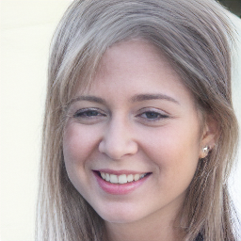
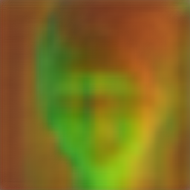
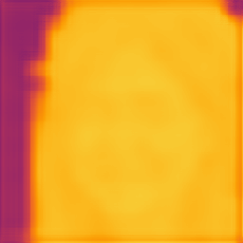
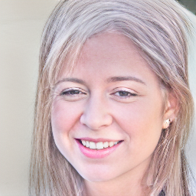
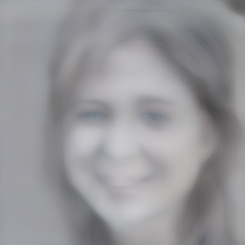
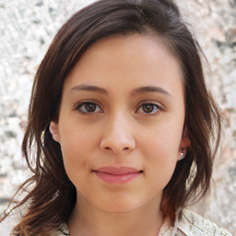
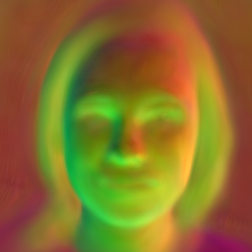
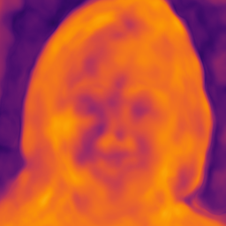
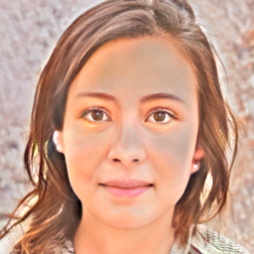
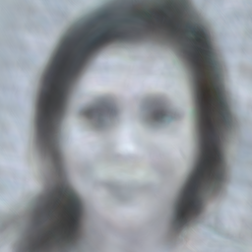
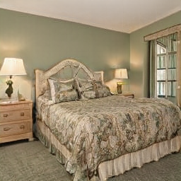
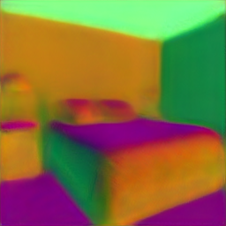
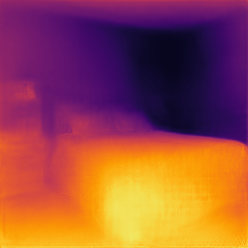
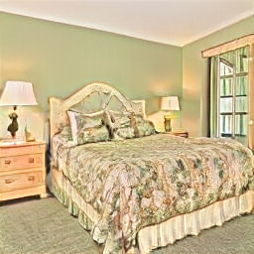
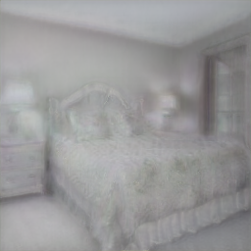
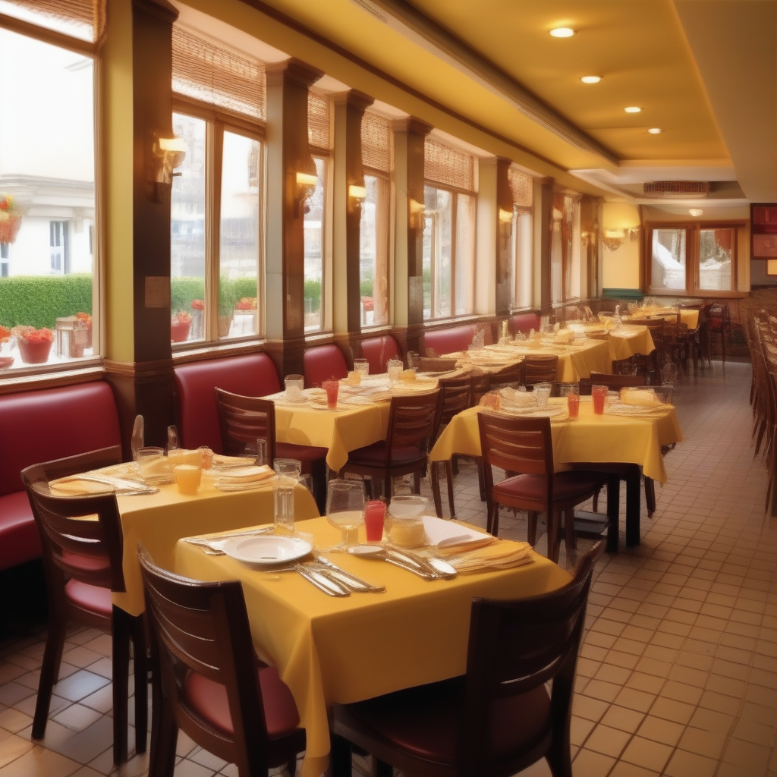
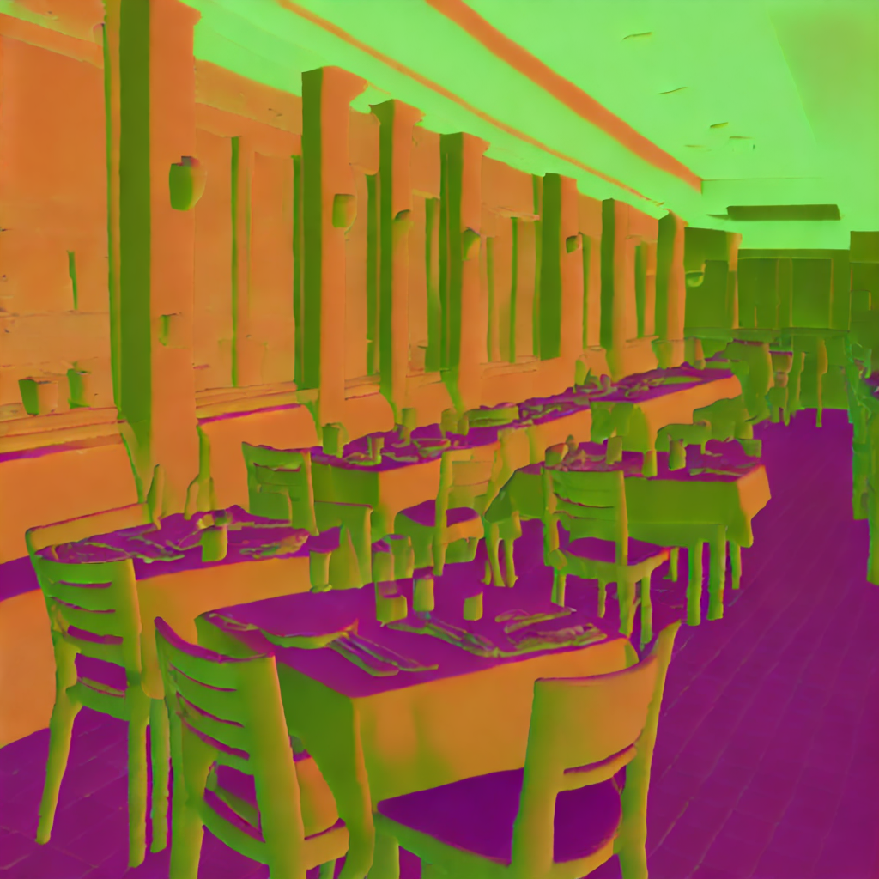
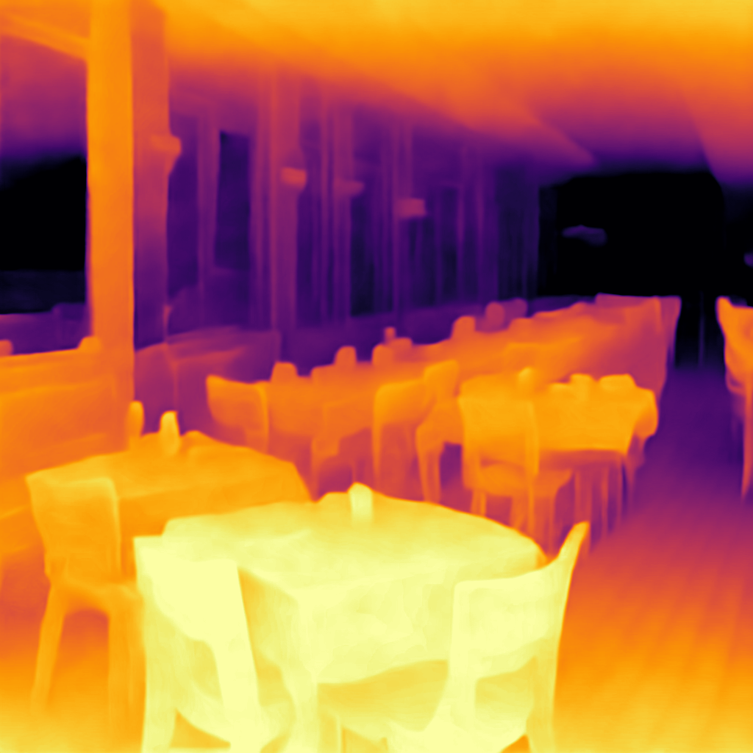
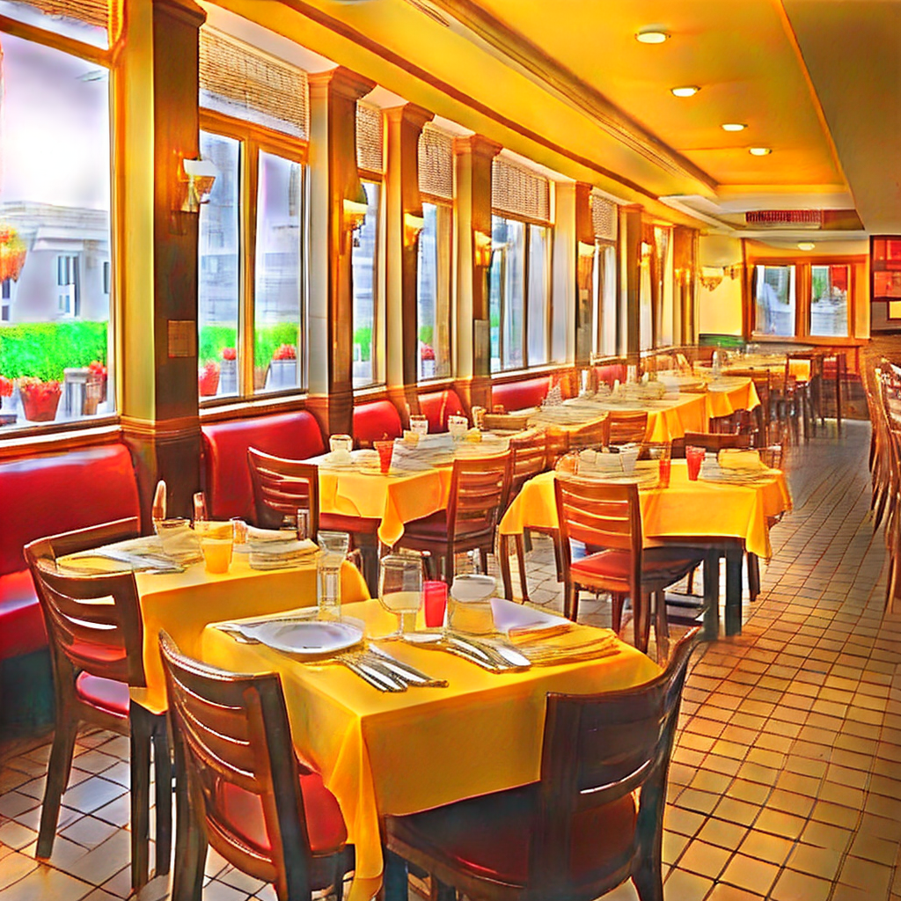
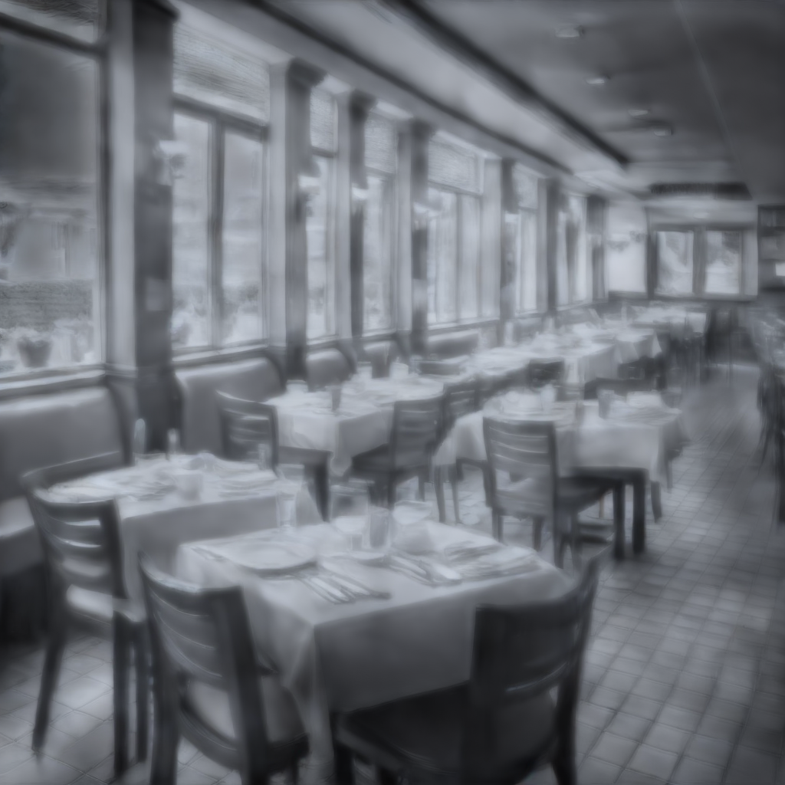
Image
Normals
Depth
Albedo
Shading
Image
Normals
Depth
Albedo
Shading
VQGAN FFHQ (Autoregressive)
StyleGAN-XL FFHQ (GAN)
Image
Normals
Depth
Albedo
Shading
StyleGAN-v2 LSUN Bedroom (GAN)
Image
Normals
Depth
Albedo
Shading
Stable Diffusion 2.1 (Diffusion)
Du, … , Bhattad. CVPR-W 2024

Slide 10
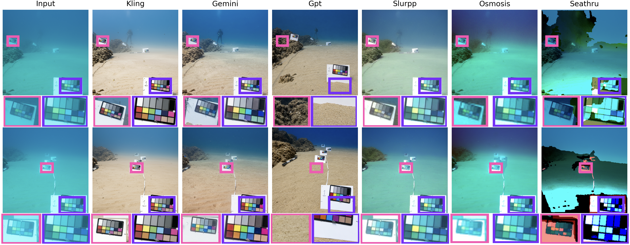
They know about water physics...(?!?)
Vision Language Models
Models using physical inference
Aghajanzadeh et al, in prep

Slide 11
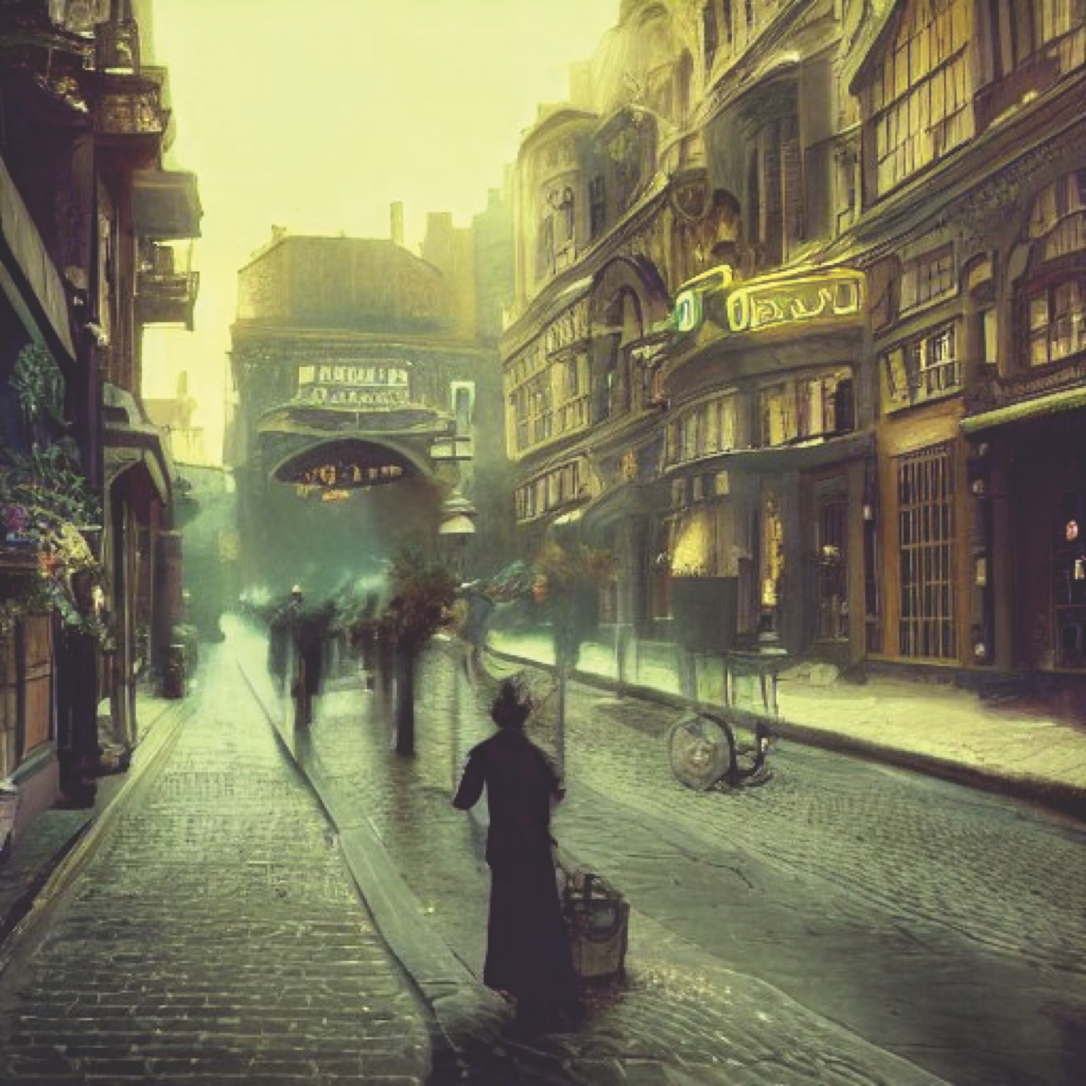
Errors: iffy projective geometry
https://huggingface.co/spaces/stabilityai/stable-diffusion/discussions/1593

Slide 12
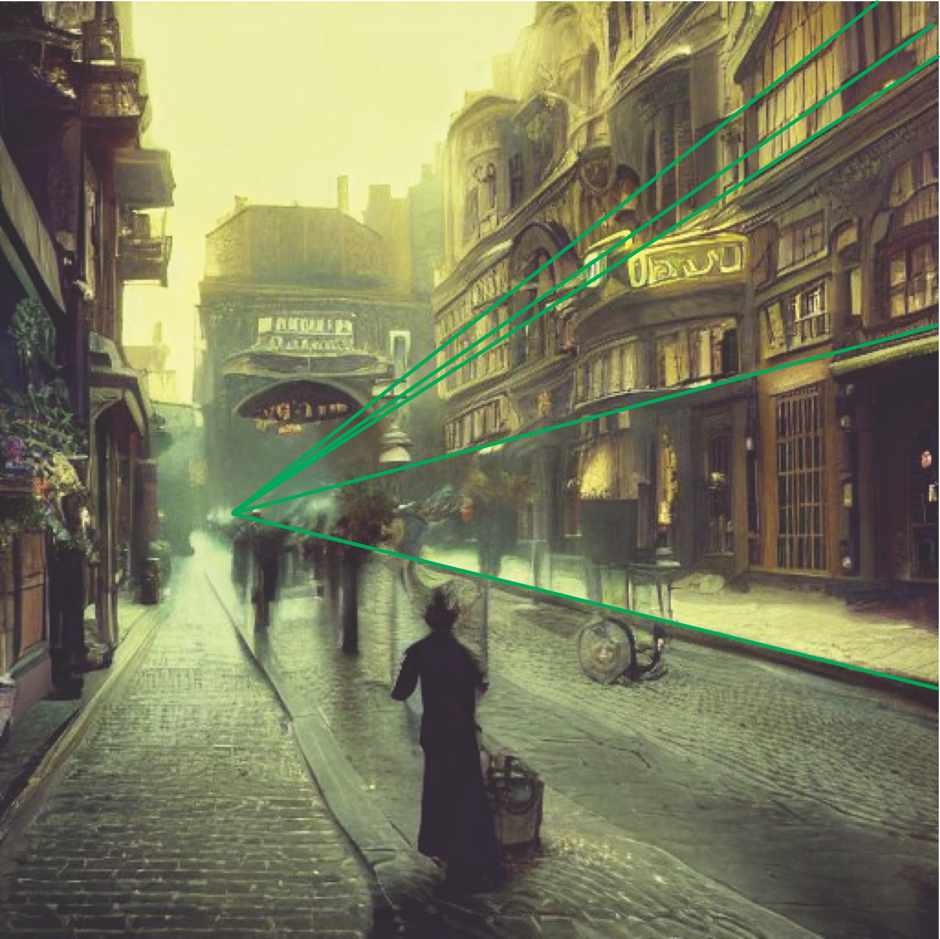
Errors: iffy projective geometry
https://huggingface.co/spaces/stabilityai/stable-diffusion/discussions/1593

Slide 13
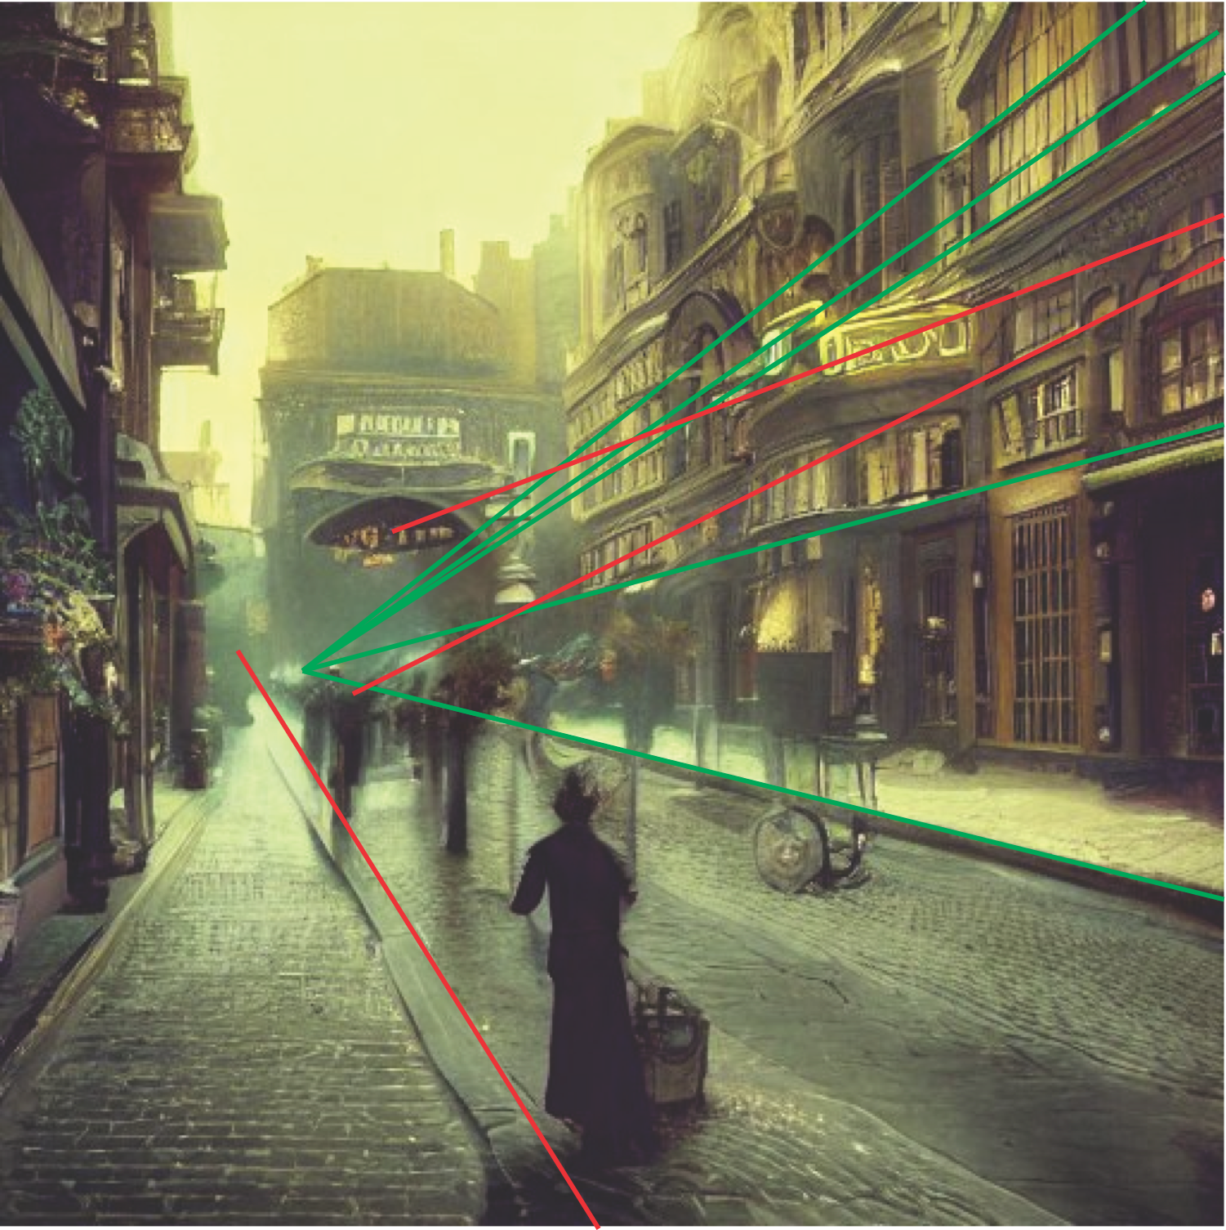
Errors: iffy projective geometry
https://huggingface.co/spaces/stabilityai/stable-diffusion/discussions/1593

Slide 14
Q: real or fake?

Slide 15
Scale
relative to
bear

Slide 16
He’s got
someone
else’s nose!
Scale
relative to
politician

Slide 17
Do the mistakes matter?
Yes
  if you care about understanding things
No
  if you’re making weird political posters, etc.
This is not the behavior of people who are carefully creating traditional software. This is the behavior of people who are growing a whole new sort of creature and then taking whatever they get.
AI Is Grown, Not Built
(Nobody knows exactly what an AI will become. That’s very bad.)
By Eliezer Yudkowsky and Nate Soares, The Atlantic

Slide 18
Main points
Increasingly large encoders can do increasingly more stuff
Easy to bodge large encoders together with language models
Quite a lot of evidence that surprising outcomes emerge
  Why surprising?
    Actually, we have very little basis to know what to expect
This may be pricing itself out of almost any market

Slide 19
Big Picture
Train models using both images and text
Models should
  accept text/images, produce text/images
  answer questions about images
Advantages
  extremely rich training opportunities
    for a general vision encoder
  lever text descriptions of objects to build detectors
    particularly important for rare or unseen objects
      a version of distributional semantics
An Introduction to Vision-Language Modeling
Bordes et al, 2024

Slide 20
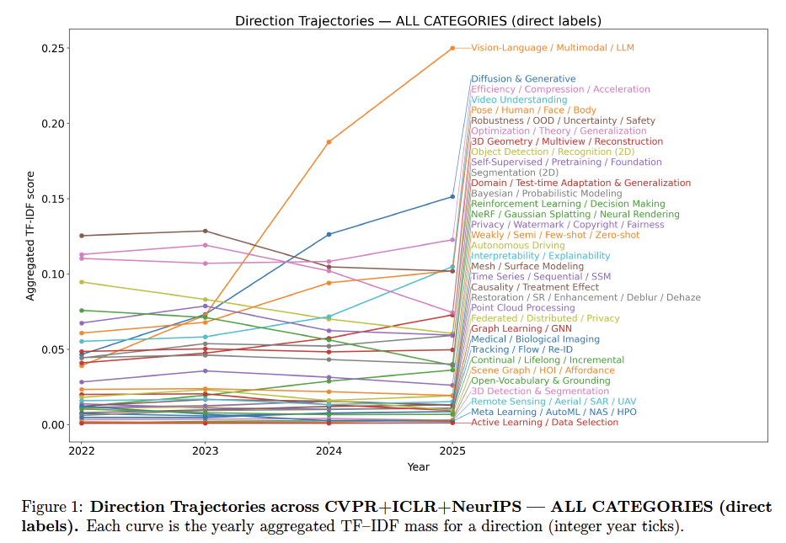
Vision Language Models: A Survey of 26K Papers (CVPR, ICLR, NeurIPS 2023–2025), Lin, 2025

Slide 21
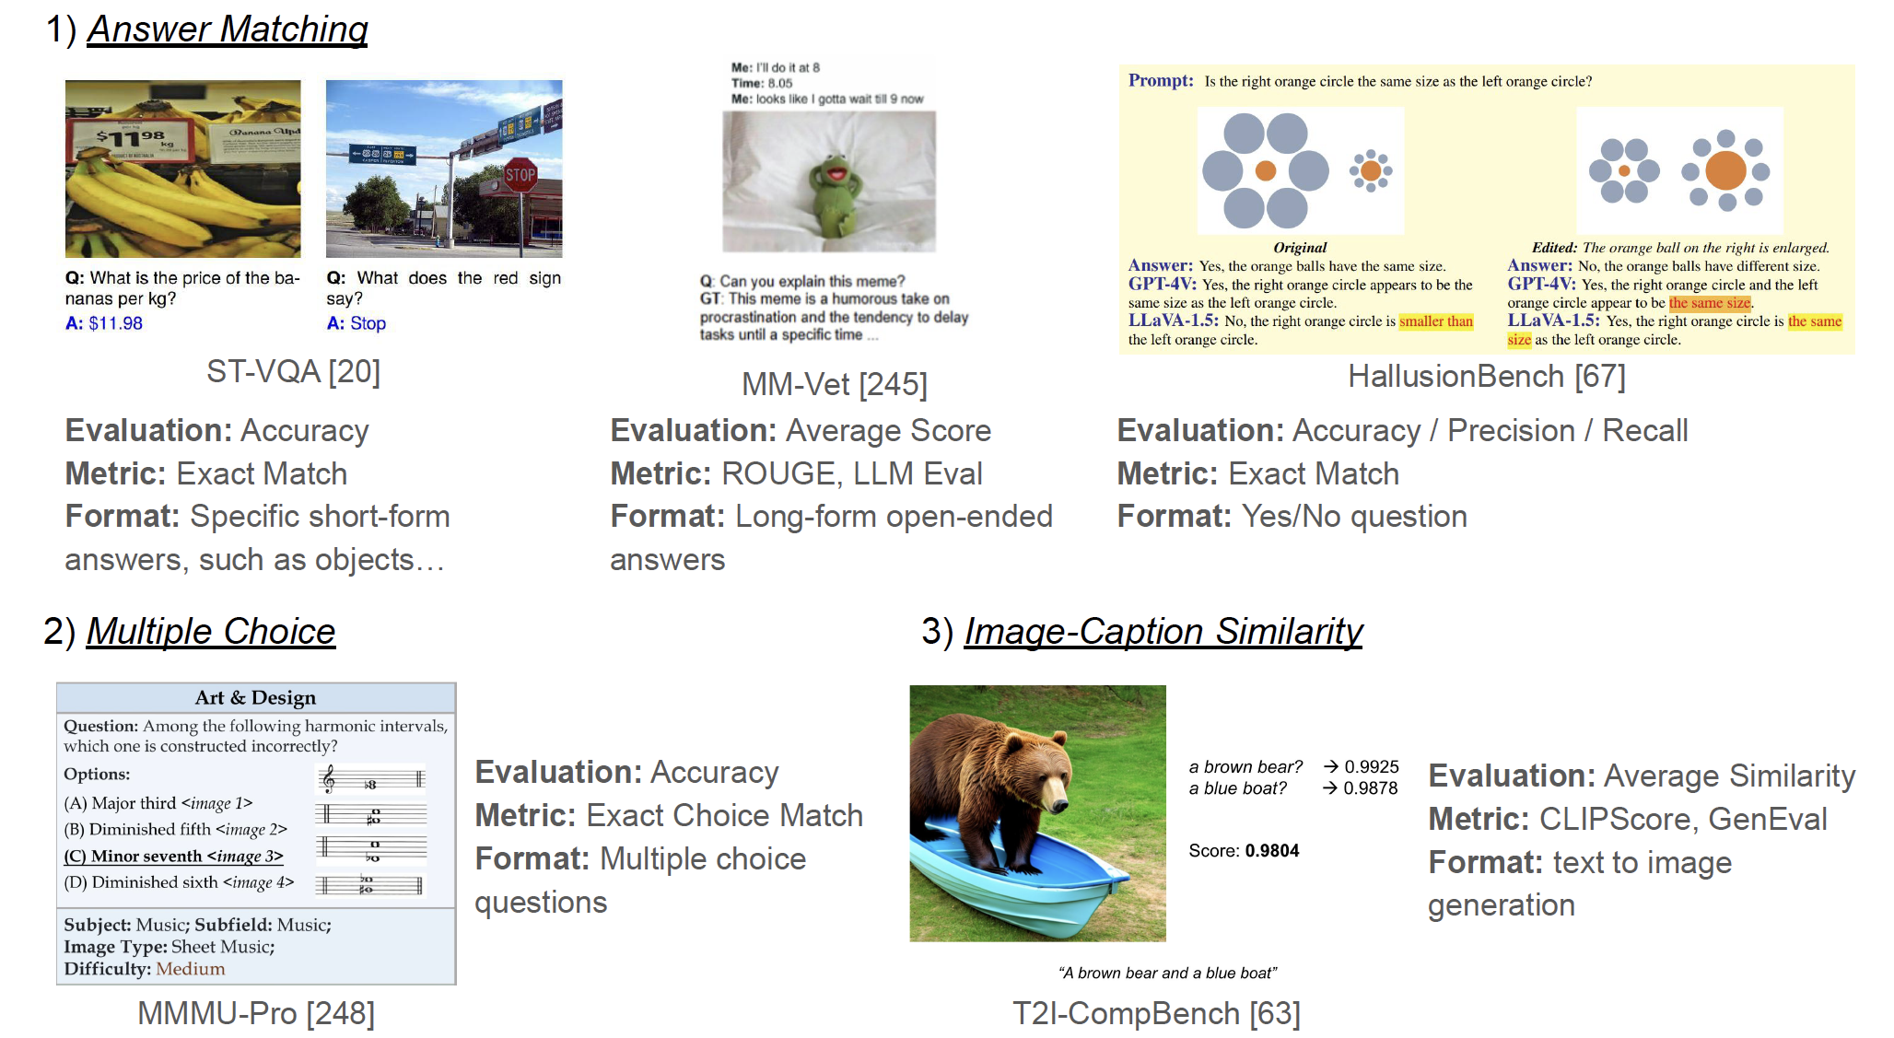
Evaluation strategies - I
A Survey of State of the Art Large Vision Language Models: Alignment,
Benchmark, Evaluations and Challenges, Li et al, 2025

Slide 22
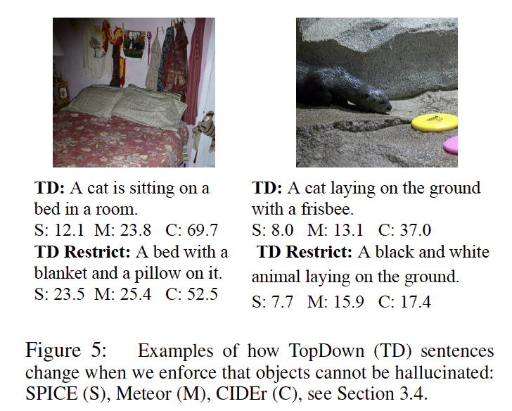
Nuisances: hallucination
Cure strategy: force entities in captions to have corresponding detector responses
Object Hallucination in Image Captioning, Rohrbach et al 2019

Slide 23
Main points
Low/efficient compute vision is hugely important
  and will likely continue to diversify
Much future action will be here

Slide 24
Very hard open questions
Transformers are super
  but ludicrously expensive and hard to train
  is there something better?
Big models can do more stuff than little models
  why?
  so what?
Could you learn to produce low-compute models?
Train a model
  What do you “expect it to know”?
  What do you “not expect it to know”?
Vision routinely breaks “the rules” of machine learning
  very little bad happens – why?

