Slide 1
Stereo-like active depth
D.A. Forsyth
University of Illinois at Urbana Champaign

Slide 2

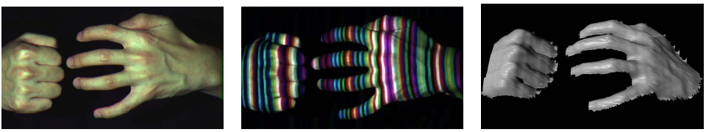
Active stereo with structured light
Project “structured” light patterns onto the object
  Simplifies the correspondence problem
  Allows us to use only one camera
camera
projector
L. Zhang, B. Curless, and S. M. Seitz. Rapid Shape Acquisition Using Color Structured Light and Multi-pass Dynamic Programming. 3DPVT 2002

Slide 3
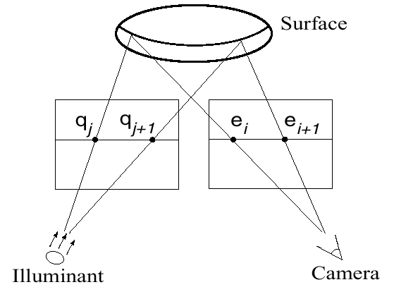
Active stereo with structured light
L. Zhang, B. Curless, and S. M. Seitz. Rapid Shape Acquisition Using Color Structured Light and Multi-pass Dynamic Programming. 3DPVT 2002

Slide 4
Active stereo with structured light
http://en.wikipedia.org/wiki/Structured-light_3D_scanner

Slide 5
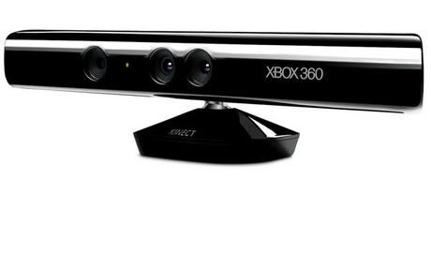
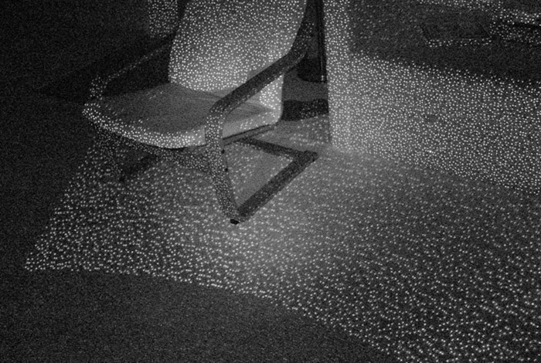
Kinect: Structured infrared light
http://bbzippo.wordpress.com/2010/11/28/kinect-in-infrared/

Slide 6
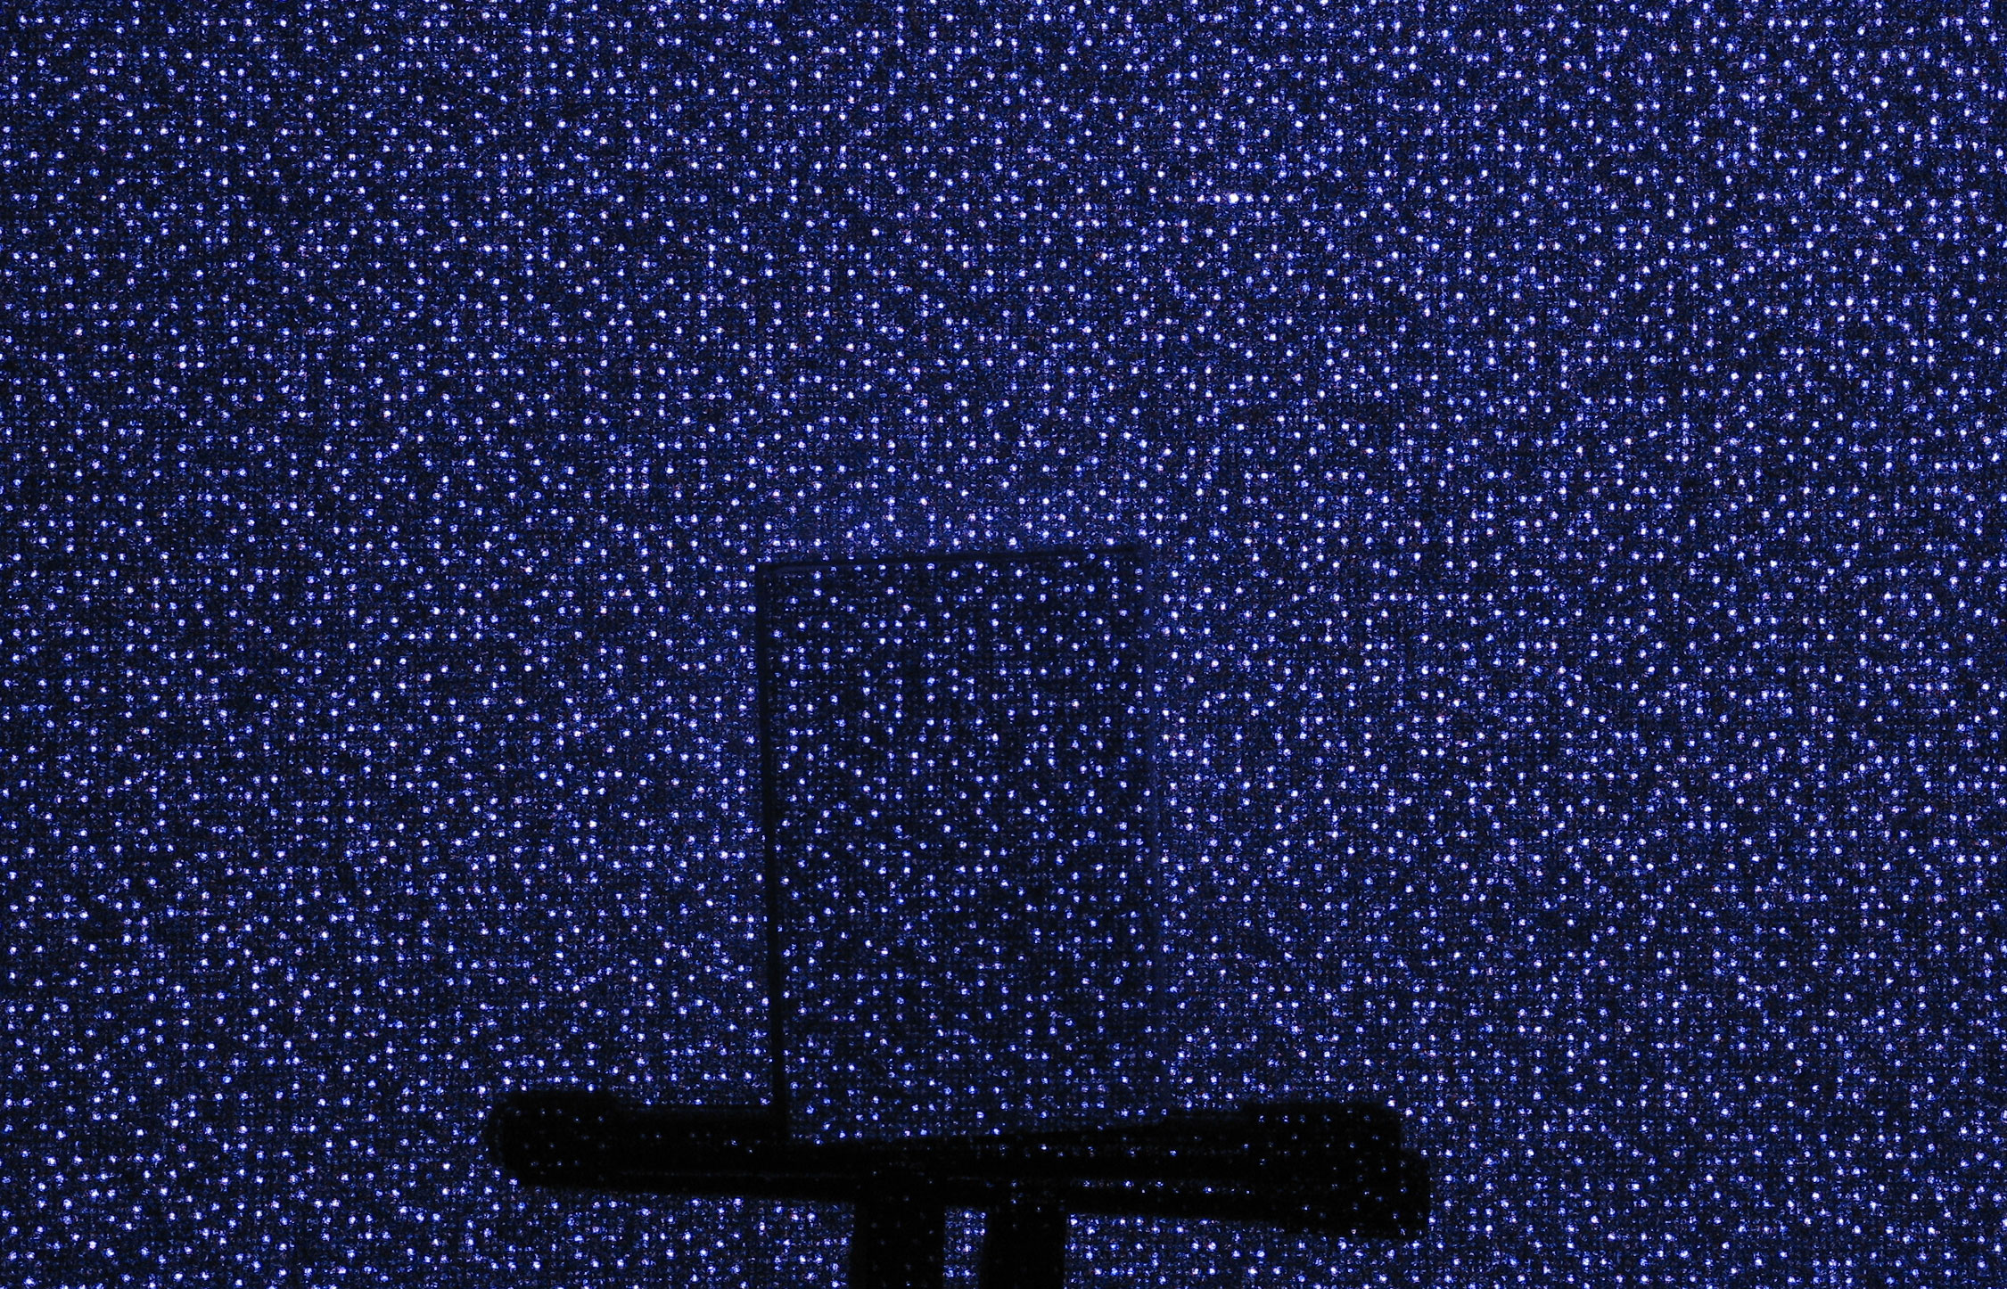
Example: Book vs. No Book
Source (via D. Hoiem)

Slide 7
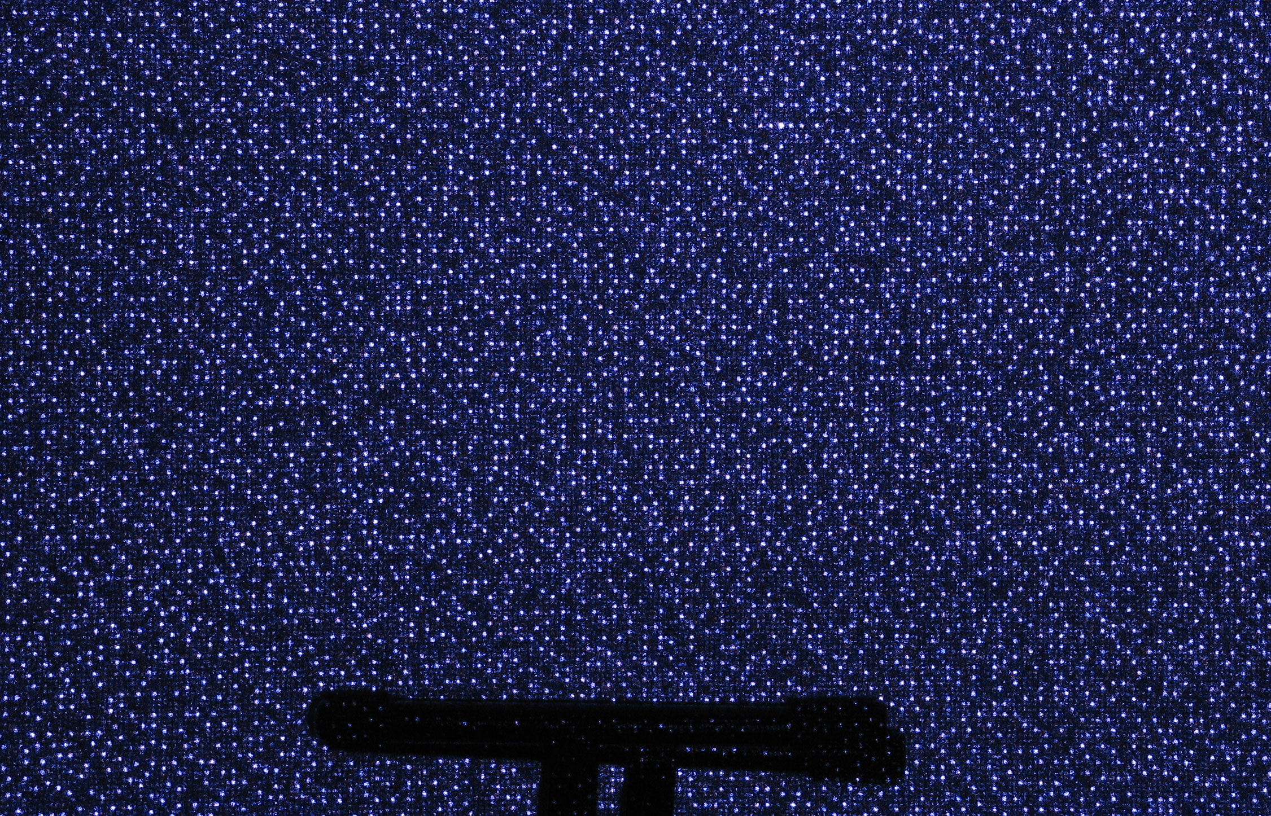
Example: Book vs. No Book
Source (via D. Hoiem)

Slide 8
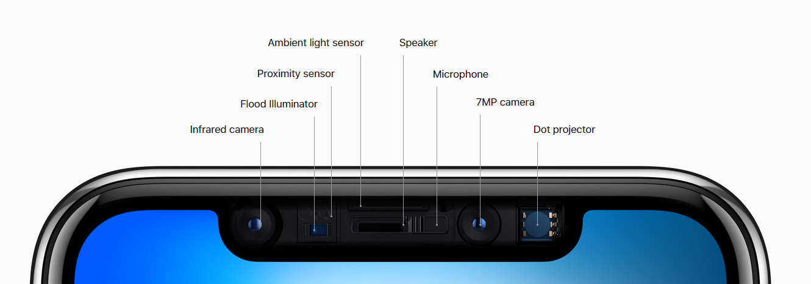

Apple TrueDepth
https://www.cnet.com/news/apple-face-id-truedepth-how-it-works/

Slide 9
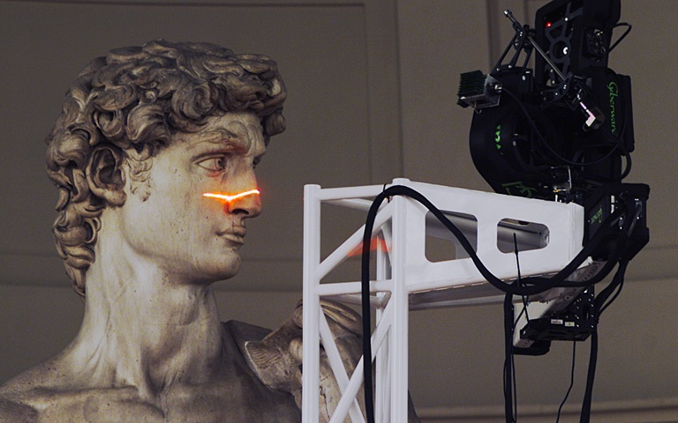
Laser scanning
Digital Michelangelo Project
Levoy et al.
http://graphics.stanford.edu/projects/mich/
Optical triangulation
  Project a single stripe of laser light
  Scan it across the surface of the object
  This is a very precise version of structured light scanning
Source: S. Seitz

Slide 10
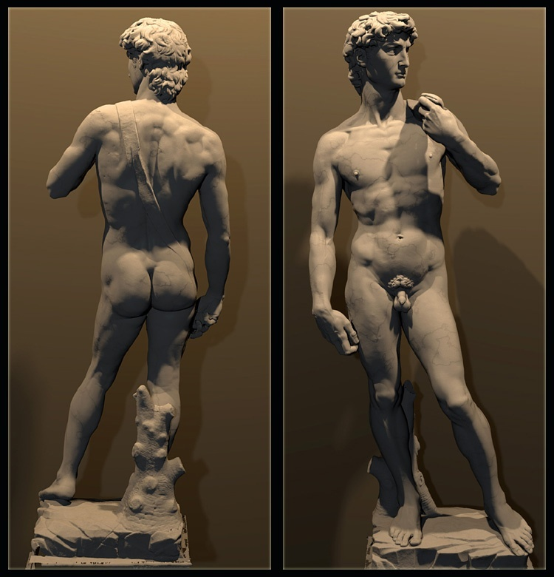
Laser scanned models
  The Digital Michelangelo Project, Levoy et al.
Source: S. Seitz

Slide 11

Laser scanned models
  The Digital Michelangelo Project, Levoy et al.
Source: S. Seitz

Slide 12
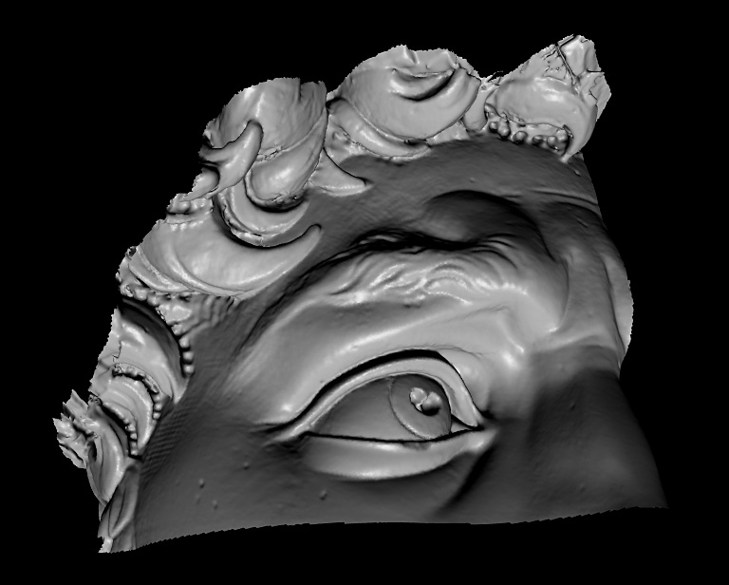
Laser scanned models
  The Digital Michelangelo Project, Levoy et al.
Source: S. Seitz

Slide 13
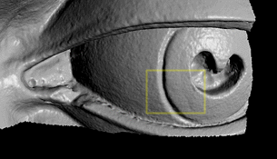
Laser scanned models
  The Digital Michelangelo Project, Levoy et al.
Source: S. Seitz

Slide 14
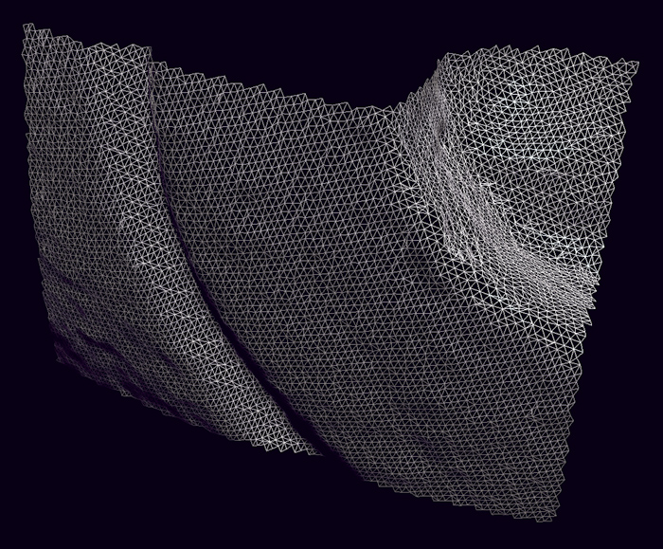
Laser scanned models
1.0 mm resolution (56 million triangles)
  The Digital Michelangelo Project, Levoy et al.
Source: S. Seitz

Slide 15
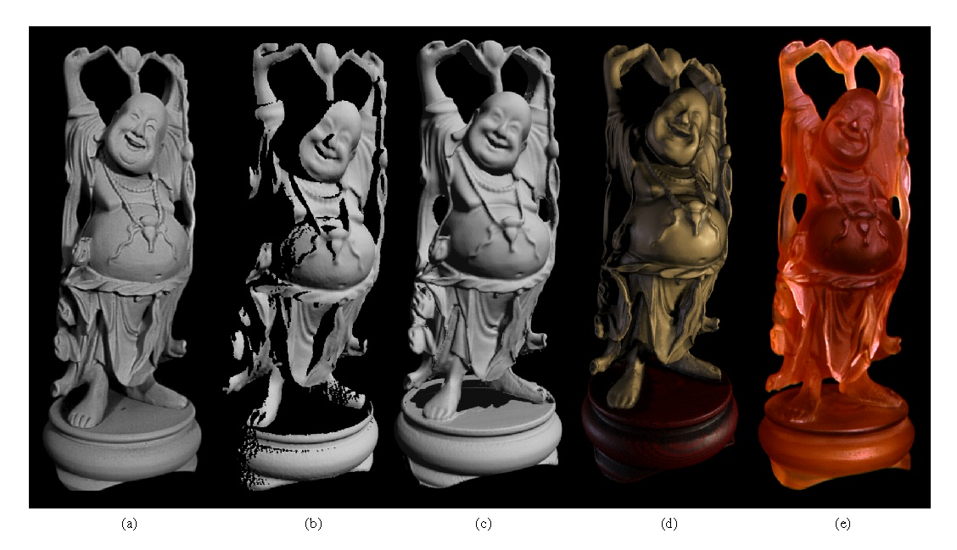
Aligning range images
A single range scan is not sufficient to capture a complex surface
Need techniques to register multiple range images
B. Curless and M. Levoy, A Volumetric Method for Building Complex Models from Range Images, SIGGRAPH 1996

Slide 16
Aligning range images
A single range scan is not sufficient to capture a complex surface
Need techniques to register multiple range images

