Slide 1
Camera calibration:
Calibration from vanishing points
D.A. Forsyth
University of Illinois at Urbana Champaign

Slide 2
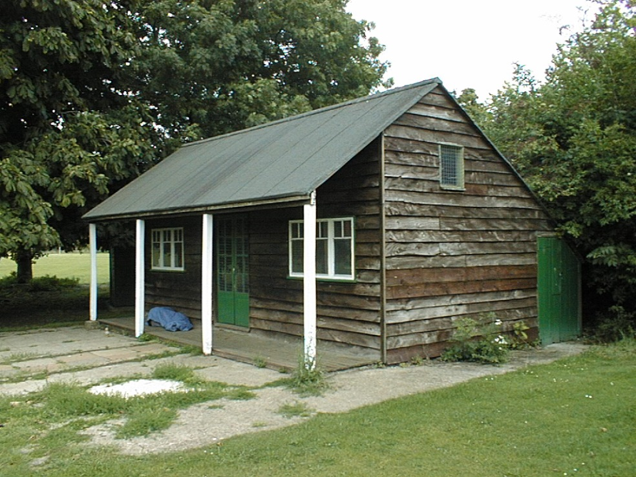
Calibration using vanishing points
Can sometimes calibrate from vanishing points
Source: A. Efros, A. Criminisi

Slide 3
Calibration using vanishing points
Can sometimes calibrate from vanishing points
Vertical vanishing
point
Vanishing
line
Vanishing
point
Vanishing
point
Source: A. Efros, A. Criminisi

Slide 4

Review: Vanishing points
image plane
vanishing point$v$
line in the scene
camera
center
All lines having the same direction share the same vanishing point

Slide 5

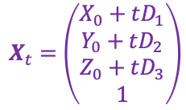


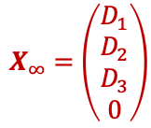
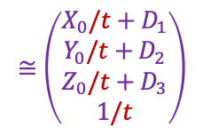
Computing vanishing points
$$v$$
$$X_{t}$$
$$X_{0}$$
Line is
$$X_{t}=\left(\begin{aligned}X_{0}+tD_{1} \\ Y_{0}+tD_{2} \\ Z_{0}+tD_{3} \\ 1\end{aligned}\right)$$
$$≅\left(\begin{aligned}X_{0}/t+D_{1} \\ Y_{0}/t+D_{2} \\ Z_{0}/t+D_{3} \\ 1/t\end{aligned}\right)$$
$$X_{∞}=\left(\begin{aligned}D_{1} \\ D_{2} \\ D_{3} \\ 0\end{aligned}\right)$$
$X∞$ is a point at infinity, $v$ is its projection: $v≅PX∞$

Slide 6
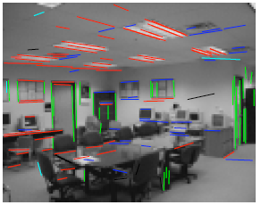




Calibration from vanishing points
Consider a scene with three orthogonal vanishing directions:
Here: $v1$, $v2$ are finite vanishing points and $v3$ is an infinite vanishing point
.
.
$$v1$$
$$v2$$
$$v3$$
Notes:
The third homogeneous coordinate of an infinite vanishing point is 0. Infinite vanishing points correspond to directions of lines that are parallel to the image plane.

Slide 7
Calibration from vanishing points
Consider a scene with three orthogonal vanishing directions:
We can align the world coordinate system with these directions
.
.
$$v1$$
$$v2$$
$$v3$$

Slide 8


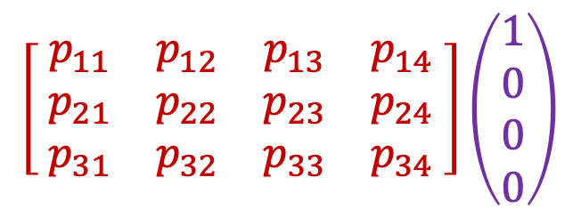



Projection of the world coordinate system
$$\left[\begin{matrix}{ p}_{11} & p_{12} & p_{13} & p_{14} \\ { p}_{21} & p_{22} & p_{23} & p_{24} \\ { p}_{31} & p_{32} & p_{33} & p_{34} \end{matrix}\right]\left(\begin{aligned}1 \\ 0 \\ 0 \\ 0\end{aligned}\right)$$
$$=p_{1}$$
$$p_{1}$$
$$p_{2}$$
$$p_{3}$$
$$p_{4}$$

Slide 9

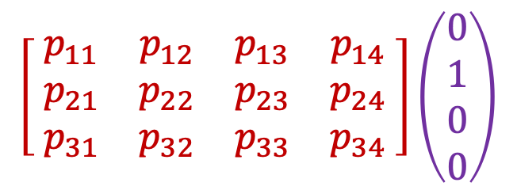
Projection of the world coordinate system
$$\left[\begin{matrix}{ p}_{11} & p_{12} & p_{13} & p_{14} \\ { p}_{21} & p_{22} & p_{23} & p_{24} \\ { p}_{31} & p_{32} & p_{33} & p_{34} \end{matrix}\right]\left(\begin{aligned}0 \\ 1 \\ 0 \\ 0\end{aligned}\right)$$
$$=p_{2}$$
$$p_{1}$$
$$p_{2}$$
$$p_{3}$$
$$p_{4}$$

Slide 10


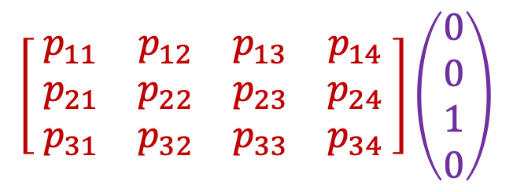
Projection of the world coordinate system
$$\left[\begin{matrix}{ p}_{11} & p_{12} & p_{13} & p_{14} \\ { p}_{21} & p_{22} & p_{23} & p_{24} \\ { p}_{31} & p_{32} & p_{33} & p_{34} \end{matrix}\right]\left(\begin{aligned}0 \\ 0 \\ 1 \\ 0\end{aligned}\right)$$
$$=p_{3}$$
$$p_{1}$$
$$p_{2}$$
$$p_{3}$$
$$p_{4}$$
Vanishing points in
$x$, $y$, $z$ directions
(i.e., $v1$, $v2$, $v3$)

Slide 11

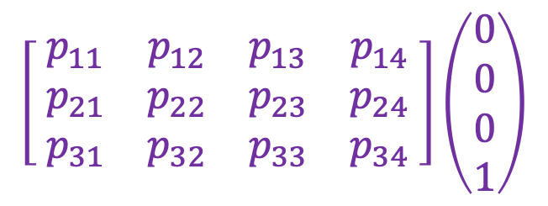
Projection of the world coordinate system
$$\left[\begin{matrix}{ p}_{11} & p_{12} & p_{13} & p_{14} \\ { p}_{21} & p_{22} & p_{23} & p_{24} \\ { p}_{31} & p_{32} & p_{33} & p_{34} \end{matrix}\right]\left(\begin{aligned}0 \\ 0 \\ 0 \\ 1\end{aligned}\right)$$
$$=p_{4}$$
$$p_{1}$$
$$p_{2}$$
$$p_{3}$$
$$p_{4}$$
Vanishing points in
$x$, $y$, $z$ directions
(i.e., $v1$, $v2$, $v3$)
Projection of world origin
Problem: this only gives us the four columns up to independent scale factors, additional constraints needed to solve for them

Slide 12
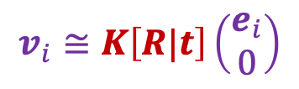



Calibration from vanishing points
Align the world coordinate system with three orthogonal vanishing directions in the scene:
$e_{1}=\left(\begin{aligned}1 \\ 0 \\ 0\end{aligned}\right),$ $e_{2}=\left(\begin{aligned}0 \\ 1 \\ 0\end{aligned}\right), e_{3}=\left(\begin{aligned}0 \\ 0 \\ 1\end{aligned}\right)$
$$v_{i}≅K\left[R|t\right]\left(\begin{aligned}e_{i} \\ 0\end{aligned}\right)$$
$$v_{i}≅KRe_{i}$$
$$e_{i}≅R^{T}K^{−1}v_{i}$$

Slide 13

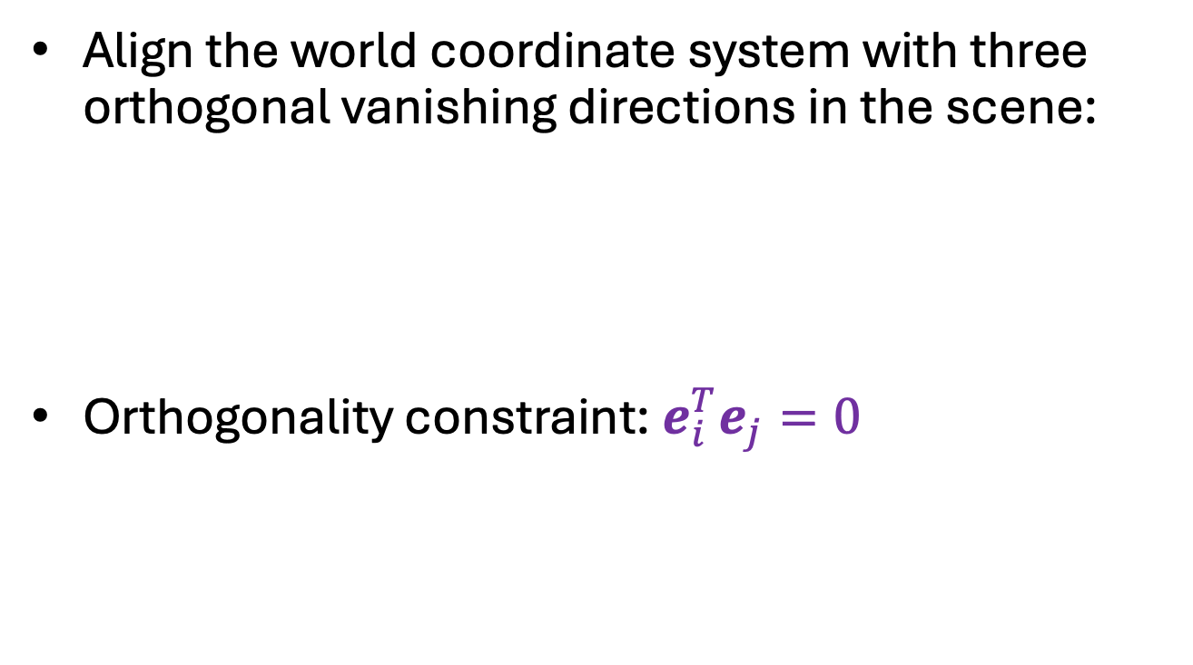



Calibration from vanishing points
Align the world coordinate system with three orthogonal vanishing directions in the scene:
Orthogonality constraint: $e_{i}^{T}e_{j}=0$
$$v_{i}≅KRe_{i}$$
$$e_{i}≅R^{T}K^{−1}v_{i}$$
$$v_{i}^{T}K^{−T}RR^{T}K^{−1}v_{j}=0$$
$$v_{i}^{T}K^{−T}K^{−1}v_{j}=0$$
Constraint on K,
- Free with three
vanishing points

Slide 14
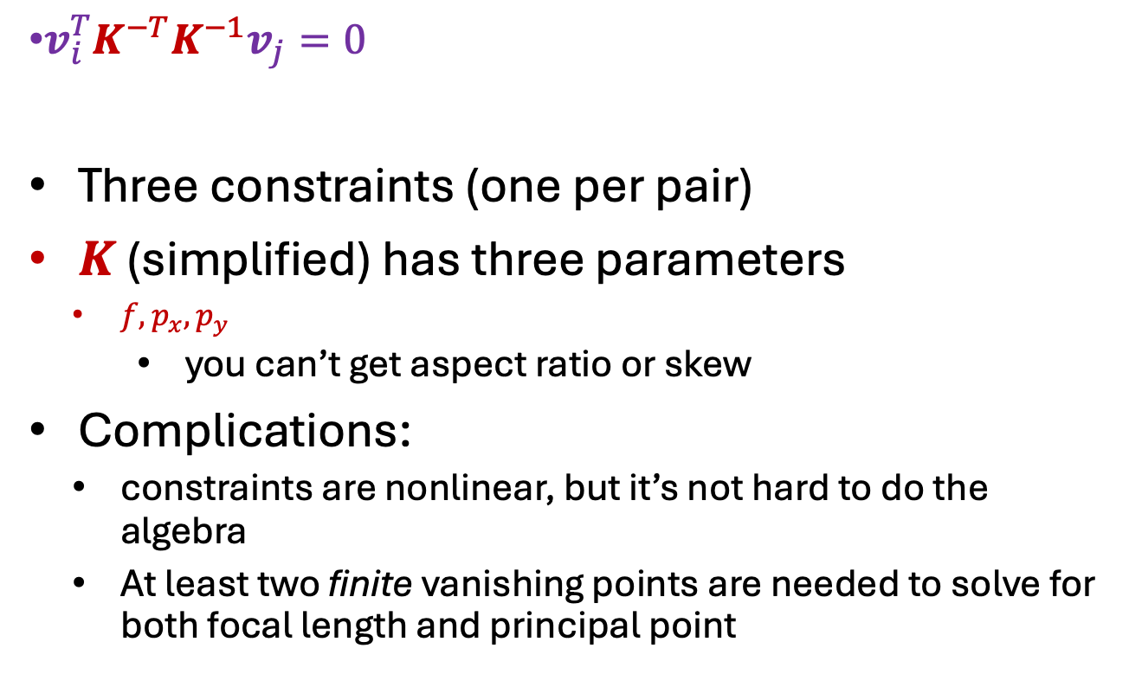
Calibration from vanishing points
$v_{i}^{T}K^{−T}K^{−1}v_{j}=0$
Three constraints (one per pair)
$K$ (simplified) has three parameters
  $f,p_{x},p_{y}$
    you can’t get aspect ratio or skew
Complications:
  constraints are nonlinear, but it’s not hard to do the algebra
  At least two finite vanishing points are needed to solve for both focal length and principal point

Slide 15
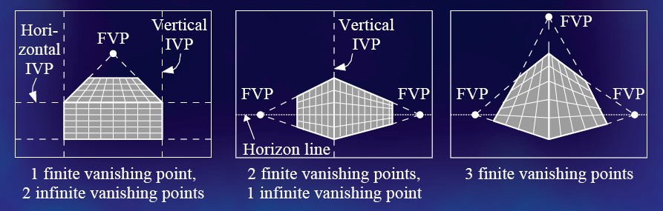
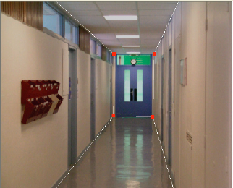
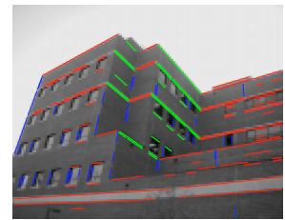
Calibration from vanishing points
Cannot recover focal length, principal point is the third vanishing point
Can solve for focal length, principal point

Slide 16

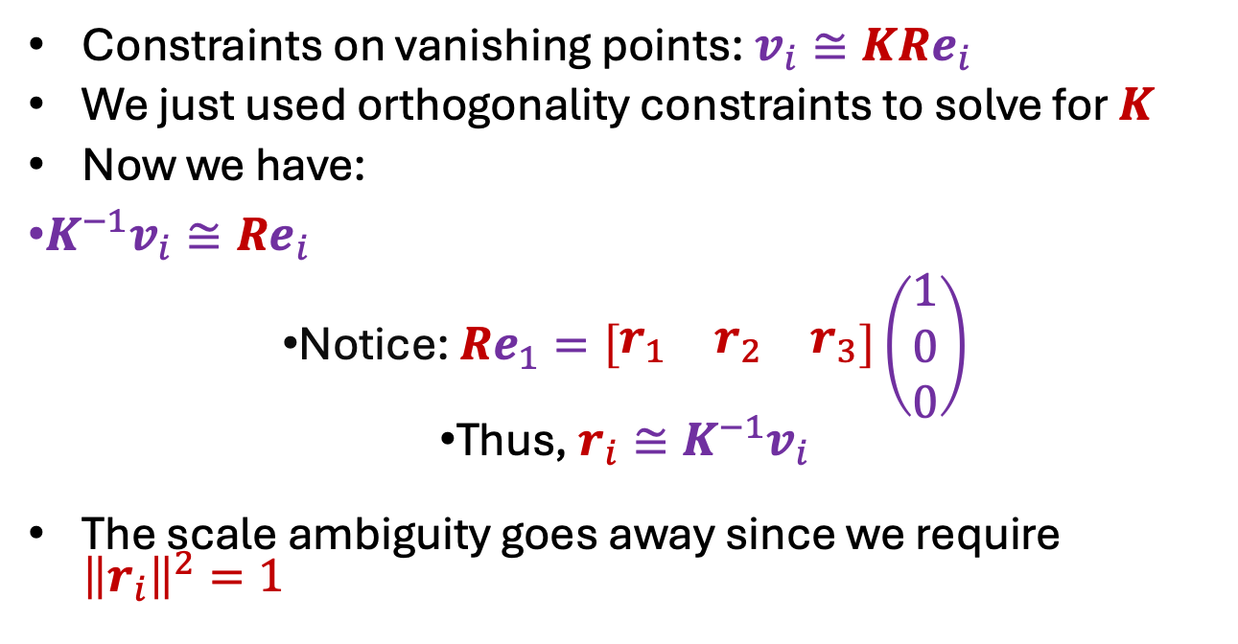
Rotation from vanishing points
Constraints on vanishing points: $v_{i}≅KRe_{i}$
We just used orthogonality constraints to solve for $K$
Now we have:
$K^{−1}v_{i}≅Re_{i}$
Notice: $Re_{1}=\left[\begin{matrix}r_{1} & r_{2} & r_{3}\end{matrix}\right]\left(\begin{aligned}1 \\ 0 \\ 0\end{aligned}\right)$
Thus, $r_{i}≅K^{−1}v_{i}$
The scale ambiguity goes away since we require ${\left\|r_{i}\right\|}^{2}=1$
$$=r_{1}$$

Slide 17
Calibration from vanishing points: Summary
Solve for intrinsic parameters (focal length, principal point) using three orthogonal vanishing points
Get extrinsic parameters (rotation) directly from vanishing points once calibration matrix is known
Advantages
  No need for calibration chart, 2D-3D correspondences
  Could be completely automatic
Disadvantages
  Only applies to certain kinds of scenes
  It is tricky to accurately localize vanishing points
  Need at least two finite vanishing points

