Slide 1
Calibrating Cameras
D.A. Forsyth,
University of Illinois at Urbana-Champaign

Slide 2
Calibration
Procedure
  View N known reference points in 3D
  Obtain locations in image plane
  Produce
    Camera intrinsics and extrinsics
Why
  recovering intrinsics for future use
  where is an object/camera in the camera/world frame?
How
  Optimization: minimize reprojection error

Slide 3
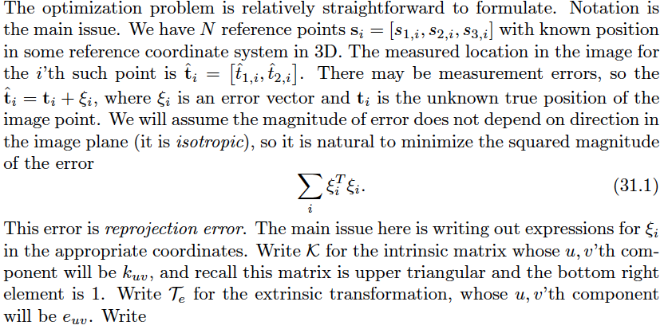
Notation

Slide 4
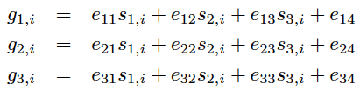
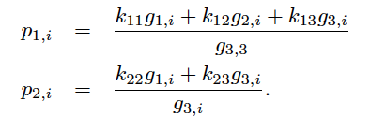
Predicting the points
Reference points transformed by extrinsics
Now apply camera transformation and intrinsics

Slide 5
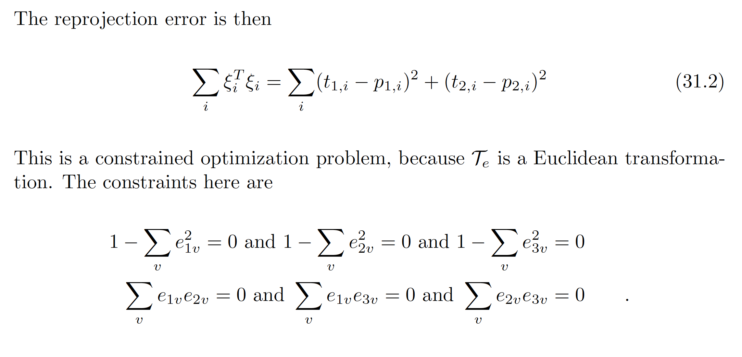
Optimization problem

Slide 6
Strategies
Chuck it into an optimizer and run
  AAARGH!
Find a good start point
  all works out
Variants
  Different point locations; points on plane; etc., etc.

