Slide 1
Cameras and simple geometry
D.A. Forsyth,
University of Illinois at Urbana Champaign

Slide 2
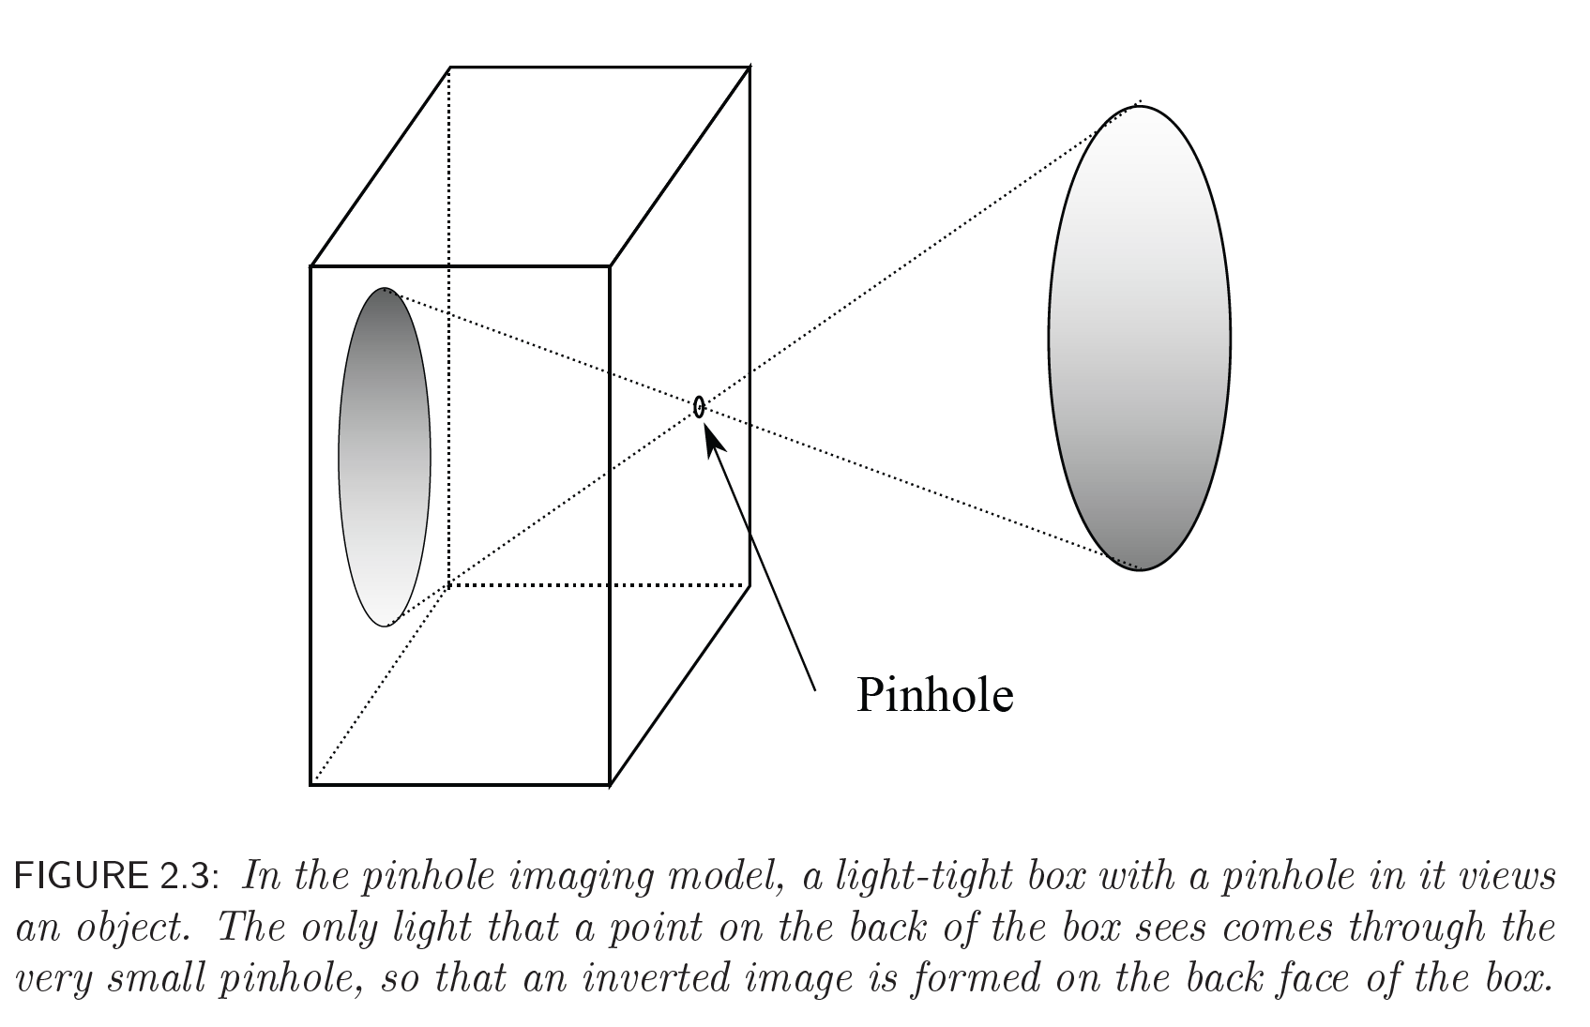
A Pinhole Camera

Slide 3
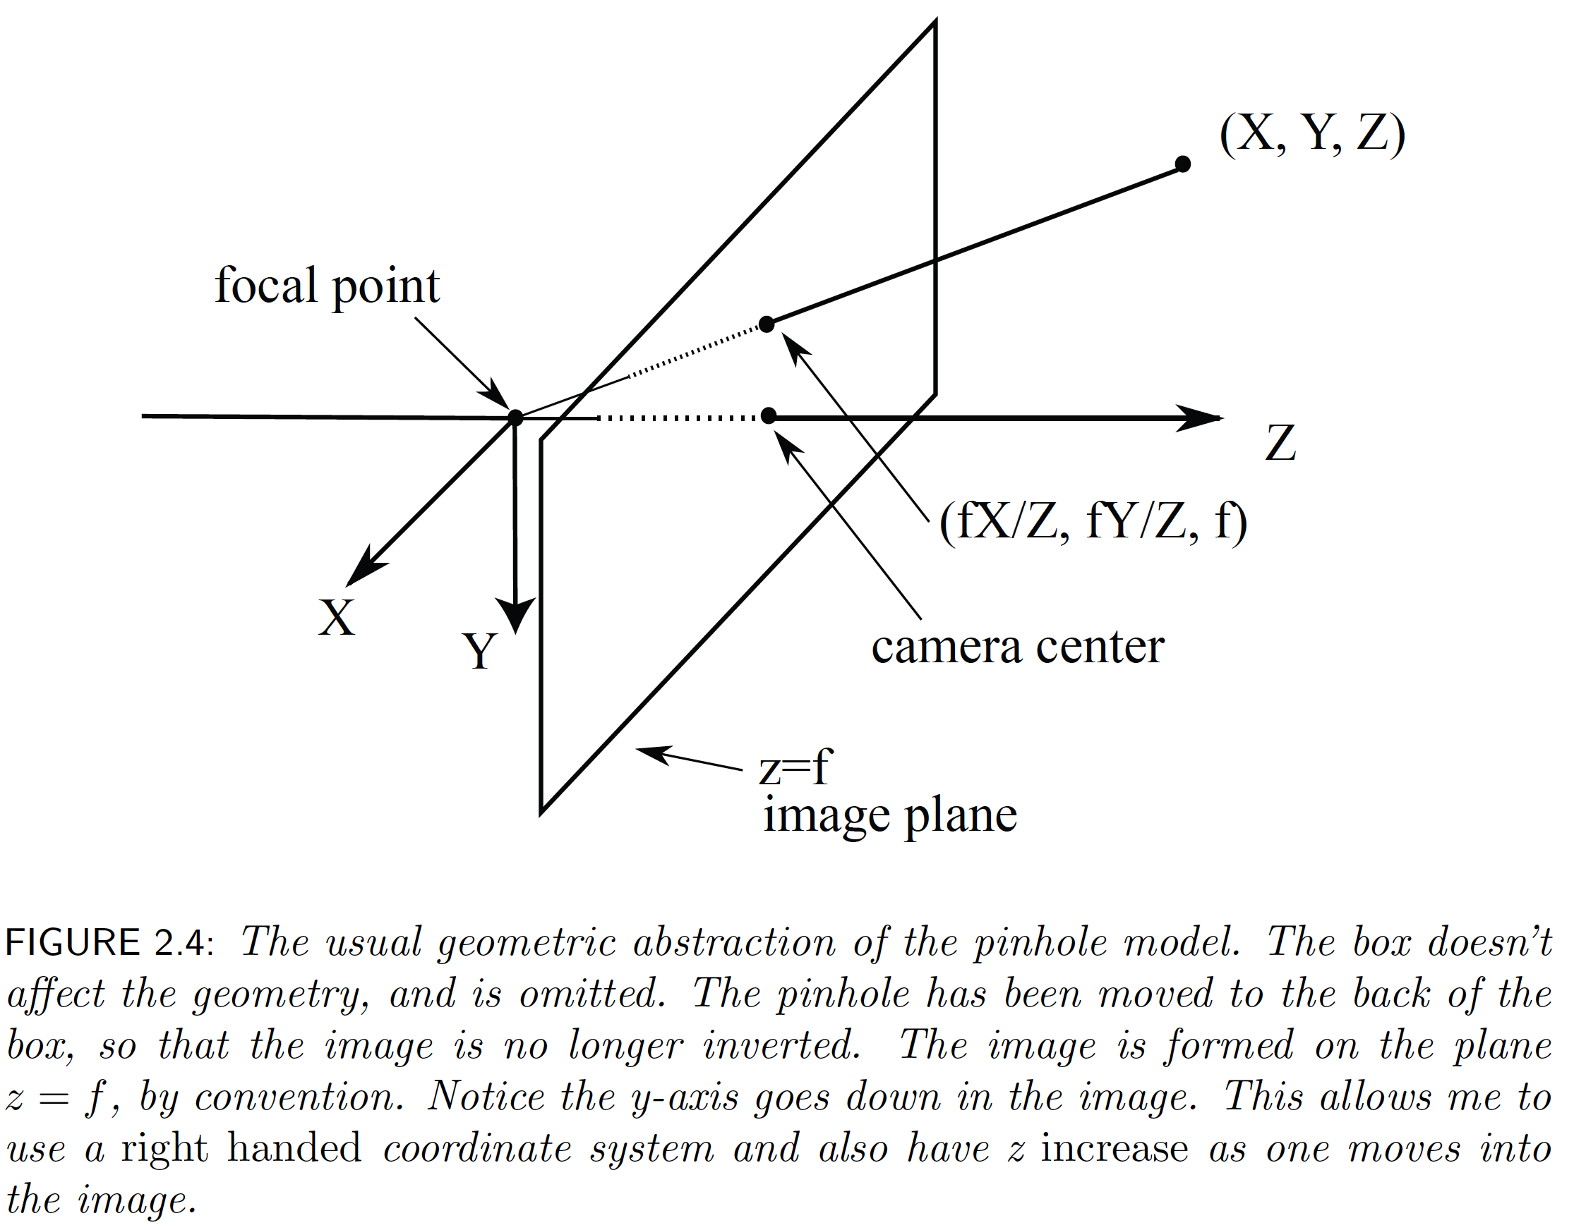
The Pinhole Camera

Slide 4
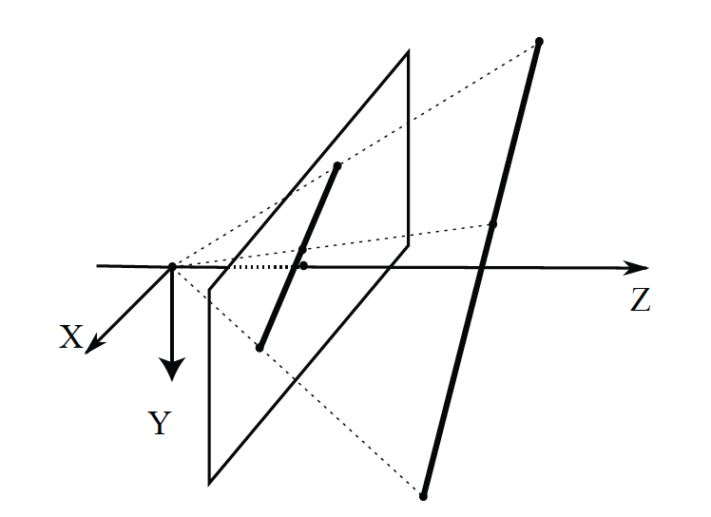
Lines project to lines

Slide 5
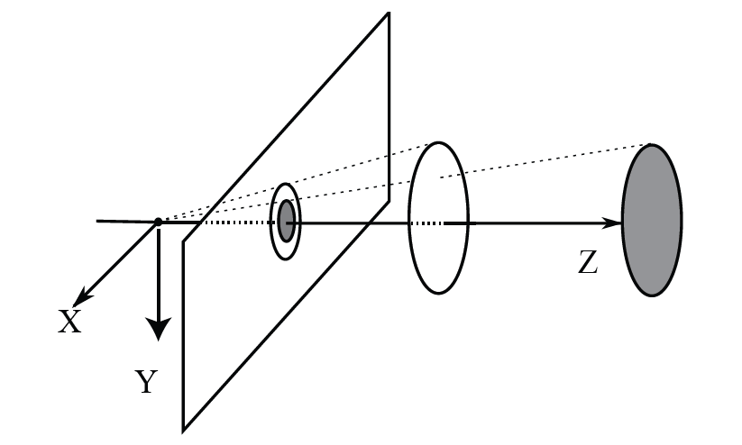
Further objects are smaller

Slide 6
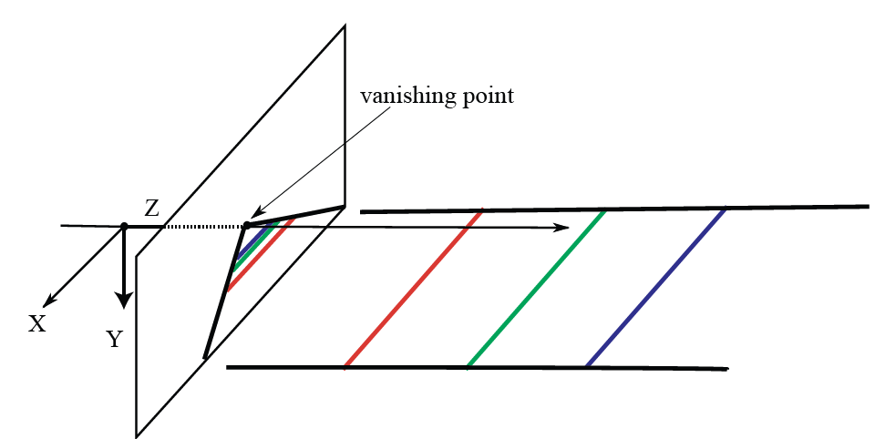
Parallel lines have vanishing points

Slide 7
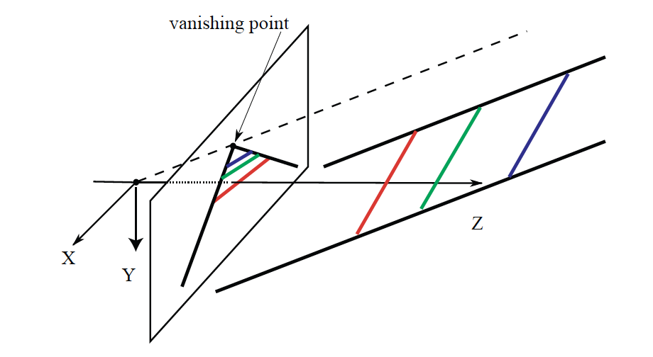
Parallel lines have vanishing points

Slide 8
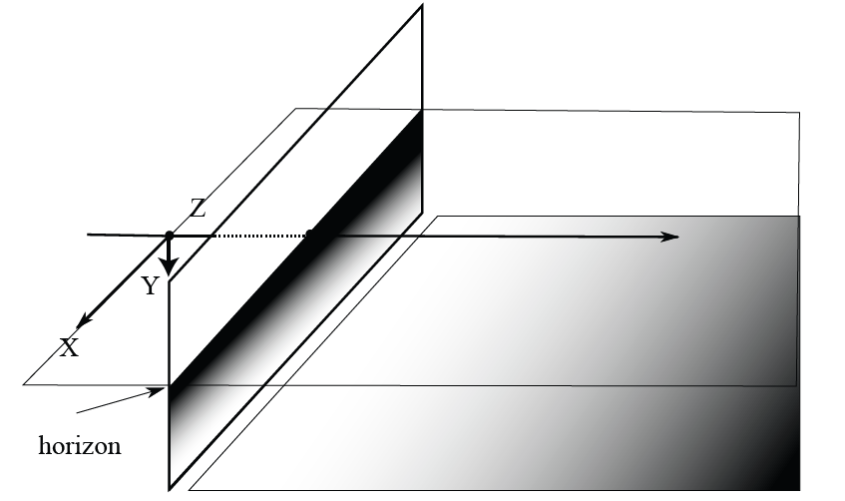
Planes have horizons

Slide 9
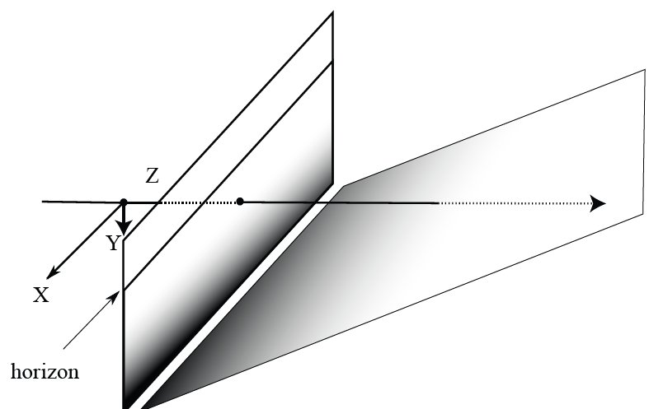
Planes have horizons

Slide 10
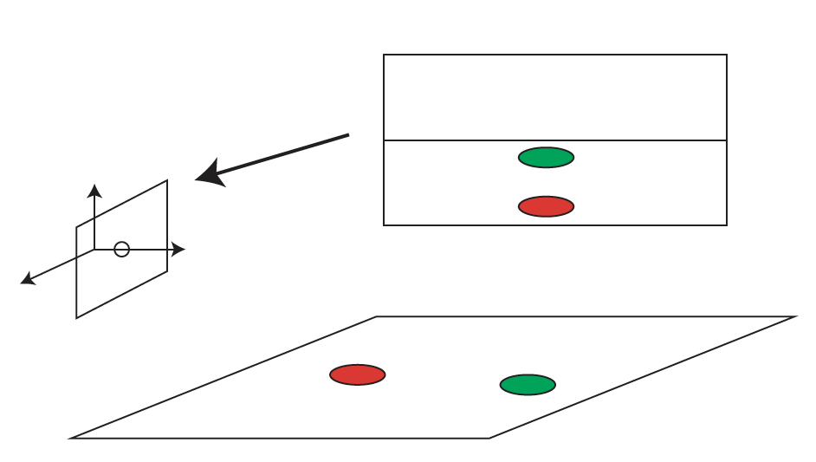
Horizons are informative - I

Slide 11

More about horizons
camera
center
ground plane
Image source: S. Seitz
Camera above or below paraglider?
Notes:
Is this parachutist higher or lower than the person taking this picture?
Lower—he is below the horizon

Slide 12
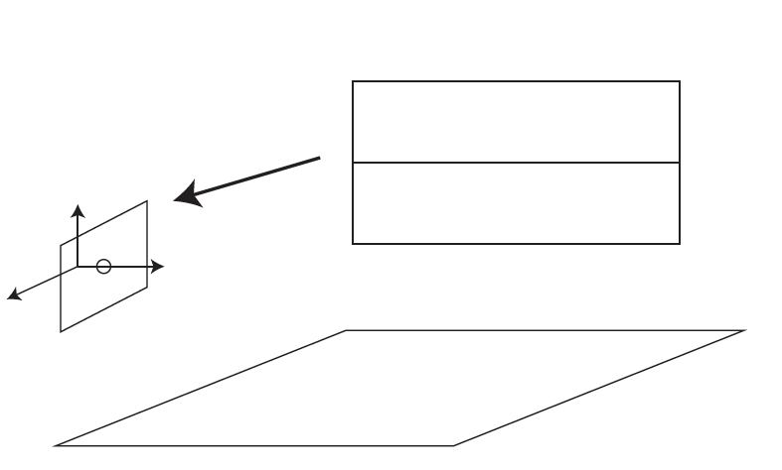
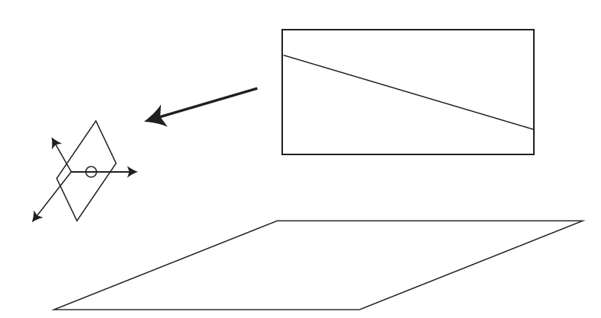
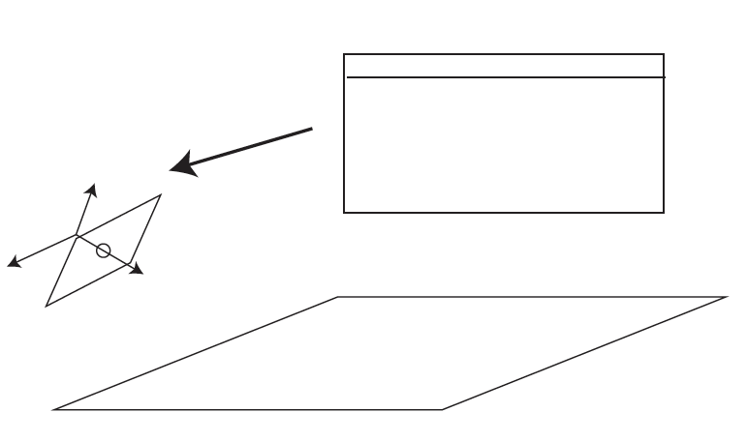
Yet more about horizons

Slide 13
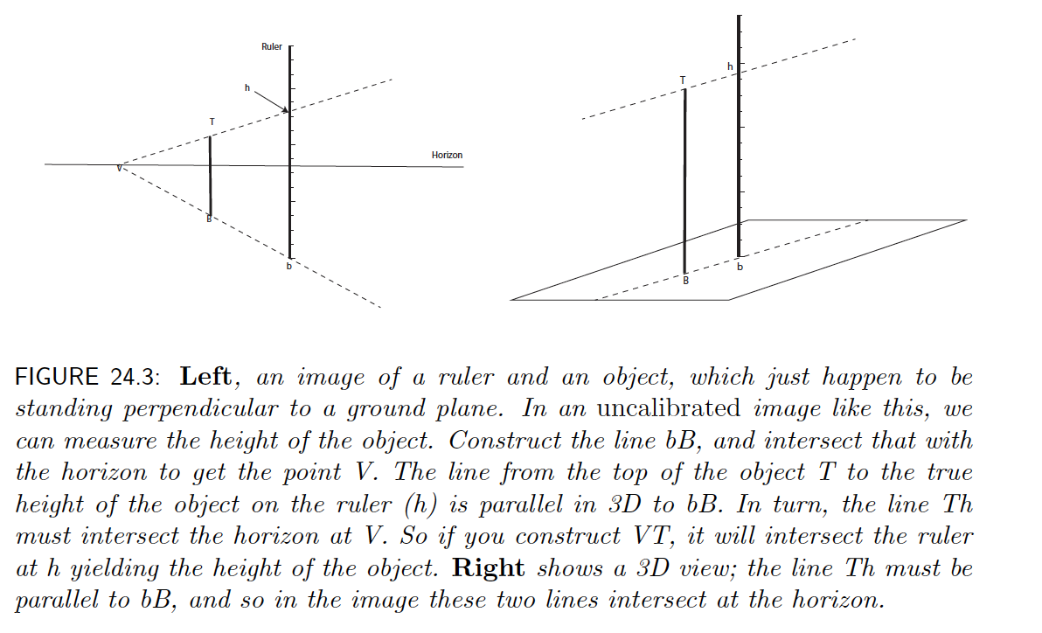
Measurements without calibration

Slide 14
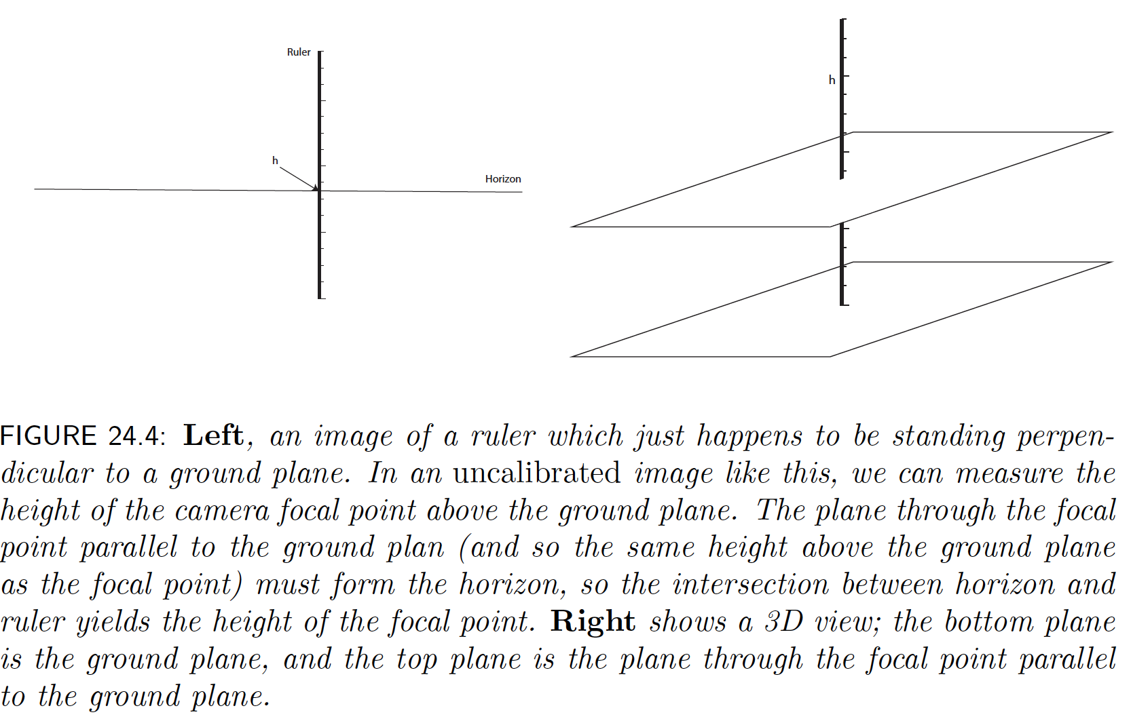
Measurements without calibration

Slide 15
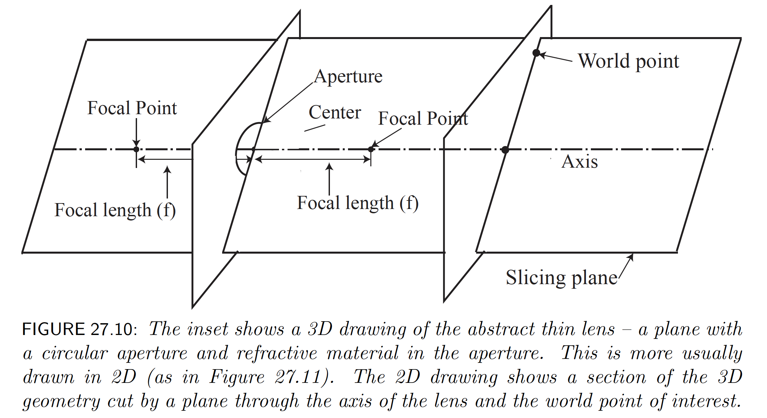
Lenses

Slide 16
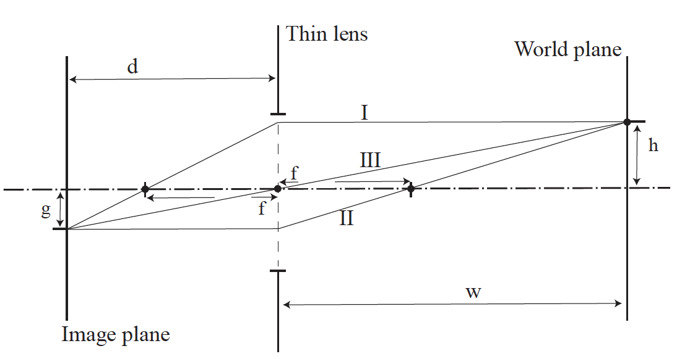
A (slice through) a thin lens

Slide 17
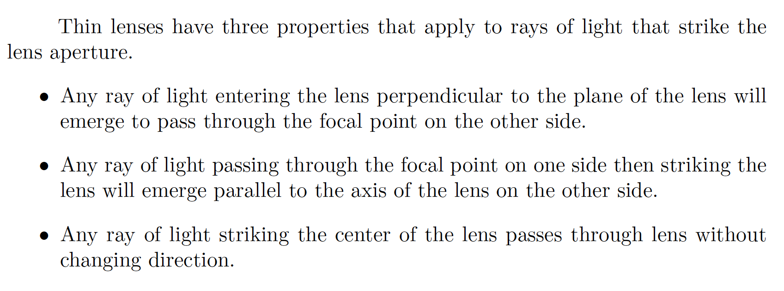
Thin lenses – the rules

Slide 18
The rules and focus

Slide 19
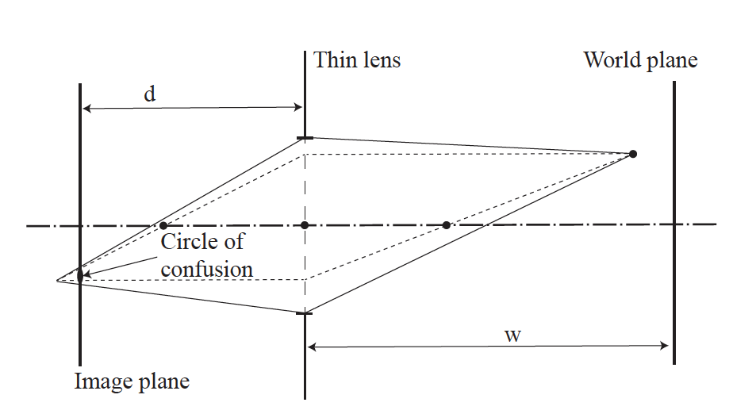
Depth of field

Slide 20
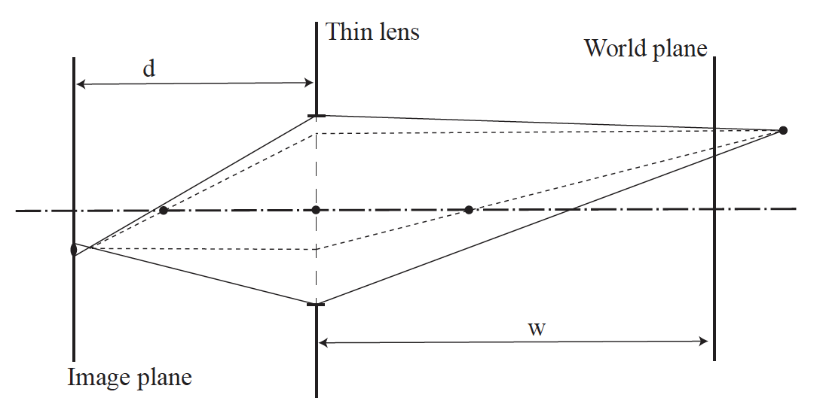
Depth of field

Slide 21
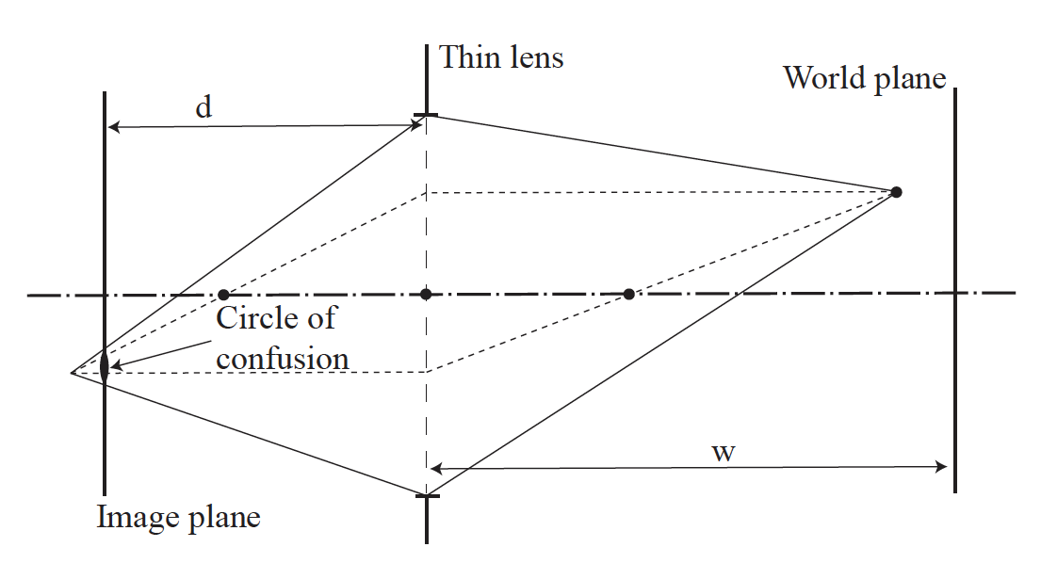
Aperture and depth of field

Slide 22
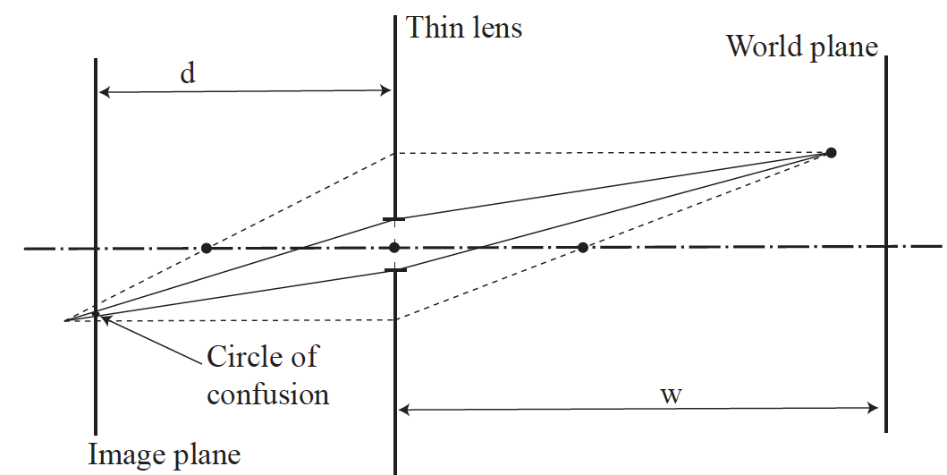
Aperture and depth of field

Slide 23
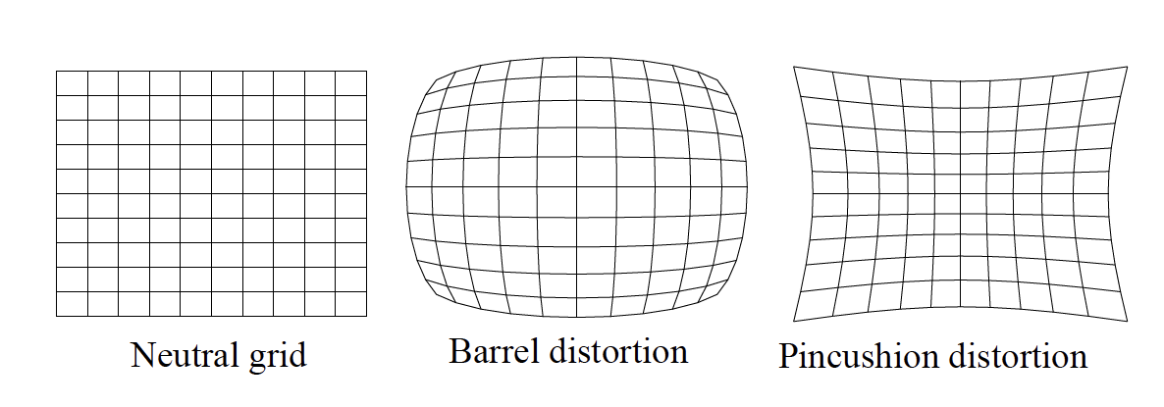
Lens distortion

Slide 24
Camera response functions
Camera sensors are almost always linear BUT
image dynamic range is too big for 8 bits
Typical cameras apply a non-linearity before or during digitization – the camera response function
This varies from camera to camera

Slide 25
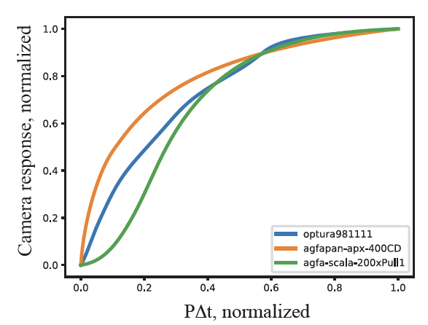
Camera response functions

Slide 26
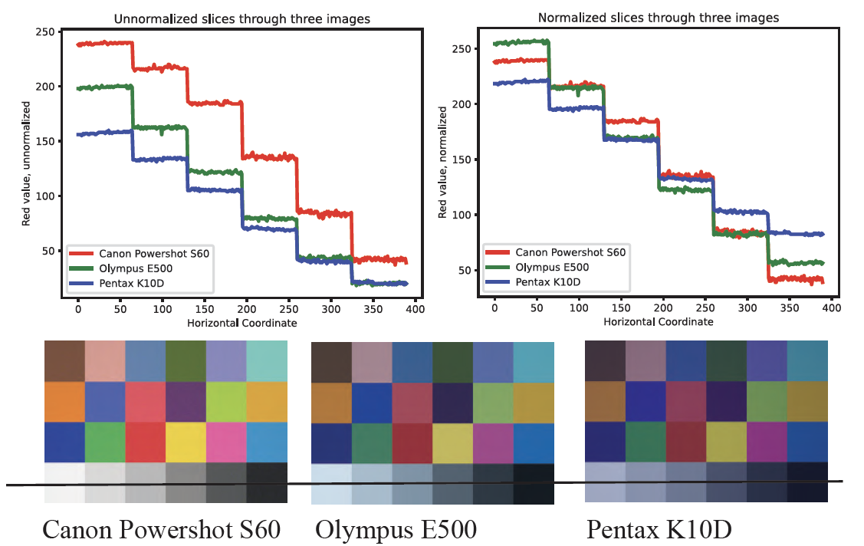
Camera response function effects

Slide 27
Camera sales over time
Source
Notes:
CIPA: Camera & Imaging Products Association

Slide 28
Camera sales over time
The full chart…
Source
Notes:
CIPA: Camera & Imaging Products Association

