Slide 1
Camera Matrices
D.A. Forsyth,
University of Illinois at Urbana Champaign

Slide 2
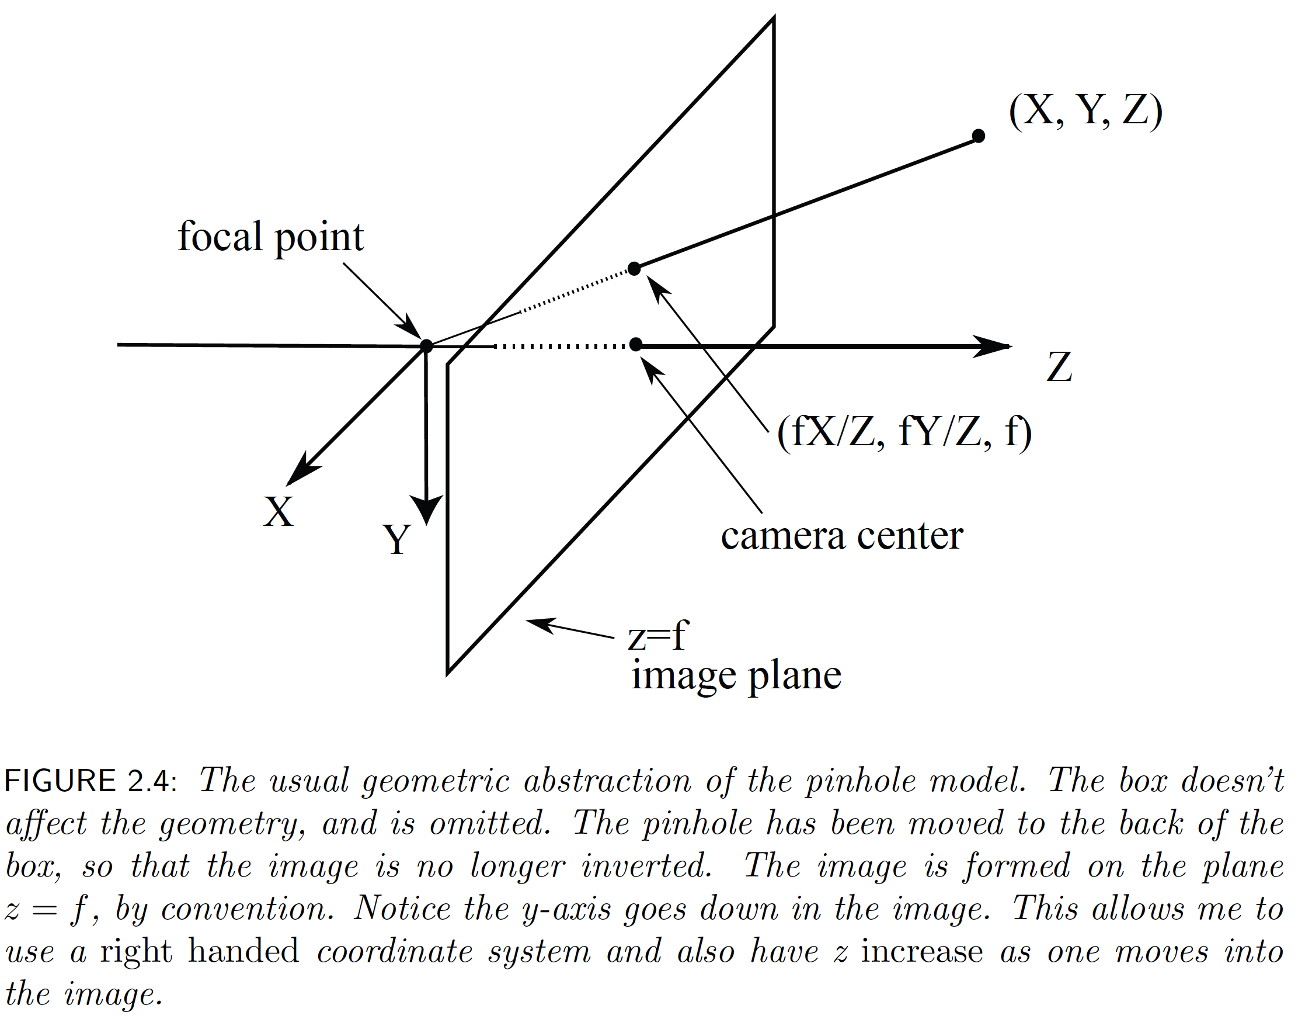
Recall

Slide 3
Notice:
Change in focal length is just a scaling
  deal with this later
  currently, f=1
Now turn into homogenous coordinates
In 3D
Camera
Affine
Homogenous
Affine
Homogenous
and

Slide 4
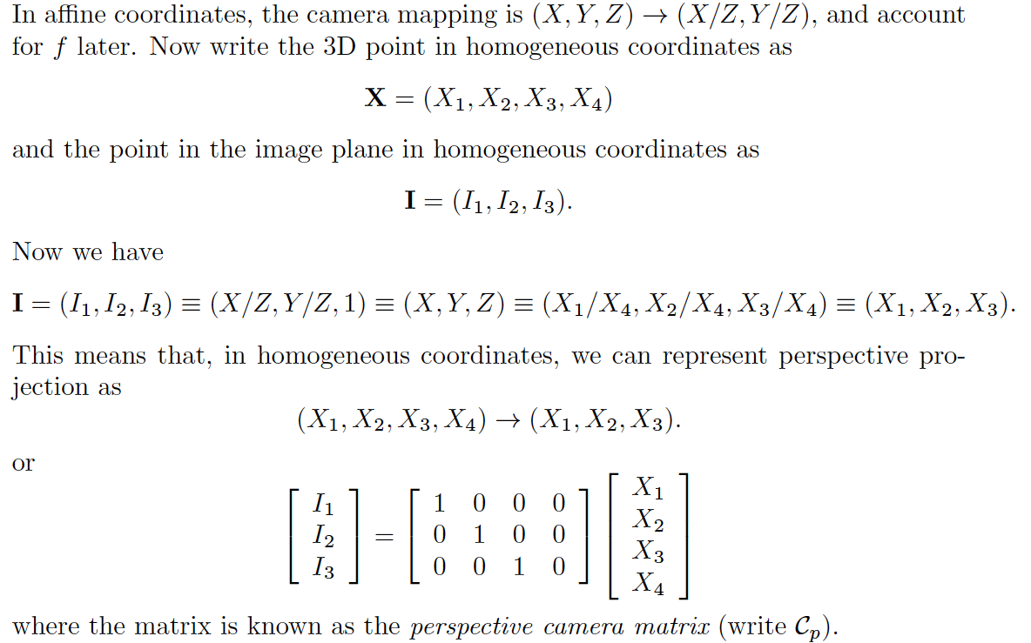
The perspective camera matrix

Slide 5
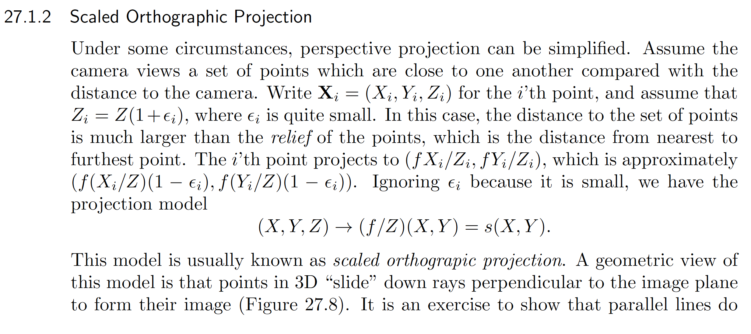
Orthographic projection
Notes:
Is this a linear function?

Slide 6
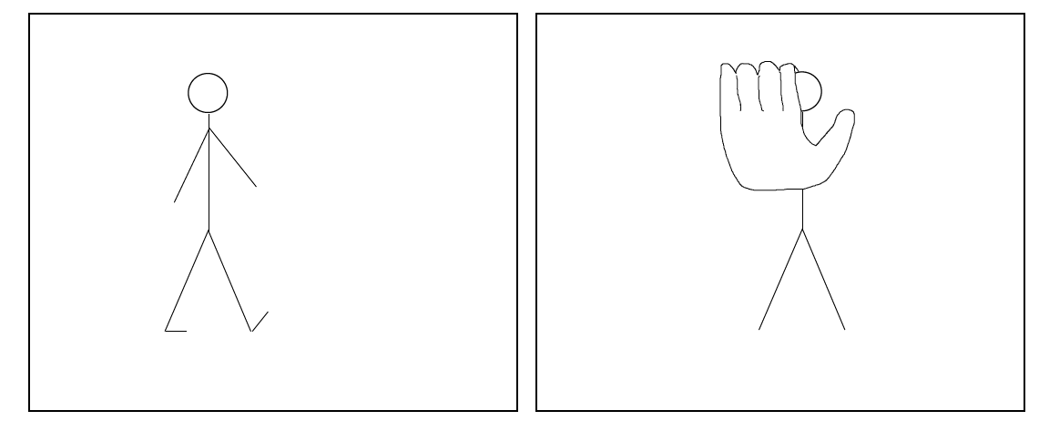
Orthographic projection
Often occurs when looking at people
  criterion: difference in depth is small compared to depth
Notes:
Is this a linear function?

Slide 7

Orthographic projection

Slide 8
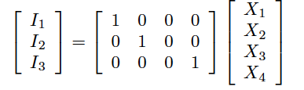
Camera matrix for orthographic

Slide 9
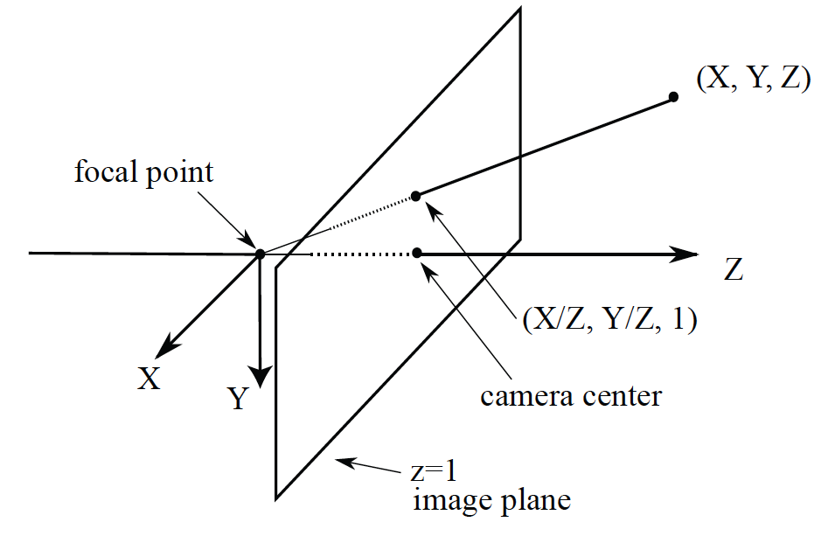
Canonical camera

Slide 10
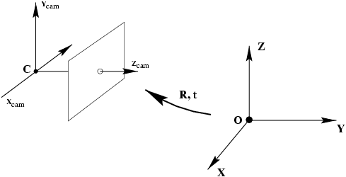
Actual camera

Slide 11
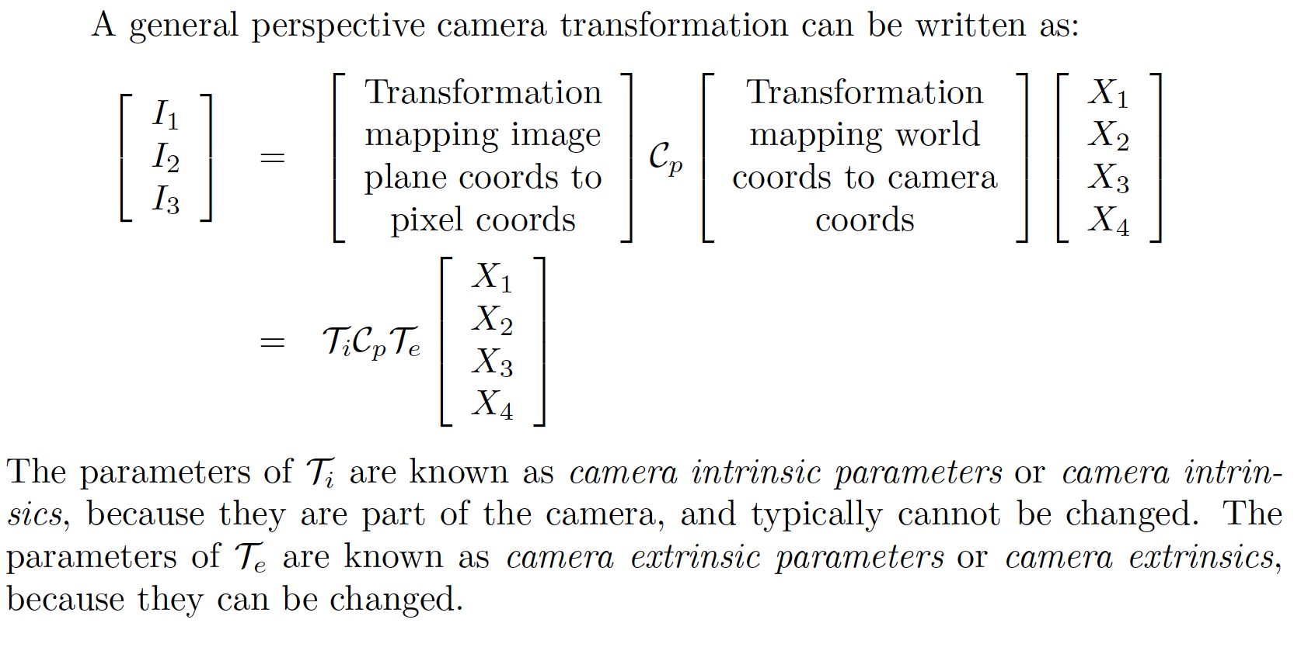
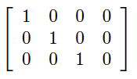

Slide 12
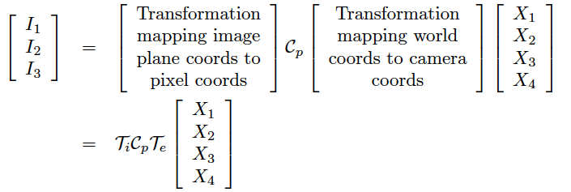
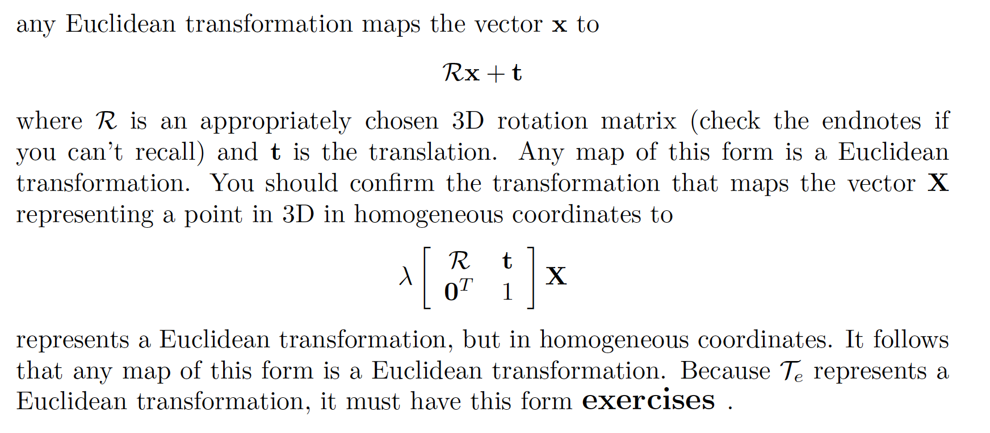
Extrinsics
Extrinsics

Slide 13
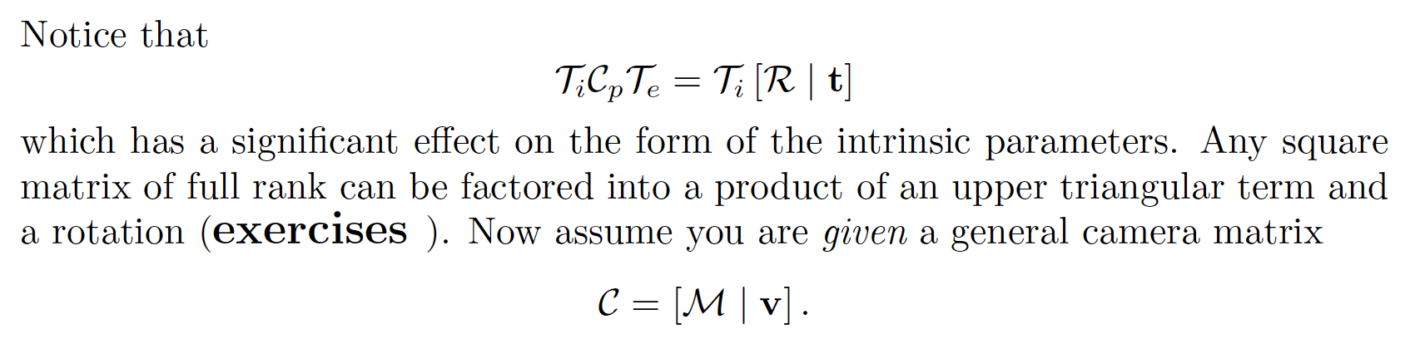
Intrinsics
Intrinsics

Slide 14
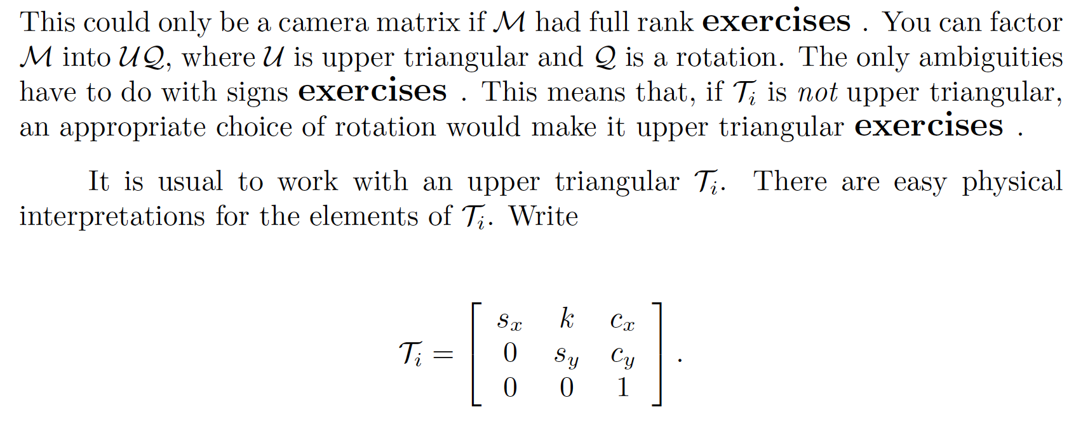
Intrinsics

Slide 15
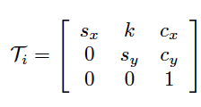
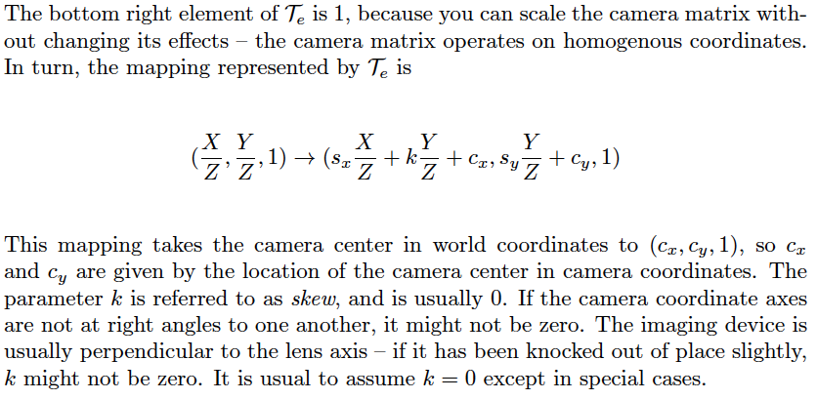
Interpreting intrinsics

Slide 16
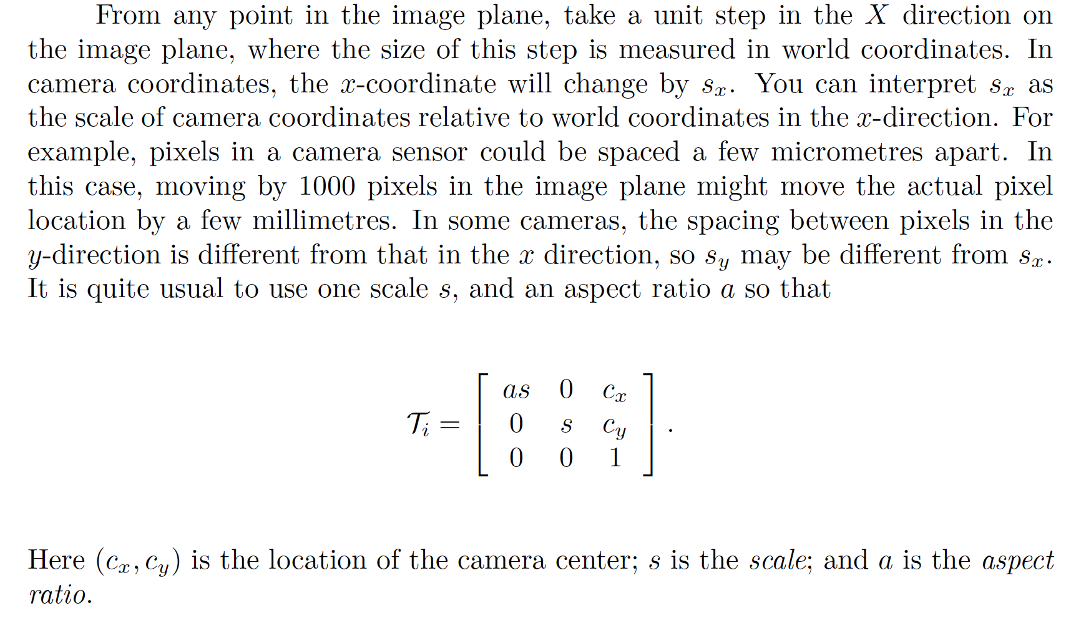
Interpreting intrinsics

Slide 17
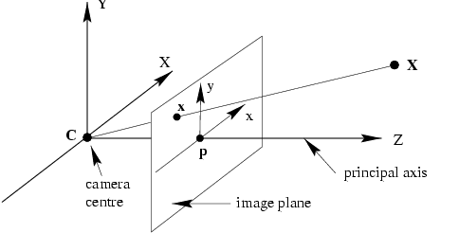
Different canonical cameras?

Slide 18
A camera views a plane
Put the plane at Z=0
Simplify

Slide 19
A camera views a plane
Transformation simplifies to
This is a homography
but may not be a general projective transformation

Slide 20
Camera rotates about its focal point
Camera 1
Camera 2
But t must be zero, because the focal point
doesn’t change (no translation)
Check – 0, 0, 0, 1 will be fp

Slide 21
Camera rotates about its focal point
Camera 1
Camera 2

Slide 22
Camera rotates about its focal point
Camera 1
Camera 2
Rotate about the focal point == apply a particular homography to image
Notice intrinsics matter here, entirely appropriate

Slide 23
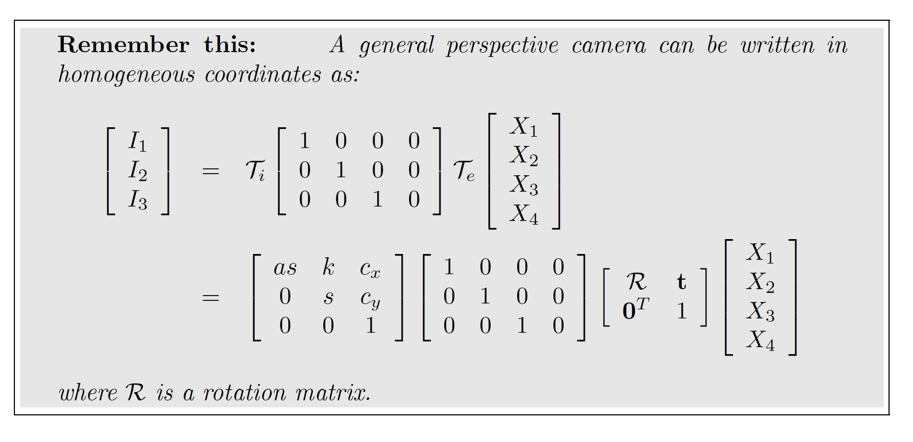

Slide 24
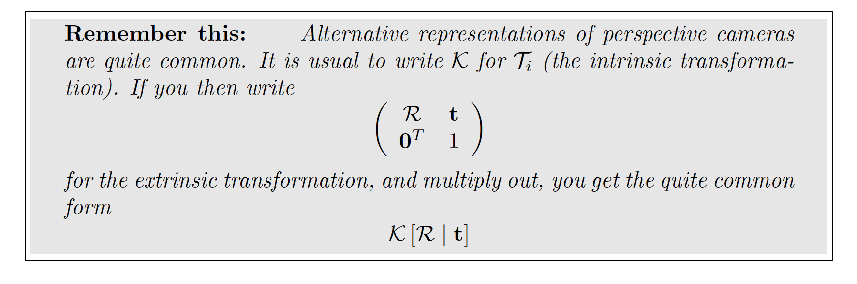

Slide 25
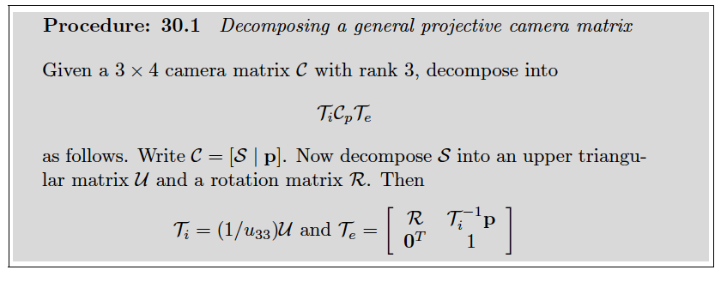

Slide 26
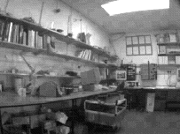
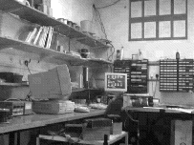
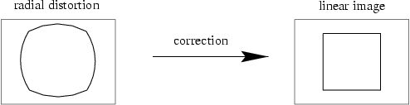
I did not discuss...

