Slide 1
Camera Calibration: Start point
D.A. Forsyth,
University of Illinois at Urbana Champaign

Slide 2
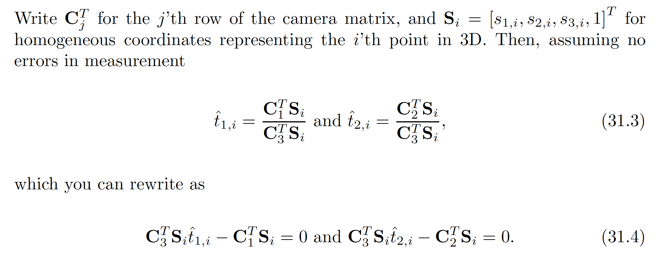
Camera matrix from linear system
x component of location of i’th point in image
One match gives two linearly independent constraints on the camera matrix

Slide 3
Camera matrix from linear system
N points gives 2N homogeneous equations
The camera matrix is 3 x 4 but scale doesn’t matter so there are
11 degrees of freedom – we can estimate it with 6 points

Slide 4
Solving
You have N homogeneous eqns in M<N unknowns
Solve by minimizing
  subject to
Eigenvalue problem:
c is eigenvector of M^T M with smallest eigenvalue

Slide 5

Camera matrix from linear system
Final linear system:
What if all the $n$ 3D points are coplanar,
  i.e., there exists a set of line parameters $Π^{T}={(a,b,c,d)}^{T}$ such that $ΠTX_{i}=0$ for all $i$?
  Then we will get degenerate solutions $(Π,0,0)$, $(0,Π,0)$, or $(0,0,Π)$

Slide 6
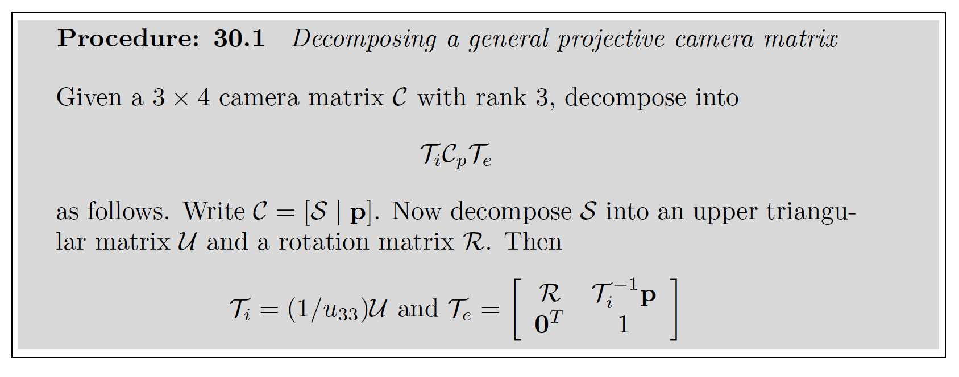
Now factor, and get start point

Slide 7
You must use reprojection error
You might think the start point is good enough
  it isn’t – it minimizes the wrong error
    Q: what does the smallest eigenvalue mean?
    A: who knows?
If you minimize reprojection error, you’re minimizing something meaningful

