Slide 1
Color:
Inference from color
D.A. Forsyth
University of Illinois at Urbana Champaign

Slide 2
Important fact
Humans appear to discount the effects of illuminant color
  This is referred to as color constancy
  Example:
    view white plate in yellow incandescent light
      report “white” (not ”yellow”)
    view white plate in blue fluorescent light
      report “white” (not “blue”)
  It isn’t perfect:
    traditional example:
      buy clothing in store light
      view in sunlight, and regret

Slide 3
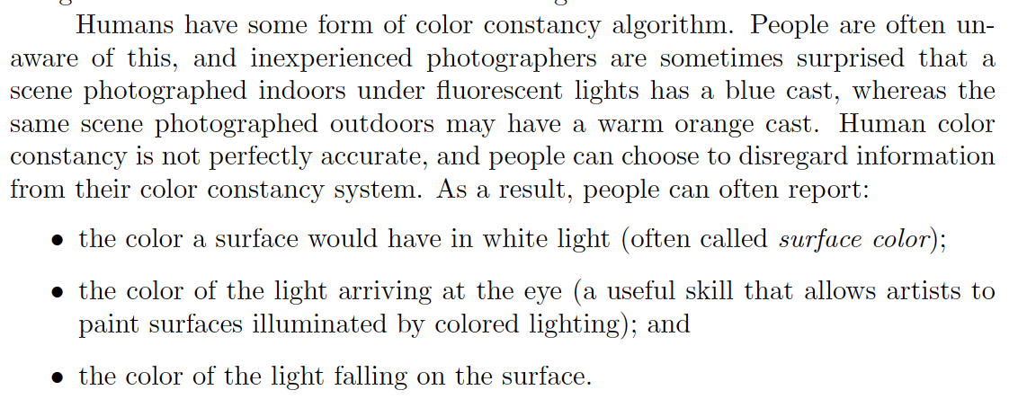
Color constancy

Slide 4
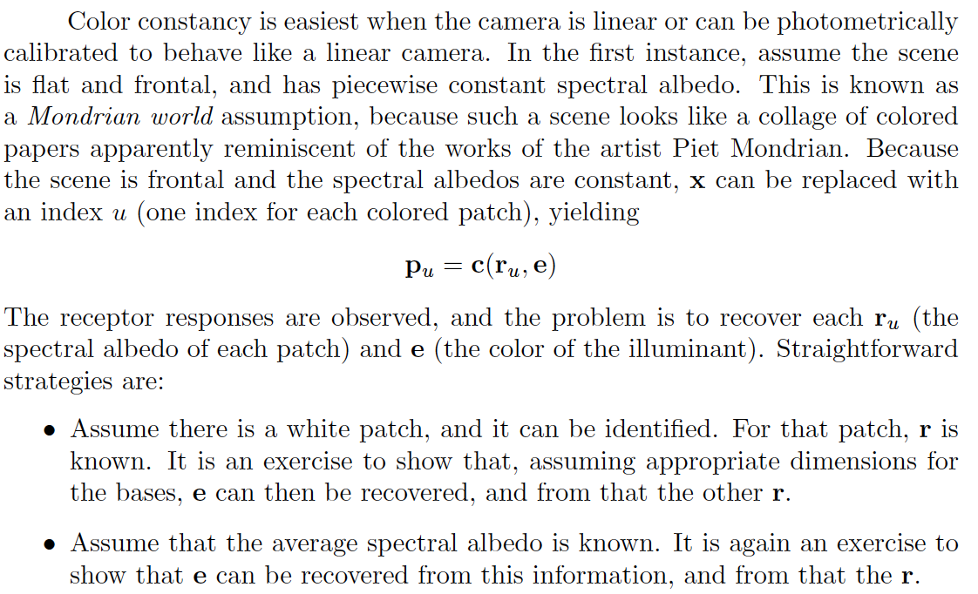
Color constancy

Slide 5
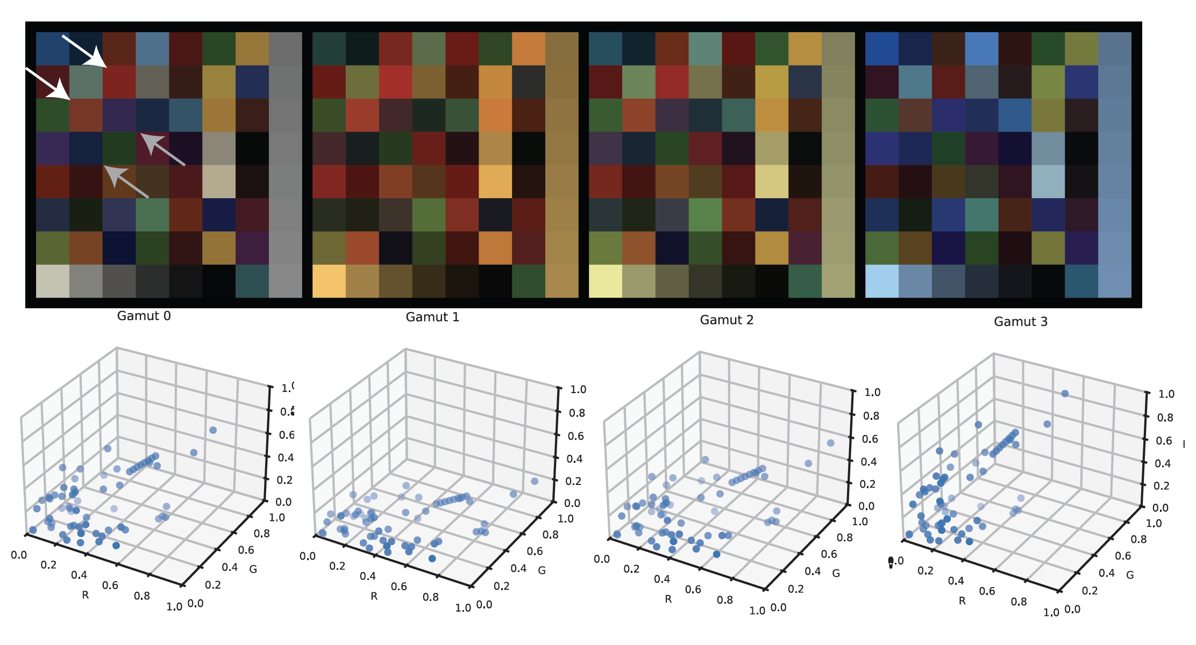
Color constancy: gamuts as a cue

Slide 6
Color constancy has morphed
White balancing
  Make the image look as though the light is white
Intrinsic images
  Report the albedo at each point
    actually, not the only intrinsic: depth, normal, etc.
    but different – you can’t get real training data easily
Relight the scene
  Make the image look as though the light had changed

Slide 7
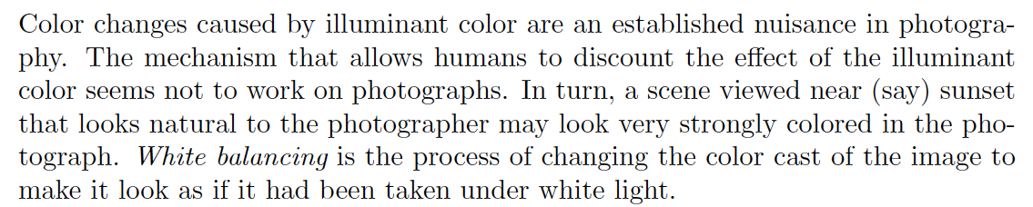
White balancing

Slide 8
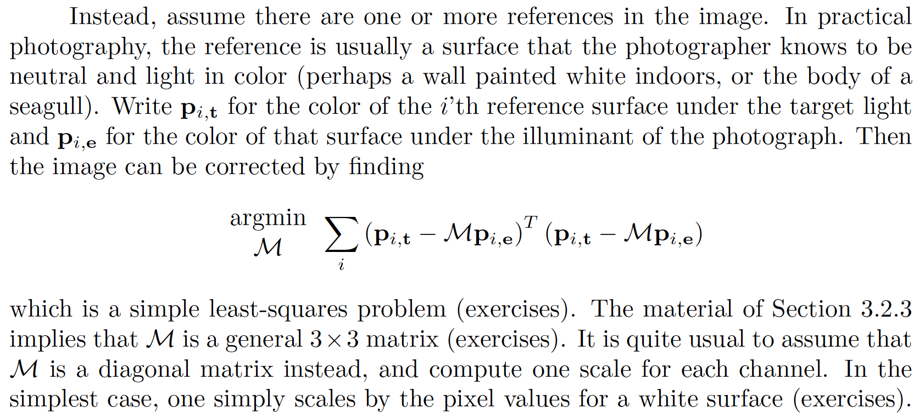
White balancing

Slide 9
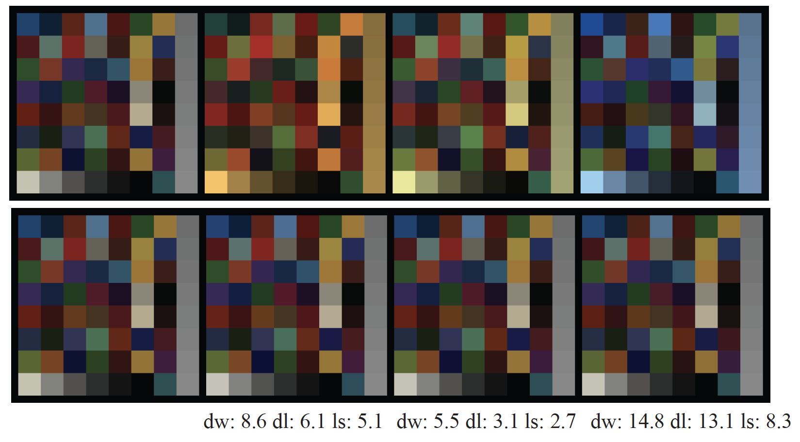
White balancing

Slide 10
Intrinsic images
Report color albedo from image
  simplest:
    lightness algorithm in R, G, and B
  harder:
    obtain dataset
      render pairs of (true illuminated image, albedo)
      simulated pairs
        true image= (piecewise constant albedo)* (slowly varying shading)
    fire up U-Net
      BUT sim to real gap
  even harder:
    use conditional diffusion model trained rendered data

Slide 11
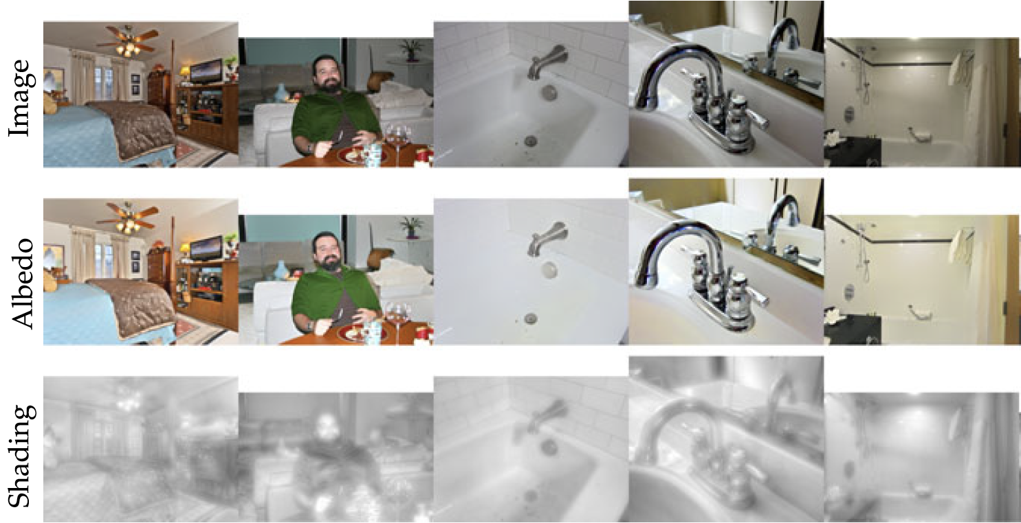
UNet with simulated data
Forsyth and Rock, 2022

Slide 12
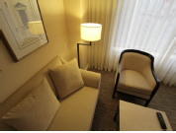
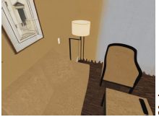
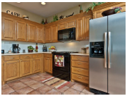
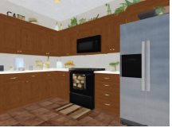
Conditional diffusion model
Image
Mean albedo estimate
Kocsis et al 2024

Slide 13
Relight the scene
Simplest version
  remove shadows
    this can be useful, but is physically weird
Harder
  Insert objects
Even harder
  Change illuminant in some way
    and produce physically correct answer

Slide 14
Shadow removal outdoors
Assume light sources are black body
  at different temperatures
You can then infer:
  light source temperature
  whether a boundary is a shadow boundary
Reconstruct by:
  Differentiate,
  knock out shadow boundaries,
  integrate

Slide 15
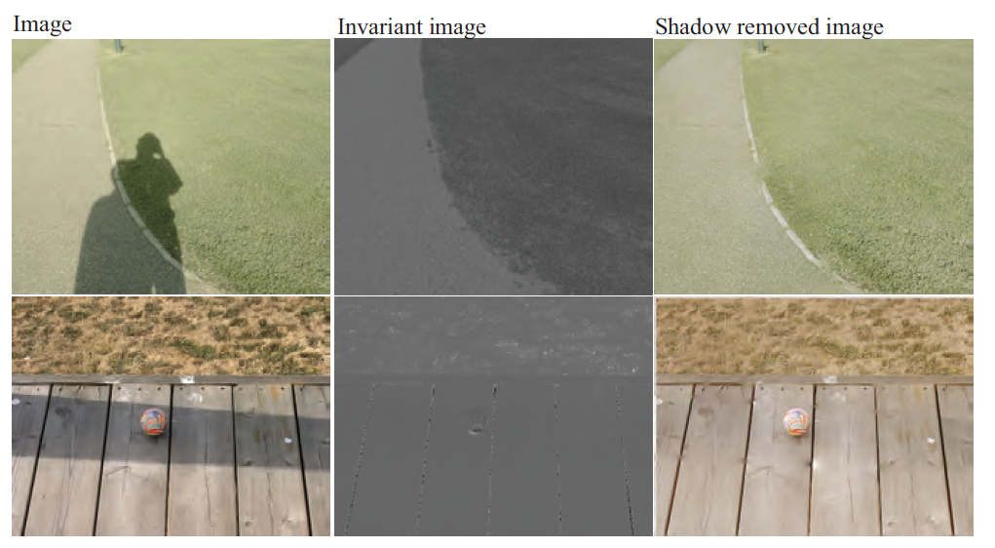
Shadow removal

Slide 16
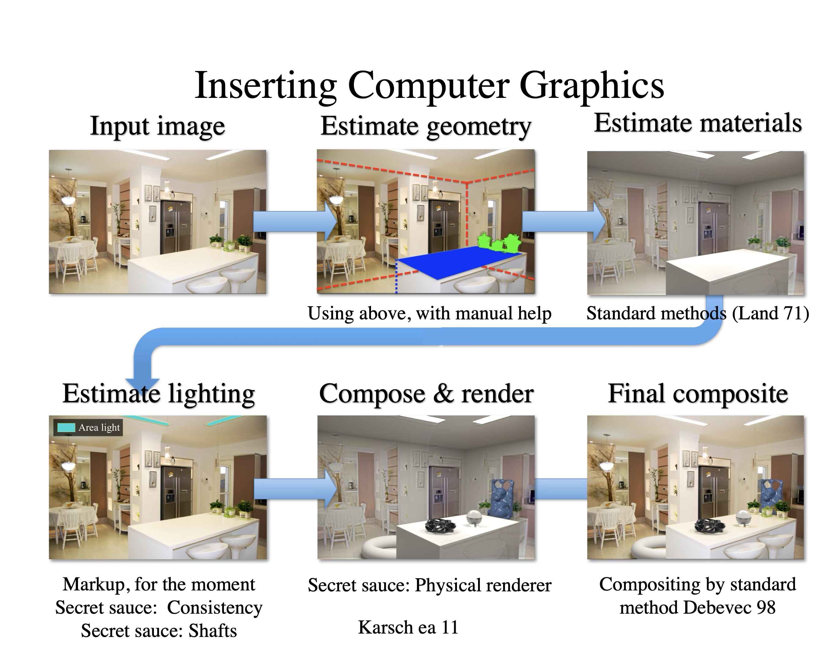

Slide 17
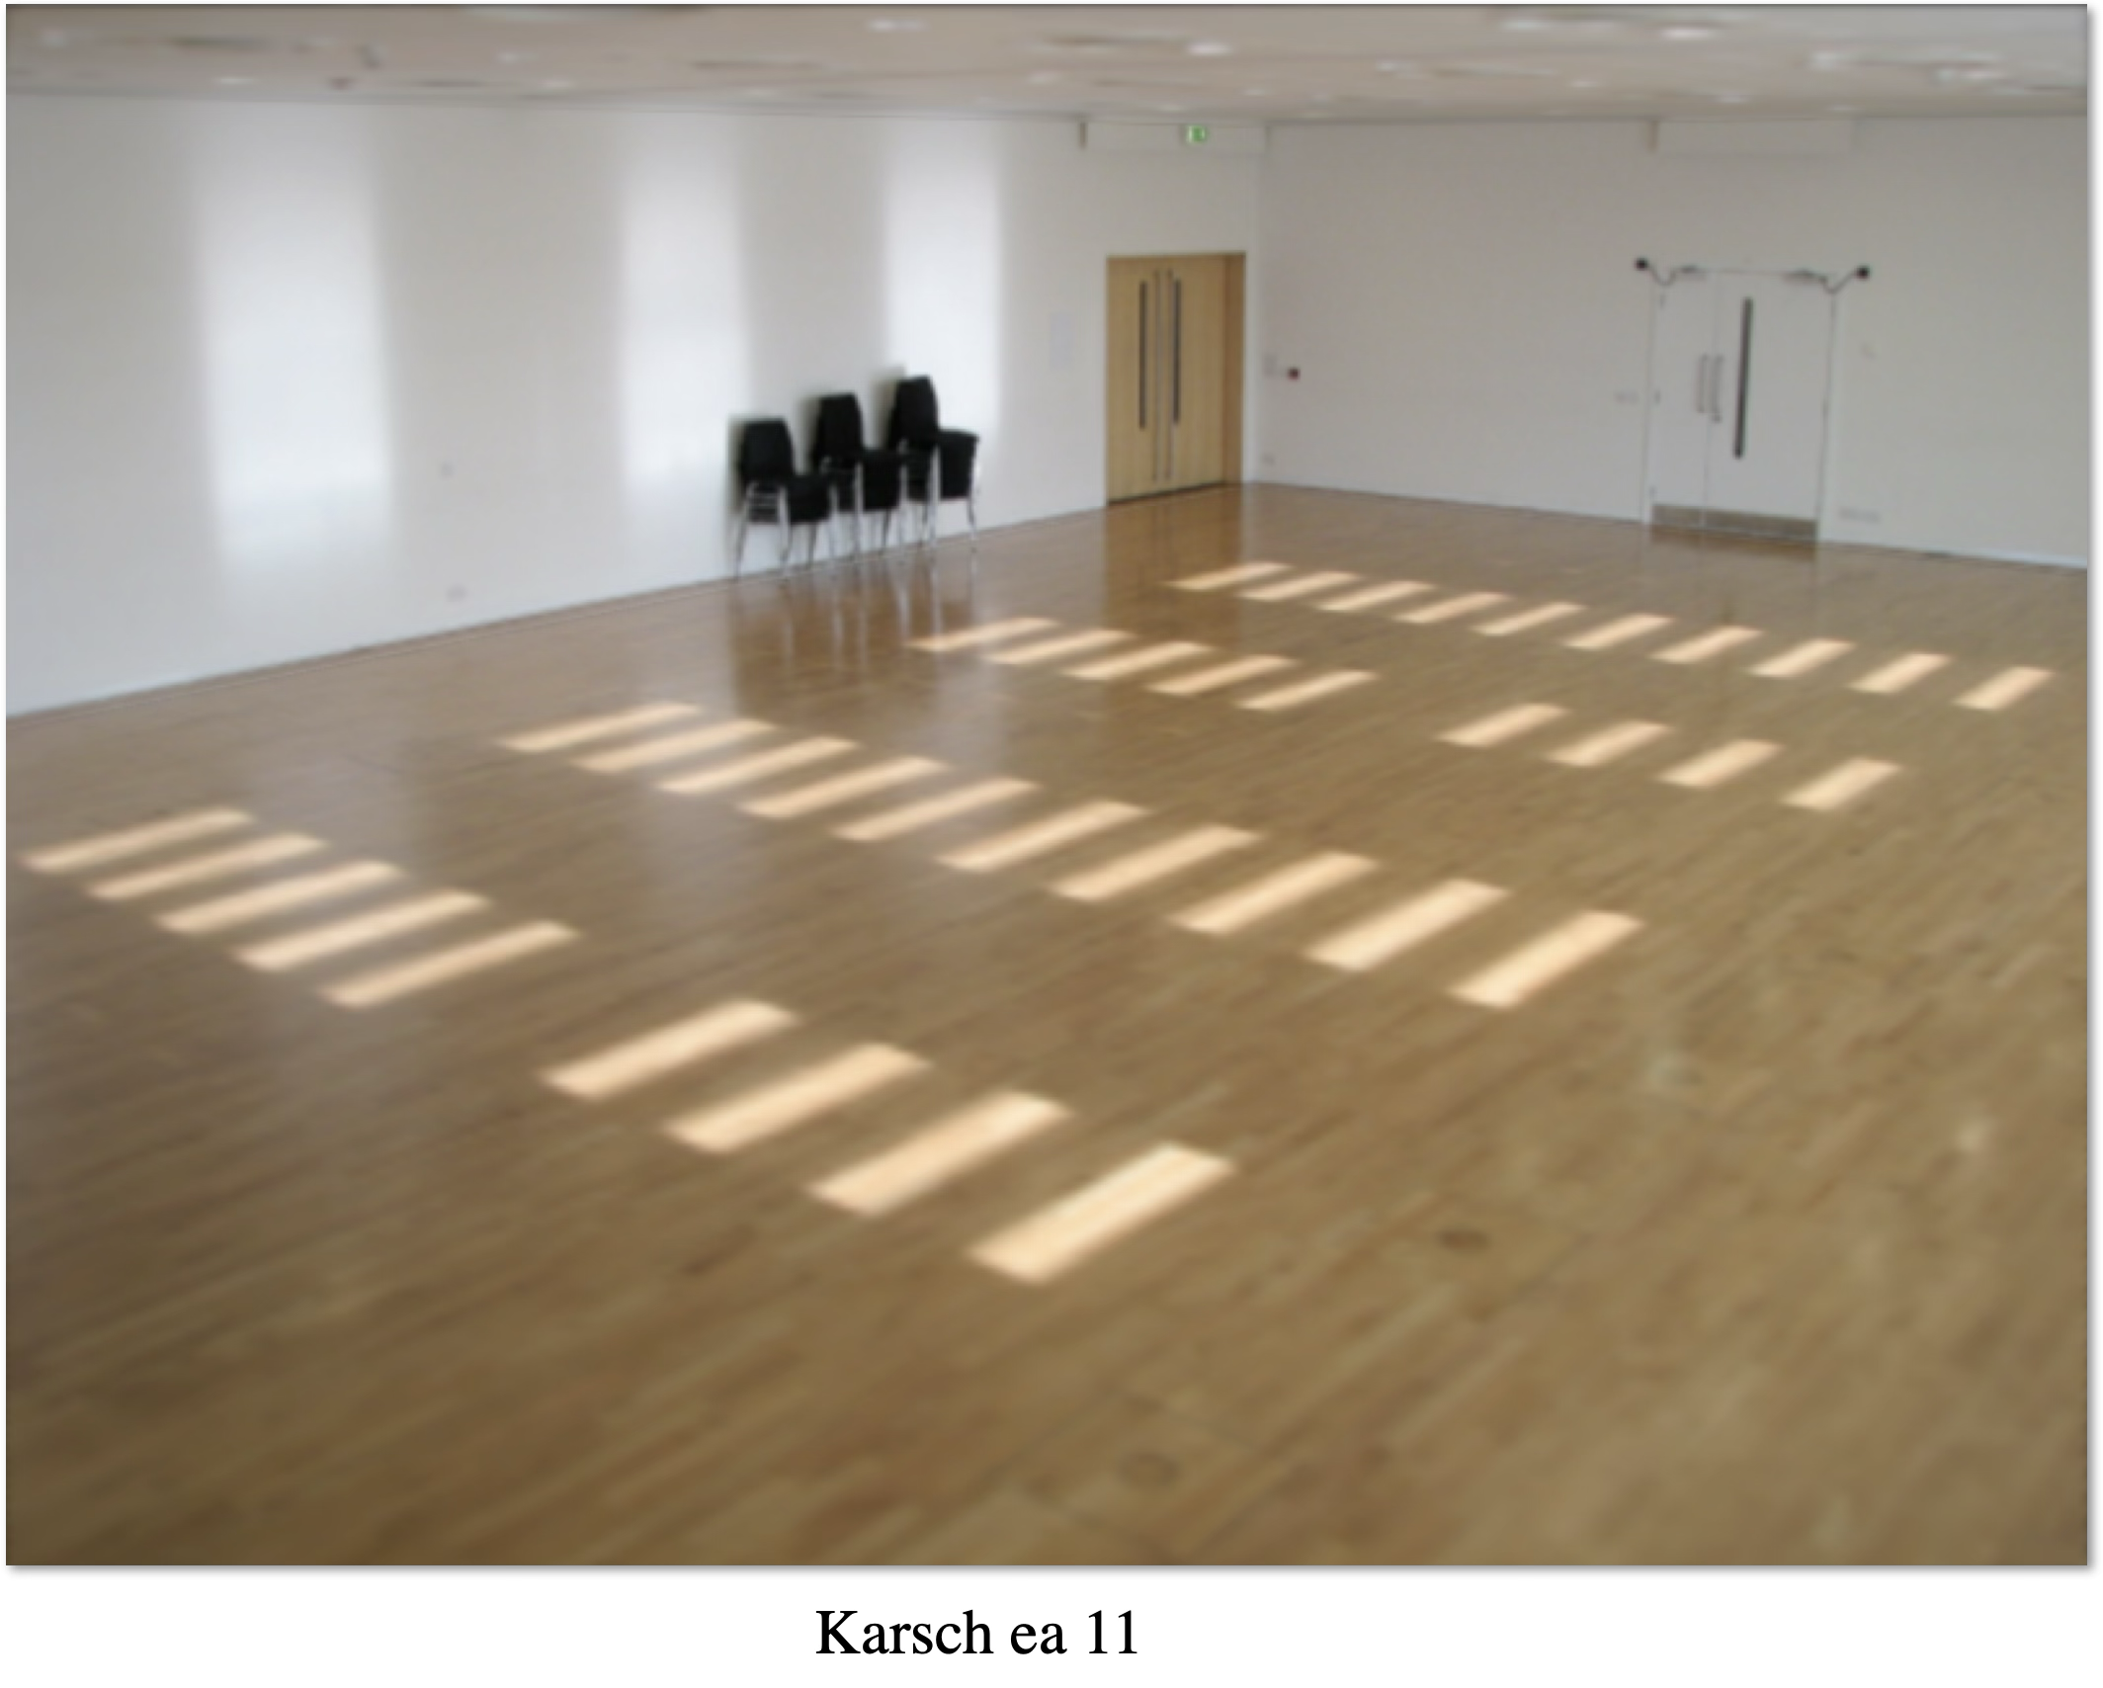

Slide 18
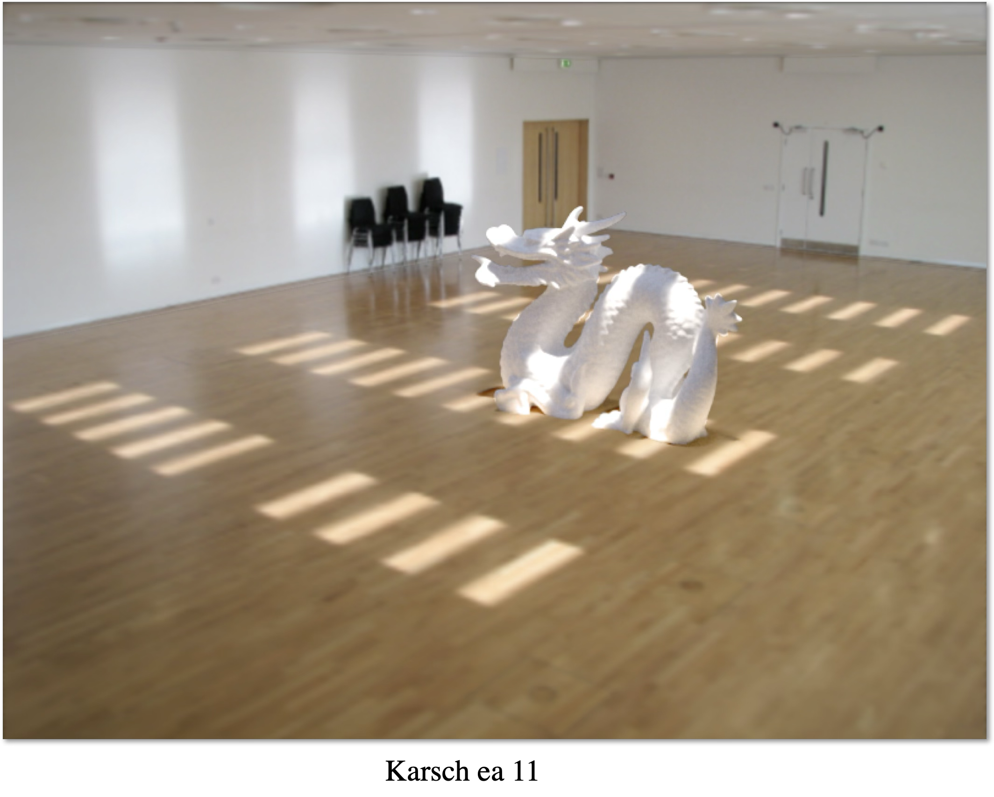

Slide 19
Changing the light
Idea:
  can recover:
    albedo
    normal
    depth
    etc
  get that, render with new light
This seems not to work all that well
  likely problem:
    errors in inferences interact in a bad way

Slide 20
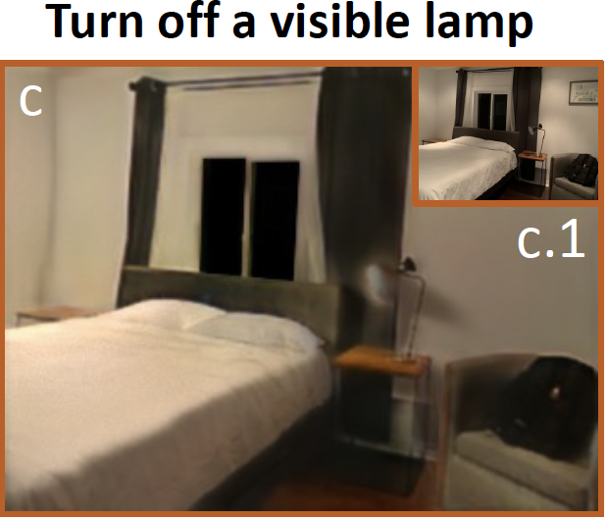
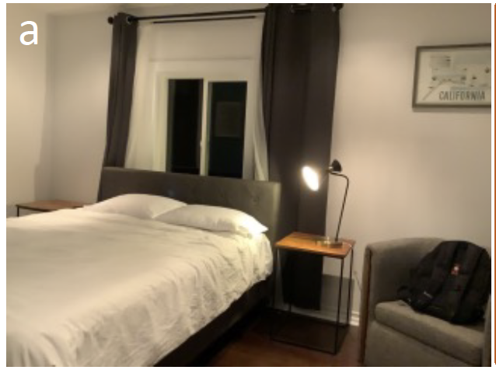
Li et al, 2022

Slide 21
Changing the light
Alternatives:
  various forms of conditional image generation
  (rather loosely) a regression problem

Slide 22
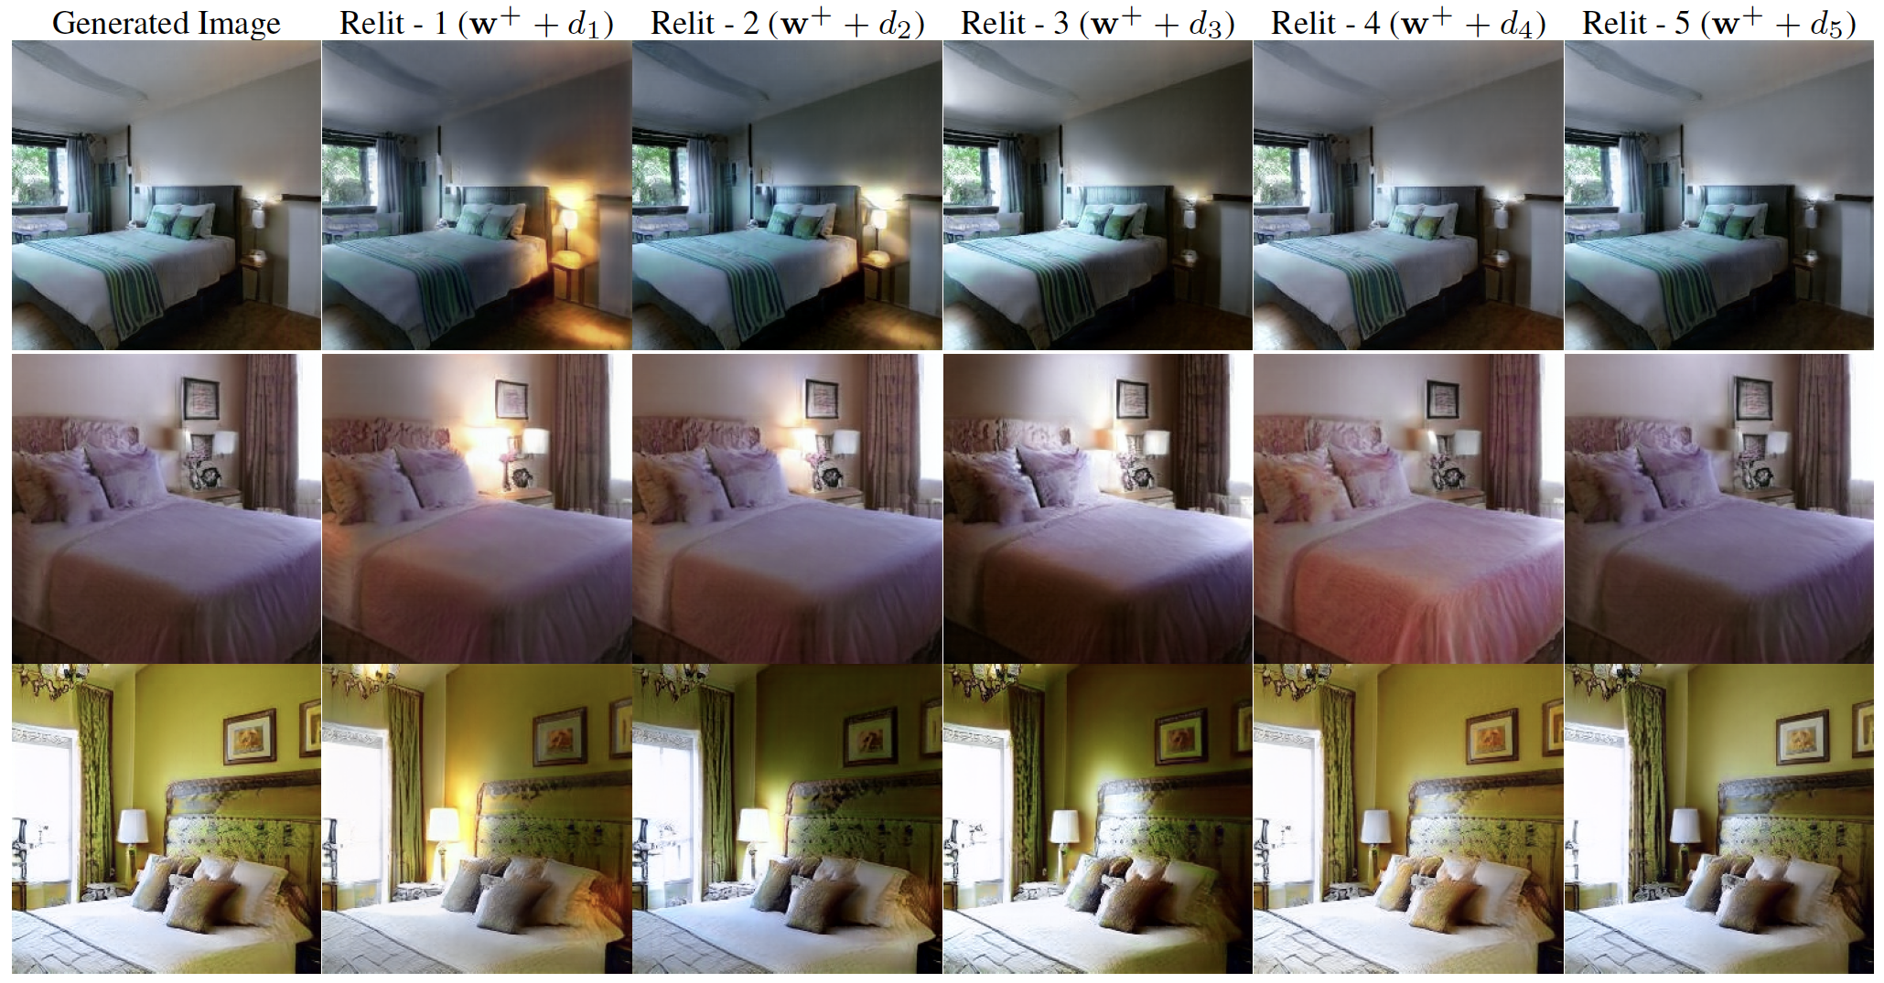
Changing the light
Bhattad et al 24

Slide 23
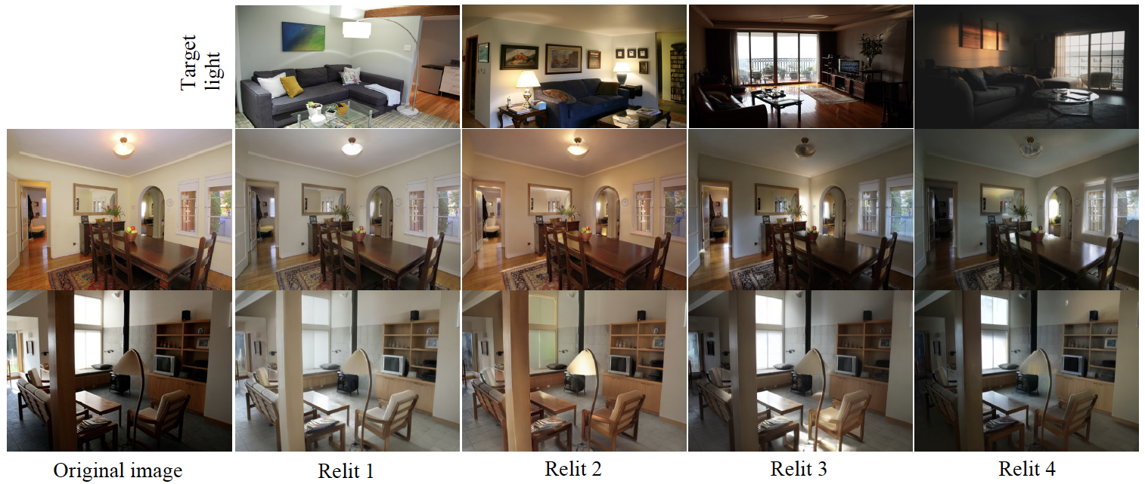
Changing the light
Xing et al 25

