Slide 1
Color:
Physics and Effects
D.A. Forsyth,
University of Illinois at Urbana Champaign

Slide 2
Color
The sensation of color occurs in the brain.
One way to get it is the response of the eye to the presence/absence of light at various wavelengths.
  others:
    Dreaming, hallucination, etc.
    Pressure on the eyelids
Different amounts at different wavelengths because:
  wavelengths absent (flourescent light vs. incandescent light)
  differentially reflected - e.g. paint on a surface
  differentially refracted - e.g. Newton’s prism
  wavelength dependent specular reflection (most metals).
  Flourescence -
    invisible wavelengths absorbed and reemitted at visible wavelengths.
  Phosphorescence (ditto, energy, longer timescale)

Slide 3
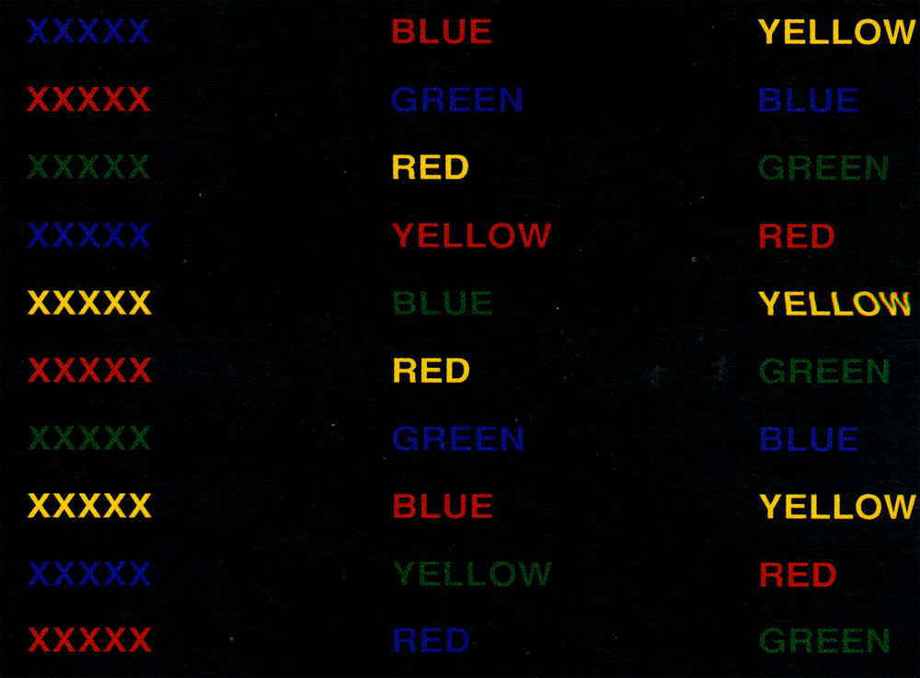

Slide 4
Stroop effect
Color perception affects all sorts of other perceptual phenomena
You name colors slowly IF the word is a different color name!

Slide 5
Monochromatic light
Use:
  a prism
  a refraction grating (CD, DVD)
  an oil film
  etc
to produce light at “a single” wavelength
You will see colors

Slide 6
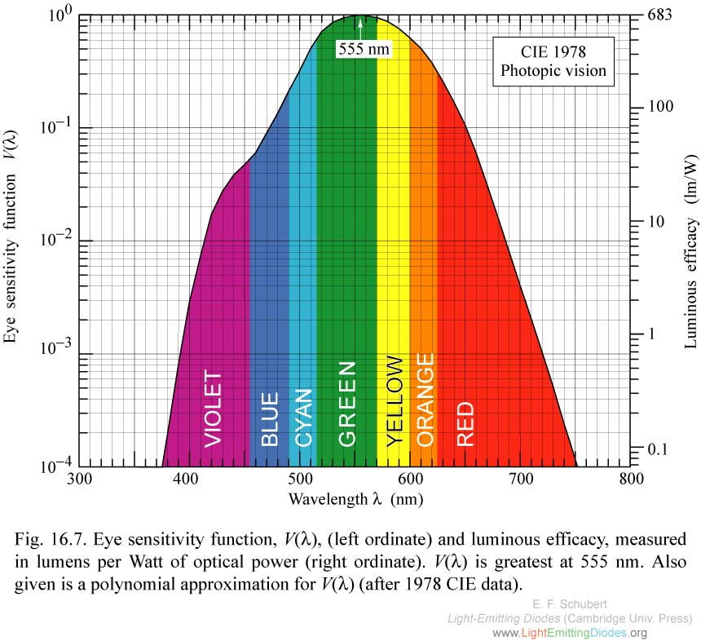
Photopic sensitivity

Slide 7
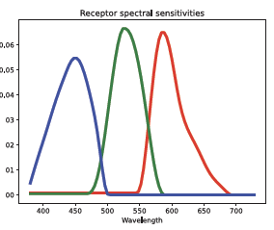
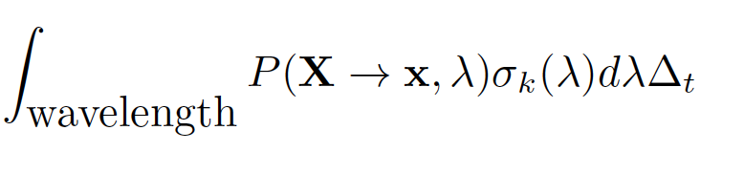
Receptors
Principle of univariance
  receptor response at different wavelengths is
    of the same kind
    in different amounts
Response to P over Delta t is:
Violet
Red

Slide 8
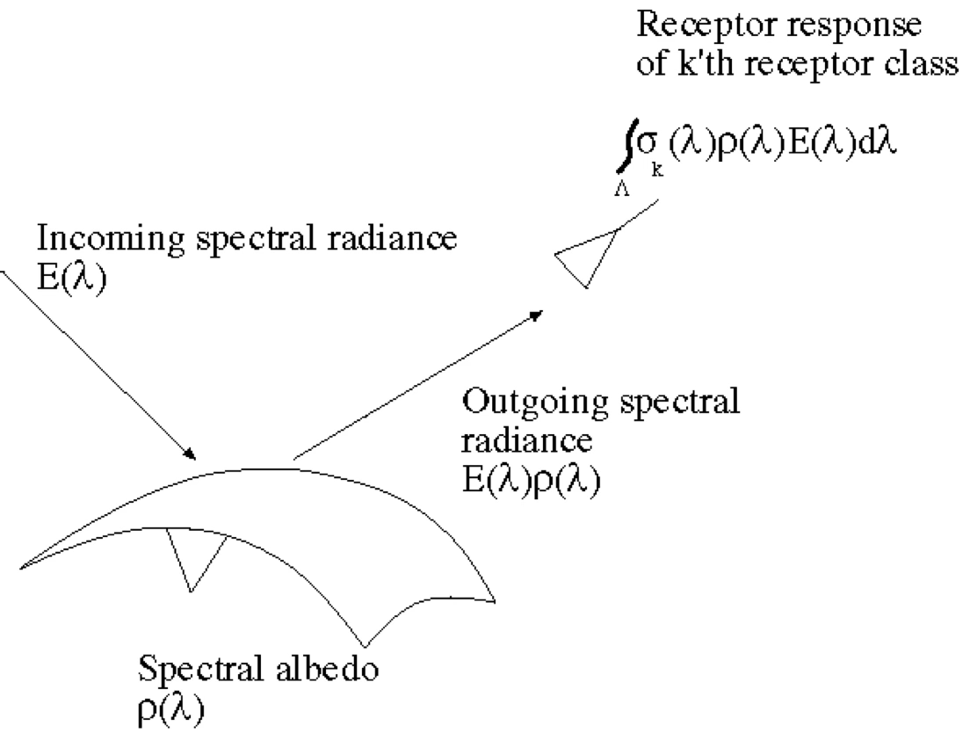
Color in camera receptors

Slide 9
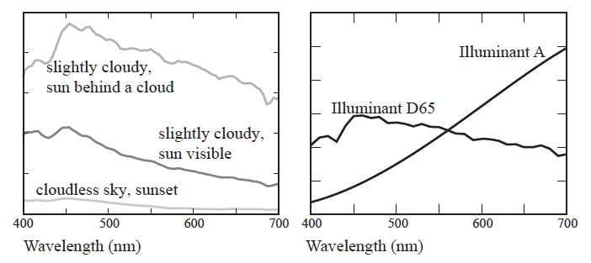
Outdoor light spectra

Slide 10
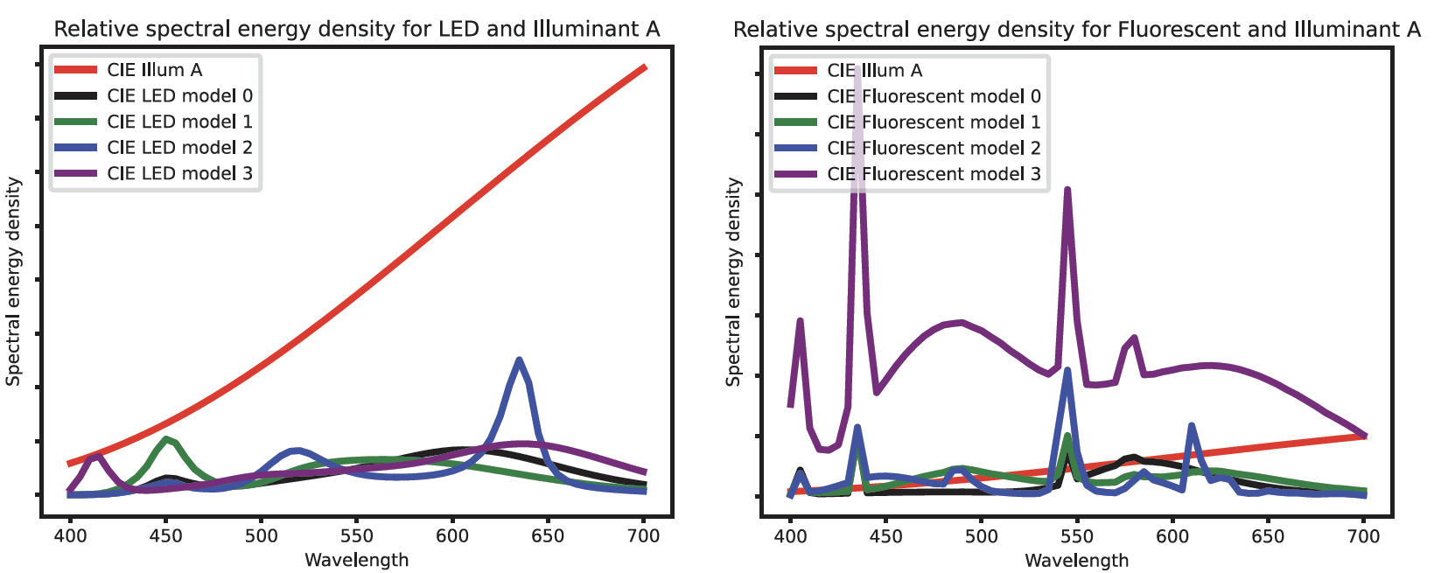
Indoor light spectra

Slide 11
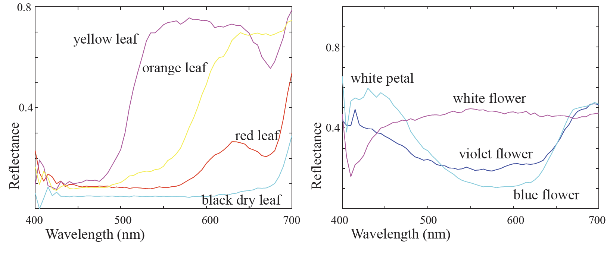
Spectral albedoes

Slide 12
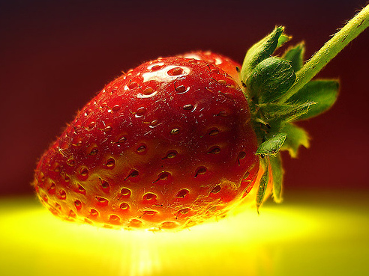
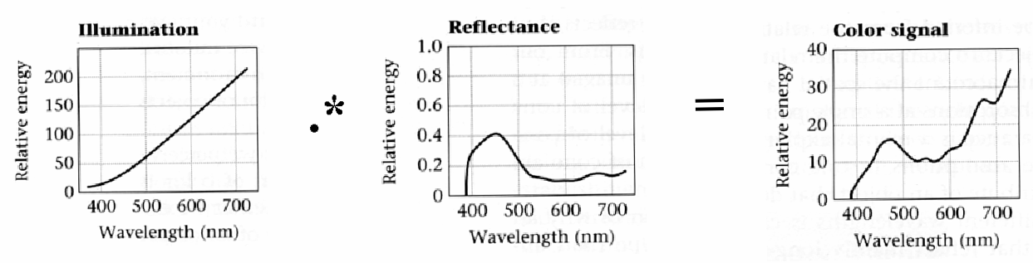
Interaction of light and surfaces
Reflected color is the result of interaction of light source spectrum with surface reflectance

Slide 13
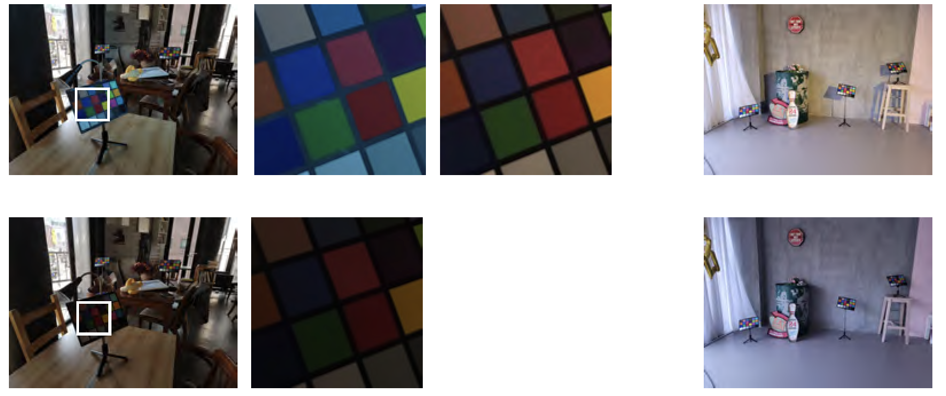
Light and surface interactions

Slide 14
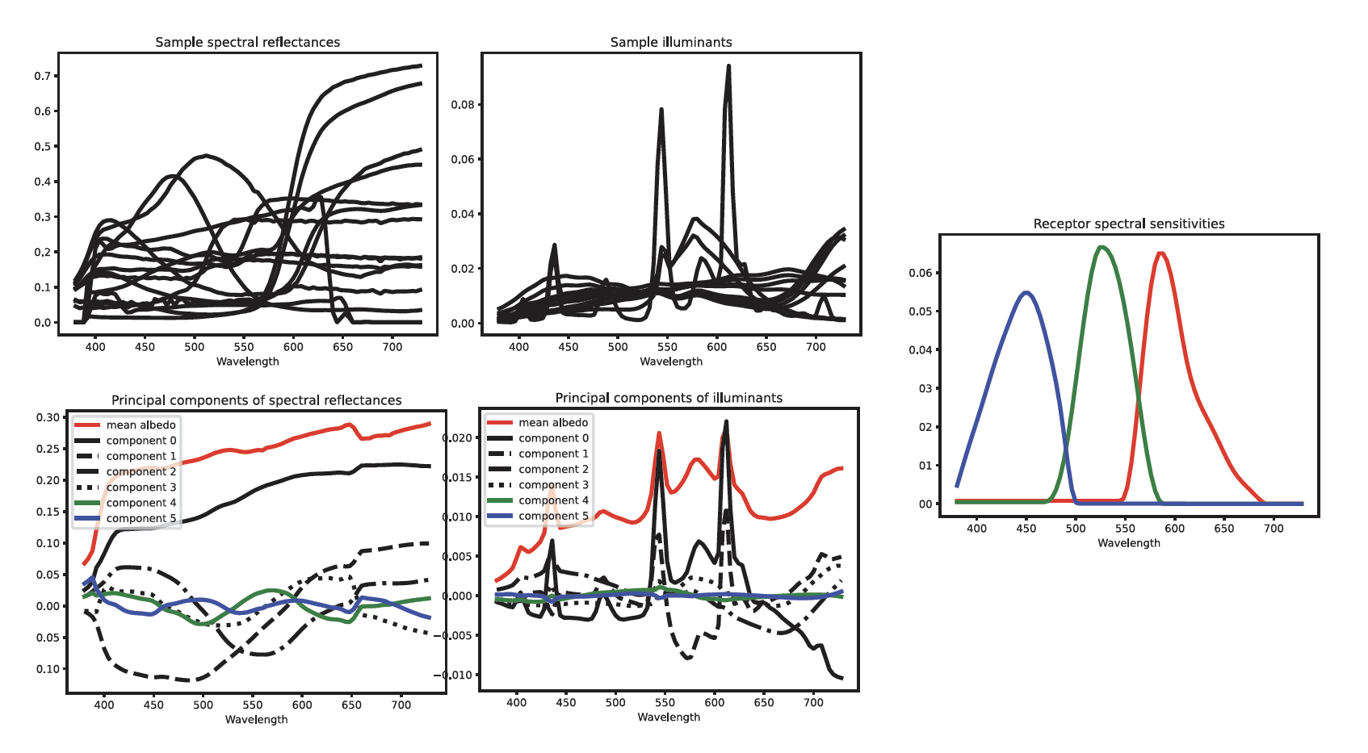
PCA models of light and surface

Slide 15
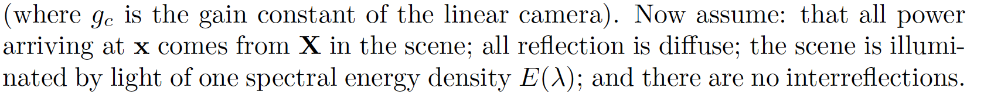
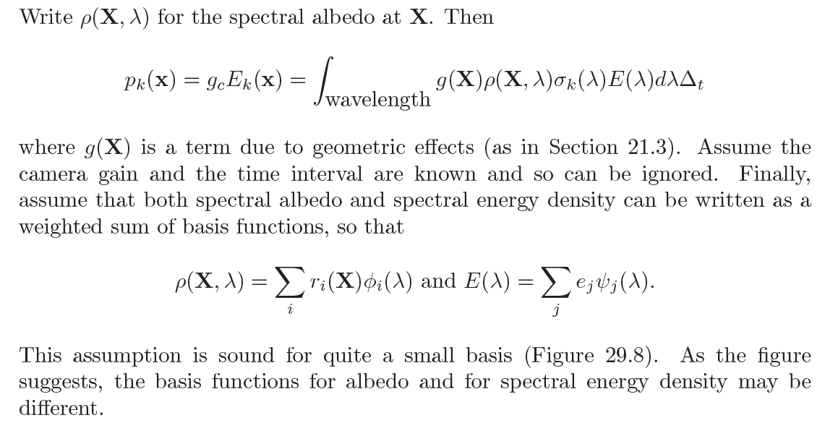
Pixel color model - I

Slide 16
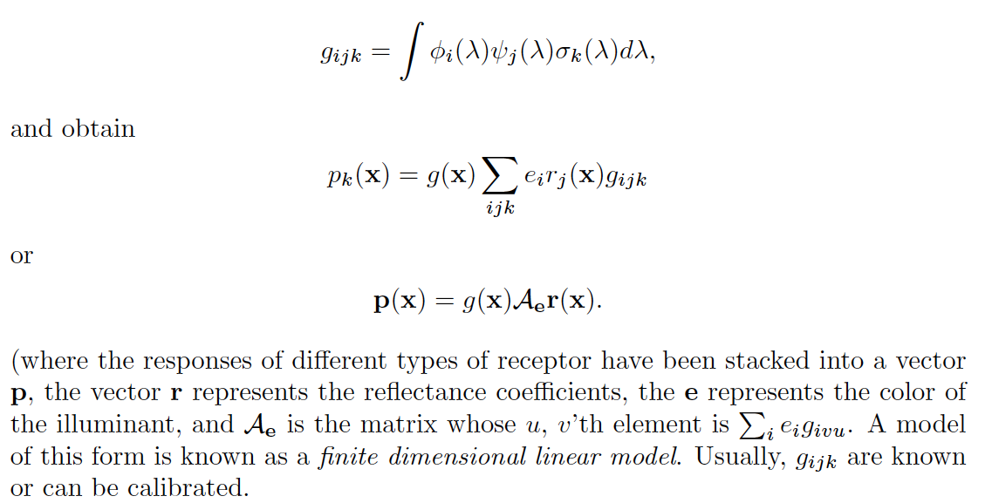
Pixel color model -III

Slide 17
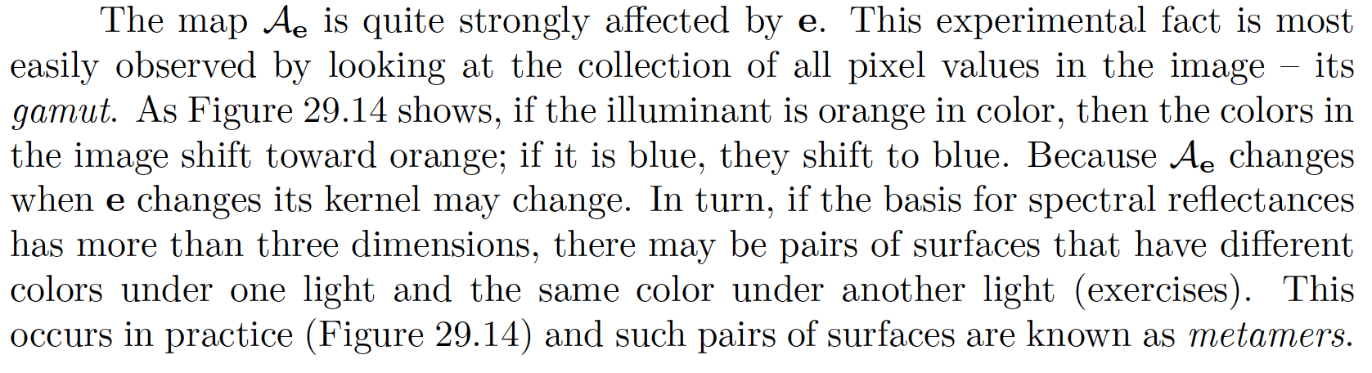
Color mapping

Slide 18
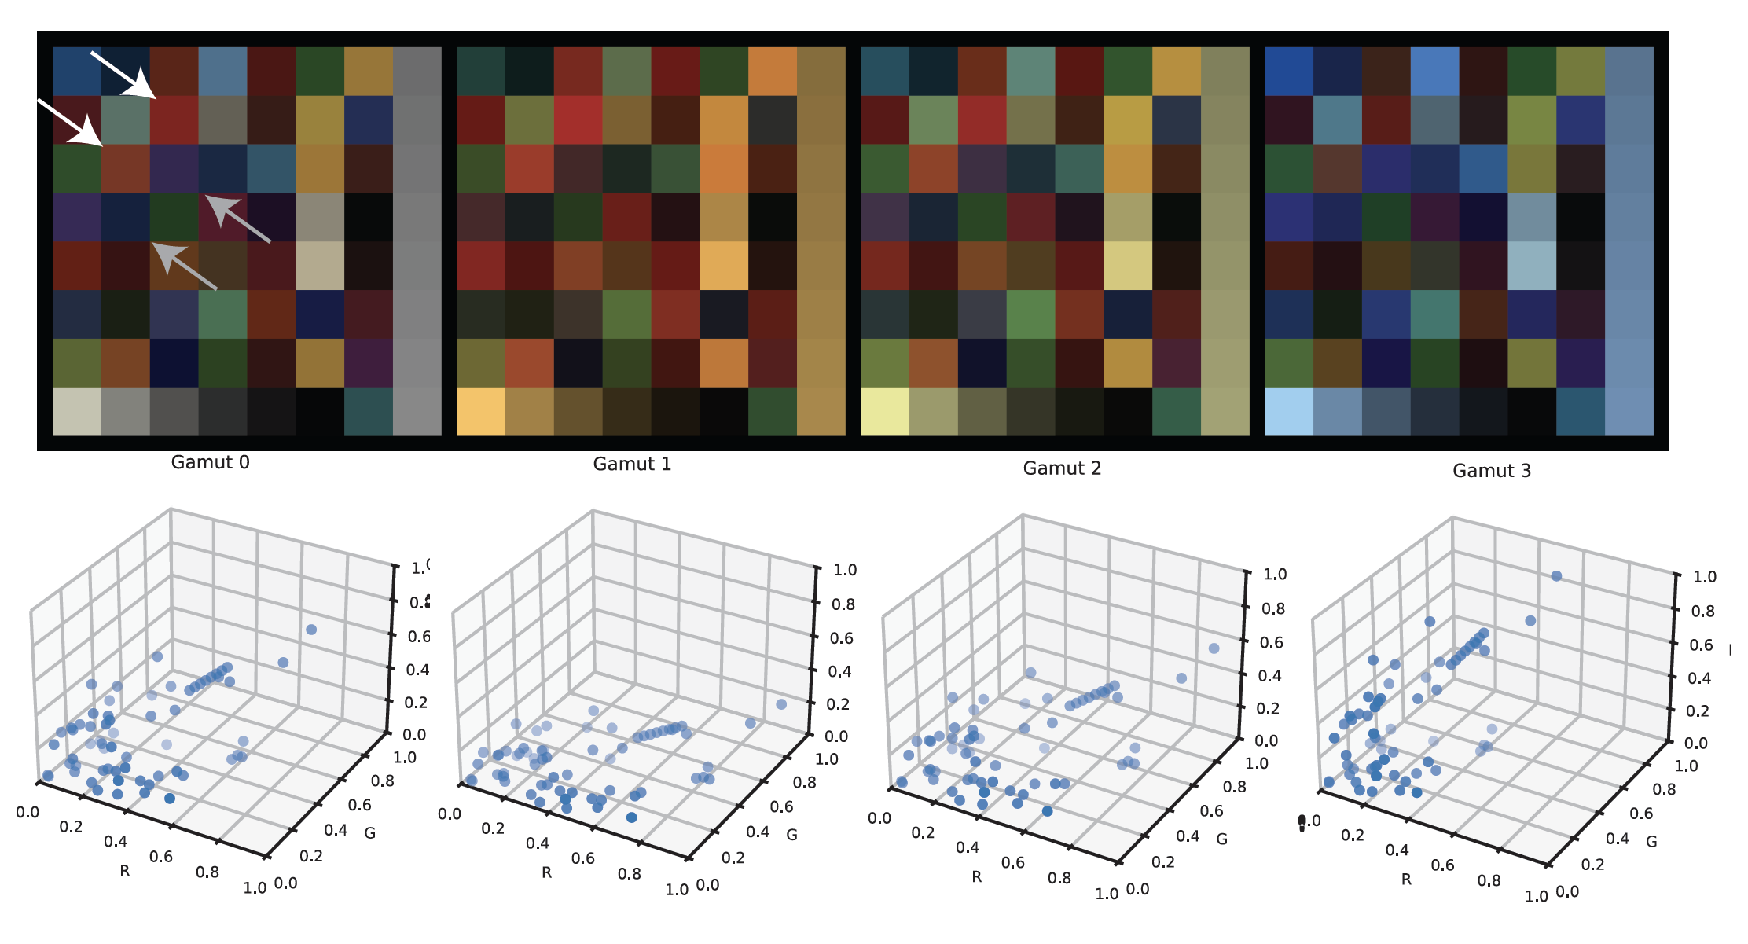
Metamerism and gamuts

