Slide 1
Color:
Color spaces
D.A. Forsyth,
University of Illinois at Urbana Champaign

Slide 2
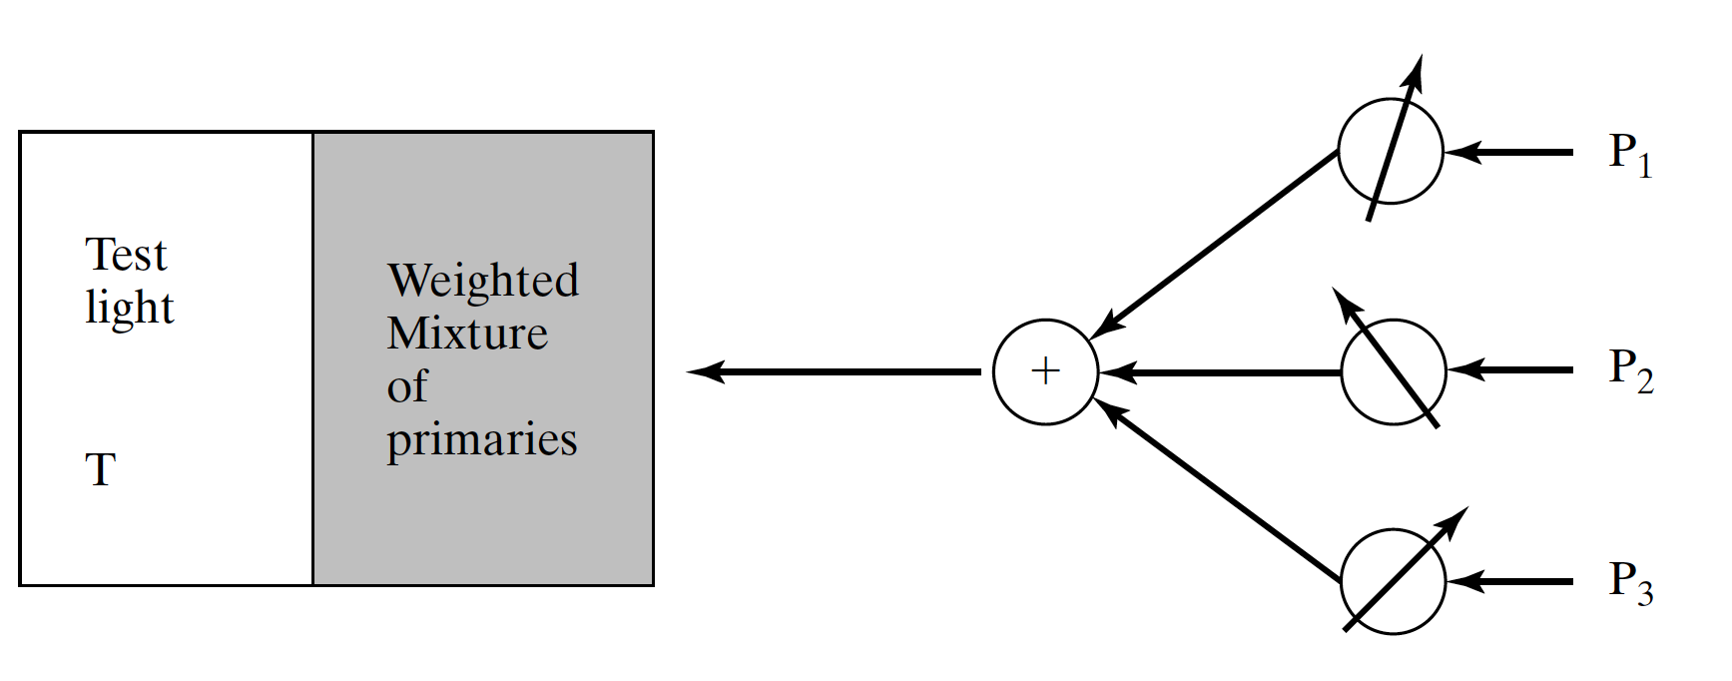
Color matching experiments - I

Slide 3
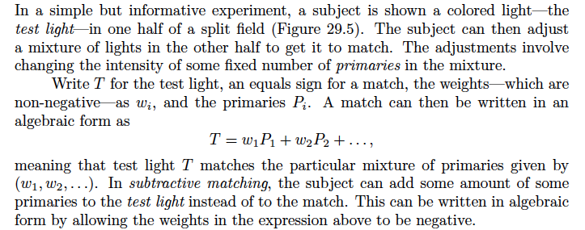
Color matching experiments - II

Slide 4
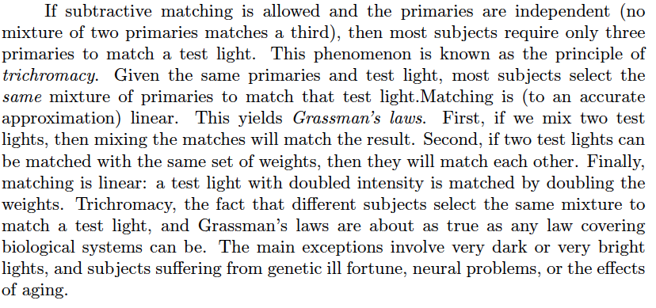
Trichromacy and Grassmann’s laws

Slide 5
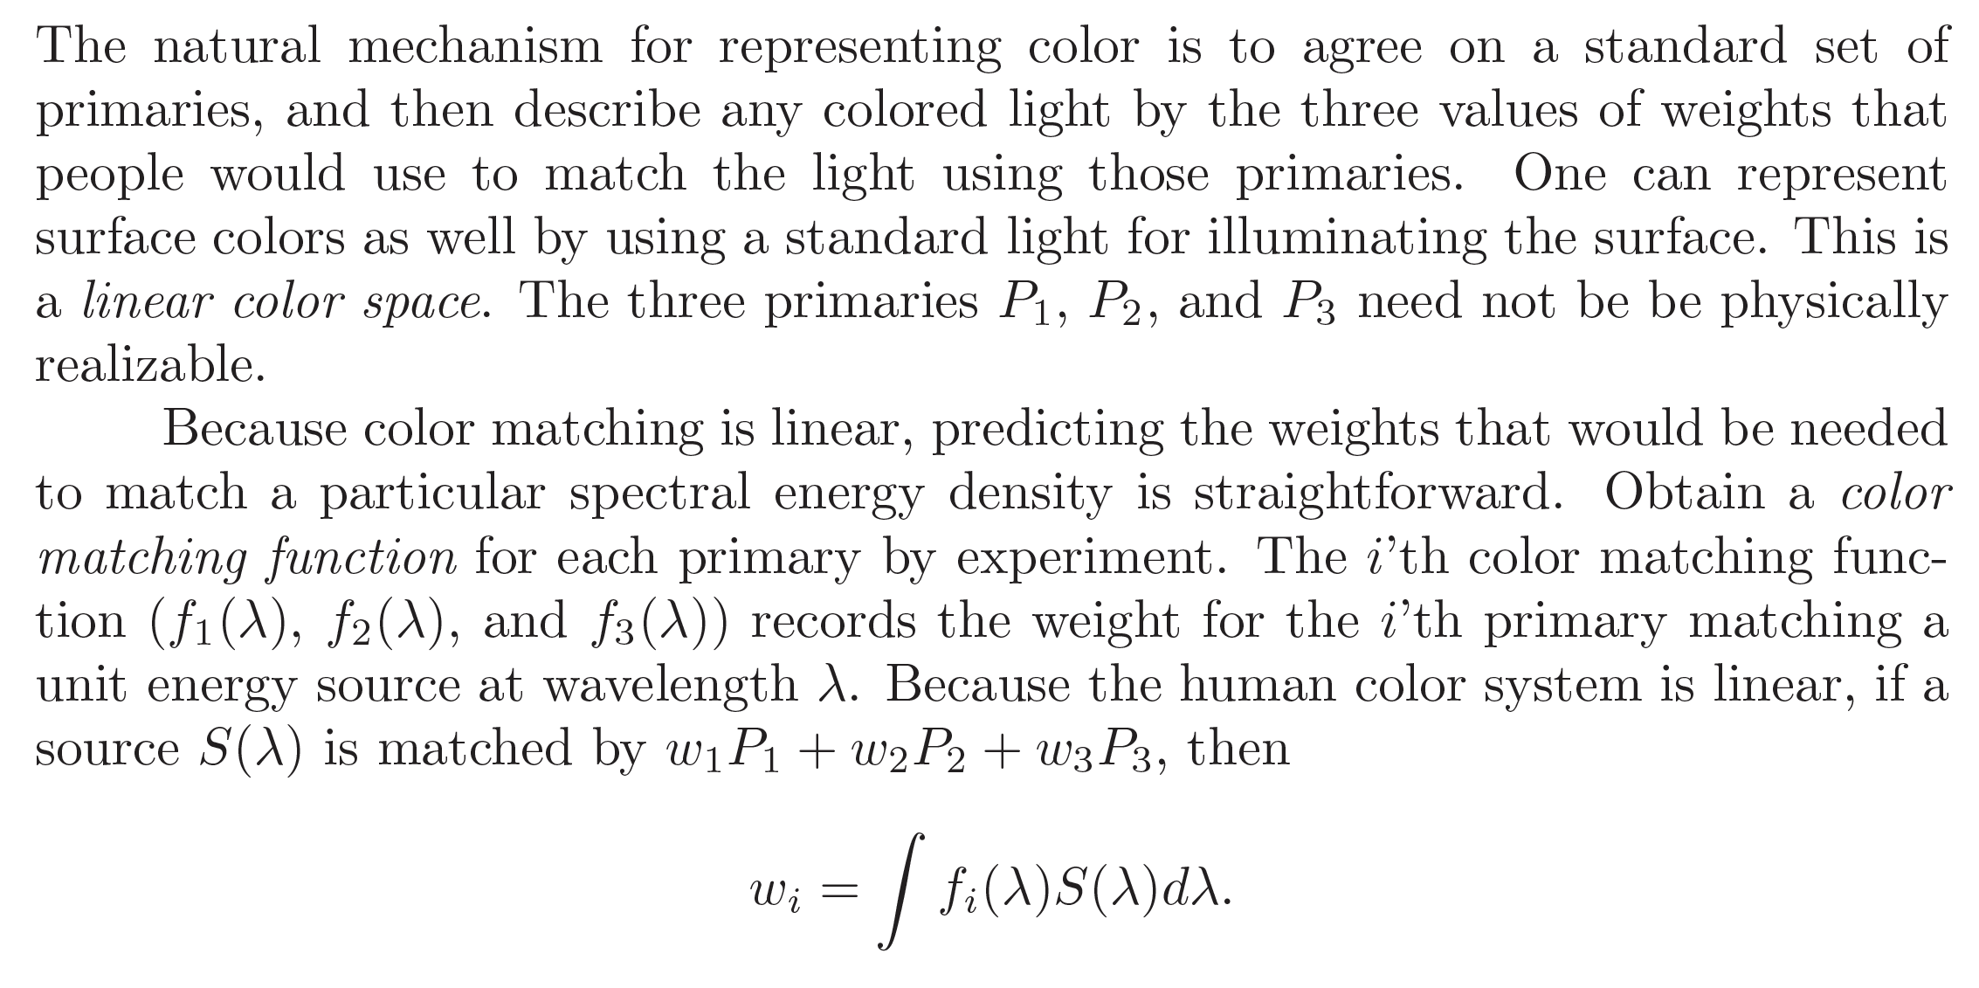
Linear Color Spaces

Slide 6
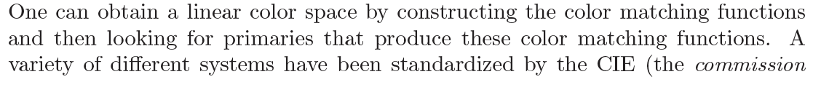
Color space from cmf

Slide 7
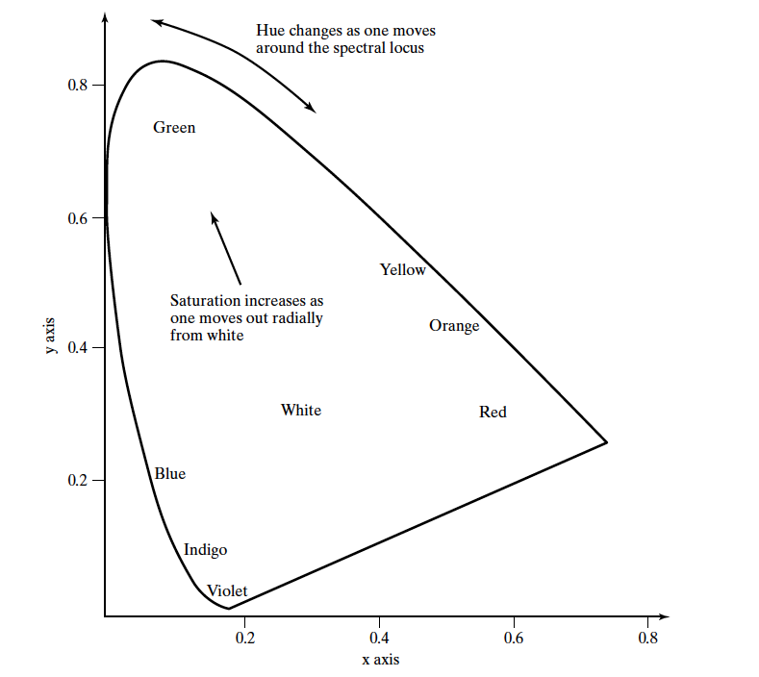
CIE xy
Obtain X, Y, Z from CIE XYZ cmfs
then:
x=X/(X+Y+Z)
y=Y/(X+Y+Z)

Slide 8
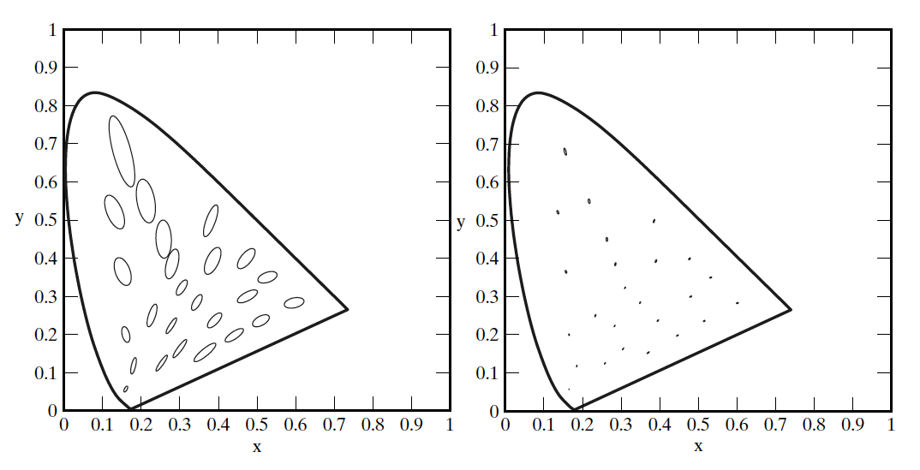
x, y isn’t uniform

Slide 9
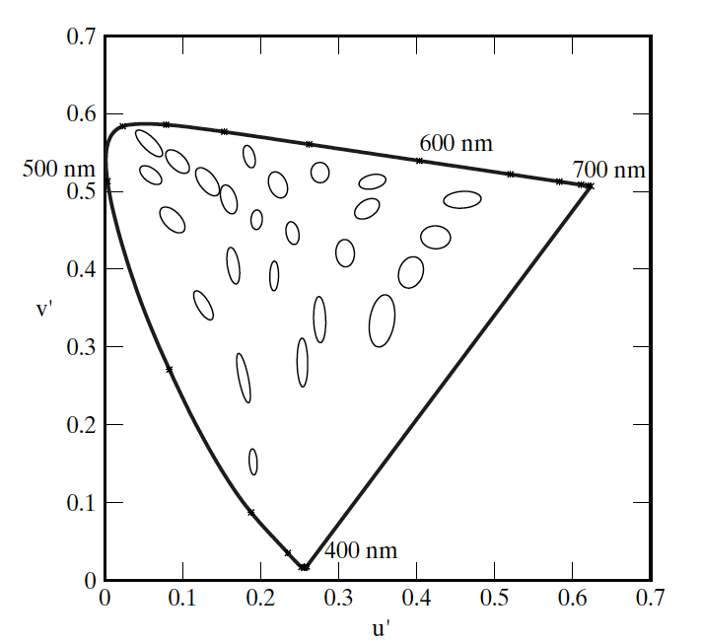
CIE u’, v’ is uniform (ish)

Slide 10
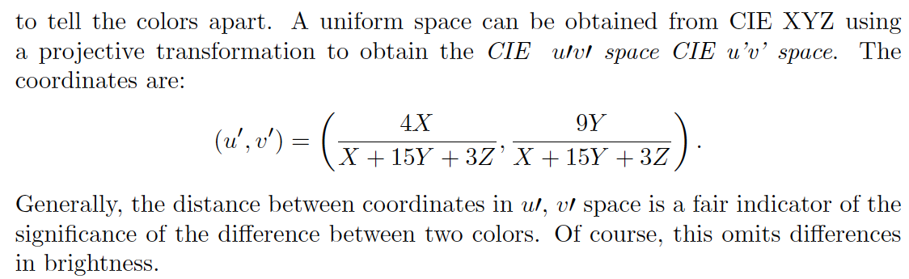
CIE u’, v’ is uniform

Slide 11
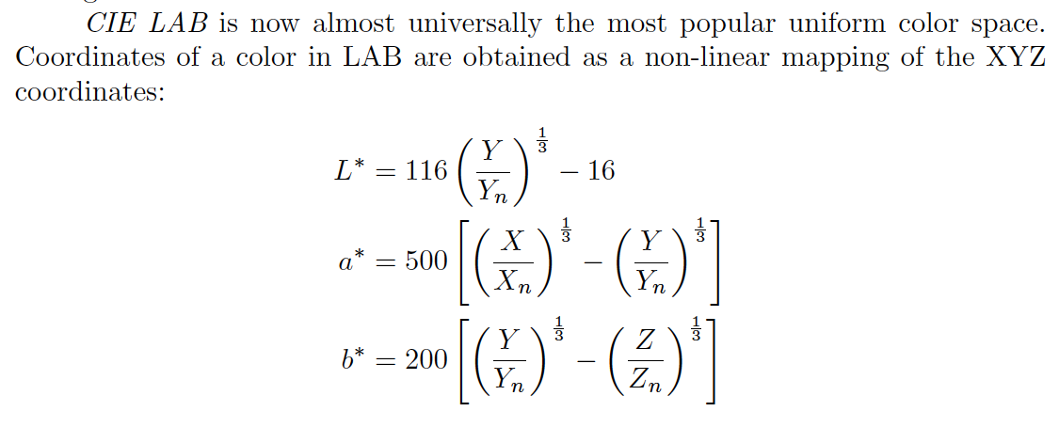
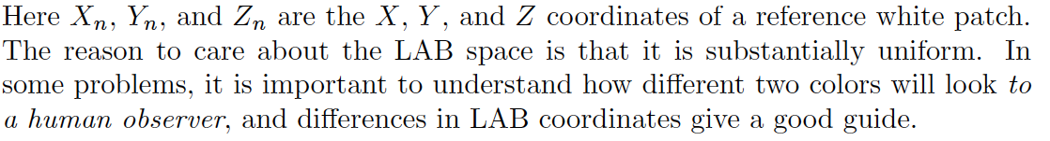
CIE LAB is substantially uniform

Slide 12
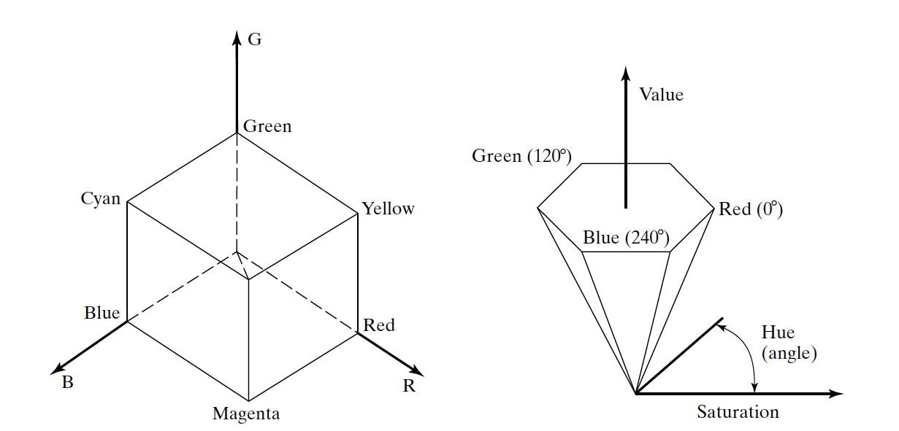
HSV is “natural”

