Slide 1
Depth from a single image
D.A. Forsyth,
University of Illinois at Urbana Champaign

Slide 2
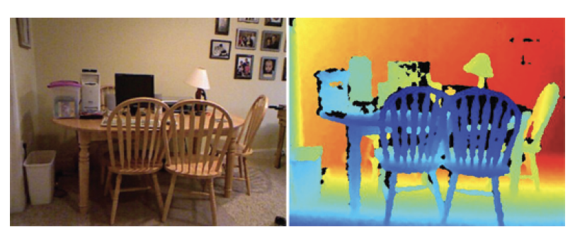
Depth from single image
Data example from NYUV2

Slide 3
What should a depth predictor predict?
Absolute depth:
  Might be very difficult to get right
    compare:
      zoomed picture of a doll-house room
      picture of real room
Relative depth:
  depth up to per-image scale
  more likely to get this right, but harder to use

Slide 4
Scale and error
Nearby objects are more interesting than distant ones
  you collide with them first
Want smaller error in small depths than in large depth
  squared error tends to yield small errors in large predictions
Relative error = error/(true value)
Want smaller relative error in small depths, too

Slide 5
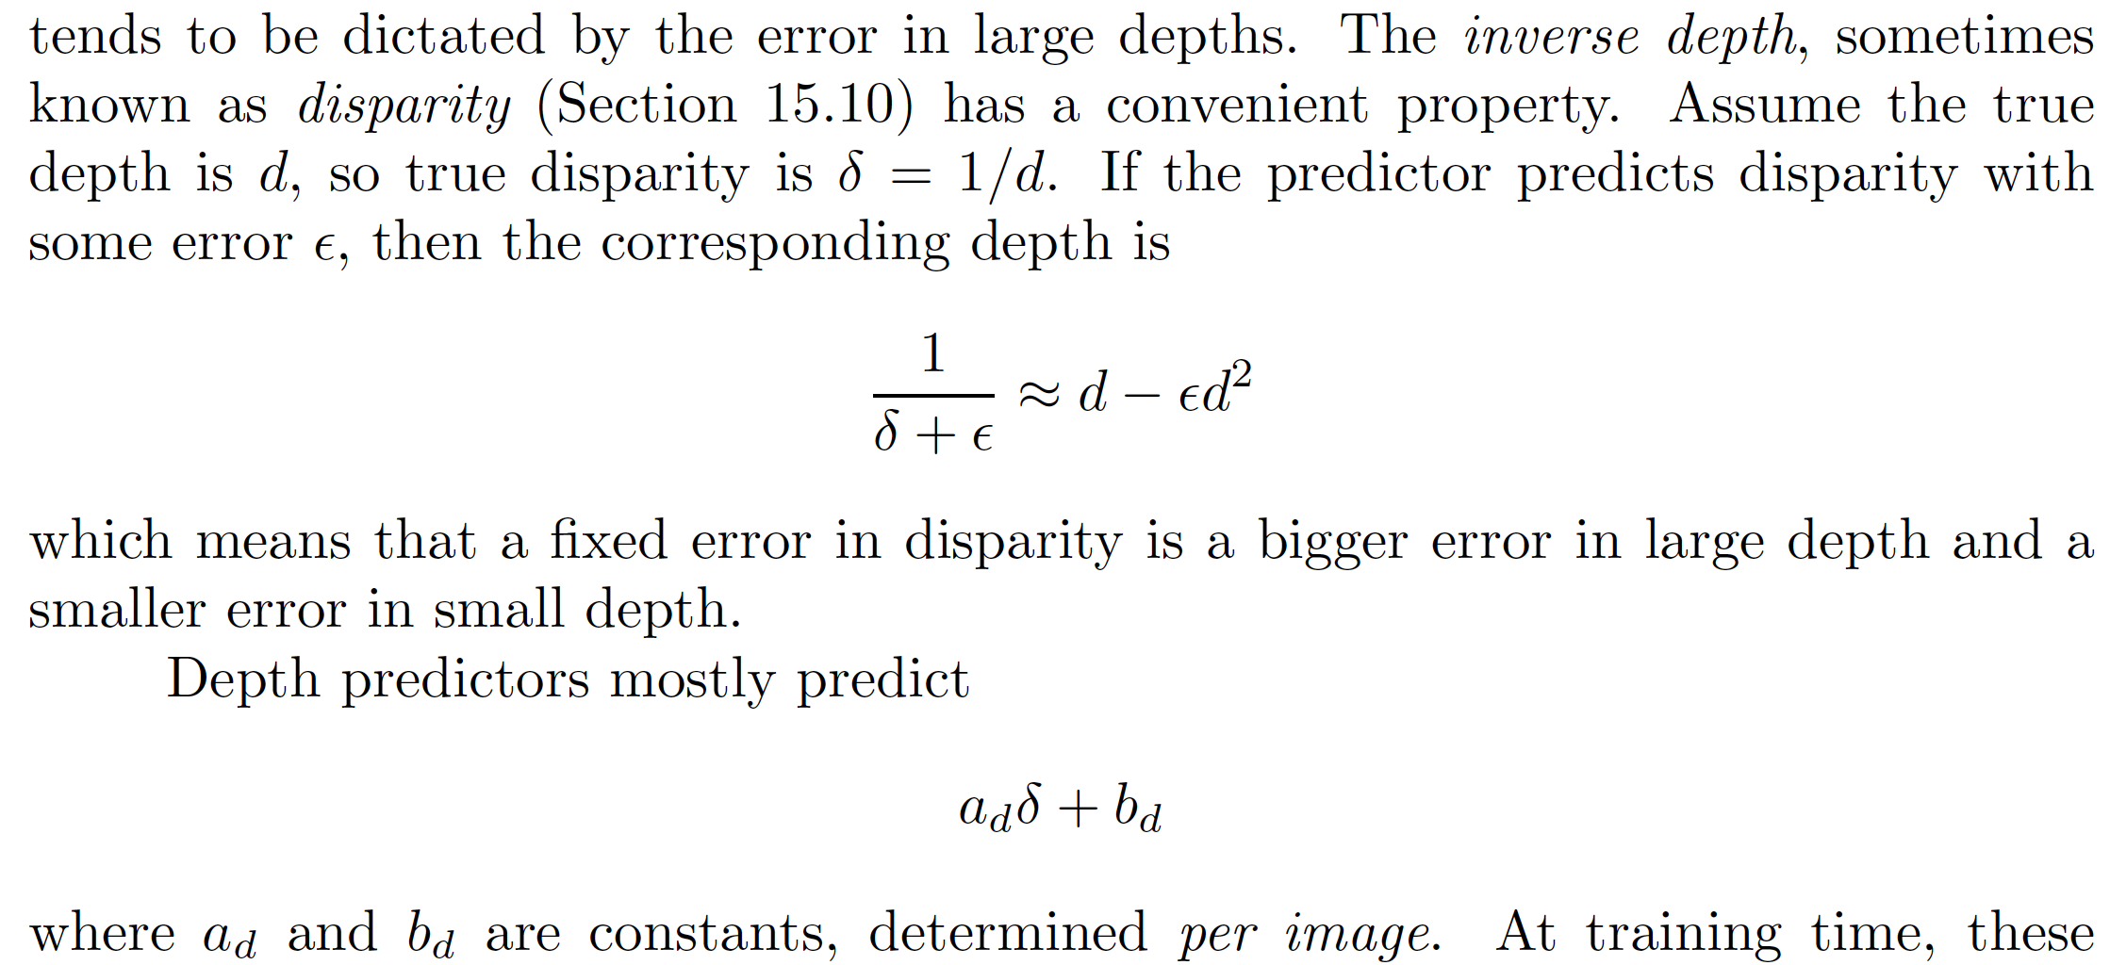
What should a depth predictor predict?
Disparity = (1/depth)

Slide 6
Losses

Slide 7
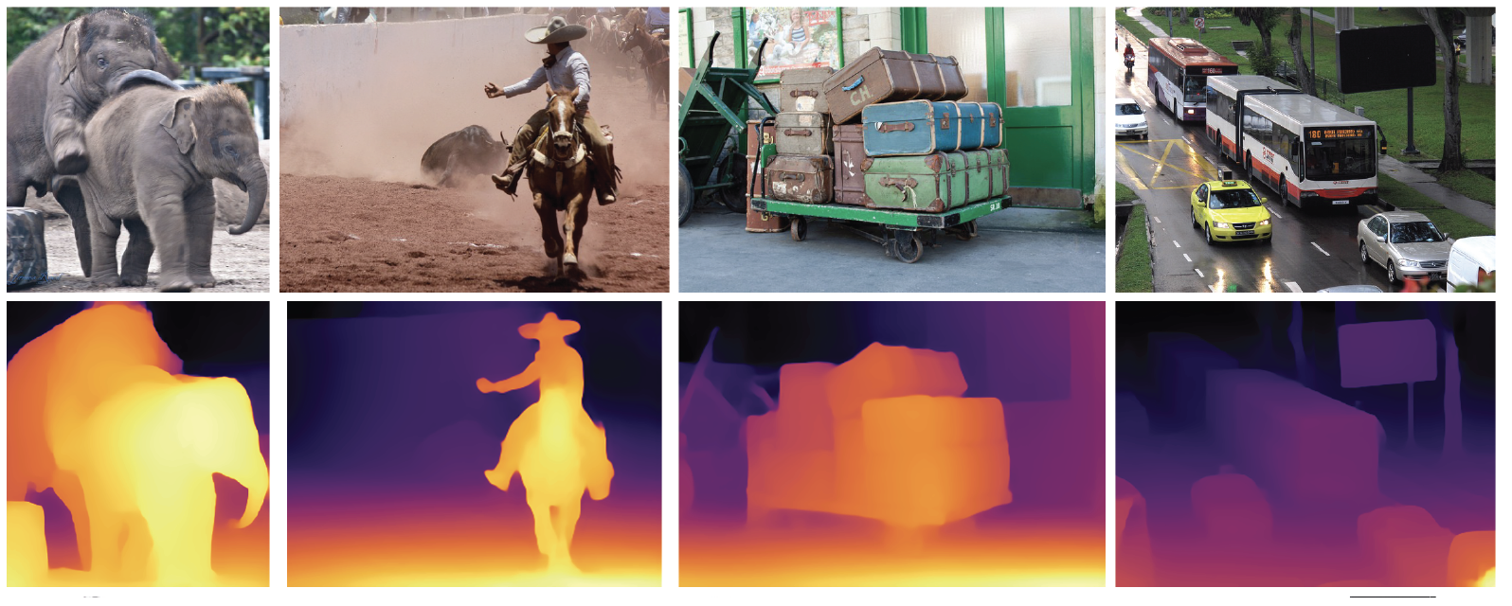
Depth predictors work really well

Slide 8
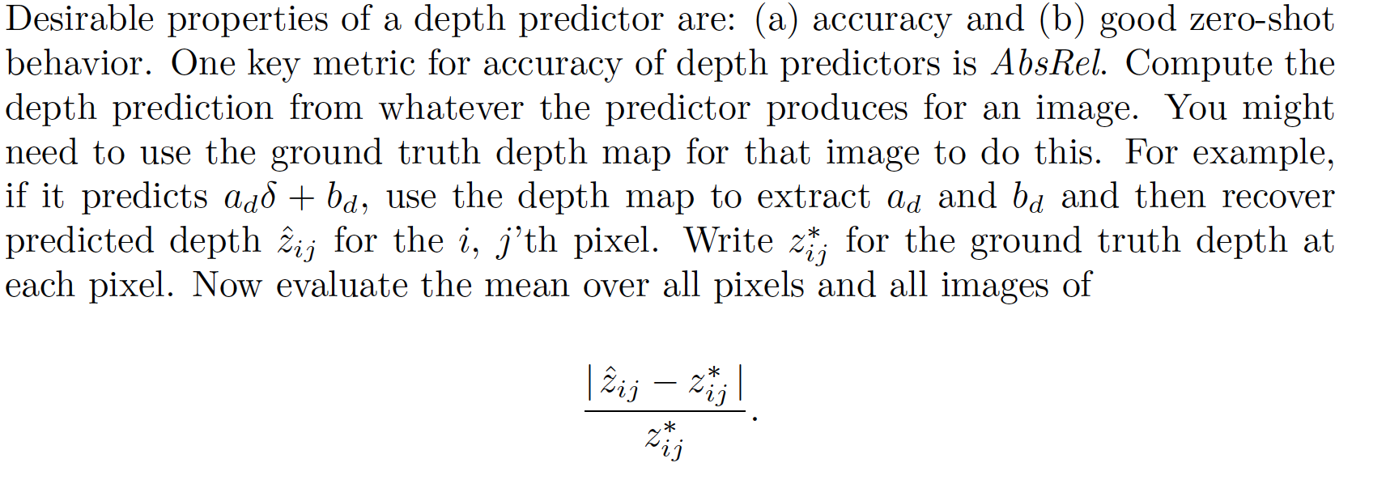
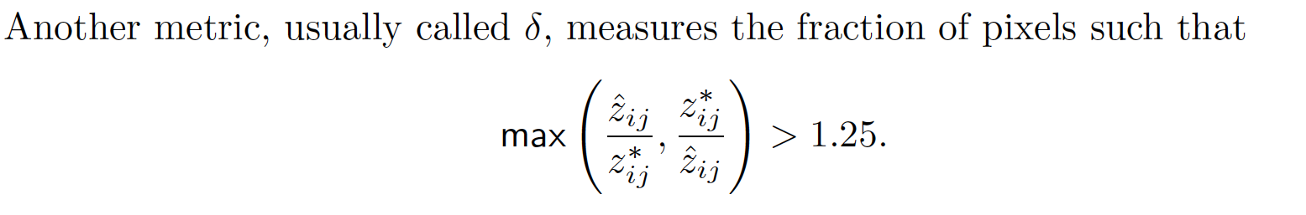
Evaluating depth predictions
Absrel
Delta

Slide 9
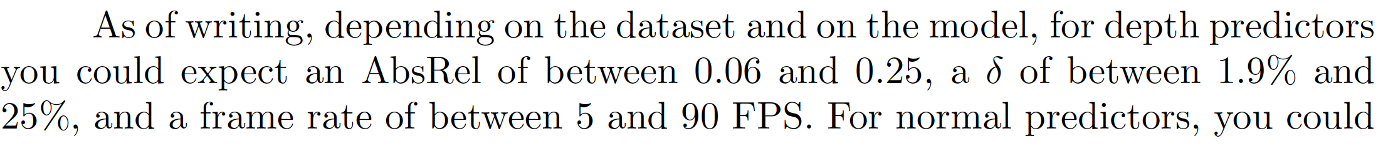
Rough SOTA
Generally, faster is less accurate
  (good sign that payoff makes sense)

Slide 10
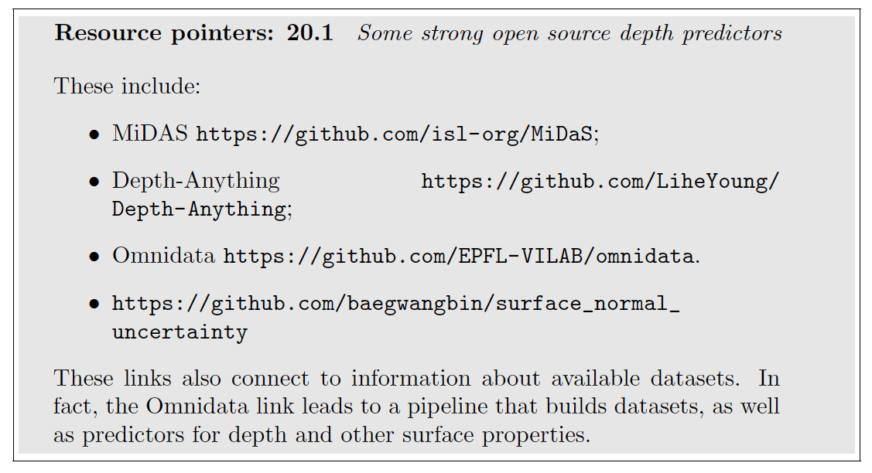
Open source predictors

Slide 11
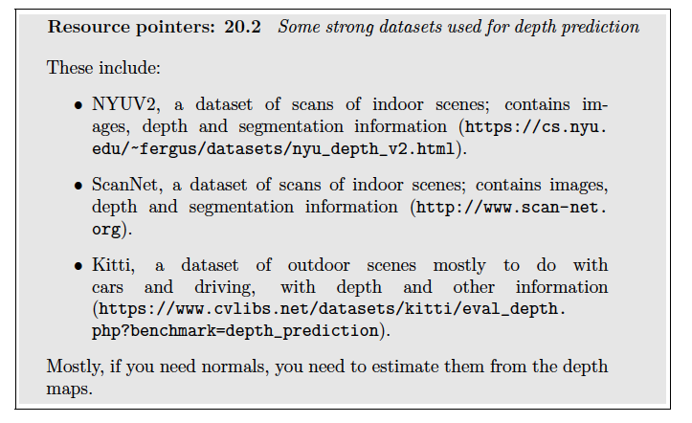
Dataset resources

Slide 12
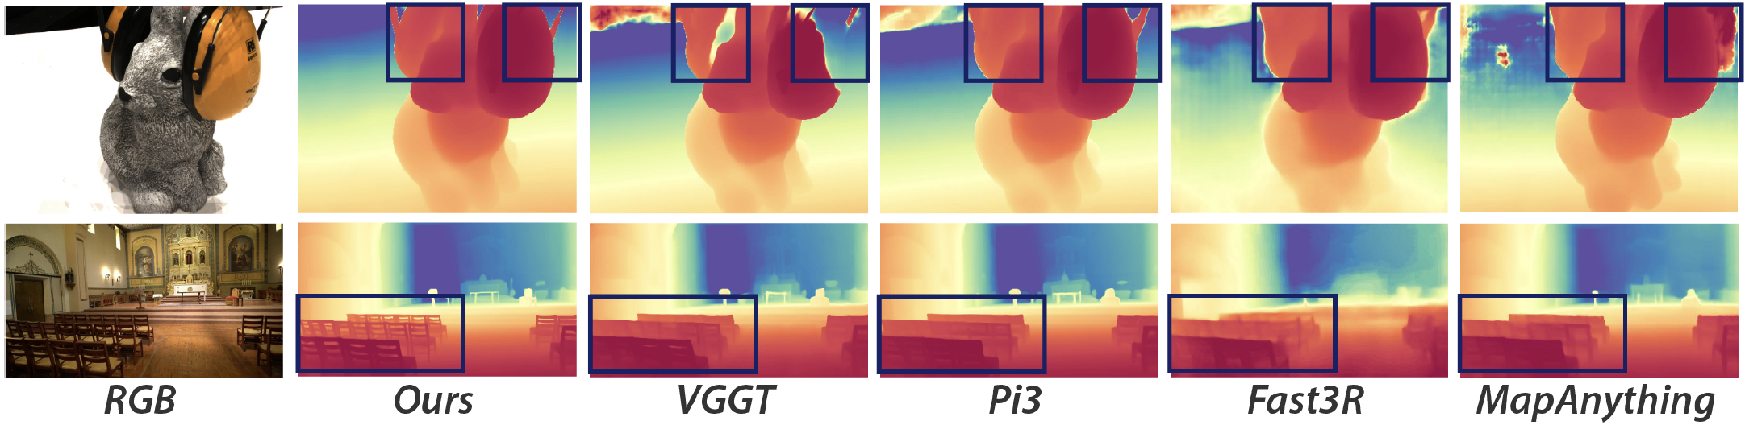
Things to think about...
Limits for single image depth prediction?
  speed
  accuracy
  spatial scale of depth predictions
  synthetic image training
  (eg depthanything v3)

