Slide 1
Smoothing and Downsampling Images
D.A. Forsyth,
University of Illinois at Urbana Champaign

Slide 2
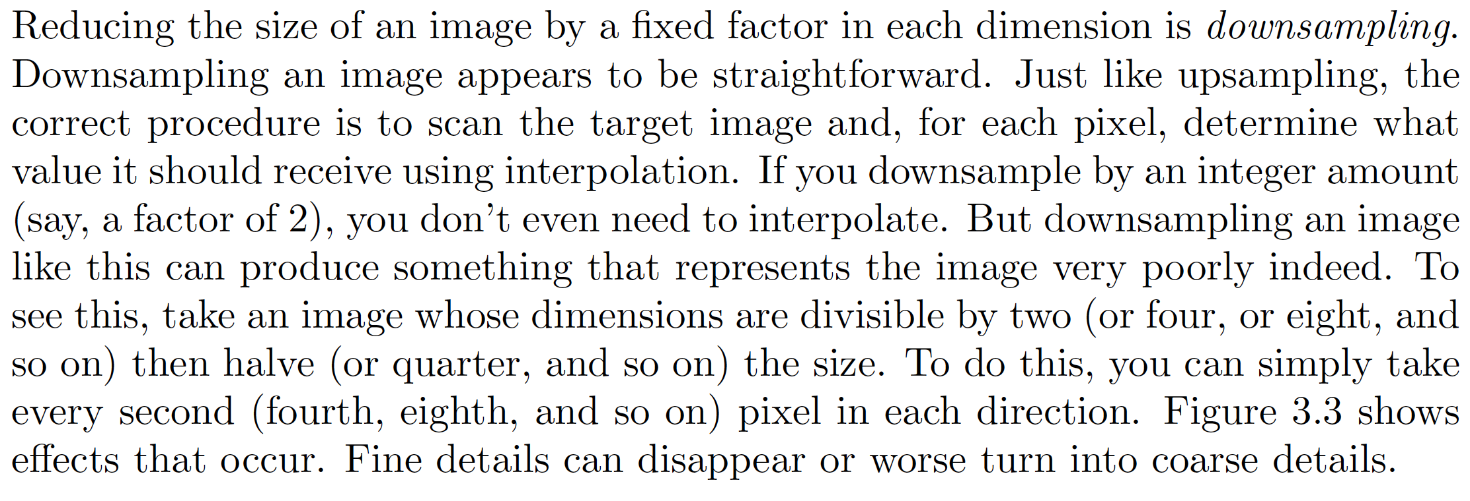
Doing the obvious
The obvious:
Inverse warp, interpolating as required

Slide 3
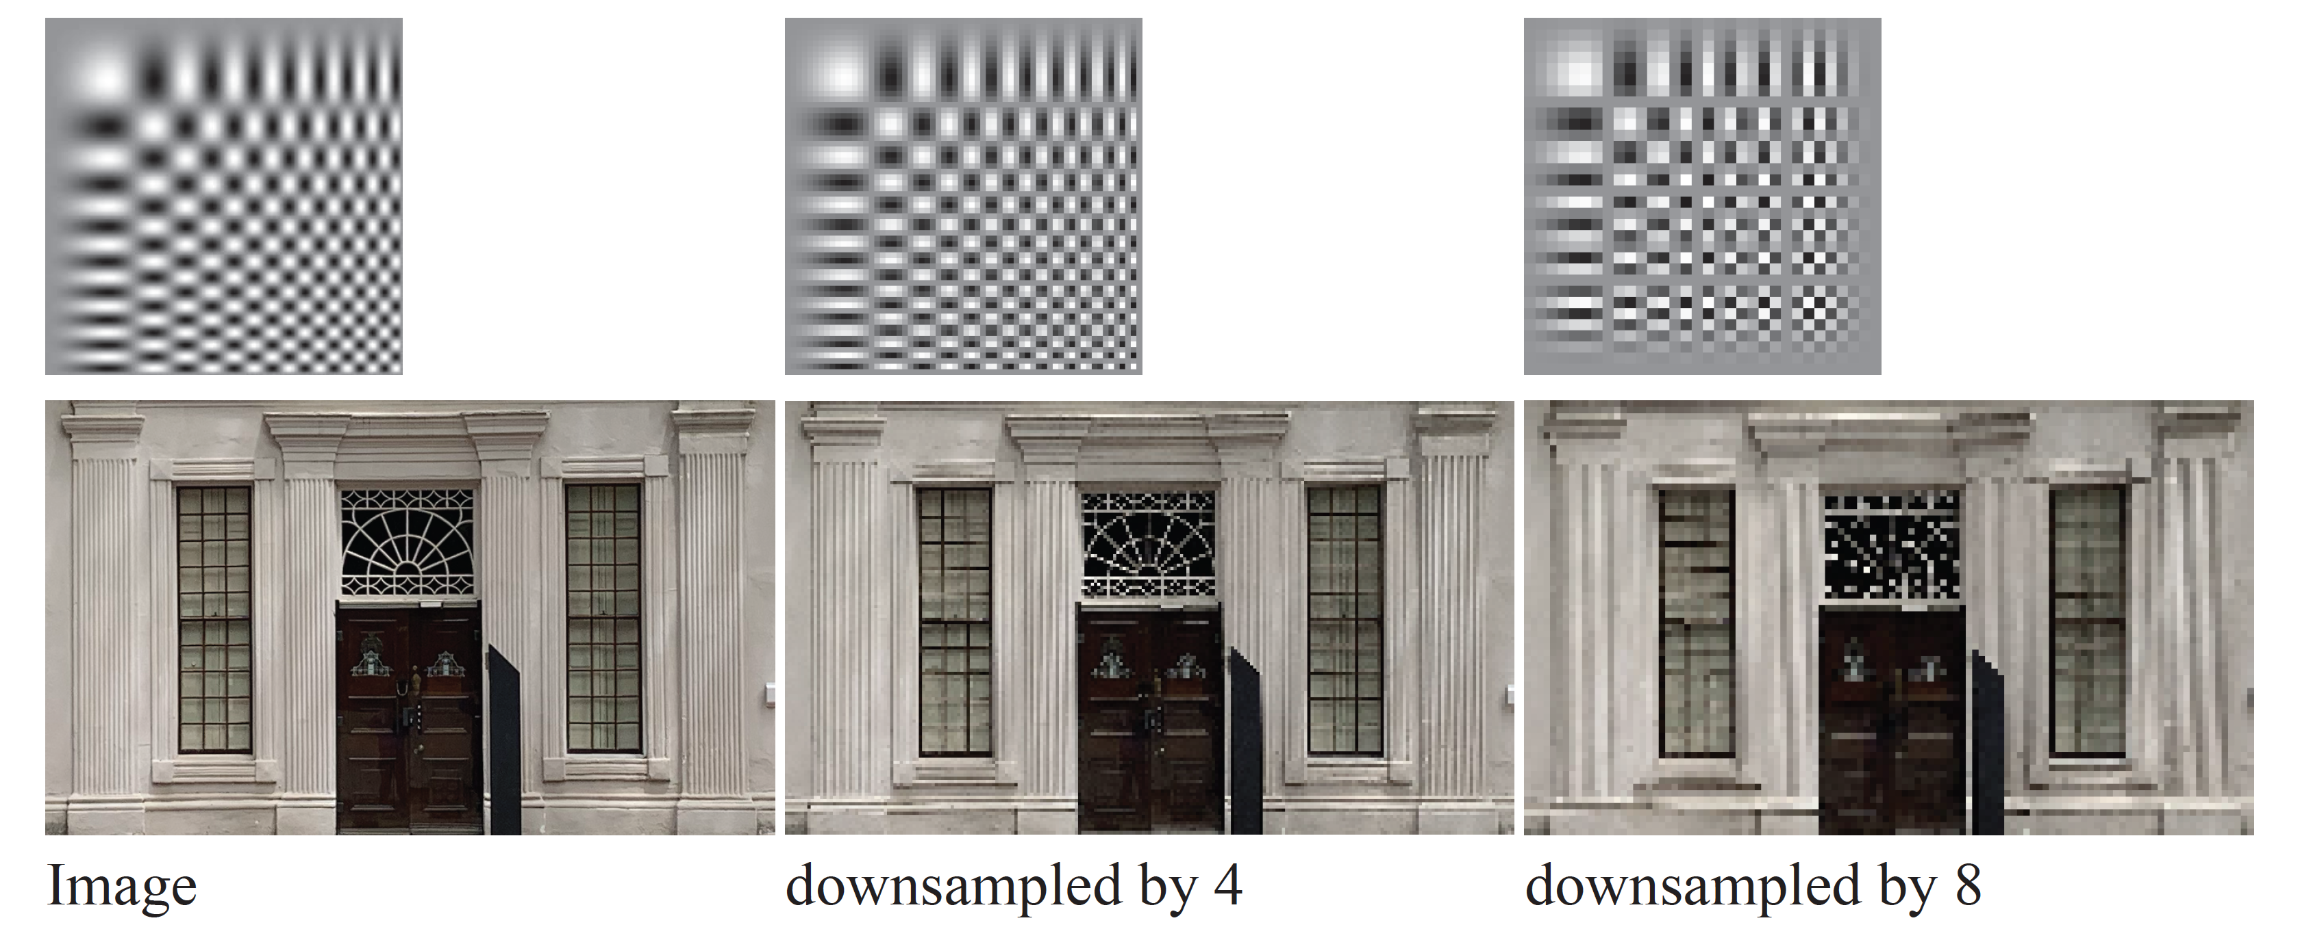
works badly!

Slide 4
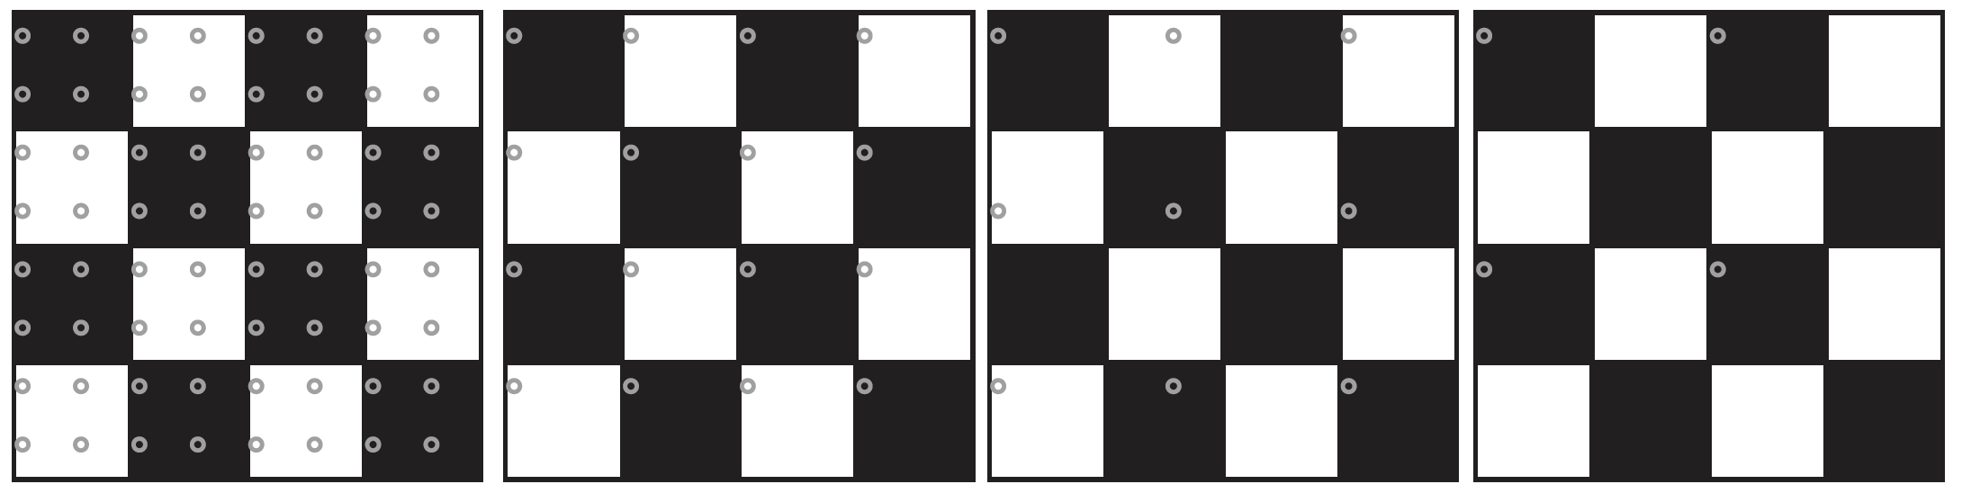
Underlying mechanism

Slide 5
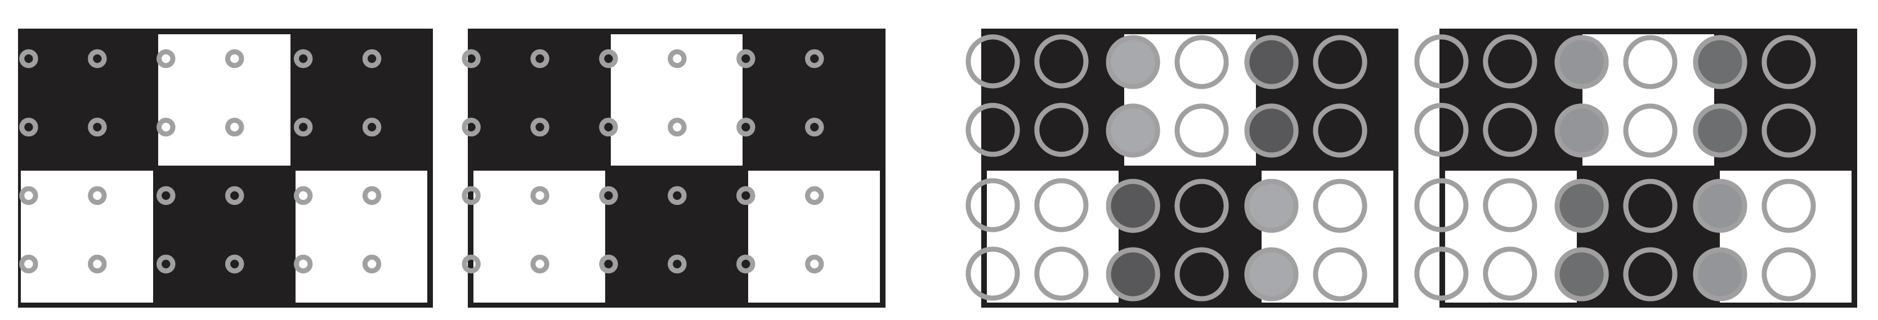
Pooling or averaging might help

Slide 6
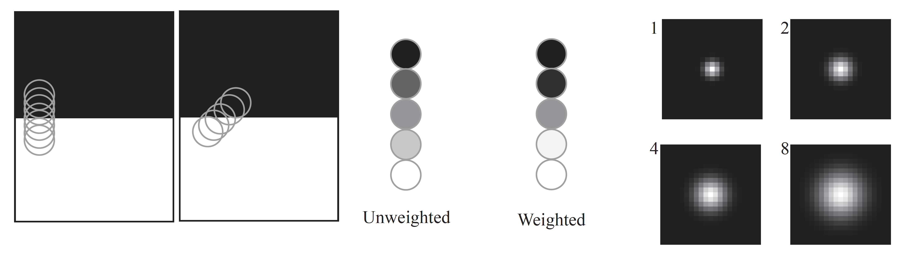
Weighted average -> better representation

Slide 7
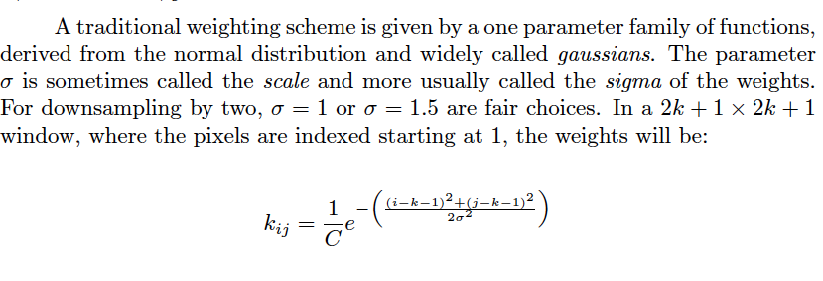
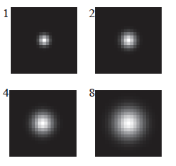
Gaussian weights

Slide 8
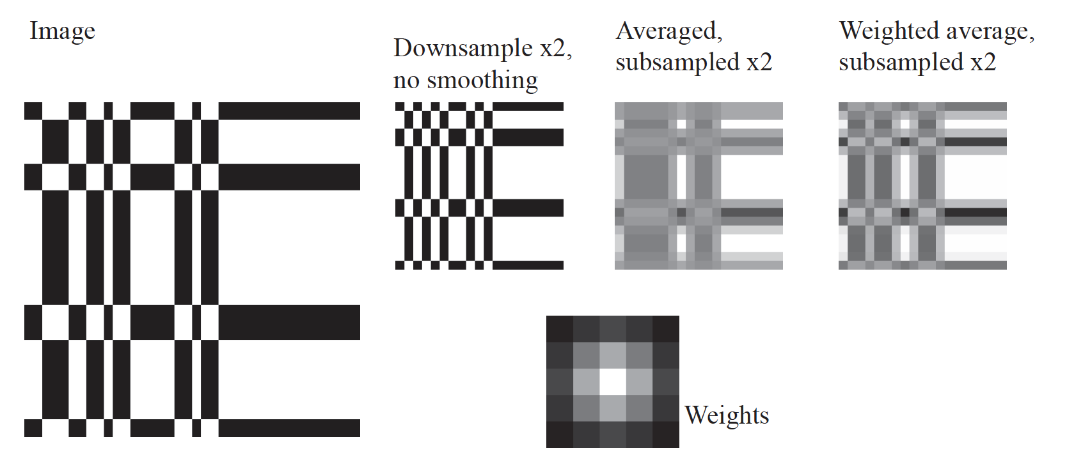
Just averaging is actually a bad idea

Slide 9
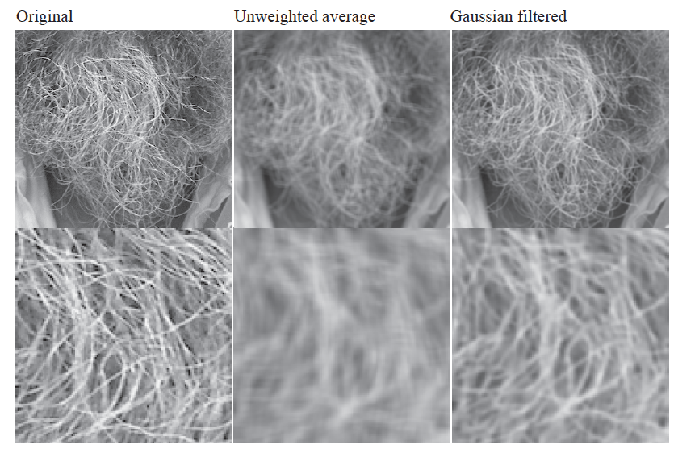
Just averaging is actually a bad idea

Slide 10
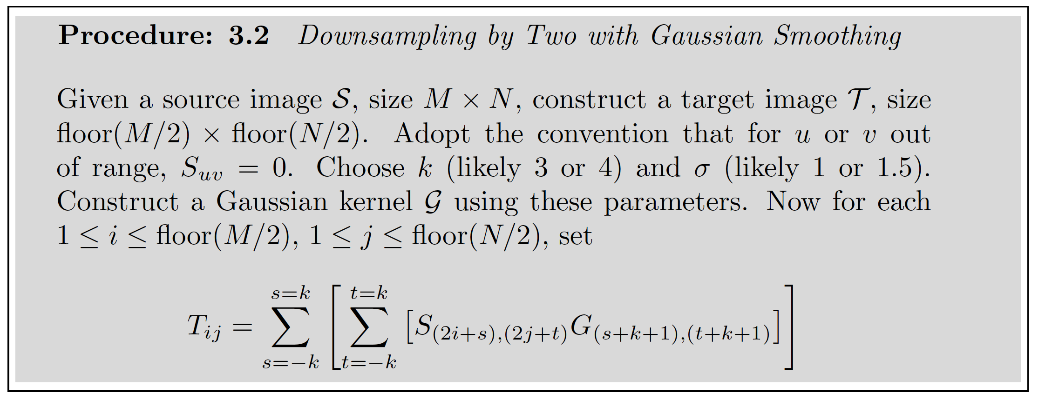
Easy case: downsample by two

Slide 11
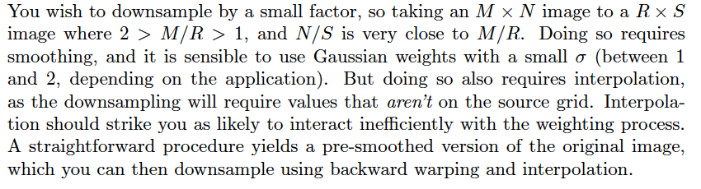
Downsample by small factor

Slide 12
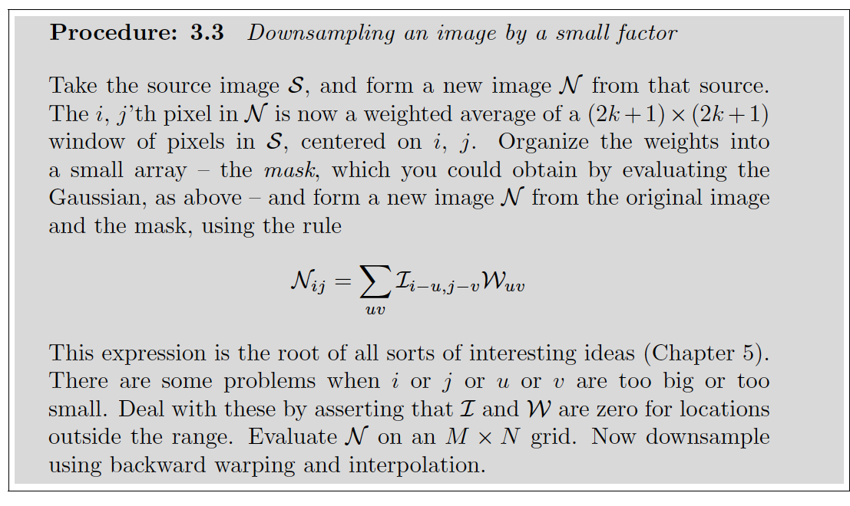
Downsample by small factor
Smooth image, then downsample

Slide 13
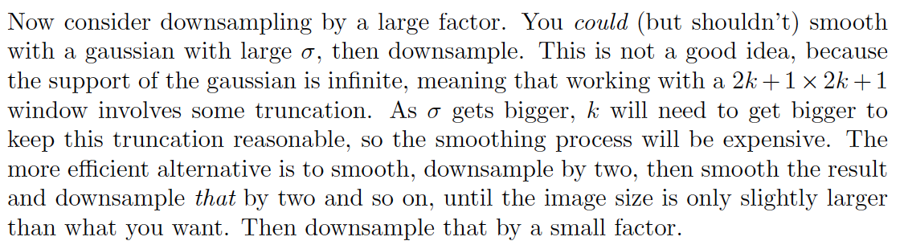
Downsampling by a big factor

Slide 14
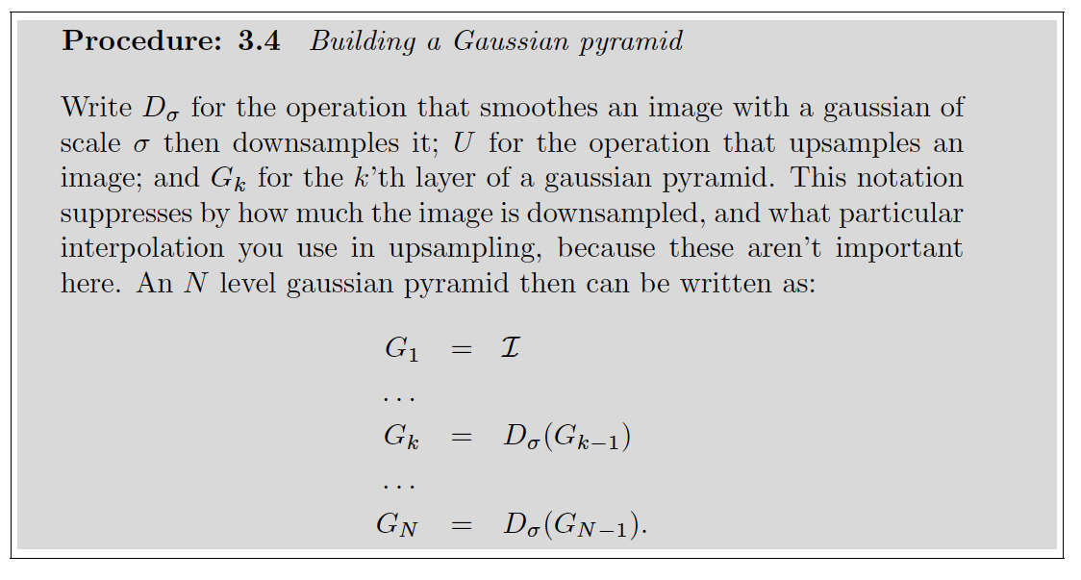
Gaussian pyramid

Slide 15
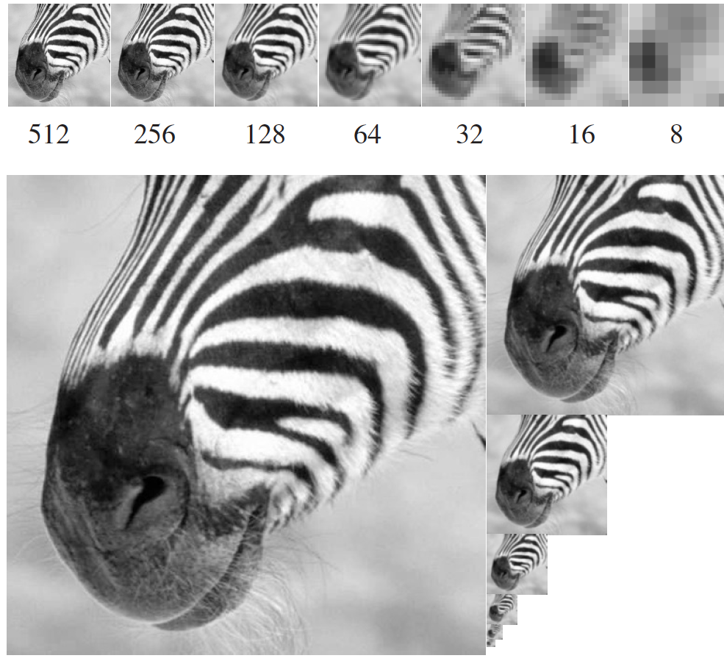
G.P.

Slide 16
Laplacian pyramid
Gaussian pyramids are redundant

Slide 17
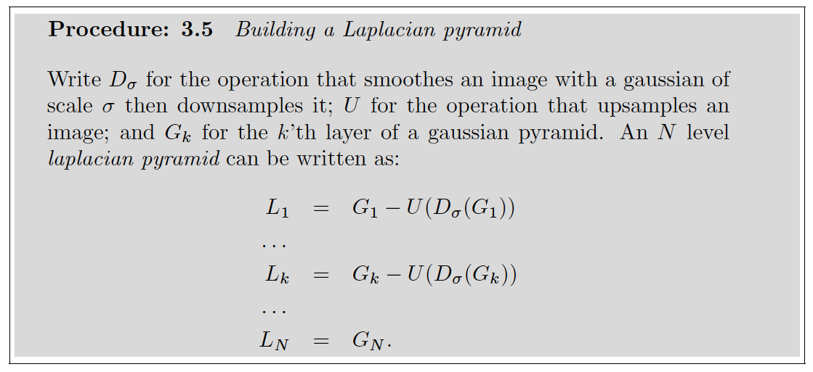
Laplacian pyramid

Slide 18
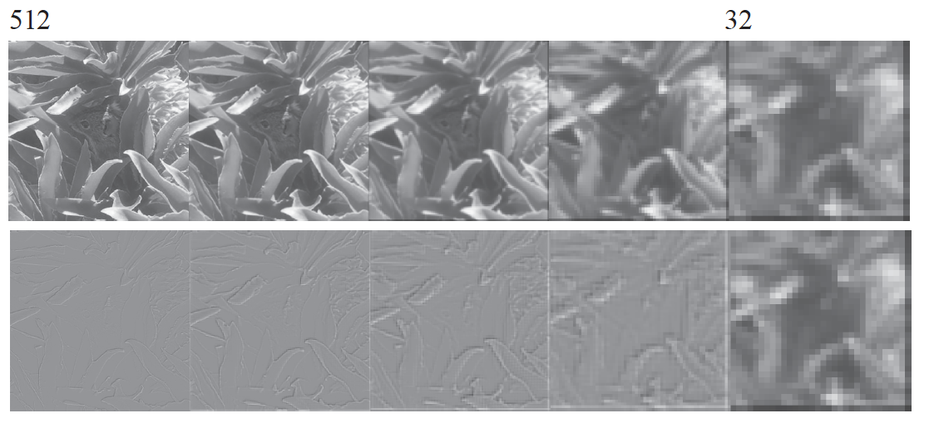
Gaussian vs Laplacian

Slide 19
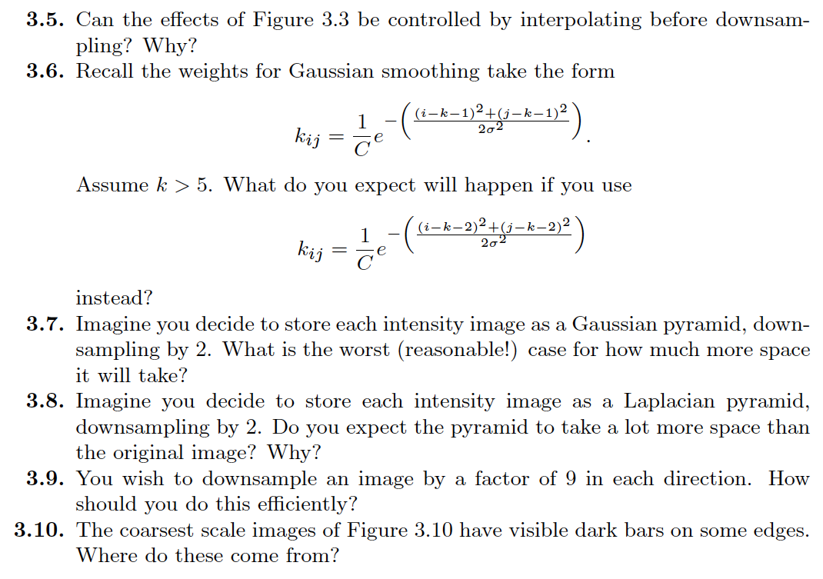
Things to think about...

