Slide 1
Edge detection by UNet
D.A. Forsyth,
University of Illinois at Urbana Champaign

Slide 2
Ideas:
Simple Image Classification:
  Classify an image into one of two classes by
    Stack some pooling, FC layers on an encoder
    Adjust result into a vector
    Pass to linear classifier
  Learn all parameters with SGD and various losses
    get training examples right
Simple image regression:
  Build U-Net
    input is image
    output is image-like thing (depth,normal, etc)
    train to produce the right answer
Merge these to produce class scores at each pixel
  rather than a depth...

Slide 3
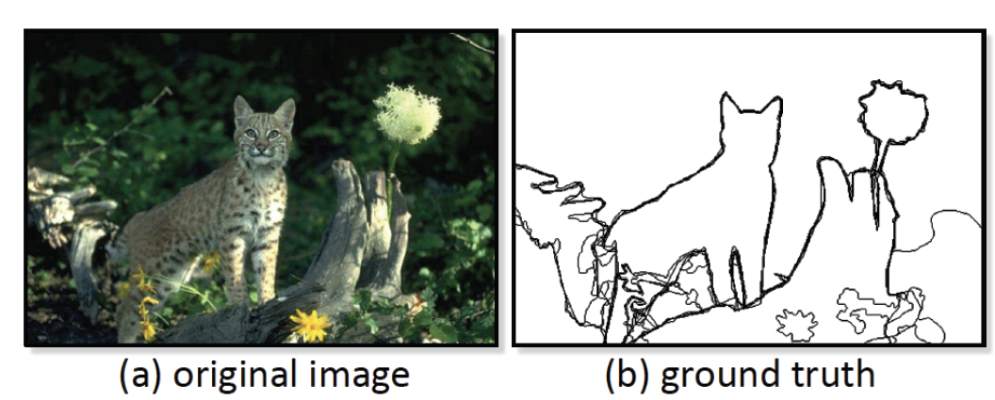
Edges
Training is tricky
  No ”true” ground truth!
Berkeley segmentation data set:
  get numerous people to mark boundaries in images

Slide 4
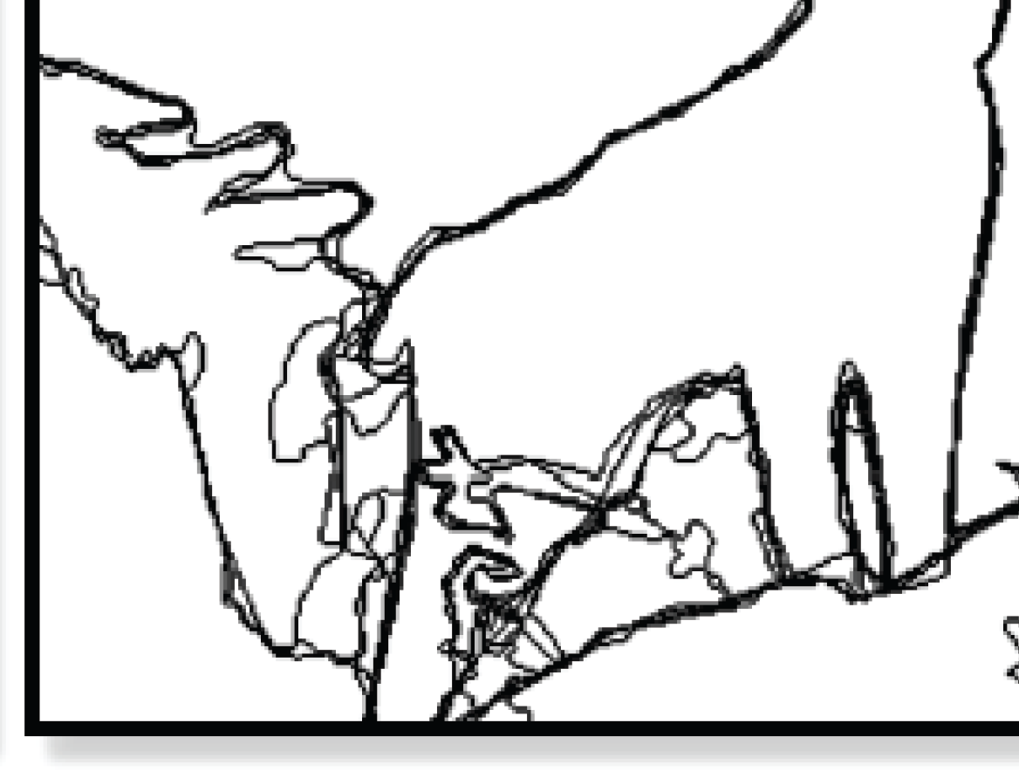
Zoom on ground truth
Multiple ground truths

Slide 5
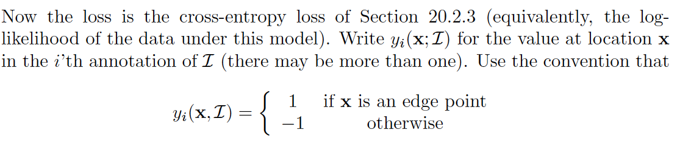
Using the data

Slide 6
Learning to classify edge points
At a high level, straightforward
  construct decoder to produce a score at each pixel
interpret the score as
network
parameters
score
location in image
image

Slide 7
Learning to classify edge points
At a high level, straightforward
  Use cross entropy loss at each location for each example
Careful:
  examples are (I_i, y_i(x))
    i.e. an image and an annotation
    different examples might have the same image
      cause different annotators mark up the same image
Loss for network:
  sum cross-entropy over all locations of all examples
This works very badly – predicts no-edge everywhere

Slide 8
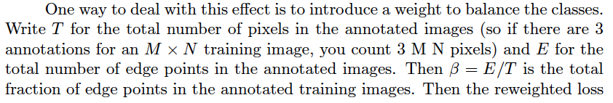
Works badly
Edge points are rare
  it is hard to beat just saying there aren’t any
Idea:
  reweight loss (high weight on edge points, low on non-edge)

Slide 9
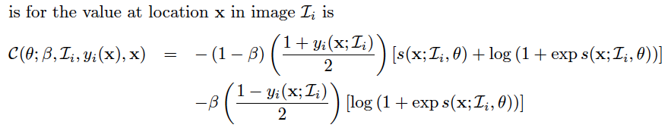
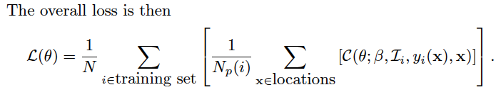
Weighted loss

Slide 10
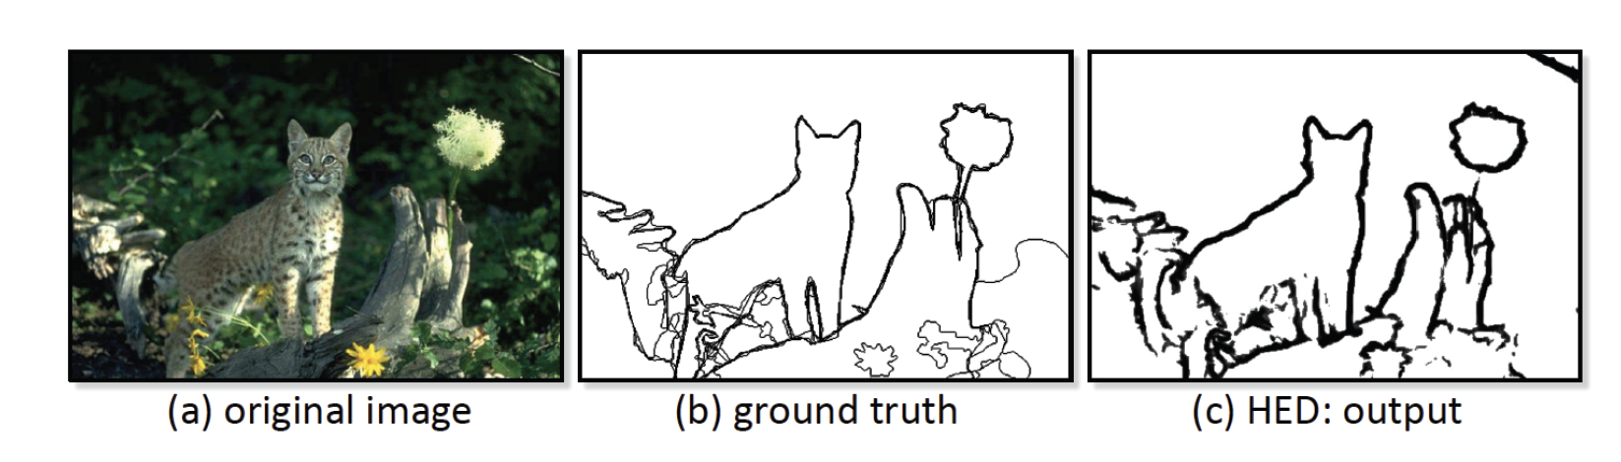
Works fine, but
  evaluation is quite tricky (notes)
  essentially, putting an edge point close to the right location should have some value
scoring appropriately requires care

Slide 11
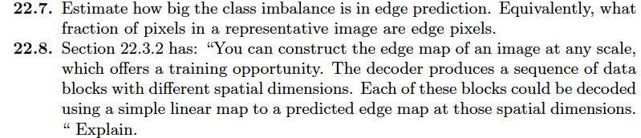
Think about this...

