Slide 1
The Extended Kalman Filter or EKF
D.A. Forsyth,
University of Illinois at Urbana-Champaign

Slide 2
Kalman filter is wonderful, but…
Linear measurement isn’t always helpful
  Example:
    our localization procedures
Linear model of movement isn’t always helpful
  Example:
    simple car model (next)
What to do about non-linearities?

Slide 3
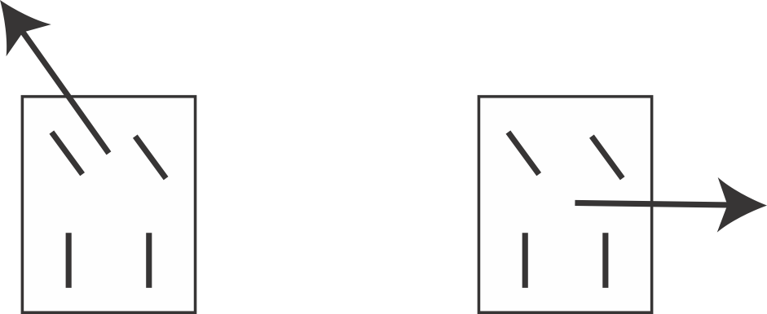
Example: Nasty dynamical model
OK
Not OK
Formally: car is non-holonomic

Slide 4
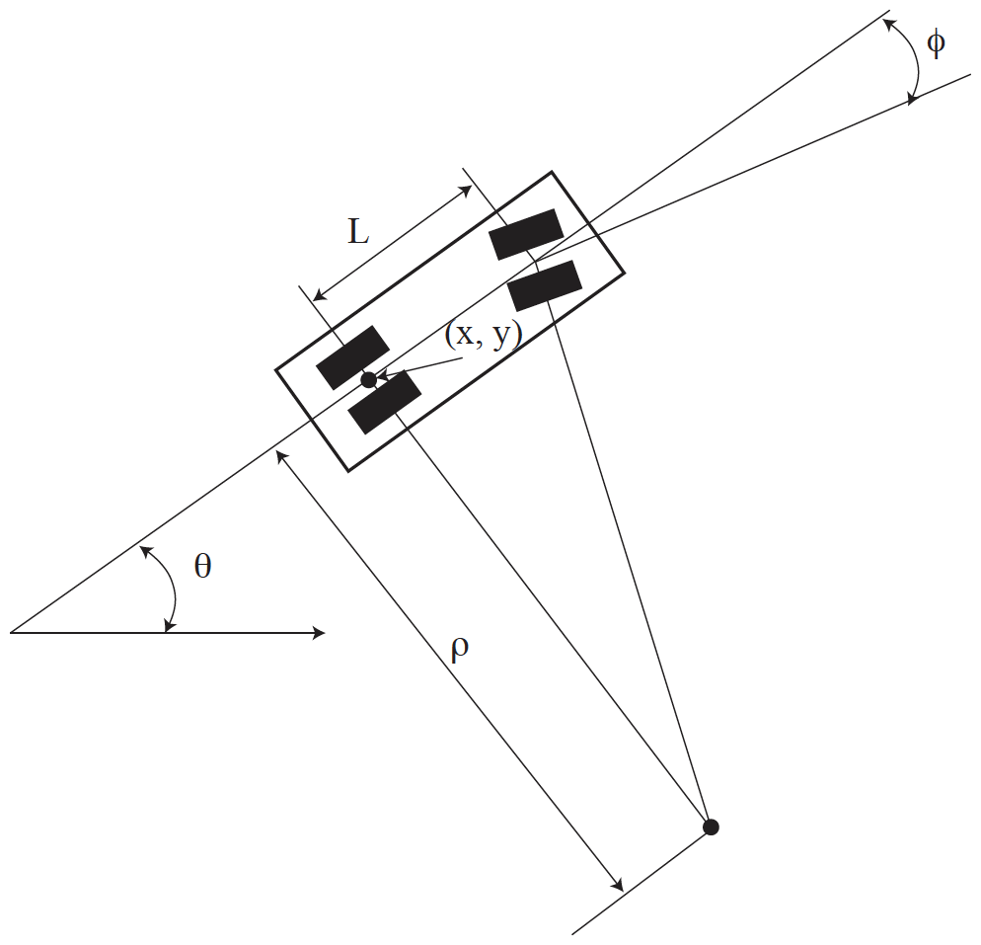
Notation for dynamics

Slide 5
Representing state
Must have:
  x, y - position of vehicle
  phi – angle of steering relative to midline
BUT
  only 2D velocity
    speed - along the midline
    rate of turn - rate at which steering angle changes
Can’t go sideways < == > 2D velocity, 3D state

Slide 6
Dynamics
Write
  s – speed along the midline
  r - rate of change of steering angle
Get:
Derivation at: https://msl.cs.uiuc.edu/planning/node658.html

Slide 7


The extended Kalman filter
If state update, measurement aren’t linear
  linearize and approximate (EKF)
    (and hope!)
  idea is straightforward, mechanics require some care
state
Noise - normal, mean 0, Cov known
observation

Slide 8
The steps, KF:
Have:
Mean and covariance of posterior
after i-1’th measurement
Construct:
Mean and covariance of predictive
distribution just before i’th measurement
Measurement arrives:
Now construct:
Mean and covariance of posterior
distribution just before i’th measurement
posterior mean is weighted combo
of prior mean and measurement
posterior covar is weighted combo
of prior covar, measurement
matrix and measurement covar

Slide 9
Linearization and noise
Two ways in which noise could affect x_i
  x_{i-1} is noisy
  AND there is n to account for
Possibly noisy input
Noise supplied to function

Slide 10
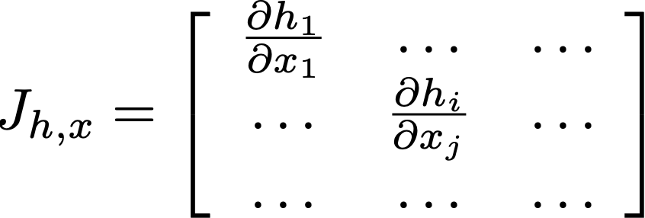


State update
Now consider some nonlinear function h(x)
  first case (input is noisy)
Approximate
Yields
Jacobian === derivative

Slide 11
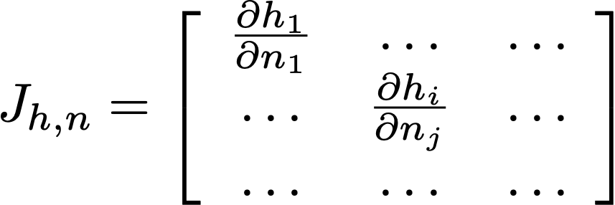
State update
Now consider some nonlinear function h(x)
  second case (noise supplied to function)
Approximate
Yields
Jacobian === derivative

Slide 12

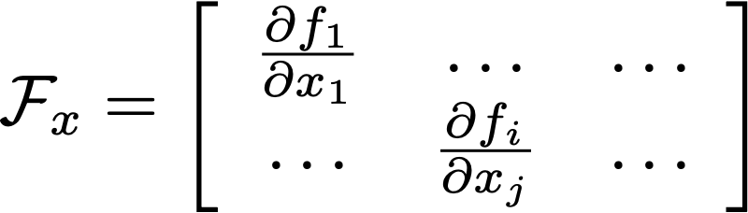
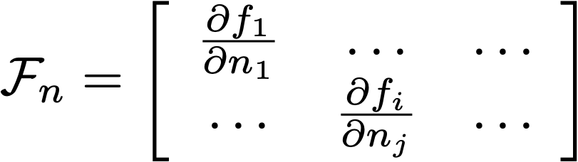
State update
Linearize:
Posterior covariance of x_{i-1}
Noise covariance

Slide 13
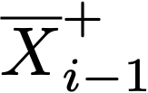


The steps, EKF:
Have:
Construct:
Measurement arrives:
Now construct:
Where:

Slide 14

The steps, EKF:
Have:
Construct:
Measurement arrives:
Now construct:
Where:

Slide 15
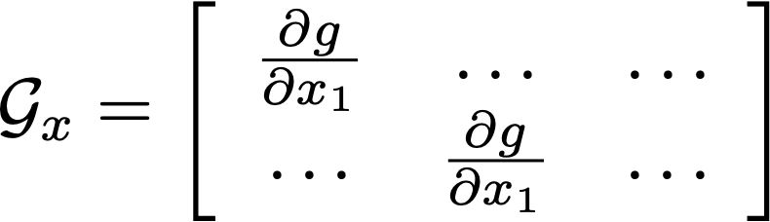
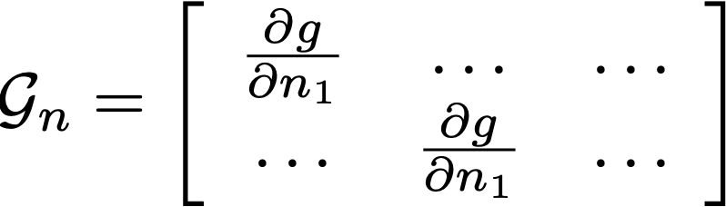
Measurement
Linearize:

Slide 16
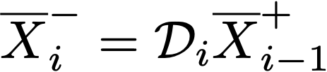



Recall: The steps, KF:
Have:
Construct:
Difference between
predicted and observed
measurement
Measurement arrives:
Now construct:
Where:

Slide 17
The steps, EKF:
Have:
Construct:
Difference between
predicted and observed
measurement
Measurement arrives:
Now construct:
Where:

Slide 18
Recall: The steps, KF:
Have:
Construct:
Measurement arrives:
Linear measurement
model
Now construct:
Where:

Slide 19

The steps, EKF:
Have:
Construct:
Measurement arrives:
Now construct:
Where:

Slide 20
Recall: The steps, KF:
Have:
Construct:
Measurement arrives:
Inverse of the covariance of y_i
Now construct:
Linear measurement
model
Where:

Slide 21
The steps, EKF:
Have:
Construct:
Measurement arrives:
Now construct:
Where:

Slide 22
Outcome and issues
Can now filter position/orientation wrt map
  linearize dynamics following recipe above
  linearize measurements ditto
There could be problems
  EKF’s are fine if the linearization is reliable
    can be awful if not

