Slide 1
EKF-SLAM
D.A. Forsyth,
University of Illinois at Urbana Champaign

Slide 2
Core idea
Observe the world from a moving platform
Build:
  a map of the world
  an estimate of pose in that map
Online:
  notice that new observations update:
    estimate of pose
    estimate of map
Filtering problem

Slide 3
Some more details
With two cameras and some calibration:
  we can recover the position of 3D points
    in the vehicle’s coordinate system
      see triangulation movie, etc.
Together with an EKF, we can use this to recover
  points in world coordinates (a map)
  vehicle location
In fact, we can do all this with one camera
  with some minor care

Slide 4
Big goal
Robot moving on the plane
  position, orientation
There are landmarks
  in fixed positions (for the moment….)
We start in some configuration
  (0, 0, 0)
  and move
Report posterior estimates of
  robot pos’n, orientation
  landmark positions in original coord frame
  when new landmarks appear, insert them
From Burgard et al slides

Slide 5
Simple case
Vehicle is car, moves in 2D
Each measurement is
  a 2D measurement
  of position of a known beacon in vehicle coords
    (i.e. we know which measurement corresponds to which 3D point)

Slide 6
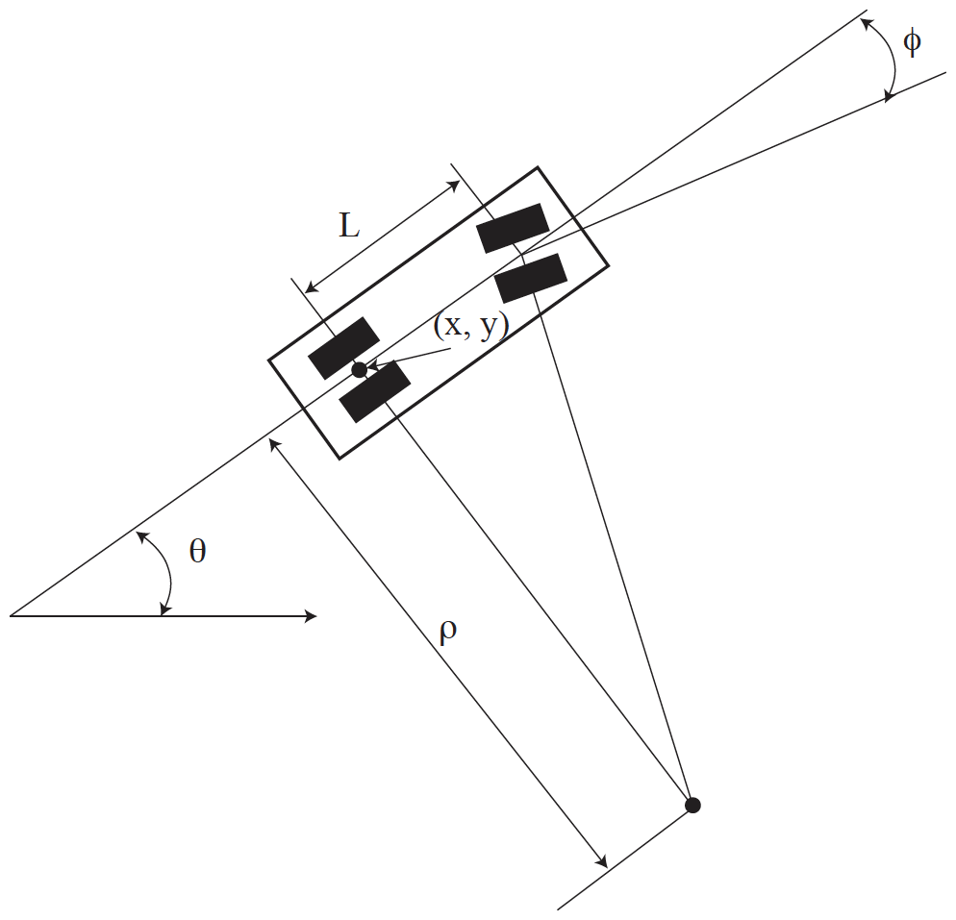
Notation for dynamics

Slide 7
Dynamics
Write
  s – speed along the midline
  r - rate of change of steering angle
Get:
Derivation at: https://msl.cs.uiuc.edu/planning/node658.html

Slide 8
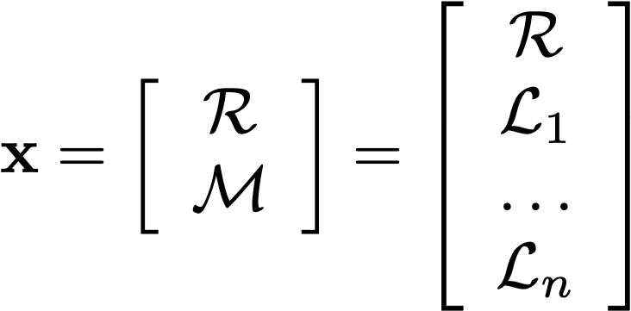
State
Position and orientation of the robot;
speed and rate of change of steering
Landmark 1 position in OCF
All landmark positions
in original coordinate
frame

Slide 9

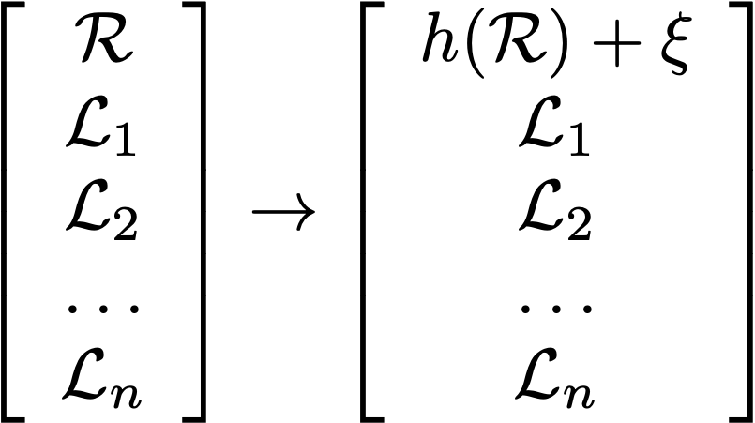
State update
The vehicle moves, as above;
  but the landmarks don’t move
  and there isn’t any noise

Slide 10
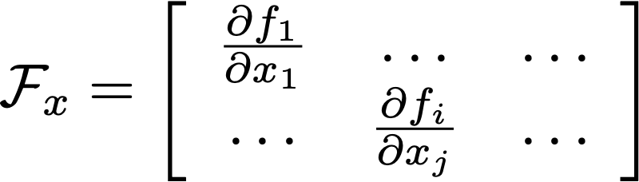
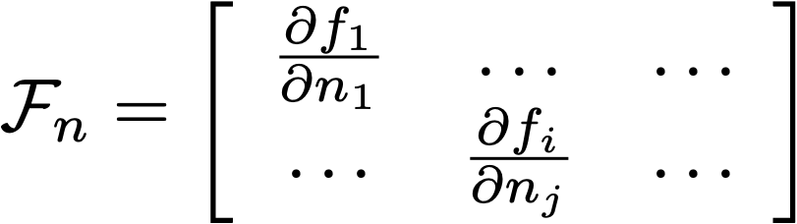
Recall: The extended Kalman filter
Linearize:
Posterior covariance of x_{i-1}
Noise covariance

Slide 11
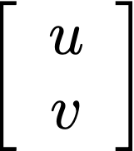
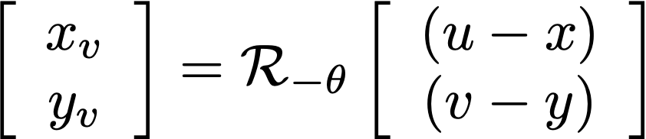
Measuring position
Landmark is at:
  in world coordinate system
We record position in vehicle’s frame:
vehicle orientation
in world coords
point posn in
world coords
Observation
THIS ISN’T LINEAR!
point posn in
vehicle coords
vehicle posn in
world coords

Slide 12
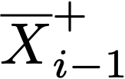




The steps, EKF:
Have:
Construct:
Measurement arrives:
Now construct:
Where:

Slide 13
In principle, now easy
Rather horrid from the point of view of complexity
    looks like we have to invert a 3+2N by 3+2N matrix!
BUT
  F_x is much simpler than it might look
    the landmarks do not move!
  F_n ditto
    there is no noise in the landmark updates - the landmarks are fixed
  Outcome:
    We can deal with landmarks one by one
      and so do many small matrix inversions rather than one large one

Slide 14
State update
The vehicle moves, as above;
  but the landmarks don’t move
  and there isn’t any noise

Slide 15
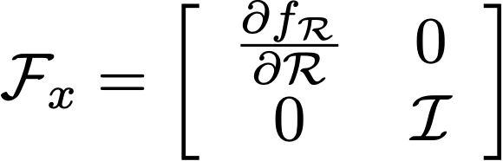
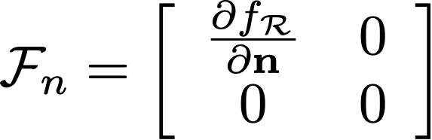
State update, II
BUT
  F_x is much simpler than it might look
    the landmarks do not move!
  F_n ditto
    there is no noise in the landmark updates - the landmarks are fixed
3
2 N
N=Number of landmarks

Slide 16
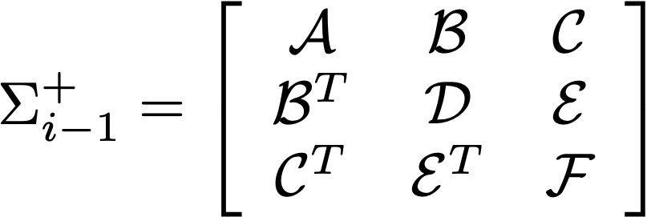
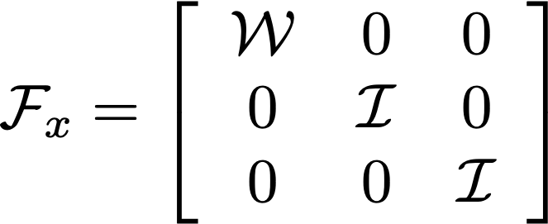
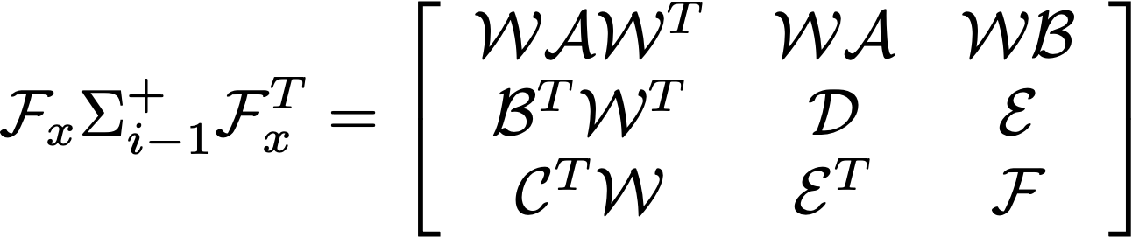
State update, III
Imagine we have 2 landmarks
Recall EKF:
Notice fewer matrix multiplies!

Slide 17
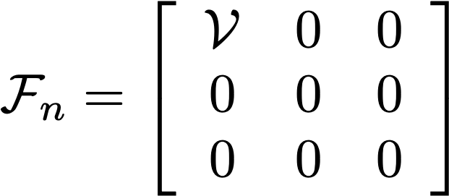
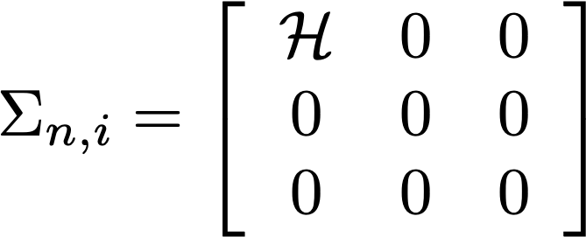
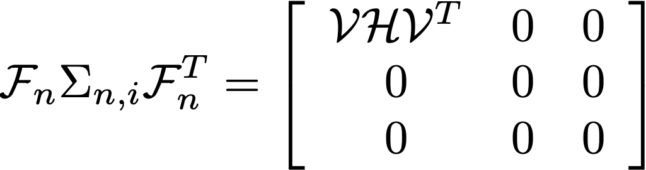
State update, IV
Imagine we have 2 landmarks
Recall EKF:
Notice fewer matrix multiplies!

Slide 18
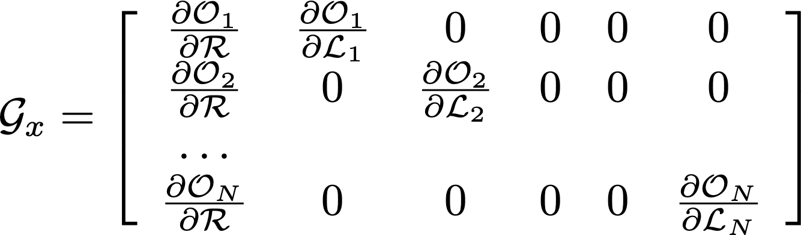
More simplifications
BUT
  G_x is much simpler than it might look
    each set of measurements affected by only one landmark!
N
N=Number of landmarks
3
2
2 N

Slide 19

More simplifications
BUT
  G_n is usually much simpler than it might look
    noise is usually additive normal noise
    This means that the term:
      is actually a block diagonal matrix

Slide 20
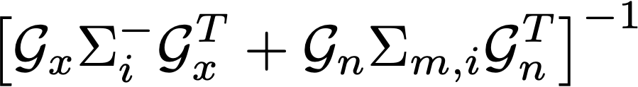
Big simplification
The nasty bit…
But notice key point
  measurements interact only through the position/orientation of the vehicle
  each measurement depends on only one landmark and pose of v.
  OR measurements are conditionally independent conditioned on pose of v.
  OR you could subdivide time and update measurements one by one
  OR matrix G_x has the sparsity structure above
(the same point, manifesting in different ways)

Slide 21
Subdividing time…
Receive observations in some order
  landmark i affects the whole state
    because it changes your estimate of the pose of the vehicle
      and that affects your estimate of state of every landmark
    BUT
      the change in estimate of pose depends ONLY on
        pose
        landmark i

Slide 22
Subdividing time
Sequence
  repeat
    move (so make predictions)
    landmark 1 measurement arrives (update pose and so all based on 1)
    …
    landmark N measurement arrives (update pose and so all based on N)

Slide 23

Steps in EKF

Slide 24
One measurement from one landmark!
Steps in EKF
3+2Nx2
3+2N x 2
2 x 2
Notice:
Inverting only a small matrix
3+2Nx2
2 x 1
Notice:
But affecting the whole state!

Slide 25
Landmarks
No measurement from a landmark?
  structure of EKF means you can process landmarks one by one
    that’s what all the matrix surgery was about
    so don’t update that landmark

Slide 26
New landmarks
Sequence
  repeat
    move (so make predictions)
    landmark 1 measurement arrives (update pose and so all based on 1)
    …
    landmark N measurement arrives (update pose and so all based on N)
    check if there is a new landmark
      if so
        initialize landmark position and covariance
          conditioned on current state and measurement
        process from now on (we have N+1 landmarks)

Slide 27
Variants
More complex vehicle dynamics
Different measurement process
  one camera
  LIDAR
  SONAR (v. hard)
  photo-consistency constraints (direct methods)
Multiple processes at different timescales
  fast:
    estimate configuration, landmarks
  slow:
    refine estimates (something like bundle adjustment)
    take more local image data into account

Slide 28
Resources
Very nice collection of links at:
Challenging drone racing dataset at:
Drone racing team at:
Many cases at:
https://github.com/Taeyoung96/SLAM-Resources-for-Beginner?tab=readme-ov-file
https://fpv.ifi.uzh.ch
https://adr.utias.utoronto.ca
https://silenceoverflow.github.io/Awesome-SLAM/#LSurvey

