Slide 1
The elements of classification
D.A. Forsyth,
University of Illinois at Urbana-Champaign

Slide 2
A classifier
Any procedure that
  accepts a set of features
  produces a class
Hugely useful and general idea
  Credit card transaction (good/fraud)
  Should I download this code (secure/insecure)
Number of classes could be big:
  Doctor (well, cold, flu, ... measles, ... etc.)

Slide 3
Summaries of performance
Error rate:
  fraction of classification attempts with wrong answer
Accuracy:
  fraction of classification attempts with right answer
Very best error rate
  Bayes error rate
  Usually, larger than zero
    example: alien tries to determine sex from height
  Usually, very hard to know accurately

Slide 5
Baselines and chance
Usually, compare performance to baselines
  other attempts at the classification problem
  At least, chance:
    randomly choose a class label for example
    Two class classifier
      maximum error rate is 0.5, whatever distribution
    Multiple classes:
      depends on the distribution of the classes

Slide 6
Only test error rate matters!
This makes evaluating a classifier delicate
  you can’t evaluate on training data
    because the classifier is chosen to do well on that data
      so estimate is biased optimistic (overfitting)
  procedure:
    separate labelled set into disjoint (train set, test set)
    train on train set
    evaluate on test set <- this is an unbiased estimate
  BUT
    classifier isn’t best available (didn’t use all data)
    estimate of accuracy isn’t perfect (small data set)

Slide 7
Cross validation
Iterate:
  randomly split into (train, test)
  train on train, evaluate on test
Accuracy:
  average of test accuracies in iteration
Best estimate of classifier:
  train on all data

Slide 8
Overfitting
Symptom:
  good behavior on train, poor behavior on test
Causes:
  (usual)
    classifier is “too flexible”, so fits train well but not test
  (unusual)
    training data may not represent general case well
Common cures:
  more data
  simpler classifier

Slide 9
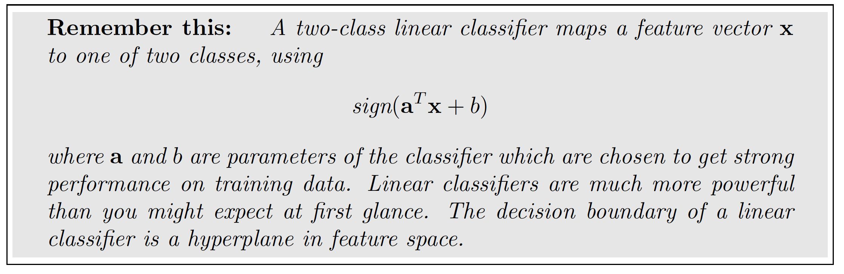
Simple, two-class linear classifier
Assume each data item is (feature vector, label)
  fv is x

Slide 10
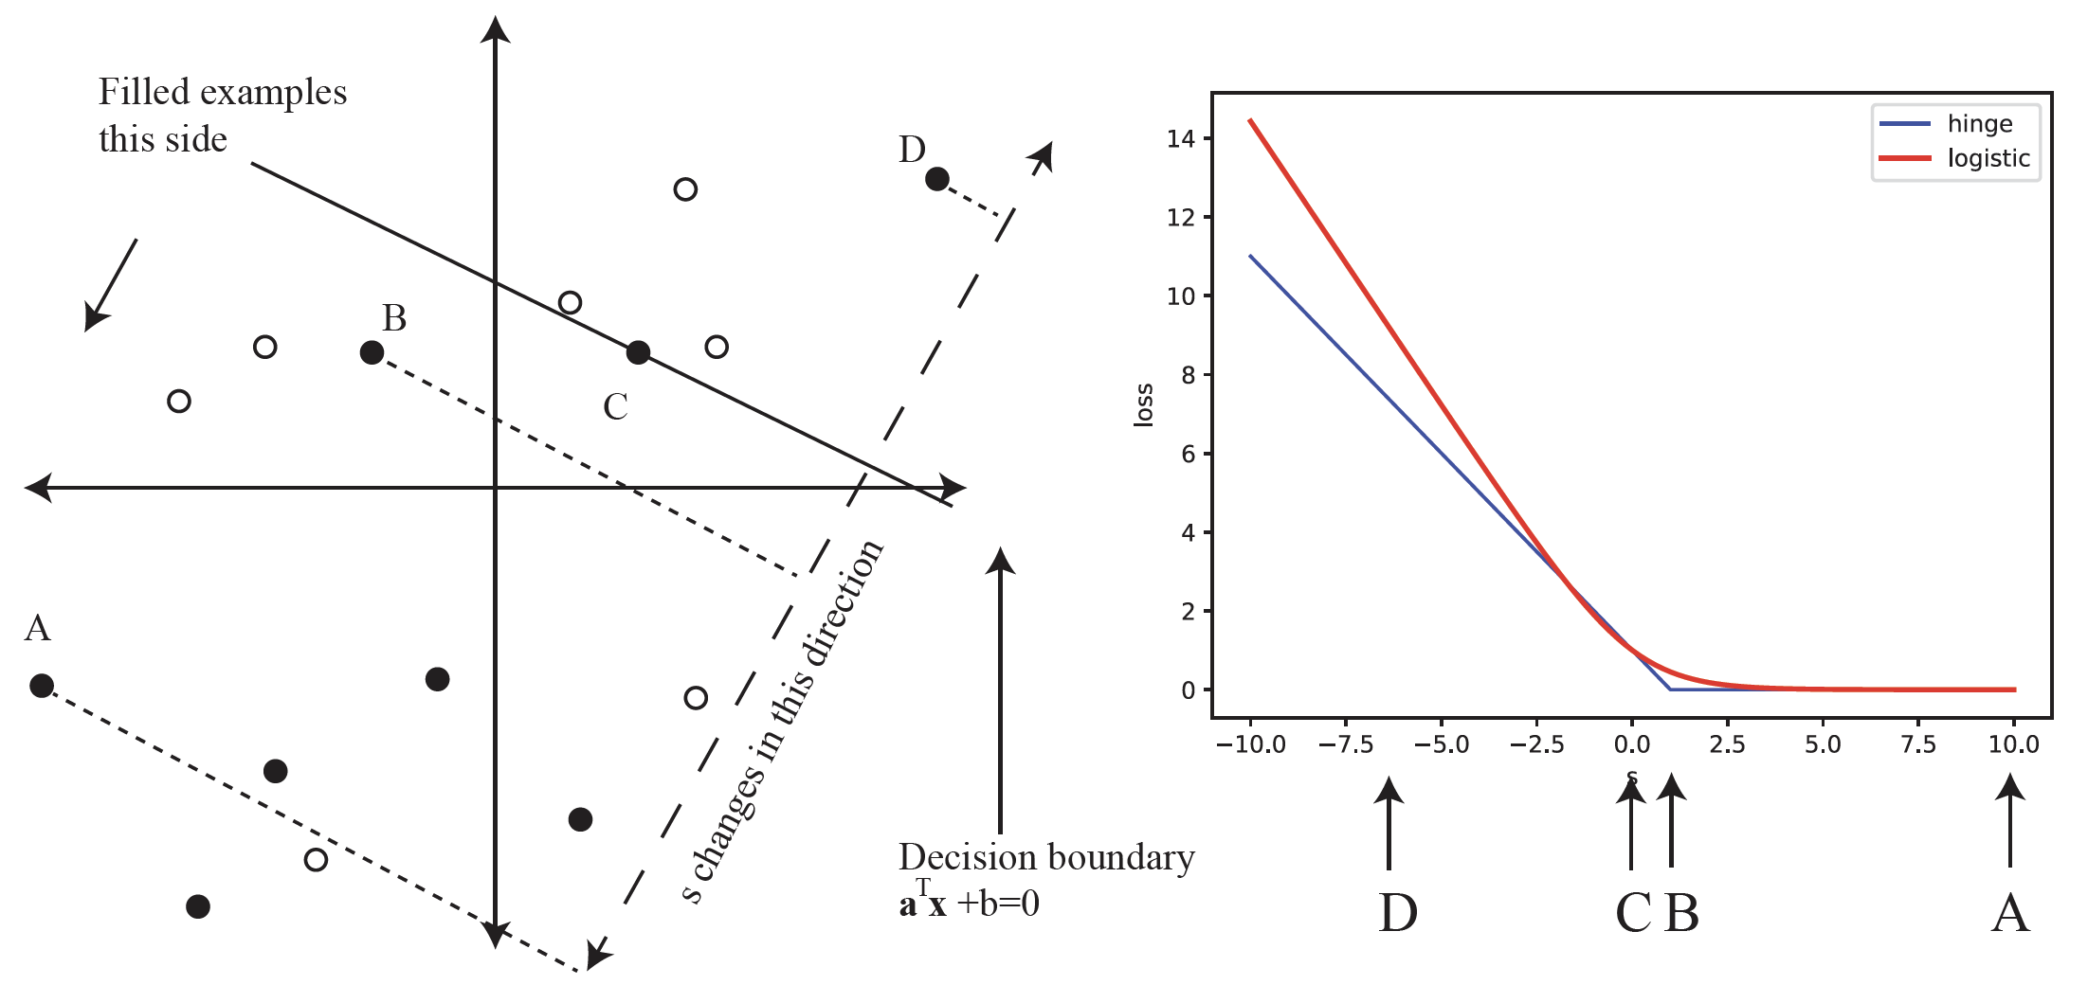
Linear classifier

Slide 11
Training a linear classifier
Choose a, b using training data
  to minimize some loss
    error rate doesn’t work (unhelpful gradient)
  losses:
    logistic regression == cross-entropy == logistic loss
    hinge loss
  These are convex approximations to the error rate
Idea:
  loss is large if misclassified
  if correctly classified:
    small if within margin
    zero otherwise

Slide 12
Linear classifier

Slide 13
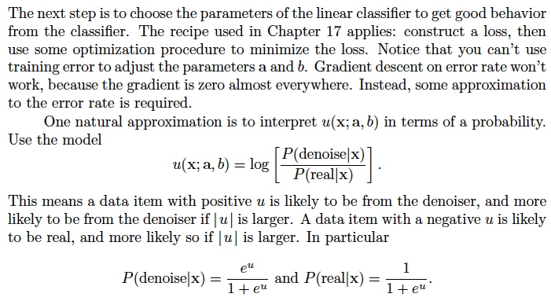
Logistic regression -I

Slide 14
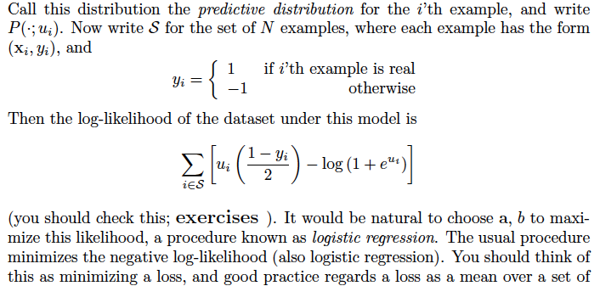
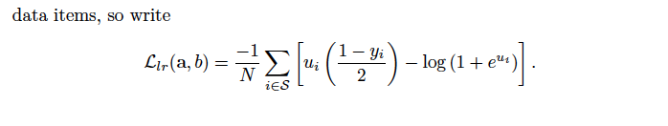
Logistic regression - II

Slide 15
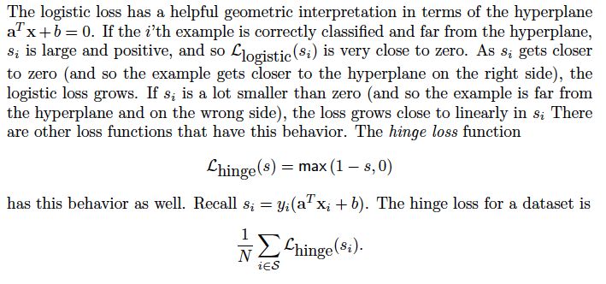
Hinge loss

Slide 16
Linear classifier

Slide 17
Where do the features come from?
Application logic
Elementary construction
Existing encoder
Learn an encoder at the same time as classifier

Slide 18
Practical issue
Take the block of features from the encoder
  turn them into a vector of fixed size
  (this will mean classifier accepts images of fixed size)
Typically:
  ensure block shrinks spatially as it moves along encoder
    by stride or pooling
  when it is small enough, straighten into vector
Pooling:
  make a data block smaller by max/average within fixed size windows (usually 2x2)

Slide 19
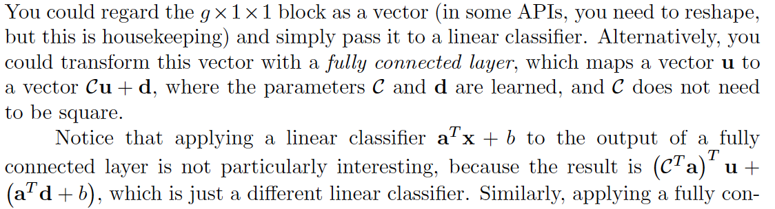
Fully connected layers
Vector describes the whole image

Slide 20
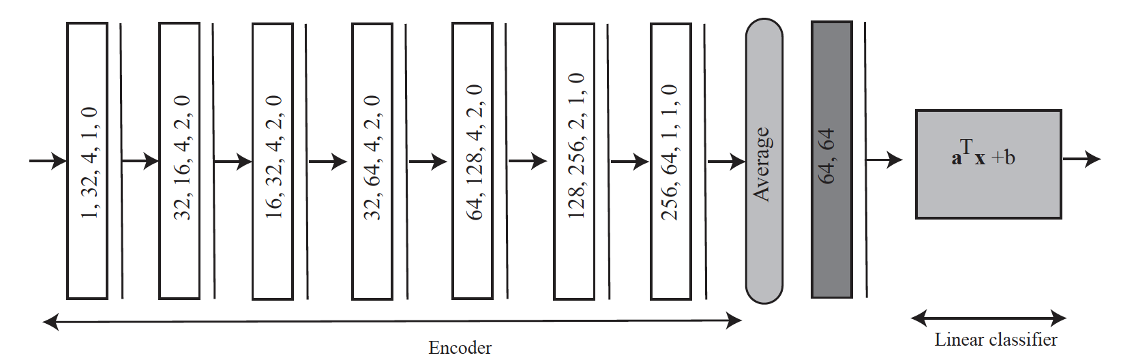
A simple image classifier

Slide 21
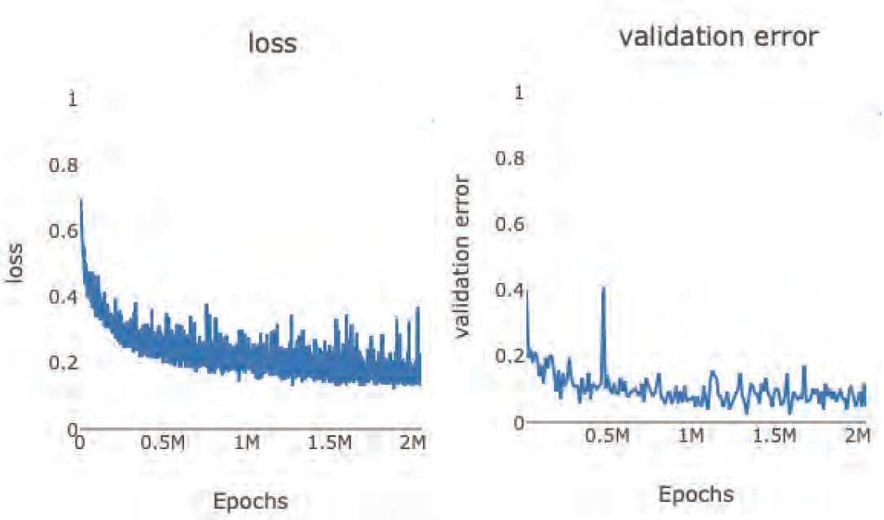
Example case: real vs denoised

Slide 22
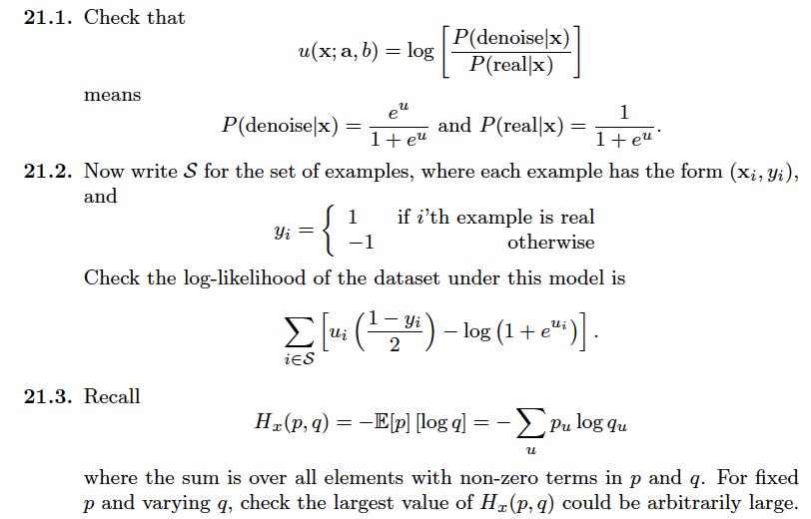
think about this...

Slide 23
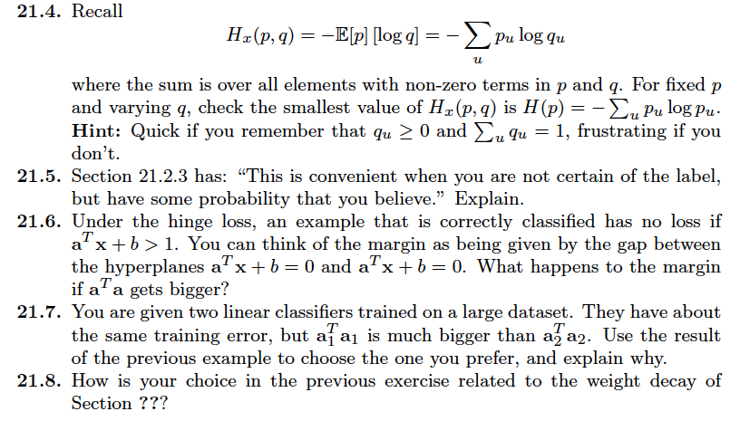
and this...

