Slide 1
Coordinate geometry:
The essential matrix
D.A. Forsyth,
University of Illinois at Urbana Champaign

Slide 2
Fundamental vs essential matrix
Fundamental matrix is a geometric concept
  true whatever the coordinate system
Essential matrix
  what happens in coordinates

Slide 3
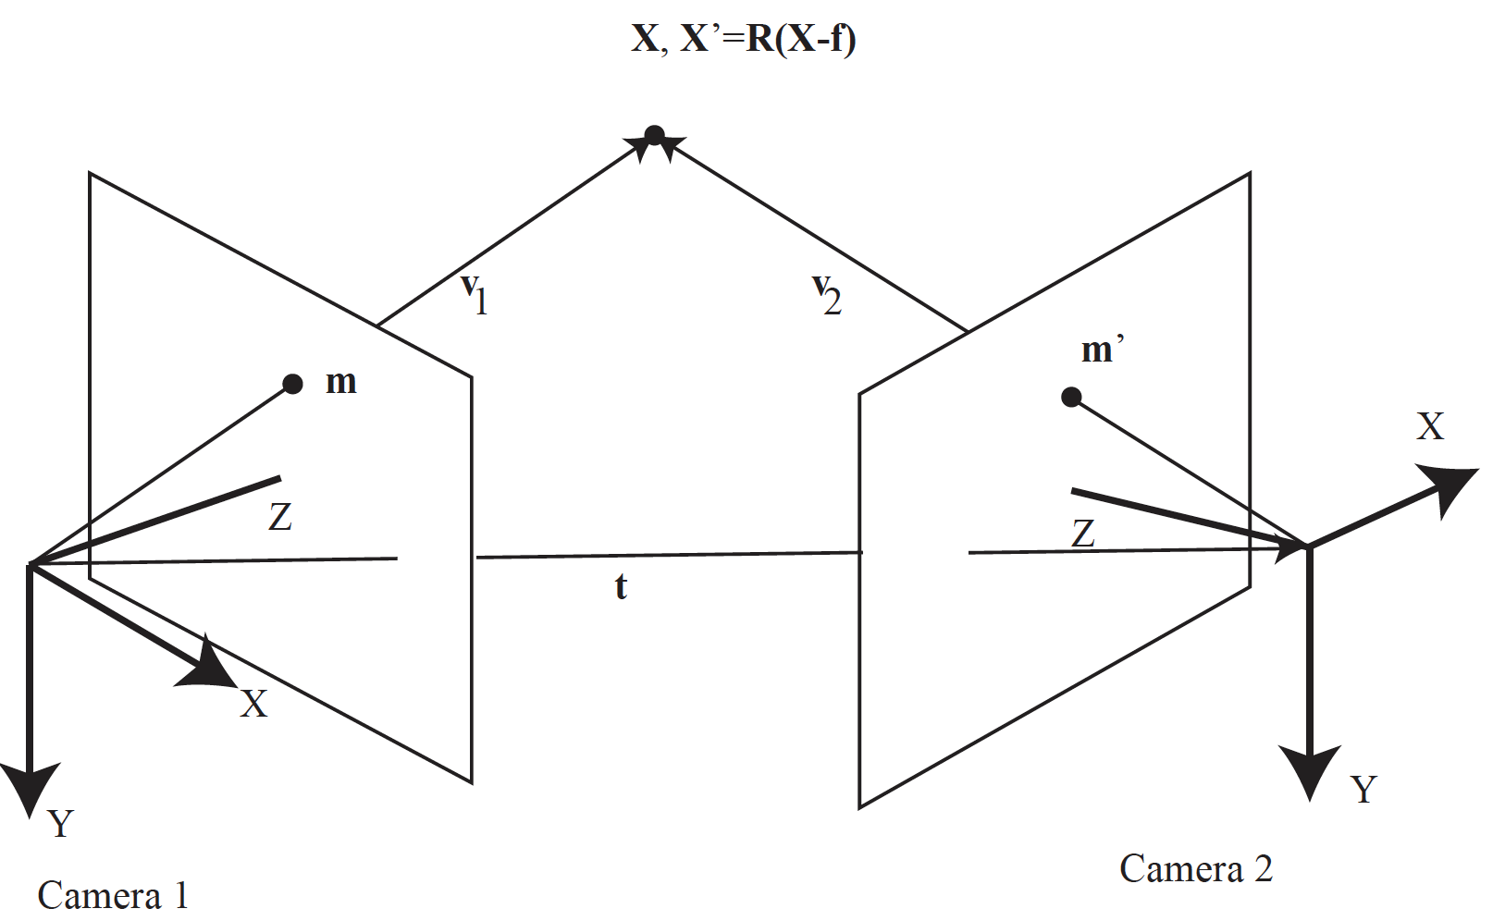

Slide 4
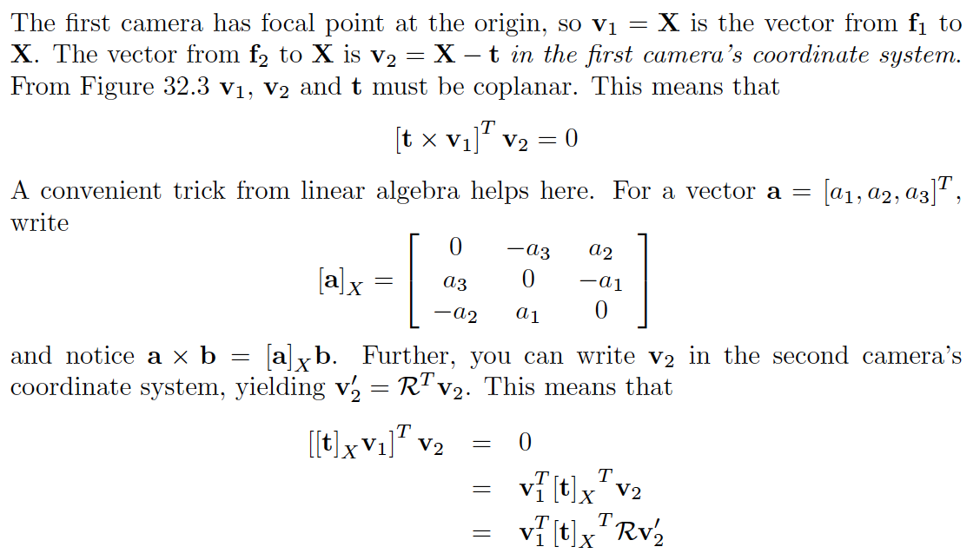

Slide 5
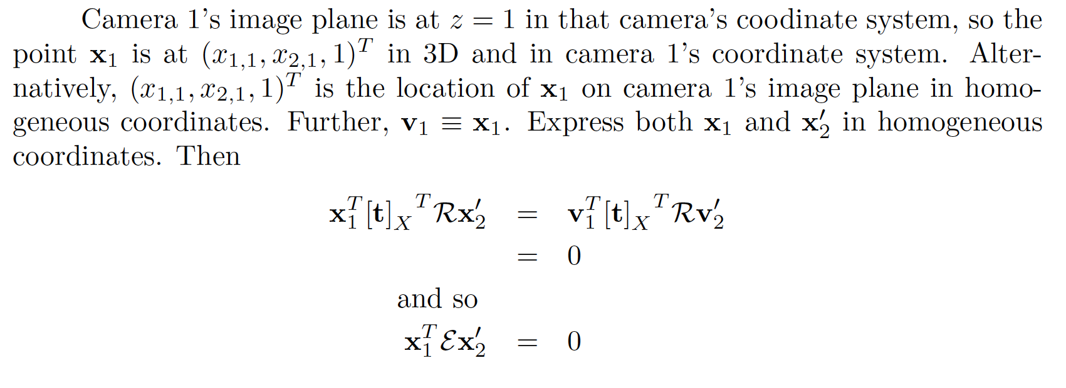
In homogenous coords,

Slide 6
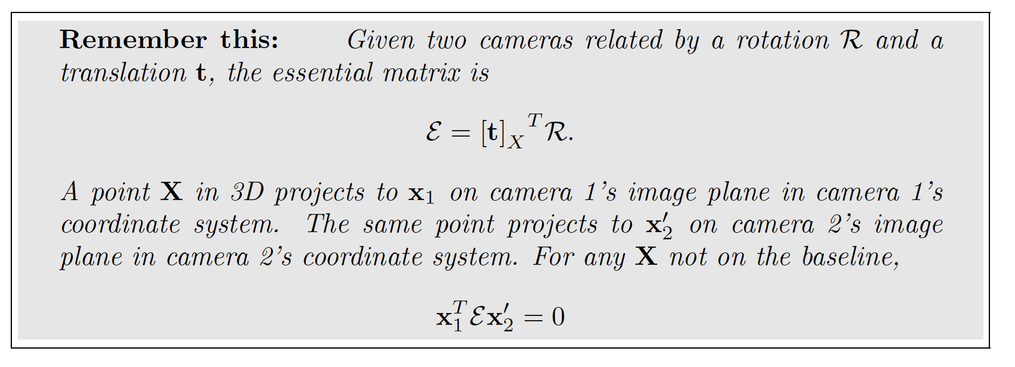
The essential matrix
it follows from fundamental matrix that something like this should be there; but here we have an expression relating it to camera transformation

Slide 7

Recall: singular value decomposition
Orthonormal
Diagonal matrix
Of non-negative singular
values

Slide 8
The essential matrix: Properties
But is orthonormal, so

Slide 9
The essential matrix: Properties
From this deduce

Slide 10
The essential matrix: Properties
The essential matrix has one singular value zero
  the other two are equal
(slightly less easy)
  any such matrix is an essential matrix

Slide 11
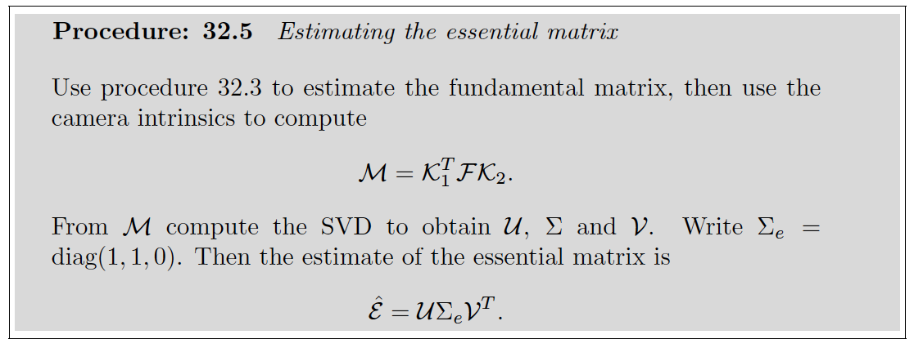
Estimating the essential matrix

