Slide 1
The simplest filtering
D.A. Forsyth
University of Illinois at Urbana Champaign

Slide 2
Issue to solve in SLAM
We have:
  reconstructions of some points
  configurations of some cameras
A new frame arrives:
  more information about old point positions
    and so, more information about previous cameras
  some new point positions
Q:
  how should we maintain point positions, cameras, in the light of new information?
    in a reasonably lightweight way?

Slide 3
Filtering - Setup
Very general model:
  We assume there is an underlying state X
  There are observations Y
    some of which are functions of this state
  There is a clock
    at each tick, the state changes with known dynamics
    at each tick, we get a new observation
    (in principle, you can do this in continuous time, but...)
Q:
  construct “best” estimate of state
    before/after observation

Slide 4
Filtering - Examples
Tracking a ball:
  object is ball
  state is 3D position+velocity
  observations are stereo pairs
Tracking a person:
  object is person
  state is body configuration
  observations are frames, clock is in camera (30 fps)
SLAM:
  state is structure of the world, location of agent
  observations
    images, lidar, angular measurements, etc.
  clock is in camera

Slide 5



In probability language...
Given
    “Prior”
We should like to know
    “Predictive distribution”
    “Posterior”
haven’t got the new obs yet
have the new obs

Slide 6
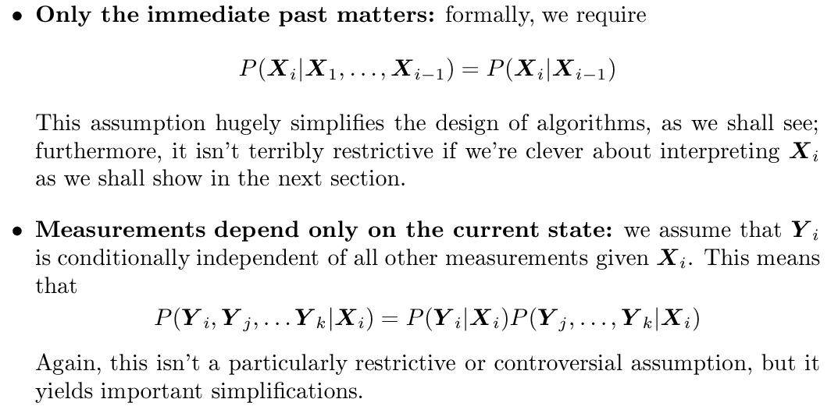
Key assumptions:

Slide 7
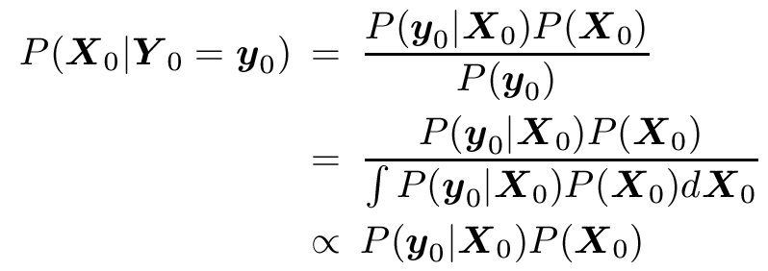
Filtering as Induction - base case
Then we have

Slide 8
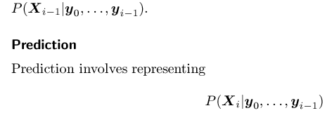
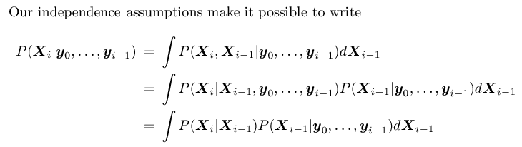
Filtering as induction - induction step
Given
Notice this is i-1
current state based
on previous
measurements

Slide 9
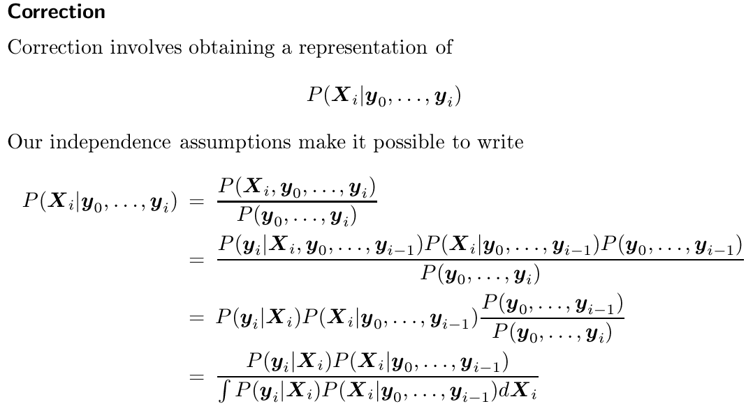
Filtering as induction - induction step
Notice this is i
Prediction based on
current measurement
as well.

Slide 10
We need
to know:
  dynamical model (how X changes with time)
  measurement model (how Y depends on X)
to represent
  all the probability distributions we deal with

Slide 11







Illuminating 1D example
Drop a measuring device on a cable down a hole
  where is it?
Setup:
  measurement of depth
  actual distance down the hole
  known which will be normal,
  known which will be normal,
Q: what is

Slide 12
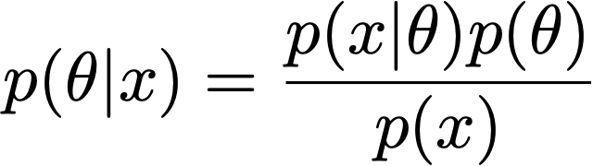

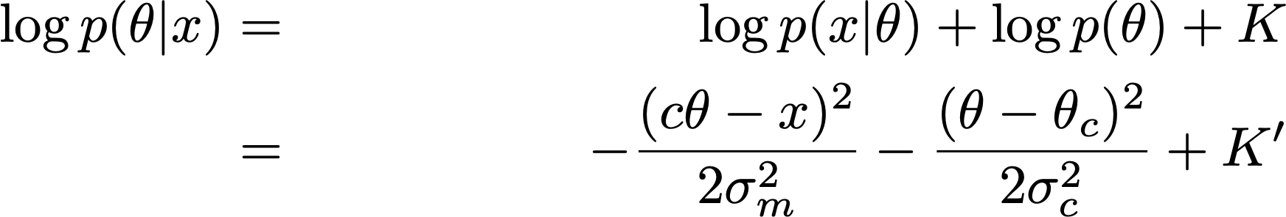
A 1D problem, II
(Bayes rule), so that:
And:

Slide 13
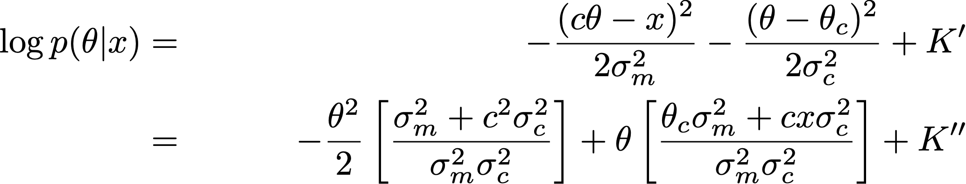
A 1D problem, III

Slide 14

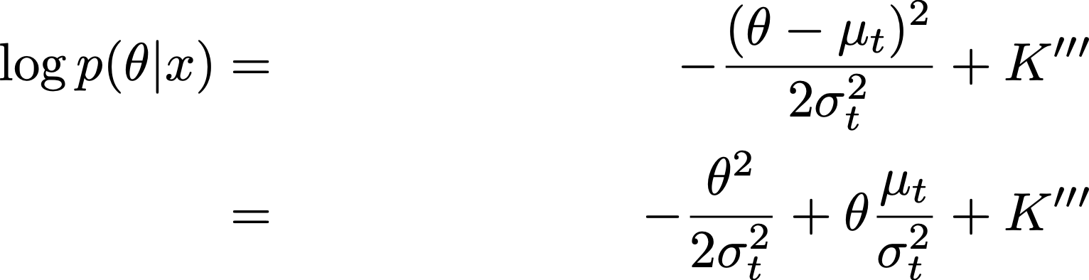
A 1D problem, IV
Now *IF* is normal
  (say )
Then

Slide 15
Pattern match

Slide 16
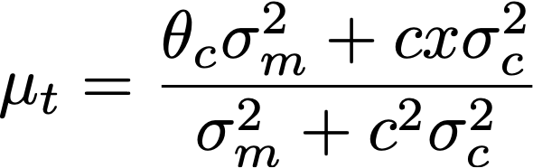
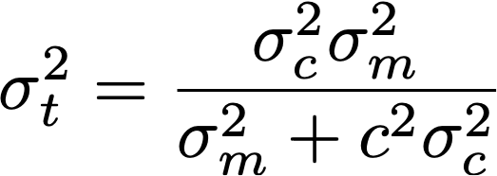
A 1D problem, V
Important checks:
  what happens if measurement is unreliable?
  what happens if prior is very diffuse?

Slide 17
Summary, with change of notation

Slide 18


A second measurement arrives...
We know that is normal
  think of this as the prior
We know that is normal
  think of this as the likelihood
So:
  the posterior must be normal
  and we can update as before!

Slide 19
Key, and crucial, property
IF
  prior is normal
  dynamics are linear + Gaussian noise
  measurement is linear+Gaussian noise
THEN
  predictive distribution is normal
  posterior is normal
Modelling distributions is just maintenance on
  means, covariances
Next measurement:
  update predictive dist.
  update posterior
  posterior for this is now prior for next

