Slide 1
Estimating Optic Flow by Optimization
D.A. Forsyth,
University of Illinois at Urbana Champaign

Slide 2
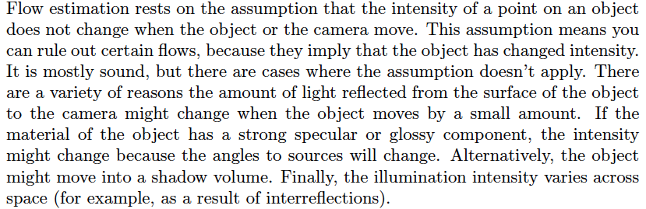
Photometric consistency
Assume:
  Color of a surface does not change when it moves
    usually, intensity
    multiple if’s, and’s, but’s

Slide 3
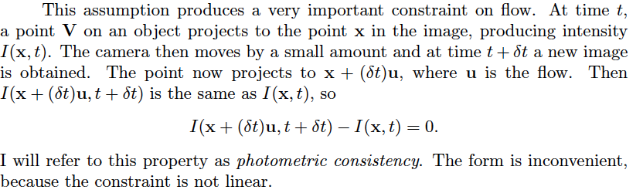
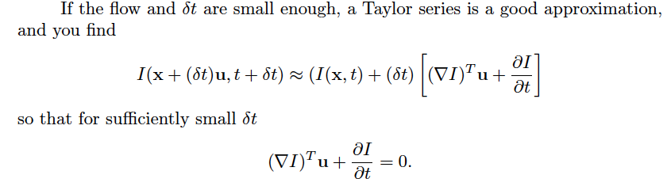
Photometric consistency - II

Slide 4
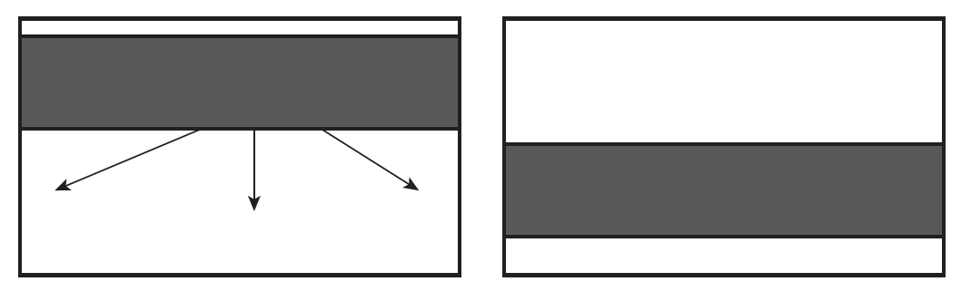
The Optical Flow Equation
Still ambiguous – one constraint on two variables

Slide 5
Largely unambiguous at corners
So smooth:
  compute flow that has
    very small gradient magnitudes
    meets optic flow equation

Slide 6
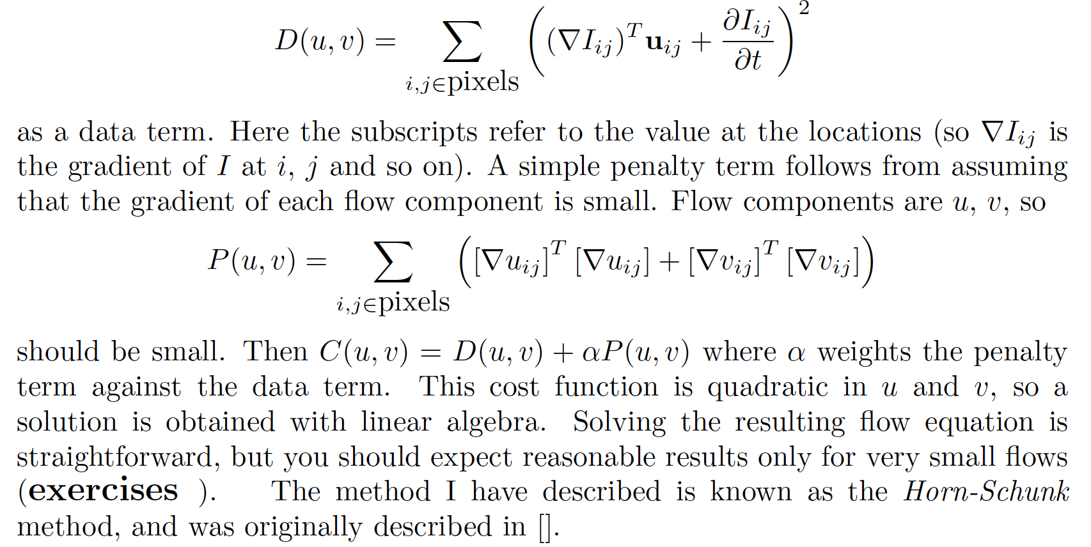
Horn-Schunk (now obsolete)

Slide 7


Farneback
Assume small image windows translate
  flow is (close to) constant in a small window
Approximate image windows with quadratic
If window translates, you get

Slide 9
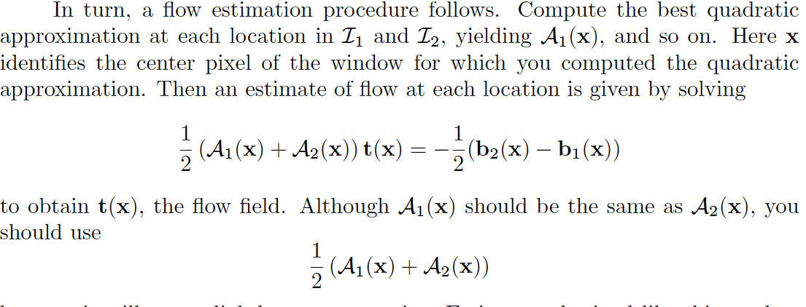
Farneback - II
Quadratic approximation at each pixel
Find flow that minimizes errors

Slide 10
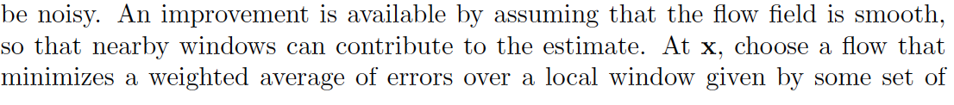
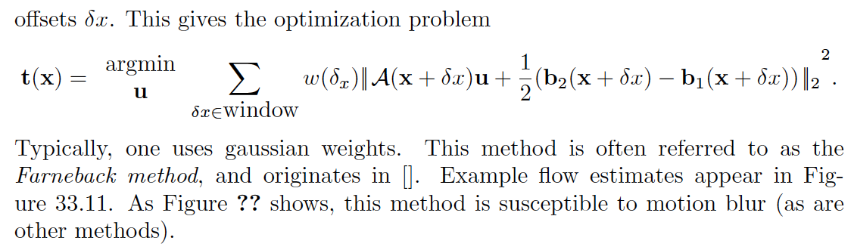
Farneback - III
Average error over windows
  and weight (gaussian weights)

Slide 11
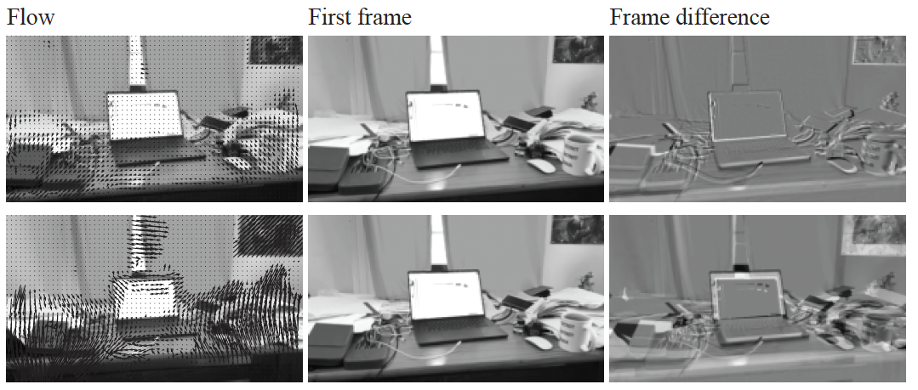
Works for small flows

Slide 12
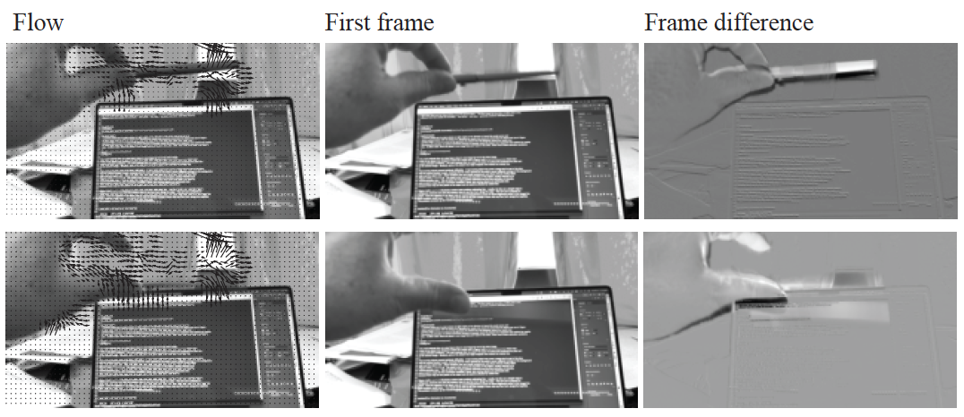
But doesn’t like motion blur...

Slide 13
Potential improvements
Robust versions of the cost function
  replace squared intensity error with something better
Iterative re-estimation of flow
  note change in derivative estimate locations
Flow estimates at multiple scales
  1 pixel flow in low res image == many pixels in hi-res
  start at coarsest scale (N), zero flow
  iterate
    estimate flow at scale s using warped image 1
      (original for N)
    upsample flow estimate to s-1
    warp image 1 at s-1
  key idea: each flow is quite small, so...

Slide 14
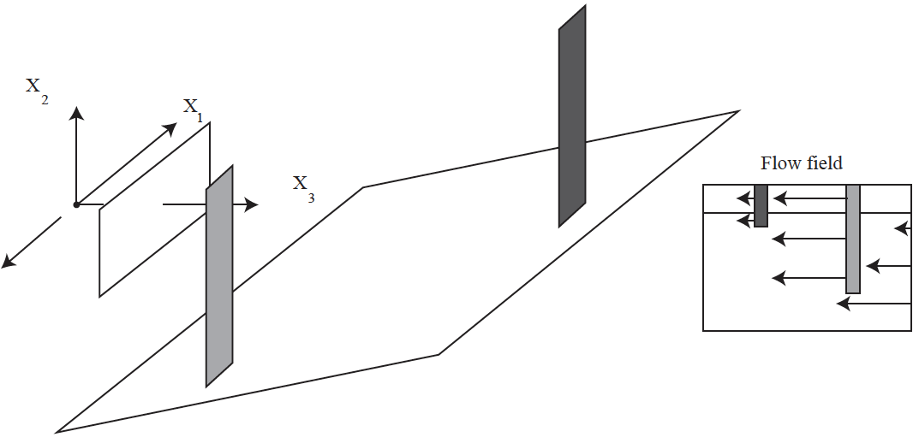
Parametric flow models

Slide 15
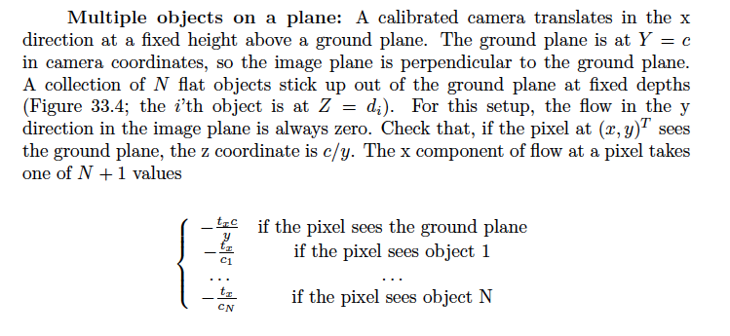
Parametric flow models
Apply the pinhole camera

Slide 16
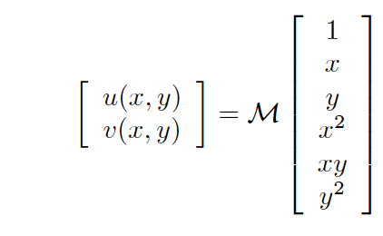
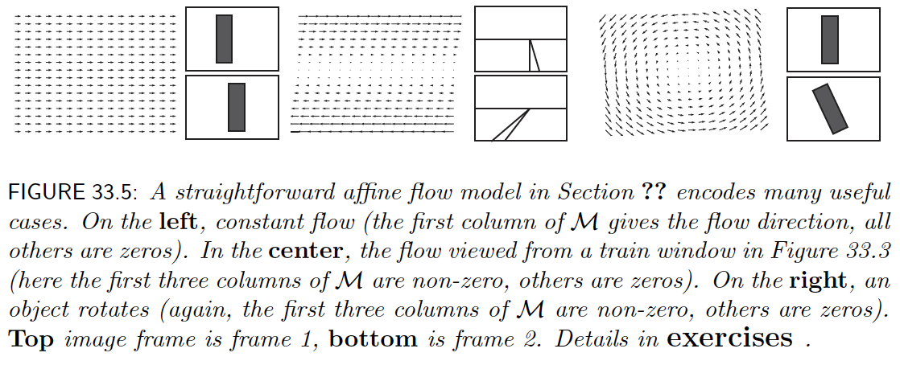
Affine flows

Slide 17
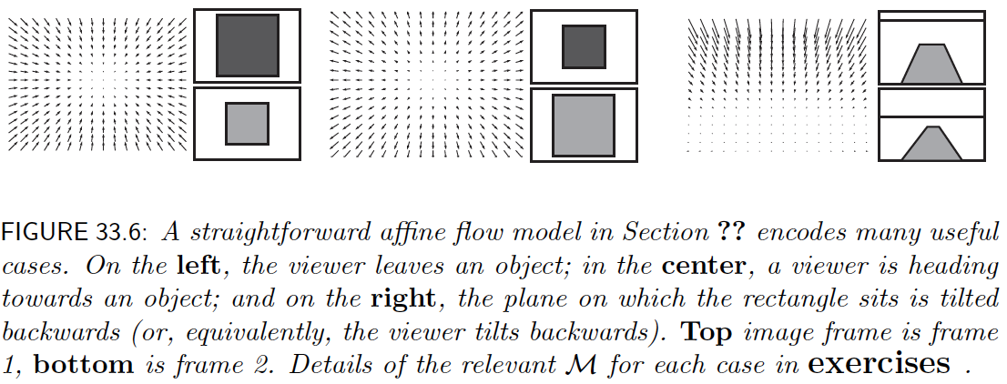
Affine flows - II

Slide 18
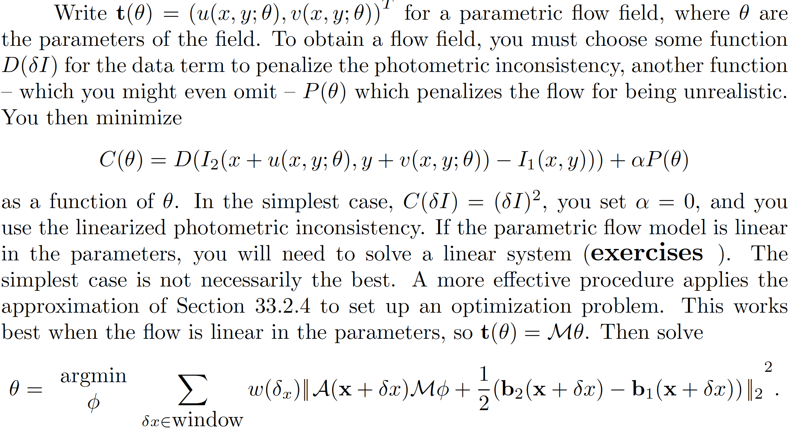
Estimation using Farneback

Slide 19
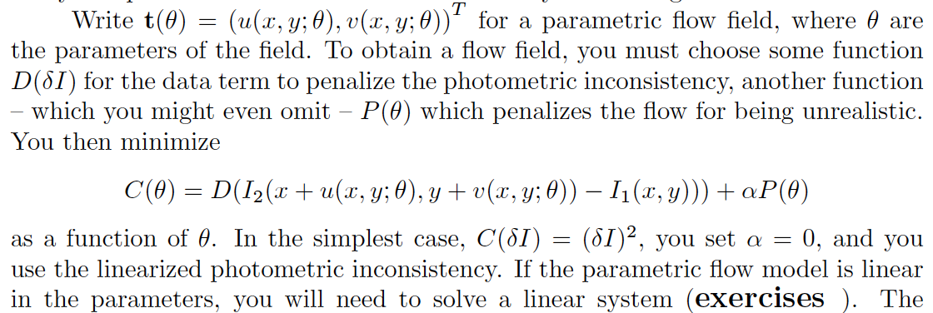
Simplest estimation

Slide 20


Estimation using Farneback
Previously :
Now u is a parametric flow model

Slide 21
Potential improvements
Robust versions of the cost function
  replace squared intensity error with something better
Iterative re-estimation of flow
  note change in derivative estimate locations
Smooth estimates
  or use overlapping windows
Segment image using flow

Slide 22
Layered motion
One model may not work for whole image
  eg the train viewing trees on ground plane
Decompose image into regions
  all pixels that share a parametric flow model
  eg tree 1, tree 2, ground plane

Slide 23
Re-estimation
Given set of parametric flow models
  you can segment
  using photometric loss
    eg at pixel, move along the flow from each model
      choose model where next intensity is closest to start intensity
Given a segmentation
  you can estimate parametric flow models
    use all pixels in the segment to estimate the models

Slide 24
Re-estimation
This is k-means
  (in fairly heavy disguise)
  soft allocation is useful (text)
Can phrase as estimating a mixture of Gaussians

Slide 25
