Slide 1
Estimating the fundamental matrix
D.A. Forsyth,
University of Illinois at Urbana Champaign

Slide 2
Follows the recipe for fitting
Find some correspondences
Set up an optimization problem
Construct a start point
In this case, the start point is usually quite good
  one sometimes doesn’t polish it

Slide 3
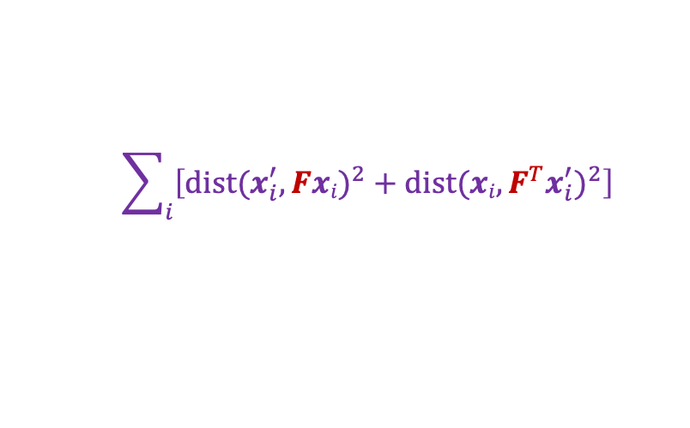
The optimization problem
Minimize sum of squared geometric distances
x_{i}
$$\sum_{i}{\left[{dist(x_{i}^{′},Fxi)}^{2}+{dist(xi,F^{T}x_{i}^{′})}^{2}\right]}$$

Slide 4

This is constrained
$$\det\left(F\right)=0$$

Slide 5
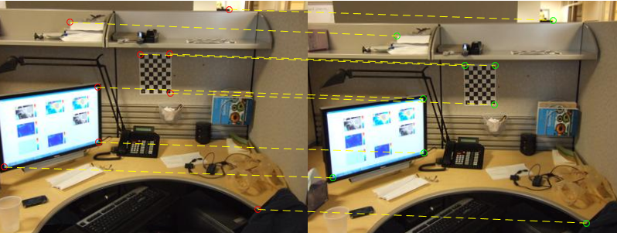

Obtaining a start point
correspondences:
  $x={(x,y,1)}^{T}$ and $x^{′}={(x′,y′,1)}^{T}$

Slide 6


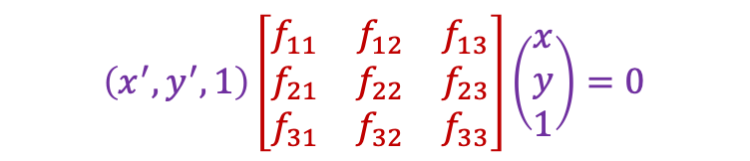
Obtaining a start point
correspondences:
  $x={(x,y,1)}^{T}$ and $x^{′}={(x′,y′,1)}^{T}$
Constraint: ${x′}^{T}Fx=0$
$$\left(x^{′}x,x^{′}y, x′,y^{′}x,y^{′}y,y′,x,y,1\right)\left(\begin{aligned}f_{11} \\ f_{12} \\ f_{13} \\ \begin{aligned}f_{21} \\ f_{22} \\ f_{23}\end{aligned} \\ \begin{aligned}f_{31} \\ f_{32} \\ f_{33}\end{aligned}\end{aligned}\right)=0$$
$$\left(x^{′},y^{′},1\right)\left[\begin{matrix}f_{11} & f_{12} & f_{13} \\ f_{21} & f_{22} & f_{23} \\ f_{31} & f_{32} & f_{33}\end{matrix}\right]\left(\begin{aligned}x \\ y \\ 1\end{aligned}\right)=0$$

Slide 7




The eight point algorithm
$$\left[\begin{matrix} & & & ⋮ & & & & & \\ x^{′}x & x^{′}y & x′ & y^{′}x & y^{′}y & y′ & x & y & 1 \\ & & & ⋮ & & & & & \end{matrix}\right]\left(\begin{aligned}f_{11} \\ f_{12} \\ f_{13} \\ \begin{aligned}f_{21} \\ f_{22} \\ f_{23}\end{aligned} \\ \begin{aligned}f_{31} \\ f_{32} \\ f_{33}\end{aligned}\end{aligned}\right)=0$$
$$U$$
Homogeneous least squares to find $f$:
Eigenvector of $U^{T}U$ with smallest eigenvalue
$${\arg{\min_{\begin{aligned} \\ \left\|f\right\|=1\end{aligned}}\left\|Uf\right\|}}_{2}^{2}$$

Slide 8


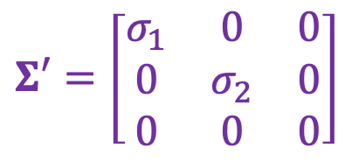

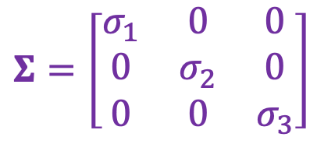
Enforcing rank-2 constraint
$F$ needs to be singular/rank 2.
  Enforce this: take SVD of the initial estimate and throw out the smallest singular value
$$F_{init}=UΣV^{T}$$
$$Σ=\left[\begin{matrix}σ_{1} & 0 & 0 \\ 0 & σ_{2} & 0 \\ 0 & 0 & σ_{3}\end{matrix}\right]$$
$$Σ′=\left[\begin{matrix}σ_{1} & 0 & 0 \\ 0 & σ_{2} & 0 \\ 0 & 0 & 0\end{matrix}\right]$$
$$F=UΣ′V^{T}$$

Slide 9
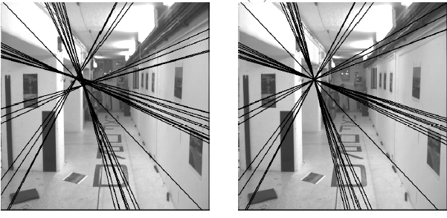

Enforcing rank-2 constraint
Initial $F$ estimate
Rank-2 estimate

Slide 10
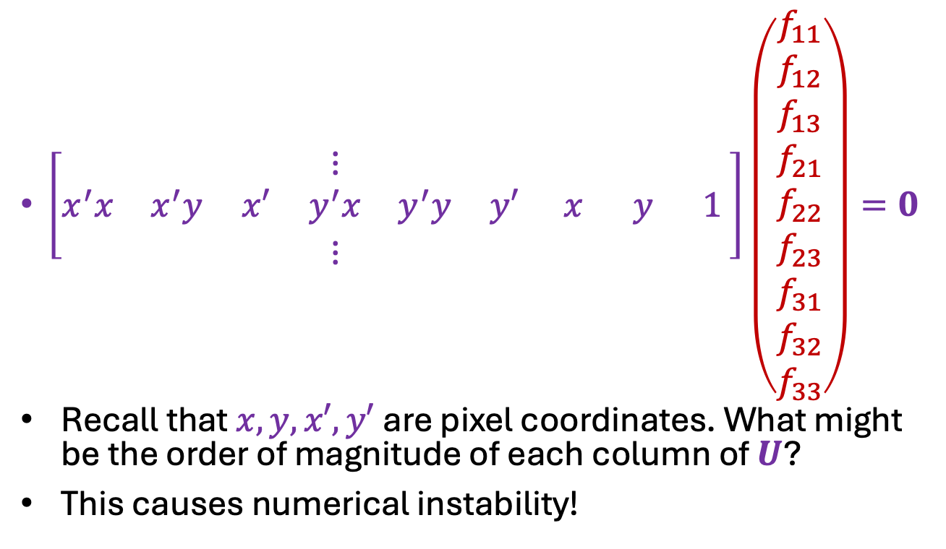
Normalized eight point algorithm
$\left[\begin{matrix} & & & ⋮ & & & & & \\ x^{′}x & x^{′}y & x′ & y^{′}x & y^{′}y & y′ & x & y & 1 \\ & & & ⋮ & & & & & \end{matrix}\right]\left(\begin{aligned}f_{11} \\ f_{12} \\ f_{13} \\ \begin{aligned}f_{21} \\ f_{22} \\ f_{23}\end{aligned} \\ \begin{aligned}f_{31} \\ f_{32} \\ f_{33}\end{aligned}\end{aligned}\right)=0$
Recall that $x, y, x′, y′$are pixel coordinates. What might be the order of magnitude of each column of $U$?
This causes numerical instability!
$$\begin{matrix}\begin{matrix}{10}^{6} & {10}^{6} & {10}^{3}\end{matrix} & \begin{matrix}{10}^{6} & {10}^{6} & {10}^{3}\end{matrix} & \begin{matrix}{10}^{3} & {10}^{3} & 1\end{matrix}\end{matrix}$$
$$U$$

Slide 11
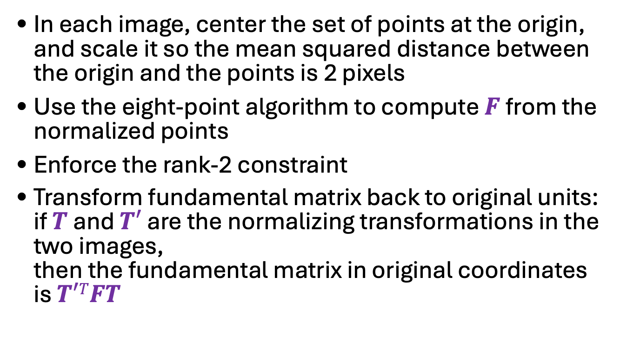
The normalized eight-point algorithm
In each image, center the set of points at the origin, and scale it so the mean squared distance between the origin and the points is 2 pixels
Use the eight-point algorithm to compute $F$ from the normalized points
Enforce the rank-2 constraint
Transform fundamental matrix back to original units: if $T$ and $T′$ are the normalizing transformations in the two images,
then the fundamental matrix in original coordinates is $T′TFT$
R. Hartley. In defense of the eight-point algorithm. TPAMI 1997

Slide 12
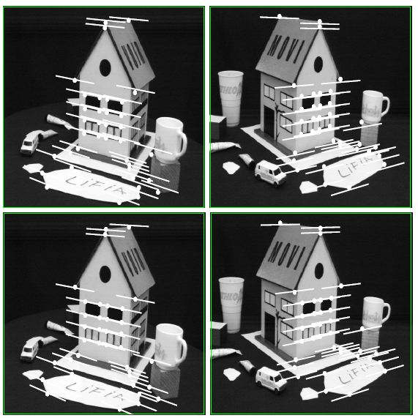
Comparison of estimation algorithms
 | 8-point | Normalized 8-point | Nonlinear least squares
Av. Dist. 1 | 2.33 pixels | 0.92 pixel | 0.86 pixel
Av. Dist. 2 | 2.18 pixels | 0.85 pixel | 0.80 pixel

Slide 13
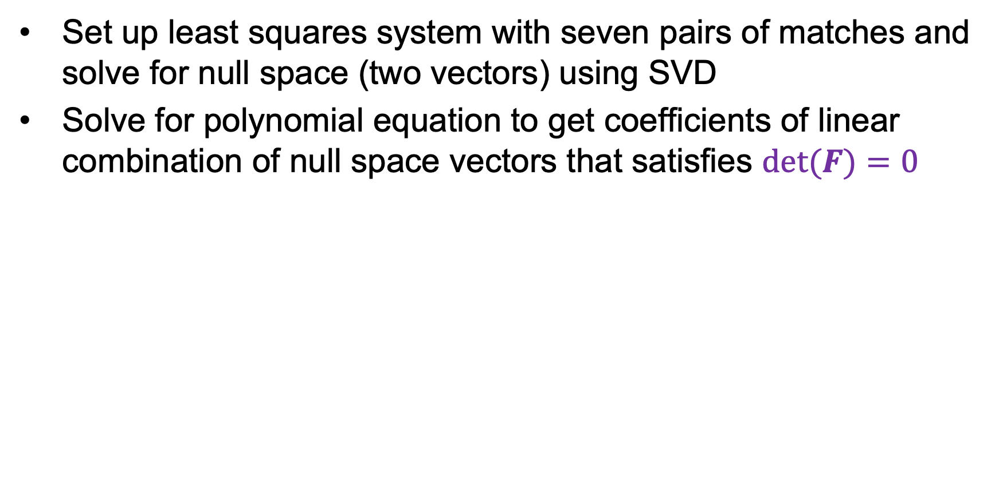
Seven-point algorithm
Set up least squares system with seven pairs of matches and solve for null space (two vectors) using SVD
Solve for polynomial equation to get coefficients of linear combination of null space vectors that satisfies $det⁡(F)=0$
Source: e.g., M. Pollefeys tutorial (2000)

