Slide 1
Epipolar Geometry and the Fundamental Matrix
D.A. Forsyth
University of Illinois at Urbana Champaign

Slide 2
Two views of the same 3D scene
Because:
  You have two
    Eyes
    Cameras
  OR the camera moves

Slide 3
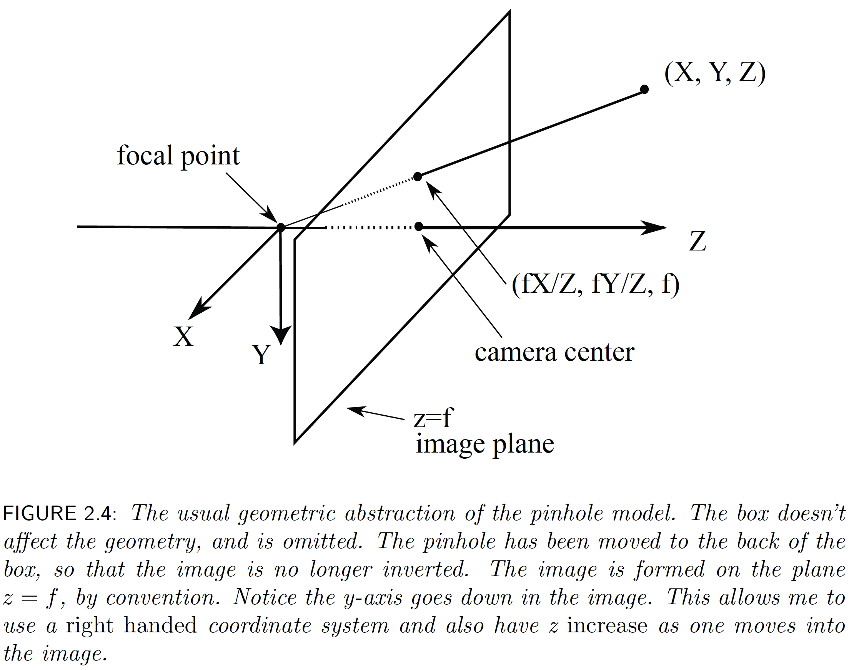
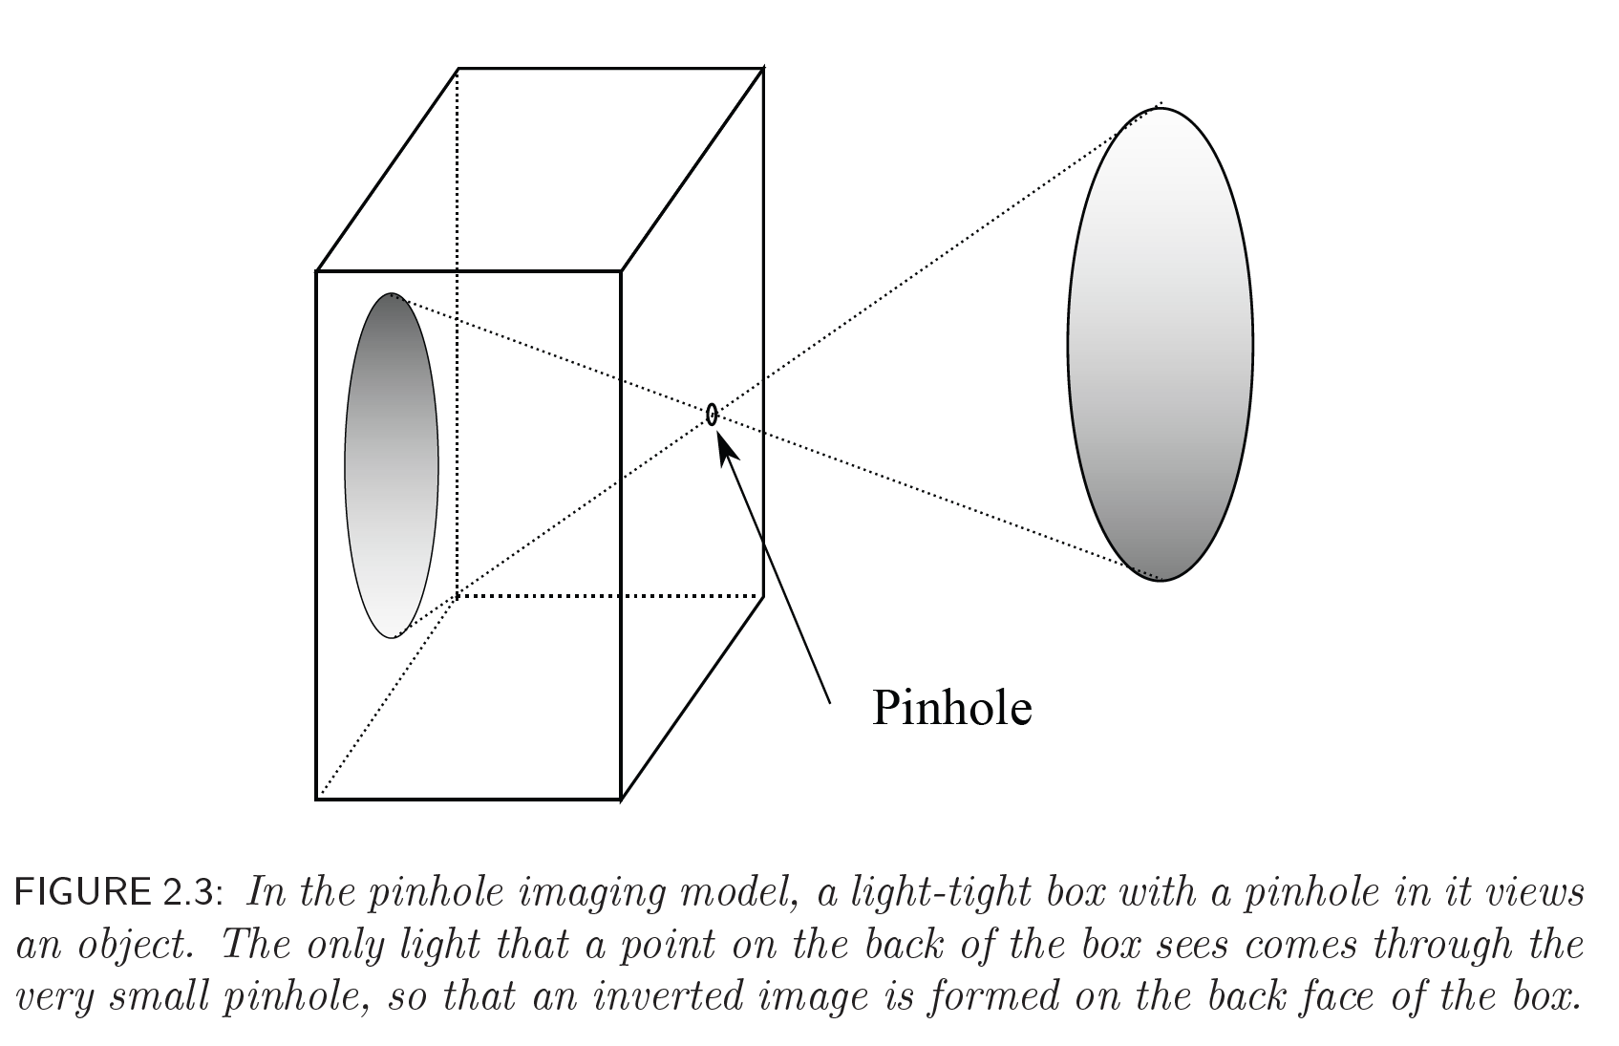
The Pinhole Camera

Slide 4
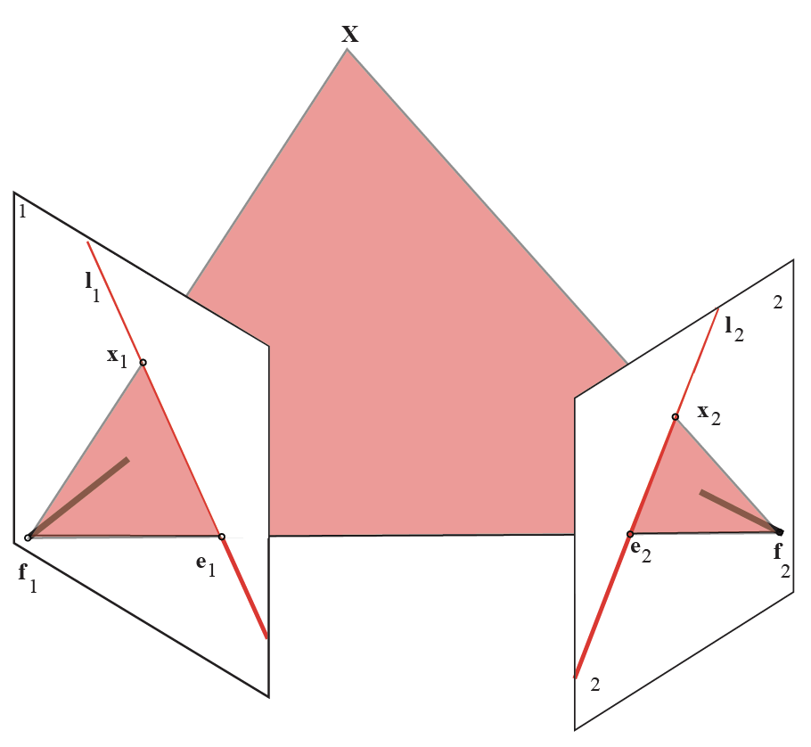

Slide 5
Epipole
Epipole

Slide 6
Epipolar plane
spans X, f_1, f_2

Slide 7
Anything in image 2 that matches x_1 MUST
- lie on epipolar plane
(cause it is in ray f_1 to X)
- lie on intersection of epipolar plane
and image plane 2

Slide 8
Epipolar line in image 2 corresponding
to x_1 in image 1

Slide 9
Epipolar line in image 1 corresponding
to x_2 in image 2

Slide 10
Conclude:
x_1, x_2 and focal points are coplanar
It follows there is a matrix F such that
x_1^T F x_2 =0

Slide 11
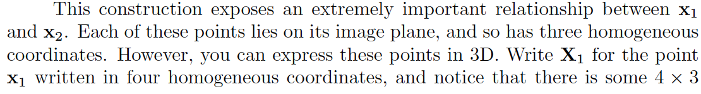
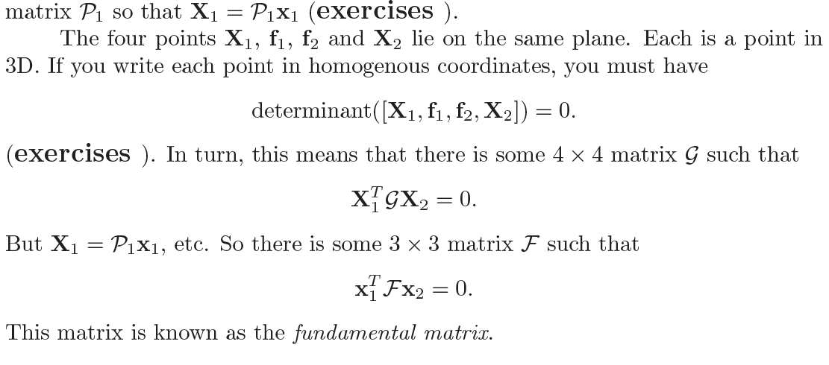
It follows...

Slide 12
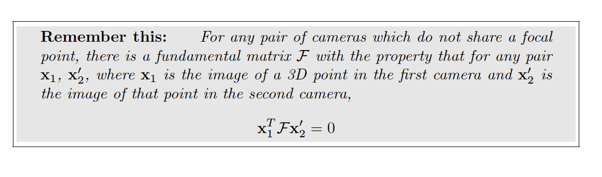
The fundamental matrix

Slide 13
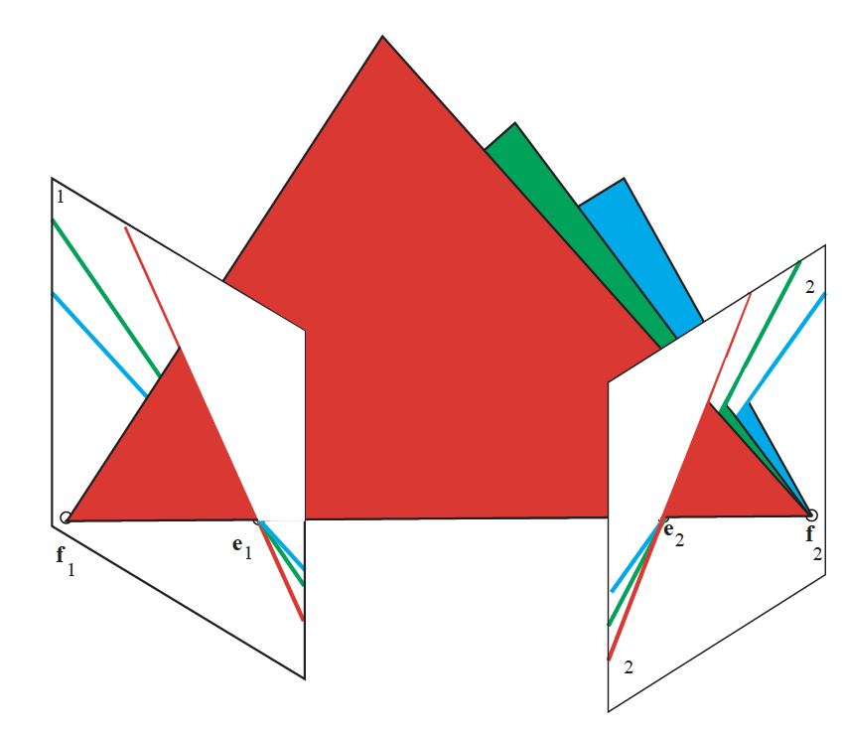

Slide 14
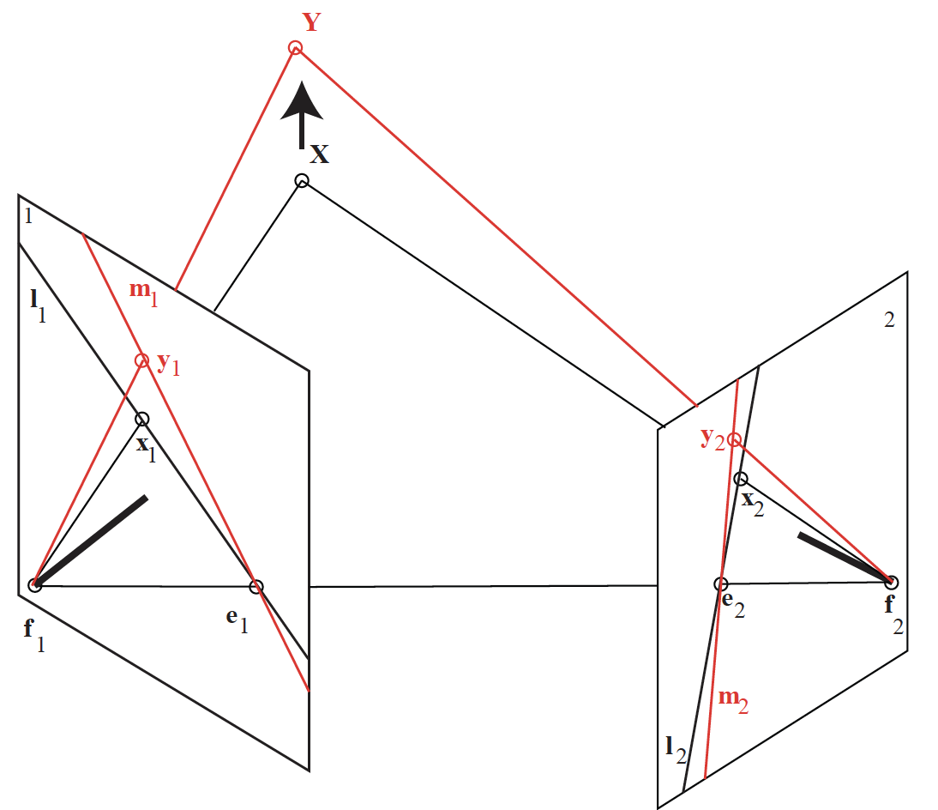
Conclude:
there is a map from points in 1
to lines through the epipole in 2
(and vice versa)

Slide 15
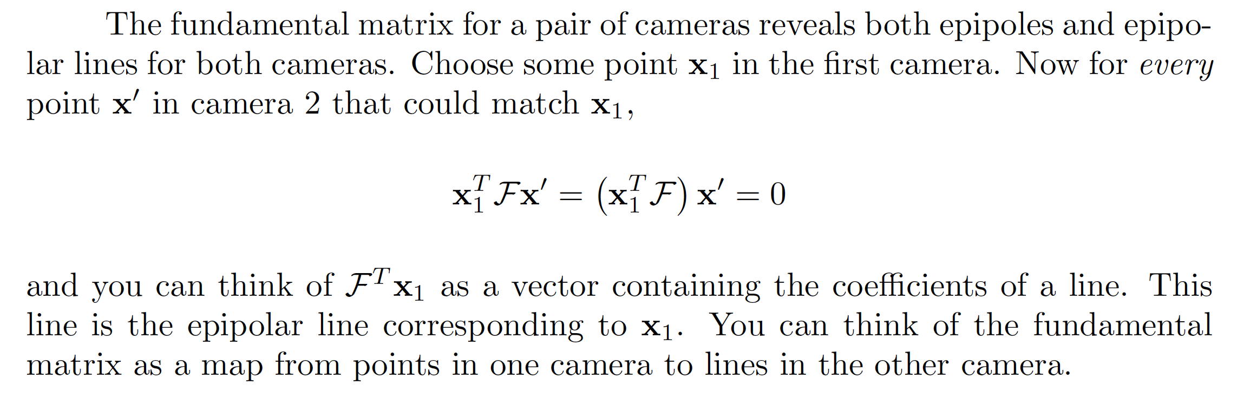
The fundamental matrix

Slide 16
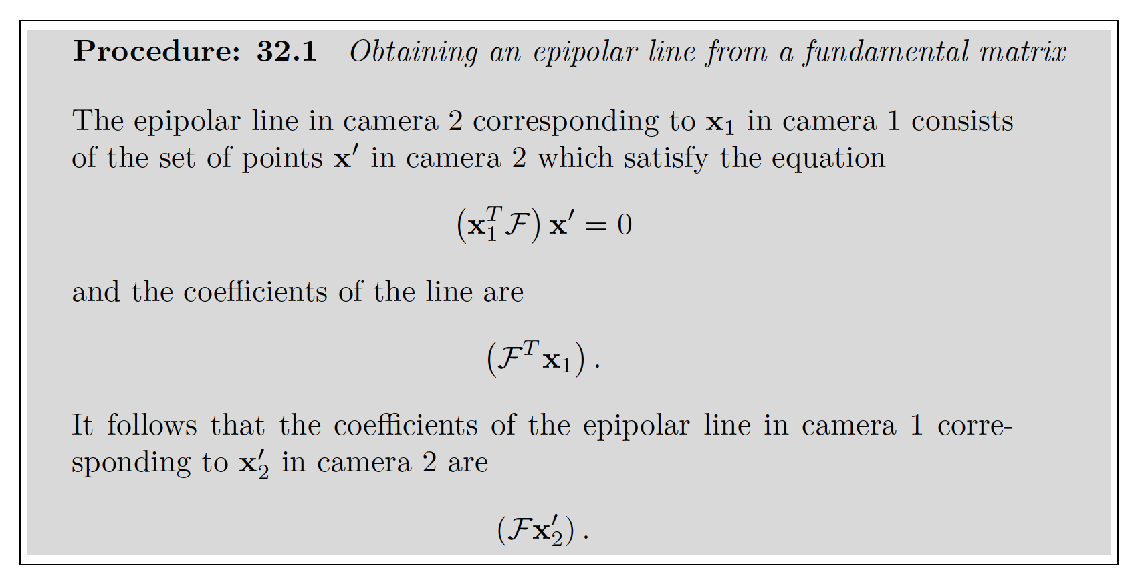

Slide 17
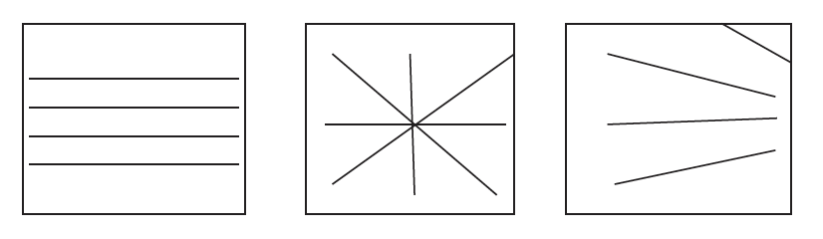
Interpreting epipoles

Slide 18
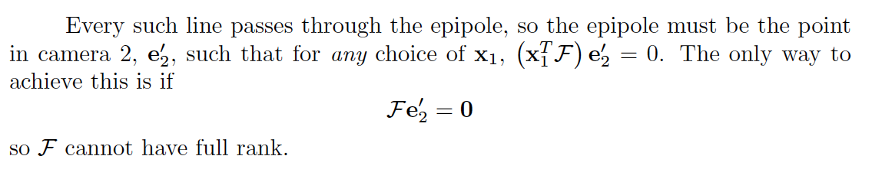
The fundamental matrix

Slide 19
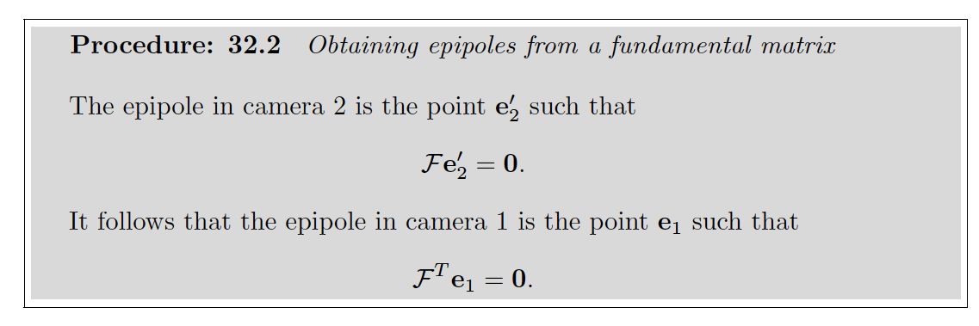
The fundamental matrix

