Slide 1
Recovering Geometric Representations –
Depths and points
D.A. Forsyth,
University of Illinois at Urbana-Champaign

Slide 2
Options
Here:
  Multiple depth maps
  Point clouds
  Voxel grids
  Implicit functions
  Density functions
Others
  CSG rep’ns
  NURBS
  etc.

Slide 3
Rep’n: Multiple depth maps
One per image
  or per cluster of images
  consistent
Advantages
  straightforward to get
  known how to pass to a triangle mesh (if dense enough)
Disadvantages
  resolution issues (eg zooming camera)
  can be tricky to render cleanly
  some geometric calculations are hard
    volume

Slide 4
Plane sweep stereo
input image
input image
reference camera
Sweep plane across a range of depths w.r.t. a reference camera
  For each depth, project each input image onto that plane (homography) and compare the resulting stack of images
R. Collins, A space-sweep approach to true multi-image matching, CVPR 1996

Slide 5
Plane sweep stereo: Key idea
✓
Image 1
Image 2
Reference image

Slide 6
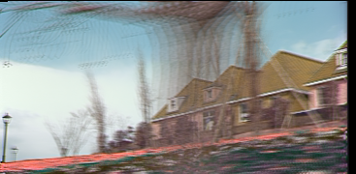
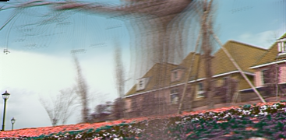
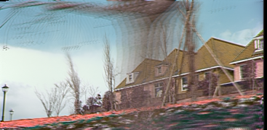
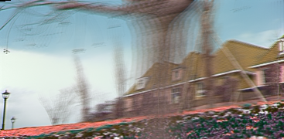
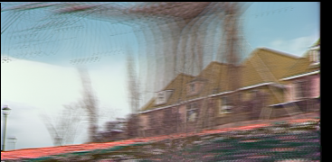
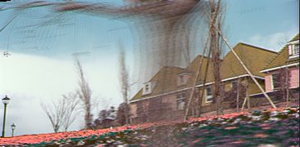
Plane sweep stereo: Fast implementation
For each depth plane
  Compute homographies projecting each image onto that depth plane
  For each pixel in the composite image stack, compute the variance
For each pixel, select the depth that gives the lowest variance
R. Yang and M. Pollefeys, Multi-Resolution Real-Time Stereo on Commodity Graphics Hardware, CVPR 2003

Slide 7
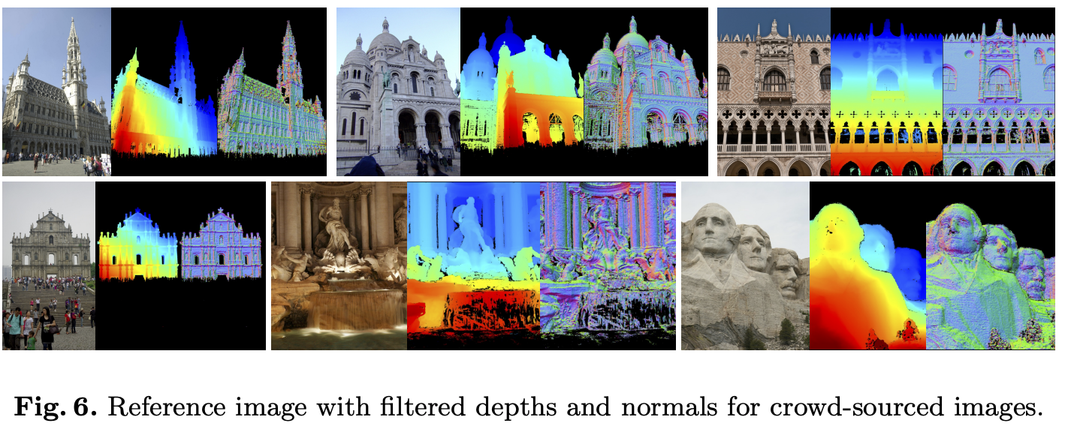
COLMAP MVS
J. Schonberger et al. Pixelwise View Selection for Unstructured Multi-View Stereo. ECCV 2016
Results video

Slide 8
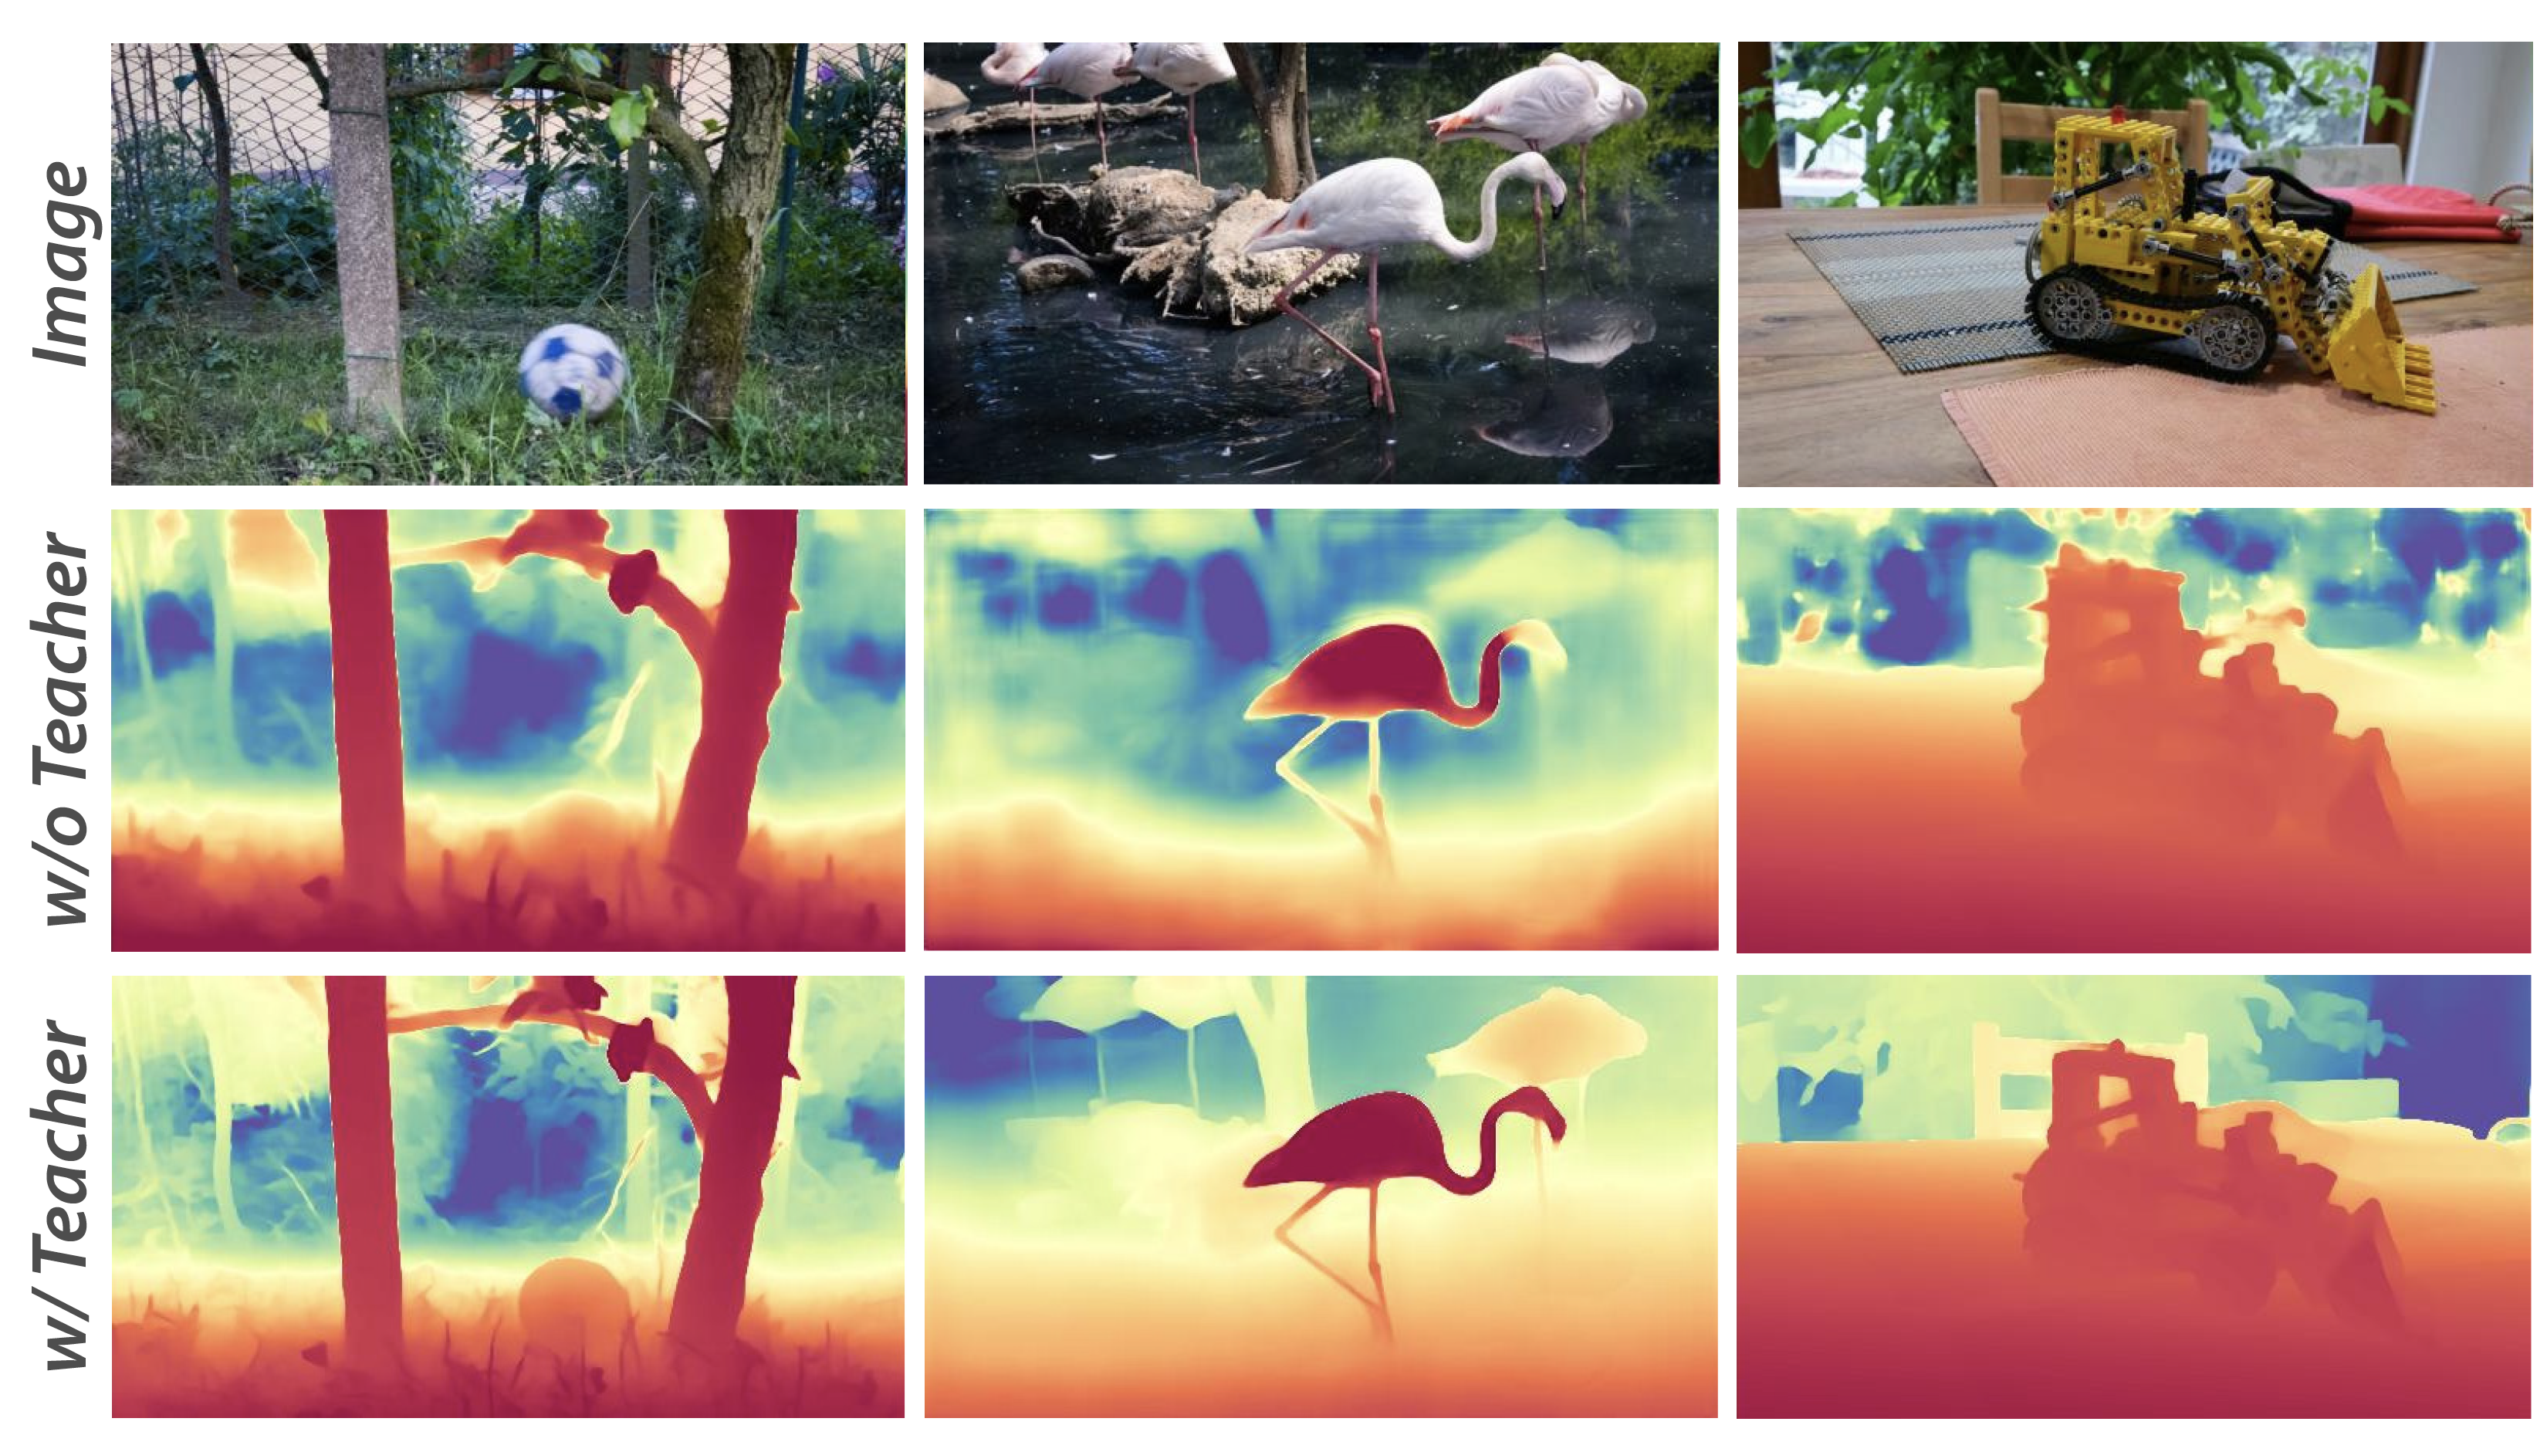
DepthAnything V3 depth maps
https://github.com/ByteDance-Seed/Depth-Anything-3

Slide 9
Options
Here:
  Multiple depth maps
  Point clouds
  Voxel grids
  Implicit functions
  Density functions
  Primitives
Others
  CSG rep’ns
  NURBS
  etc.

Slide 10
Rep’n: point cloud
Large number of points in 3D
  with attached color
Advantages
  easy to render
  easy to construct
  known how to pass to triangle mesh (if dense enough)
Disadvantages
  many geometric computations quite hard
    volume, intersection, etc

Slide 11
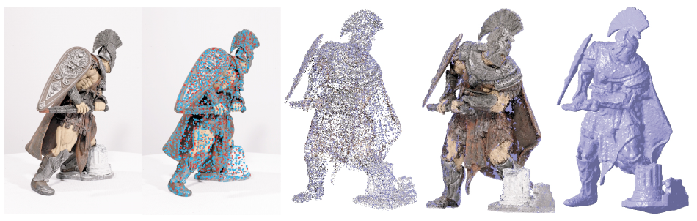
Patch-based multi-view stereo
Detect keypoints
Triangulate a sparse set of initial matches
Iteratively expand matches to nearby locations
  (because the surface is made of patches)
Use visibility constraints to filter out false matches
Y. Furukawa and J. Ponce, Accurate, Dense, and Robust Multi-View Stereopsis, CVPR 2007.
PMVS software

Slide 12
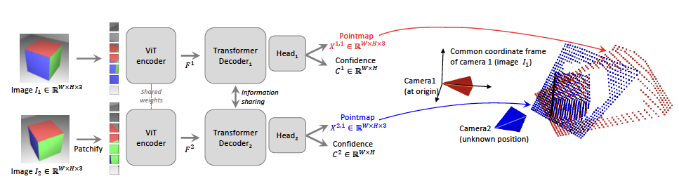
DUST3R – I
Accept two images, make a point map for each
DUSt3R: Geometric 3D Vision Made Easy, Wang et al, 2024

Slide 13
Point maps
one (3D) point per pixel
  so WxHx3
I1 is in canonical frame, both calibrated
  point map at (i, j) with depth z(i, j) contains
point map for I2 is in I1 frame

Slide 14
Now train
Simplest
  accept image pair
  produce pointmap
Train w/ ground truth
  recalling I2 pointmap is in I1’s frame
  lots of data of form (image pair, depthmap pair)
Loss:
  scaled L2 regression loss between prediction, g.t.
  weighted by confidence term

Slide 15
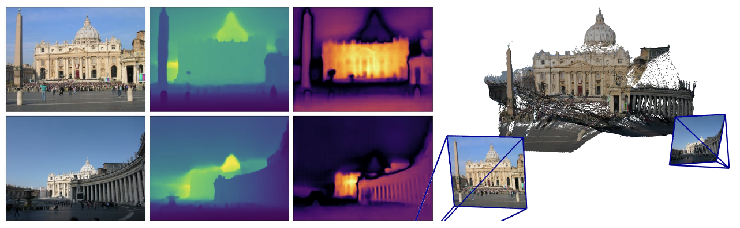
Image
Depth
Confidence
Point cloud
DUSt3R: Geometric 3D Vision Made Easy, Wang et al, 2024

Slide 16
Downstream
I1, I2 pixel correspondences
  find nearest neighbors in pointmaps
Camera intrinsics
  pointmap is in I1’s frame
    easy optimization
Relative camera pose
  predict twice using I1, I2 then I2, I1
  register the two predictions
    first in I1’s frame, second in I2’s frame
Absolute pose
  register

Slide 17
More than two frames
Like SFM pipeline:
  find pairs with many overlapping points
  reconstruct for every such pair
  register reconstructions

Slide 18
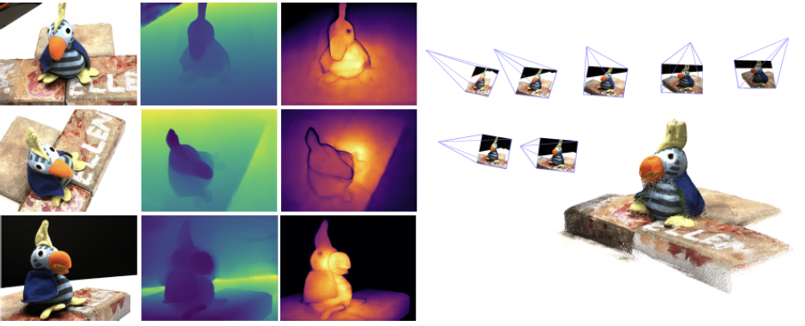
Image
Depth
Confidence
Point cloud
DUSt3R: Geometric 3D Vision Made Easy, Wang et al, 2024

Slide 19
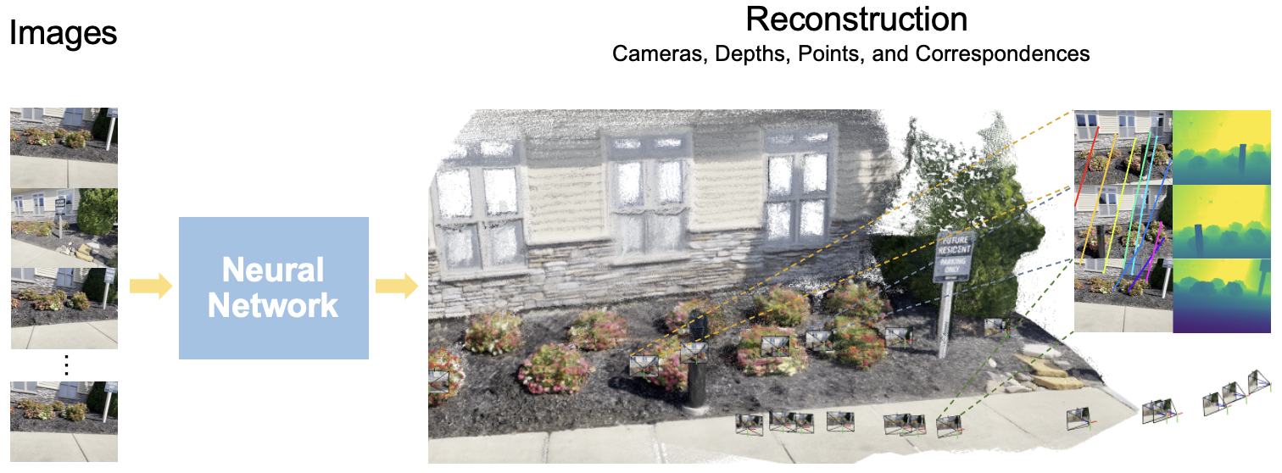
VGGT
https://vgg-t.github.io

Slide 20
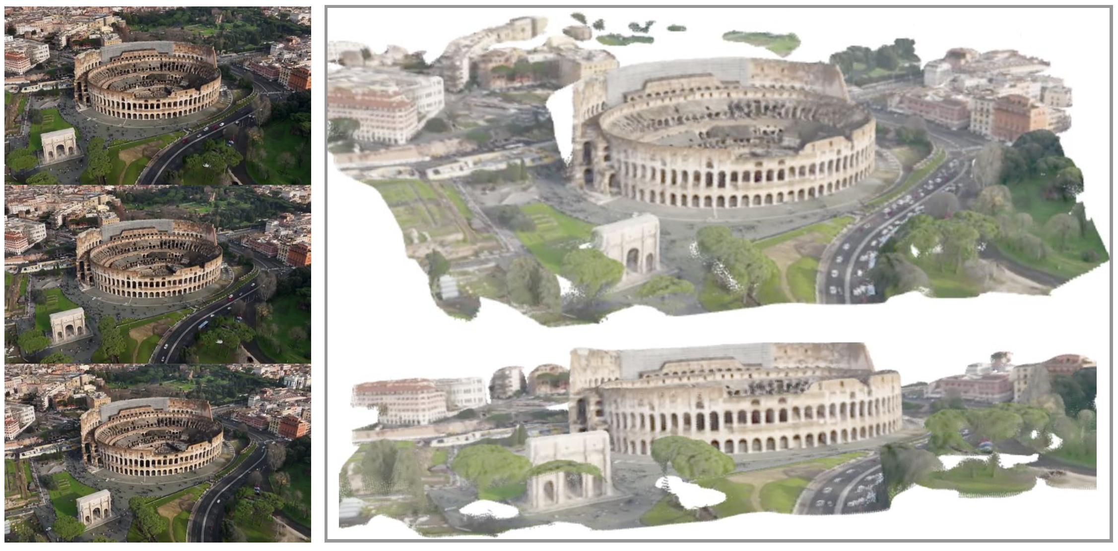
VGGT
https://vgg-t.github.io

Slide 21
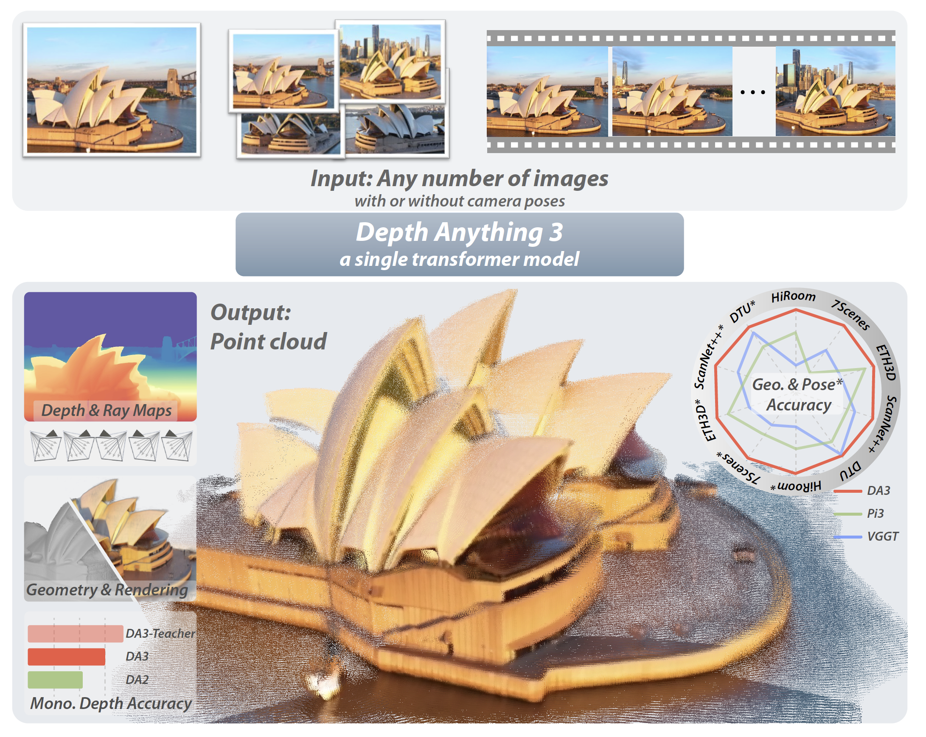
https://github.com/ByteDance-Seed/Depth-Anything-3

