Slide 1
Recovering Geometric Representations –
Voxels and Density
D.A. Forsyth,
University of Illinois at Urbana-Champaign

Slide 2
Options
Here:
  Multiple depth maps
  Point clouds
  Voxel grids
  Implicit functions
  Density functions
Others
  CSG rep’ns
  NURBS
  etc.

Slide 3
Rep’n: voxel grid (++)
Grid 3D into voxels, label
  occupied, empty (maybe edge)
Advantages
  easy to construct
  known how to pass to triangle mesh (if dense enough)
Disadvantages
  serious problems with resolution and scale
  many geometric computations quite hard
    volume, intersection, etc

Slide 4
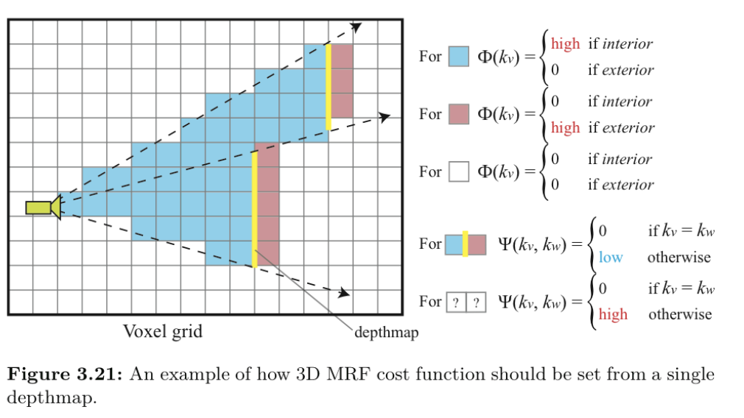
Volumetric fusion, I
Work in voxel space
Depths from cameras
  yield likely labels for SOME voxels (blue – empty; pink – occupied)
Other voxels by optimization
Furukawa + Hernandez, 15, Multi-View Stereo: A tutorial

Slide 5
Volumetric fusion, II
Other voxels:
  ideally,
    agree with original estimates;
    agree with neighbors
  This yields a cost function (rather like in stereo above)
Furukawa + Hernandez, 15, Multi-View Stereo: A tutorial

Slide 6
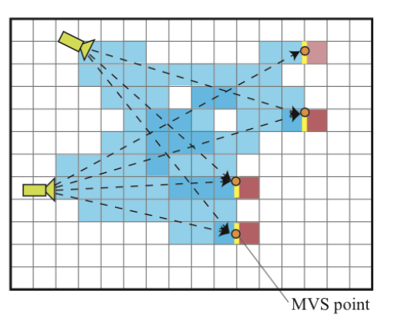
Volumetric fusion, III
Deals with multiple cameras easily
Furukawa + Hernandez, 15, Multi-View Stereo: A tutorial

Slide 7
Volumetric fusion, IV
You can use this to turn point clouds into volumes as well
Furukawa + Hernandez, 15, Multi-View Stereo: A tutorial

Slide 8
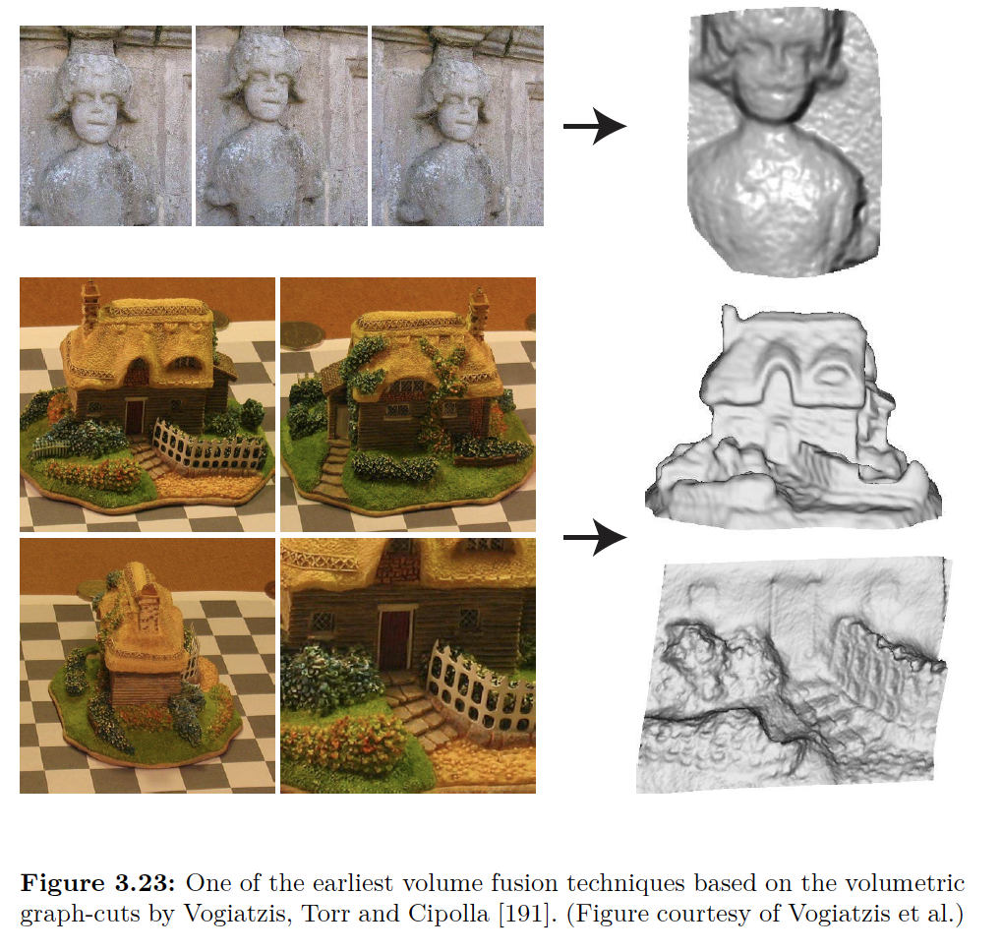
Furukawa + Hernandez, 15, Multi-View Stereo: A tutorial

Slide 9
Options
Here:
  Multiple depth maps
  Point clouds
  Voxel grids
  Implicit functions
  Density functions
  Primitives
Others
  CSG rep’ns
  NURBS
  etc.

Slide 10
Rep’n: Implicit function
Idea:
  boundary between full/empty cells in space
    like a continuous version of voxel field BUT
      continuous field, not voxel grid
Advantages
  extremely rich range of field representations
  good rendering and generalization properties
  easy to pass to
    mesh
Disadvantages
  many geometric properties hard to compute

Slide 11
Options
Here:
  Multiple depth maps
  Point clouds
  Voxel grids
  Implicit functions
  Density functions
  Primitives
Others
  CSG rep’ns
  NURBS
  etc.

Slide 12
Rep’n: density fields
Idea:
  construct density field, color field in space
    like a continuous version of voxel field BUT
      continuous field, not voxel grid
      density, not (full, empty)
Advantages
  extremely rich range of field representations
  good rendering and generalization properties
  easy to pass to
    mesh, signed distance field
Disadvantages
  many geometric properties hard to compute

Slide 13
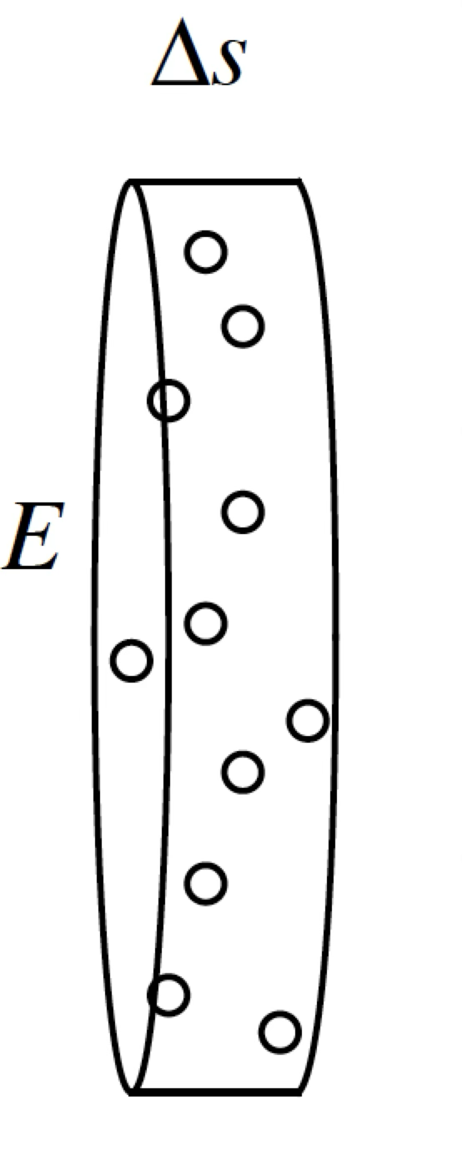
Model
There is a field in space that
  absorbs light
  generates light
    colored
Accounting yields light at eye as a function of field
Incoming light
Outgoing light

Slide 14
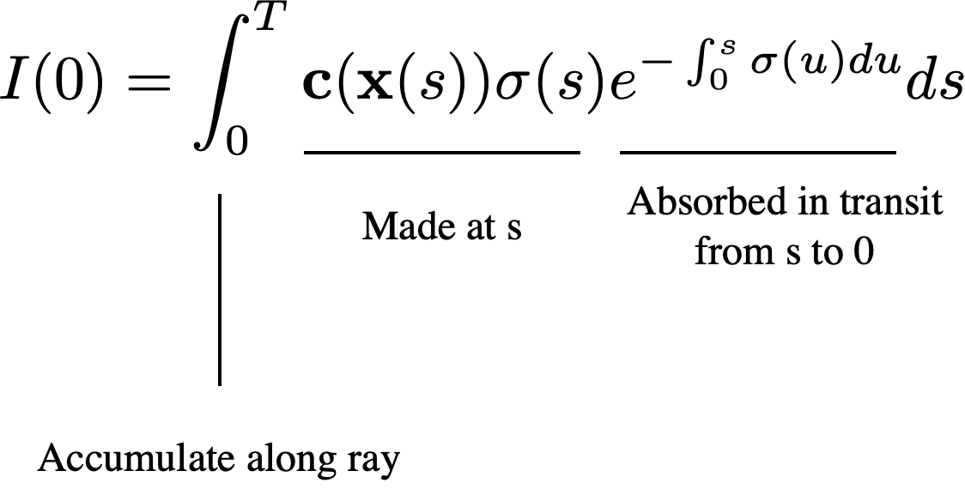
Accounting (!)
Color at x (which is s along ray)
Intensity at eye
Density at s along ray

Slide 15
Rendering
Integration problem
  walk back along ray from viewpoint, sampling
    collect color at sample point
    accumulate transmission
      if weight is too small, stop walking
This could be nasty…
  variety of strategies, depending on what we know about c, sigma, eg
    known in voxels
      cut ray into segments (per voxel), compute integral per segment
    parametric function
      cut ray into uniform segments, one sample per segment
but the integral is a differentiable function of c, sigma

Slide 16
Building a Nerf
Build functional approximation to predict
  c, sigma as functions of position, direction, parameters
Render this object with a volume renderer
  to make images
Learn this object by
  adjusting parameters (gradient descent etc)
    so that images it produces, with renderer are the same as
      known images
      geometrically calibrated to one another

Slide 17
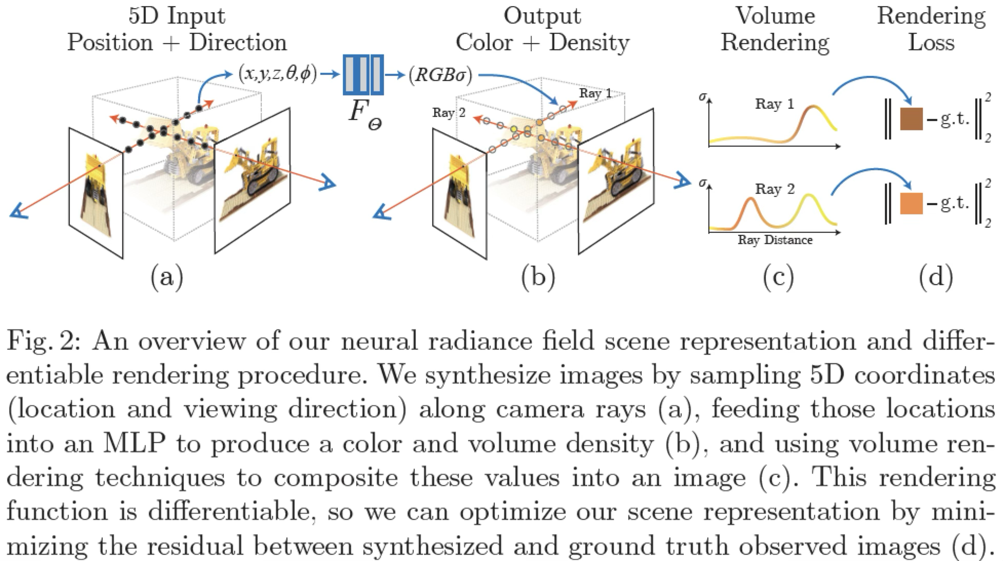
Mildenhall et al, 20

Slide 18
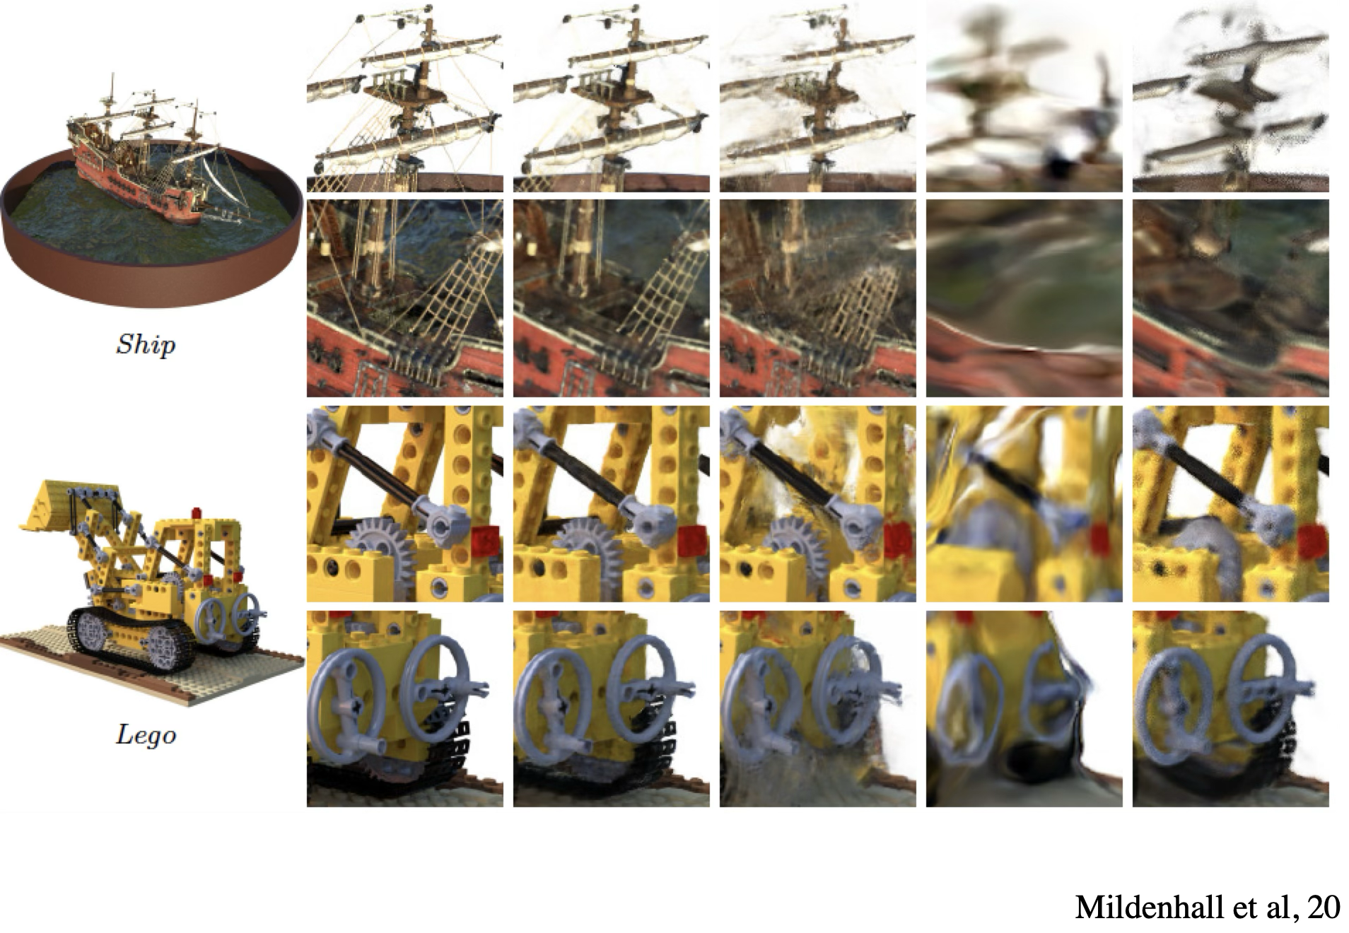

Slide 19
Variants
Very wide range of functional approximations
  gaussian splats

